Slide 1

Sub Regional Conference, Rajkot
W I R C, I C A I
Facing Forward
Focus on Future
July 25, 2021
Value Addition Through Internal Audit
IFC Risk Matrices – Help to IA
Presented by CA Ashish Jaiswal
www.cnkindia.com
MUMBAI | BENGALURU | CHENNAI | VADODARA | AHMEDABAD | GANDHINAGAR | DELHI | DUBAI | SHARJAH

Slide 2

What’s in for Today !!
Value Addition Through Internal Audit
IFC Risk Matrices – Help to IA
# | Content
1 | Regulatory Backdrop
2 | Internal Audit – Value Proposition
3 | IFC & Risk Matrix
4 | Internal Audit – Value Unlock
5 | Case Studies – How IA can create Value

Slide 3

Value Addition Through Internal Audit
IFC Risk Matrices – Help to IA
Basics First !!

Slide 4
Regulatory Backdrop
Companies Act 1956
does not expressly state requirement of internal audit
But, has parked in Companies (Auditor’s Report) Order, 2003 (CARO) with specific requirement to comment on internal control.
Companies Act 2013
Section 138 has an expressly stated appointment of internal auditor for better internal control and corporate governance.
Further Companies Act 2013 also requires the below mentioned stakeholders to comment on adequacy on internal control of the organization
Auditors
Section 143(3): Auditor’s report shall state whether the company has adequate internal financial controls system in place and operating effectiveness of such controls.
Directors
Audit Committee
Section 177(4): Every Audit Committee shall act in accordance with terms of reference specified in writing by the Board which shall, inter alia, include evaluation of internal financial controls and risk management systems.
Section 134(5)(e) of 2013 Act, requires Directors’ Responsibility Statement of listed companies to specifically assert on adequacy and operating effectiveness of internal financial controls. They also need to state that that proper systems are enabled for IFC for ensuring compliance with all applicable laws.
Independent Directors
Section 149 (8) :Code for Independent Directors has one of its Roles and Function that Independent Directors shall satisfy themselves on the integrity of financial information and that financial controls and systems of risk management are robust and defensible.
Value Addition Through Internal Audit
www.cnkindia.com

Slide 5

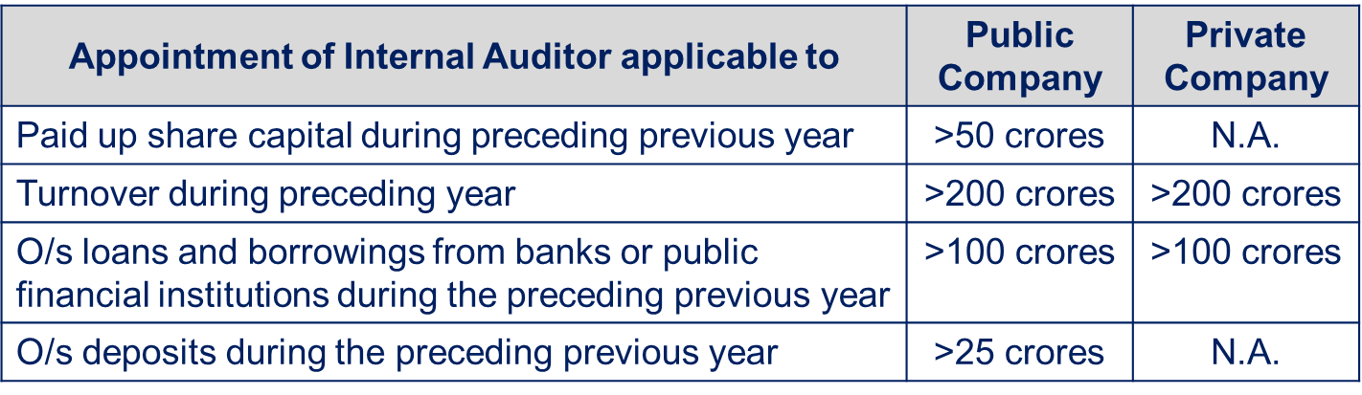
Applicability of Internal Audit
Sec 138 of The Companies Act 2013 and Rule 13 of the Companies (Accounts) Rules 2014 :
IA is applicable to all Listed Public Limited companies. For other companies :
Statutory Auditor has to mention about the adequacy of Internal controls in Annual Report !
Even the Cost auditor has to confirm the adequacy of Internal controls in Cost Audit report !
Many organizations get IA done voluntarily also !!
Value Addition Through Internal Audit
www.cnkindia.com

Slide 6

Value Addition Through Internal Audit
IFC Risk Matrices – Help to IA
Internal Audit – A value proposition

Slide 7
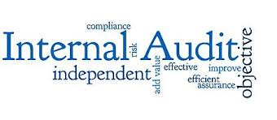
Internal Audit
Internal auditing is an independent, objective assurance and consulting activity
Designed to add value and improve an organization’s operations.
It helps an organization accomplish its objectives by bringing a systematic, disciplined approach to evaluate and improve the effectiveness of risk management, control and governance processes.
Value Addition Through Internal Audit
www.cnkindia.com

Slide 8
Internal Audit
Governance
Risk Management
Process Improvements
Value Addition Through Internal Audit
www.cnkindia.com

Slide 9

Governance
Governance = How things are done
Documentation
Authority Matrix
System based controls
Work Flow
Policies and Procedures
ERM
Internal Financial Controls
Risk control Matrix
Entity Level Controls
Value Addition Through Internal Audit
www.cnkindia.com

Slide 10
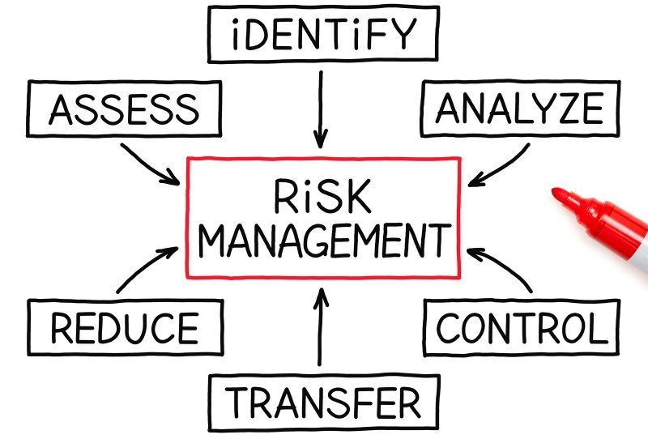
Risk Management
Risk = What can go wrong
Financial Risk
Reporting Risk
Operational Risk
Compliance Risk
Strategic Risk
Reputational Risk
Value Addition Through Internal Audit
www.cnkindia.com

Slide 11
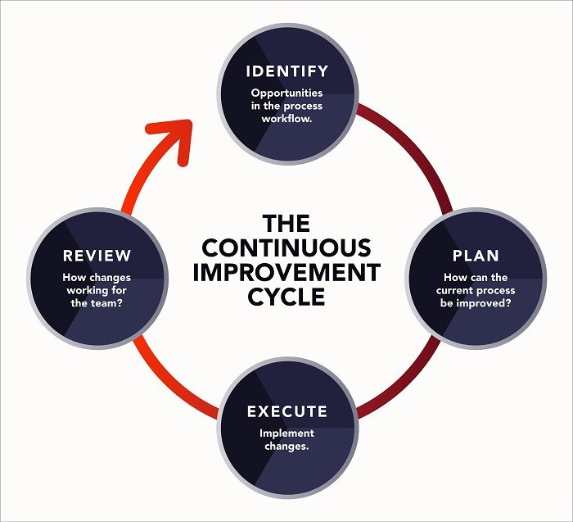
Process Improvements
Process Improvement = how it can be done better
Duplication
Manual work
Standardization
Desk Procedures
Better way
Enhancing controls
Optimum utilization of resources
Cost Saving Opportunities
Value Addition Through Internal Audit
www.cnkindia.com

Slide 12
Internal Audit Value Proposition
Assurance
Insight
Objectivity
Core Value of IA
Focusing on these three core internal audit concepts within your communication with stakeholders will enable them understand the core value your internal audit activity provides.
Value Addition Through Internal Audit
www.cnkindia.com

Slide 13
Assurance on Governance Risk and Control
Governance
Risk
Control
Internal auditing provides assurance on the organization’s governance, risk management, and control processes to help the organization achieve its strategic, operational, financial, and compliance objectives
Value Addition Through Internal Audit
www.cnkindia.com

Slide 14
Insight into business and processes
Catalyst
Analysis
Assessments
Internal auditing is a catalyst for improving an organization’s effectiveness and efficiency by providing insight and recommendations based on analyses and assessments of data and business process.
Value Addition Through Internal Audit
www.cnkindia.com

Slide 15
Objectivity while Reporting
Integrity
Independence
Accountability
With commitment to integrity and accountability, internal auditing provides value to governing bodies and senior management as an objective source of independent advice.
Value Addition Through Internal Audit
www.cnkindia.com

Slide 16
3 Line Model
Governing Body
Accountable to Stakeholders
Role : Integrity, Leadership and Transparency
External Assurance Providers
Management
To manage Operations (including Risk)
Internal Audit
Independent Assurance
First Line Roles
Execution of Business Operations
Second Line Roles
Expertise, Support, Risk Management
Third Line Role
Independent and Objective Assurance and Advice
Management is Accountable and Reports to the Governing Body.
The Governing Body sets the tone at top and provides the resources, authority, direction and supervises the work of Management
The auditor receives its directions from Governing body, coordinates and cooperates with Management for the reviews and presents a independent report to the Governing Body
Source : The IIA
Value Addition Through Internal Audit
www.cnkindia.com

Slide 17
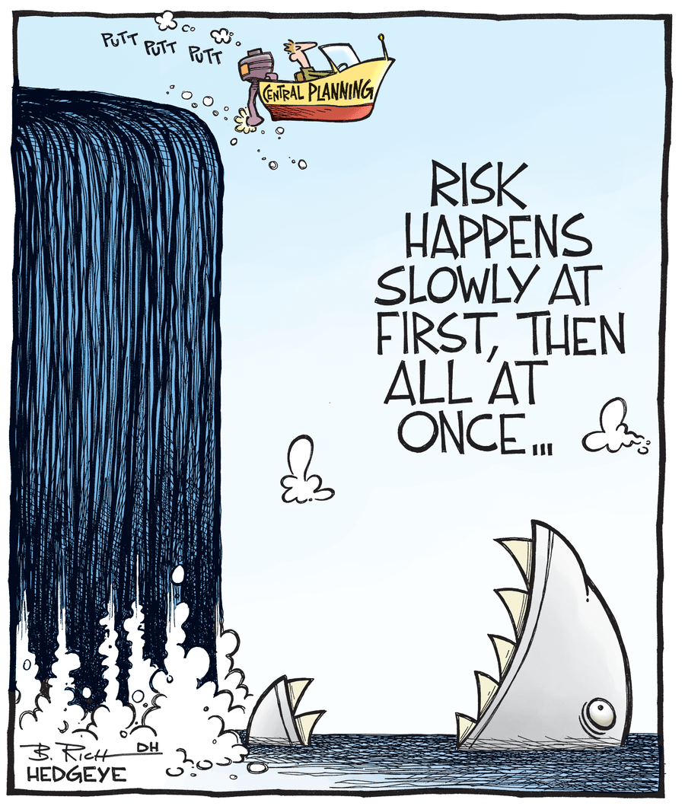
Value Addition Through Internal Audit
IFC Risk Matrices – Help to IA
IFC- Risk Matrix

Slide 18
Internal Financial Control
Ensuring the orderly and efficient conduct of its business
Including adherence to company’s policies
ICFR is a subset of the broader concept of Internal Financial Control
Safeguarding of its assets
Prevention and detection of frauds and errors
IFC means
any control
which helps in
Accuracy and completeness of the accounting records
Timely preparation of reliable financial information
Value Addition Through Internal Audit
www.cnkindia.com

Slide 19
What does IFC mean ?
Internal Financial Controls =
Internal Controls over Financial Reporting
Operational Controls
Controls to ensure
Regulatory
Compliance
Fraud Prevention and Fraud Monitoring controls
‘Internal Financial Controls’ has a broad connotation – however, from the perspective of assurance expected from Statutory Auditors, the focus is only on Internal Controls over Financial Reporting.
Value Addition Through Internal Audit
www.cnkindia.com

Slide 20
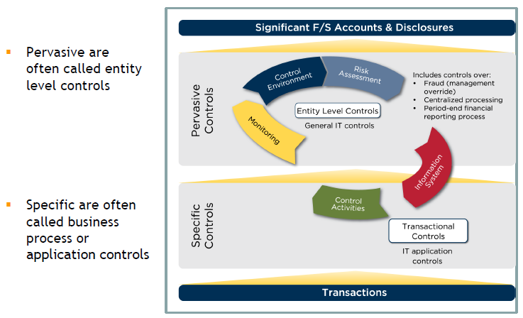
IFC Controls
Value Addition Through Internal Audit
www.cnkindia.com

Slide 21
IFC Approach
Review Financial Statements, Policies and Reporting Requirements
Identify Risk related to material Misstatements/ misreporting, including fraud risk or risk of management override. Establish materiality thresholds.
Assess Entity Level Controls established that directly or indirectly constitute/impact internal financial control over financial reporting.
Based on assessment of entity level controls and analysis of financial statements, drill down to significant accounts, disclosures and reporting obligations. Assess Process/Account Level Controls
Control Environment
Risk Assessment
Control Activities
Information & Communication
Monitoring
COSO Components
Prepare the RCM for IFC
Value Addition Through Internal Audit
www.cnkindia.com

Slide 22
Risk Control Matrix
Area - Sub-Process
COSO Component
Risk Rating (Normal/ Significant)
Control Objective
Risk Event
Control Description
Maker
Checker
Deficiency – Material Weakness/ Significant Deficiency
Process
Value Addition Through Internal Audit
www.cnkindia.com

Slide 23
Risk Control Matrix
Reference to Statute / SOP / Manual
Frequency of Control
Control Owner
Key Control (Y/N)
Nature of Control (Preventive /
Detective)
Control Type (Manual / Automated)
Financial Assertions
Anti Fraud Control (Y / N)
Value Addition Through Internal Audit
www.cnkindia.com

Slide 24

Value Addition Through Internal Audit
IFC Risk Matrices – Help to IA
Internal Audit – Value Unlock

Slide 25
IFC and Internal Audit
Internal Audit
IFC
Value and Assurance
Value Addition Through Internal Audit
www.cnkindia.com

Slide 26
Internal Audit Objectives
Objectives
Org Objectives
Optimum Utilization
Evaluate Internal Controls
Safeguard Assets
Compliance & Reliability
Adherence to Policy
Facilitate achievement of Organisations’ objectives
Optimum Utilization of resources
Evaluate Internal controls, systems and procedures
Safeguarding of assets (Inventory, Fixed Assets, Data, Receivables)
Identification, assessments and control of risks
Facilitating corporate governance code compliance
Reporting independently to the Audit Committee
Reviewing compliance with policies, procedures, laws and regulations
Increasing reliability on financial statements
Value Addition Through Internal Audit
www.cnkindia.com

Slide 27

Internal Audit – Value Add !!
Efforts
Time
Resources
Value
Improvement
Saving
Assurance
Value Addition Through Internal Audit
www.cnkindia.com

Slide 28
Internal Audit Framework
Management Expectations – Audit Universe
Audit Plan
Audit Program
Audit Execution
Reporting and Perception
Feedback and Improvements
Pain Areas
Objectives – what the IA would want to achieve
Auditor is expected to be:
  Watchdog
  Facilitator
  Policeman
  Investigator
  Eyes and Ears
  Mentor, Guide
  Cross Functional Coordinator
Authority and Responsibility
IFC Testing
Frequency and Coverage
Analytical Tools to be used
Internal Audit Framework
Value Addition Through Internal Audit
www.cnkindia.com

Slide 29
Audit Execution
Process Understanding
Scope overview
SOP reading
Discussion with Process owners
Document current process followed
ERP work-flow
DOA, SOD
IFC and RCM
Criterion
Listing of existing controls
Update the audit checklist
Testing procedure
Identifying data population, stratification and sampling
Records, reports, documents, data to be obtained
Materiality levels
Audit procedure
Testing the controls
Data analytics
Control Gap analysis
Documenting evidences
Obtaining further information
Investigation and quantification
Value Addition Through Internal Audit
www.cnkindia.com

Slide 30
…Audit Execution
Root cause and impact
Why the deviation occurred
What impact it has on business
Likelihood of recurrence
This is the basis for assessments
Report
Risk rating
Discuss with Process owner
Documentation
Entire process with records, data, analysis and conclusions to be documented in audit working papers
Recommendations for improvements
Review further inputs, if any
Final observation
Value Addition Through Internal Audit
www.cnkindia.com

Slide 31

Risk Assessment and Recommendations
Quantify the impact to the extent possible
Evaluate the possibility of recurrence
Auditor needs to be Objective in this analysis and must put forward his views along with reasons
Ensure that the recommendations are discussed with the process owners and evaluated with regard to the implementation plan
Value Addition Through Internal Audit
www.cnkindia.com

Slide 32
Value Addition Through Internal Audit
IFC Risk Matrices – Help to IA
Internal Audit –
Case Studies #1: Jobwork

Slide 33
# 1: Job Work
Scenario:
Engg Company > INR 500 Cr turnover
Huge infrastructure set up
Gets Job work done upto 15% of the volumes
ARC and normal loss % well defined
Hear say – many of the job workers were asked to set up facility for bottlenecks few years back and are cheaper than our cost
Internal Auditor’s initial findings
W/O based Quantities
Quantities reconciled (Input-output)
QC approves quality
Invoice as per ARC
Above normal loss is deducted as per ARC
Regular payments, reconciliations
Internal Auditor’s Insight
Std process also outsourced. Machine breakdown triggered jobwork
Cost comparison considers OT cost, logistics not considered, last reviewed 3 years back
Ex employee started his own unit to whom job work was allotted
Job workers has higher % of normal loss
Value Un-Lock
Correct cost comparison & Evaluations
Yearly evaluation
Inhouse resources optimized
Outsourcing reduced by 7%
Resulted into cost savings and better control
Value Addition Through Internal Audit
www.cnkindia.com

Slide 34
Value Addition Through Internal Audit
IFC Risk Matrices – Help to IA
Internal Audit –
Case Studies #2: Engg Stores and Spares

Slide 35
#2 : Engg Stores and Spares
Scenario:
Mid Size Mgf Company : INR 300 Cr turnover
Customised solutions – Niche area
Imported, Automated machines with pneumatics, PLCs, highly advanced technology : 60 Cr Invested
Engg stores and spares value : 2-3 Crores
Repair and Maintenance cost : Rs. 2 Cr
Internal Auditor’s initial findings
Stock register updated real time basis
Items duly tagged and kept at locations
Requisition slip based issue
Physical verification – minor deviations
Aging analysis done and 40% items > 6 months reported
Internal Auditor’s Insight
Breakdown report shows ‘no spares’ as reason for delay in repairs beyond 2 weeks
Spares received with new machines not tagged/ identifiable in ERP
Critical spares/ Shelf life not mentioned
Air freight paid for spares : Rs. 25 lacs
Issues not on basis of Job card
Value Un-Lock
Critical spares identified with Minimum stock Levels defined – reduction in downtime
System control over dedicated spares, Spares capitalized
Reduction in Delays in Deliveries
25% savings in freight cost as reduced no of emergency purchases.
Accepts the minor risk of obsolescence
Value Addition Through Internal Audit
www.cnkindia.com

Slide 36
Value Addition Through Internal Audit
IFC Risk Matrices – Help to IA
Internal Audit –
Case Studies #3: Overtime

Slide 37
#3 : Overtime
Scenario:
Large corporate : INR 4000 Cr turnover
Over 1000 employees
Various SBUs
Critical operations : Various Duty points
OT cost about 23% of salary cost
Internal Auditor’s initial findings
OT duly recorded as per bio matrix
Paid on double rate
OT is approved, reasons recorded
Statutory limit of 75 hours per quarter per person breached – reported
20% OT – no reliever, 20% OT - vacancy
Internal Auditor’s Insight
Post facto approval system of OT
Many > 30 shifts OT in a quarter, > 2days
Few skilled people – OT compulsory
Resource smoothing Co level not attempted
Vacancy not filled up No cost benefit analysis
Efficiency of OT not monitored
Value Un-Lock
Half of the vacancy from resource smoothing
Planned OT approval initiated and monitored
OT cost reduced to 11% of Salary cost
Close monitoring reduced absenteeism
Vacancy evaluation done and recruitments started, training started
Value Addition Through Internal Audit
www.cnkindia.com

Slide 38
Value Addition Through Internal Audit
IFC Risk Matrices – Help to IA
Internal Audit –
Case Studies #4: Current Assets Review

Slide 39
#4 : Current Assets Review
Scenario:
Small Co – JV, INR 50 cr turnover
Service sector
Forward integration with local partner
Rentals and sale of spares, repairs
Deals with large corporates
Internal Auditor’s initial findings
Inventory of 2 Cr at JV location
Physical verification not done as material was not segregated
Aging of Debtors : > 50 % above 12 months – slack in real estate business
Internal Auditor’s Insight
Local partner’s facility used as common facility
Balance confirmations is not received
Local partner reluctant to initiate legal cases for recovery
Service records not available – only invoice
Value Un-Lock
Misappropriation identified
Partial recovery / salvage
Co withdraws from the JV
Plans to start its own operations
Value Addition Through Internal Audit
www.cnkindia.com

Slide 40


Value Addition Through Internal Audit
IFC Risk Matrices – Help to IA

Slide 41
THANK YOU
Feedback please
CA Ashish Jaiswal
Partner
C N K & Associates LLP
9825917354
ashish@cnkindia.com
www.cnkindia.com
MUMBAI | BENGALURU | CHENNAI | VADODARA | AHMEDABAD | GANDHINAGAR | DELHI | DUBAI | SHARJAH

