Slide 1
INTERPLAY of LAWS
dealing with
ECONOMIC OFFENCES
(With Emphasis on International Transactions)
Ashwani Taneja
(FCA, ACS, AICWA, FICA, DISA, NCFM, LL.B, LL.M)
(EX- MEMBER, INCOME TAX APPELLATE TRIBUNAL- MINISTRY OF LAW & JUSTICE-GOVERNMENT OF INDIA)
Mobile: 9810064777
EMAIL: ashwani@taxindia.net

Slide 2
IMPACT OF ECONOMIC OFFENCES LAWS ON BUSINESS ENTITIES

Slide 3
The 26,134
Imprisonment Clauses in India’s Business Laws
GAUTAM CHIKERMANE RISHI AGRAWAL

Slide 4
Over 26,000 ways an entrepreneur can land in jail for non-compliance of business laws
[Research report by TeamLease RegTech and Observer Research Foundation (ORF)]

Slide 5
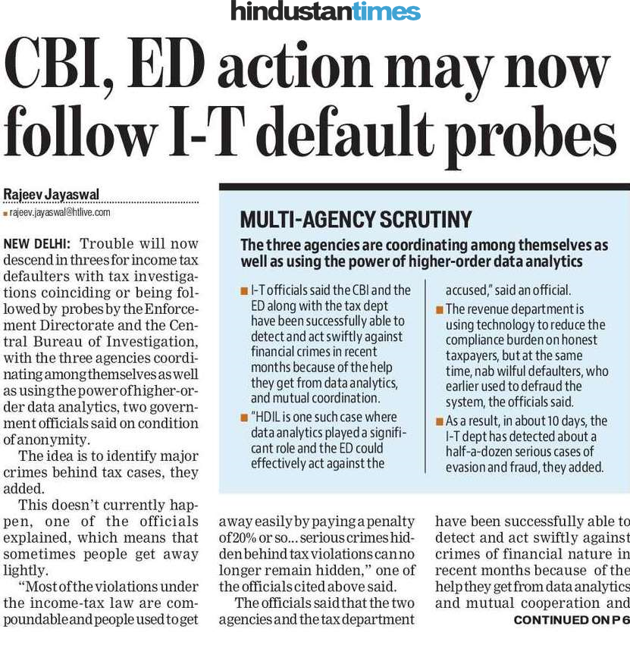

Slide 6
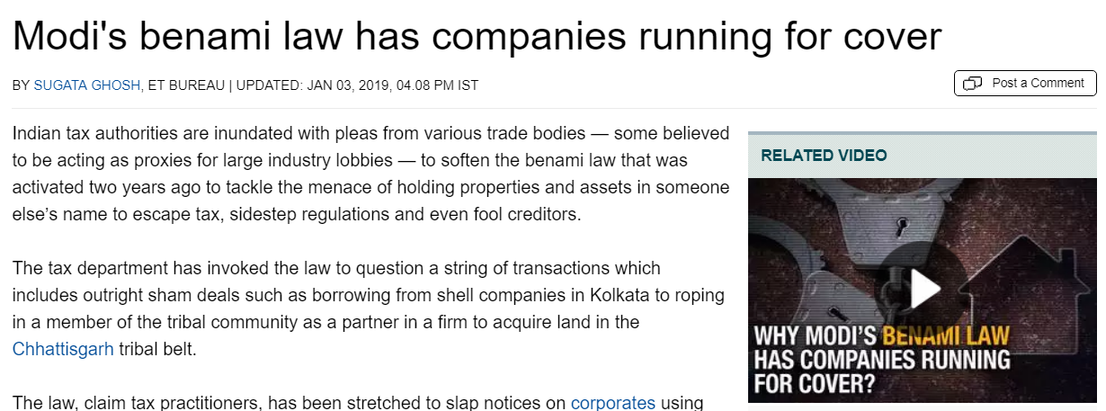
Recent news

Slide 7
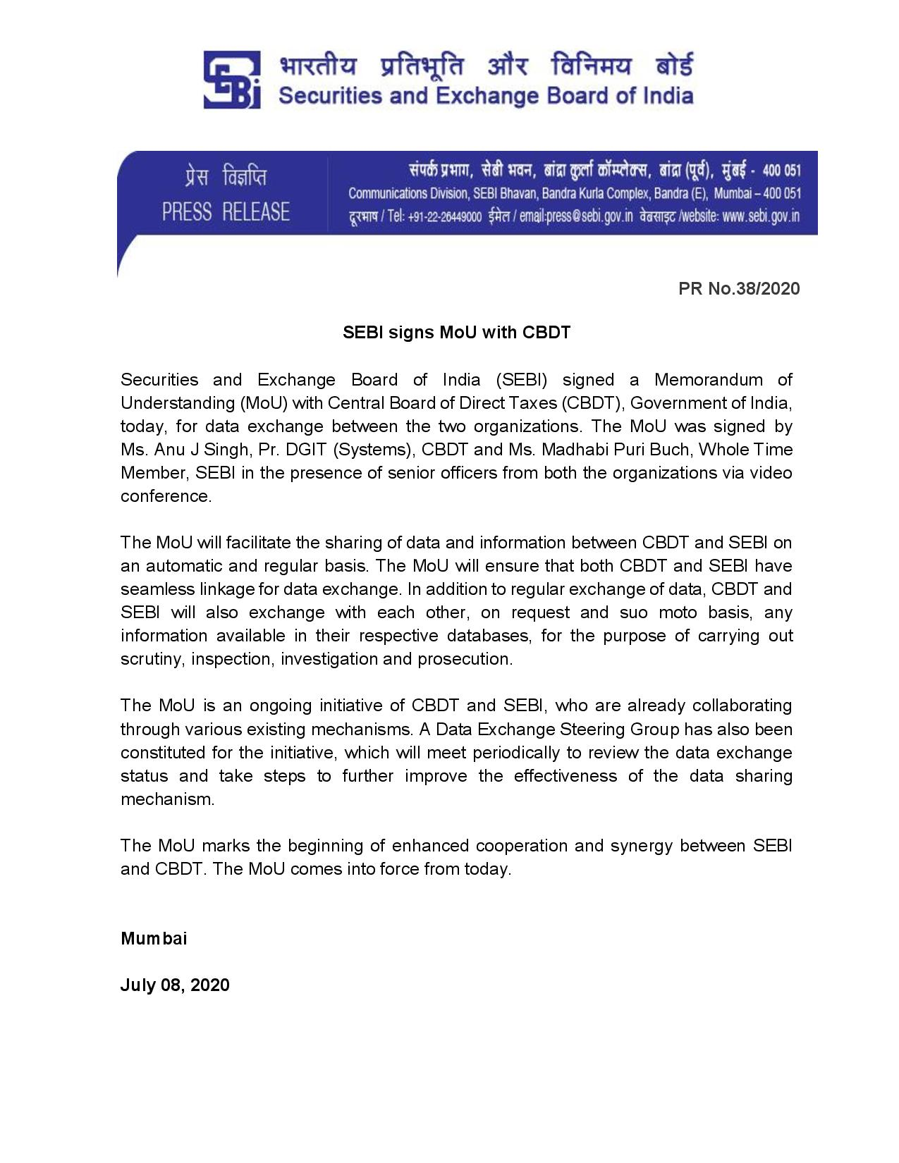

Slide 9
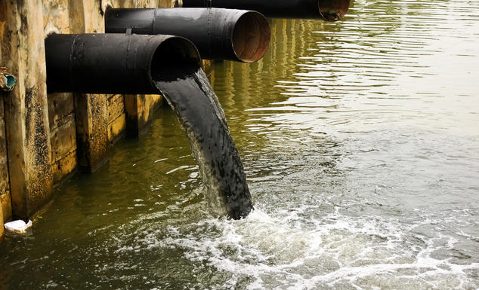
CASE-STUDY
2. ALLEGED VIOLATION OF ENVIORNMENT PROTECTION ACT AND WATER POLLUTION ACT IN THE YEAR 2009.
1. FACTORY PURCHASED IN THE YEAR 2005.
3.POC ILLEGALLY CALCULATED FROM THE YEAR 2007-08 TILL 2012-13.
4. FACTORY ACQUIRED IN 2005 HAVING NO NEXUS WITH POC ATTACHED BY THE ED UNDER PMLA IN 2018

Slide 10
Interplay of various Laws Dealing With Economic Offences.
Implication under Income-tax Act on benamidar and beneficial owner vis-à-vis the unexplained investments and credits
Impact on holding company structures for denial of beneficial ownership criteria
1
Whether Persons acting in concert are subject to Benami law?
Income-tax Act,
1961
Benami law
4
2
SEBI Regulations
Companies Act, 2013
Property outside India – whether covered under the Benami law or under Black Money law?
PMLA invoked, Benami law applicable
Prohibition of
Money Laundering Act, 2003 and
Black Money law
Significant Beneficial Owners Reporting
Dematerialization of shares in Unlisted Public Company – step to curb benami dealing ?
3

Slide 11
INCOME TAX ACT,1961
BLACK MONEY ACT,2015
PBPT ACT, 1988
COMPANIES ACT, 2013
SMUGGLING (SCHEDULED OFFENCE)
SEBI Act,1992
PMLA, 2002
FEMA, 1999
Insolvency and Bankruptcy Code,2015

Slide 12
NEW FINDINGS of INVESTIGATION AGENCIES
MOST COMMON INGREDIENT FOUND IN VIOLATION OF LAWS RELATED TO ECONOMIC OFFENCES
TRANSACTIONS DONE ARE ‘BENAMI’ IN NATURE.

Slide 13
Benami Transaction – Background
A
B
Sale consideration
Beneficial owner
Seller
C
Transfer of title
Benamidar
Factors leading to the origin of Benami law
Fraud on creditors | Tax evasion | Black Money
Corrupt practices

Slide 14
What is a Benami Transaction?
TRANSACTION / ARRANGEMENT
A
B
C
D
Property transferred to or held by Benamidar; and
Consideration paid by Beneficial owner; and
Property held for benefit of Beneficial owner
Property held in Fictitious Name
Owner
Not aware of ownership
Denies ownership
Payer of Consideration
Not traceable
Fictitious
Exception
Person acting in fiduciary capacity - Executor, Trustee, Partner, Director
Karta
Spouse / child
Brother, Sister, lineal D/A (Jt. Ownership)
Consideration paid out of known sources

Slide 15
Authorities under Benami law
Authorities
Initiating Officer (IO)
Approving Authority
Adjudicating Authority
Appellate Tribunal
Administrator
Assistant / Deputy Commissioner of Income Tax
Additional / Joint Commissioner of Income Tax
Bench of three Members chaired by CIT / Joint Secretary
Bench of three Members
Income Tax Officer
Conducting inquiries, impound documents
Provisional attachment of property
Grants approval to IO
Pass order confirming or revoking the provisional attachment
Pass order for confiscation of property
Review the order passed by Adjudicating Authority
To receive and manage the property
To dispose of the property
Adjudicating authority to pass order confirming / revoking the provisional attachment within one year from the date of reference made by the IO

Slide 16
Assistance from other Authorities
Authorities
RBI
Income Tax Authorities
Foreign Exchange Management Act
Customs and Central Excise Department
SEBI
Narcotics Drugs and Psychotropic Substances Act
Any ‘body corporate’ constituted or established under State of Central Act.
Recognized Stock Exchange
Central Government, State Government, local authorities or banking companies, notified by Central Government
‘Shell Companies’ - PMO set up a task force in February 2017 under the joint chairmanship of the Revenue Secretary and Secretary, MCA

Slide 17
FUNDAMENTAL QUESTIONS
Whether transactions done in the past and properties held presently (purchased decades back) can also be attached under new benami law?
Whether there is any future time limit for making attachment of the property purchased today under this law?
Whether properties acquired in the names of close relatives can also be attached as ‘benami’ e.g. in the name of Brother, Sister, Mother, Father, Grand Parents, Grand Children, Wife’s Brother/Sister, Sister’s Husband etc.
What about property acquired in the name of wife or children? (Contd……)

Slide 18
.
)
5. What kinds of properties are covered under new PBPT Act, 1988;
whether immovable properties only are covered or movable also covered?
6. Whether it affects any particular class of people or any individual (of any class) can be roped in?
7. Whether the bonafide intention/motive of the person can be an escape route and such transaction can be excluded from the proceedings under PBPT Act, 1988?
8. Is there any protection to the purchaser who had no knowledge of benami transaction? Any protection available to a bonafide purchaser under the new law? (Contd……)

Slide 19
(…….Cont.)
9. Whether the provisions of the PBPT Act, 1988 debar the provisions of benami law and vice-versa?
10. Is there any scope of U-Turn if benami transaction is done inadvertently?
11. Is there any provision of compounding or settlement under the law?
12. Whether the application of other laws is debarred if the provisions of PBPT Act, 1988 are applicable?
13.Is there any provision of compensation from the government to the affected party for the wrong attachment done by Department?

Slide 20
Few Startling Facts about New Benami Law:
• Retrospective Operation: It attempts to cover old transactions done even prior to 1.11.2016 (date of notification of new law).
•Word – ‘held’ used in current definition of benami property. It covers ‘held’ as on date.

Slide 21
No Future Time Limit
There is no future time limit for taking action under the new law for transaction being done now. Thus, it is essential to ensure for the buyers that property being purchased is NOT a benami property.

Slide 22
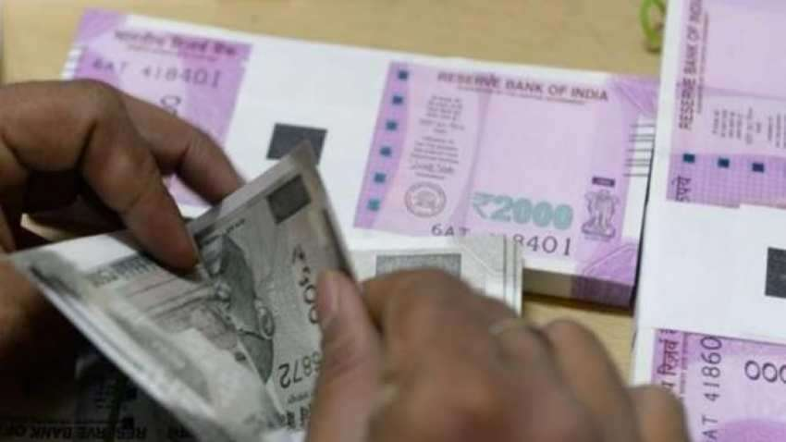
Any Property Covered: It covers not only immovable properties like land & building but also movable and other assets e.g. shares, FDRs, bank accounts, Gold etc.

Slide 23
Any Class: It may hit not only rich but poor also, as it has no threshold limit.
It may affect not only urban people but rural also, as it extends to whole of India.
Any Profile: It is troubling not only errant politicians, but also officers in the public service or otherwise, businessmen, employees of PSUs as well as private sectors and every else who may possess wealth in the form of properties not found registered in their names.

Slide 24
Any Structure: It is roping in corporate as well as non-corporate entities and individuals as well.

Slide 25
Any Intention: Whether there was malafide intention of the offender or not, if Benami transaction has been done, then property transferred/held as Benami may be acquired/confiscated under this law.
• Any Motive: Intention or motive may be relevant for prosecution u/s 53, but not for acquisition/confiscation of the property.

Slide 26
Inadequate Protection
for Bonafide Purchasers:
Though protection has been provided to the purchasers of bonafide properties, but it is neither absolute nor free from ifs and buts.

Slide 27
Makes no distinction between
‘Black Money’ and ‘Tax-Paid Money’:
Any property held Benami shall be treated as Benami Property under the law and all consequences of its confiscation and prosecution of offenders shall follow irrespective of the fact whether BLACK MONEY was used or TAX-PAID MONEY was used.

Slide 28
No U-Turn allowed:
Once benami transactions is done and benami property is acquired, its re-transfer is not allowed under the law. Thus, its correction or reversal is NOT envisaged under the old or new law. There is no scope of confession or surrender or settlement or compounding etc. Thus, legal consequences of entering into the benami transaction are imminent viz. confiscation of benami property and prosecution of the offender.

Slide 29
Multiplier Effect:
Provisions of the Benami Law are in addition to provisions contained in any other law. These are not designed to be mutually exclusive. Thus, in any given situation all three laws i.e. Income Tax Law, PMLA as well as Benami Law can be invoked simultaneously if violation has taken place or offence has been committed in respective laws.

Slide 30
No compensation for any damage:
There is no provision for payment of any compensation to the person whose property is confiscated under PBPT Act, 1988. Similarly no damage can be claimed for vacation of any wrongful attachment done under this law.

Slide 31
Variety of other issues arising under new Benami Law
Is Benami Law applicable to properties situated outside India?
What if the jewellery purchased 10 to 20 years back and the person in possession is not having the receipt of the jewellery. Can that be roped into benami transaction?

Slide 32
If anyone purchase land through NRI salary and paid money through NRI account cheque and registered the land on wife's name. Will this land considered as benami property?
If A is from Punjab, but wants to do business in Himachal, where he can not buy property, so he buys a property in the name of his cousin who is a ‘himachali’, and sets up a hotel, and starts reaping benefits, will that property be considered benami or not?

Slide 33
Interplay with Income Tax Act
Whether provisions of Benami law can apply to the transaction covered under section 68 and 69A ?
Implication under section 56(2)(x) ?
01
02
Whether application of both the law is mutually exclusive or it can be cumulative also ?
Whether a transaction subjected to GAAR be also exposed to the Benami Law ?
04
03

Slide 34
Interplay with Income Tax Act - Holding Structures
Ultimate Parent
Typical issues in holding company structures
Benefits under tax treaties available to beneficial owners
Beneficial Ownership of Assets and Income of SPV under challenge under the Income Tax Proceedings
Can denial of tax treaties on beneficial ownership criterion be the basis for invoking Benami law?
100%
Hold Co SPV Singapore/ Mauritius
Beneficial Owner?
Implications under Benami law
Is the Ultimate Parent a Beneficial Owner?
Is SPV a Benamidar? Holding Property for the Ultimate Parent- Consideration provided by Ultimate Parent
Can shares held in Indian company be held as Benami Property? Subject to provisional attachment?
Holding company structures – recognized under various commercial laws – Can it be subject to challenge under Benami law?
100%
Subscription of shares of I Co / ECB to I Co
Indian company
Burden of showing that transaction is benami lies on the IO

Slide 35
Significant Beneficial Owner disclosure under Companies Act 2013 – uncover Benami holding?
Significant Beneficial Owner (SBO)
Key considerations
SBO required to make disclosures of his beneficial interest to the Reporting Company, which in turn to be reported to Registrar of Companies
SBO disclosures would enable the authorities to “follow the money” in monetary examinations including suspect accounts/assets held by Benamidars
Holding of persons “acting together” is clubbed in respect of their shareholding / influence / control. However, this term has not been defined
For determining situations of “acting together”, can one take reference from definition of “Persons acting in concert (PAC)” from SEBI Takeover Regulations, 2011?
Individual – acting alone or together, or through one or more persons or trust, possess one or more of the following rights or entitlements in reporting company
1.
Holds indirectly, or together with any direct holdings, not less than 10% of the shares
2.
Holds indirectly, or together with any direct holdings, not less than 10% of the voting rights in the shares
3.
Has right to receive or participate in not less than 10% of the total distributable dividend, through indirect holdings alone, or together with any direct holdings
4.
Has right to exercise or actually exercises, significant influence or control, in any manner other than through direct holdings alone
Objective threshold
Subjective threshold

Slide 36
Burden of proof and Intention of the person
P. Leelavathi (D) v. Shankaranarayana Rao (SC - Civil Appeal No. 1099 of 2008) (2019)
Burden of proof on the person who assert the transaction is benami which is to be discharged by legal evidence
Mangathai Ammal (Died) vs. Rajeshwari and Ors. (SC - Civil Appeal No. 4805 of 2019) (SC)
Intention of the person contributed to the purchase money relevant to determine the nature of transaction as benami
The Amendment Act would not be applicable retrospectively
Followed in Smt. Pamela Bhardwaj case by Tribunal under the amended Benami law

Slide 37
Determination of beneficial owner of alleged property prerequisite for treating transaction as Benami
1
Manpreet Estate LLP (Benamidar)
5 Individuals & 5 directors of Companies
Developer
Seller
IO Allegation
Manpreet Estate LLP (MEL) has taken loan from DHFL which was related party of RKW Developers P L (RKW)
Consideration received by sellers transferred to RKW or to its related concerns
RKW was beneficiary of development activity undertaken by MEL on said property
3
2
Employees
4
DHFL
Related party – common promoters, directors and office
RKW Developers (Beneficial owner)
Lender
Prerequisite for determining transaction as benami – identification of beneficial owner of alleged property
Evidences establishing the genuineness of transaction which are at arm’s length relevant to determine nature of transaction as benami
Admissibility of written evidences vs. oral evidence
Attachment of properties as per rules prescribed
IO v. M/s. Manpreet Estates LLP (FPA-PBPT-206/MUM/2018)(2019)

Slide 38
Remits funds to his friend who is resident in India
buys land in his name
Land acquisition in India by an NRI (based in USA) (cannot buy agricultural land in India being a non-resident)
Search by ITD takes place
BENAMI LAW PROCEEDINGS
He (Indian Friend) makes a statement that he is mere facilitator for transactions done by NRI friend
INCOME TAX PROCEEDINGS
FEMA PROCEEDINGS

Slide 39
ANTI-MONEY LAUNDERING:
The Prevention of Money Laundering Act,2002 defines the offence of Money Laundering u/s 3 as

Slide 40
FEW FUNDAMENTAL QUESTIONS
What is ‘Money Laundering’?
Is it different from tax evasion?
Whether tax evasion is also Money Laundering?
What are the authorities governing Money Laundering Laws in India?
What is the punishment or offence of money laundering defined under PMLA,2002 ?

Slide 41
What are consequences if provisions of PMLA are invoked by Enforcement Directorate?
What are the broad powers vested with Enforcement Directorate?
What kind of properties are attached as prescribed in PMLA,2002? Whether a property purchased out of any business activity which is not legitimate in the eyes of law can be covered under PMLA ? What all things cannot be covered under Illegal business?

Slide 42
What are the legal remedies available ?
What are the precautions to be taken to avoid entering into money laundering laws?
What is the effect and impact of attachment of property by Enforcement Directorate?

Slide 43
What is a status of Bonafide purchaser ?
What is the status of a ‘Donee’ of a property which was involved in money laundering?
What is status of Property purchased with clear transaction but previously subject to Money Laundering or Benami effect?
Whether Unexplained Cash Credit (Loan) added by Income Tax into Taxable income, be covered under Money Laundering ?

Slide 44
Which Hawala transactions (Entries) can be covered under PMLA ?
How overlapping of multiple offences & laws are dealt with (like IPC and these laws) ? Which Act will prevail ? Whether punishment under one Law will rest the matter ?

Slide 45
Whether Statements made by third party about accommodation entry/transaction lead to attachment and confiscation of property under any law?
Can property gifted out of Benami, Money Laundering & Black Money transaction be confiscated and recovered ?

Slide 46
Can defaults in bank loans obtains through fraud can be covered under Money Laundering or any other Law?

Slide 47
MONEY LAUNDERING:
The PMLA defines the offence of Money Laundering u/s 3 as “Whosoever directly or indirectly attempts to indulge or knowingly assists or knowingly is a party or is actually involved in any process or activity connected with the proceeds of crime including its concealment, possession, acquisition or use and projecting or claiming as untainted property shall be guilty of offence of Money Laundering”.

Slide 50
PROCESS OF MONEY LAUNDERING
STAGE –I
COMMISSION OF THE SCHEDULED OFFENCE
STAGE-II
GENERATION OF PROCEEDS OF CRIME
STAGE-III
COMMISSION OF MONEY LAUNDERING BY:
PLACEMENT
LAYERING
INTEGRATION

Slide 51
MONEY LAUNDERING INVOLVES 3 STAGES
PLACEMENT
ASSIMILATING OF PROCEEDS OF CRIME INTO FINANCIAL SYSTEM
LAYERING
ROUTING OF ASSIMILATED PROCEEDS OF CRIME TO HIDE ITS SOURCE
INTEGRATION
RE INTRODUCTION OF THE PROCEEDS OF CRIME SUBSEQUENT TO ABOVE TWO STAGES TO PROJECT SUCH PROCEEDS OF CRIME AS WHITE MONEY.

Slide 52
PROCEEDS OF CRIME 2 (1)(u):
It is defined as:
“proceeds of crime” means any property derived or obtained, directly or indirectly, by any person as a result of criminal activity relating to a scheduled offence or the value of any such property or where such property is taken or held outside the country, then the property equivalent in the value held within the country or abroad;

Slide 53
SCHEDULED OFFENCE
The Scheduled Offences are the offences as prescribed in the schedule to the PMLA, which is divided in 3 parts i.e. Part ‘A’ ‘B’ ‘C’.
The Schedule Offence is the genesis of the offence of Money laundering, as there cannot be any offence of Money Laundering unless and until an Offence provided in the Schedule of the PMLA has been first committed.

Slide 54
REVERSE BURDEN OF PROOF
Section 24:- “In any proceedings relating to proceeds of crime under this act-
a) in case of person charged with offence of Money Laundering, the authority or the court shall unless the contrary is proved, presume that such proceeds of crime are involved in Money Laundering.
b) in case of any other person the authority or court may presume that such proceeds of crime are involved in Money Laundering.”

Slide 55
WEB OF ACTIONS
Investigation/Search by Income Tax/Police/CBI/NCB/
Forest Deptt.
Investigation by Enforcement Directorate
Provisional Attachment of Property (PAO)
Complaint for Scheduled Offence
(Charge sheet) filed in the Jurisdictional Court
Complaint to Court
Adjudicating Authority
Special Court
Confirmation of Provisional Attachment
Conviction for Scheduled Offence
Conviction for Offence of Money Laundering
Confiscation of Property involved in Money Laundering

Slide 56
BANK
COMPANY
LOAN OBTAINED BY FRAUD
PROPERTY ACQUIRED QUA BANK LOAN ACQUIRED THROUGH FRAUD
PROPERTY IS THUS PROCEEDS OF CRIME
PROPERTY

Slide 57
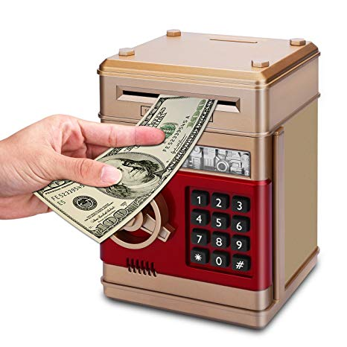
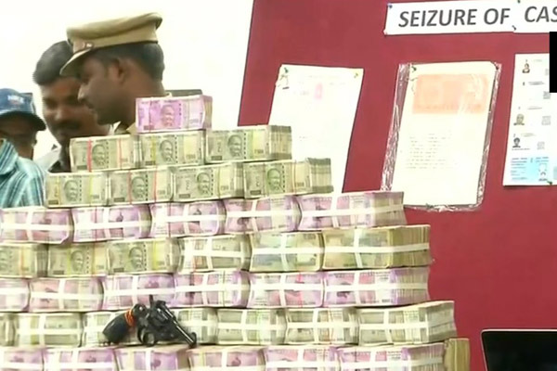
FDR created in the bank in the year 2018 out of funds having no nexus with the scheme
Bitcoin scheme floated in the year 2015 which ended in the year 2017
FDR attached by ED without identifying any transaction linking POC with the attached property

Slide 58
STEPS INVOLVED in CORRECT APPROACH

Slide 59
ROLE OF CHARTERED ACCOUNTANTS, TAX LAWYERS and COMPANY EXECUTIVES IN HANDLING NOTICES AND ATTACHMENT ORDERS ISSUED BY THE ED

Slide 60
Finding out the source(s) and quantifying amount of Proceeds of Crime (POC) from commission of an offence
Identifying the Properties to be attached (acquired with POC)
Identifying the source of such properties and connecting it with the POC.
Identifying Loan utilization in the attached property.
Calculation of the correct value of the POC.
Valuation of the property attached and comparison with the alleged POC.
Proper Financial Accounting and Analysis.
Preparation of Money Trail for the attached properties to demonstrate the source(s) of funds.

Slide 61
The Black Money (Undisclosed Foreign Income and Assets) and Imposition of Tax Act, 2015

Slide 62
LIABILITY UNDER THE ACT: CHARGE OF TAX
As per Section 3(1) of BMA :-
There shall be charged on every assessee
for every assessment year commencing on or after the 1st day of April, 2016
subject to the provisions of this Act
a tax in respect of his total undisclosed foreign income and asset of the previous year at the rate of thirty per cent of such undisclosed income and asset:

Slide 63
Particulars | Undisclosed Foreign Income | Undisclosed Foreign Asset
A) Amount of income /value of asset | ( 1) Which has not been disclosed in the return of income furnished by the assessee under sections 139(1) or 139(4) or 139(5) of the IT Act; (2) In respect of which a return is required to be furnished but no return of income has been furnished within time specified under the IT Act. | Value of undisclosed foreign asset (as per section 3(2), of the BMA
B) Deduc tion/reduction | No deduction in respect of any expenditure or allowance or set off of any loss {refer section 5(1)(i) | Following two specified items (section 5(1)(ii)) of the BMA: The income which has been assessed to tax for any AY under the IT Act prior to A Y to which the BMA applies {i.e. for and up to AY 2015-16) or Any income which is assessable or has been assessed to tax for any A Y under the BMA (i.e. from and after AY 2016 17
C) Assess able income / asset | Sum of A(1) and A(2) above | A (1) less B (a) or B (b) above

Slide 64
COMPUTATION OF TOTAL UNDISCLOSED FOREIGN INCOME AND ASSET
Income from source located outside India (foreign income or ‘FI’) which has not been disclosed in IT Return | XX
FI in respect of which no IT return has been filed | XX
FMV of Undisclosed Foreign Asset (no explanation or unsatisfactory explanation about the source of investment has been provided) – valuation u/r 3 of BMR | XX
Less :
Income which has been assessed to tax for any assessment year under the IT Act prior to relevant assessment year in which the BMA applies. | (XX)
Income which is assessable or has been assessed to tax for any assessment year in which the BMA applies | (XX)
In case of immovable properties, the deduction will be :
Value of undisclosed foreign asset as on the first day of the financial year in the same proportion as assessed/assessable foreign income bears total costs | (XX)
Total value of Undisclosed Foreign Income and Asset | XX
Tax @ 30% | XX

Slide 65
ASHWANI TANEJA
(FCA, ACS, AICWA, FICA, DISA, NCFM, LL.B, LL.M)
(Ex- Member, Income Tax Appellate Tribunal- Ministry of Law & Justice-Government of India)
Email: ashwani@taxindia.net
Ashwani Taneja
(FCA, ACS, AICWA, FICA, DISA, NCFM, LL.B, LL.M)
(EX- MEMBER, INCOME TAX APPELLATE TRIBUNAL- MINISTRY OF LAW & JUSTICE-GOVERNMENT OF INDIA)
Mobile: 9810064777
EMAIL: ashwani@taxindia.net

