Slide 1

Refund under GST Law- Amendments and Changes

Slide 2
Latest Amendments Under Refund – FA 2022
Extension of Time Limit for filing the Refund
Inverted Duty Structure: Input Services
Risky Exporters - Refund of IGST paid on Exports- Withholding of Refund
Re-Credit of ITC in Electronic Credit Ledger
Value of Zero Rated Supplies for Refund Purpose
Claim of refund under inverted duty structure where the supplier is supplying goods under some concessional notification
Refund under deemed Exports
Refund to Exporter of Electricity – Procedure Prescribed
Exports by Duty Free Shops
Date of filing of refund application in case of Mismatch in Shipping Bill
Specified Officer for SEZ developer/ Unit

Slide 3
Extension of Time Limit for filing the Refund
{N. No. 13/2022–Central Tax dated 05th July 2022}
After the suo-moto extensions of limitation period under various laws by the Hon’ble Supreme Court, the exclusion of such extended period from computing two years limitation for filing the refund application was a continuous matter of debate amongst the taxpayers and the tax department.
Finally, the time period from 01.03.2020 to 28.02.2022 to be excluded fromcalculation of the limitation period for filing refund claim by an applicant as well asfor issuance of demand/ order (by proper officer) in respect of erroneous refunds.
(iii) excludes the period from the 1st day of March, 2020 to the 28th day of February, 2022for computation of period of limitation for filing refund application under section 54 or section 55 of the said Act.

Slide 4
Relevant Date
The provision have to be understood very minutely. Due to Clause ‘e’
the refunds for a larger period is still available to apply for the refund.
Hence this requires utmost attention

Slide 5
Inverted Duty Structure: Input Services
[N. No. 14/2022–Central Tax dated 05th July 2022]
Inverted Rated Duty Structure: Input Services – Blockage of ITC on input services shall be reduced in the hands of taxpayers to some extent(Partial Relief- at least recognized the presence of input services)
In the case of refund arising due to inverted duty structure, the department had taken the view that the full ITC utilised by the assessee shall be deducted from the ITC availed on inputs to compute the net ITC for refund on inputs.
On the instructions of the Hon’ble Supreme Court in the matter of VKC Footwear, the formula has been amended to consider the utilisation of ITC by the assessee in proportion to ITC availed on Inputs & Inputs Services.

Slide 6
Formula for calculation of refund
The formula in Rule 89(5) is amended for computing refund under “Inverted Duty Structure” as under:
Maximum Refund Amount = {(Turnover of inverted rated supply of goods and services) x Net ITC ÷ Adjusted Total Turnover} - {tax payable on such inverted rated supply of goods and services x (Net ITC ÷ ITC availed on inputs and input services)}.
Maximum Refund Amount = {(Turnover of inverted rated supply of goods and services) x Net ITC ÷ Adjusted Total Turnover} - {tax payable on such inverted rated supply of goods and services x (Net ITC ÷ ITC availed on inputs and input services)}.

Slide 7
Impact
Turnover of inverted rated supplies: Rs.1,000 (A)
Net ITC (i.e., ITC claimed on inputs): Rs.500 (B)
Total Turnover: Rs.10,000 (C)
Total ITC (i.e., ITC claimed on inputs and input services): Rs.750 (D)
Tax payable on inverted supplies: Rs.50 (E)
The refund as per the original formula = (A * B / C) - E
= (1,000 * 500 / 10,000) – 50
= nil
The refund as per the revised formula = (A * B / C) – (E * B / D)
= (1,000 * 500 / 10,000) – (50 * 500 / 750)
= Rs.17/-

Slide 8
Risky Exporters - Refund of IGST paid on Exports- Withholding of Refund
[N. No. 14/2022–Central Tax dated 05th July 2022]
In cases where the refund of IGST paid on exports was withheld/ suspended due to suspicion on the exporters such as high risk exporters identified by DGARM;
the refund would be transmitted to the system generated refund application in Form GST RFD 01 for due verification by GST officers.
Presently these refunds get stuck for longer periods. This procedure will result in expediting the refund process in such cases.
Relevant amendments are done in Rule 96 of CGST Rules retrospectively w.e.f.01.07.2017

Slide 9
Re-Credit of ITC in Electronic Credit Ledger
[Circular No. 174/06/2022 dated 06.07.2022]
[N. No. 14/2022–Central Tax dated 05th July 2022]
In cases where the assessee deposits the amount of erroneously granted refund along with interest and penalty, the amount of ITC debited in Electronic Credit Ledger is eligible for Re-Credit.
A new Form GST PMT 03A for re-credit of such ITC erroneously refunded to the assessee, in the Electronic Credit Ledger
Categories of refunds where re-credit can be done using FORM GST PMT-03A:
• Refund of IGST obtained in contravention of sub-rule (10) of rule 96
• Refund of unutilised ITC on account of export of goods/services without payment of tax.
• Refund of unutilised ITC on account of zero-rated supply of goods/services to SEZ developer/Unit without payment of tax
• Refund of unutilised ITC due to inverted tax structure

Slide 10
Important
Till the time the functionality is fully automated, taxpayer has to make a written request to the officer for re-credit of amount, where the order of re-credit in Form GST PMT-03Ashall be preferably passed within 30 days of date of receipt of request.

Slide 11
Value of Zero Rated Supplies for Refund Purpose [N. No. 14/2022–Central Tax dated 05th July 2022]
zero-rated supply without payment of IGST under LUT/Bond
the value of goods exported out of India shall be taken as
  FOB value
  declared in the Shipping Bill or Bill of Export form, as the case maybe, as per the Shipping Bill and Bill of Export (Forms) Regulations,2017
  The value declared in Tax Invoice or Bill of supply
  Which ever is lower

Slide 12
Claim of refund under inverted duty structure where the supplier is supplying goods under some concessional notification
[Circular No. 173/04/2022 dated 06.07.2022]
Amendment in para 3.2 of Circular No. 135/05/2020-GST dated 31.03.2020
  Erstwhile Para 3.2 of the Circular clarifies that benefit of Refund of Inverted Duty Rate structure shall not be available where Input and Output are same though attracting different rate of tax at different points in time.
  Now, it is further clarified in Para 3.2 that where Input and Output are same and the rate of tax of output supply is less than the rate of tax on inputs at the same point of time due to supply of goods by the supplier under such concessional notification, the benefit of refund shall be available for credit accumulated on account of the same

Slide 13
Cont..
It is further clarified that the said refund shall not be allowed in the cases where output supply is either Nil rated or fully exempted, and also supply of such goods or services are not notified by the Government for their exclusion from refund of accumulated ITC under inverted duty structure.

Slide 14
Refund under deemed Exports
[#Circular No. 172/04/2022 dated 06.07.2022]
Input Tax Credit (ITC) availed by the recipient of deemed export for claiming refund of tax paid on supplies regarded as deemed exports would not be subjected to provisions of Section 17 of the CGST Act, 2017 since the same was not an ITC as per provisions of Chapter V of the CGST Act, 2017 and was made available to ensure ease in claiming refunds.
Such ITC is not to be included in the "Net ITC" for computation of refund of unutilised ITC under rule 89(4) & rule 89 (5) of the CGST Rules, 2017.

Slide 15
Refund to Exporter of Electricity – Procedure Prescribed
[Circular No. 175/07/2022 dated 06.07.2022
N. No. 14/2022–Central Tax dated 05th July 2022]
Amendment in Rule 89(2) of CGST Rules to prescribe procedure for refund of unutilized Input Tax Credit on account of Export of Electricity.
This would facilitate the exporters of electricity in claiming refund of unutilized ITC on zero rated supplies.
This amendment is clarificatory in nature and for ease of claiming refund as the refund of unutilizedITC on zero rated supply of exempted goods/services is already permissible under Section 16 of the IGST Act.

Slide 16
Date of filing of refund application in case of Mismatch in Shipping Bill
[N. No. 14/2022–Central Tax dated 05th July 2022]
Clause in Rule 96(1)(b) has been inserted
If there is any mismatch between the data furnished by the exporter of goods inShipping Bill and those furnished in statement of outward supplies in FORMGSTR-1,
such application for refund of integrated tax paid on the goods exported out of India(Export with payment of tax) shall be deemed to have been filed on such date whensuch mismatch in respect of the said shipping bill is rectified by the exporter.

Slide 17
Specified Officer for SEZ developer/ Unit
[N. No. 14/2022–Central Tax dated 05th July 2022]
In respect of refunds pertaining to supplies to SEZ Developer/Unit, an Explanation is inserted in sub-rule (1) of rule 89 of CGST Rules to clarify that ‘specified officer’ under the said sub-rule shall mean the ‘specified officer’ or ‘authorized officer’, as defined under SEZ Rules, 2006.
Rule 89(1)
Explanation.—For the purposes of this sub-rule, ―specified officer‖means a ―specified officer‖ or an ―authorised officer as defined under rule2 of the Special Economic Zone Rules, 2006.‘;

Slide 18
Relevant Date – SEZ
[(ba) in case of zero-rated supply of goods or services or both to a Special Economic Zone developer or a Special Economic Zone unit where a refund of tax paid is available in respect of such supplies themselves, or as the case may be, the inputs or input services used in such supplies, the due date for furnishing of return under section 39 in respect of such supplies;]
* Inserted (w.e.f. a date yet to be notified) by s. 113 of The Finance Act 2022 (No. 06 of 2022).

Slide 19
Refunds
CGST Act | Chapter XI | Sections: 54,55,56,57, 58
IGST Act | Chapter VI | Section15
CGST Rules | Chapter X | Rules: 89,90,91,92,93,94,95,96,96A, 96B,97,97A

Slide 20
Relevant Section/ Rules (CGST)
Sections
  54. Refund of tax
  55. Refund in certain cases
  56. Interest on delayed refunds
  57. Consumer Welfare Fund
  58. Utilisation of Fund
Other Relevant Sections
  33. Tax to be indicated in tax invoice
  57. Consumer Welfare Fund
  49. Payment of tax, interest, penalty etc.
  39 Furnishing of returns
  77. Tax wrongfully collected and paid
Rules
  89. Application for refund of tax, interest, penalty, fees or any other amount
  90. Acknowledgement
  91. Grant of provisional refund
  92. Order sanctioning refund
  93. Credit of the amount of rejected refund claim
  94. Order sanctioning interest on delayed refunds
  95. Refund of tax to certain persons
  96. Refund of integrated tax paid on goods or services exported out of India
  96A. Refund of integrated tax paid on export of goods or services under bond or Letter of Undertaking
  96B. Recovery of refund of unutilised input tax credit or integrated tax paid on export of goods where export proceeds not realised.
  97. Consumer Welfare Fund
  97A. Manual filing and processing

Slide 21
Forms prescribed under the GST Law
FORMS | PARTICULARS
FORM-GST-RFD-01 | Application for Refund.
FORM-GST-RFD-02 | Acknowledgment
FORM-GST-RFD-03 | Deficiency Memo.
FORM-GST-RFD-04 | Provisional Refund Order.
FORM-GST-RFD-05 | Payment Order.
FORM-GST-RFD-06 | Refund Sanction/Rejection Order
FORM-GST-RFD-07 | Order for Complete adjustment of sanctioned Refund
FORM-GST-RFD-08 | Notice for rejection of application for refund
FORM-GST-RFD-09 | Reply to show cause notice
FORM-GST-RFD-10 | Application for Refund by any specialized agency of UN or any Multilateral Financial Institution and Organization, Consulate or Embassy of foreign countries, etc
FORM-GST-RFD-11 | Furnishing of a bond or Letter of Undertaking for export of goods or services
FORM-GST-RFD-01 A | Application for Refund (Manual).
FORM-GST-RFD-01 B | Refund Order Details.
FORM-GST-RFD-10 B | Application for refund by Duty-Free Shops/Duty Paid Shops (Retail outlets).

Slide 22
NOTIFICATION NO. 16/2020 DATED 23.03.2020
Rule 89(4)(C) Substituted:- ( Refund)
“Turnover of zero-rated supply of goods" means the value of zero-rated supply of goods made during the relevant period without payment of tax under bond or letter of undertaking or the value which is 1.5 times the value of like goods domestically supplied by the same or, similarly placed, supplier, as declared by the supplier, whichever is less, other than the turnover of supplies in respect of which refund is claimed under sub-rules (4A) or (4B) or both;‟.

Slide 23
Sec.89(4):
Refund of unutilised credit in case of zero rated supplies of Goods/Services under LUT (Sec. 16(3) of IGST Act, 2017) would be determined as per the formula:
Refund Amount = (Turnover of Zero rated supply of goods + Turnover of Zero rated supply of services) x Net ITC / Adjusted Total Turnover.
"Refund amount" means the maximum refund that is admissible;
"Net ITC" means input tax credit availed on inputs and input services during the relevant period;
"Turnover of zero-rated supply of goods" means the value of zero-rated supply of goods made during the relevant period without payment of tax under bond or letter of undertaking; (Now Amended)
“Turnover of zero-rated supply of goods” means the value of zero-rated supply of goods made during the relevant period without payment of tax under bond or letter of undertaking or the value which is 1.5 times the value of like goods domestically supplied by the same or, similarly placed, supplier, as declared by the supplier, whichever is less, other than the turnover of supplies in respect of which refund is claimed under sub-rules (4A) or (4B) or both; (vide Nno 16/20 dated 23-03-2020)
"Turnover of zero-rated supply of services" means the value of zero-rated supply of services made without payment of tax under bond or letter of undertaking, calculated in the following manner, namely:-
Zero-rated supply of services is the aggregate of the payments received during the relevant period for zero-rated supply of services and zero-rated supply of services where supply has been completed for which payment had been received in advance in any period prior to the relevant period reduced by advances received for zero-rated supply of services for which the supply of services has not been completed during the relevant period;

Slide 24
(G) "Adjusted Total turnover" means the turnover in a State or a Union territory, as defined under clause (112) of section 2, excluding the value of exempt supplies other than zero-rated supplies, during the relevant period; and
the turnover of zero-rated supply of services determined in terms of clause (D) above and non-zero-rated supply of services, excluding-
the value of exempt supplies other than zero-rated supplies; and
the turnover of supplies in respect of which refund is claimed under sub-rule (4A) or sub-rule (4B) or both, if any, during the relevant period.
    Circular No. 147/03//2021-GST dated 12th March 2021
    ..\..\Notification\Refund Circular_Refund_147.pdf

Slide 25
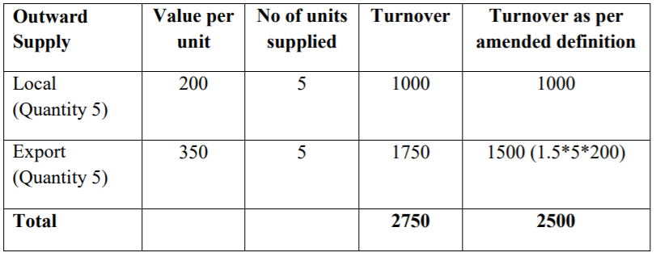
Calculation of Refund Claim pursuant to Rule 89 (4) of CGST Rules, 2017
Illustration:
Suppose a supplier is manufacturing only one type of goods and is supplying the same goods in both domestic market and overseas. During the relevant period of refund, the details of his inward supply and outward supply details are shown in the table below:
Net admissible ITC = Rs. 270

Slide 26
The formula for calculation of refund as per Rule 89(4) is :
Refund Amount = (Turnover of zero-rated supply of goods + Turnover of zero-rated supply of services) x Net ITC ÷Adjusted Total Turnover
Turnover of Zero-rated supply of goods (as per amended definition) = Rs. 1500 Adjusted Total Turnover= Rs. 1000 + Rs. 1500 = Rs. 2500 [and not Rs. 1000 + Rs. 1750] Net ITC = Rs. 270
Refund Amount = Rs. 1500*270/2500 = Rs. 162
Thus, the admissible refund amount in the instant case is Rs. 162.

Slide 27
Certain Clarifications:
Board has issued master circular on refund No. 125/44/2019 – GST, dated 18-11-2019.
During the processing of the refund claim, the value of the goods declared in the GST invoice and the value in the corresponding shipping bill / bill of export should be examined and the lower of the two values should be sanctioned as refund. [Para 9 of Circular No. 37/11/2018 – GST, dated 15-03-2018]
Procedure for rectification of errors made while filing the returns in Form GSTR-3B has been provided in Circular No. 26/26/2017 – GST, dated 29-12-2017.
Self-declaration for non-prosecution is not warranted with every claim of refund, in cases of exports of goods under LUT. [Para 7 of Circular No. 37/11/2018 – GST, dated 15-03-2018]
It has been clarified that tax payers can club the refund of different months across the successive financial years(Para 11 of Circular No. 37/11/2018 – GST, dated 15-03-2018 ). Restriction on bunching of refund claims across financial years shall not apply based on the pronouncement of Hon’ble Delhi High Court in Order dated 21.01.2020, in the matter of M/s Pitambra Books P. Ltd. vide circular no. 135/05/2020 – CGST, dated 31-03-2020.
Refund of accumulated ITC shall be restricted to the ITC as per those invoices, the details of which are uploaded by the supplier in FORM GSTR-1 and are reflected in the FORM GSTR-2A of the applicant. [Para 5 of Circular No. 135/05/2020 – CGST, dated 31-03-2020].
Applicant have to furnish details of inward supplies / details of invoices reflecting in Form GSTR-2A in Annexure B. Further, applicant also have to mention HSN/SAC code which is mentioned on the inward invoices. In cases where supplier is not mandated to mention HSN/SAC code on invoice, the applicant need not mention HSN/SAC code in respect of such an inward supply. [Para 6 of Circular No. 135/05/2020 – CGST, dated 31-03-2020].

Slide 28
Certain Clarifications:
Any refund claim for a tax period may be filed only after furnishing all the returns in FORM GSTR-1 and FORM GSTR-3B which were due to be furnished on or before the date on which the refund application is being filed.
In cases, where zero-rated supplies were made before filing the LUT and refund claims for unutilized input tax credit got filed. In this regard, it is emphasized that the substantive benefits of zero rating may not be denied where it has been established that exports in terms of the relevant provisions have been made. The delay in furnishing of LUT in such cases may be condoned and the facility for export under LUT may be allowed on ex post facto basis taking into account the facts and circumstances of each case. [Para 4 of Circular No. 37/11/2018 – GST, dated 15-3-2018 & Para 44 of Circular No. 125/44/2019 – GST, dated 18-11-2019.]
It is clarified that “Net ITC” in the formula provided will not include credit pertains to “Transitional Credit” as the transitional credit pertains to duties and taxes paid under the existing laws viz., under Central Excise Act, 1944 and Chapter V of the Finance Act, 1994, the same cannot be said to have been availed during the relevant period and thus, cannot be treated as part of ‘Net ITC’ and thus no refund of such unutilized transitional credit is admissible. [Para 50 of Circular No. 125/44/2019 – GST, dated 18-11-2019.]

Slide 29
The refund claim may be withheld by proper officer of Customs
Under following circumstances, proper officer will withheld the payment of refund
Defaulted in furnishing any return;
Defaulted in payment of tax, interest or penalty which is not stayed by any Court or Tribunal or Appellate Authority by the specified date. Specified date means the last date for filing an appeal under this Act.
Proper officer will withheld the refund due until the said person has furnished the return or paid the tax, interest or penalty, as the case may be or deduct from the refund due, any tax, interest, penalty, fee or any other amount which the taxable person is liable to pay but which remains unpaid under this Act or under the existing law. [S. 54(10) & ( 11) ]

Slide 30
Refund Under Rule 96 is not allowed in following cases
Applicant claiming refund of integrated tax paid on export of goods or services should not have received goods and has availed any of the following benefits
❑ Benefit of Deemed Exports
❑ Received goods at a concessional rate of 0.1%
❑ Availed benefits under EOU
❑ has imported any goods under EPCG, Advance Authorization schemes
❑ In all these cases, the person exporting the goods should export without payment of Integrated tax under Bond/LUT.
In all these cases, the person exporting the goods should export without payment of Integrated tax under Bond/LUT
{“Explanation.- For the purpose of this sub-rule, the benefit of the notifications mentioned therein shall not be considered to have been availed only where the registered person has paid Integrated Goods and Services Tax and Compensation Cess on inputs and has availed exemption of only Basic Customs Duty (BCD) under the said notifications.”. }vide N.no 16/2020 dated 23-03-2020.(Amendment to Rule 96(10)

Slide 31
NOTIFICATION NO. 16/2020 DATED 23.03.2020
New Rule 96B Inserted:
“96B. Recovery of refund of unutilised input tax credit or integrated tax paid on export of goods where export proceeds not realized
–(1) Where any refund of unutilised input tax credit on account of export of goods or of integrated tax paid on export of goods has been paid to an applicant but the sale proceeds in respect of such export goods have not been realised, in full or in part, in India within the period allowed under the Foreign Exchange Management Act, 1999 (42 of 1999), including any extension of such period, the person to whom the refund has been made shall deposit the amount so refunded, to the extent of non realization of sale proceeds, along with applicable interest within thirty days of the expiry of the said period or, as the case may be, the extended period, failing which the amount refunded shall be recovered in accordance with the provisions of section 73 or 74 of the Act, as the case may be, as is applicable for recovery of erroneous refund, along with interest under section50:
Provided that where sale proceeds, or any part thereof, in respect of such export goods are not realised by the applicant within the period allowed under the Foreign Exchange Management Act, 1999 (42 of 1999), but the Reserve Bank of India writes off the requirement of realization of sale proceeds on merits, the refund paid to the applicant shall not be recovered.

Slide 32
NOTIFICATION NO. 16/2020 DATED 23.03.2020
(2) Where the sale proceeds are realised by the applicant, in full or part, after the amount of refund has been recovered from him under sub-rule (1) and the applicant produces evidence about such realisation within a period of three months from the date of realisation of sale proceeds, the amount so recovered shall be refunded by the proper officer, to the applicant to the extent of realisation of sale proceeds, provided the sale proceeds have been realised within such extended period as permitted by the Reserve Bank of India.”.

Slide 33
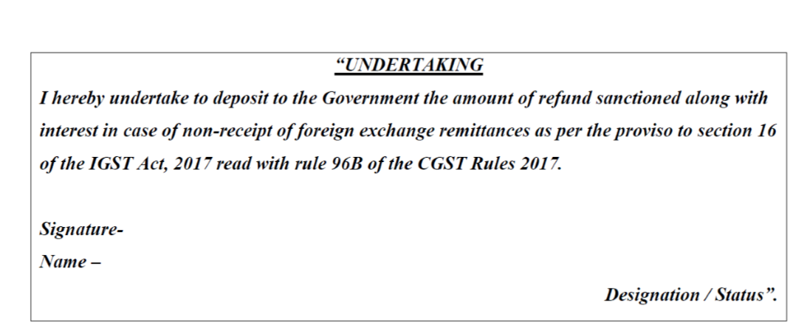

Slide 34
The Government of India as well as the Reserve Bank has been receiving representations from Exporters Trade bodies to extend the period of realization of export proceeds in view of the outbreak of pandemic COVID- 19. It has, therefore, been decided, in consultation with Government of India, to increase the present period of realization and repatriation to India of the amount representing the full export value of goods or software or services exported, from nine months to fifteen months from the date of export, for the exports made up to or on July 31, 2020. [Circular No. 27 / RBI / 2019 – 2020 / 206, dated 01-04-2020]
If the sales proceeds or any part thereof is not realized within the stipulated time prescribed under FEMA but Reserve Bank of India (RBI) writes off the requirement of realization of sale proceeds on merits, the refund amount would not be recovered from such exporters.
If exporter realized the export proceeds, in full or part, after the amount has been recovered from him as mentioned aforesaid, in such scenario, exporters have to submit the proper proof or evidence of realization of export proceeds within in a period of 3 months from the realization of proceeds before the proper officer and then he will refund the amount to the exporters. However, realization of export proceeds should be within the extended time period permitted by RBI.

Slide 35
Notification No 15/2021-CT dated 18th May 2021
in rule 90, -
(a) in sub-rule (3), the following proviso shall be inserted, -
“Provided that the time period, from the date of filing of the refund claim in FORM GST RFD-01 till the date of communication of the deficiencies in FORM GST RFD-03 by the proper officer, shall be excluded from the period of two years as specified under sub-section (1) of Section 54, in respect of any such fresh refund claim filed by the applicant after rectification of the deficiencies.";

Slide 36
Notification No 15/2021-CT dated 18th May 2021
in rule 90, -
(b) after sub-rule (4),
the following sub-rules shall be inserted, namely: -
“(5) The applicant may, at any time before issuance of provisional refund sanction order in FORM GST RFD-04 or final refund sanction order in FORM GST RFD-06 or payment order in FORM GST RFD-05 or refund withhold order in FORM GST RFD-07 or notice in FORM GST RFD-08, in respect of any refund application filed in FORM GST RFD-01, withdraw the said application for refund by filing an application in FORM GST RFD-01W.

Slide 37
Notification No 15/2021-CT dated 18th May 2021
in rule 90, -
(6) On submission of application for withdrawal of refund in FORM GST RFD-01W, any amount debited by the applicant from electronic credit ledger or electronic cash ledger, as the case may be, while filing application for refund in FORM GST RFD-01, shall be credited back to the ledger from which such debit was made.”;

Slide 38
in rule 92, -
(a) in sub-rule (1), the proviso shall be omitted;
(b) in sub-rule (2), -
  (i) for the word and letter “Part B”, the word and letter “Part A” shall be substituted;
  (ii) the following proviso shall be inserted, namely: -
  “Provided that where the proper officer or the Commissioner is satisfied that the refund is no longer liable to be withheld, he may pass an order for release of withheld refund in Part B of FORM GST RFD- 07.”;

Slide 39
(iv) in rule 96, -
  in sub-rule (6), for the word and letter “Part B”, the word and letter “Part A” shall be substituted;
  (b) in sub-rule (7), for the words, letters and figures, “after passing an order in FORM GST RFD-06”, the words, letters and figures, “by passing an order in FORM GST RFD-06 after passing an order for release of withheld refund in Part B of FORM GST RFD-07” shall be substituted;

Slide 40
For FORM GST RFD-07, the following FORM shall be substituted, namely: -
Notification\notfctn-15-central-tax-english-2021.pdf

Slide 41
CIRCULAR 135/05/2020 DATED 31-03-2020
Bunching of refund claims across Financial Years
On perusal of the provisions under sub-section (3) of section 16 of the Integrated Goods and Services Tax Act, 2017 and sub-section (3) of section 54 of the CGST Act, there appears no bar in claiming refund by clubbing different months across successive Financial Years.
Refund of accumulated input tax credit (itc) on account of reduction in GST Rate.
An applicant trading in goods has purchased, say goods “X” attracting 18% GST. However, subsequently, the rate ofGST on “X” has been reduced to, say 12%. It is being claimed that accumulation of ITC in such a case is also covered as accumulation on account of inverted duty structure and such applicants have sought refund of accumulated ITC under clause (ii) of sub-section (3) of section 54 of the CGST Act.

Slide 42
CIRCULAR 135/05/2020 DATED 31-03-2020
Change in manner of refund of tax paid on supplies other than zero rated supplies
Circular No. 125/44/2019-GST dated 18.11.2019, in para 3, categorizes the refund applications to be filed in FORM GST RFD-01 as under:
Refund of unutilized input tax credit (ITC) on account of exports without payment of tax;
Refund of tax paid on export of services with payment of tax; .
Refund of unutilized ITC on account of supplies made to SEZ Unit/SEZ Developer without payment of tax;
Refund of tax paid on supplies made to SEZ Unit/SEZ Developer with payment of tax;
Refund of unutilized ITC on account of accumulation due to inverted tax structure;
Refund to supplier of tax paid on deemed export supplies;
Refund to recipient of tax paid on deemed export supplies;
Refund of excess balance in the electronic cash ledger;
Refund of excess payment of tax;
Refund of tax paid on intra-State supply which is subsequently held to be inter State supply and vice versa;
Refund on account of assessment/provisional assessment/appeal/any other order;
Refund on account of “any other” ground or reason.

Slide 43
The impact of this provision is that any such refund of tax paid on supplies other than zero rated supplies will now be admissible proportionately in the respective original mode of payment i.e. in cases of refund, where the tax to be refunded has been paid by debiting both electronic cash and credit ledgers (other than the refund of tax paid on zero-rated supplies or deemed export), the refund to be paid in cash and credit shall be calculated in the same proportion in which the cash and credit ledger has been debited for discharging the total tax liability for the relevant period for which application for refund has been filed. Such amount, shall be accordingly paid by issuance of order in FORM GST RFD-06 for amount refundable in cash and FORM GST PMT-03 to re-credit the amount attributable to credit as ITC in the electronic credit ledger.

Slide 44
CIRCULAR 135/05/2020 DATED 31-03-2020
Guidelines for refunds of Input Tax Credit under Section 54(3)
It has been decided that the refund of accumulated ITC shall be restricted to the ITC as per those invoices, the details of which are uploaded by the supplier in FORM GSTR-1 and are reflected in the FORM GSTR-2A of the applicant.
New Requirement to mention HSN/SAC in Annexure ‘B’
References have also been received from the field formations that HSN wise details of goods and services are not available in FORM GSTR-2A and therefore it becomes very difficult to distinguish ITC on capital goods and/or input services out of total ITC for a relevant tax period. It has been recommended that a column relating to HSN/SAC Code should be added in the statement of invoices relating to inward supply as provided in Annexure–B of the circular No. 125/44/2019- GST dated 18.11.2019 so as to easily identify between the supplies of goods and services.

Slide 45
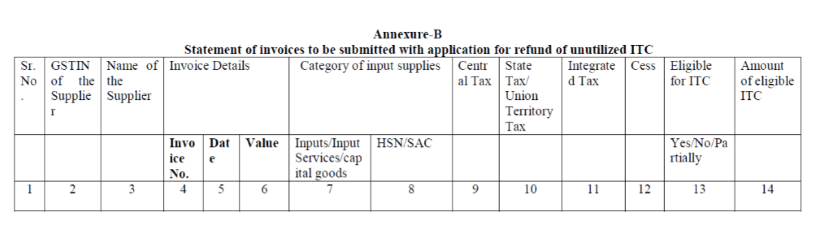

Slide 46
Mis-match of Data & Error Codes
The matching between the two data sources is done at invoice level and any mis-match of the laid down parameters results in one or more of the following errors/responses:
SB000 | Successfully validated
SB001 | Invalid SB details
SB002 | EGM not filed
SB003 | GSTIN mismatch
SB004 | Record already received and validated
SB005 | Invalid invoice number
SB006 | Gateway EGM not available

Slide 47
SBOO1 | This may occur due mention of wrong shipping bill number furnished in GSTR 1/Table 6A. The possible reason for such mismatch could be a clerical error made by the exporter at the time of filling of GSTR 1/Table 6A, which can be rectified by making amendments in GSTR 1 by using Form 9A. Form 9A has been made available by GSTN w.e.f. 15.12.2017 in exporter’s login at the GST common portal.
SB002 | Exporter has to approach their shipping line/airline/carrier to file the EGM immediately
SB003 | This error occurs when GSTIN declared in the SB does not match with the GSTIN mentioned in the corresponding GST return. In this case too, the exporter has to make necessary changes in GSTR 1 by use of amendment Form 9A. Exporters should note that there is no provision of amendment in the shipping bill once the EGM is filed.
SB004 | This error occurs due to duplicate/ repeat transmission of shipping bill-invoice record from GSTN. The previous transmission would have already been validated for IGST refund by ICES.

Slide 48
SB005 | The details an exporter is required to enter in the “invoice” column while filing the SB pertains to the invoice issued by him compliant to GST Invoice Rules. The invoice number shall be matched with GSTN to validate exports and IGST payment. There should not be any difference between commercial invoice and GST invoice after implementation of GST since as per the GST law, IGST is to be paid on the actual transaction value of the supply between the exporter and the consignee, which should be the same as the one declared In the commercial invoice. If SB005 is due to a data entry mistake in GSTR 1, it can be amended in Form 9A. But any mistake in the SB cannot be amended once EGM is filed. Also, if the exporter has used a separate invoice in the SB, he cannot include that in his GSTR 1 in lieu of his GST invoice. Thus, SB005 error, as of now, cannot be corrected by any amendment either in GSTR-1 or in the Shipping Bill.
SB006 | Error SB006 occurs due to discontinuance of transference copy of shipping bill. An alternate mechanism to treat final Bill of Lading as valid document for integrated with EGM should be followed – CBI&C circular No. 08/2018-Customs dated 23-3-2018. In cases of exports through ICDs, if the gateway EGM is not filed electronically or it contains some error, response code SB006 appears. It is noticed that gateway EGM in case of many ICD shipping bills have been manually filed, leading to such refunds not being processed. While the Customs at gateway ports are pursuing this matter with the shipping lines, the exporters can also approach their shipping line to file the EGMs electronically.

Slide 49
Mismatch of invoice number (Error code SB005)
This is the most common error committed by the exporters, which occurs due to mismatch in invoice declared in shipping bill and GSTR 1 for the same supply .This can happen due to:
Typographical mistake while entering data in GSTR 1 or the SB.
The exporter uses two sets of invoices, one invoice for GST and another invoice for exports resulting in mismatch of invoice numbers.
If SB005 is due to a data entry mistake in GSTR 1, it can be amended in Form 9A. But any mistake in the SB cannot be amended once EGM is filed. Also, if the exporter has used a separate invoice in the SB, he cannot include that in his GSTR 1 in lieu of his GST invoice. CB&IC had issued many clarifications to overcome the problems of SB005 errors. Circular No’s. 42/2017 – Customs, dated 07-11-2017, 6/2018 – Customs, dated 16-03-2018, 8/2018 – Customs, dated 23-03-2018, 15/2018 – Customs, dated 06-06-2018, 22/2018 – Customs, dated 18-07-2018, 40/2018 – Customs, dated 24-10-2018, 01/2019 – Customs, dated 02-01-2019, 25/2019 – Customs, dated 27-08-2019, 26/2019 – Customs, dated 27-08-2019, 131/1/2020 – GST, dated 23-01-2020 and 22/2020 – Customs, dated 21-04-2020

Slide 50
Mistake in description of shipping bill about payment of IGST
In some cases, exporter pays IGST but by mistake mentions ‘NA’ in shipping Bill instead of ‘P’. In such case, refund should be granted after verifying payment of IGST based on GST returns – CBI&C circular No. 08/2018-Customs dated 23-3-2018.
Other Reasons (Code SB000)
SB000 (Successfully Validated) is the response code which comes when all the decided parameters like GST1N, SB number, invoice number etc. match between GSTN and Customs databases. This code implies that the SB is ready for inclusion in the IGST refund scroll. However, it might happen that even with SB000. the SB does not appear in the refund scroll. This could be due to:
The exports might have been made under bond or LUT, hence not eligible for refund.
If a shipping bill covers multiple invoices, few of the invoices might have been successfully validated with code SB000 whereas other invoices might be containing other types of error/s.
Composite rate of drawback has been claimed for that SB during the transitional period between 01.07.2017 to 30.09.2017, thus making the SB ineligible for IGST refund.
Where the IGST claimed amount is less than Rs. 1000/-.
In all the above cases, the scroll amount shall automatically become zero and the SBs shall not be included in the refund scroll.

Slide 51
There can be instances where the SBs will figure in the temporary IGST scroll but not in the final scroll. This could happen if there is an alert/suspension on the IEC in ICES or if the account of the IEC is not validated by Public Finance Management System (PFMS). In case of multiple errors in the refund claim, each such error would be required to be corrected individually in order to get refund. In some cases the IGST Refund could not be disbursed due to Indian Financial System Code (IFSC) not being accepted by Public Financial Management System (PFMS) /not registered at PFMS, in this regards, JNCH (Nhava Sheva) has issued Public Notice No. 38/2018, dated 12-03-2018, for guidance to the trade / exporters.

Slide 52
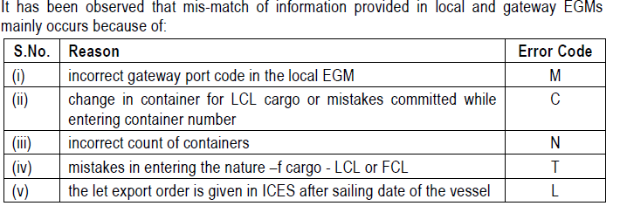

Slide 53
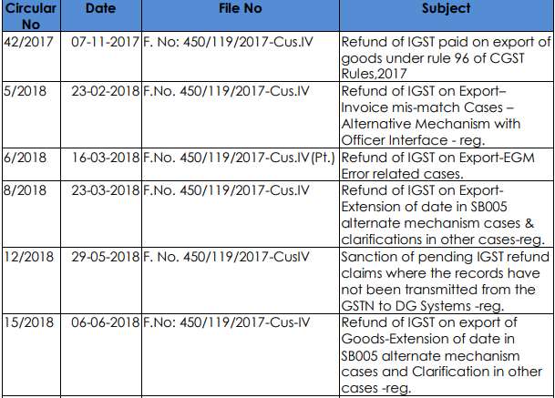

Slide 54
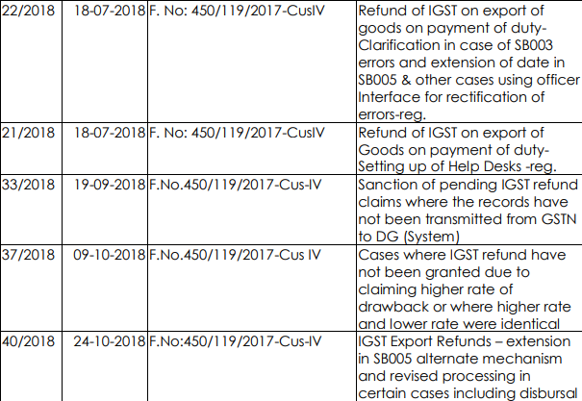

Slide 55
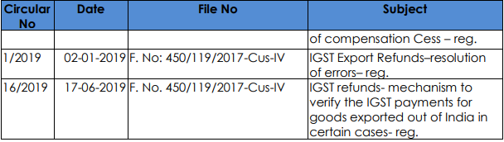

Slide 56
Circular No. 17/17/2017 - GST dated 15.11.2017
Circular No. 24/24/2017— GST dated 21.12.2017
Circular No. 37/11/2018— GST dated 15.03.2018
Circular No. 45/19/2018— GST dated 30.05.2018(Corrigendum – 18.07.2019)
Circular No. 56/30/2018— GST dated 24.08.2018
Circular No. 59/33/2018— GST dated 04.09.2018
Circular No. 70/44/2018— GST dated 26.10.2018
Circular No. 79/53/2018— GST dated 31.12.2018
Circular No. 94/13/2019— GST dated 28.03.2019
Circular No. 104/23/2019— GST dated 28.06.2019
Circular No. 106/25/2019— GST dated 29.06.2019
Master circular 125/44/2019 – dated 18.11.2019
Circular No. 135/2020 dated 31.03.2020
Circular No. 137/2020 dated 13.04.2020
N.No 16/2020 CT (R) dated 23-03-2020.

Slide 57


Slide 58
Disclaimer
The views expressed are solely of the author and the content of this document is solely for information purpose and not to be construed as a professional advice. In cases where the reader has any legal issues, he/she must in all cases seek independent legal advice.

Slide 59

Presented by:
FCA Archana Jain (Founder)
ARCHANA JAIN &CO.
F-13, KIRTI NAGAR,
DELHI-15. ca.archanajain11@gmail.com aj@archanajain.com
9999009508,011-49090618,7291984444(WA)

