Slide 1
09/12/2022 Friday AT 4.00PM
Physical Meeting
ORGANISED BY
RAJKOT BRANCH OF WIRC of ICAI

Slide 2
Get Familiar with TallyPrime Release 2.1
Notes:
In this busy audit season, time is of the essence. With huge volume of data per client and huge number of clients to serve, efficiency is extremely critical. TallyPrime Release 2.1 has been designed to help you save time so you can focus on the more important audit related activities.

Slide 3
Session Objectives
Automated Opening of Company – Auto Login, Menu buttons buckated and flexibility like using File explorer
Marked Voucher feature – easing Audit / Statutory compliance
Scenario using Reversing Journal
Navigate faster with ‘Go To’ and Open Reports menu.
Generate reports with required filters instantly with ‘Save View’ and How to delete the Save View Report.
Change View and Exception Report on each tally screen.
Faster access to Clients’ data
Audit section with Master Configuration, verification and sampling tools
A more powerful reporting engine
Securely Analyze data on the go via ‘Tally Reports in Browser’

Slide 4
TallyPrime Release 1.0
Go To
Menu Style
Chart of Accounts
Navigation changes
User based login
Balance sheet Audit
Optimized Printing
E-Invoice
…..
Option to co-exist TallyPrime and Tally.ERP9
Best option for CAs / Tax Professionals

Slide 5
Inculcate habit of micro analysis of your business data using reports.
• View every Transaction-wise, Product-wise, Brand-wise profitability.
• Ratio Analysis: An Owner’s Dashboard, analysing strength & health view of business.
• Sales Trend with Multi-Columnar Reports & Multi-dimensional Pivot Reports
• Taxes Triangulation Reports and many more…

Slide 6
The strength of your Mail ID as Tally.NET ID
Notes:
Important information to Chartered Accountants:
Once their e-mail id is registered as Tally.NET ID, it can be used for Tally Reports in Browser, Remote Access, etc., Also, the local data can be accessed using the Tally.NET ID.

Slide 7
Securely Analyze live data on the go
Tally Reports in Browser
Notes:
Accessing client’s live data for analysis
Access client’s data via Mobile or any gadget through browser.
Check reports and download them in Excel format for further study.
Drill down until transactions from reports.
No edit of transactions will assure your customers that you are only accessing the reports and seeing transactions
Device friendly view of reports on browser will make data access experience a delight to you.

Slide 8
Working Remotely on Tally Prime

Slide 9
Agenda
Major use cases for working remotely
Major Tools in Tally for connectivity
Remote Access in Tally
Tally Reports in Browser
Tally Rental Options for Staff and articles & TVU

Slide 10
Major use cases
Articles are working from Home. (Need Partly to access Tally)
Clients accountant want to clarify a doubt with article or his CA
Articles/CA want to make notes when traveling on vouchers
Occasionally need staff to co-ordinate from home in emergency. Generally a LAN environment
Rare scenario, need staff/client to make an entry and he doesn’t have access to Tally at home

Slide 11
Remote Access step by step
1. Enable Remote Access
2. Giver permission to remote user
3. Connect the company
4. User logs in remotely from his computer using Tally.NET id
5. Remote user selects and start working on desired company

Slide 12
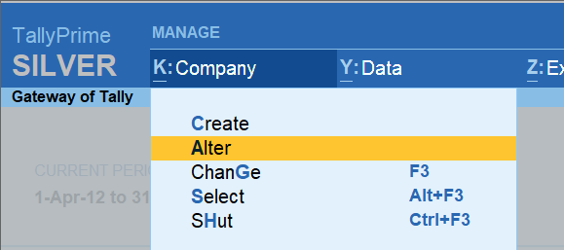
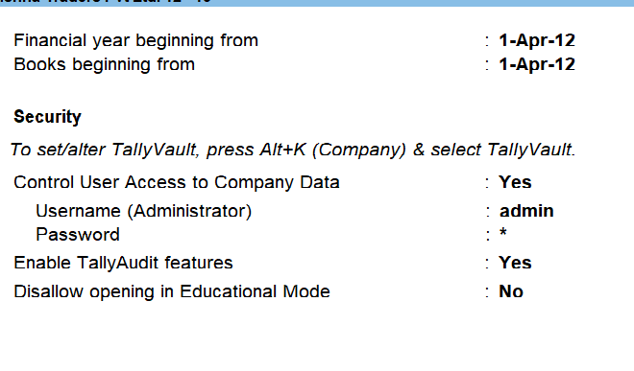
1. Enabling Company Level

Slide 13
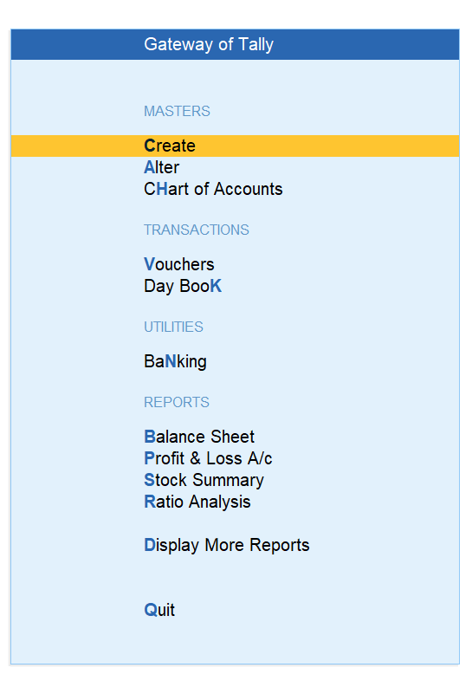
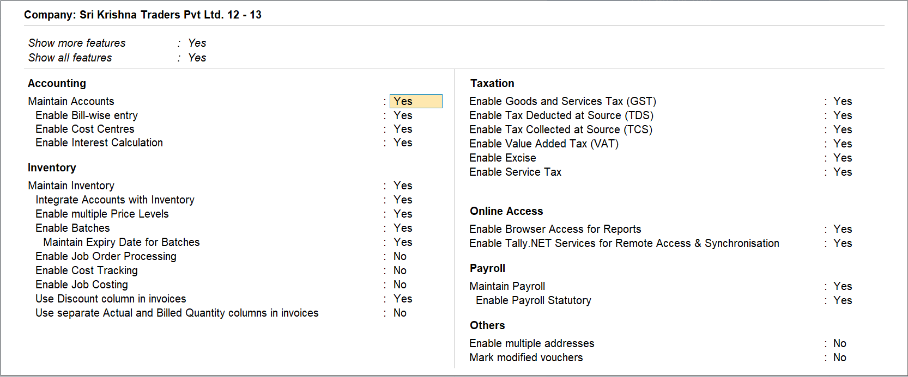
1. Enabling – F11 -> Online Access ->”Yes”

Slide 14
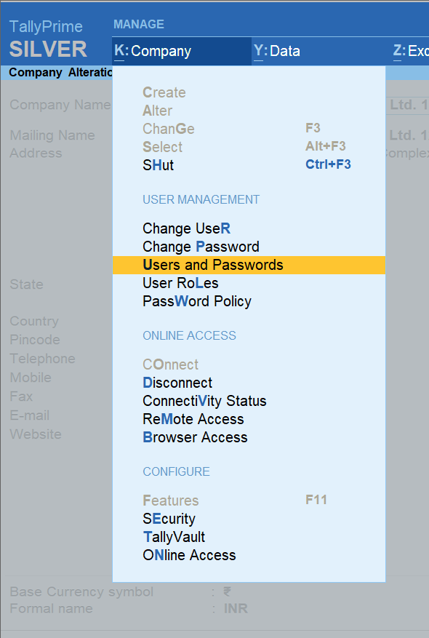
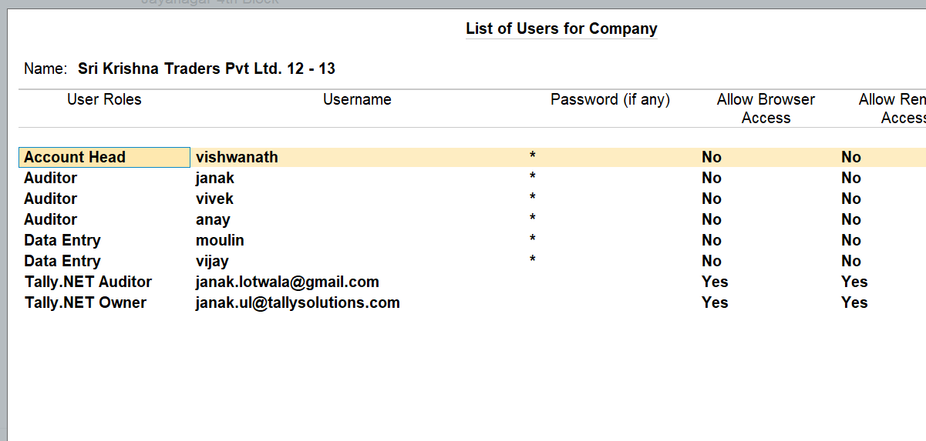
2. User Access

Slide 15
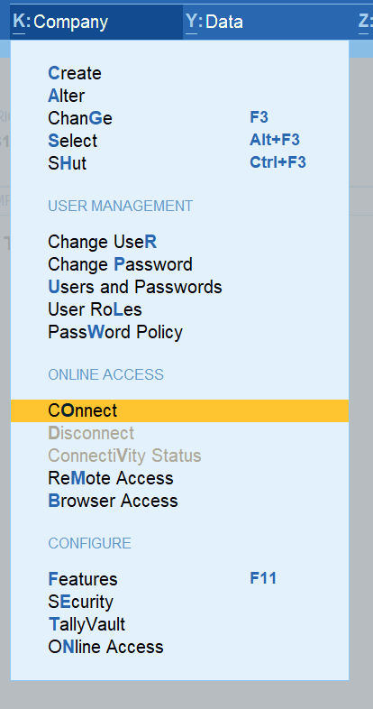
3. Connecting the company

Slide 16
4. Remote Login

Slide 17
5. Remote Login & Working

Slide 18
Tally Reports in Browser

Slide 19
1. Enabling Company Level

Slide 20
1. Enabling – F11 -> Online Access ->”Yes”

Slide 21
2. User Access

Slide 22
3. Connecting the company

Slide 23
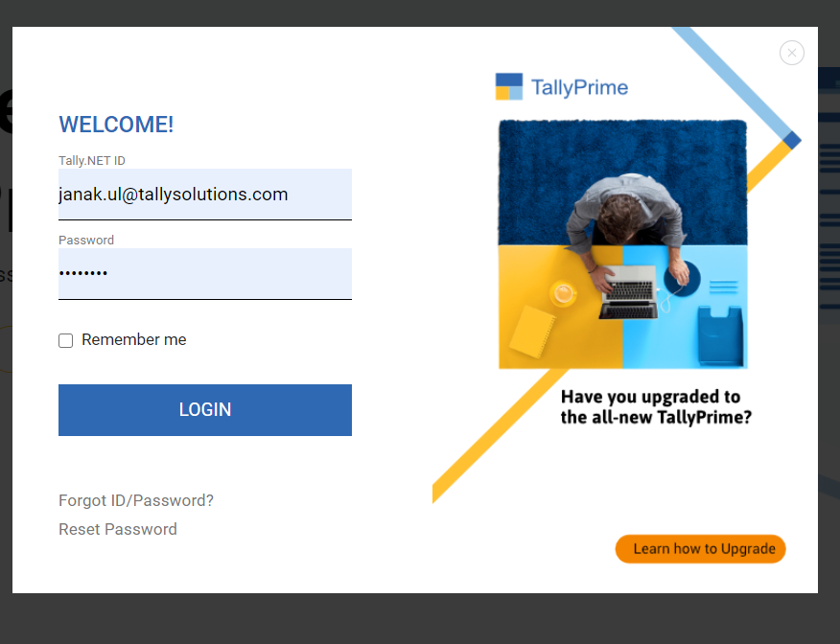
Internet Login

Slide 24
TRiB
Design
Security
Mobile responsive design
Horizontal / Vertical
Scale factor
Show Details
Change of date / period
Most of Tally reports available
TallyPrime needs to be open
Company needs to be connected
User ID needs to be added in Tally data
Your data – Your Control

Slide 25
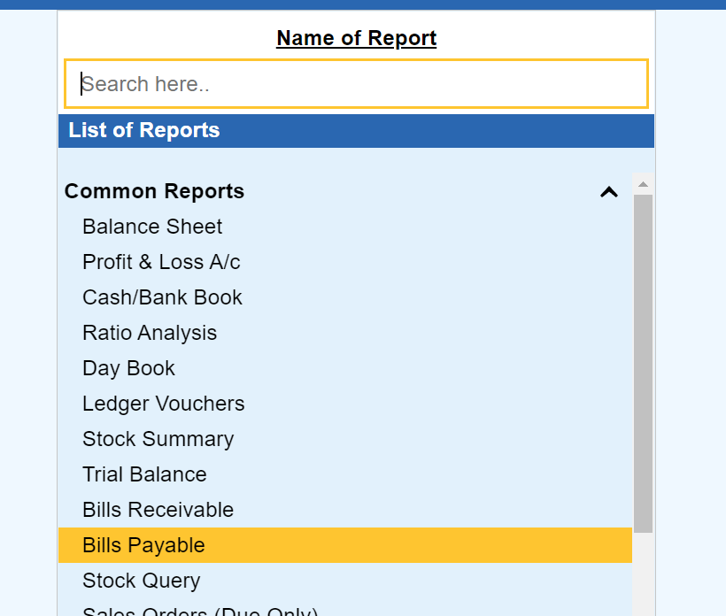
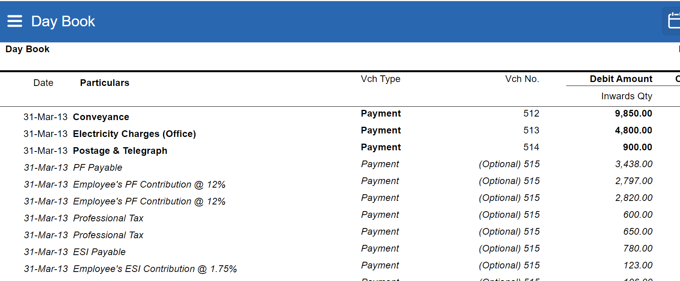
Accessing the reports

Slide 26
Tally Paperless Audit

Slide 27
Step 1: User Management

Slide 28
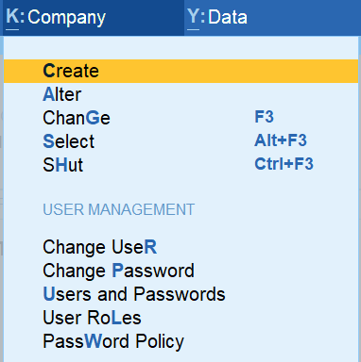
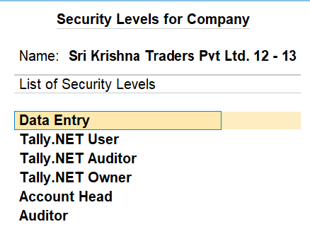
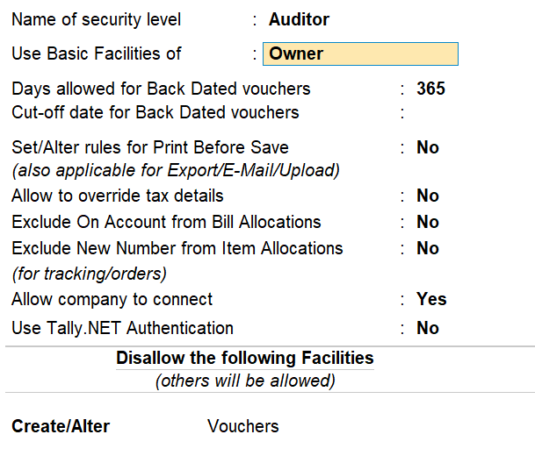
Creating Different User Types
Top Menu ->Company-> User roles

Slide 29
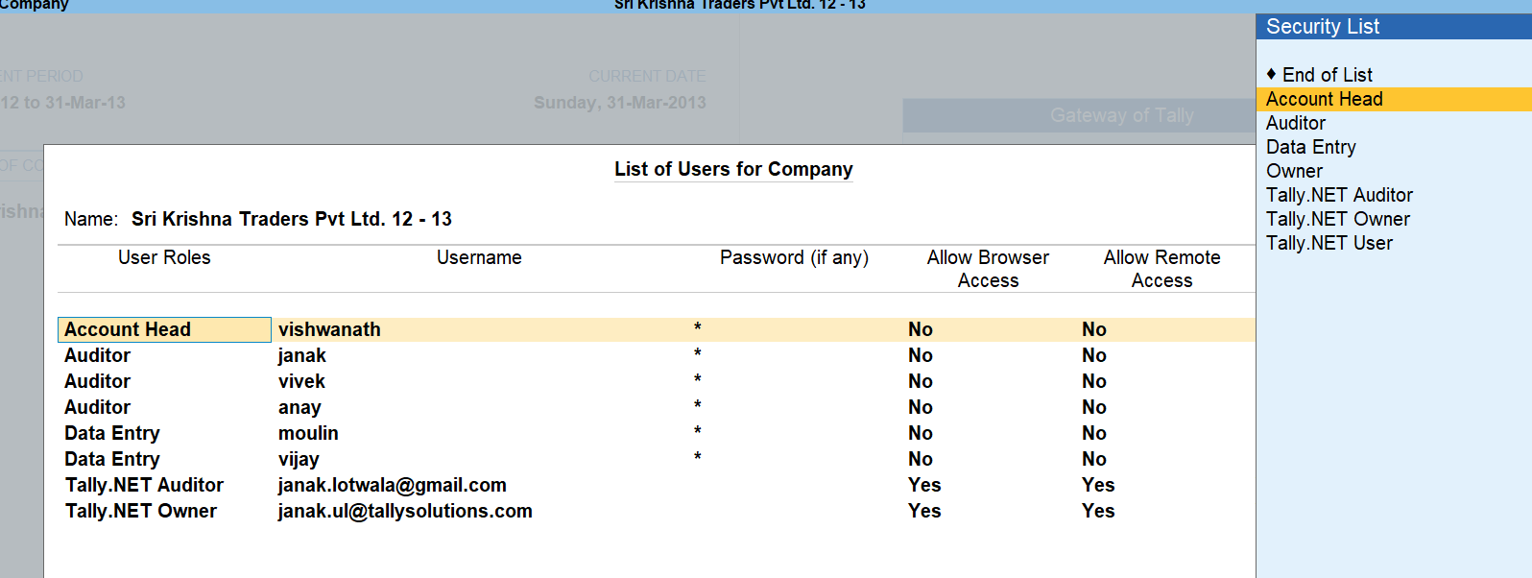
Creating Users
GOT->Company Info->Security Control->Users & Password

Slide 30
Decreasing time by focusing on special transaction

Slide 31
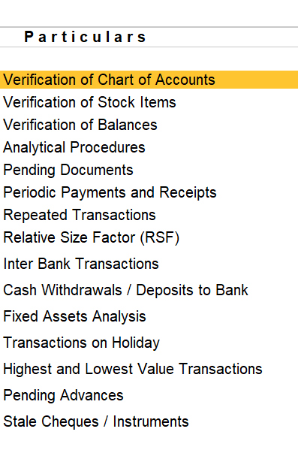
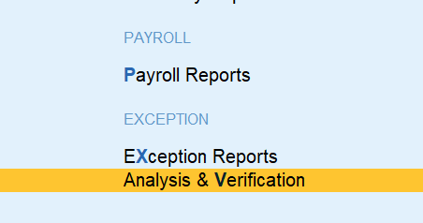
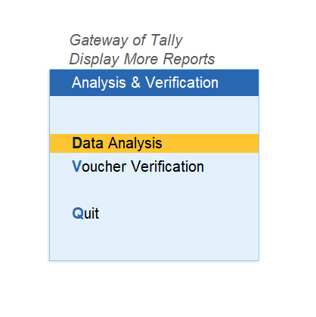
Data Analysis

Slide 32
Verifying Chart of Accounts & Stock items

Slide 33
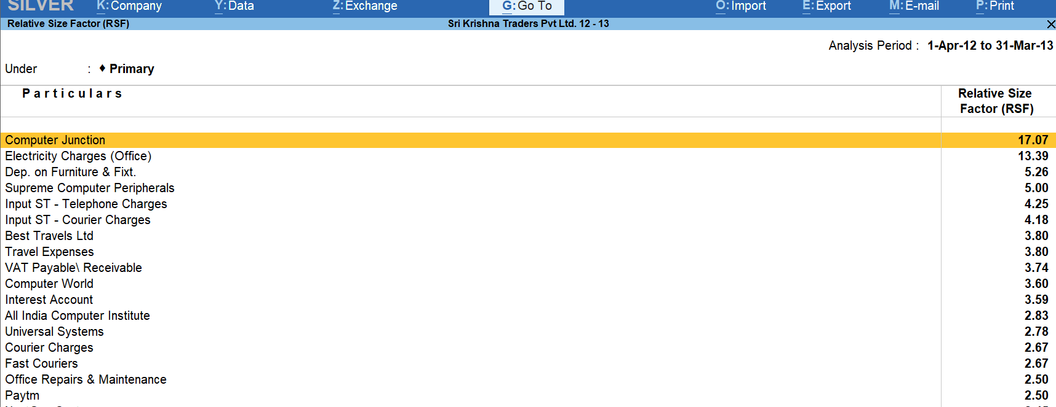
Relative Size Factor

Slide 34
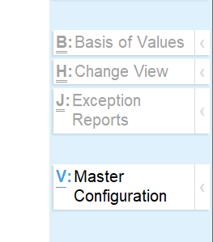
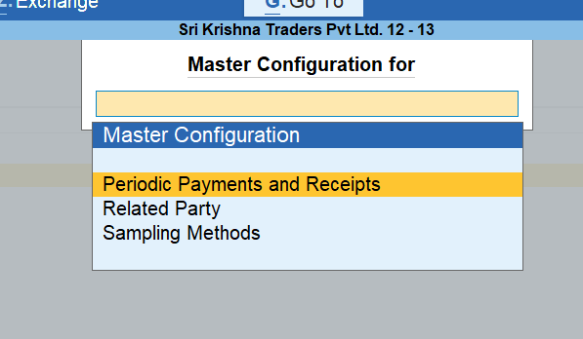
Master Configuration

Slide 35
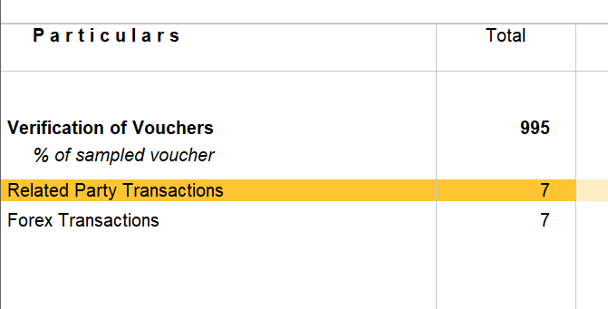
Categorizing Related Parties

Slide 36
2. Creating a Sample for Audit

Slide 37
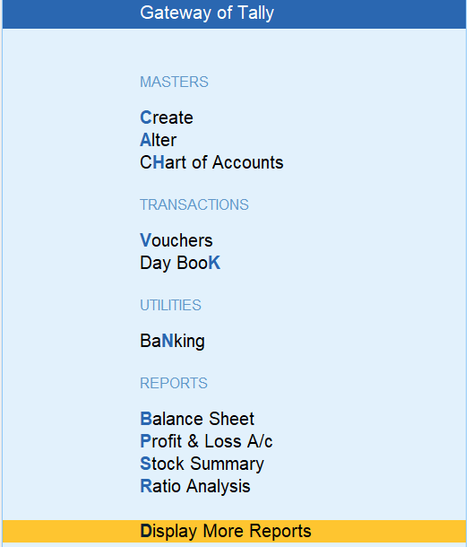
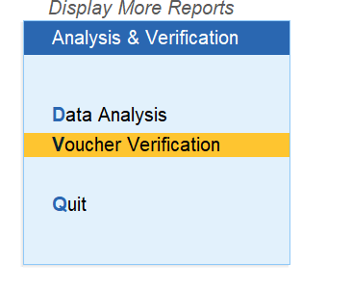
Sampling Data

Slide 38
Sampling Dashboard
Total Transactions in the FY
Altered Transaction
Special Category Transactions
Sampled Transaction for Audit & Audited Transaction

Slide 39
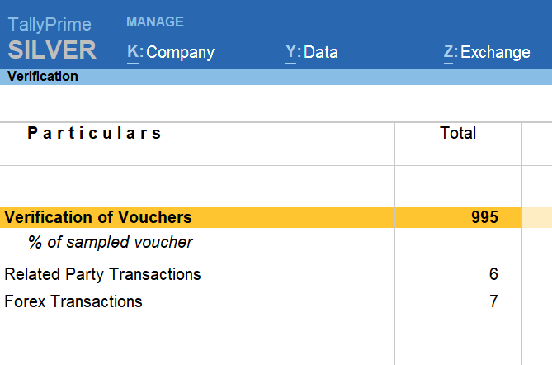
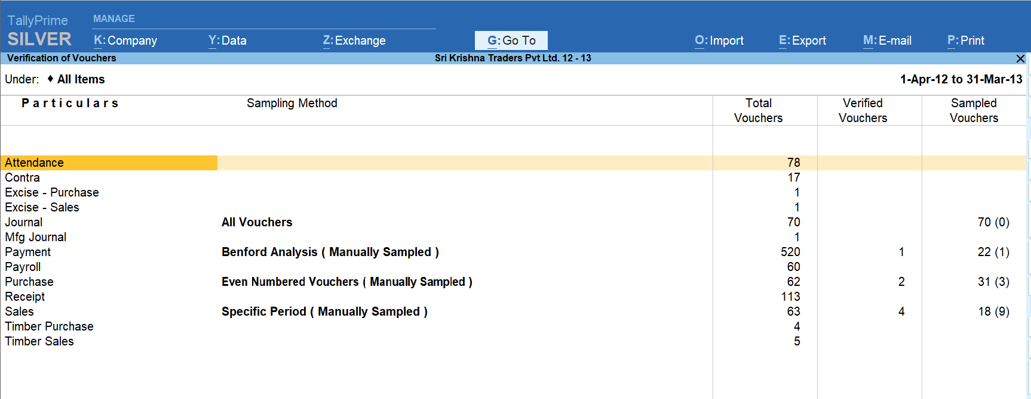
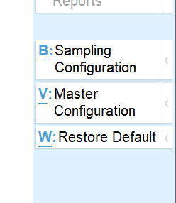
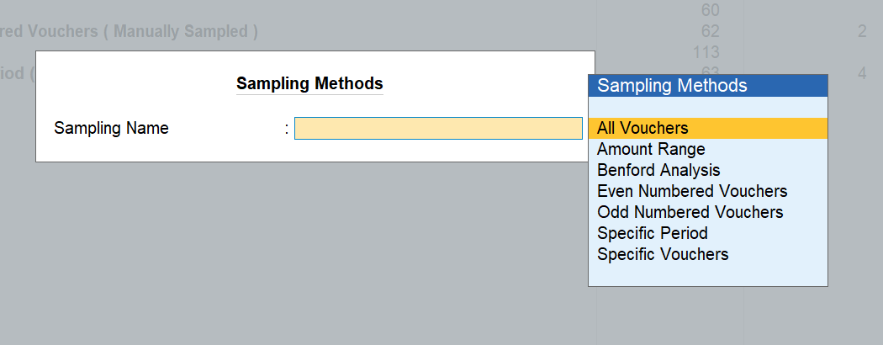
How to create sample
Analysis & Verification->Voucher Verification->Total Vouchers->Select Ledger type->Sampling Configuration

Slide 40
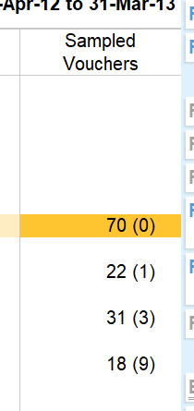
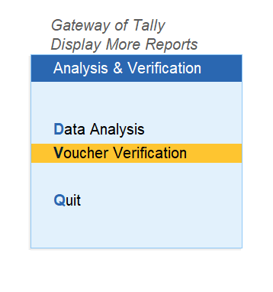
Auditing Sampled Vouchers
Voucher Verification->Total Vouchers->Sampled Voucher>Click on them

Slide 41
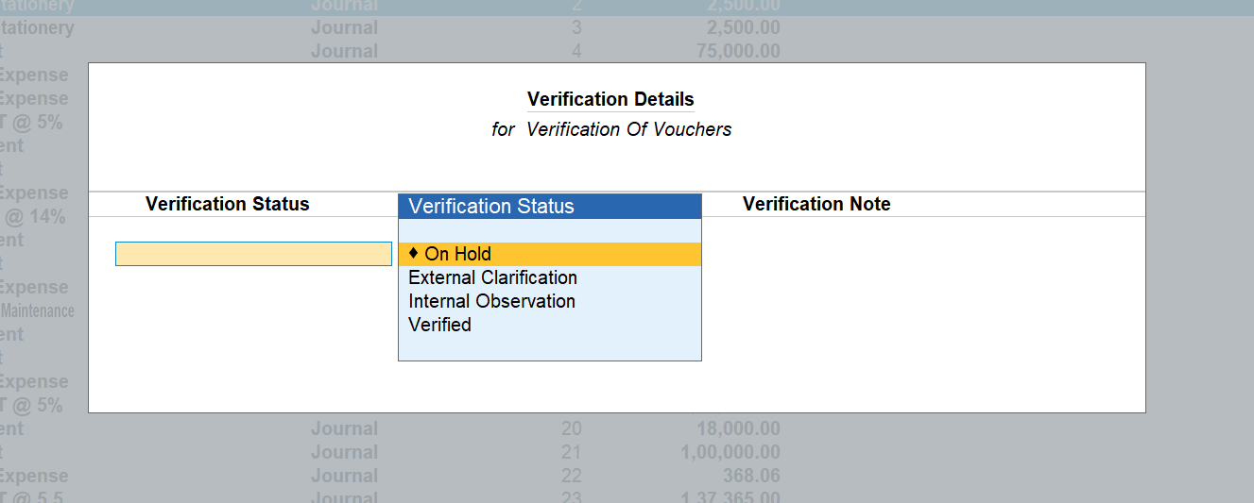
Auditing Sampled Vouchers

Slide 42
Viewing different Vouchers verification dashboard
Voucher Verification->Total Vouchers-> On RHS press Ctrl and Alt for shortcuts and seeing different reports

Slide 43
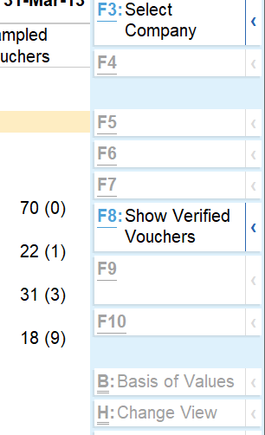
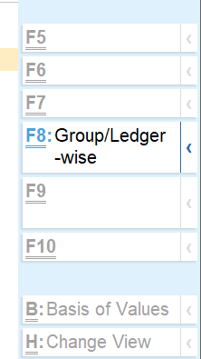
Report viewing through Ctrl & Alt Options on RHS

Slide 44
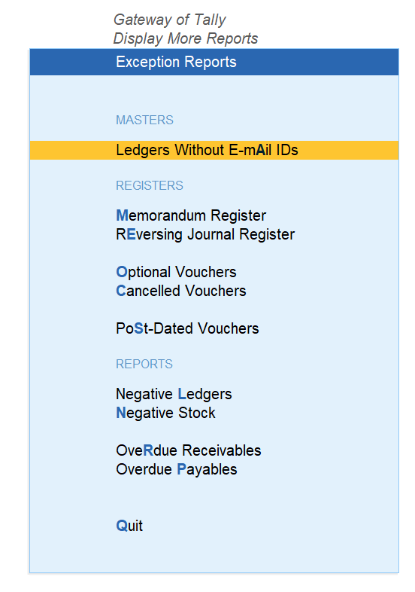
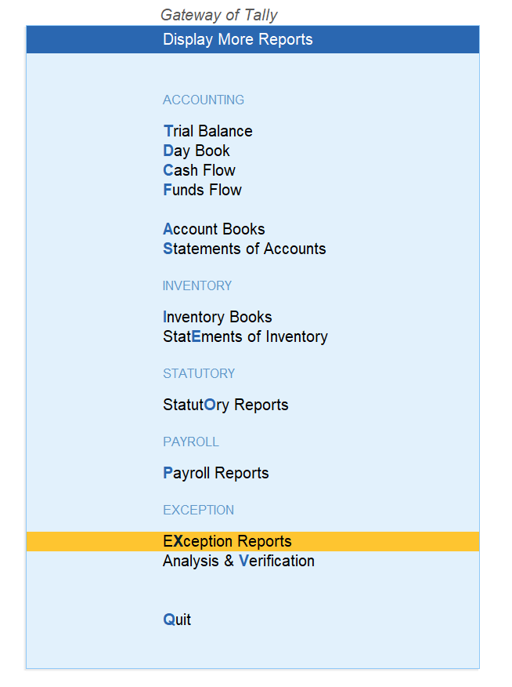
Exception Reports

Slide 45
Generate reports with required filters instantly with ‘Save View’

Slide 46
UC1: Quick access to Trial Balance by setting a default view
Notes:
Use Case 1: Set default view of Trail Balance as CA sees it
Go to Display more reports → Trial Balance
Press F12 → enable ‘Opening Balance’ and ‘Show Transactions’
Make the report detailed
This is how you would see Trial Balance and next time you access this report again it goes back to show only closing balances.
Now, let us experience our latest ‘Report Save’.
Save this report by name ‘TB with Op Bal and Transactions’ and enable ‘Set this as default view for the report’ (ensure you save it to ‘All Companies (this computer) . Explain the simplicity in which it saves for all companies, for all other companies you need not do this.

Slide 47
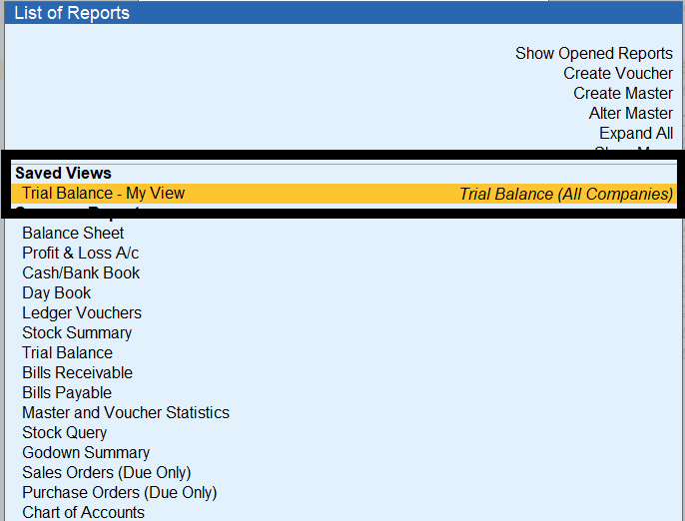
Go to Saved Views

Slide 48
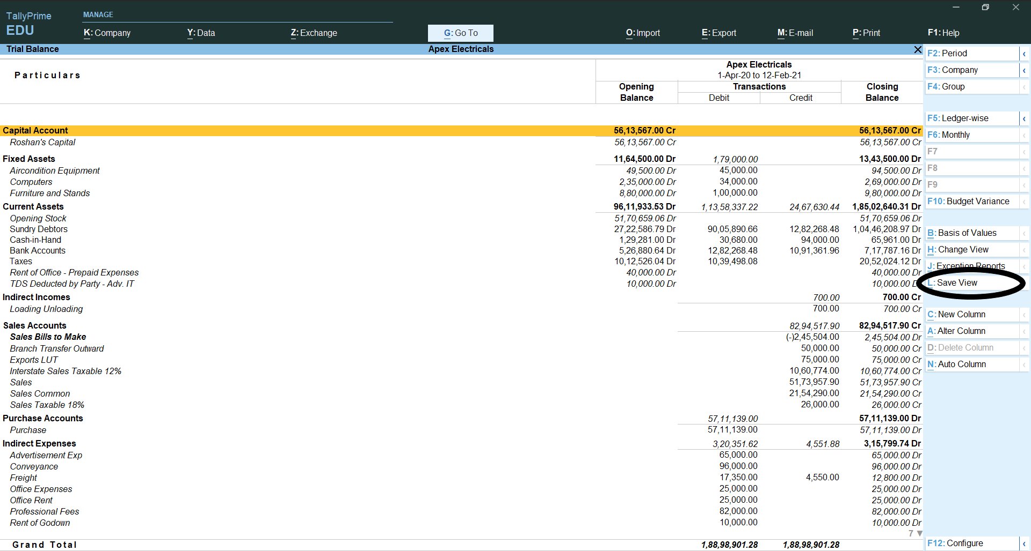
Save View for particular report

Slide 49
UC2: Access Cash payments in excess of 10,000 seamlessly
Notes:
Use Case 2: Cash payments in excess of 10,000
Go to Display more reports → Account Books → Cash Book → Cash A/c
Drill down to voucher report and select full Financial Year i.e., April to March
Click on ‘Basis of Values’ and select ‘Credit Entries only’ under ‘Type of Voucher entries’
Filter the report using ‘Range’ and having condition ‘Voucher having Ledger Amount greater than 10,001’
This is how you would get the desired report, now count the number of steps required (around 10 steps) to get this report.
Now, save this report as ‘Cash payments > 10 K’ and save it by enabling ‘Save with the master selected to open the report’ and ‘Save with the selected period’.

Slide 50
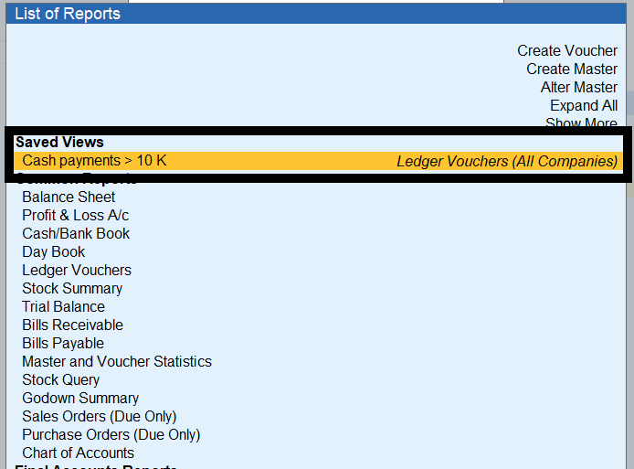
Go to Saved View

Slide 51
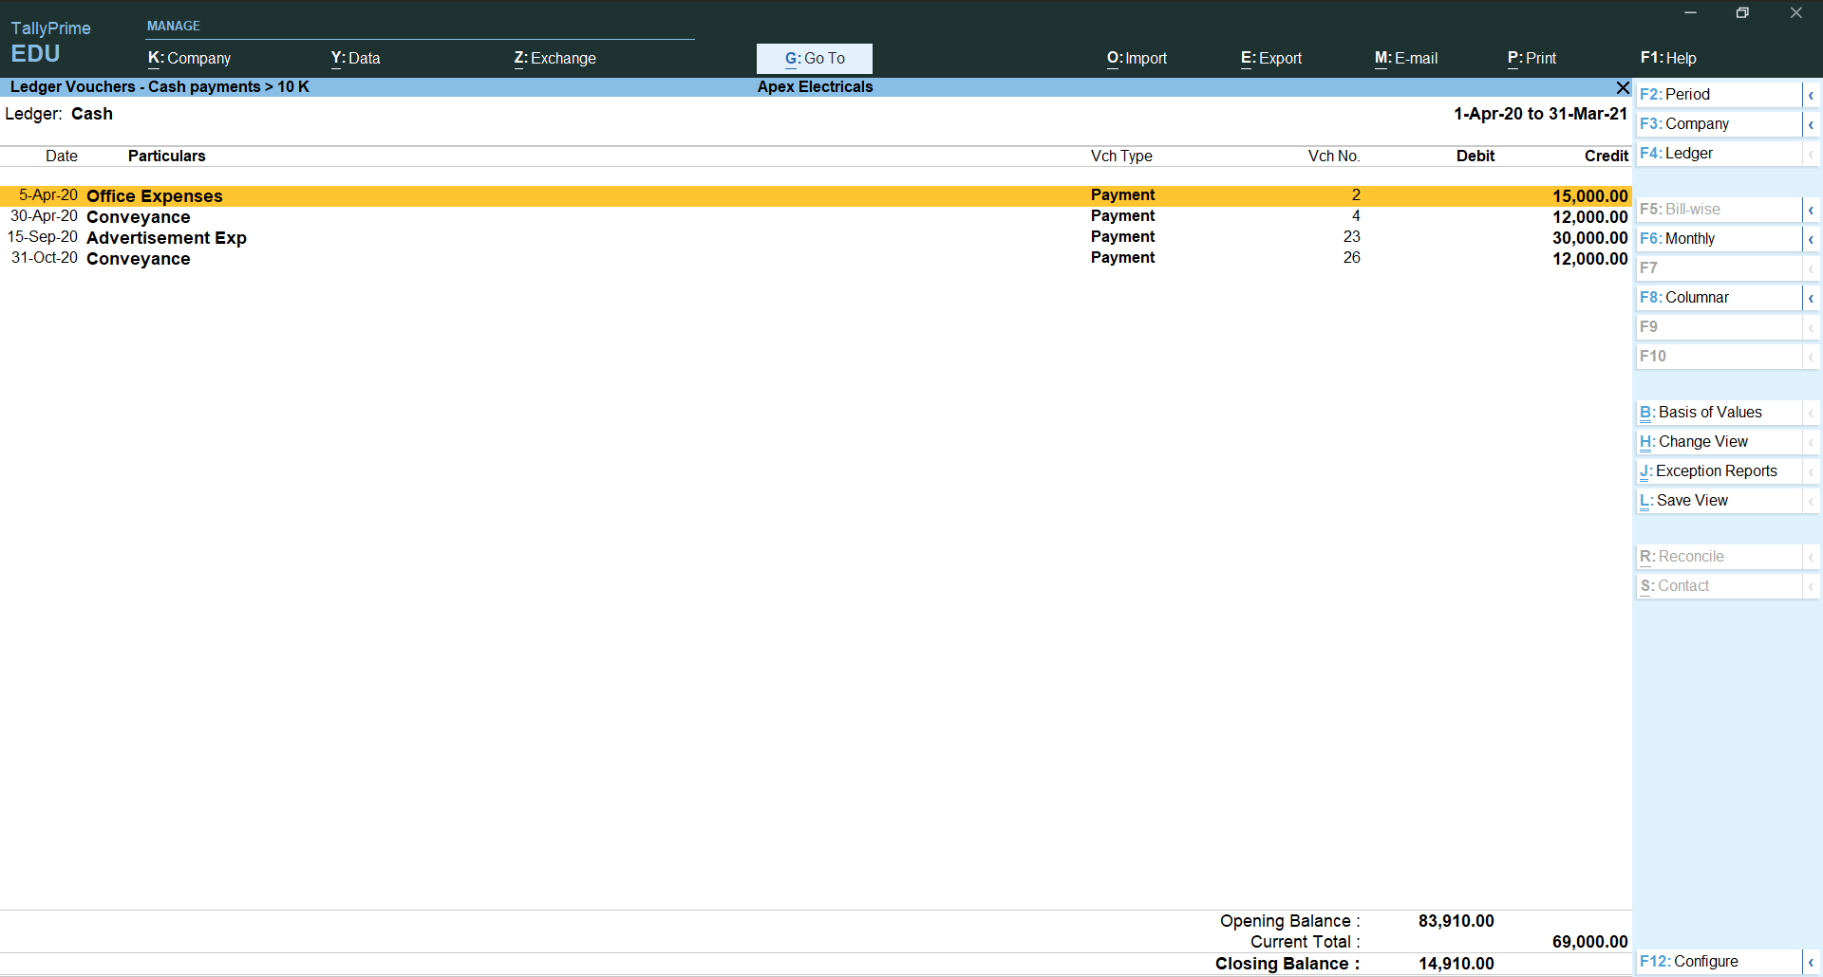
Report of Cash payments > 10 K

Slide 52
UC3: Flexibility to set Quarterly GSTR-1 for current period
Notes:
Use Case 3: Quarterly GSTR-1 for current period
Go to Display more reports → Statutory Reports → GST Reports → GSTR-1
It shows by default last Quarter (e.g. if you are in Feb 2021, it will show report for October to December 2020)
Change the period to current Quarter (e.g. January to March 2021)
Now, save this report as ‘GSTR-1 Qtr Jan-Mar 2021’ and save it by enabling ‘Save with the selected period’.

Slide 53
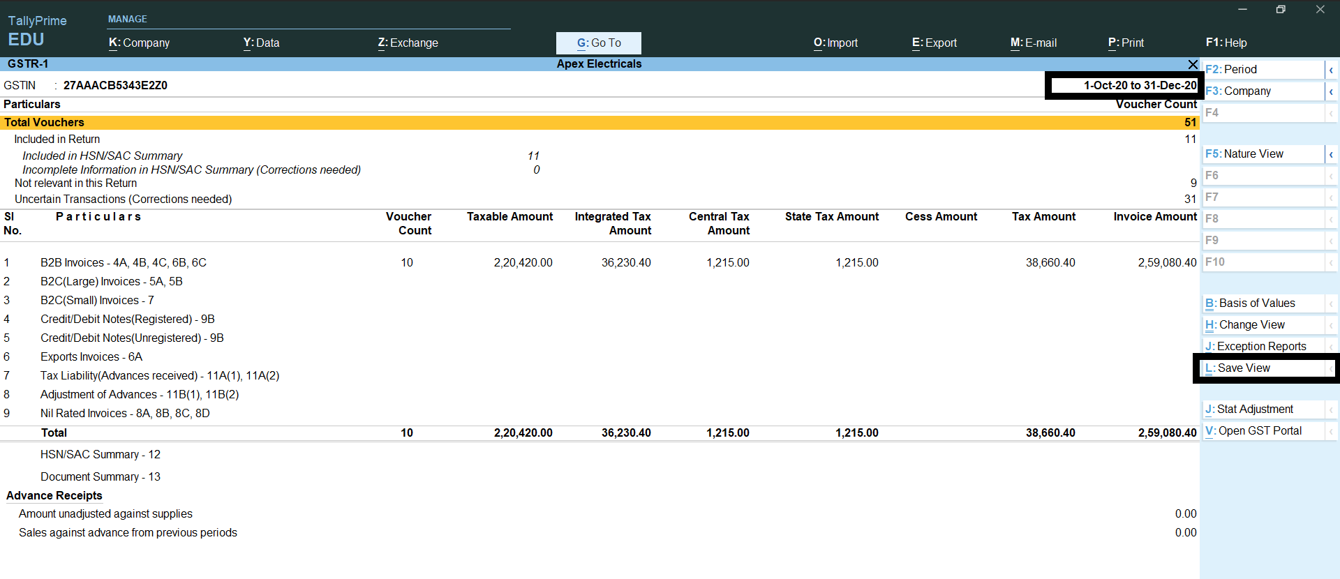
GSTR1 for current quarter report

Slide 54
UC4: Flexibility to default the comparative view of previous year Balance Sheet with current financial year for quick access
Notes:
Use Case 4: Compare previous year Balance sheet with current year
Select Balance Sheet
Add a new column and select previous financial year
Now, save this report as ‘Comparison with Last Year Balance Sheet and ‘Save with the selected period’ is enabled automatically. By setting it for a single company you will be able to set it for all clients’ data.

Slide 55
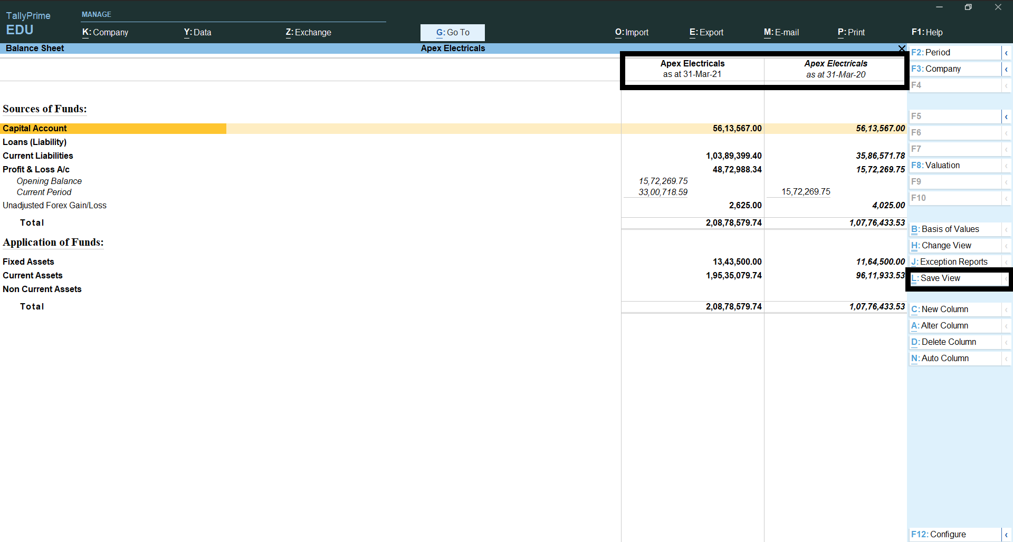
Compare previous year Balance sheet with current year

Slide 56
UC5: Flexibility to save configurations/filters to view Debtors having Credit Balance
Notes:
Use Case 5: Debtors having Credit Balance
Go to Display more reports → Exception Reports → Negative Ledgers
Now you will get all ledgers with negative balances
Filter the report by ‘Range’ option, search filter is ‘Ledger having Group Name with Name containing Debtors’
Now you will get all customer ledgers which are in Credit Balance (i.e., Debtors having Credit balances – it could be advances received or excess amount received)
Now, save this report as ‘Debtors having Credit balances’. Similarly, you can search for Creditors and save the report as ‘Creditors having Debit Balances’ and save the report.

Slide 57
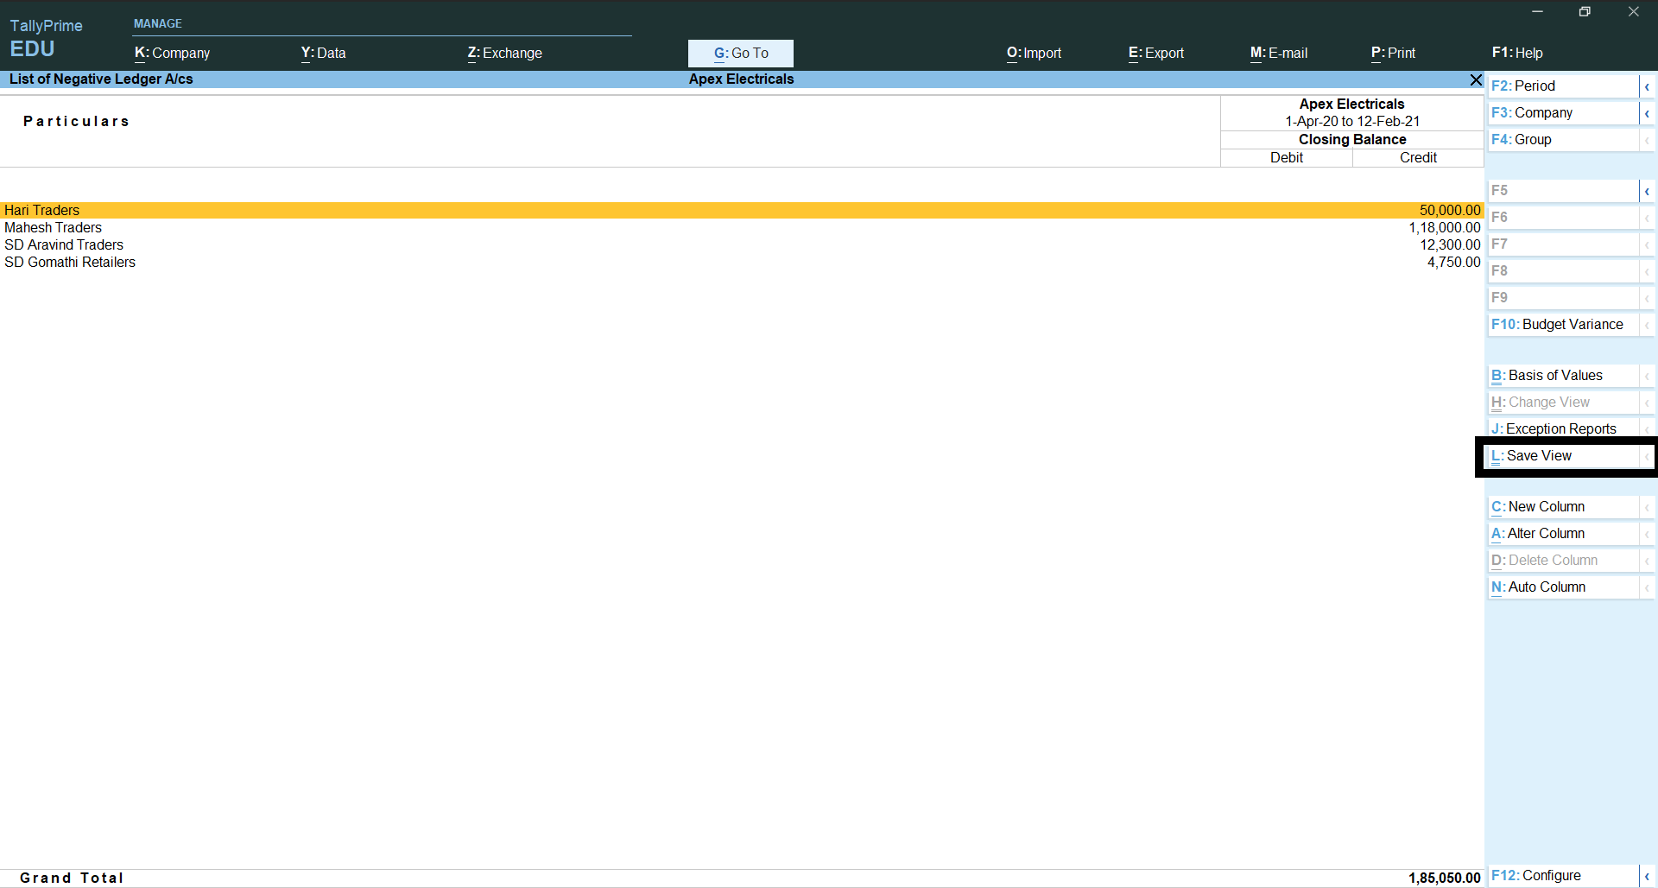
Debtors having Credit Balance

Slide 58
What type of reports can be saved under ‘Save view’?
You can save reports with
F12 Configuration,
Period,
Range/Value filtered,
New Column,
Auto Column,
Group Company.

Slide 59
Can I modify a Saved view?
Yes, you can modify a saved view. Select the saved view which you want to modify through Go To and click on ‘Save View’ button again to modify it.

Slide 60
Can I delete Saved views?
Yes, you can delete saved view individually by clicking on ‘Change View’ in saved view. Also, you can delete all saved views in one go through Help → Troubleshooting → Delete Views Saved for All Companies or This Company

Slide 61
Navigate faster with ‘Go To’
Notes:
Here, explain ‘Go To’ capability to access ‘Saved Reports’ first. All saved reports are available in one place, and they are prioritized in the list as ‘Saved Views’, that simple it is to access your favorite reports in TallyPrime.

Slide 62
UC1: Flexibility to post Depreciation entry from Balance Sheet
Report to Transaction | Report to another Report
Notes:
Use Case 1: Simply post Depreciation entry from Balance Sheet
Go to Balance Sheet → Fixed Asset
Press F12 → enable ‘Opening Balance’ and ‘Show Transactions’
Now, as a Chartered Accountant you see some of the Fixed Assets having only Debit Balance. Means the depreciation entry is not yet done. Being in the same screen click on ‘Go To’ and select ‘Create Voucher’. Post depreciation entry by selecting Journal voucher. Explain the flexibility of posting the transactions using Go To.
Talk about the report updating immediately with depreciation entry. It is that simple and flexible by ‘Go To’ capability in TallyPrime.

Slide 63
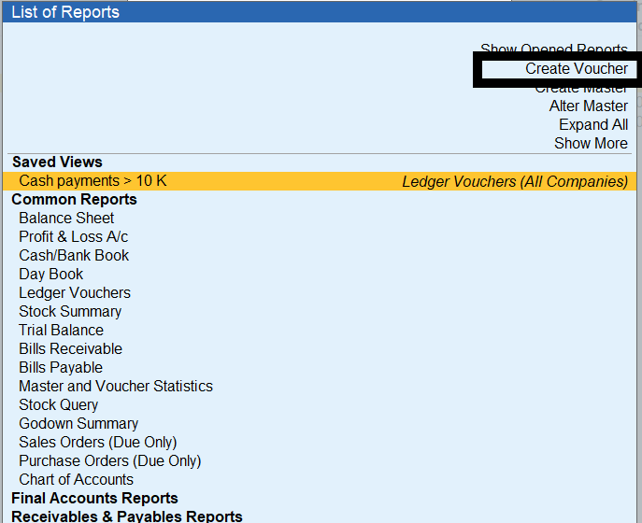
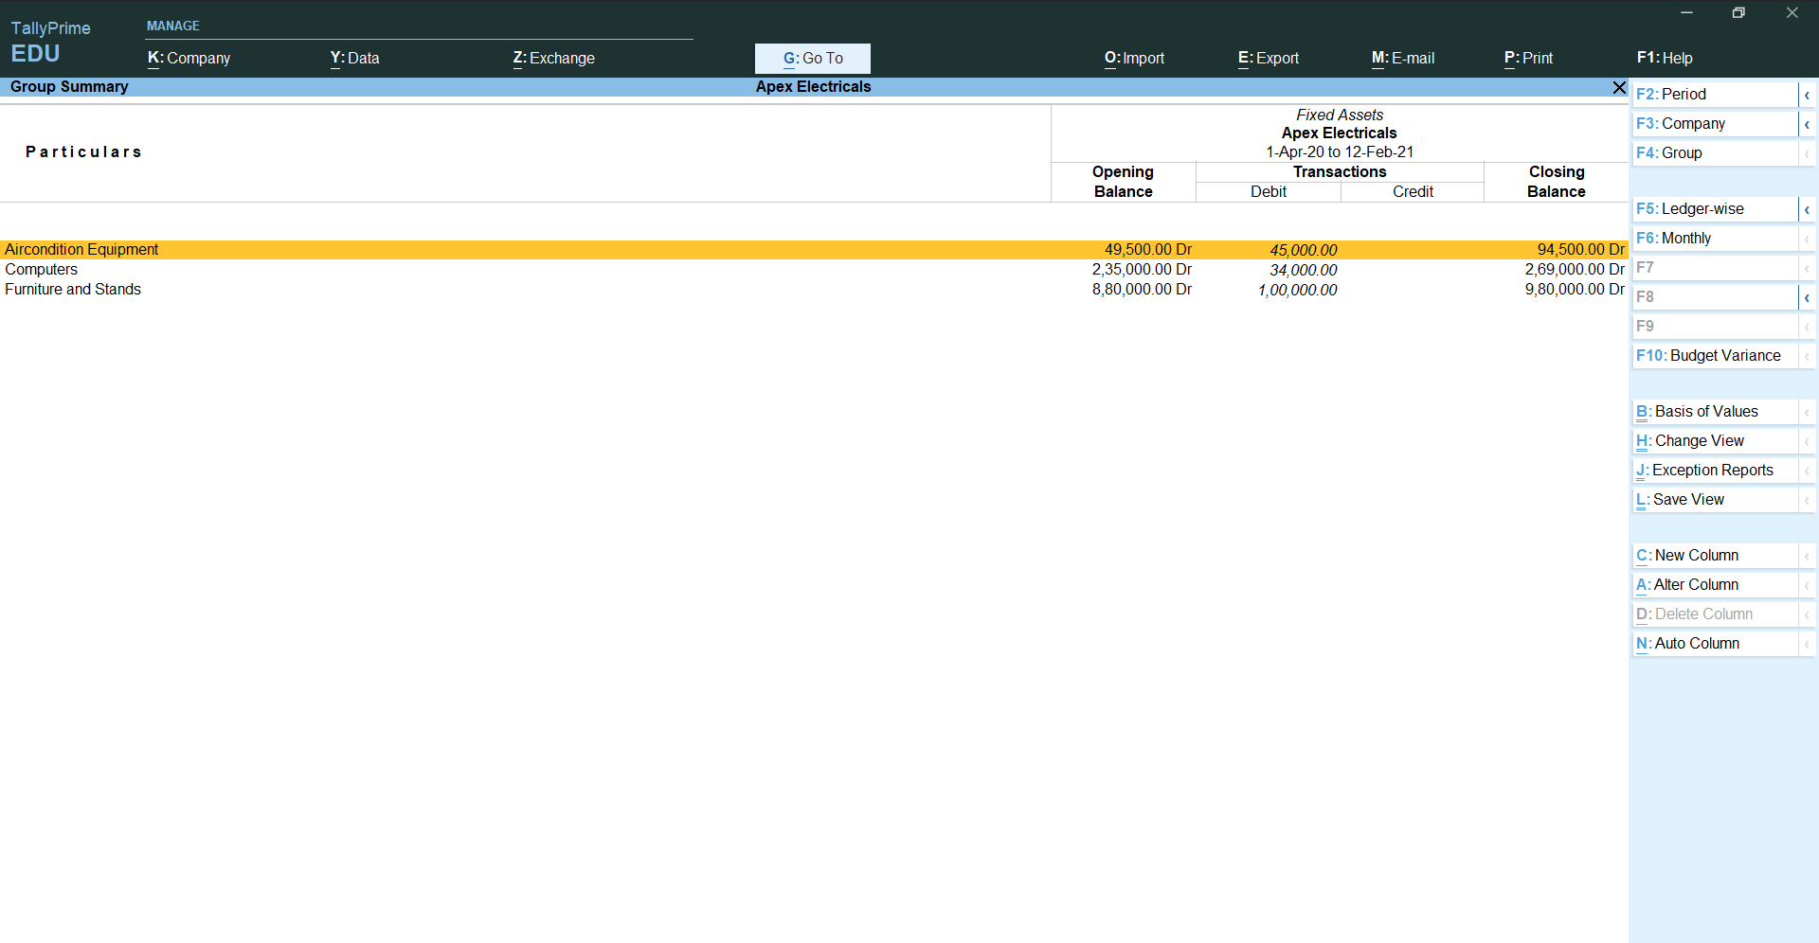
Depreciation entry from Balance Sheet

Slide 64
UC3: Flexibility to quickly search reports from Go To
Relative Size Factor | Repeated Transactions | Verification of Balances
Notes:
Use Case 2: Easily search reports from Go To
Click on ‘Go To’ and search for reports like Relative Size Factor | Repeated Transactions | Verification of Balances
Relative Size Factor – Show ‘Advertisement Expenses’ here, it shows relative size factor or 6.00 – drill down and show the transactions. Top 2 transactions – 30,000 and 5,000
Repeated Transactions – Show ‘Conveyance’ here, 12,000 Rs. Paid 8 times and ‘Advertisement Exp’ Rs. 5,000 paid 7 times
As a Chartered Accountant, you may simply type search for reports you access for audit purpose in Go To of TallyPrime and get them instantly.
Stress on the search words relative, repeated, verification, balances, etc.,

Slide 65
Can we see list of opened reports till now?
Yes, you can see all opened reports under ‘Go To’, all your opened reports is available ‘Show Opened Reports’. Through this you can select any of them again and go

Slide 66
Audit made easy
Save Time in Reconciliation
Respond Faster
Smart Analysis

Slide 67
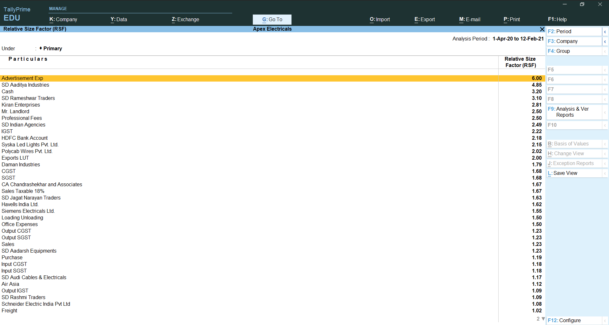
Related Size Factor

Slide 68
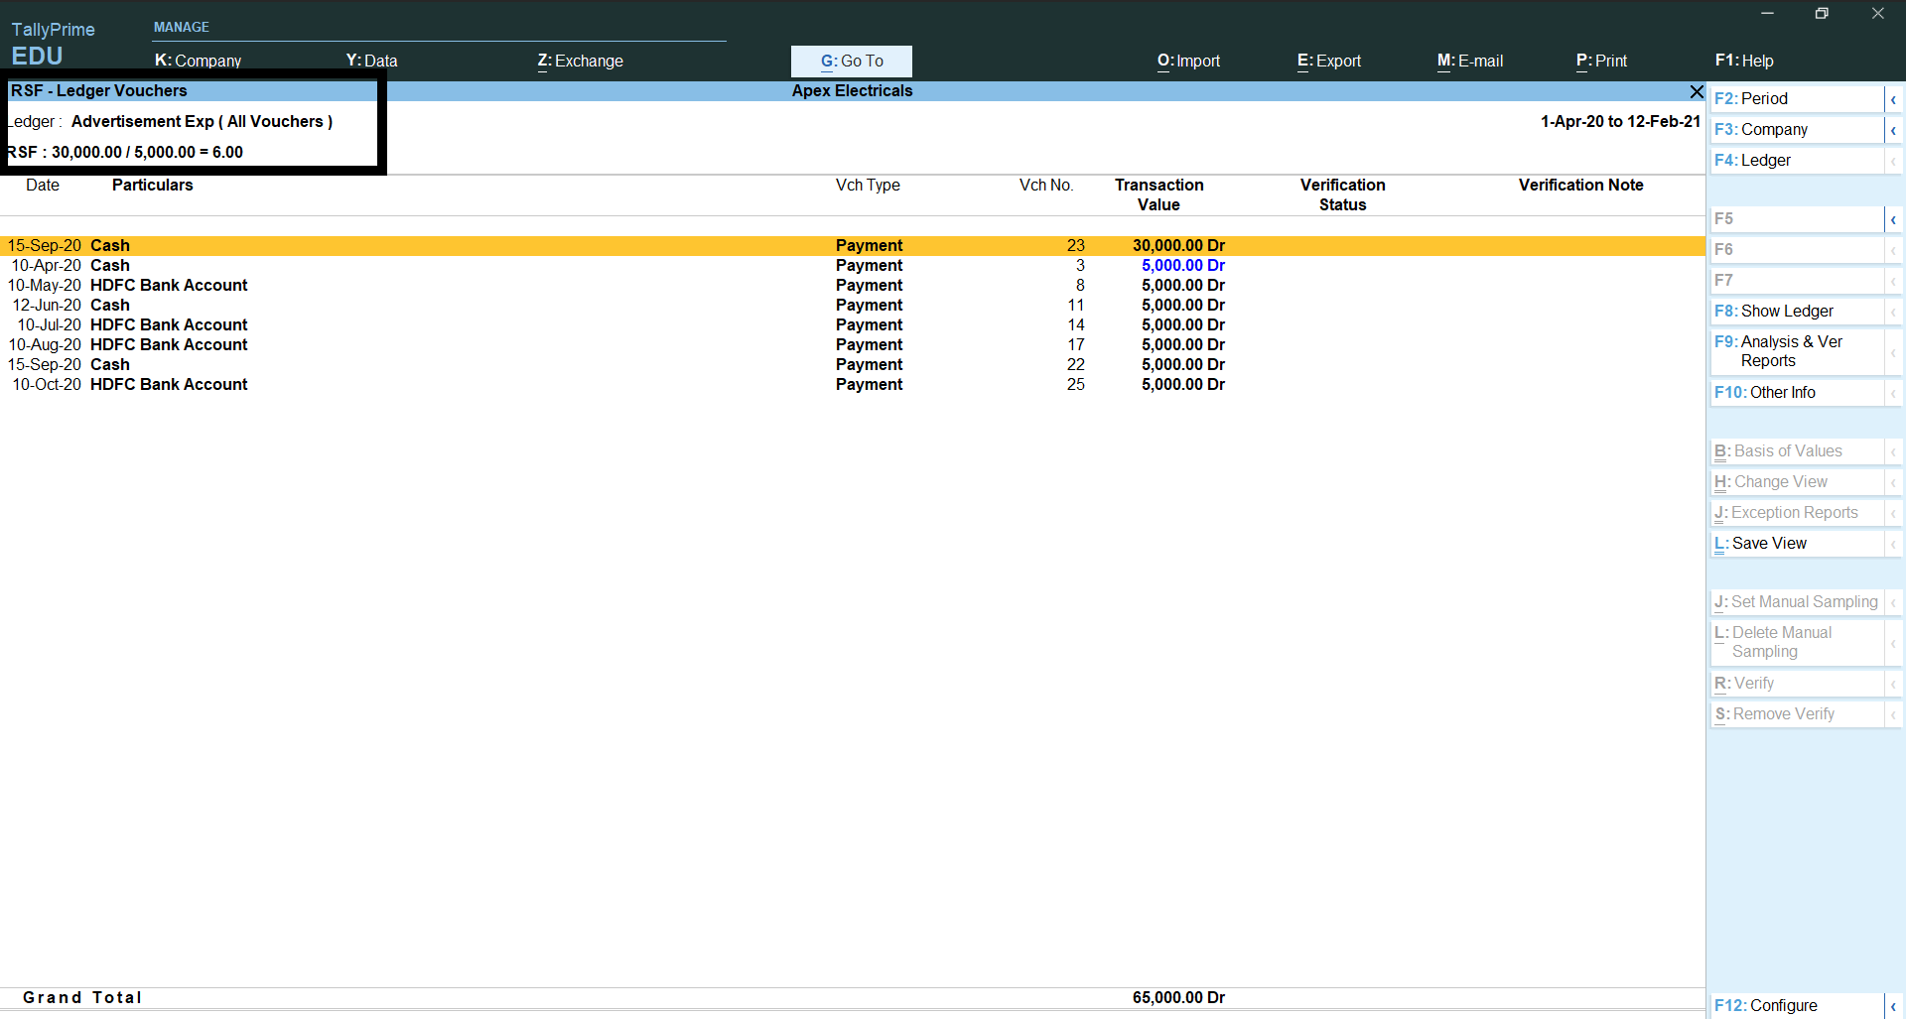
Related Size Factor

Slide 69
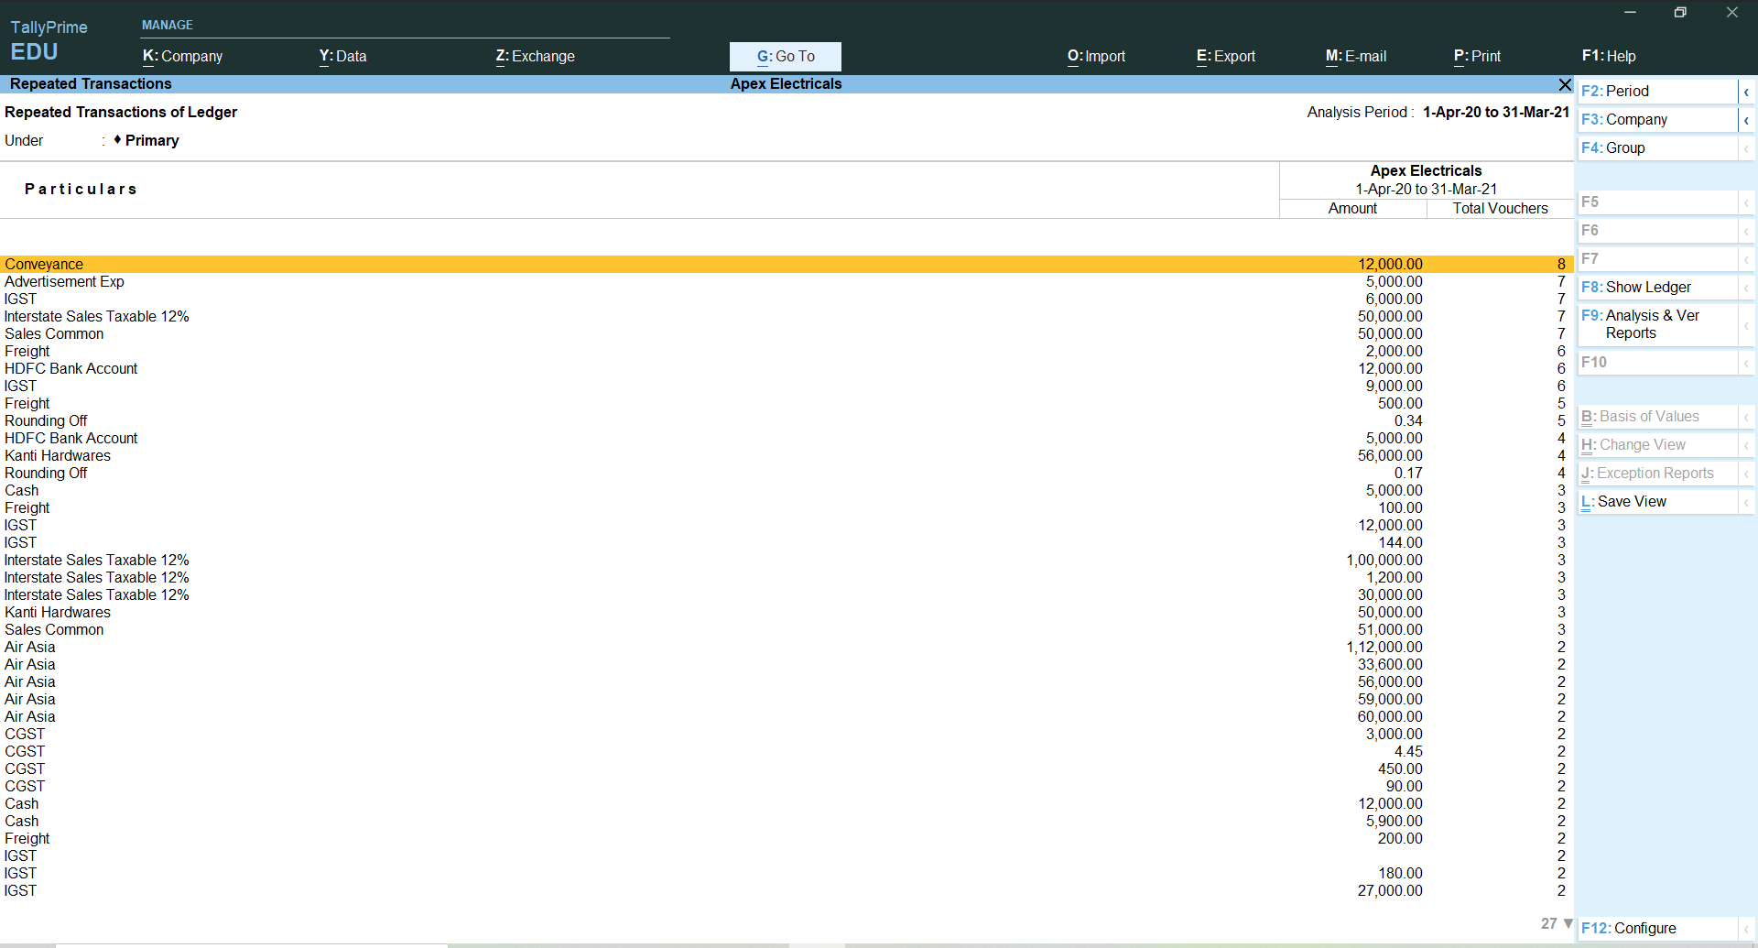
Repeated Transaction

Slide 70
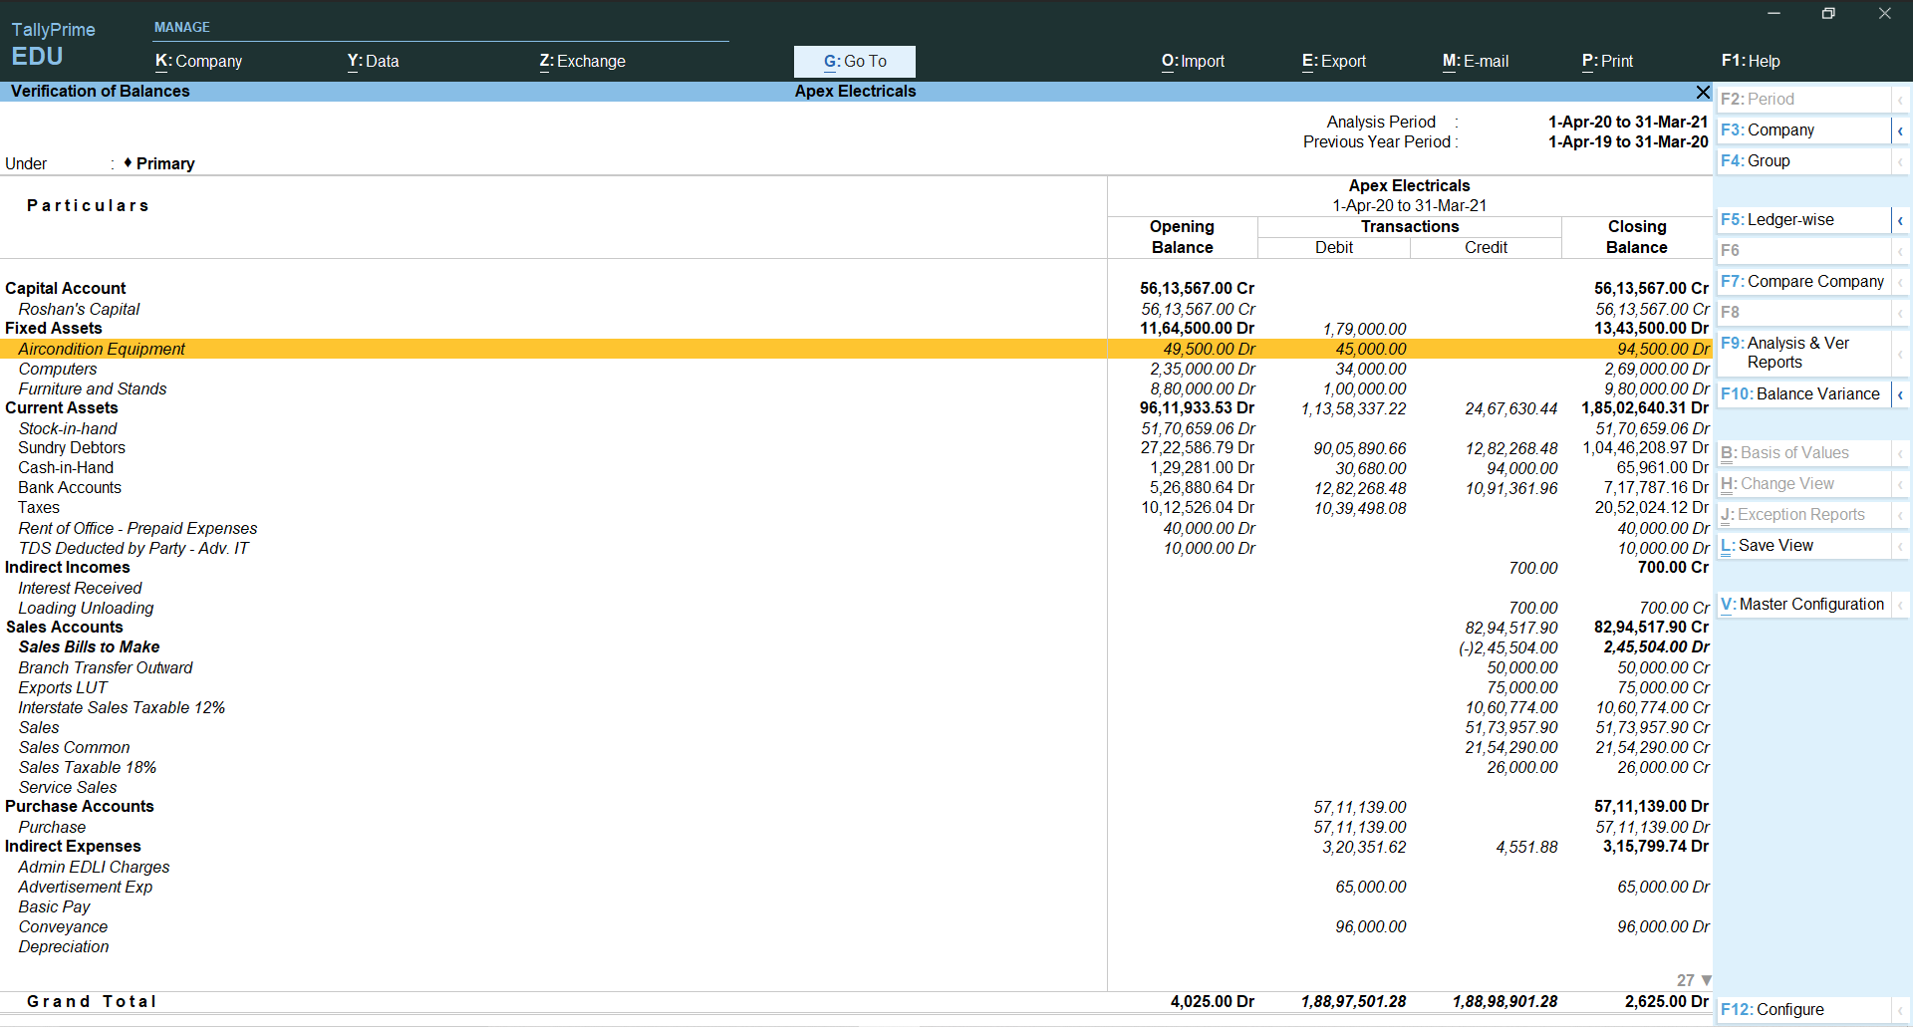
Verification of Balance (Ledger Balance)

Slide 71
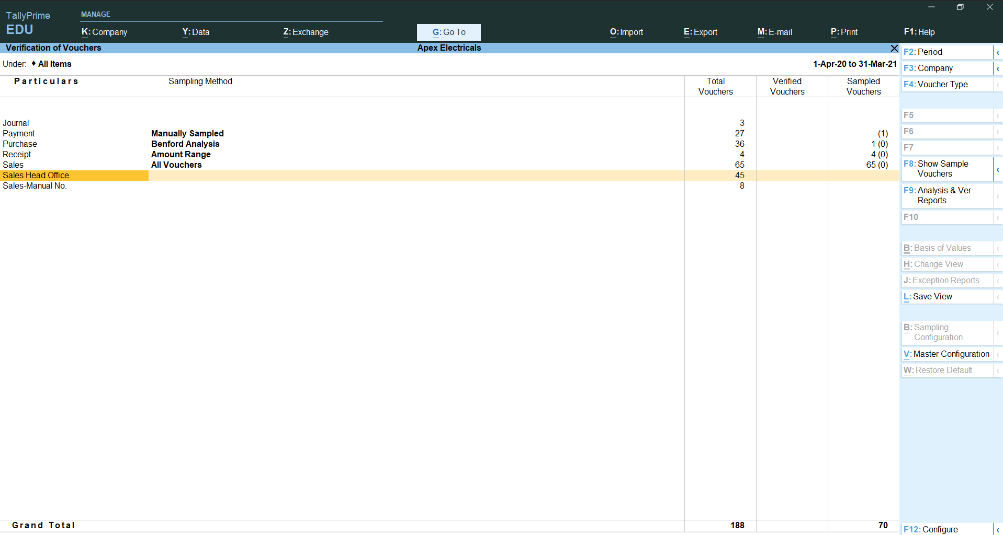
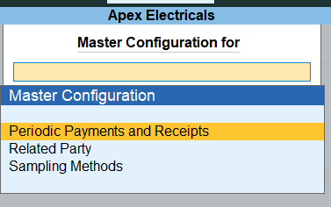
Verification of Voucher and Master Configuration

Slide 72
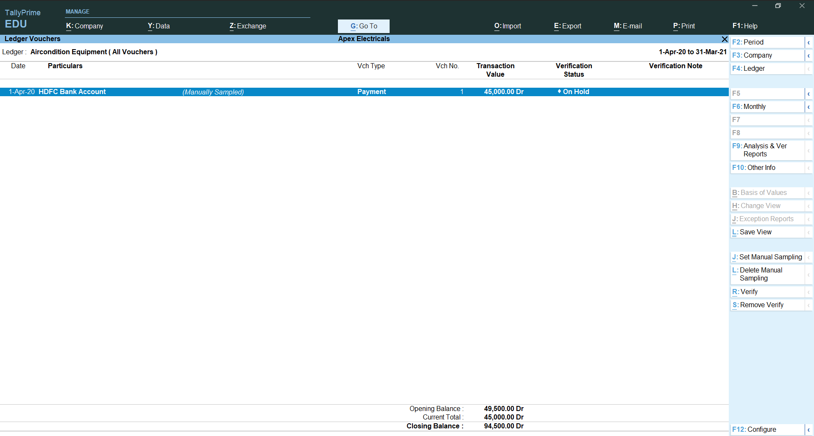
Verification of Balance (Ledger Balance)

Slide 73
Sampling Configuration

Slide 74
Voucher verification with verification note

Slide 75
Related party reporting

Slide 76
Marked Transactions

Slide 77
Marked Transactions

Slide 78
Get confidence on the certainty of invoices via e-Invoice and e-Way bill report
Notes:
Check on the certainty of e-Invoice and e-Way bills during your audit
Improve Clients’ operations by guiding them to access the power of E-invoice & E-way bill report which gives a bird’s eye view of the status of each invoice which will help them to analyze and take quick decisions accordingly.
e-Invoice
Access e-Invoice report through Go To and select who year i.e., April 20 to March 21
Check e-Invoice generated buckets
E-Way bill
Access e-Way bill report through Go To and select who year i.e., April 20 to March 21
Check e-Way bill generated buckets

Slide 79
UC1B: Instantly generate/print an e-invoice + e-Way Bill (with QR code) as soon as you save an invoice
Notes:
Use Case 1: Instantly generate e-way bills at the end of each invoice.
Just print your invoices from TallyPrime and e-way bill with the QR code will get printed as annexure along with it. No need to spend additional time in specifying HSN-wise SKUs on NIC portal for the generation of e-Way Bill.

Slide 81
Use Case 2: Quick Bulk generation of E-Way Bills
Notes:
Use Case 2: Bulk generation of E-Invoices + E-Way Bills
Approval pending
Invoice generated by one employee and Eway bill generated by another person
Transporter's vehicle comes at evening 5
Top Menu > Exchange > Bulk (at a click of ctrl spacebar keys) > Send for generation

Slide 83
Use Case 3: Instantly fetch and update E-Way Bill information in Tally for the E-Way Bills generated from another Billing system / on Portal with simplicity
Notes:
Use Case 3: Update E-Way Bill information in Tally data
TallyPrime will both adapt to and simplify the exceptional situations you may encounter while managing e-way bills
You can instantly fetch and update e-way bill information for invoices which were recorded post generation of e-way bill outside the product.
Some other application for eWay Bill generation and update the eway billl details to tally data.

Slide 85
Use Case 4: Flexibility to generate E-way Bill with Part A only, later update the Part B details shared by transporter in a single click.
Notes:
Use Case 4: Generation of E-way Bill with Part A only
It is quite possible and practical that transporter details are not available with you while generating e-way bill. Do not worry! Upload your invoice and generate e-way bill with Part A details. Once you have all information related to your transporter, just fill in the Part B details for such invoices and upload this information in a single click from TallyPrime. Your e-way bill details will be updated!

Slide 87
Use Case 5: Get bird’s eye view of E-Way Bill Report and take appropriate actions easily to be compliant.
Notes:
Use Case 5: E-Way Bill Reports
TallyPrime also provides you a very useful set of e-way bill related reports that help you take appropriate decisions to be compliant.
Track all your e-way bill related activities from the e-way bill report and get to know their status in real-time uploaded / pending / cancelled
Get an overview of documents ready for upload from the preview report. This will help you verify the documents before you upload them.
There is also a summary report which gives you post-upload status (successfully uploaded/ rejected by e-way bill systems) leading to confidence that you are in control of your e-way bill activities.
The product will guide you to send the right information to the NIC portal for e-way bill generation thereby preventing errors. In case the NIC portal rejects a request for any specific reason, you will be able to easily detect and correct them. This just means that you can trust your e-way bill data completely.
There is also a summary report which gives you post-upload status (successfully uploaded/ rejected by e-way bill systems) leading to confidence that you are in control of your e-way bill activities.
The product will guide you to send the right information to the NIC portal for e-way bill generation thereby preventing errors. In case the NIC portal rejects a request for any specific reason, you will be able to easily detect and correct them. This just means that you can trust your e-way bill data completely.

Slide 88
Use Case 6: Manage other operations like cancellation/extension related to e-Way Bill with simplicity!
Notes:
Use Case 6: Handle other operations:
An order for which e-way bill is already generated stands cancelled. You can cancel the e-way bill instantly.
Due to some unforeseen reason, the transporter is unable to reach the destination in time. You can extend the e-way bill timeline from within TallyPrime before expiry of its deadline.

Slide 91
Additional capability to verify GSTIN & HSN/SAC Codes

Slide 92
Use Case 1: Realtime validation of GSTIN for a Party (Single/Multi-Mode) with simplicity!
Notes:
Validate GSTIN during Party ledger creation with simplicity
Additionally, also Release 2 gives you flexibility to validate Multi-GSTIN validation via Update Party GSTIN

Slide 95
Handle interruptions & Multi-task better using ‘Top Menu’
Company | Data | Go To | Export | Print | E-Mail
Notes:
Use Case 1: Continue your work by handling interruptions using Top Menu
Go to Journal Voucher and do an adjustment entry as part the audit process
During the transaction you remembered that you want to print ‘Group Outstandings’ of Debtors.
Simply click on ‘Print’ on Top Menu and select ‘Others’, now print the report.
Then you are back to your adjustment entry.
Similarly, explain other menus available on Top Menu. Export, Data, Company, etc., Now TallyPrime is so flexible that you can handle interruptions so that you do not loose the flow of your work. The fixed Top Menu will be always available to you from any screen.

Slide 96
Use Case 2: Realtime validation of HSN for a Stock Item (Single/Multi-Mode) with simplicity!
Notes:
Validate HSN during SKU/Stock Item creation with simplicity
Additionally, also Release 2 gives you flexibility to validate Multi-HSN validation via GST Rate Setup

Slide 98
A more powerful reporting engine

Slide 99
Quick access to critical information of a transaction from Related Reports
GST Tax Analysis | TDS – Tax Analysis | TCS – Tax Analysis
Notes:
Access critical info for a transaction from Related Reports
Go to one of the Sales transaction in October 2020 and click on ‘Related Reports’, show GST Tax Analysis to see the tax percentage and calculation of GST.
Go to Journal voucher in any of the month and click on ‘Related Reports’, show TDS Tax Analysis to see the tax percentage and calculation of TDS.
Show TCS too in Sales

Slide 100
Analyze reports from different perspectives using 'Basis of value'
Valuation Method | Pending or Overdue Bills | Resident or Non-Resident for TDS
Notes:
Analyze reports applying basis of values
Go to Stock Summary and click ‘Basis of Values’, explain why this button where CA can apply and analyze reports. Show by selecting a ‘Stock Valuation’ method to produce it to Bank.
Go to Bills Payable and click ‘Basis of Values’. Show by selecting ‘Overdue bills’ which shows only overdue bills.
Go to TDS Outstanding Report and click ‘Basis of Values’. Show by selecting ‘Non-resident’ which shows for Non-resident transactions only. Also, drill down in any one of the Nature of Payments, show ‘All bills’ under Basis of Values which shows all bill where payments are made.

Slide 101
See a report in a different view through ‘Change View'
Sales Register Extract | Columnar Report for Purchase Register
Notes:
See a report in a different view through ‘Change View’
Go to Sales Register, click on ‘Change View’ and select ‘Extract’.
Go to Purchase Register, click on ‘Change View’ and select ‘Columnar’.

Slide 102
Faster access to Clients’ data
Single sign-in | Select from Drive | Specify Path
Notes:
Access, restore / backup data seamlessly
Have multiple companies of clients having same username and password, loan one company by entering username and password and load other company and show it opens without asking for username and password. (Stress on how simple and time saving feature for Chartered Accountant and his articles as they will be working on different company data having same username and password, single sign-in in TallyPrime is very important for them)
Access data of your clients using ‘Select from Drive’ option
Different client’s data in different folder (stress on folder selection through browsing)
Same client’s data of different financial years (stress on different data folders for different financial years)
Also, just copy the path where company data is available and paste in Tally to access it.
Restore data from folder wherever backup is kept using ‘Select from Drive’ browse or ‘Specify path’ option. (stress on restore of multiple companies is possible from different locations, keep two backups in different folders and select both to restore it to single destination folder)

Slide 103
Streamlined ‘Shortcut Keys’ in TallyPrime
Remove and Restore Line | Copy and Paste | + and - keys
Notes:
Why change in short cut keys?
The need to streamline the keys with windows short cut keys. Also, to avoid duplication of keys, viz., a key does one operation in one screen and the same key does a different operation in another screen. Now there are no duplicate keys across TallyPrime, which will reduce the training needs.
Streamlined ‘Shortcut Keys’ in TallyPrime
Go to a Ledger Report with transactions available, press Ctrl + R to remove line by selecting single line, multiple lines by Shift + Down Arrow key or random lines by Space Bar. Restore the lines by clicking Ctrl + U.
Now TallyPrime has adopted Windows Global Keys Ctrl + C for Copy and Ctrl + V for Paste, show this for Narration from one voucher to another voucher.
Go to Day Book and show ‘+’ and ‘-’ keys to go to next date or previous date transactions. This capability is extended to ledger and group reports too, go to Ledger Vouchers, Group Summary or Group Vouchers, select any one of the ledger or group. Then press + or – to jump to next / previous ledger or group.

Slide 104
Questions and answers

Slide 105
Thank you !
VANDANA V. DODHIA & Co.
Chartered Accountants
vandana.dodhia@gmail.com 9820029281

