Slide 1

Input Tax Credit

Slide 2

Seamless..Litigation…
CA Umesh Sharma

Slide 3


Slide 4


Slide 5


Slide 6
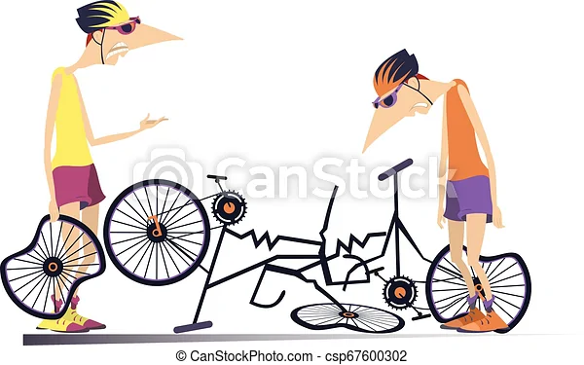

Slide 7
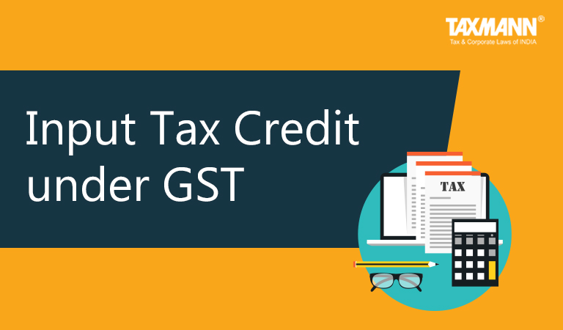
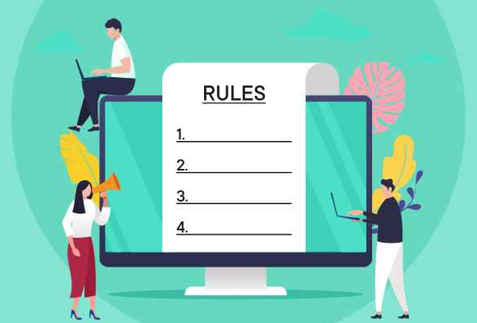
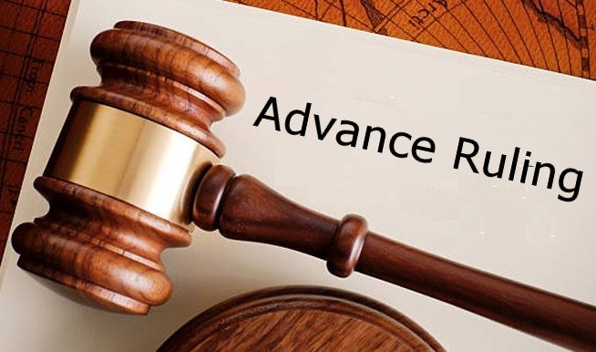
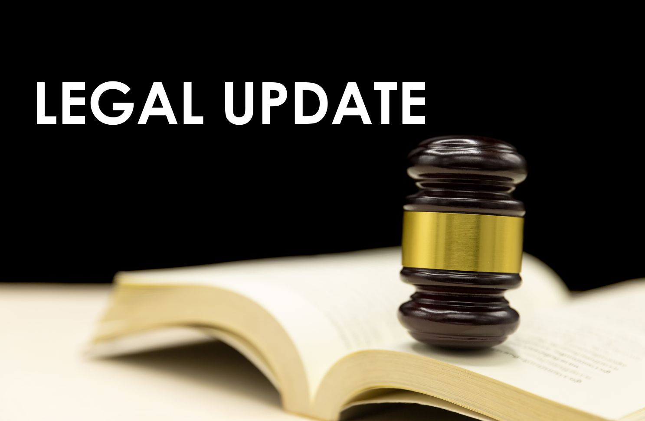

Sections
Rules
Advance Rulings
Supreme Court & High Court Judgement
Scrutiny
Parameter
Agenda

Slide 8

Section 16.
Eligibility and conditions for taking input tax credit.

Slide 9
R
Sec 16 (1) Every registered person shall, subject to such conditions and restrictions as may be prescribed and, in the manner, specified in section 49, be entitled to take credit of input tax charged on any supply of goods or services or both to him which are used or intended to be used in the course or furtherance of his business and the said amount shall be credited to the electronic credit ledger of such person.
2017-18
To
2022-23
No Change

Slide 10

Section 16. Eligibility and conditions for taking input tax credit.
R
Sec 16 (2) Notwithstanding anything contained in this section, no registered person shall be entitled to the credit of any input tax in respect of any supply of goods or services or both to him unless,—
WEST BENGAL AAR

Slide 11

WEST BENGAL AAR
M/S. STORM COMMUNICATIONS PRIVATE LIMITED
If the person is not registered in a particular state, the tax paid on the inward supplies in that state is not ‘input tax’ in relation to the said person.

Slide 12
Sec 16 (2) (a) he is in possession of a tax invoice or debit note issued by a supplier registered under this Act, or such other tax paying documents as may be prescribed;
R
2017-18
To
2022-23
No Change

Slide 13
S
Sec 16 (2)(aa) the details of the invoice or debit note referred to in clause (a) has been furnished by the supplier in the statement of outward supplies and such details have been communicated to the recipient of such invoice or debit note in the manner specified under section 37;
2017-18
2018-19
2019-20
2020-21
2021-22
2022-23
Not in
Existence
Not in
Existence
Not in
Existence
Not in
Existence
w.e.f. 01.01.2022
Applicable
&
No change

Slide 14
Mahalaxmi Infra Contract Ltd..Jharkand HC
As there was not harm in given liberty to assessee to rectify its mistake of mentioning wrong GSTN number, court in interest of justice gave such liberty to assessee..
Rectification of GSTR1 of FY 2018-19 should be allowed now.

Slide 15
R
Sec (16) (2) (b) he has received the goods or services or both.
Explanation.— For the purposes of this clause, it shall be deemed that the registered person has received the goods where the goods are delivered by the supplier to a recipient or any other person on the direction of such registered person, whether acting as an agent or otherwise, before or during movement of goods, either by way of transfer of documents of title to goods or otherwise;
Sec (16) (2) (b) he has received the goods or services or both.
Explanation.—For the purposes of this clause, it shall be deemed that the registered person has received the goods or, as the case may be, services—
(i) where the goods are delivered by the supplier to a recipient or any other person on the direction of such registered person, whether acting as an agent or otherwise, before or during movement of goods, either by way of transfer of documents of title to goods or otherwise;
(ii) where the services are provided by the supplier to any person on the direction of and on account of such registered person.
Before 01.02.2019
After 01.02.2019

Slide 16
S
Sec 16 (2) (ba) the details of input tax credit in respect of the said supply communicated to such registered person under section 38 has not been restricted;
Applicable
After 01.10.2022

Slide 17
Before 01.10.2022
S
Sec 16 2 (c) subject to the provisions of section 43, the tax charged in respect of such supply has been actually paid to the Government, either in cash or through utilization of input tax credit admissible in respect of the said supply;
After 01.10.2022
Sec 16 2 (c) subject to the provisions of section 41, the tax charged in respect of such supply has been actually paid to the Government, either in cash or through utilization of input tax credit admissible in respect of the said supply;
CALCUTTA
HIGH COURT

Slide 18

CALCUTTA
HIGH COURT
Tycoon Suppliers Private Limited V/s Union of India And Ors.
Constitutional validity of Section 16(2)(c) of the Cgst act.
Sec 16 of the Cgst act,2017 Input Tax Credit …The court observed that there is no scope for passing of any interim order in the matter since the constitutional validity of Sec 16(2) (c) of the Act has been challenged.
Held that:- The Hon’ble High Court directed the respondents file affidavit in opposition within four weeks. Petitioner to file reply, if any, thereto, be filed within two weeks thereafter. List this matter for final hearing after seven weeks.

Slide 19
MADHYA PRADESH HIGH COURT
Cummins Technologies India Pvt. Ltd. V/s Union of India
So far as constitutional validity of Section 16(2)(c) of Central Goods and Service Tax Act,2017 and Rule 86A of the Central Goods and Service Tax Rules,2017 is concerned, same is already under challenge before other High Courts. In view of the aforesaid, no cause survives now and this petition is accordingly disposed of.

Slide 20
R
Sec 16 (2)(d) he has furnished the return under section 39:
2017-18
To
2022-23
No Change

Slide 21
Sec 16 (2)…
Provided that where the goods against an invoice are received in lots or instalments, the registered person shall be entitled to take credit upon receipt of the last lot or instalment:
Provided further that where a recipient fails to pay to the supplier of goods or services or both, other than the supplies on which tax is payable on reverse charge basis, the amount towards the value of supply along with tax payable thereon within a period of one hundred and eighty days from the date of issue of invoice by the supplier, an amount equal to the input tax credit availed by the recipient shall be added to his output tax liability, along with interest thereon, in such manner as may be prescribed: [See Rule 37]
Provided also that the recipient shall be entitled to avail of the credit of input tax on payment made by him of the amount towards the value of supply of goods or services or both along with tax payable thereon.
R
2017-18
To
2022-23
No Change

Slide 22
Sec 16 (3) Where the registered person has claimed depreciation on the tax component of the cost of capital goods and plant and machinery under the provisions of the Income-tax Act, 1961, the input tax credit on the said tax component shall not be allowed.
R
2017-18
To
2022-23
No Change
GUJARAT
High court

Slide 23
R
Sec 16 (4) A registered person shall not be entitled to take input tax credit in respect of any invoice or debit note for supply of goods or services or both after the due date of furnishing of the return under section 39 for the month of September following the end of financial year to which such invoice or invoice relating to such debit note pertains or furnishing of the relevant annual return, whichever is earlier. [See Rule 37(4)]
2017-18
2018-19
2019-20
2020-21
2021-22
2022-23
Extended upto March 2019
No Change
No Change
w.e.f 01.01.2021
Such debit note
w.e.f. 01.10.2022
thirtieth day of November
No Change

Slide 24
GUJARAT
High court
Surat Mercantile Association V/s Union of India & 2 others
The subject matter of challenge in the present writ application is to the constitutional validity of Section 16(4) of the GST Act, 2017
the argument is that the taxpayers cannot be made to suffer by not allowing the ITC on account of the failure on the part of the respondents to notify the Forms GSTR - 2 and GSTR - 3 respectively.

Slide 25
MADHYA PRADESH
High court
R.K. Modi and Sons V/s Union of India
U/s 16(4) :It is a matter of adjudication whether there was any willful delay on the part of the petitioner to submit the return or not to accommodate ITC ? No case for interference is made out in the matter.

Slide 26
KERALA
HIGH COURT
St. joseph tea company ltd. V/s The State Tax officer
The only possible manner in which the issue can be resolved is for the petitioner to pay tax for the period covered by provisional registration from 01.07.2017 to 09.03.2018 along with applicable interest under Form GST DRC-03 dealing with intimation of payment made voluntarily or made against the show cause notice (SCN) or statement. If such payment is effected, the recipients of the petitioner under its provisional registration (ID) for the period from 01.07.20217 to 09.07.2018 shall not be denied ITC only on the ground that the transaction is not reflected in GSTR 2A.

Slide 27
MADRAS HIGH
COURT JUDGEMENT
M/S. D.Y. BEATHEL ENTERPRISES VS. THE STATE TAX OFFICER-2021
There shall not be any automatic reversal of input tax credit from the buyer on non ¬payment of tax by the seller. In case of default in payment of tax by the seller, recovery shall be made from the seller. Reversal of credit from buyer shall also be an option but only for exceptional situations.

Slide 28
Internal Circular of MH SGST
Internal Circular of MH SGST.pdf

Slide 29
Section 155.
Burden of proof.

Slide 30
Where any person claims that he is eligible for input tax credit under this Act, the burden of proving such claim shall lie on such person.
2017-18
To
2022-23
No Change
KERALA
HIGH COURT

Slide 31
Section 140. Transitional arrangements for input tax credit.

Slide 32
Section 140.
A registered person, other than a person opting to pay tax under section 10, shall be entitled to take, in his electronic credit ledger, the amount of CENVAT credit 1[of eligible duties] caried forward in the return relating to the period ending with the day immediately preceding the appointed day, furnished by him under the existing law 5[within such time and] in such manner as may be prescribed:

Slide 33
SUPREME COURT
Union of India V/s Filco trade centre pvt. ltd
The time for opening the GST Common Portal for filing concerned forms for availing Transitional Credit through TRAN-1 and TRAN-2 is extended for 60 days i.e. till 30.11.2022

Slide 34
Section 17.
Apportionment of credit and blocked credits.

Slide 35
WEST BENGAL AAR
Toplink Motorcar Private Limited
  The applicant is eligible to avail input tax credit on purchases of demo vehicles which can be set off against output tax payable under GST.

Slide 36
GUJARAT AAR
Tata Motors Ltd
  ITC on GST paid on canteen facility is blocked credit under Section 17 (5)(b)(i) of CGST Act and inadmissible to applicant.
  Held that:- The Hon’ble Authority for Advance Ruling held that ITC on GST paid on canteen facility is blocked credit under Section 17 (5)(b)(i) of the Act and inadmissible to applicant. GST, at the hands on the applicant, is not leviable on the amount representing the employees portion of canteen charges, which is collected by the applicant and paid to the Canteen service provider.

Slide 37
GUJARAT AAR
Emcure Pharmaceuticals Limited
  GST, at the hands of employer, is not leviable on the amount representing the employees portion of canteen charges, which is collected by employer and paid to the Canteen service provider. GST, at the hands of employer, is not leviable on free bus transportation facility provided to its employees. ITC on GST paid on canteen facility is blocked credit under Section 17 (5)(b)(i) CGST Act and inadmissible. ITC on GST paid on hiring of Bus, having approved seating capacity of more than 13 persons used for transportation of passengers, is admissible.

Slide 38
Maharashtra AAR
Tata Motors Limited
With effect from 01.02.2019, Input tax credit is allowed on GST charged by service provider on hiring of bus/motor vehicle having seating capacity of more than thirteen person for transportation of employees to & from workplace

Slide 39
R
17 (5) (b) the following supply of goods or services or both—
(iv) travel benefits extended to employees on vacation such as leave or home travel concession;"
17 (5) (b) the following supply of goods or services or both—
(iii) travel benefits extended to employees on vacation such as leave or home travel concession:
Provided that the input tax credit in respect of such goods or services or both shall be available, where it is obligatory for an employer to provide to its employees under any law for the time being in force.
Before 01.02.2019
After 01.02.2019

Slide 40
R
17 (5) (c) works contract services when supplied for construction of an immovable property (other than plant and machinery) except where it is an input service for further supply of works contract service;
17 (5) (d) goods or services or both received by a taxable person for construction of an immovable property (other than plant or machinery) on his own account including when such goods or services or both are used in the course or furtherance of business.
Explanation.—For the purposes of clauses (c) and (d), the expression “construction” includes re-construction, renovation, additions or alterations or repairs, to the extent of capitalization, to the said immovable property;
2017-18
To
2022-23
No
Change
Supreme Court

Slide 41
Supreme Court
Chief Commissioner VS. Safari Retreats Private Ltd
ITC in respect of goods or services used for construction of immovable property for letting out. ( Hearing is on)(case Pending)

Slide 42
MAHARASHTRA AAR
Western Concessions Private Limited
  Appellant is not entitled to avail the ITC of GST paid on goods and services used for construction of Tie-in pipelines.

Slide 43
R
17 (5) (e) goods or services or both on which tax has been paid under section 10;
(f) goods or services or both received by a non-resident taxable person except on goods imported by him;
(g) goods or services or both used for personal consumption;
(h) goods lost, stolen, destroyed, written off or disposed of by way of gift or free samples; and
(i) any tax paid in accordance with the provisions of sections 74, 129 and 130.
2017-18
To
2022-23
No
Change
MADRAS
HIGH COURT

Slide 44
MADRAS
HIGH COURT
Ars Steels & Alloy International Pvt. Ltd. V/s The State Tax officer, Group
The reversal of ITC involving Section 17(5)(h) by the revenue, in cases of loss by consumption of input which is inherent to manufacturing loss is misconceived, as such loss is not contemplated or covered by the situations adumbrated under Section 17(5)(h).

Slide 45
KARNATAKA AAR
Surfa Coats (India) Private Limited
  Input tax credit shall not be available to the supplier on the inputs, input services and capital goods to the extent they are used in relation to the gifts or Free samples distributed without any consideration.

Slide 46
TELANGANA AAR
Bambino Pasta Food Industries Private Limited
  The expenditure made towards corporate responsibility under section 135 ofthe Companies Act, 2013, is an expenditure made in the furtherance of the business. Hencethe tax paid on purchases made to meet the obligations under
  Corporate social responsibility
  will be eligible for input tax credit under CGST Act and SGST Act.

Slide 47
TAMILNADU AAR
MRF Ltd
  A proportionate reversal of the input tax credit is not required to be done by applicant in case of a post purchase discount given by the supplier through the C2FO platform.

Slide 48
R
17 (6) The Government may prescribe the manner in which the credit referred to in sub-sections (1) and (2) may be attributed.
Explanation.—For the purposes of this Chapter and Chapter VI, the expression “plant and machinery” means apparatus, equipment, and machinery fixed to earth by foundation or structural support that are used for making outward supply of goods or services or both and includes such foundation and structural supports but excludes—
(i) land, building or any other civil structures;
(ii) telecommunication towers; and
(iii) pipelines laid outside the factory premises.
2017-18
To
2022-23
No
Change

Slide 49
Gujarat AAR
Maanicare System India Private Limited
ITC is eligible on GST paid under Reverse Charge Mechanism @ 5% for hiring of buses for transportation of employees but only with effect from 01/02/2019.

Slide 50
MAHARASHTRA AAR
Posco India Pune Processing Center Private Limited
Input tax credit is not admissible in respect of GST paid for hotel stay in case of rent free hotel accommodation provided to General Manager and Managing Director of the company.

Slide 51
GUJARAT-AAR
Wago Private Limited
Input tax credit is not admissible on Air-conditioning and Cooling System and Ventilation System, as this is blocked credit falling under Section 17(5)(c) Cgst act.

Slide 52
Gujarat AAR
Aristo bullion pvt. ltd.
The applicant/appellant can use the Input Tax Credit Balance available in its Electronic Credit Ledger, which has been legitimately earned on the inputs / inward supplies (meant for outward supply of Bullions) for payment of ‘output tax’ (GST) on its outward supply of Castor Oil Seeds. In other words, It is decided that payment of output tax on Castor Oil Seeds through utilization of Input Tax Credit taken on Gold & Silver Dore Bars etc. cannot be denied merely on the ground that the inputs have no nexus with outward supply.

Slide 53
R
Sec(18)(1)(d) where an exempt supply of goods or services or both by a registered person becomes a taxable supply, such person shall be entitled to take credit of input tax in respect of inputs held in stock and inputs contained in semi-finished or finished goods held in stock relatable to such exempt supply and on capital goods exclusively used for such exempt supply on the day immediately preceding the date from which such supply becomes taxable:
Provided that the credit on capital goods shall be reduced by such percentage points as may be prescribed. [See Rule 40(1)]
2017-18
To
2022-23
No
Change
Reclaim?

Slide 54
Section 38. Communication of details of inward supplies and input tax credit.

Slide 55
R
Sec 38 (1) Every registered person, other than an Input Service Distributor or a non-resident taxable person or a person paying tax under the provisions of section 10 or section 51 or section 52, shall verify, validate, modify or delete, if required, the details relating to outward supplies and credit or debit notes communicated under sub-section (1) of section 37 to prepare the details of his inward supplies and credit or debit notes and may include therein, the details of inward supplies and credit or debit notes received by him in respect of such supplies that have not been declared by the supplier under sub-section (1) of section 37.
Sec 38 (1) The details of outward supplies furnished by the registered persons under sub-section (1) of section 37 and of such other supplies as may be prescribed, and an auto-generated statement containing the details of input tax credit shall be made available electronically to the recipients of such supplies in such form and manner, within such time, and subject to such conditions and restrictions as may be prescribed.
Before 01.10.2022
After 01.10.2022

Slide 56
S
Sec 38 (2) The auto-generated statement under sub-section (1) shall consist of—
(a) details of inward supplies in respect of which credit of input tax may be available to the recipient; and
(b) details of supplies in respect of which such credit cannot be availed, whether wholly or partly, by the recipient, on account of the details of the said supplies being furnished under sub-section (1) of section 37,–
(i) by any registered person within such period of taking registration as may be prescribed; or
After 01.10.2022

Slide 57
S
Sec 38 (2)
(ii) by any registered person, who has defaulted in payment of tax and where such default has continued for such period as may be prescribed; or
After 01.10.2022

Slide 58
Sec 38 (2)
(iii) by any registered person, the output tax payable by whom in accordance with the statement of outward supplies furnished by him under the said sub-section during such period, as may be prescribed, exceeds the output tax paid by him during the said period by such limit as may be prescribed; or
R
After 01.10.2022

Slide 59
R
Sec 38 (2)
(iv) by any registered person who, during such period as may be prescribed, has availed credit of input tax of an amount that exceeds the credit that can be availed by him in accordance with clause (a), by such limit as may be prescribed; or
After 01.10.2022

Slide 60
R
Sec 38 (2)
(v) by any registered person, who has defaulted in discharging his tax liability in accordance with the provisions of sub-section (12) of section 49 subject to such conditions and restrictions as may be prescribed; or
After 01.10.2022

Slide 61
R
Sec 38 (2)
(vi) by such other class of persons as may be prescribed.
After 01.10.2022

Slide 62
Sec 38 (3) The details of supplies modified, deleted or included by the recipient and furnished under sub-section (2) shall be communicated to the supplier concerned in such manner and within such time as may be prescribed.
Sec 38 (4) The details of supplies modified, deleted or included by the recipient in the return furnished under sub-section (2) or sub-section (4) of section 39 shall be communicated to the supplier concerned in such manner and within such time as may be prescribed.
Sec 38 (3) The details of supplies modified, deleted or included by the recipient and furnished under sub-section (2) shall be communicated to the supplier concerned in such manner and within such time as may be prescribed.
Sec 38 (4) The details of supplies modified, deleted or included by the recipient in the return furnished under sub-section (2) or sub-section (4) of section 39 shall be communicated to the supplier concerned in such manner and within such time as may be prescribed.
Removed W.e.f 01.10.2022

Slide 63
Sec 38 (5) Any registered person, who has furnished the details under sub-section (2) for any tax period and which have remained unmatched under section 42 or section 43, shall, upon discovery of any error or omission therein, rectify such error or omission in the tax period during which such error or omission is noticed in such manner as may be prescribed, and shall pay the tax and interest, if any, in case there is a short payment of tax on account of such error or omission, in the return to be furnished for such tax period:
Provided that no rectification of error or omission in respect of the details furnished under sub-section (2) shall be allowed after furnishing of the return under section 39 for the month of September following the end of the financial year to which such details pertain, or furnishing of the relevant annual return, whichever is earlier."
Removed W.e.f 01.10.2022

Slide 64
Section 41. Availment of input tax credit.

Slide 65
Sec 41 (1) Every registered person shall, subject to such conditions and restrictions as may be prescribed, be entitled to avail the credit of eligible input tax, as self-assessed, in his return and such amount shall be credited to his electronic credit ledger.
Sec 41 (1) Every registered person shall, subject to such conditions and restrictions as may be prescribed, be entitled to take the credit of eligible input tax, as self-assessed, in his return and such amount shall be credited on a provisional basis to his electronic credit ledger
R
Before 01.10.2022
After 01.10.2022

Slide 66
Sec 41 (2) The credit referred to in sub-section (1) shall be utilised only for payment of selfassessed output tax as per the return referred to in the said sub-section. [See Rule 69]
Sec 41 (2) The credit of input tax availed by a registered person under sub-section (1) in respect of such supplies of goods or services or both, the tax payable whereon has not been paid by the supplier, shall be reversed along with applicable interest, by the said person in such manner as may be prescribed:
Provided that where the said supplier makes payment of the tax payable in respect of the aforesaid supplies, the said registered person may re-avail the amount of credit reversed by him in such manner as may be prescribed.
S
Before 01.10.2022
After 01.10.2022

Slide 67
Rule 36. Documentary requirements and conditions for claiming input tax credit.

Slide 68
Rule 36 (1) The input tax credit shall be availed by a registered person, including the Input Service Distributor, on the basis of any of the following documents, namely,-

Slide 69
Rule 36 (1)(a) an invoice issued by the supplier of goods or services or both in accordance with the provisions of section 31;
Rule 36 (1)(b) an invoice issued in accordance with the provisions of clause (f) of sub-section (3) of section 31, subject to the payment of tax;
Rule 36 (1)(c) a debit note issued by a supplier in accordance with the provisions of section 34;
2017-18
To
2022-23
No Change

Slide 70
Rule 36 (d) a bill of entry or any similar document prescribed under the Customs Act, 1962 or rules made thereunder for the assessment of integrated tax on imports;
Rule 36 (e) an Input Service Distributor invoice or Input Service Distributor credit note or any document issued by an Input Service Distributor in accordance with the provisions of sub-rule (1) of rule 54.
2017-18
To
2022-23
No Change

Slide 71
Rule 36 (2) Input tax credit shall be availed by a registered person only if all the applicable particulars as specified in the provisions of Chapter VI are contained in the said document and the relevant information, as contained in the said document, is furnished in FORM GSTR-2 by such person.
2017-18
2018-19
2019-20
2020-21
2021-22
2022-23
No Change
No Change
No Change
No Change
w.e.f. 01.10.2022
Omitted
No Change

Slide 72
Rule 36 (2) Provided that if the said document does not contain all the specified particulars but contains the details of the amount of tax charged, description of goods or services, total value of supply of goods or services or both, GSTIN of the supplier and recipient and place of supply in case of inter-State supply, input tax credit may be availed by such registered person.
2017-18
2018-19
2019-20
2020-21
2021-22
2022-23
Inserted on
04.09.2018
No Change
No Change
No Change
No Change
No Change

Slide 73
Rule 36 (3) No input tax credit shall be availed by a registered person in respect of any tax that has been paid in pursuance of any order where any demand has been confirmed on account of any fraud, willful misstatement or suppression of facts.
2017-18
2018-19
2019-20
2020-21
2021-22
2022-23
No Change
No Change
No Change
No Change
No Change
No Change

Slide 74
Rule 36 (4) Input tax credit to be availed by a registered person in respect of invoices or debit notes, the details of which have not been uploaded by the suppliers under sub-section (1) of section 37, shall not exceed 20 per cent of the eligible credit available in respect of invoices or debit notes the details of which have been uploaded by the suppliers under sub-section (1) of section 37
2017-18
2018-19
2019-20
2019-20
2020-21
Not in existence
Not in existence
Inserted on
09.10.2019
W.e.f 01.01.2020
10 Per cent
W.e.f 01.01.2021
5 Per cent

Slide 75
Rule 36 (4) Summary
% | Effective Date
120% of 2A | 09/10/2019
110% of 2A | 01/01/2020
105% of 2A | 01/01/2021
100% of 2B | 01/01/2022

Slide 76
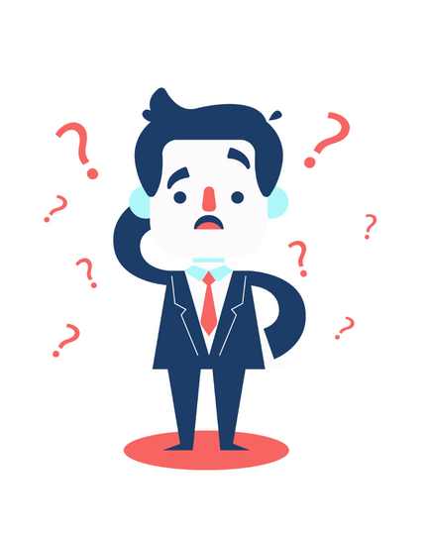
Inserted on
01.01.2022
Rule 36 (4) No input tax credit shall be availed by a registered person in respect of invoices or debit notes the details of which are required to be furnished under sub-section (1) of section 37 unless,-
(a) the details of such invoices or debit notes have been furnished by the supplier in the statement of outward supplies in FORM GSTR-1 or using the invoice furnishing facility; and
(b) the details of input tax credit in respect of such invoices or debit notes have been communicated to the registered person in FORM GSTR-2B under sub-rule (7) of rule 60.

Slide 77
Rule 37.
(4) The time limit specified in sub-section (4) of section 16 shall not apply to a claim for reavailing of any credit, in accordance with the provisions of the Act or the provisions of this Chapter, that had been reversed earlier.
Omitted after
01.10.2022

Slide 78
Scrutiny Parameter

Slide 79
Section 16(2)(a) Person shall be entitled to take credit if he is in possession of invoice issued by the registered supplier
Section 29(2) The proper officer may cancel the registration of a person from date, including any retrospective date.
For Example: Bogus Registration
Rule 21. Registration to be cancelled in certain cases
Check registration status of the supplier from GSTN portal.
Parameter 0069
(Scrutiny Para_1)
In-eligible ITC claimed from non-genuine taxpayers (NGTPs) whose RC is cancelled ab-initio.

Slide 80
Section 16(2)(c) Tax charged in has been actually paid to the Government, either in cash or through utilization of ITC admissible in respect of the said supply.
Section 16(2) Conditions for taking input tax credit.
Check return filled history of the supplier from GSTN portal.
Parameter 0072 (Scrutiny Para_4)
In-eligible ITC claimed from GSTR 3B Non-filers.

Slide 81
Section 16(2)(a) Registered person shall be entitled to the credit of ITC if he is in possession of a tax invoice
Section 31. Tax Invoice – A registered person supplying taxable good shall be required to issue tax invoice
Check registration status of the supplier from GSTN portal.
Parameter 0074 (Scrutiny Para_6)
In-eligible ITC claimed from RC is cancelled suppliers.

Slide 82
Rule 36(4): Input tax credit claimed by person shall not exceed specified percentage of ITC appearing in GSTR2A.
Section 16(2). Conditions for taking input tax credit
Reconcile the party wise ITC claimed in GSTR3B/9 with the ITC appearing in GSTR2A/GSTR9_8A.
Check return filled history of the supplier from GSTN portal.
Section 16(2)(aa). Details of the invoice or debit note has been furnished by the supplier & communicated to the recipient in the manner specified under section 37. (w.e.f. 1.1.2022)
Parameter 0073 (Scrutiny Para_5)
Excess ITC claimed in GSTR 9/3B which is not confirmed in GSTR 2A or 8A of GSTR 9.

Slide 83
Section 16(4). Input tax credit can be claimed up to filing of September return of next financial year or the date of filing of annual return whichever is earlier.
Rule 36(4). The time limit given in Section 16(4) shall not apply to a claim for reavailing of ITC that had been reversed earlier.
Proviso of Section 16(4). For financial year 2017-18 Input tax credit shall be available up to filing of return of March 2019.
Parameter 0078 (Scrutiny Para_11)
ITC claims after the last date of availment of ITC as per the section 16(4)-GSTR 3B.

Slide 84
Section 16(4). Input tax credit can be claimed up to filing of September return of next financial year or the date of filing of annual return whichever is earlier.
Rule 37(4). The time limit given in Section 16(4) shall not apply to a claim for reavailing of ITC that had been reversed earlier.
Proviso of Section 16(4). For financial year 2017-18 Input tax credit shall be available up to filing of return of March 2019.
Section 16(2). Conditions for taking input tax credit
Section 16(2)(aa). Details of the invoice or debit note has been furnished by the supplier & communicated to the recipient in the manner specified under section 37. (w.e.f. 1.1.2022)
Parameter 0079 (Scrutiny Para_12)
ITC on purchase invoices uploaded by supplier in GSTR 1 filed after last date of availment -sec16(4).

Slide 85
Section 20. Manner of distribution of credit by Input Service Distributor.
Rule 39. Procedure for distribution of input tax credit by Input Service Distributor.
Section 21. Manner of recovery of credit distributed in excess.
Rule 65. Form and manner of submission of return by an Input Service Distributor. (GSTR-6)
Rule 54(1). Tax invoice by Input Service Distributor.
Reconcile claim made under GSTR9_6E and GSTR3B_4(A)(4).
Auditor must insure that tax declared under GSTR9_6G is less than or equal to GSTR 2A_ISD.
Parameter 0082 (Scrutiny Para_16)
Excess ISD ITC availed in GSTR9_6G Vs GSTR 2A_ISD.

Slide 86
Section 9(3). Notified supplies of Goods and Services.
Section 9(4). Supplies received from unregistered persons (Exempted from w.e.f. 13.10.2017)
Section 5. Levy and collection of tax on Import of Service
Section 38(2). Furnishing details of Inward supplies
Insure that tax declared under GSTR9_4G is greater than or equal to ITC claimed in GSTR9_6CDF.
Parameter 0083 (Scrutiny Para_17)
Excess RCM ITC GSTR9_6CDF than liability shown in GSTR 9_4G.

Slide 87
Summary of Litigation…
Gross/ Net reporting of ITC in 3B w.e.f July 2022.
16(2): Payment of tax by Supplier to Govt.
16(2)(aa): Filing of GSTR1 by Supplier and Reflection in 2B of Recipient.
16(4): Late filing by Recipient V/s by the Supplier.
17(5): ITC on renting of Immovable Property.
38: Denial ITC reflected in 2B.
Reclaim of ITC.
Interest and Penalty.

Slide 88
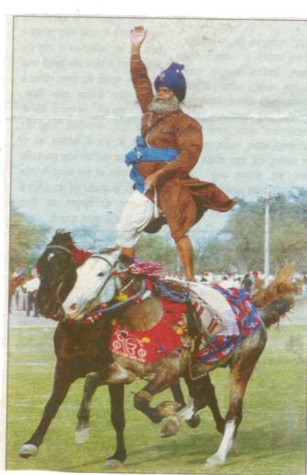
All the best in GST …..

Slide 89

Be happy, Supply Happiness to ALL without Consideration.

Slide 90

Sorry for any mistakes….
Keep sharing knowledge….
THANKS

Slide 91








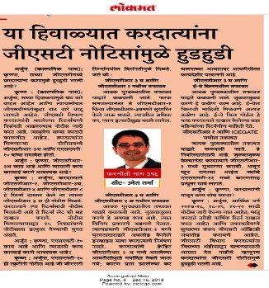
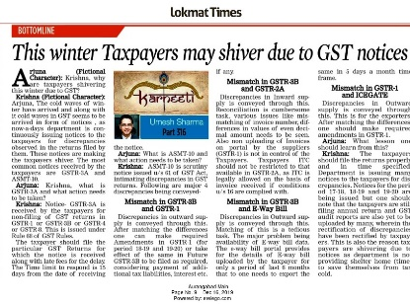
9822079900
fcaumeshsharma@gmail.com

