Slide 1
Government Policies & Startup Support System For Entrepreneurship Development
For Startup Ventures & SMEs
Nikhil Suthar

Slide 2
OBJECTIVE
The primary objective of this initiative is to attract investments from across the globe and strengthen India’s manufacturing sector. It is being led by the Department for Promotion of Industry and Internal Trade (DPIIT), Ministry of Commerce and Industry, Government of India.
The Make in India programme is very important for the economic growth of India as it aims at utilising the existing Indian talent base, creating additional employment opportunities and empowering secondary and tertiary sector. The programme also aims at improving India’s rank on the Ease of Doing Business index by eliminating the unnecessary laws and regulations, making bureaucratic processes easier, making the government more transparent, responsive and accountable.
The symbol of this initiative is a giant lion having many wheels. This indicates peaceful progress and way to the vibrant future of the country. A giant walking lion with many wheels represents courage, strength, tenacity, and wisdom.
Notes:
<a href="http://www.freepik.com">Designed by katemangostar / Freepik</a>

Slide 3
‘Make In India’ Initiative:
Facilitate Investment
Build Best in Class Manufacturing Infrastructure
Enhance Skill Development
Protect Intellectual Property
Foster Innovation

Slide 4
Startup Policies
By, State & Central Government

Slide 5
The state provides support to start-ups at different stages of life cycle. Sector agnostic schemes such as, Student Start-up and Innovation Policy provides support to start-ups at proof of concept / minimum viable product stage, whereas, Scheme for assistance for Start-ups / Innovation provides support to start-ups at seed funding and scale up stage.
The State has also implemented different sector specific schemes in the area of IT-ITeS, Electronics and Biotech for providing support to sector specific needs of the start-ups.
All the four schemes providing support to startups are listed as follows:
Scheme for assistance for Startups/Innovation – Gujarat Industrial Policy 2020
Student Startup and Innovation Policy (SSIP) (2017-21)
Scheme of assistance for Incubators and Start-ups under Electronics & IT/ITeS Start-up Policy for the State of Gujarat (2016-21)
Scheme of assistance for Biotechnology (BT) Industry Under Gujarat State Biotechnology Policy (2016-21)
Page 3
Notes:
Illustration:
https://www.freepik.com/free-vector/cartoon-characters-coworking-center-creative-space-freelancers-designers-work-together_3266662.htm

Slide 6
Scheme for assistance for Startups/Innovation
Gujarat Industrial Policy 2020
Assistance up to INR 30 lakh as a seed support to the startups
Sustenance allowance of INR 20,000 per month to the startups and INR 25,000 per month to women led startups for a period of one year
For the startup scheme, woman entrepreneur led startup means, any startup founded / co-founded by at least one woman.
Assistance up to INR 1 lakh per startup for obtaining training in soft skills on reimbursement basis
Additional assistance up to INR 10 lakh for the startups generating significant impact on the society.
Assistance up to INR 3 lakh to enroll and participate for national/international recognized acceleration program
For mid-level Pre-Series A funding of startups, a separate fund under Gujarat Venture Finance Limited (GVFL) for smaller ticket funding between INR 50 lakh to INR 3 crore
Additional 1% Interest Subsidy, maximum up to 9% on term loans to applicant under the provisions of scheme for assistance to MSMEs.

Slide 7
Student Startup and Innovation Policy (SSIP)
Education Department - GoG
Up to INR 2 Lakh support for creation of Proof of Concept (POC) or Minimum Viable Prototypes (MVP)
Intellectual Property Right (IPR) support up to INR 50,000 for each innovation

Slide 8
Scheme of assistance for Incubators and Start-ups
Electronics & IT/ITeS Start-up Policy for the State of Gujarat (2016-21)
Lease rental subsidy at the scale of 50 sq.ft. per employee, for 2 years on reimbursement basis at the rate of INR 15/sqft/month
Interest Subsidy at the rate of 9% per annum subject to a ceiling of Rs. 2 lakh per year for a maximum duration of 2 years
Patent Assistance at the rate of 75% of cost of obtaining patent subject to ceiling of Rs. 2 lakh per patent for domestic patent and INR 5 lakh per patent for international patent
Bandwidth Subsidy at the rate of 70% of annual bandwidth charges, subject to a ceiling of Rs. 20,000 for 2 years
Rs. 5000 per skill certification per person subject to overall ceiling of INR 1 lakh per annum per startup for 2 years
Assistance of INR 1 lakh for prototype/ product development and additional assistance of INR 1 lakh for marketing
Matching equity support of additional 25% of capital from Gujarat Venture Finance Limited (GVFL), at which the capital was raised within 6 months of such raising subject to a ceiling of INR 5 crore.
In all e-Governance Projects undertaken by Govt. of Gujarat, part of work of value range between 5% and 10% is outsourced to start-ups and students of technical colleges in Gujarat.

Slide 9
Scheme of assistance for Biotechnology Industry
Gujarat State Biotechnology Policy (2016-21)
50% of capital expenditure, excluding cost of land, for setting up a pilot production facility, subject to a ceiling of INR. 10 lakhs, within 2 years
Assistance of INR 1 lakh for product prototype developed through outsourcing and INR 1 lakh for marketing
100% reimbursement of Stamp Duty and Registration Fee paid
Lease rental subsidy at the scale of 50 sq.ft. per employee, for 2 years on reimbursement basis at the rate of INR 15/sqft/month
Interest Subsidy at the rate of 9% per annum subject to a ceiling of Rs. 2 lakh per year
Patent Assistance at the rate of 75% of cost of obtaining patent subject to ceiling of Rs. 2 lakh per patent for domestic patent and INR 5 lakh per patent for international patent. Total assistance is limited to INR 4 lakh for domestic patent and INR 10 lakh for international patent.
Rs. 5000 per skill certification per person subject to overall ceiling of Rs. 20000 per month per startup for 2 years

Slide 10
Startup India Seed Fund Scheme
Government of India
Easy availability of capital is essential for entrepreneurs at the early stages of growth of an enterprise.
Funding from angel investors and venture capital firms becomes available to startups only after the proof of concept has been provided. Similarly, banks provide loans only to asset-backed applicants. It is essential to provide seed funding to startups with an innovative idea to conduct proof of concept trials.

Slide 11
Startup Incubators
A startup incubator is a collaborative program designed to help new startups succeed. Incubators help entrepreneurs solve some of the problems commonly associated with running a startup by providing workspace, seed funding, mentoring, and training. The sole purpose of a startup incubator is to help entrepreneurs grow their business.
Startup incubators are usually non-profit organizations, which are usually run by both public and private entities. Incubators are often associated with universities, and some business schools allow their students and alumni to take part in these programs. There are several other incubators, however, that are formed by governments, civic groups, startup organizations or successful entrepreneurs.
While most of the media emphasis focuses on tech startups, incubators aren't just limited to one industry. In fact, the focus of incubators varies by region.
Page 3
Notes:
Illustration:
https://www.freepik.com/free-vector/cartoon-characters-coworking-center-creative-space-freelancers-designers-work-together_3266662.htm

Slide 12
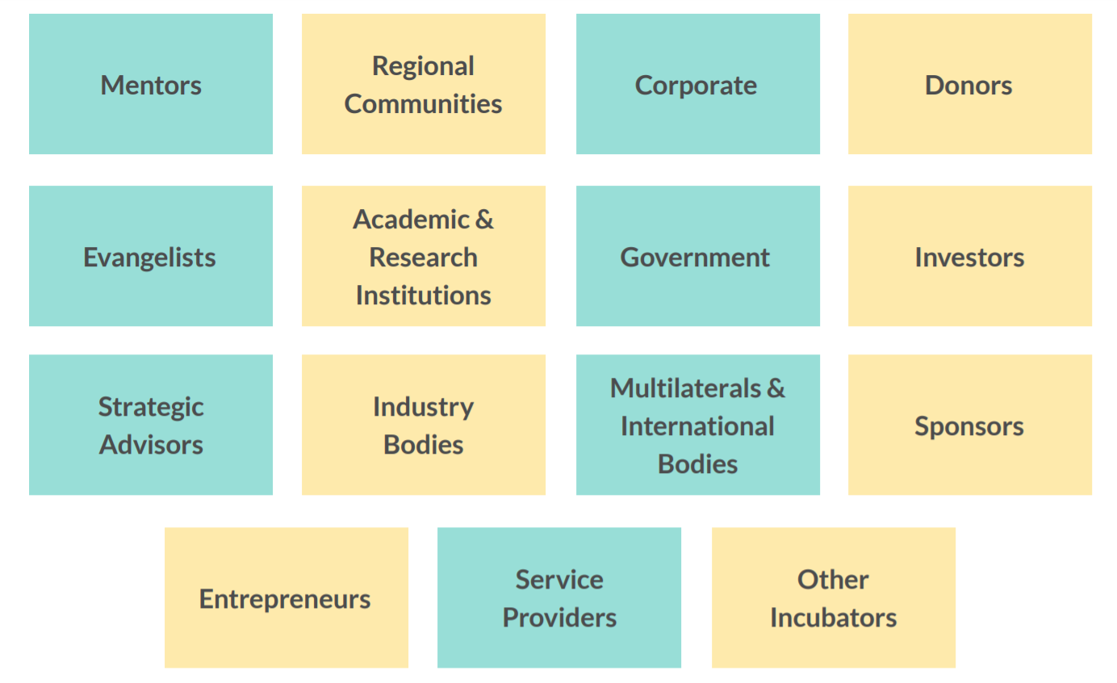
Ecosystem Stakeholders
An Initiative by
Notes:
<a href="https://www.freepik.com/free-photos-vectors/business">Business vector created by pikisuperstar - www.freepik.com</a>

Slide 13
Startup Counselling & Hand-holding Support
Idea to Impact, PoC to Product, Innovation to IP & Mind to Market Support
Co-working Space & Allied Resources
Access of Pre-Seed & Seed Grants & Funding Opportunities
Flexi & Dedicated Work Desk, Meeting Lounges, Seminar Hall & Allied Resources
Government Grants / Schemes, Private Seed, Angle & VC Funding, Short & Long term Loans
Industry & Academic Mentor Connect
Startup Community Connect
Easy Connect of Vast & Experienced Pool of Experts
Networking opportunities to connect with ecosystem stakeholders
Single Window Support

Slide 14
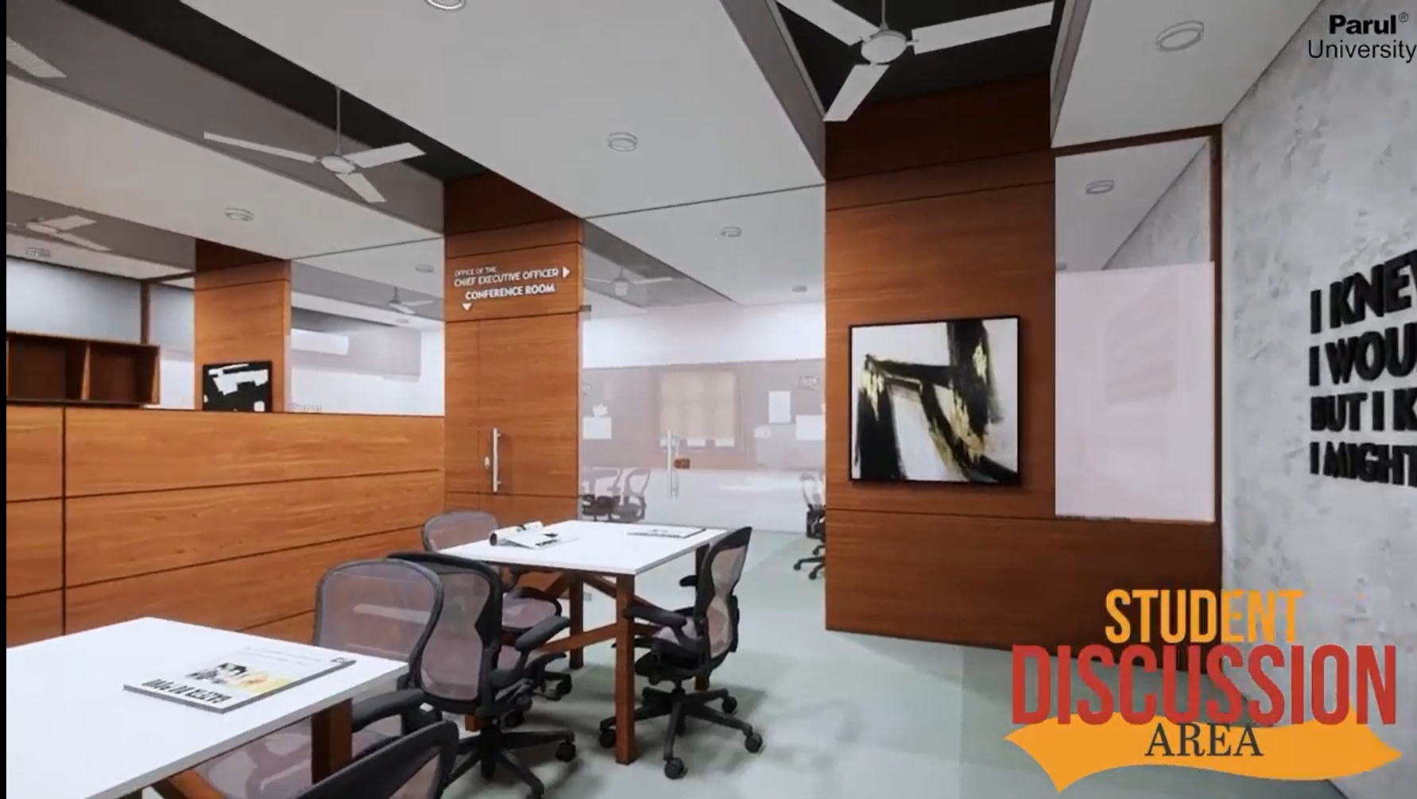
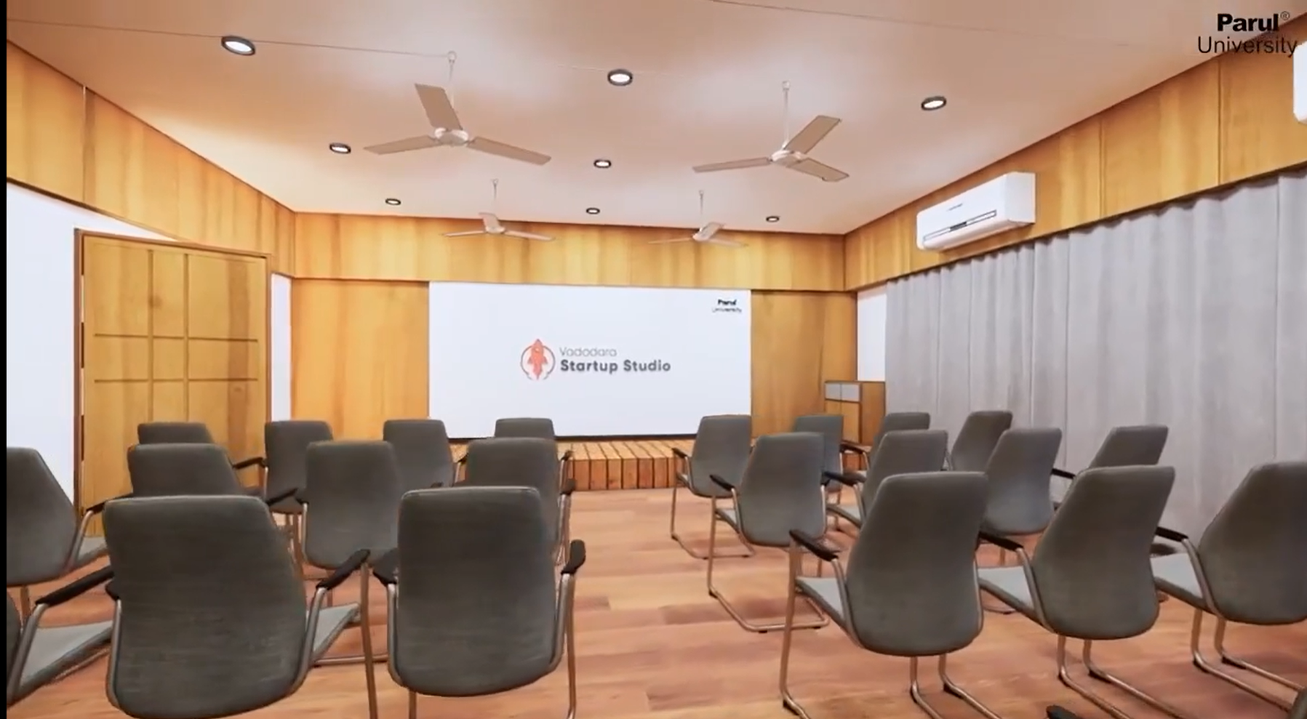
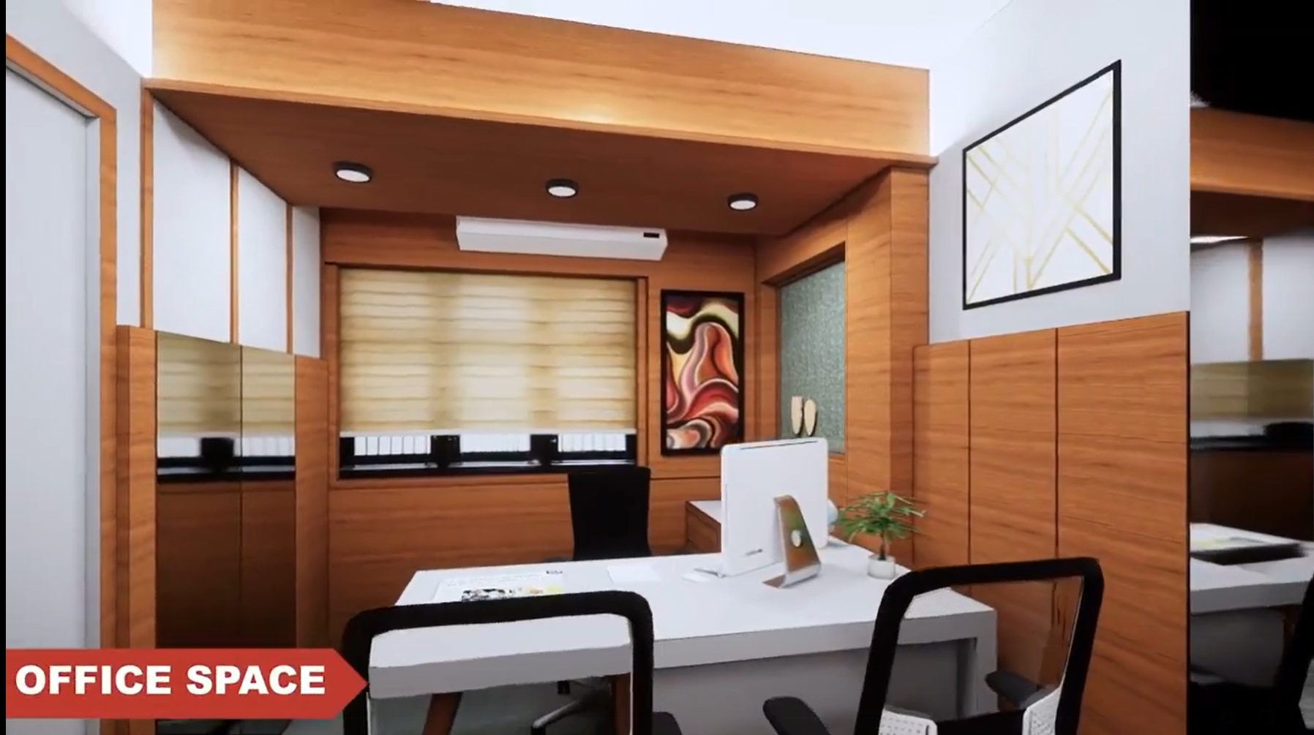
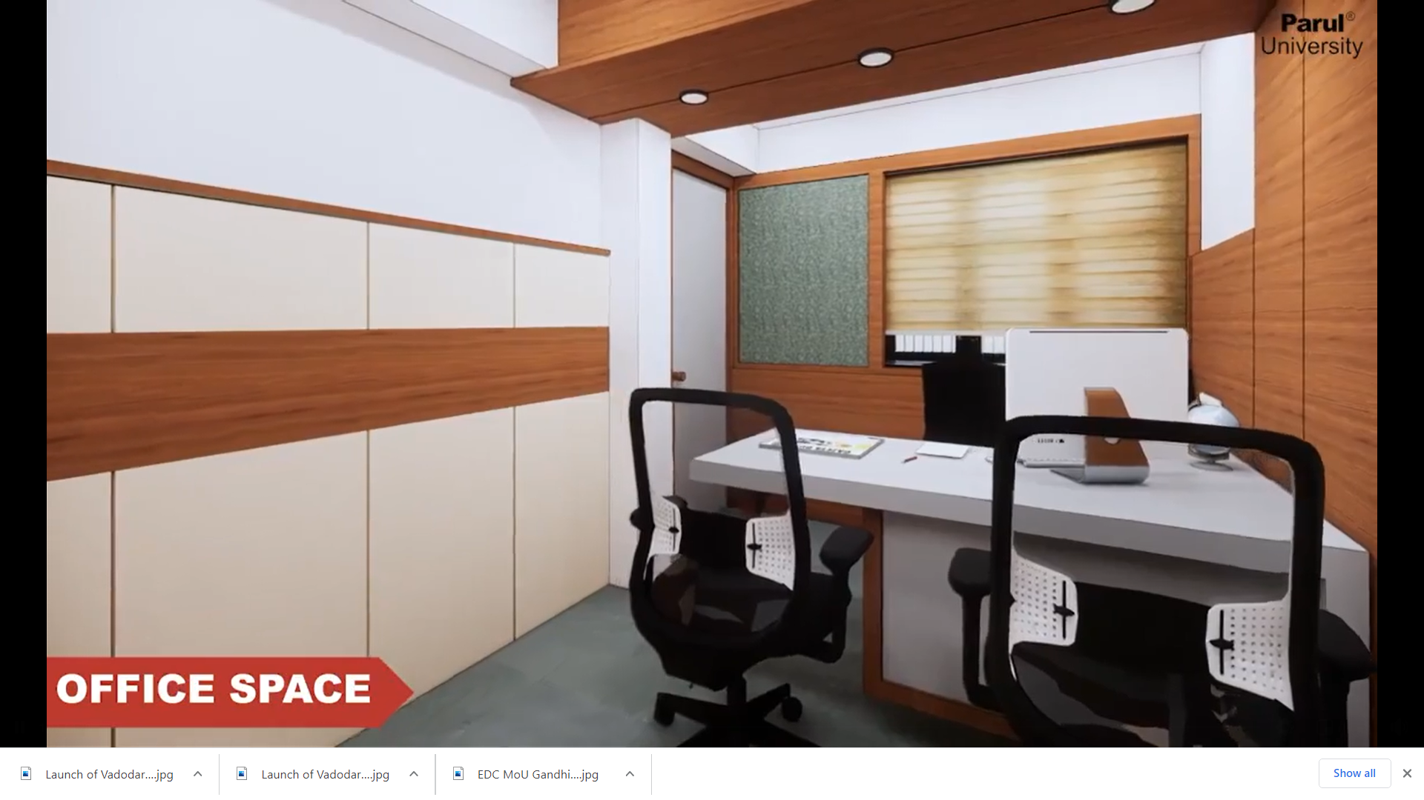
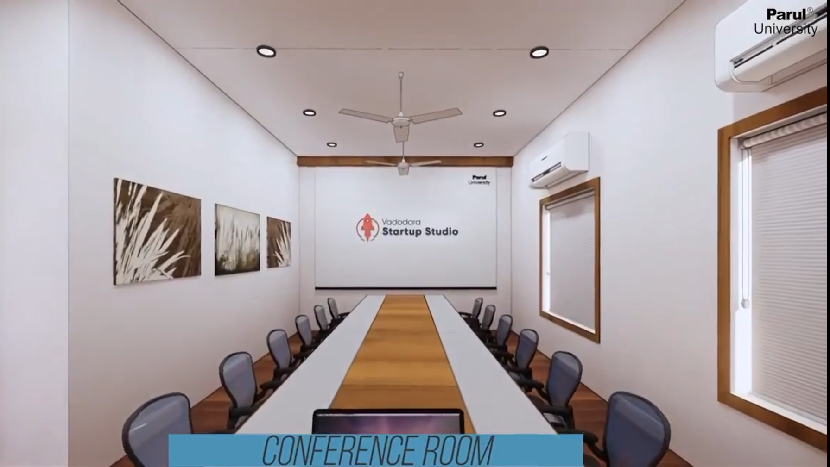
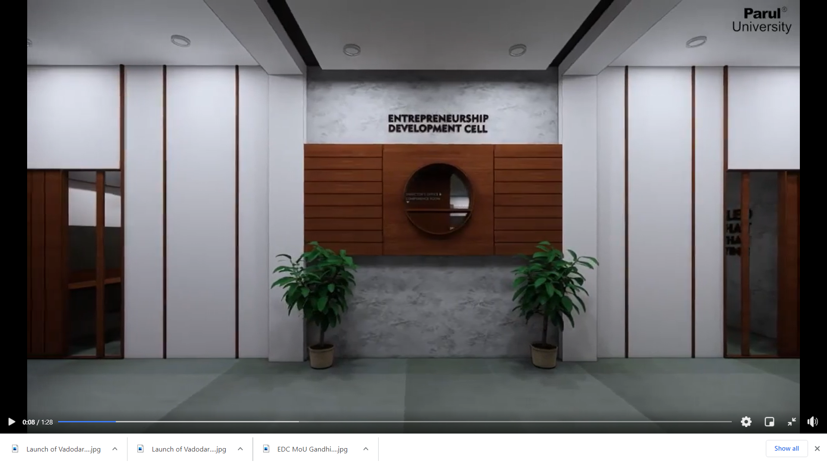
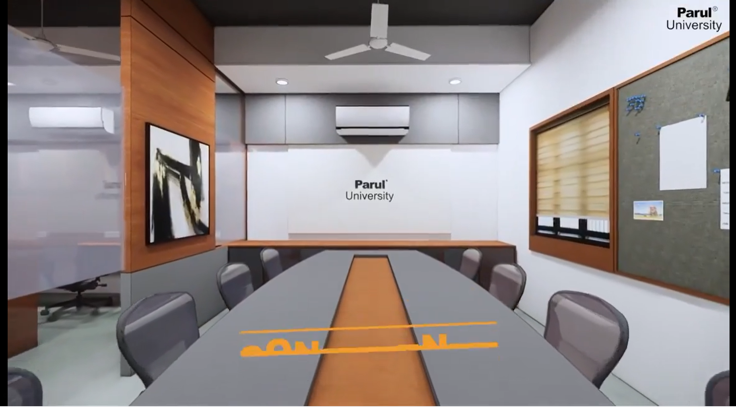

Slide 15
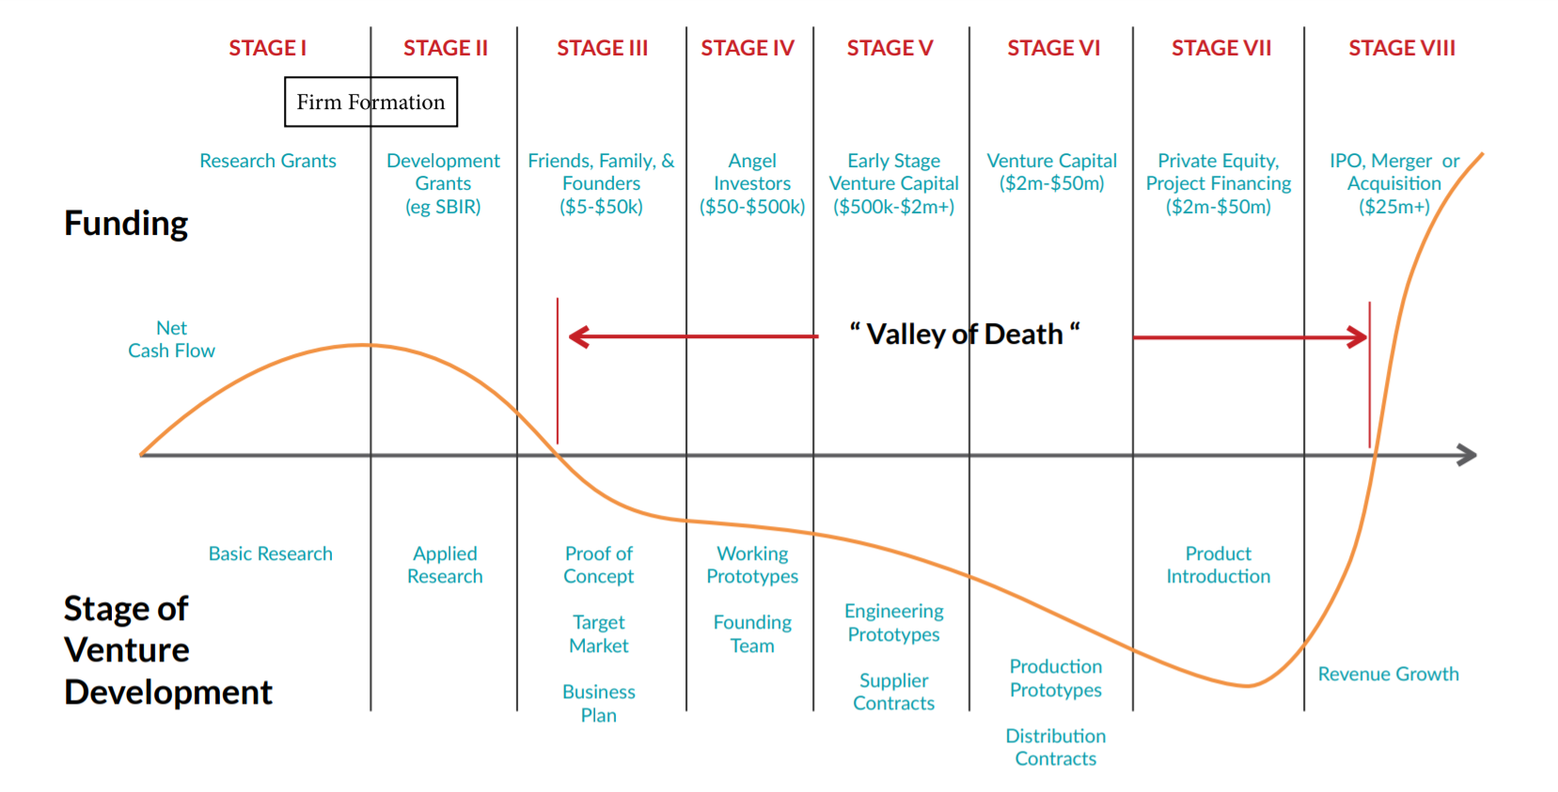
Valley of Death
Notes:
<a href="https://www.freepik.com/free-photos-vectors/business">Business vector created by pikisuperstar - www.freepik.com</a>

Slide 16
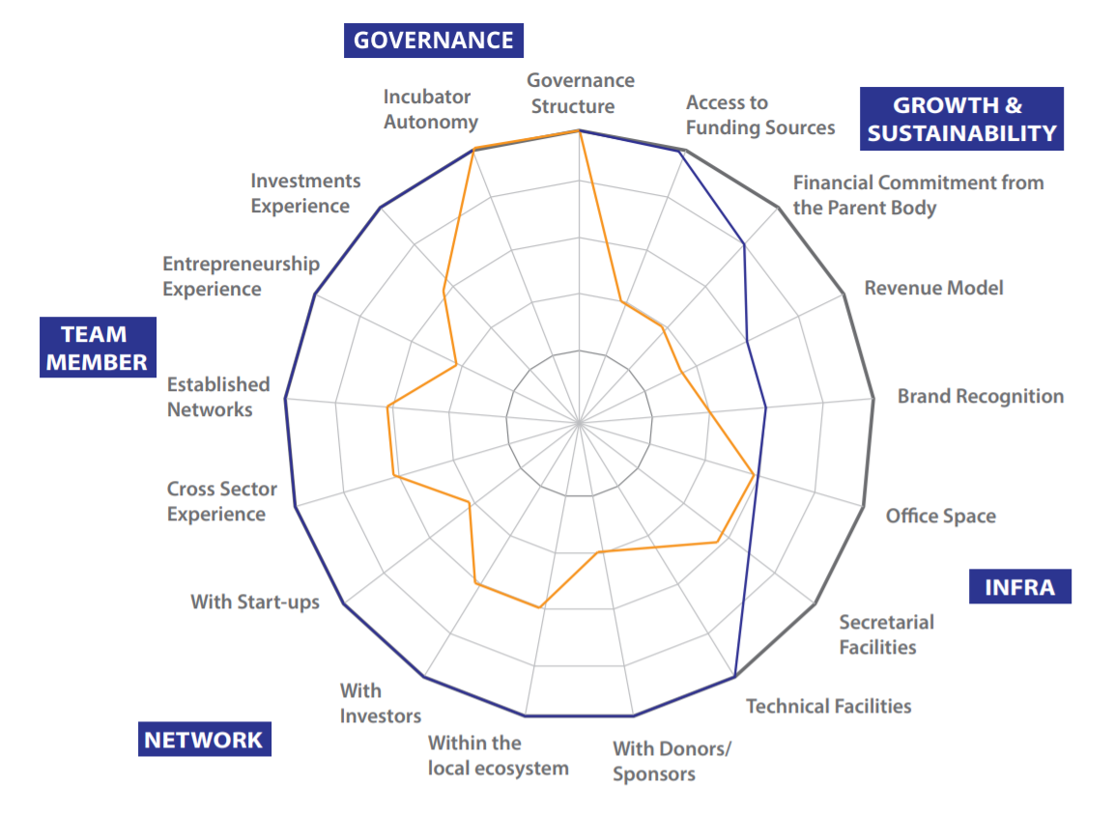
Critical Success Factors Framework
Notes:
<a href="https://www.freepik.com/free-photos-vectors/business">Business vector created by pikisuperstar - www.freepik.com</a>

Slide 17
DISRUPTING DISRUPTORS
An Initiative by
Stop making Plans & Start Experimenting!

Slide 18
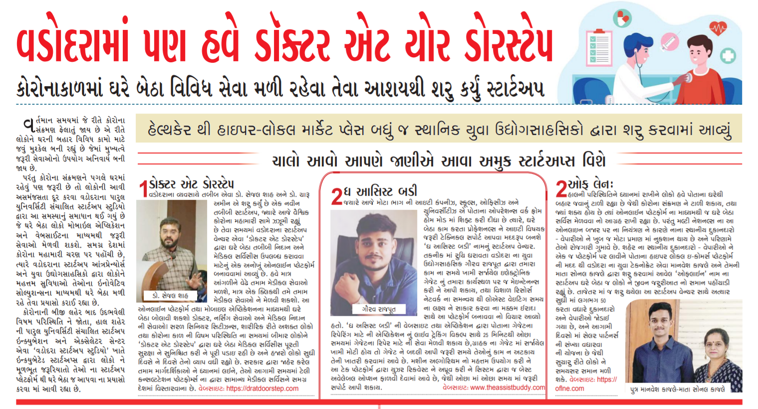

Slide 19
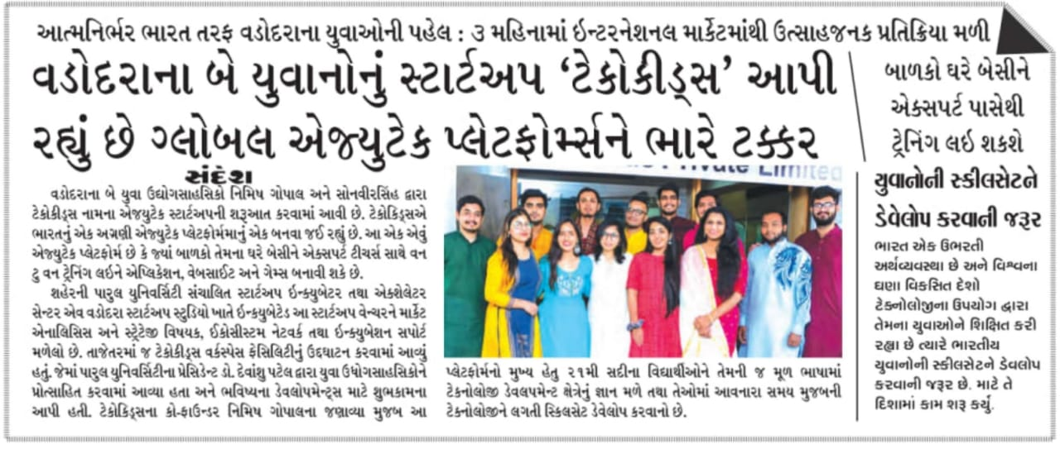

Slide 20
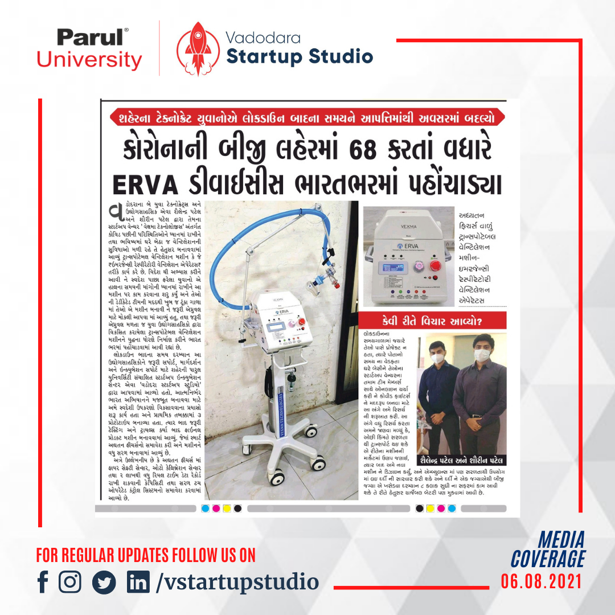

Slide 21
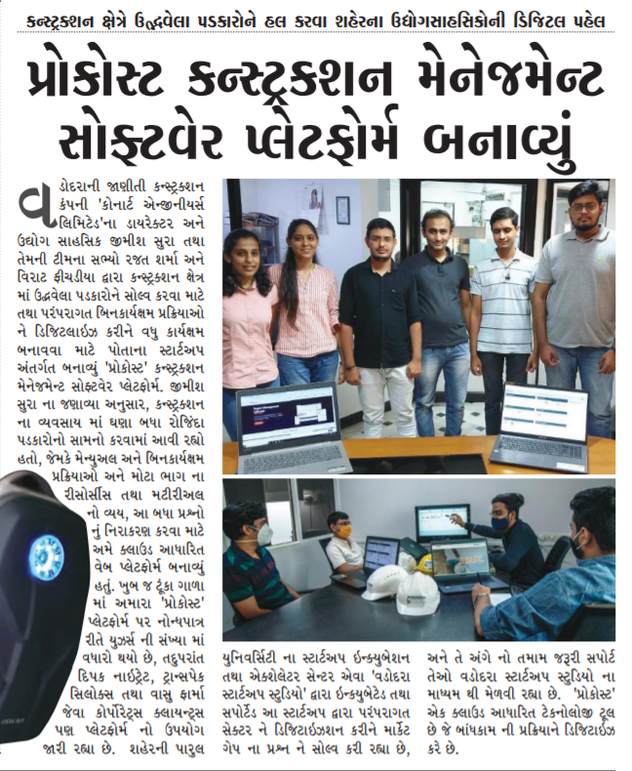
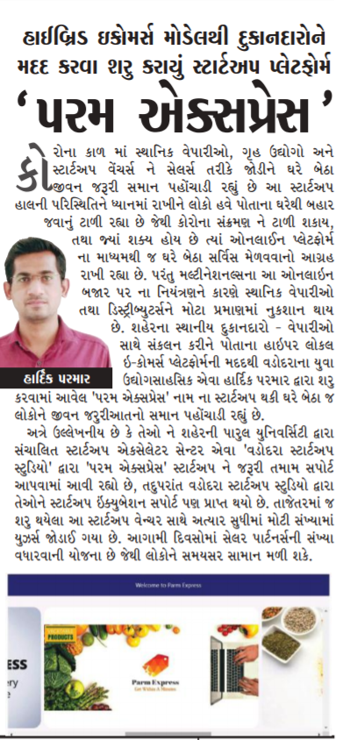
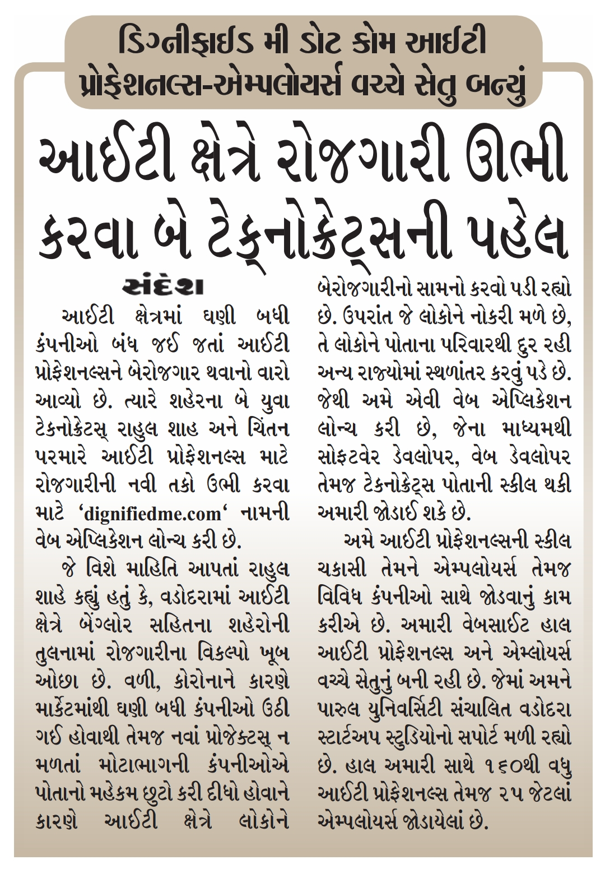

Slide 22
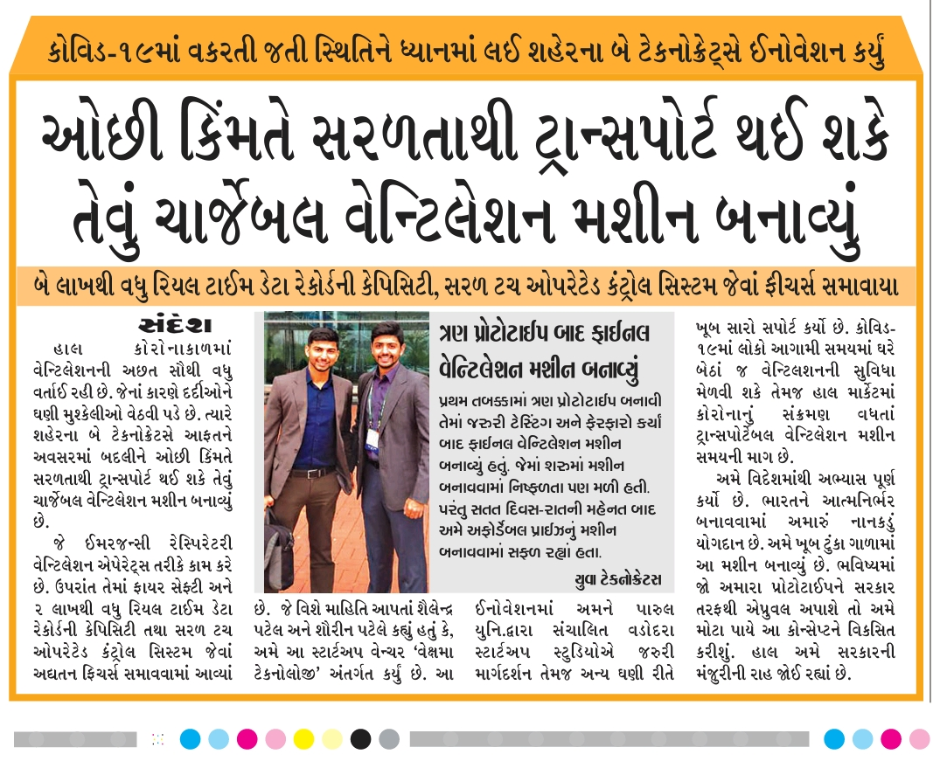
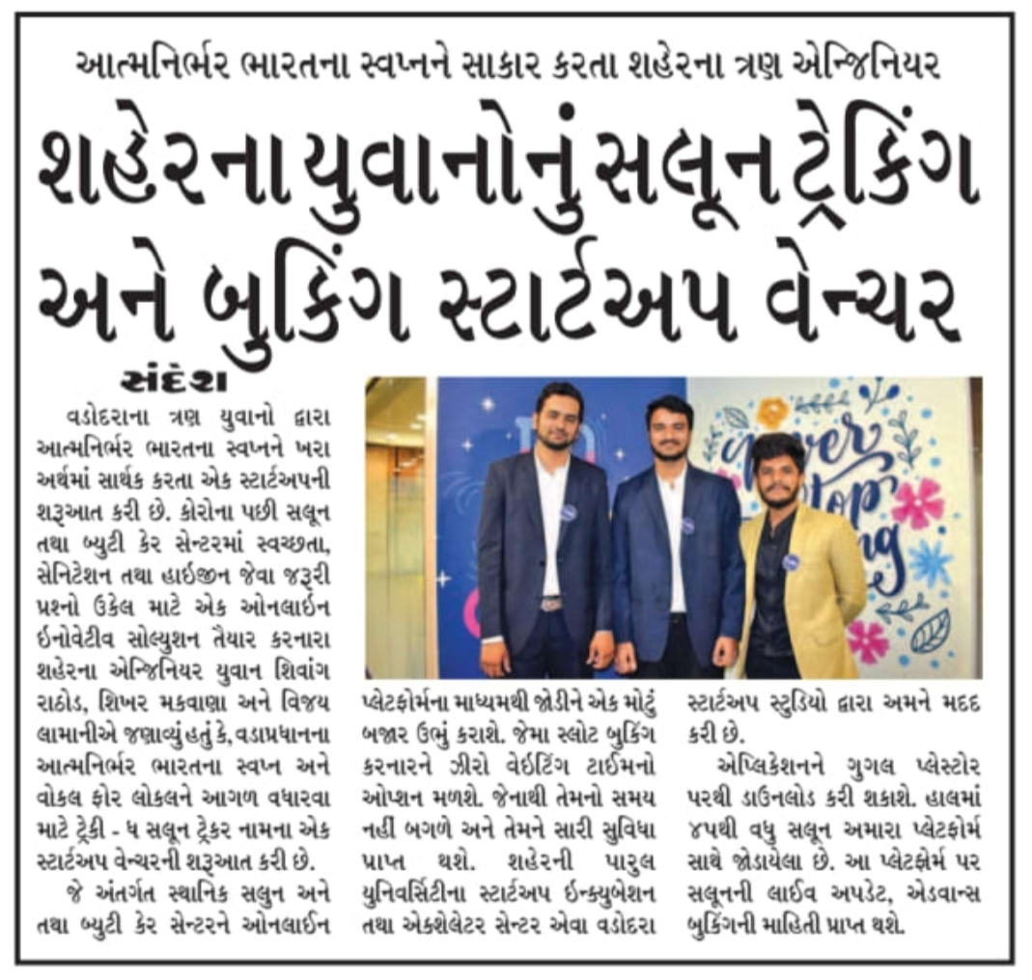

Slide 24
Reach us:
Vadodara Startup Studio – Parul University, Above Diva Hospital, Near Amitnagar Circle, VIP Road, Karelibagh, Vadodara, Gujarat 390022
vss@paruluniversity.ac.in
+91 972 512 5484

