Slide 1
VALUATION MODELS FOR STARTUPS & CASE STUDY
- CA JALAJ CHHAYA

Slide 2
VALUATION-PERSPECTIVE

Slide 3
Methods of How to Value a Start up
Berkus Method
Ideal for companies having valuation of less than 2 million $
Ideal for pre revenue start ups
Box is divided into 5 criterias
Sound idea (Basic value)
Prototype (Technology)
Quality Management Team (Execution)
Strategic Relationships (go-to-market)
Product Roll out or sales

Slide 4
RISK FACTOR SUMMATION METHOD
This is add on to Berkus method where there are further 12 risk variables adjusted
Management risk
Stage of business
Political risk
Manufacturing risk
Sales risk
Capital raising risk
Competition risk
Technology risk
Litigation risk
International risk
Reputation risk

Slide 5
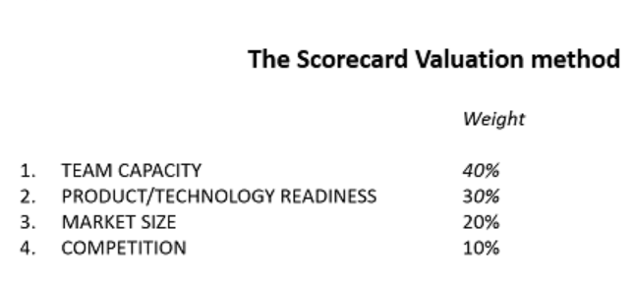
SCORECARD VALUATION METHOD
This is add on to Risk Summation method where there are weights assigned for overall success of the project

Slide 6
COMPARABLE TRANSACTION METHOD
This method considers 2-3 important factors based on industry: Monthly recurring revenue (Saas), HR Headcount, Number of outlets (Retail), Patent Filed (Medtech), monthly active users (messengers). Mostly one can take, P&L, Sales, Gross Margin, etc.

Slide 7
BOOK VALUE METHOD
Prescribed as one of the methods for star up valuation but this is not much relevant for start ups
Books value is basically net worth of the company
It mostly focuses on tangible assets which are there on books while start ups ideally raise fund on intangible assets like goodwill to be created, or business to be generated from the idea, etc.

Slide 8
LIQUIDATION VALUE METHOD
Prescribed as one of the methods for star up valuation but this is not much relevant for start ups
As the name suggests this is the value which one is expected to receive shall the company get liquidated
It is more of a risk management valuation technique to evaluate what is the minimum/liquidated amount one can expect to receive shall the company stops being a going concern
Method is more relevant for auctionable or properties under bankruptcy

Slide 9
DISCOUNTED CASH FLOW METHOD
This method is based on projections of cash to be generated over the long run
For example we are projecting cash generation for next 10 years and at an assumed growth of x%
This growth and number is then discounted at Net Present Value using a discounting rate
Discounting rate is generally considering risk adjustment/industry dynamics/inflation/ROI available from other investment options, etc.
The value derived can then be used for base negotiation for the valuation
Although usable for start ups not an idealistic approach taken by them

Slide 10
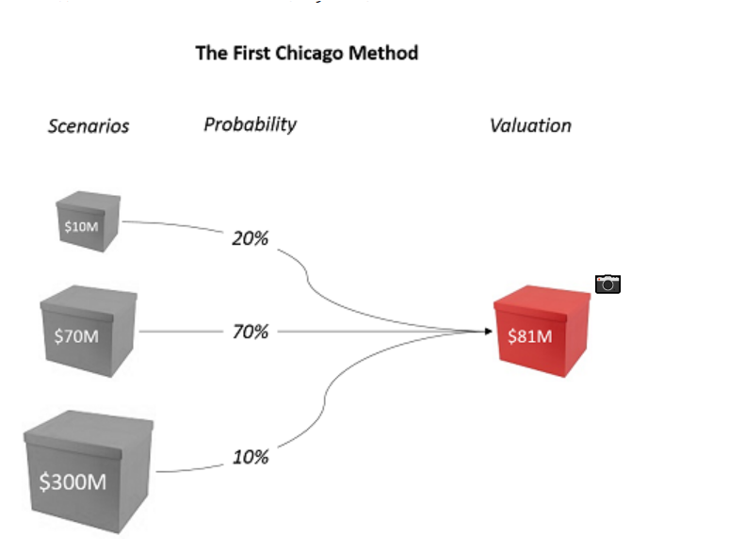
THE FIRST CHICAGO METHOD
We can term this as weighted average of probabilistic approach
Here valuation is done by using 3 different scenarios worst case, normal & best-case scenario. Then probability are assigned to the same. The weighted average of these are then considered as valuation base

Slide 11
VENTURE CAPITAL METHOD
This is based on perception of venture capitalists/investors
Basically, when a VC invests, they assumes an X ROI say 25%
Also investors thinks that certain business can achieve say 10mn after 8 years
Based on above two factors and expected ROI and offcourse considering other market conditions a value of the company is arrived

Slide 12
PRE-SEED FUNDING
The earliest stage of funding a new company comes so early in the process that it is not generally included among the rounds of funding at all. Known as "pre-seed" funding, this stage typically refers to the period in which a company's founders are first getting their operations off the ground. The most common "pre-seed" funders are the founders themselves, as well as close friends, supporters and family.
Depending upon the nature of the company and the initial costs set up with developing the business idea, this funding stage can happen very quickly or may take a long time. It's also likely that investors at this stage are not making an investment in exchange for equity in the company. In most cases, the investors in a pre-seed funding situation are the company founders themselves.

Slide 13
SEED FUNDING
There are many potential investors in a seed funding situation: founders, friends, family, incubators, venture capital companies and more. One of the most common types of investors participating in seed funding is a so-called "angel investor."
Angel investors tend to appreciate riskier ventures (such as startups with little by way of a proven track record so far) and expect an equity stake in the company in exchange for their investment.
While seed funding rounds vary significantly in terms of the amount of capital they generate for a new company, it's not uncommon for these rounds to produce anywhere from $10,000 up to $2 million for the startup in question.

Slide 14
SERIES A FUNDING
The first round after the seed stage is Series A funding. In this round, it’s important to have a plan for developing a business model that will generate long-term profit. Often times, seed startups have great ideas that generate a substantial amount of enthusiastic users, but the company doesn’t know how it will monetize the business.
Typically, Series A rounds raise approximately $2 million to $15 million, but this number has increased on average due to high tech industry valuations, or unicorns. In 2021, the median Series A funding was $10 million.
The investors involved in the Series A round come from more traditional venture capital firms. Well-known venture capital firms that participate in Series A funding include Sequoia Capital, IDG Capital, Google Ventures, and Intel Capital.

Slide 15
SERIES B, C & SUBSEQUENT FUNDING
Companies undergoing a Series B funding round are well-established, and their valuations tend to reflect that; most Series B companies have valuations between around $30 million and $60 million
Businesses that raise a Series C funding are already quite successful. These companies look for additional funding in order to help them develop new products, expand into new markets, or even to acquire other companies. In Series C rounds, investors inject capital into the meat of successful businesses, in an effort to receive more than double that amount back. Series C funding is focused on scaling the company, growing as quickly and as successfully as possible.
In Series C, groups such as hedge funds, investment banks, private equity firms, and large secondary market groups accompany the type of investors mentioned above. The reason for this is that the company has already proven itself to have a successful business model; these new investors come to the table expecting to invest significant sums of money into companies that are already thriving as a means of helping to secure their own position as business leaders.

Slide 16
PRE & POST MONEY VALUATION
Pre-money valuation is the value of a company before it goes public or receives other investments such as external funding or financing.
Potential investors can use the pre-money value of a company to determine how much it's worth before they invest their money.
Pre-money valuations are different from post-money valuations, which determine a company's worth after it receives funding or financing.
Pre-Money Valuation = Post-Money Valuation - Investment Amount
So a company whose post-money valuation is $20 million after receiving a $3 million investment has a pre-money valuation of $17 million.

Slide 17
WAY OF INVESTMENT-CCPS
Convertible preferred stock is a type of preferred share that pays a dividend and can be converted into common stock at a fixed conversion ratio after a specified time.
Convertible preferred stock is a type of hybrid security that has features of both debt and equity, arising from the dividend payment and conversion option, respectively.
Once the common share trades above the conversion price, it may be worthwhile for the preferred shareholders to convert their preferred stock to common shares.
After preferred shareholders convert their shares, they give up their rights as a preferred shareholder (no fixed dividend or higher claim on assets) and become a common shareholder (ability to vote and participate in share price appreciation).

Slide 18
START UP INCUBATION
A startup incubator is a collaborative program designed to help new startups succeed. Incubators help entrepreneurs solve some of the problems commonly associated with running a startup by providing workspace, seed funding, mentoring, and training (see list below for a a more extensive list of common incubator services). The sole purpose of a startup incubator is to help entrepreneurs grow their business.

Slide 19
FACTORS TO BE CONSIDERED DURING VALUATION
Cash burn/Tenure: Zomato/OLA
Scalability: Industry specific or generic: 1mg/Paytm
Competition from bigger companies: Car dekho/True Value/ OLX Autos
Investor credibility: Navi insurance: Sachin Bansal
Online Or Brick & Mortar
Disruptive Technology/Crowded market space
Sectoral analysis: Insurance broking industry is in boom right now
Comparative data: Vcc Edge
Does it solve a problem or is it a convenience product
Geography catered?: Partsavatar caters Canada while similar model may not work in India
Exit Strategy/company planning: IPO planned?

Slide 20
UNACADEMY
Founded in 2010
Run as a Youtube channel till 2016 when they launched their app
Focus on exams which are job related UPSC, Railways etc
Current stats 30mn users, 3.5mn paid users, 20k educators, 1.5bn youtube views
Softbank final round valued Unacademy at 1.4bn$

Slide 21
MEESHO
Platform for showcasing stores for digital stores
Targets organized markets & unbranded products
Helps online retailers and resellers.
Meesho does packing, logistics and delivery
Unicorn valued at 2.1bn$ in 2021
Similar to Amazon/Shopify
Revenue model, commission for products from resellers, delivery charges from customers
Cash burn so far

Slide 22
BYJU’S
2009
Started online classes for CAT
2011
Registers it as a company Think & Learn
2013
Series A 9mn USD from Aarin Capital
2014
Launches Tablet Programme for 8th to 12th
2015
25mn Series A Sequoia Capital & introduces BYJU’s app
2016
Series C & D fund raise 75mn and 50mn
2017
Series F at a valuation of 600mn USD & SRK as a brand ambassador
2018
Becomes a unicorn
2020
Raises money through bond becomes largest ed tech 10.5bn USD. Acquires White Jr & Labinapp & Aakash education

Slide 23
APNA
Founded in 2019 the youngest start up to achieve latest unicorn status
It is a blue collared hiring platform which claims 16mn users in Android with 150k recuiters across 42 cities
It helps facilitate 15mn interviews every month
Companies raised 100mn in last round of funding led by Tiger Global putting company s valuation at 1.1bn USD
The valuation was even before Apna started generating any revenue

Slide 27
INNOVATION/CROWDED MARKET?
Valuation base cannot be only because an innovation is excellent or extremely new to the market
Zerodha was pioneer in online trading low cost/easy to operate and open. Took a lot of tech to built up
Due to heavy demand groww and upstox based on similar model made a killing. Isnt it smart to invest in upstox copying an already successful business model?
Bharatpe replicates the stores where paytm / gpay where already in system

Slide 28
ETHICAL MORAL OR ITS JUST BUSINESS?
When India is on the breakout of investment from across the global 1 out of 100 start ups may become successful
As an investor or person raising investment is it moral to raise fund seeing the plan is not long term? Seeing the probability of a successful business is less but market is hot and we are able to raise
The Answer here is personal to each for his own

Slide 29
SOURCES
https://inc42.com/buzz/top-startup-incubators-india/
https://smash.vc/startups-india/
https://www.stephnass.com/blog/how-to-value-a-startup
https://www.hurunindia.net/hurun-india-future-unicorn-list-2021
VCCH & Prowess Software

Slide 30
THANK YOU
QUESTIONS

