Slide 1
GST & Indirect Taxes Committee of ICAI Rajkot branch of WIRC of ICAI NATIONAL CONFERENCE ON GST 18th December 2022 Classification Concepts in GST CA. Viral M Khandhar

Slide 3
AGENDA
Need for Classification in GST
Introduction to HSN Coding System and First Schedule to Customs Tariff Act, 1975
Tools for Classification for Goods
Classification of Services

Slide 6
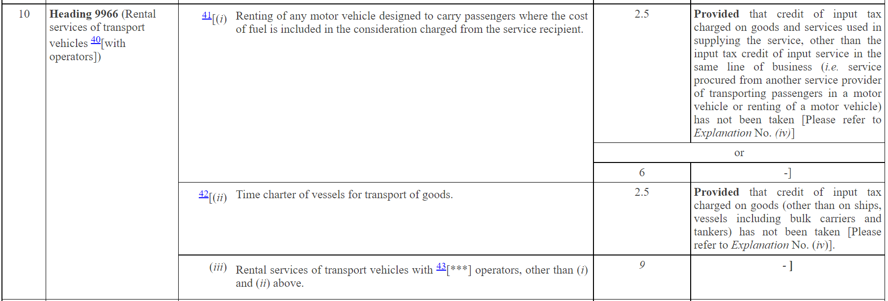
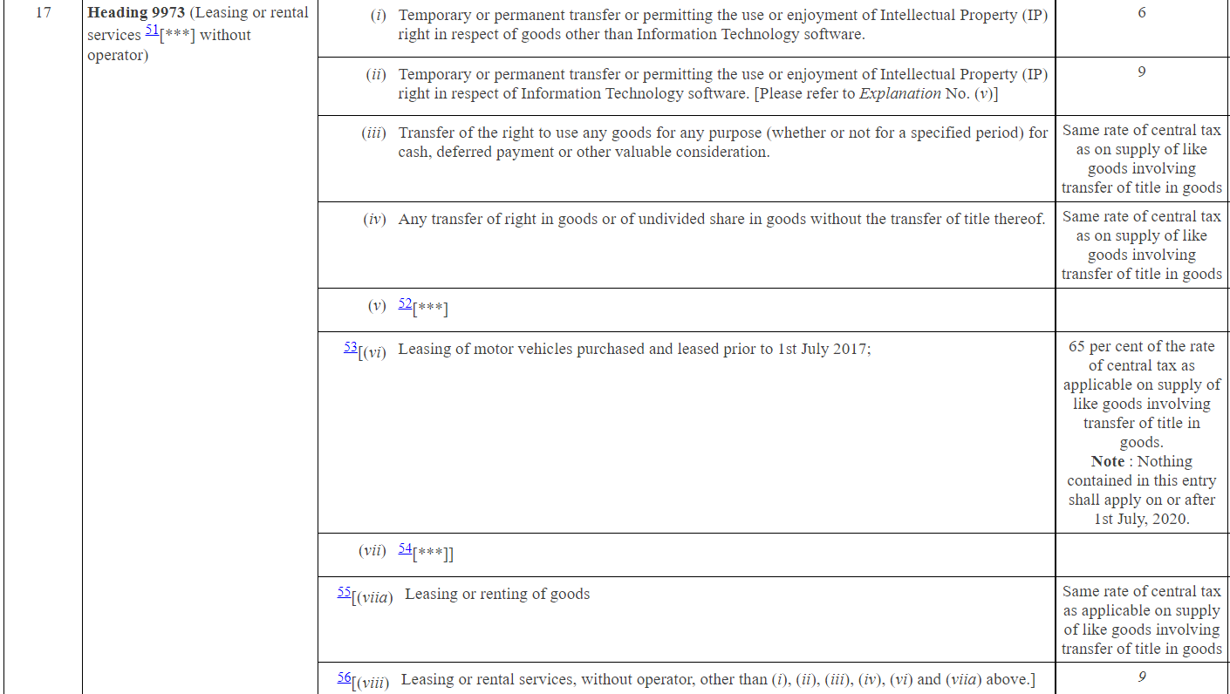

Slide 7
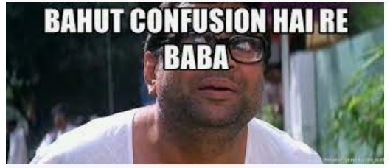
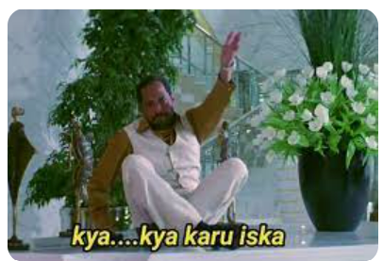

Slide 8
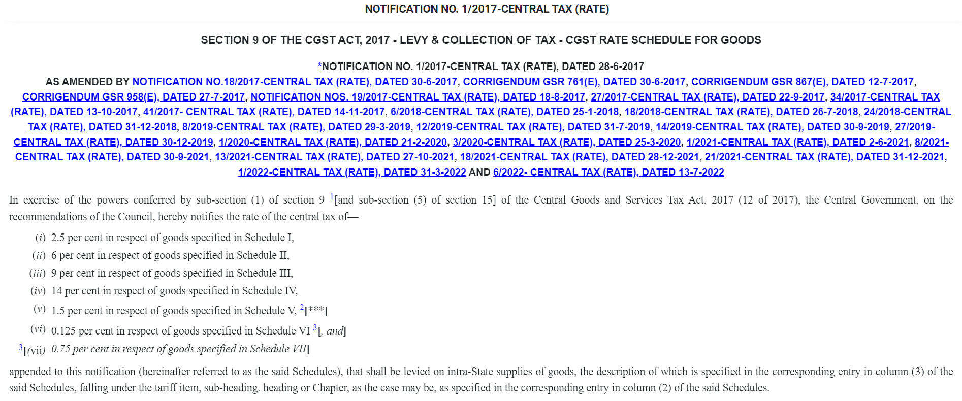

Slide 9
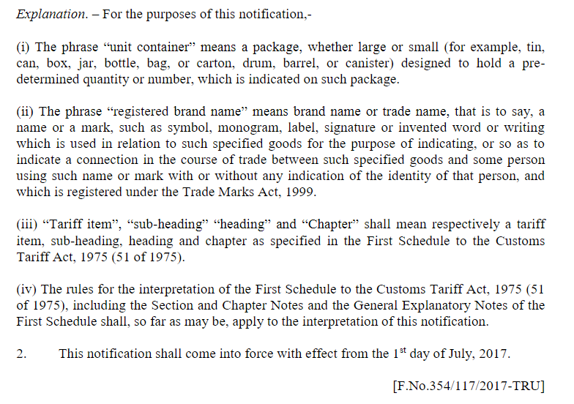
NOTIFICATION NO. 01/2017 – CENTRAL TAX (RATE)

Slide 11
INTRODUCTION TO HSN AND FIRST SCHEDULE TO THE CUSTOMS TARIFF ACT,1975

Slide 12
FIRST SCHEDULE TO CUSTOMS TARIFF ACT, 1975
SECTION
CHAPTER
HEADING
SUB-HEADING
TARIFF ITEM
21 SECTIONS
98 CHAPTERS
~1244 HEADINGS
~5244 SUB-HEADINGS

Slide 13
SECTIONS
SECTION I. LIVE ANIMALS, ANIMAL PRODUCTS
SECTION II. VEGETABLE PRODUCTS
SECTION VII. PLASTICS AND ARTICLES THEREOF, RUBBER AND ARTICLES THEREOF
SECTION XI. TEXTILE & TEXTILE ARTICLES
SECTION XVII. VEHICLES; AIRCRAFT; VESSELS & ASSOCIATED TRANSPORT EQUIPMENT
SECTION XIX. ARMS AND AMMUNITION; PARTS AND ACCESSORIES THEREOF
SECTION XXI. WORKS OF ART, COLLECTORS' PIECES AND ANTIQUES

Slide 14
SECTION II
Chapter 6 - Live trees and other plants; bulbs, roots and the like; cut flowers and ornamental foliage
Chapter 7 - Edible vegetables and certain roots and tubers
Chapter 8- Edible fruit and nuts; peel of citrus fruits or melons
Chapter 10 - Cereals
Chapter 9 - Coffee, tea, mate and spices

Slide 15
Chapter 10 – Cereals
1001 – WHEAT AND MESLIN
1002 - RYE
1003 - BARLEY
1005 – MAIZE (CORN)
1004 – OATS
1006 – RICE

Slide 16
1006 – RICE
1006 10 – Rice in the husk ( Paddy or rough)
1006 20 - Husked (Brown) Rice
1006 30 - Semi-milled or wholly-milled rice, whether or not polished or glazed :
1006 30 10 - - - Rice, parboiled
1006 30 20 - - - Basmati Rice
1006 30 90 - - - Other

Slide 17
ROSES
(HSN 06 03 11 00)
06
The First two digits indicates the Chapter Number
03
The next two digits indicates the Heading under the Chapter
11
The next two digits indicates the sub-heading under the Heading – 6 digit code
00
The last two digits classify the product under the sub-heading – Tariff item

Slide 18
Project analysis slide 2
TOOLS OF CLASSIFICATION OF GOODS
SECTION NOTES
HSN EXPLANATORY NOTES
TOOLS OF CLASSIFICATION OF GOODS
CHAPTER NOTES
GENERAL RULES OF INTERPRETATION
SUPPLEMENTARY NOTES
JUDICIAL PRECEDENTS / THEORIES

Slide 19
SECTION NOTES & CHAPTER NOTES
Certain Sections and Chapters are preceded by Notes which form an integral part of the Harmonized System and have the same legal force.
Defines the precise scope and limits of each sub-heading or headings.
Made the drafting of the heading, sub-heading simpler and also defined terms that are essential to avoid confusion
Referred to as the “Legal Notes”

Slide 20
HSN EXPLANATORY NOTES
For ensuring uniformity, the World Customs Organization has published various Explanatory Notes to various heading/sub-headings.
They do not form part of the legal provisions of the HS but are the official interpretation of the WCO.
Not exhaustive, unchangeable commentary on the overall scope of the headings and sub-headings.
Gives a better understanding of the tariff headings
5 volumes and amending supplements

Slide 21
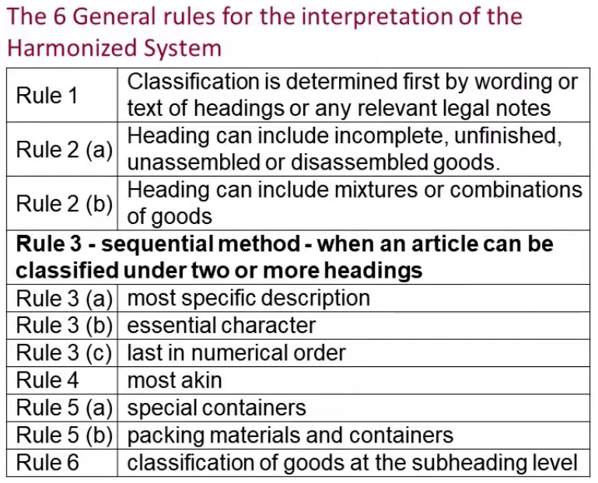
GENERAL RULES OF INTERPRETATION
Notes:
2(a) – shirt without collars or sleeves
2(b) – nylon shirt and cotton shirt
If watch with calculator, then use Rule 3
3(a) – carpet for car shaped to placed in car, then choose 47 – Carpet and not accessories under 87
3(b) – baby seat with batteries, rock with music – go by essential character – essentially it is a seat
There can be another case of combining 3-4 items, a cup with sanitiser for gifting, then go individually
3(c) – go by last numerical rule
4 -

Slide 22
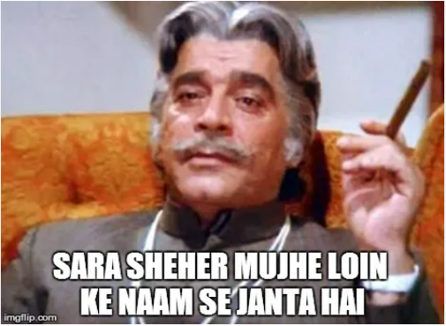
TRADE PARLANCE THEORY
A word in statute should be construed in its popular sense and not in the strict or technical sense, ‘Popular sense’ means that which people conversant with the subject matter with which the statue is dealing would attribute to it.
“Where a word has a scientific or technical meaning and also an ordinary meaning according to common parlance, it is in the latter sense that in a taxing statute the word must be held to have been used, unless contrary intention is clearly expressed by the Legislature.”
The test ignores the technical meaning or scientific meaning if open market exists for the commodities commonly traded.

Slide 23
OTHER AIDS OF CLASSIFICATION
End use Classification
Expert Opinion

Slide 24
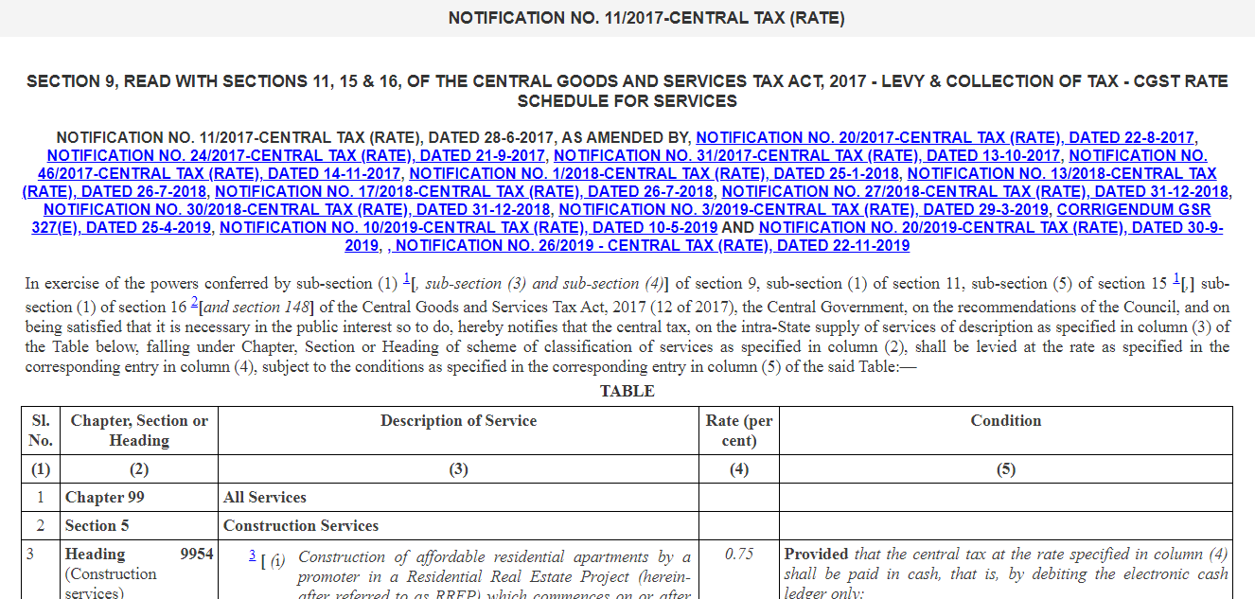
Classification of Services

Slide 25
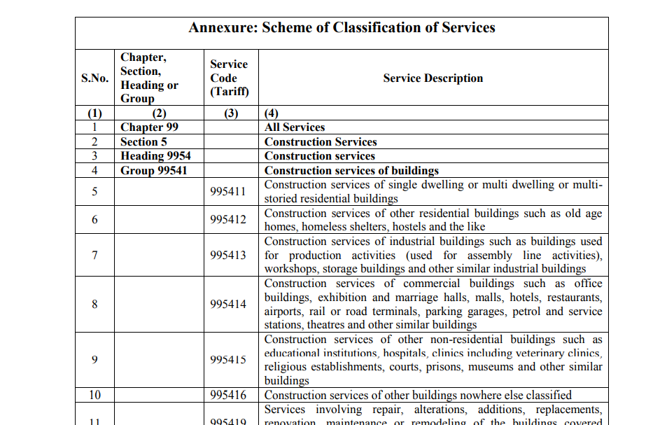

Slide 26
Thank You
viralkhandhar@gmail.com
988 411 5250

