Slide 1
National Conference on GST at Rajkot
Organised by GST & IDT Committee of ICAI
Compiled by:
Team JHA Legal

Slide 2
Agenda
Introduction
Recovery
Provisional Attachment
Adjudication
2

Slide 3
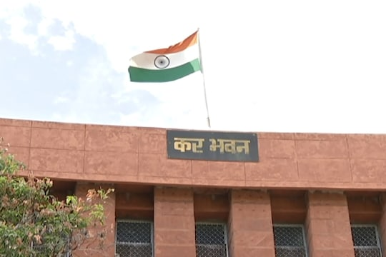
Law
Act
Rules
Notifications
ROD – Orders
Judgements of Courts
AR’s (only for applicant)
How officers understands law !
Circular
Press Release
Guidelines
Instructions
FAQ’s
AR’s
Trade Notices
Past experience !
Revenue Bias !
Whether law is good/ bad?
Constitution of India
Only HC/ SC can decide

Slide 4
Jurisprudence
Bengal Iron Corporation Vs. Commercial Taxes Officers
[1994 Supp. 1 SCC 310]
So far as clarifications/circulars issued by the Central Government and/or State Government are concerned, they represent merely their understanding of the statutory provisions. They are not binding upon the courts. It is true that those clarifications and circulars were communicated to the concerned dealers but even so nothing prevents the State from recovering the tax, if in truth such tax was leviable according to law. There can be no estoppel against the statute. The understanding of the Government, whether in favour or against the assessee, is nothing more than its understanding and opinion. ….. While acting in quasi-judicial capacity, they are bound by law and not by any administrative instructions, opinions, clarifications or circulars. Law is what is declared by this Court and the High Court — to wit, it is for this Court and the High Court to declare what does a particular provision of statute say, and not for the executive. Of course, the Parliament/Legislature never speaks or explains what does a provision enacted by it mean.
4
Notes:
Para 18

Slide 5
Jurisprudence
CIT Vs. Anjum M.H. Ghaswala
[(2002) 1 SCC 633 (SC)]
Shri Ramamurti, learned Senior Counsel appearing for some of the respondents placed strong reliance on the press release dated 21-5-1996 issued by the Board in support of the contentions raised on behalf of the respondents. It is true that by this press release the Board had interpreted the provisions of the Act in a particular manner. Be that as it may, we would like to make it clear that every clarificatory note or press release issued by the Board does not have the statutory force like the circulars issued by the Board under Section 119 of the Act. It is only those circulars issued by the Board under the provisions of Section 119 of the Act, will have the statutory force and will be binding on every income tax authority. Therefore, the press release relied upon by Shri Ramamurti not being a circular issued under Section 119 of the Act will not be of any assistance to the respondents in support of their contentions.
5
Notes:
Para 32

Slide 6
Jurisprudence
Suchitra Components Ltd. Vs Commissioner Of Central Excise, Guntur
[(2006) 12 SCC 452]
We have heard Mr. A.R. Madhav Rao, learned Counsel for the appellant and Mr. K. Radhakrishna, learned Senior Counsel for the respondent. We have perused the orders passed by the lower Authorities and also of the Tribunal. The point raised by the learned Counsel for the appellant is covered by the recent judgment of this Court in Civil Appeal No. 4488 of 2005, Commissioner of Central Excise, Bangalore v. Mysore Electricals Industries Ltd. reported in MANU/SC/8687/2006 : 2006(204)ELT517(SC) . In the said Judgment, this Court held that a beneficial circular has to be applied retrospectively while oppressive circular has to be applied prospectively. Thus, when the circular is against the assessee, they have right to claim enforcement of the same prospectively.
6

Slide 7
From Statute
Sec. 168. Power to issue instructions or directions.
(1) The Board may, if it considers it necessary or expedient so to do for the purpose of uniformity in the implementation of this Act, issue such orders, instructions or directions to the central tax officers as it may deem fit, and thereupon all such officers and all other persons employed in the implementation of this Act shall observe and follow such orders, instructions or directions.
7

Slide 8
Jurisprudence
Sirpur Paper Mill Limited vs. The Commissioner of Wealth Tax
[1971 SCR (1) 304]
It enacts that no orders, instructions or directions shall be given by the Board so as to interfere with the discretion of the Appellate Assistant Commissioner of Wealth Tax in the exercise of his appellate functions. It does not, however, imply that the Board may give any directions or instructions to the Wealth Tax Officer or to the Commissioner in exercise of his quasi-judicial function. Such an interpretation would be plainly contrary to the scheme of the Act and the nature of the power conferred upon the authorities 'invested with quasi-judicial power. The Commissioner appears, in our judgment,' to have wholly misapprehended the true character of the jurisdiction with which he is by the Act entrusted and has surrendered his judgment to the directions of the Board of Revenue.
8

Slide 9
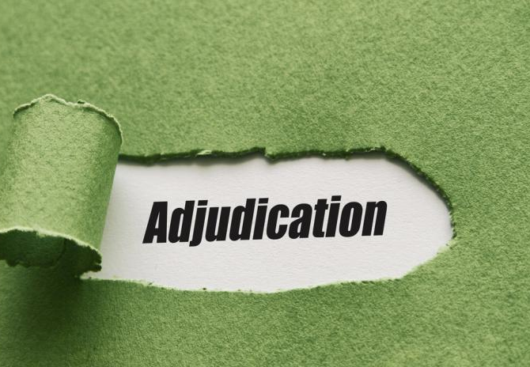

Slide 10
From Statute
Section 73: Applicable in case of non-payment or short payment of tax without fraud or willful-misstatement or suppression of facts
Section 74: Applicable in case of non-payment or short payment of tax with fraud or willful-misstatement or suppression of facts
Proper officer to issue a Show Cause Notice in both cases
Mere statement containing the non-payment or short payment can be served for subsequent periods instead of detailed show cause notice, only if the grounds raised are identical to the ones raised in the previous year.
Time limit for the proper officer to issue notice – at least 3 months prior to issuance of order
Time limit for the proper officer to issue notice – at least 6 months prior to issuance of order
Time limit for the proper officer to issue an order is within three years from the due date for furnishing of annual return.
Time limit for the proper officer to issue an order is within five years from the due date for furnishing of annual return.

Slide 11
From Statute
Section 73: Applicable in case of non-payment or short payment of tax without fraud or willful-misstatement or suppression of facts
Section 74: Applicable in case of non-payment or short payment of tax with fraud or willful-misstatement or suppression of facts
Situation | Penalty Amount
Within 30 days after the issuance of the show cause notice | No penalty
After 30 days of issuance of show cause notice or after the issuance of order | 10% of tax or Rs. 10,000 whichever is higher
Situation | Penalty Amount
Before issuance of show cause notice | 15% of the tax amount
Within 30 days after the issuance of the show cause notice | 25% of the tax amount
Within 30 days from the issuance of order | 50% of the tax amount
In any other case | 100% of the tax amount (equivalent to tax)

Slide 12
Structure of SCN
Circular No. 1053/2/2017-CX Dt. 10.03.2017 [Pre-GST]
Introduction of the Case
Legal Frame Work
Factual statement and appreciation of evidences
Discussion on facts and legal frame work
Discussion on limitation
Calculation of duty and other amounts due
Statement of charges
Authority to adjudicate

Slide 13
SCN : Jurisprudence
Comm. of Central Ex. Bangalore Vs. Brindavan Beverages Pvt. Ltd.
[(2007) 5 SCC 387]
Show cause is the foundation stone on which department has to build up its case.
Allegations in SCN has to be specific
Allegations in SCN not to be vague, lacs detail and/ or unintelligible

Slide 14
Suppression : Jurisprudence
Collector of Central Excise Vs. Chemphar Drugs and Liniments
[(1989) 2 SCC 127 (SC)]
… Something positive other than mere inaction or failure on the part of the manufacturer or producer or conscious or deliberate withholding of information when the manufacturer knew otherwise, is required before it is saddled with any liability, beyond the period of six months. Whether in a particular set of facts and circumstances there was any fraud or collusion or wilful misstatement or suppression or contravention of any provision of any Act, is a question of fact depending upon the facts and circumstances of a particular case.
The Tribunal came to the conclusion that the facts referred to hereinbefore do not warrant any inference of fraud. The assessee declared the goods on the basis of their belief of the interpretation of the provisions of the law that the exempted goods were not required to be included and these did not include the value of the exempted goods which they manufactured at the relevant time. The Tribunal found that explanation was plausible, and also noted that the department had full knowledge of the facts about manufacture of all the goods manufactured by the respondent when the declaration was filed by the respondent. …
In that view of the matter and in view of the requirements of Section 11-A of the Act, the claim had to be limited for a period of six months as the Tribunal did. We are therefore, of the opinion that the Tribunal was right in its conclusion. The appeal therefore fails and is accordingly dismissed.

Slide 15
Suppression : Jurisprudence …
Continental Foundation Joint Venture Vs. Comm. of Central Excise
[2007 (10) SCC 337 (SC)]
The expression 'suppression" has been used in the proviso to Section 11A of the Act accompanied by very strong words as 'fraud' or "collusion" and, therefore, has to be construed strictly. Mere omission to give correct information is not suppression of facts unless it was deliberate to stop the payment of duty. Suppression means failure to disclose full information with the intent to evade payment of duty. When the facts are known to both the parties, omission by one party to do what he might have done would not render it suppression. When the Revenue invokes the extended period of limitation under Section 11A the burden is cast upon it to prove suppression of fact. An incorrect statement cannot be equated with a willful misstatement. The latter implies making of an incorrect statement with the knowledge that the statement was not correct.
Notes:
Para 12.

Slide 16
Suppression : From Statute
Explanation 2 to Sec. 74:
For the purposes of this Act, the expression “suppression” shall mean non-declaration of facts or information which a taxable person is required to declare in the return, statement, report or any other document furnished under this Act or the rules made thereunder, or failure to furnish any information on being asked for, in writing, by the proper officer.

Slide 17
Suppression : Jurisprudence
Cosmic Dye Chemical Vs. Collector Of Central Excise
[(1995) 6 SCC 117 (SC)]
Brief Facts:
Company was dealing in two chemicals, one exempted from excise duty another taxable
For taxable product, co. availed turnover linked exemption by declaring turnover of excisable goods below threshold provided, by treating exempt turnover as non-excisable
Deptt. levied penalty apart from interest and tax, which was upheld by FAA & Tribunal
Tribunal while dismissing appeal, hold that intention is irrelevant in case of mis-statement or suppression of facts
Supreme Court observed:
Department had the information, through responses received on other occasions, and gate passes
Term ‘Wilful’ preceded the phrase ‘mis-statement or suppression of facts’
Qualified by the immediately succeeding words – ‘with intent to evade payment of duty
On the date of declaration – two non jurisdictional HC’s treated exempt goods as non-excisable
HELD – Mis-statement or suppression of facts must be wilful.
Notes:
Para 14.

Slide 18
Suppression : Jurisprudence (Cont…)
Continental Foundation Joint Venture Vs. Comm. of Central Excise
[2007 (10) SCC 337 (SC)]
As far as fraud and collusion are concerned, it is evident that the intent to evade duty is built into these very words. So far as misstatement or suppression of facts are concerned, they are clearly qualified by the word “wilful”, preceding the words “misstatement or suppression of facts” which means with intent to evade duty. The next set of words “contravention of any of the provisions of this Act or Rules” are again qualified by the immediately following words “with intent to evade payment of duty”. Therefore, there cannot be suppression or misstatement of fact, which is not wilful and yet constitute a permissible ground for the purpose of the proviso to Section 11-A. Misstatement of fact must be wilful.
Notes:
Para 14.

Slide 19
Adjudication Vs. Assessment
Assessment
Sec. 2(11) “assessment” means determination of tax liability under this Act and includes self-assessment, re-assessment, provisional assessment, summary assessment and best judgment assessment;
Adjudication:
The act of giving a judgment or of deciding a legal problem
Bloomsburry Legal
The giving or pronouncing a judgment or decree in a cause;
Black’s law Legal
To judge; to formally issue a final judgment in a court proceeding. Synonymous with adjudge.
Sphinx Legal
The formal judgment or decision of a court or tribunal
Oxford Law
Notes:
Pooran Mal – (1974) 93 ITR 505 (SC)
Para No. 7 of – Yashwant Sinha Vs. CBI – 2019 (25) GSTL 161 (SC)
“Test of admissibility of evidence lies in its relevancy unless there is an express or necessarily implied prohibition in the constitution or other law. Evidence obtained as a result of illegal search or seizure is not liable to be shut out.”

Slide 20
Adjudication Vs. Assessment
Sec, 73/ 74:
(9) The proper officer shall, after considering the representation, if any, made by the person chargeable with tax, determine the amount of tax, interest and penalty due from such person and issue an order.
Sec, 75:
(10) The adjudication proceedings shall be deemed to be concluded, if the order is not issued within three years as provided for in sub-section (10) of section 73 or within five years as provided for in sub-section (10) of section 74.
Notes:
Pooran Mal – (1974) 93 ITR 505 (SC)
Para No. 7 of – Yashwant Sinha Vs. CBI – 2019 (25) GSTL 161 (SC)
“Test of admissibility of evidence lies in its relevancy unless there is an express or necessarily implied prohibition in the constitution or other law. Evidence obtained as a result of illegal search or seizure is not liable to be shut out.”

Slide 21
Nemo Judex in Causa Sua

Slide 22
Jurisprudence
Ashok Kumar Yadaav Vs. State of Haryana
(1985) 4 SCC 417
We agree with the petitioners that it is one of the fundamental principles of our jurisprudence that no man can be a judge in his own cause and that if there is a reasonable likelihood of bias it is “in accordance with natural justice and common sense that the justice likely to be so biased should be incapacitated from sitting”. The question is not whether the judge is actually biased or in fact decides partially, but whether there is a real livelihood of bias. What is objectionable in such a case is not that the decision is actually tainted with bias but that the circumstances are such as to create a reasonable apprehension in the mind of others that there is a likelihood of bias affecting the decision. The basic principle underlying this rule is that justice must not only be done but must also appear to be done and this rule has received wide recognition in several decisions of this Court. It is also important to note that this rule is not confined to cases where judicial power stricto sensu is exercised. It is appropriately extended to all cases where an independent mind has to be applied to arrive at a fair and just decision between the rival claims of parties. Justice is not the function of the courts alone; it is also the duty of all those who are expected to decide fairly between contending parties. The strict standards applied to authorities exercising judicial power are being increasingly applied to administrative bodies, for it is vital to the maintenance of the rule of law in a Welfare State where the jurisdiction of administrative bodies is increasing at a rapid pace that the instrumentalities of the State should discharge their functions in a fair and just manner.
Notes:
Para 16

Slide 23
Jurisprudence
Swastik Plastic Vs. Commissioner of DGST
[W.P.(C) 5680/2022, Del-HC, 04.04.2022]
Mr. Chunni Lal Roy …
Carried out Search/ Investigation
Passed the order u/s 74
“6. Prima facie, according to us, there would be a likelihood of bias, if the person, who carried out the search and seizure operation, is also empowered to conduct the adjudication proceedings.”

Slide 24
Audi Alteram Partem
Notes:
Para 16.
18.02.2011

Slide 25
From Statute
Sec. 73/74(1) of CGST Act
Show Cause Notice
Rule 142 (1)(a) of CGST Rules
Summary of SCN in DRC – 01
Rule 142 (1A)
Pre-SCN Consultation
Pre SCN Enquiry:
Sec. 61
Sec. 70
Rule 71

Slide 26
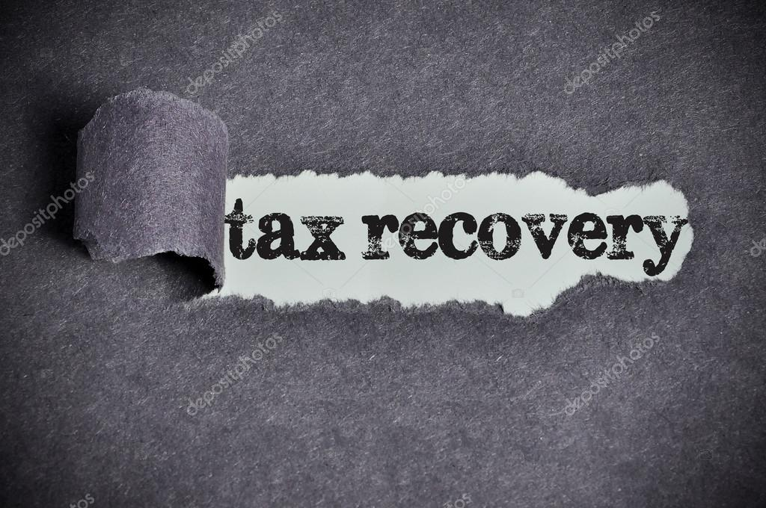

Slide 27
Constitutional Aspects
Article 265:
No Tax shall be levied or collected except by authority of law.
Hukum Chand Shyam Lal Vs. UOI & Others
[(1976) 2 SCC 128 (SC)]
It is well settled that where a power is required to be exercised by certain authority in a certain way, it should be exercised in that manner or not at all, and all other modes of performance are necessarily forbidden. It is all the more necessary to observe this rule where power is of a drastic nature and its exercise in a mode other than the one provided will be violative of the fundamental principles of natural justice.

Slide 28
Statutory Provisions – Recovery
Sec. 79. Recovery of Tax
(1) Where any amount payable by a person to the Government under any of the provisions of this Act or the rules made thereunder is not paid, the proper officer shall proceed to recover the amount by one or more of the following modes, namely:……
When amount becomes payable ?
At the stage of enquiry Or
On passing of adjudication order ?
Notes:
Amount payable – After determination of tax u/s 73/ 74 SCN then order u/s – 73(9) or 74(9)

Slide 29
Statutory Provisions – Determination
Sec. 74 Determination of Tax
(9) The proper officer shall, after considering the representation, if any, made by the person chargeable with tax, determine the amount of tax, interest and penalty due from such person and issue an order.
Sec. 78 Initiation of recovery proceedings.
Any amount payable by a taxable person in pursuance of an order passed under this Act shall be paid by such person within a period of three months from the date of service of such order failing which recovery proceedings shall be initiated:
Notes:
Amount payable – After determination of tax u/s 73/ 74 SCN then order u/s – 73(9) or 74(9)

Slide 30
Collection of Tax (Process)
Enquiry
Adjudication
Recovery
Notes:
Amount payable – After determination of tax u/s 73/ 74 SCN then order u/s – 73(9) or 74(9)

Slide 31
Dabur India Ltd. Vs. State of UP – 1990 (49) ELT 3 (SC)
Government should not use coercive measures like threatening not to renew the licence to do business in order to recover monies due to it. Only legal steps should be taken for such recovery. "We would not like to hear from a litigant in this country that the Government is coercing citizens of this Country to make payment which the litigant is contending not to be leviable......If any money is due to the Government, the Government should take steps but not take extra legal steps or manoeuvre. Therefore, we direct that the right of renewal of the petitioner of licence must be judged and attended to in accordance with law and the occasion not utilised to coerce the petitioners to a course of action not warranted by law and procedure."
Notes:
Procedure of law must be followed:
Dipak Babaria (014) 2 SCC 128
Hukum Chand Shyam Lal - (1976) 2 SCC 128 (SC)
Seth Brothers - (1969) 2 SCC 324 (SC)
Shri Mandir Sita Ramji Vs. Lt. Governor Of Delhi - (1975) 4 SCC 298 (SC)

Slide 32
Century Metal Recycling Vs. UOI – 2009 (234) ELT 234 (P&H)
As far as the amount deposited by the petitioners is concerned, case of the petitioners is that the same was deposited under coercion. Case of the respondents was that the same was deposited voluntarily. Whatever be the position, unless there is assessment and demand, the amount deposited by the petitioners cannot be appropriated. No justification has been shown for retaining the amount deposited, except saying that since it was voluntarily deposited. In view of this admitted position, the petitioners are entitled to be returned the amount paid.
Notes:
SLP (Civil) No. 30354 of 2008] Rejected on 05.01.2019
Unless there is an assessment and demand, the amount deposited by the petitioner, even though termed as voluntary, cannot be appropriated.

Slide 33
Bhumi Associates Vs. Union of India (Guj. HC)
R/SCA/ 3196/2021 Dt. 16.02.2021
Directions to CBIC/ CC CT/ CCST to guidelines by suitable Circular/ Instructions:
No Recovery by any mode during proceeding u/s 67 under any circumstances
Voluntary Payments – Next Day after conclusion of proceedings
Facility of filing complaint/ grievance after the end of search proceedings
Strict disciplinary action against violating officer

Slide 34
Instruction No. 1/2022-23 – Investigation (25.05.2022)
Sub.: Deposit of Tax during the course of Search, Inspection or Investigation:
Some taxpayers after voluntarily depositing alleged use of force and coercion by officers;
Voluntary Payments done by taxpayers only by using login credentials;
Voluntary Payments during are permissible before issue of SCN, it may save taxpayer from higher penalty;
Recovery of taxes can be made only after adjudication order is passed (Sec. 79);
Law doesn’t stop taxpayer to pay tax liability voluntarily ascertained by him or by tax officers.
Notes:
25.05.2022

Slide 35
Nandhi Dhall Mills India Pvt. Ltd. Vs. SIO & Ors (Mad. HC)
WP No. 5192 of 2020, Dt. 07.04.2021
Facts:
Manufacturer of Food Grains/ Dhaal, Registered as well as UR brands
During Investigation tax payer agree to deposit the amount in 8 instalments, two of which has been paid, after that retraction.
Observations:
The basis of this argument is flawed as I am not in agreement with the submission that Section 74(5) is a statutory sanction for advance tax payment, pending final determination in assessment. In my view, this is contrary to the scheme of assessment under Section 74, as I have noticed in paragraphs 12 to 16 above.
The ratio of the decisions relied by the petitioner and several more besides, are to the effect that no collection can be insisted upon prior to a final determination of liability being made. These decisions, in my view, still hold the field.
Merely because an assessee has, under the stress of investigation, signed a statement admitting tax liability and d has also made a few payments as per the statement, cannot lead to self-assessment or self-ascertainment….

Slide 36
Deem Distributor Pvt. Ltd. Vs. UOI (Tel. HC)
WP No. 7063/2021 Dt. 03.08.2021
Facts:
Allegation by deptt: Availment of ITC on the basis of invoices which were issued by fictitious firms who are issuing fake invoices.
During investigation taxpayer paid INR 35 Lacs
Taxpayer was further advised to pay INR 1.17 Cr.
Observations:
In our opinion, sub-Section (5) of Section 74 of the Act gives a choice to the tax payer to make any payment, if he is so chooses, but it does not confer any power on the respondents to make a demand as if there has been a determination of liability of the Assessee and demand tax along with interest and penalty.
Before ascertainment of liability, the 4th respondent could not have issued the letter dt.25.04.2019 to the petitioner asking him immediately reverse the input tax credit of Rs.1,52,35,820/- allegedly availed.
Also no advisory jurisdiction is conferred on the respondents to issue any 'advises' of the nature issued to the petitioner by 3rd respondent on 22.1.2021 asking him to pay Rs.1,17,35,822/-.

Slide 37
Deem Distributor Pvt. Ltd. Vs. UOI (Tel. HC)
In our opinion, no tax demand can be issued or raised when investigation is still in progress. The respondents cannot be allowed to put the cart before the horse and collect any tax, interest or penalty before they determine, in an enquiry, after putting the petitioner/assessee of notice, and we are of the opinion that their action is wholly arbitrary and without jurisdiction.

Slide 38
Bundl Technologies Pvt. Ltd. Vs. UOI
Writ Appeal No. 1274/2021, Karnataka High Court, Order Dated 03.03.2022
31. The submission by the company that Green Finch is neither a non existent entity nor that the company has rightly availed input tax credit is concerned need not be adverted to in this proceeding, as the same is pending investigation. Article 265 of the Constitution mandates that collection of tax has to be by the authority of law. If tax is collected without any authority of law, the same would amount to depriving a person of his property without any authority of law and would infringe his right under Article 300A of the Constitution of India as well. In the instant case, the only provision which permits deposit of an amount during pendency of an investigation is section 74(5) of CGST Act, which is not attracted in the fact situation of the case. Therefore, it is evident that amount has been collected from Company in violation of Article 265 and 300-A of the Constitution. Therefore, the contention of the Department that amount under deposit be made subject to the outcome of the pending investigation cannot be accepted. The Department, therefore, is liable to refund the amount to the Company.”
Notes:
Original Case (SB) – 14.09.2021

Slide 39
Notes:
Collection of cheque at the time of Search – Guj VAT -
Atul Motors Pvt. Ltd. – (2014) 69 VST 289 Gujrat HC

Slide 40
Statutory Provisions – Provisional Attachment
Sec. 83 – Provisional Attachment
(1) Where during the pendency of any proceedings under section 62 or section 63 or section 64 or section 67 or section 73 or section 74, the Commissioner is of the opinion that for the purpose of protecting the interest of the Government revenue, it is necessary so to do, he may, by order in writing attach provisionally any property, including bank account, belonging to the taxable person in such manner as may be prescribed.
Notes:
Amount payable – After determination of tax u/s 73/ 74 SCN then order u/s – 73(9) or 74(9)
62 – Non Filers
63 – URD
64 – Summary Assessment

Slide 41
Remark Flour Mills Pvt. Ltd. Vs. State of Gujrat – Dt. 19.04.2018
… The petitioner's opposition to the points raised by the Department would require a detailed scrutiny and examination of materials not fully before us. In any case, we do not intend to bypass the assessment proceedings. Suffice it to say that at this stage to pass an order of provisional attachment would neither be permissible nor be proper. To reiterate, when the petitioner's classification on the basis of which the tax has so far been collected, cannot be stated to be without any basis nor can it be stated that the petitioner has no prima facie case, and when the assessment proceedings are yet to be completed, resorting to such extreme power of attachment without anything further to suggest that the liability if ultimately finalized, the petitioner will not pay, would simply not be permissible.
Notes:
GST Case:
Issue – Classification of branded/ non branded floor
PDC Collected
Dual SCN
Remark Floor Mills Pvt. Ltd. – Guj. HC – 19.04.2018 – 12 GSTL 481 (Guj. HC)

Slide 42
Radha Krishan Industries (SC) – Dt. 20.04.2021
(iv) The power to order a provisional attachment of the property of the taxable person including a bank account is draconian in nature and the conditions which are prescribed by the statute for a valid exercise of the power must be strictly fulfilled;
(v) The exercise of the power for ordering a provisional attachment must be preceded by the formation of an opinion by the Commissioner that it is necessary so to do for the purpose` of protecting the interest of the government revenue. Before ordering a provisional attachment the Commissioner must form an opinion on the basis of tangible material that the assessee is likely to defeat the demand, if any, and that therefore, it is necessary so to do for the purpose of protecting the interest of the government revenue.
(vi) The expression “necessary so to do for protecting the government revenue” implicates that the interests of the government revenue cannot be protected without ordering a provisional attachment;

Slide 43
Roshni Sana Jaiswal Vs. Comm. of State Tax (Del. HC)
WP(C) No. 2348 of 2020, Dt. 12.05.2021
Facts:
Investigation against ‘Milkfood Ltd.’, petitioner is Director cum Share Holder, Providing Strategic guidance and working as mentor/ advisor.
Allegation – Fake Invoices. Many Bank Accounts attached, along with that of petitioner.
Observations:
Subsection 1 of Section 83 of the Act in no uncertain terms states that provisional attachment can be ordered only qua property, including bank account, belonging to the taxable person. Furthermore, the definition of the “taxable person”, as set out in Section 2(107) of the Act3, provides that only that person can be a taxable person, who is registered or liable to be registered as per the Act. It is not even the case of the respondent that the petitioner is either registered or was liable to be registered, in terms of the provisions of Section 2(107) of the Act. Therefore, according to us, the proceedings must fail on this score alone.

Slide 44
Opinion for Provisional Attachment – Can delegation be there ?
Sec. 83. Provisional attachment to protect revenue in certain cases
(1) Where during the pendency of any proceedings under section 62 or section 63 or section 64 or section 67 or section 73 or section 74, the Commissioner is of the opinion that for the purpose of protecting the interest of the Government revenue, it is necessary so to do, he may, by order in writing attach provisionally any property, including bank account, belonging to the taxable person in such manner as may be prescribed.
(2) Every such provisional attachment shall cease to have effect after the expiry of a period of one year from the date of the order made under sub-section (1).
Sec. 5(3) The Commissioner may, subject to such conditions and limitations as may be specified in this behalf by him, delegate his powers to any other officer who is subordinate to him.
Notes:
83 – Commissioner to be of opinion for

Slide 45
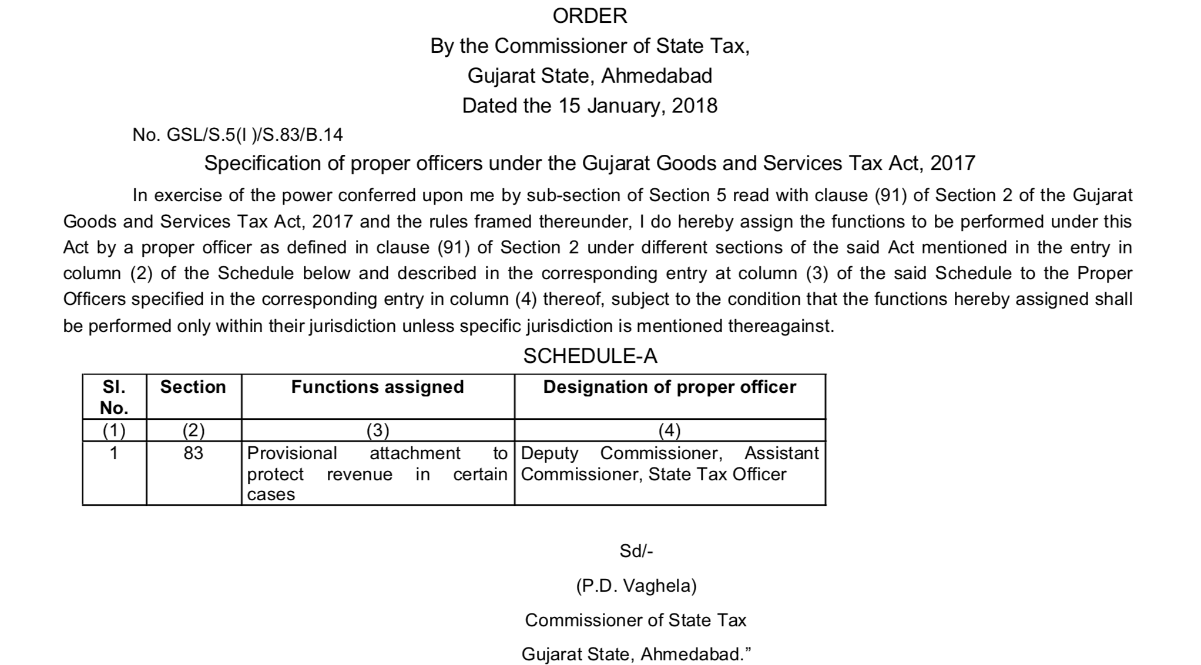
Delegation of powers for Provisional Attachment
Notes:
By Gujrat SGCT Commissioner

Slide 46
Statutory Provisions
Sec. 168(2) of CGST Act
The Commissioner specified in clause (91) of section 2, sub-section (3) of section 5, clause (b) of sub-section (9) of section 25, sub-sections (3) and (4) of section 35, sub-section (1) of section 37, sub-section (2) of section 38, sub-section (6) of section 39, sub-section (5) of section 66, sub-section (1) of section 143, sub-section (1) of section 151, clause (l) of sub-section (3) of section 158 and section 167 shall mean a Commissioner or Joint Secretary posted in the Board and such Commissioner or Joint Secretary shall exercise the powers specified in the said sections with the approval of the Board.
No such corresponding provision in SGST.
Notes:
SGST – no 168(2)

Slide 47
Valerius Industries Vs. UOI – Guj HC – 28.08.2019
Para 30: The comparison of the provisions of the State GST Act and the CGST would indicate that there is a vast difference between the two. Section 168(2) of the CGST Act clarifies that the Commissioner specified in sub-section (3) of Section 5 shall mean a Commissioner or Joint Secretary posted in the Board and such Commissioner or Joint Secretary shall exercise the powers specified in the said section with the approval of the Board. Thus, the distinguishing feature is that so far as the CGST Act is concerned, the power of delegation under Section 5(3) of the Act therein is with the Commissioner in the Board and not the Commissioner of the Central Tax. Whereas, so far as Section 5(3) of the State GST Act is concerned, the Commissioner would be the Commissioner of the State Tax. If the provisions of the CGST Act would have been applicable to the facts of the present case, then there would have been no difficulty at all in quashing the order passed by the Commissioner of the State Tax delegating his power of Section 83 to the subordinate officers on the ground that the same is without jurisdiction. …
Para 35. In the case in hand, Section 83 makes it abundantly clear that it is the Commissioner’s opinion which is relevant. The Legislature has thought fit to confer this power upon the Commissioner. Whether such power conferred upon the Commissioner by the legislature could have been delegated to the three subordinate officers referred to above by virtue of the order dated 15th January, 2018 passed in exercise of power under sub-section (3) of Section 5 read with clause 19 of Section 2 of the Act and the rules framed thereunder. In our opinion, the answer has to be in the negative. Although there is no specific challenge to the order dated 15th January, 2015 passed by the Commissioner of State Tax delegating his power under Section 83 to the subordinate officers, yet, we are of the view that by virtue of such order, such impugned order of provisional attachment cannot be defended.
Notes:
2019 (30) G.S.T.L. 15 (Guj.)
Further – Reason to believe for Sec. 67 are altogether on different footing and not relevant for Sec. 83

Slide 48
Radha Krishan Industries (SC) – Dt. 20.04.2021
FFT: Remedy against provisional attachment ?
Appeal to Appellate Authority ?
Appeal to GST Tribunal ?
Writ under Article 32/ 226 ?
The Joint Commissioner while ordering a provisional attachment under section 83 was acting as a delegate of the Commissioner in pursuance of the delegation effected under Section 5(3) and an appeal against the order of provisional attachment was not available under Section 107 (1);
The writ petition before the High Court under Article 226 of the Constitution challenging the order of provisional attachment was maintainable;
The High Court has erred in dismissing the writ petition on the ground that it was not maintainable;

Slide 49
Can CC/ OD Account be Provisionally Attached ?
Banking Regulation Act, 1949
Manish Scrap Traders Vs Principal Commissioner
(Guj. High Court) - 12.01.2022
The law is well-settled that a cash credit account of the assessee cannot be provisionally attached in exercise of powers under Section 83 of the CGST Act.

Slide 50
Finance Act 2021
106. Amendment in Sec. 83 – Provisional Attachment
Existing
(1) Where during the pendency of any proceedings under section 62 or section 63 or section 64 or section 67 or section 73 or section 74, the Commissioner is of the opinion that for the purpose of protecting the interest of the Government revenue, it is necessary so to do, he may, by order in writing attach provisionally any property, including bank account, belonging to the taxable person in such manner as may be prescribed.
Proposed
(1) Where, after the initiation of any proceeding under Chapter XII, Chapter XIV or Chapter XV, the Commissioner is of the opinion that for the purpose of protecting the interest of the Government revenue it is necessary so to do, he may, by order in writing, attach provisionally, any property, including bank account, belonging to the taxable person or any person specified in sub-section (1A) of section 122, in such manner as may be prescribed.”.
Memorandum: Section 83 of the CGST Act is being amended so as to provide that provisional attachment shall remain valid for the entire period starting from the initiation of any proceeding under Chapter XII, Chapter XIV or Chapter XV till the expiry of a period of one year from the date of order made thereunder.
Notes:
Extra Coverage –
61: Scrutiny
68: Goods in Movement
69: Arrest
70: Summon

Slide 51
GST World ® One Nation One Tax One Market
Jatin Harjai FCA
Advocate
+91 97994 94482
jatin.harjai@icloud.com
@Jatin_Harjai

