Slide 1


Full day Conference on Bank Branch Audit
“Smart Planning, Agricultural Advances, Natural Calamities and LFAR”
Rajkot Branch of CIRC of ICAI
Sunday, 26th March 2023

Slide 2


AGENDA
1. Introduction
2. Smart Planning
3. Agricultural Advances
4. Restructuring Natural Calamities
5. Interest Subvention
6. LFAR

Slide 3
DISCLAIMER
The views expressed in this presentation are my personal views and should not be construed to be the views of either the ICAI or my firm Agarwal & Saxena, Chartered Accountants.
These views do not and shall not be considered as a professional advice.
No part of this presentation maybe reproduced or copied in any form or by any means without my written permission.

Slide 4

Introduction

Slide 5
SCB’s GNPA Ratio

Slide 6
Provision Coverage Ratio

Slide 7
Growth in SMA’s and NPA’s

Slide 8
Analysis of Frauds
Amount in crores

Slide 9



What made news during 2023??
RBI Master Circular on IRAC of 01st April 2022 : RBI consolidated various circulars issued post RBI MC of 01st July 2015/ 01st October 2021 upto 31st March 2022.
RBI focus on NPA automation, Inter office accounts review, Whistle Blower mechanism and IFC.
RBIs continued expectations with respect to EWS (Early Warning System) and fraud management system.
Demonetisation of SBNs on
08th November 2016

Slide 10


What made news during 2023??
IT Skill gap of Auditors wrt Digital platform loans, AI empowered algorithms, Block Chain technology in LC, BG, CBDC (Central Bank Digital Currency) and New Age Auditing trends (Forensic, Agile Auditing etc)
Audit of Auditors by the regulator, Press, Government and Public - an ongoing process.
Min coverage of 70% FB and NFB credit exposure for FY 2022-23. Effective FY 2023-24 banks given discretion to decide business coverage for SBA as per their BD policy. Not more than 2 branches to be allotted to each SBA. RBI letter of 06th March 2023.
Demonetisation of SBNs on
08th November 2016

Slide 11

Smart Planning

Slide 12
Smart Planning : Branch Audit – Take a Macro Look!
Balance Sheet
Advances
Profit & Loss
LFAR
Other Statements
Tax Audit
Certificates
12

Slide 13
Smart Planning : Branch Audit – A Walk Through!
01
Appointment letter received
02
Confirm disqualifications – if any
03
Indebtedness, Independence, Fidelity & Secrecy (Partners & Team) – SQC 1
04
Post NOC from Previous Auditors - Dispatch EL SA-210 (Draft)
05
Back office preparation – Document Meeting – SA 300
13

Slide 14
Smart Planning : Branch Audit – A Walk Through!
06
Send enquiry letter to Branch (Draft)
Send enquiry letter to Branch (Draft)
07
Team constitution as per Branch Size
Team constitution as per Branch Size
08
Member A: Advances (IRAC + LFAR)
Member A: Advances (IRAC + LFAR)
09
Member B: Balance Sheet, P/L and other statements
Member B: Balance Sheet, P/L and other statements
10
Member C: Tax Audit & Misc.
Member C: Tax Audit & Misc.
14

Slide 15
Smart Planning : Branch Audit – A Walk Through!
11
Obtain SA-580 MRL (Draft)
12
Sign specified Statements & Certificates only as per appointment letter with UDIN
13
Issue Audit Report – SA 700, 701, 705, 706 etc (Revised)
15

Slide 16
Smart Planning : Agenda for Pre – Audit Meeting – Read and discuss thoroughly!
    Branch Appointment letter – Terms etc.
    Statements, Certificates etc – Which and how many to be s/d?
    Banks Closing Instructions
RBI Master Directions, Circulars, Press Releases
Identify Staff with necessary skill sets
16

Slide 17
Smart Planning : Consequential Risks in Bank Branch Audits?
  Risk of incorrect attestation/ reporting
Risk of non-compliance - RBI Master Directions, Circulars, etc and Banks/ SCAs Closing instructions etc
    This is second level bullet dummy text
Risk of RBI RBS/AFI divergence/ ICAI DC
Non identification of Control Risk weakness – Operational & Credit
17

Slide 18
Smart Planning : Ensure your Audit Procedures comply with…
SQC -1
Ensure Compliance
Important SAs
GN on Bank Audit 2023
AS/ Technical Standards
Quality Review and Peer Review requirements
RBI regulations
18

Slide 19
Smart Planning : Compliance with Standards on Auditing
SA 230
Documentation
SA 240
Auditor’s responsibilities relating to Fraud in an audit of FS
SA 320
Materiality in planning and performing an audit
SA 520
Analytical Procedures

Slide 20
Smart Planning : Compliance with Standards on Auditing`
SA 500
Audit Evidence
SA 505
External Confirmation
SA 530
Audit Sampling
SA 260
Communication with those charged with governance

Slide 21
Smart Planning : Compliance with Standards on Auditing
SA 580
Written Representation
SA 610
Using the work of Internal Auditors
SA 210
Agreeing the Terms of Audit Engagements

Slide 22
Smart Planning : Compliance with Standards on Auditing
SA 700
Forming an opinion and reporting on Financial Statements
SA 701
Communicating Key Audit Matters in the Independent Auditor’s Report
SA 706
Emphasis of matter paragraphs and other matter paragraphs in the Independent Auditor’s Report
SA 705
Modifications to the Opinion in the Independent Auditor’s Report

Slide 23

Smart Planning : SA 230 : Two Important Documents!
STATEMENT OF ACCOUNTS of all the Borrowers accounts DOWNGRADED vide MOC by the Audit team – document detailed reasons for classifying as NPA with regulatory reference. (DOCUMENT 1)
STATEMENT OF ACCOUNTS of all potential NPAs which were NOT CLASSIFIED as NPA – document reasons of not issuing MOC with regulatory reference. (DOCUMENT 2)
Two important documents to be obtained other than documents to ensure SAE
23

Slide 24
Smart Planning : Pre-Sign Off Checklist
Relevant for the Signing Partner
To Ensure
All risks/ departments have been covered during the course of audit by the team members.
24

Slide 25
Smart Planning : Pre Sign Off Checklist to include check for RFA
(Red Flagged Accounts)
Obtain list of RFA Accounts from the branch (Exposure >= Rs 50 crore) For exposure < Rs 50 crore bank specific
Where RED FLAG has not been removed within 6 months, whether the same has been reported as a SUSPECTED FRAUD or FRAUD
Obtain list of all accounts flagged as RFA by other banks but have not been flagged as RFA by the Bank
In 100% of such advances, review them akin to a forensic audit to identify possible frauds / NPA

Slide 26
Smart Planning : Pre-Sign Off Checklist to include check for EWS
(Early Warning Signals)
Whether Advances have been reviewed and mapped with the Early Warning Signals (EWS) as listed in Annexure II of the Master Direction on Frauds
Tabulate and report in the LFAR unless the EWS are material and the account needs to be reported as FRAUD BY AUDITORS
Also refer to “Early Signals of Fraud in Banking Sector” issued by ICAI
26

Slide 27
LFAR
Para I> Assets 5. Advances e) Review/ Monitoring/ Supervision
(e)(viii) Whether the branch has any red-flagged account (Total exposure of Rs 50 crore and above) ? If yes, whether any deviations were observed related to compliance of bank’s policy related with Red Flagged Accounts?
Additional Audit Procedures :
List of RFA Accounts from the branch
Whether RED FLAG removed within 6 months? If not, whether reported as a SUSPECTED FRAUD or FRAUD – and consequently provided for
Obtain the list of all accounts flagged as RFA by other banks but not flagged as RFA by the Bank – Verify CRILC Reports
100% of such cases - ensure that the accounts are reviewed in line of a forensic audit to identify possible frauds / NPA and provided for

Slide 28
LFAR PARA III. GENERAL 4. FRAUDS
NEW PARAs :
Furnish particulars of :
(i) Frauds detected/ classified but confirmation of reporting to RBI not available on record at branch
(ii) Whether any suspected or likely fraud cases are reported by branch to higher office during the year? If yes, provide the details thereof related to status of investigation
(iv) Whether the system of Early Warning Framework is working effectively and, as required the early warning signals from the basis for classifying an account as RFA

Slide 29
LFAR PARA III. GENERAL 4. FRAUDS
NEW PARAs Continued… :
(iii) In respect of fraud, based on your overall observation, comments on the potential risk areas which might lead to perpetuation of fraud. Examples:
falsification of accounts
false representation by the borrower
misappropriation of funds especially through related party/ shell company transactions;
forgery and fabrication of financial documents like invoices, debtor lists, stock statements, trade credit documents, shipping bills, work orders and encumbrance certificates and avail credit;

Slide 30
LFAR PARA III. GENERAL 4. FRAUDS
Use of current accounts outside consortium where Trust and Retention Account (TRA) is maintained, to divert funds;
List of Debtors/ Creditors which were being fabricated and receivables were not followed up/ write off of debt of related parties;
Fake export/ shipping bill, etc,;
Over statements of invoice amounts, stock statements, shipping bills, turnover;
fly by night operations – including the cases where vendors, related/ associate parties, manufacturing units etc. aren’t available on the registered addresses; Round Tripping of funds, etc.

Slide 31
Smart Planning : Pre-Sign Off Checklist to include check for CFR
(Central Fraud Registry)
Has the branch used CFR for Credit appraisal in respect of granting new facilities or renewal of facilities?
For selected borrowers with limits of Rs 100 lacs and above, take screen shots/ proof by visiting the CFR portal and documenting the same

Slide 32
Smart Planning : Pre-Sign Off Checklist to include check for CERSAI
Map all NPAs where Collaterals have been taken as Security with the CERSAI portal to ensure existence of the same as on date of audit
Take print outs of the same as proof and document the same
CERSAI is applicable to both moveable and immoveable properties

Slide 33
LFAR Para I. Assets 5. Advances e) Review/ Monitoring/ Supervision
(e)(vi) Whether there is a substantial deterioration in value of security during financial year as per latest valuation report in comparison with earlier valuation report on record? (50% or more???)
Additional Audit Procedure : Map all NPAs where Collaterals have been taken as Security with the CERSAI portal to ensure existence of the same as on date of audit

Slide 34
Smart Planning : Pre-Sign Off Checklist to include check for LEI
(Legal Entity Identifier)
Ensure that all borrowers with
limits of Rs 100 crore and above have been registered as a LEI (Legal Entity Identifier) in terms of the RBI guidelines as at 31.03.2023
If not, list all such entities for LFAR reporting and also in case the same has expired and is pending renewal as at 31.03.2023

Slide 35
Smart Planning : Pre-Sign Off Checklist to include check for Exception Reports
Review Exception reports as at the year end and a few days prior to that t0o
Rule out any irregularity which requires adjustment in the financial statements by way of an MOC
35

Slide 36
LFAR Para III. GENERAL 2. BOOKS & RECORDS
(a) Whether there are any software/ systems (manual or otherwise) used at branch which are not integrated with the CBS? If yes, give details
(b)(i) In case the branch has been subjected to IS Audit whether there are any adverse features reported and have a direct bearing on the branch accounts and are pending compliance ? If yes, give details
(b)(ii) Whether branch is generating, and verifying exception reports at the periodicity as prescribed by the bank

Slide 37
LFAr Para III. GENERAL 2. BOOKS & RECORDS
(b)(iii) Whether the system warrants expeditious compliance of daily exception reports and whether there are any major observations pending such compliance at the year end.
(b)(iv) Whether procedures have been laid out for manual intervention to system generated data and proper authentication of the related transactions arising there from along with proper audit trail of manual intervention has been obtained
(b)(v) Furnish Your comments on data integrity (including data entry, checking correctness/ integrity of data, no back ended strategies etc.) which is used for MIS at HO/ CO level.

Slide 38
Smart Planning : Pre-Sign Off Checklist to include check for CRILC Reports
Review selected stressed accounts and seek the CRILC report as on date
for possible SMA-0, SMA-01, and, SMA-02 classification for further review and
possible MOC/ NPA classification.
38

Slide 39
LFAR Para I.Assets 5. Advances f) Asset Classification,
Provisioning of Advances and Resolution of Stressed Assets
(f)(i)(a) Has the branch identified and classified advances into standard/ substandard/doubtful/loss assets through the computer system, without manual intervention?
(f)(i)(c) Whether the branch is following the system of classifying the account into SMA-0, SMA-1, and SMA-2. Whether the auditor disagrees with the branch classification of advances into standard (Including SMA-0, SMA-1, SMA-2) / substandard / doubtful/loss assets, the details of such advances, with reasons should be given

Slide 40
Smart Planning Tips : Seek and obtain data!
Trial Balances – 2 FY’s
JOTRPT- Advances/ Deposits
LAOPI (Overdue TL)
CC_OD balance file
Loans balance file – TL
40

Slide 41
Smart Planning Tips : Seek data from branch!
Enquiry letter as per draft
Email ids for External Confirmation
General Ledger Balances (GLB) for current and previous year – Data
41

Slide 42
Smart Planning : Things you need to carry to the branch….
Branch Audit Programme
Bank’s Closing Circular/ instructions
RBI Master circular / Master Directions/ PR/ FAQ/ etc
CBS Codes & Utility reports
RBI Circulars issued during the year/ ICAI GN on Bank Audit
Other Audit Aids (Letter heads/ Stamps/Digital Signatures etc.
Previous year audit file (in case of same bank)
42
Notes:
Refer to the 2001 CISA Review Technical Information Manual pages 20-51 for specifics and details.
The SHORTCUT APPROACH avoids all back office preparations to land up in the wrong end.
Back office efforts are the main essence of any assignment – be it bank audit or any other assignment.
Listed aids are THE most important aids in a BANK AUDIT- these need to be read thoroughly by all the TEAM MEMBERS.- “PRE” AUDIT
Check lists and the audit programme need to be EVOLVED to suit your AUDIT STYLE.
Selection of the staff members and their training is equally important

Slide 43
Smart Planning : Read and understand all relevant RBI Regulations!!
RBI issued a number of Master Circulars during the year after a long gap during which period Master Directions were being issued.
Earlier after 2016, RBI had started issuing Master Directions on subjects to consolidate various circulars etc, thereon and no Master Circulars were issued during this period.
Members to refer to www.rbi.org.on for:
RBI Master Circulars
RBI Master Direction
Circulars
Press Releases
FAQs
wherever they wish to seek further clarifications on any matter/subject.
43

Slide 44
Smart Planning : Mother of Bank Branch Audit – MC on IRAC Norms
The contents of RBI Master circular on Prudential norms on IRAC pertaining to Advances (DOR.STR.REC.4/21.04.048/2022-23 dated April 01, 2022) would be applicable for branch audits for the year ending 31st March 2023.
RBI issued a Master Circular on IRAC norms on 01.10.2021 after 01.07.2015.
MC on IRAC revised on 01.04.2022
44

Slide 45
Smart Planning : Important Circulars issued during the FY 2022-23
RBI website (www.rbi.org.in)
Master Circular on SHG-Bank Linkage Programme (RBI/2022-23/2 FIDD.CO.FID.BC.No.1/12.1.033/2022-23) | April 01 , 2022
Master Circular – Housing Finance (RBI/2022-23/16 DOR.CRE.REC.No.6/8.12.001/2022-23 | April 01, 2022
Master Circular - Bank Finance to Non-Banking Financial Companies (NBFCs) | April 01, 2022
Master Circular – Basel III Capital Regulations | April 01, 2022
Consolidated Circular on Opening of Current Accounts and CC/OD Accounts by Banks (RBI/2022-23/27 DOR.CRE.REC.23/21.8.008/2022-23) | April 19, 2022
45
Notes:
A reading of the other relevant circulars issued by RBI would not only help us in getting updated about the changes but would help us in understanding each subject- like Capital Adequacy is an important subject which we as auditors certify.
Understanding the importance of such subjects would help us completing the assignment more qualitatively.

Slide 46
Smart Planning : Important Master Directions for reference
RBI website (www.rbi.org.in)
Master Direction – Know Your Customer (KYC) Direction | February 25, 2016 (Updated as of May 10, 2021)
Master Directions on Frauds – Classification and Reporting by commercial banks and select FIs | July 1, 2016 (Updated July 03, 2017)
Master Direction – Regional Rural Banks - Priority Sector Lending – Targets and classification | September 04, 2020 (Updated as of October 20, 2022)
Master Direction – Reserve Bank of India (Relief Measures by Banks in areas affected by natural calamities) | October 17, 2018
Master Direction on Lending to MSME Sector | July 24, 2017 (Updated as on July 29, 2022)
46
Notes:
A reading of the other relevant circulars issued by RBI would not only help us in getting updated about the changes but would help us in understanding each subject- like Capital Adequacy is an important subject which we as auditors certify.
Understanding the importance of such subjects would help us completing the assignment more qualitatively.

Slide 47
Smart Planning : Important Master Directions for reference
RBI website (www.rbi.org.in)
Master Direction – Reserve Bank (Interest rates on Advances) 2016 | March 03, 2016 (Updated as on June 10, 2021)
Master Direction on RBI (Interest rate on Deposits) Directions, 2016 | March 03, 2016 (Updated as on September 16, 2022)
Master Direction on Lending to MSME Sector | July 24, 2017 (Updated as on July 29, 2022)
Master Direction on Financial Statements - Presentation and Disclosures | August 30, 2021 (Updated as on February 20, 2023)
47
Notes:
A reading of the other relevant circulars issued by RBI would not only help us in getting updated about the changes but would help us in understanding each subject- like Capital Adequacy is an important subject which we as auditors certify.
Understanding the importance of such subjects would help us completing the assignment more qualitatively.

Slide 48
Smart Planning : Important FAQs
RBI website (www.rbi.org.in)
FAQs on MSME | Updated as on October 1, 2021
FAQs on Priority Sector Lending – Targets and Classification | Updated as on November 09, 2021
FAQs on UDIN available on udin.icai.org
Index on Circulars available on RBI website and Guidance Note on Bank Audit 2023 – download and tabulate for reference and record
48
Notes:
A reading of the other relevant circulars issued by RBI would not only help us in getting updated about the changes but would help us in understanding each subject- like Capital Adequacy is an important subject which we as auditors certify.
Understanding the importance of such subjects would help us completing the assignment more qualitatively.

Slide 49

Agricultural Advances

Slide 50
Smart Execution : Agricultural Advances – Clear all confusions!
Rabi Crops/ Rabi Season
Cropping period
Short duration Crops
Indirect Agricultural activities
Multi Cropping farmers/ loans
Kharif Crop/ Kharif Season
Harvesting period
End date of Rabi/ Kharif season
Mono Cropping Farmers/ Loans
Long duration Crops
Due date of repayment
Allied activities
50

Slide 51
Agricultural Advances – Short and Long Duration Crops
(Crop Season < 1 year)
SHORT DURATION CROPS
NPA when Overdue for Two Crop Seasons
Agricultural Advances
Crop Season > 1 year
(State level Bankers Committee to decide crop season of each crop)
LONG
DURATION CROPS
NPA when Overdue for One Crop Season
51

Slide 52
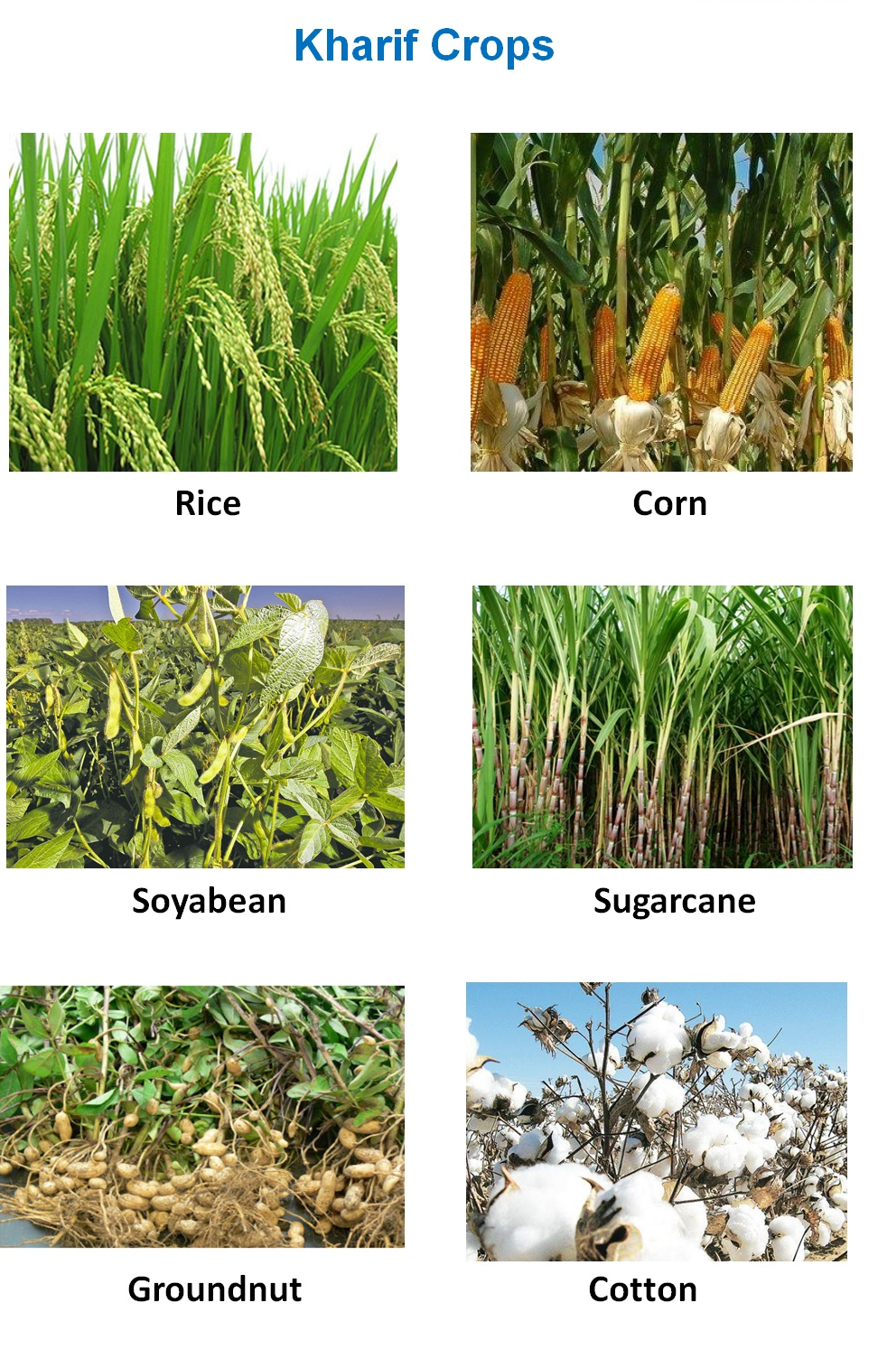
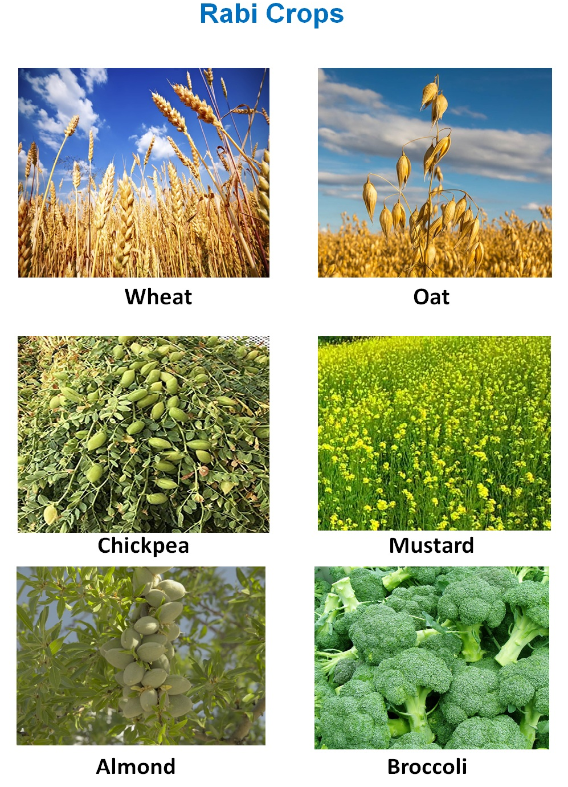
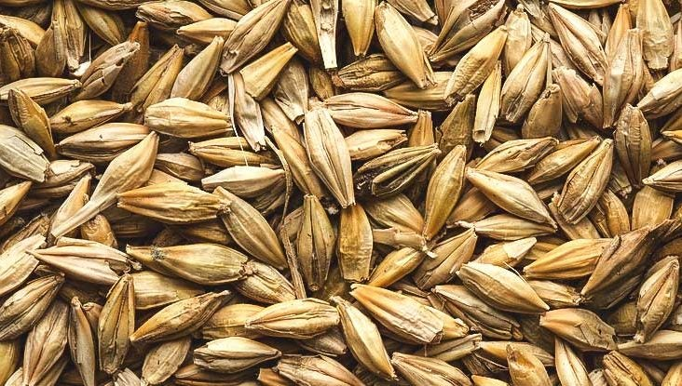

Agricultural Advances – Rabi & Kharif Crops
Barley
Pea

Slide 53
Agricultural Advances – Rabi Season Crops – Things to remember
Cropping period : October to December
RABI SEASON
Harvesting period : April to June
Agricultural Advances
Rabi Season ends : 30th June
(State level Bankers Committee to decide crop season of each crop)
Due date for repayment : 1 Year from the date of first drawl
Rabi Crops : Wheat, Barley, Peas, Gram
53

Slide 54
Agricultural Advances – Kharif Season Crops – Things to remember
Cropping period : June to September
KHARIF SEASON
Harvesting period : October to December
Agricultural Advances
Kharif Season ends : 31st December
(State level Bankers Committee to decide crop season of each crop)
Due date for repayment : 1 Year from the date of first drawl
Rabi Crops : Paddy, Maize, Moong, Arhar
54

Slide 55
Agricultural Advances – Zaid Crops – Things to remember
Cropping to Harvesting period : March to June
SUMMER SEASON
(Between Rabi and Kharif Crops)
Banks do not sanction loans for these Crops / summer Season
Agricultural Advances
Farmers use this period to increase productivity
(State level Bankers Committee to decide crop season of each crop)
Zaid Crops : Cucumber, Water melon, Muskmelon
55

Slide 56


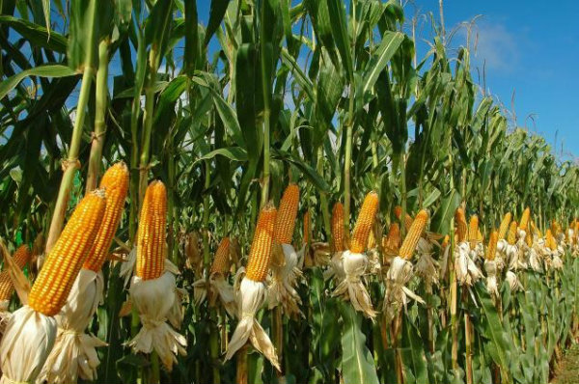

Kharif Season – Ends 31st December
COTTON
MILLET
PADDY
MAIZE

Slide 57
Agricultural Advances – Mono Cropping farmers/ Mono Crop loans
Mono Cropping farmers / Mono Crop loans
Farmer grows only in ONE SEASON i.e. Kharif or Rabi Season
Due date for repayment : One year from date of first drawl depending on type of Crop
Agricultural Advances
IRAC norms : Two Crop seasons would mean TWO RABI SEASONS or TWO KHARIF SEASONS
57

Slide 58
Agricultural Advances – Multi Cropping farmers/ Multi Crop loans
Multi Cropping farmers / Multi Crop loans
Farmer grows in BOTH SEASONS i.e. Kharif and Rabi Season
Due date for repayment : One year from date of first drawl depending on type of Crop
Agricultural Advances
IRAC norms : Two Crop seasons would mean RABI & KHARIF SEASONS or KHARIF & RABI SEASONS
58

Slide 59
Agricultural Advances – A Summary
Particulars | Rabi Season | Kharif Season | Summer Season (Zaid)
Cropping period | October to December | June/ July to August/ September (onset of monsoon) | March to June
Harvesting period | April to June | September/ October to October to December | Summer months
Water Source | Rains/ Irrigation | Monsoon rains/ Irrigation | Irrigation
59

Slide 60
Agricultural Advances – A Summary
Particulars | Rabi Season | Kharif Season | Summer Season (Zaid)
Crops | Wheat, Barley, Pea, Gram, Mustard | Paddy, Maize, Jowar, Bajra, Arhar, Moong, Urad, Cotton, Jute, Groundnut, Soyabean | Watermelon, Muskmelon, Cucumber, Vegetables, fodder crops
Places | Punjab, Haryana, Himachal Pradesh, J&K, Uttarakhand, Uttar Pradesh | Assam, West Bengal, Coastal regions of Odisha, Andhra Pradesh, Telangana, Tamil Nadu, Kerala, Maharashtra (konkan coast), Punjab, Haryana, Uttar Pradesh, Bihar | Punjab, Haryana, Tamil Nadu, Haryana and Uttar Pradesh
60

Slide 61
Direct and Indirect/ Allied Agricultural Advances
Annexure “2” to the extant “RBI MC” lists out instances of “Direct Agriculture Advances” where NPA norms relating to Agriculture advances are applicable
Such relaxed NPA norms do not however apply to any other Agricultural Advances (other than those specified in Annexure 2) whether styled as “Allied” or “Indirect” Agricultural Advances
61

Slide 62
90 days NPA norms to Agricultural activities??
When will 90 days norms apply?
Loans for activities other than those listed in Annexure “2” to RBI MC 01.04.2022
Allied Agricultural activites : Dairy, animal husbandry, poultry, bee keeping, sericulture (upto cocoon stage)
Agricultural Advances
Indirect Agricultural loans and Terms loans : Advances to NON AGRICULTURISTS
Loans to Fisheries
62

Slide 63
Rural Housing Advances
Rural Housing Advances granted to “Agriculturists” under the following schemes, banks have been advised to ensure that the repayment of interest and instalments are linked to the “crop” cycles:
Golden Jubilee Rural Housing Finance Scheme
Indira Awas Yojana/ Pradhan Mantri Gram Awas Yojana
63
Notes:
Where there is potential threats of recovery due to erosion in the value of the security or non availability of security and existence of other factors, frauds committed by borrowers etc. the account should be straight away classified as doubtful asset or loss asset as appropriate, irrespective of the period for which it has remained as NPA.
When an account becomes NPA and the realizable value of security is less than 50% of the value assessed by the Branch or accepted by RBI at the time of last RBI inspection, as the case may be, the account should be classified straight away as Doubtful Debts.
RBI has clarified that such a situation is called erosion in the value of security.

Slide 64
Agricultural Advances
Loans given to “Non-Agriculturists” - normal 90 days delinquency norms will apply
Purpose of loan to be “verified” from loan documents/ circular
In case of natural calamities refer to guidelines RBI Circular (Para 4.2.13 (ii) of Master Circular)
64

Slide 65
NPA Classification – Short Duration Crops
Mono Cropping/ Single Cropping farmer loans
Particulars | Rabi Season | Kharif Season
Year of sanction | 2019-20 | 2019-20
Date of first drawal of the loan | 01.10.2019 | 01.06.2019
Due Date of repayment (1 year from drawal date) | 30.09.2020 | 31.05.2019
Crop Season | Rabi 2019-20 | Kharif 2019-20
Season – Cropping to Harvest | Oct 19 to June 20 | June 19 to Dec 20
Season Ends | 30th June 20 | 31st Dec 20
Add : 1st Crop Season | Rabi 2020-21 | Kharif 2020-21
Add : 2nd Crop Season | Rabi 2021-22 | Kharif 2021-22
NPA date | 30.06.2022 | 31.12.2022
Reason of NPA date – Day end process rule | Since 2nd crop season ends on 30.06.22 | Since 2nd crop season ends on 31.12.22
65
Notes:
Banks have a tendency to not accrue normal expenses – because of their accounting policies of 12 months expenditure.
A reading of the accounting policy of the bank should constitute one of the first steps in bank audits. As per AS-1 the major accounting policies should form part of the final accounts- some banks have started printing the same behind the BS/PL of the branch returns.
Apart from framing this years MOC’s the auditor would also need to ensure that the previous years MOC’s have been accounted for.
CROSS SELLING- is a new business which signifies the competition banks are facing- accounting of such commission needs to be as per the Accounting policy of the bank- refer the closing circular of the bank.

Slide 66
NPA Classification – Short Duration Crops
Multi Cropping/ Double Cropping farmer loans
Particulars | Rabi Season | Kharif Season
Year of sanction | 2020-21 | 2020-21
Date of first drawal of the loan | 01.10.2020 | 01.07.2020
Due Date of repayment (1 year from drawal date) | 30.09.2021 | 30.06.2021
Crop Season | Rabi 2020-21 | Kharif 2020-21
Season – Cropping to Harvest | Oct 20 to June 21 | June 20 to Dec 20
Season Ends | 30th June 2021 | 31st Dec 2020
Add : 1st Crop Season | Rabi 2021-22 (Oct 21 to June 22) | Kharif 2021-22 (June to Dec 21)
Add : 2nd Crop Season | Kharif 2022 (June to Dec 22) | Rabi 2021-22 (Oct 21 to June 22)
NPA date | 31.12.2022 | 30.06.2022
Reason of NPA date – Day end process rule | Since 2nd crop season is Kharif which ends on 31.12.22 | Since 2nd crop season ends on 30.06.22
66
Notes:
Banks have a tendency to not accrue normal expenses – because of their accounting policies of 12 months expenditure.
A reading of the accounting policy of the bank should constitute one of the first steps in bank audits. As per AS-1 the major accounting policies should form part of the final accounts- some banks have started printing the same behind the BS/PL of the branch returns.
Apart from framing this years MOC’s the auditor would also need to ensure that the previous years MOC’s have been accounted for.
CROSS SELLING- is a new business which signifies the competition banks are facing- accounting of such commission needs to be as per the Accounting policy of the bank- refer the closing circular of the bank.

Slide 67
NPA Classification – Long Duration Crops
Particulars | Rabi/ Summer Season (Sugarcane)
Year of sanction of loan | 2019-20
Cropping Season | January to December or January to June (Crop maturity period of 12 or 18 months)
Date of loan disbursement | 01.01.2020
Due date of repayment (12 months or 18 months from date of drawal) | 31.12.2020 or 30.06.2021
Add: One long duration crop season ending on | 31.12.2021 or 30.06.2022
Date of NPA – Day end process rule | 31.12.2021 or 30.06.2022
67
Notes:
Banks have a tendency to not accrue normal expenses – because of their accounting policies of 12 months expenditure.
A reading of the accounting policy of the bank should constitute one of the first steps in bank audits. As per AS-1 the major accounting policies should form part of the final accounts- some banks have started printing the same behind the BS/PL of the branch returns.
Apart from framing this years MOC’s the auditor would also need to ensure that the previous years MOC’s have been accounted for.
CROSS SELLING- is a new business which signifies the competition banks are facing- accounting of such commission needs to be as per the Accounting policy of the bank- refer the closing circular of the bank.

Slide 68
Agricultural activities eligible for relaxed NPA norms
Auditors to check “cropping season” of specific “crops” in their State with the SLBC decision
68
Notes:
Banks have a tendency to not accrue normal expenses – because of their accounting policies of 12 months expenditure.
A reading of the accounting policy of the bank should constitute one of the first steps in bank audits. As per AS-1 the major accounting policies should form part of the final accounts- some banks have started printing the same behind the BS/PL of the branch returns.
Apart from framing this years MOC’s the auditor would also need to ensure that the previous years MOC’s have been accounted for.
CROSS SELLING- is a new business which signifies the competition banks are facing- accounting of such commission needs to be as per the Accounting policy of the bank- refer the closing circular of the bank.

Slide 69
90 days NPA norms – Priority Sector
Loans eligible for “Priority Sector” – as per Master Direction of 07.07.2016 but not in Annexure “2”
All Priority Sector loans are NOT NECESSARILY ELIGIBLE FOR RELAXED NPA NORMS
69

Slide 70
Smart Execution : Agricultural Advances
Identify all accounts where the balance outstanding is either double or more than the sanctioned limit from the data or loan balance outstanding file as at the year end to identify Potential NPAs.
Review can also be extended to those accounts where the said balance is more than 50% of the sanctioned limit
70
Notes:
Banks have a tendency to not accrue normal expenses – because of their accounting policies of 12 months expenditure.
A reading of the accounting policy of the bank should constitute one of the first steps in bank audits. As per AS-1 the major accounting policies should form part of the final accounts- some banks have started printing the same behind the BS/PL of the branch returns.
Apart from framing this years MOC’s the auditor would also need to ensure that the previous years MOC’s have been accounted for.
CROSS SELLING- is a new business which signifies the competition banks are facing- accounting of such commission needs to be as per the Accounting policy of the bank- refer the closing circular of the bank.

Slide 71
Frequently Asked Questions – Case Study
ANSWER
NO
Order of government officials are only administrative in nature and cannot override provisions of the extant RBI circulars on IRAC and provisioning norms
Can be retained as “Standard” only on being restructured UNDER NATURAL CALAMITY.
ISSUE
ISSUE
Whether the order of the District Magistrate or other government official(s) in respect of non recovery of Agricultural loans from the farmers would impact the classification of such accounts as NPA?
Whether the order of the District Magistrate or other government official(s) in respect of non recovery of Agricultural loans from the farmers would impact the classification of such accounts as NPA?
71

Slide 72
Frequently Asked Questions – Case Study
ANSWER
YES. Agricultural loans would be downgraded on being restructured unless the repayment period/ due dates have been extended on account of NATURAL CALAMITIES as a relief measure. All other cases of restructuring would involve downgrading the asset classification.
ISSUE
ISSUE
Whether Agricultural loans need to be downgraded on being restructured?
Whether the order of the District Magistrate or other government official(s) in respect of non recovery of Agricultural loans from the farmers would impact the classification of such accounts as NPA?
72

Slide 73
Frequently Asked Questions – Case Study
The auditor observes that an Agricultural Term loan for the construction of a godown was overdue since the past 2.5 years on account of non payment of 5 half yearly instalments. Branch justifies the Standard asset classification based on the relaxed delinquency norms applicable to Agriculture loans. Advise
NPA since construction of a godown is not included in the list of activities eligible for crop season linked asset classification norms as per Annexure 2 to the MC of 01.04.2022.
73

Slide 74
Frequently Asked Questions – Case Study
Certain KCC accounts in a branch were not renewed within 180 days. The branch however clarifies that the applicable period is 36 months in respect of KCC accounts (12 months plus 2 crop seasons). Advise the auditor
Although no specific clarification available, the Branch opinion is justified. RBI MC on KCC dated July 3, 2017 clarifies that sanction of KCC limits is automatic and is linked to the crop season. KCC limits are also part of Annex 2 of the RBI MC April 1, 2022 and linked to crop season linked asset classification norms.
74

Slide 75
Restructuring – Natural Calamities

Slide 76
Restructuring : Natural Calamities
Master Direction on the relief measures by banks in areas affected by natural calamities (FIDD.Co.FSD.BC.8/05.10.001//2017-18 dated July 3, 2017.
Natural Calamities – What does it encompass?
National Disaster Management Framework recognises 12 types of natural calamities viz.
Cyclone | Drought
Earthquake | Fire
Flood | Tsunami
Hailstorm | Landslide
Avalanche | Cloud burst
Pest Attack | Cold Wave/ Frost

Slide 77
Restructuring : Natural Calamities
For 4 calamities i.e. drought, hailstorms, pest attack and cold wave/ frost, the Ministry of Agriculture is the nodal ministry.
Remaining 8 calamities Ministry of Home Affairs is required to make appropriate arrangements.
To ensure that the borrower has been affected by natural calamities, auditors should confirm the same with the lists of affected villages as may have been issued by the local administration/District Collector/ Government authorities.

Slide 78
Natural Calamities : Loan Covered
Agricultural loans consisting of production credit (Crop Loans) and Long term (investment) Credit
Medium Enterprises - depending on severity of loan if decided by SLBC/ DCC
Other Loans – allied activities, rural artisans, traders, micro/ small industrial units
78

Slide 79
Restructuring – Agricultural Loans (Natural Calamities)
Conversion into Term Loan of Short - Term Loan
Conversion into Term Loan of Long - Term Agriculture Loans
In case of natural calamities where only crop for that year is damaged and productive assets are not damaged – postpone instalment/ interest by ONE YEAR
In case of natural calamities where productive assets are partially or totally damaged and the borrower is in need of a new loan. – MAX 5 YEARS
79

Slide 80
Restructuring – Other Loans (Natural Calamities)
01
Loans granted for allied activities
02
Loans given to rural artisans, traders, micro/small industrial units;
03
In case of extreme situations, loans granted to medium enterprises. (As per decision of SLBC/ DCC)
80

Slide 81
Restructuring : Natural Calamities
Additional Collateral Security
Banks not to insist on additional collateral security for such
restructured loans
Moratorium Period on Restructuring
Minimum moratorium period of at least 1 year
81

Slide 82
Asset Classification on Restructuring
01
Classification to remain the same as prevalent at the time of restructuring for a period of 1 year.
02
Restructured portion of the ST loans & LT loans converted into fresh loans may be treated as current dues & need not be classified as NPA
03
Classification would thereafter be governed by the revised terms and conditions. (Required to make higher provisions)
82

Slide 83
Asset Classification on Restructuring
04
Classification of the remaining amount due, not restructured will continue to be governed by the original terms and conditions.
05
Additional finance may be treated as “standard asset”. Future asset classification of the same to be governed by the terms and conditions of the sanction of additional finance
83

Slide 84
Restructuring – Natural Calamities (Conditions ½)
In the event of extreme calamity
Asset Classification of the restructured accounts as on date of Calamity will continue
SLBC/DCC is of the view that if this period will not be sufficient for the banking sector to reschedule all the loans, they should immediately approach RBI giving the reasons for seeking extension.
If restructuring is completed within a period of 3 months from the date of natural calamity.
84

Slide 85
Restructuring – Natural Calamities (Conditions 2/2)
Exception
Accounts restructured for the second time or more on account of natural Calamities
Any restructuring necessitated on account of recurrence of natural calamity would not be treated as “second restructuring”.
Retain the same asset classification category on restructuring
85

Slide 86
Restructuring – Natural Calamities (Other Guidelines)
All short term loans, except those which are overdue at the time of occurrence of the natural calamity, are eligible for restructuring/ conversion to term loans
86

Slide 87

Interest Subvention

Slide 88
RBI/2022-23/139 FIDD.CO.FSD.BC.No. 13/05.02.001/2022-23
Dated November 23, 2022
Modified Interest Subvention Scheme for Short Term Loans for Agriculture and Allied Activities availed through Kisan Cash Credit (KCC) during the financial years 2022-23 and 2023-24

Slide 89
Interest Subvention
Government of India has approved the continuation of the interest subvention scheme (ISS) with modifications for financial years 2022-23 and 2023-24 with following stipulations :
Provide ST Crop loans and ST loans for allied activities upto and overall limit of Rs. 3 Lakh to farmers through KCC at concessional interest rate
Financial Year | Lending rate to farmers | Rate of Interest Subvention to Lending Institutions
20220-23 | 7% | 1.50%
2023-24 | 7% | 1.50%

Slide 90
Interest Subvention
An additional interest subvention of 3% per annum will be provided to farmers repaying in time. This also implies that the farmers repaying promptly would get short term crop loans and/or short terms loans for animal activities @4% per annum during FY 2022-23 and 2023-24.
All the short term loans processed in 2022-23 and 2023-24 are required to be brought on ISS portal/ DBT platform.
Lending institutions are advised to capture and submit category-wise date of beneficiaries under the Scheme and report the same on the ISS portal, individual farmer-wise, to settle audited claims arising from 2022-23 onwards

Slide 91
Interest Subvention – Illustration I
Overall KCC Limit – Rs. 2.5 Lakhs
Limit under Crop loan – Rs. 1.5 Lakhs
Sub-limit under Animal and/ or Dairy and/or Bee Keeping and/or Fisheries – Rs. 1 Lakh
IS and PRI benefit will be available on overall Rs. 2.5 Lakhs i.e.
Rs. 1.5 Lakhs – Crop Loan + Rs. 1 Lakh – Animal Husbandry and/or Dairy and/or Bee Keeping and/or Fisheries
Where IS is Interest Subvention and PRI is Prompt Repayment Incentive

Slide 92
Interest Subvention – Illustration II
Overall KCC Limit – Rs. 3 Lakhs
Limit under Crop loan – Rs. 0.5 Lakhs
Sub-limit under Animal and/ or Dairy and/or Bee Keeping and/or Fisheries – Rs. 2.5 Lakhs
IS and PRI benefit will be available on overall Rs. 2.5 Lakhs i.e.
Rs. 0.5 Lakhs – Crop Loan + Rs. 2 Lakh – Animal Husbandry and/or Dairy and/or Bee Keeping and/or Fisheries

Slide 93
Interest Subvention – Illustration III
Overall KCC Limit – Rs. 4 Lakhs
Limit under Crop loan – Rs. 1.75 Lakhs
Sub-limit under Animal and/ or Dairy and/or Bee Keeping and/or Fisheries – Rs. 2.25 Lakh
IS and PRI benefit will be available on overall Rs. 3 Lakh i.e.
Rs. 1.75 Lakhs – Crop Loan + Rs. 1.25 Lakh – Animal Husbandry and/or Dairy and/or Bee Keeping and/or Fisheries

Slide 94
Interest Subvention – Illustration IV
Overall KCC Limit – Rs. 4.5 Lakh
Limit under Crop loan – Rs. 2 Lakh
Sub-limit under Animal and/ or Dairy and/or Bee Keeping and/or Fisheries – Rs. 2.5 Lakh
IS and PRI benefit will be available on overall Rs. 3 Lakhs i.e.
Rs. 2 Lakh – Crop Loan + Rs. 1 Lakh – Animal Husbandry and/or Dairy and/or Bee Keeping and/or Fisheries

Slide 95
Interest Subvention – Illustration V
Interest Subvention – Illustration V
Overall KCC Limit – Rs. 4 Lakh
Limit under Crop loan – Rs. 3.15 Lakh
Sub-limit under Animal and/ or Dairy and/or Bee Keeping and/or Fisheries – Rs. 0.85 Lakh
Overall KCC Limit – Rs. 4 Lakh
Limit under Crop loan – Rs. 3.15 Lakh
Sub-limit under Animal and/ or Dairy and/or Bee Keeping and/or Fisheries – Rs. 0.85 Lakh
IS and PRI benefit will be available on overall Rs. 3 Lakh for crop loan component only

Slide 96
LFAR

Slide 97
LFAR AT A GLANCE!!
LFAR TO BE USED AS AUDIT CHECKLIST/ PROGRAMME
DETAILED
INFORMATION
SPECIFIC CONFIRMATIONS IN MRL (SA 580) WRT LFAR
LFAR TO BE USED AS AUDIT CHECKLIST/ PROGRAMME
DETAILED
INFORMATION
SPECIFIC CONFIRMATIONS IN MRL (SA 580) WRT LFAR
LFAR TO BE USED AS AUDIT CHECKLIST/ PROGRAMME
LFAR ADVERSE OBSERVATIONS TO BE MAPPED TO AUDIT REPORT AND REPORT ON IFCoFR
LFAR ADVERSE OBSERVATIONS TO BE MAPPED TO AUDIT REPORT AND REPORT ON IFCoFR
REVISED LFAR PARAS WOULD BE TIME CONSUMING
COMPULSORY DOCUMENTATION (SA 230) FOR ALL PARAS
REVISED LFAR PARAS WOULD BE TIME CONSUMING
COMPULSORY DOCUMENTATION (SA 230) FOR ALL PARAS
REVISED LFAR PARAS WOULD BE TIME CONSUMING
CBS REPORTS & AUDIT TRAIL
TRANSACTION AUDIT Vs PROCESS AUDIT
ADDITIONAL PARAS BY SCA’s, IF ANY
CBS REPORTS & AUDIT TRAIL
TRANSACTION AUDIT Vs PROCESS AUDIT
ADDITIONAL PARAS BY SCA’s, IF ANY
CBS REPORTS & AUDIT TRAIL

Slide 98

Technical Guide on Revised Formats of Long Form Audit Report dated 22nd March 2021 issued by ICAI
Section A – LFAR in case of Banks
Section B – LFAR in case of Bank Branches

Slide 99
LFAR I. Assets 1. Cash
NEW PARA :
(C)(ii)
Does the figure of the balance in the branch books in respect of cash with its ATM(s) tally with the amounts of balances with the respective ATMs, based on the year end scrolls generated by the ATMs?
If there is any difference, same should be reported.

Slide 100
LFAR I. Assets 2. Balance with RBI, SBI & other banks
MODIFIED PARA : (b)(iii)
Old LFAR
LFAR 2021
Details of old outstanding entries pending to be reconciled for more than 6 months was required
Details of old outstanding entries pending to be reconciled for more than 15 days is required
NEW PARA : (b)(iv)
Where the branch maintains an account with RBI : Details of Entries originated prior to, but communicated/ recorded after the year end in relation to currency chest operations at the branch/ other link branches, involving deposits into/ withdrawals from the currency chest attached to such branches

Slide 101
LFAR I. Assets 3. Money-at-call and Short Notice
(b) Has the year-end balance been duly confirmed and reconciled?
(c) Has interest accrued up to the year-end been properly recorded?

Slide 102
LFAR I. Assets 5. Advances
CHANGE IN THRESHOLD OF LARGE ADVACES :
Old LFAR
LFAR 2021
LARGE ADVANCES : OS Amount in excess of 10% of the aggregate advances or Rs. 2 Crore, whichever is less
LARGE ADVANCES : OS Amount in excess of 10% of fund-based and non-fund-based advances or Rs. 10 Crores, whichever is less
For all account above threshold : TRANSACTION AUDIT / account specific details to be seen and commented ; Below threshold : PROCESS AUDIT
Auditors would now need to check “All Large Advances” (Materiality : SA 320 only with respect to transaction audit of such Advances BUT Audit Sampling SA 530 in selecting Large advances not allowed)

Slide 103
LFAR I. Assets 5. Advances
For all accounts above the threshold, the transaction audit/ account specific details to be seen and commented, whereas below the threshold, the process needs to be checked and commented upon. Comments of the branch auditor on advances with significant adverse features, which might need attention of the management/ Statutory Central Auditors, should be appended to the LFAR
The critical comments based on the review of the above and other test check should be given in respective paragraphs as give in the LFAR

Slide 104
LFAR I. Assets 5. Advances
a) List of Accounts Examined
Details of all accounts examined has to be given in the table below :
Account No. | Account Name | Balance as at year end – funded | Balance as at the year end – Non funded | Total
Total |  | A | B | C=A+B
Total Outstanding of the branch |  | X | Y | Z=X+Y
Percentage examined |  | A as % of X | B as % of Y | C as % of Z

Slide 105
LFAR I. Assets 5. Advances
b) Credit Appraisal
(b)(ii) Have you come across cases of quick mortality in accounts, where the facility became non-performing within a period of 12 months from the date of first sanction? Details of such accounts may be provided in following manner:-
• Account No.
• Account Name
• Balance as at year end
(b)(iii) Whether in borrowal accounts the applicable interest rate is correctly fed into the system?

Slide 106
LFAR I. Assets 5. Advances
b) Credit Appraisal
(b)(iv) Whether Interest rate is reviewed periodically as per the guidelines as applicable to floating rate loans linked to MCLR/ EBLR (External Benchmark Lending Rate) ?
(b)(v) Have you come across cases of FREQUENT RENEWAL/ ROLLOVER of short-term loans? If Yes, give details of such accounts
Correct and valid credit rating of the credit facilities of bank’s borrowers from ARBI accredited Credit Rating Agencies has been fed into the system ?

Slide 107
LFAR I. Assets 5. Advances
c) Sanctioning/ Disbursement
(c)(i) In the cases examined by you, have you come across instances of:
(a) credit facilities having been sanctioned beyond the delegated authority or limit fixed for the branch? (Audit Report – Report on other legal and Regulatory Requirements)
(b) Are such cases promptly reported to higher authorities?
(c)(iii)Did the bank provide loans to companies for buy-back of shares/ securities?

Slide 108
LFAR I. Assets 5. Advances e) Review/ Monitoring/ Supervision
(e)(ii)(b) Is the Drawing Power properly computed?
(e)(ii)(c) Whether the latest audited financial statements are obtained for accounts reviewed/ renewed during the year?
(e)(iii)(c) Details of :
Cases where stock audit was required but was not conducted
Where stock audit was conducted but no action was taken on adverse features

Slide 109
LFAR I. Assets 5. Advances e) Review/ Monitoring/ Supervision
(e)(v) Does the branch have on its record, a due diligence report in the form and manner required by RBI for advances under consortium and multiple banking arrangements.
Give the list of accounts where such certificate/report is not obtained or not available on record
In case, the branch is not the lead bank, copy of certificate/ report should be obtained from lead bank for review and record

Slide 110
LFAR I. Assets 5. Advances f) Asset Classification,
Provisioning of Advances and Resolution of Stressed Assets
(f)(i)(e) List of accounts (with outstanding in excess of Rs. 10.00 crore) which have either been downgraded or upgraded with regard to their classification as Non-Performing Asset or Standard Asset during the year and the reason thereof.
(f)(i)(f) Whether RBI guidelines on income recognition and provisioning have been followed?

Slide 111
LFAR I. Assets 5. Advances f) Asset Classification,
Provisioning of Advances and Resolution of Stressed Assets
(f)(ii)(a) Whether the branch has reported accounts restructured or rephased during the year to Controlling Authority of the bank?
(f)(ii)(b) Whether the RBI Guidelines for restructuring on all such cases have been followed?
(f)(ii)(c) Whether the branch complies with the regulatory stance for resolution of stressed assets, including the compliance with board approved policies in this regard, tracking/ reporting of defaults for resolution purposed among others?

Slide 112
LFAR I. Assets 5. Advances f) Asset Classification,
Provisioning of Advances and Resolution of Stressed Assets
(f)(iii)(a) Whether the upgradations in non-performing advances is in line with norms of Reserve Bank of India
(f)(iii)(b) Where the auditor disagrees with upgradation of accounts? If yes, give reasons thereof.
(f)(v) Whether there are any accounts wherein process under IBC is mandated but not initiated by the branch?
Whether there are any borrowers at the branch against whom the process of IBC is initiated by any of the creditors including bank? If yes, list of such accounts and comment on the adequacy of provision made thereto to be provided?

Slide 113
LFAR I. Assets 5. Advances f) Asset Classification,
Provisioning of Advances and Resolution of Stressed Assets
(f)(vi)(a) Have appropriate claims for credit guarantee (ECGC and others), if any, been duly lodged and settled?
(f)(vi)(b) Give details of claims rejected?
(f)(vi)(c) Whether the rejection is appropriately considered while determining the provisioning requirements

Slide 114
LFAR I. Assets 5. Advances
g) Non fund based facilities
(g)(iii) List of instances where interchangeability between fund based and non-fund-based facilities was allowed subsequent to devolvement of LC/ invocation of BG

Slide 115
LFAR I. Assets 6. Other Assets
a) Suspense/ Sundry Accounts
(ii) Did your test check indicate any unusual items in Suspense accounts? If so, report their nature and the amounts involved. Are there any intangible items under this head e.g. losses not provided/ pending investigation?

Slide 116
LFAR II. Liabilities 1. Deposits
(a) Does the bank have a system of identification of dormant/ inoperative accounts and internal controls with regard to operations in such accounts?
New PARAs:
(c) Whether the Scheme of automatic renewal of deposits applied to FCNR(B) deposits? Where such deposits have been renewed, report whether the branch has satisfied itself as to the ‘non-resident status’ of the depositor and whether the renewal is made as per the applicable regulatory guidelines and the original receipts/ soft copy have been dispatched.
(d) Is the branch complying with the regulations on minimum balance requirement and levy of charges on non-maintenance of minimum balance in individual savings account?

Slide 117
LFAR II. Liabilities 1. Deposits
II. Liabilities 1. Bills Payable, Sundry Deposits etc
(b) Does your test check indicate any unusual items or material withdrawals or debits in these accounts?

Slide 118
LFAR III. Profit and Loss Account
(d) Does the bank have a system of estimating and providing interest accrued on overdue/matured/ unpaid/ unclaimed term deposits including in respect of deceased depositors (interest shall be paid)?
(e) Are there any divergent trends in major items of income and expenditure, in comparison with corresponding previous year, which are not satisfactorily explained by the branch? If, so the same may be reported.

Slide 119
LFAR III. GENERAL 1. GOLD/ BULLION/ SECURITY ITEMS
(a) Does the system ensure that gold/ bullion is in effective joint custody of two or more officials as per the controlling authorities of the bank?
(b) Does the branch maintain adequate records for receipt, issues and balances of gold/ bullion and updated regularly? Does the periodic verification reveal any excess/ shortage of stocks as compared to book records and if any discrepancies observed have been promptly reported to the controlling authorities of the bank ?
(c) Does the system of the Bank ensure adequate internal control over issue and custody of security items ? (Term Deposit Receipts, Drafts, Pay Orders, Cheque Books, Traveller’s Cheques, Gift Cheques, etc) Whether the system is being followed by the branch? Have you come across cases of missing/lost items?

Slide 120
LFAR III. GENERAL 3. INTER BRANCH ACCOUNTS
Does the branch expeditiously comply with/ respond to the communications from the designated cell / Head Office as regards unmatched transactions? As at the year-end are there any unresponded / uncomplied queries or communications beyond 7 days?

Slide 121
LFAR III. GENERAL 5. KYC/ AML GUIDELINES
Whether the branch has adequate systems and processes, as required, to ensure adherence to KYC/ AML guidelines towards prevention of money laundering and terrorist financing
Whether the branch followed the KYC/ AML guidelines based on the test check carried out by the branch auditors

Slide 122
LFAR III. GENERAL 5. MANAGEMENT INFORMATION SYSTEM
(a) Whether the branch has proper systems and procedures to ensure data integrity relating to all data inputs which are to be used for MIS at corporate office level and for supervisory reporting purposes. Have you come across any instances where data integrity was compromised?

Slide 123
Changes in Appendix to LFAR
(A) For Branches dealing in Foreign Exchange Transactions – New Paras : Nostro Accounts
(c) Are there any dormant/ closed Nostro Accounts for which balances continue to exist ?
(d) Have the Nostro balances been converted at year end at the rates of exchange as prescribed by controlling authorities?
(e) In case, any matter deserves special attention of the management ?

Slide 124
Changes in Appendix to LFAR
(C) For Branches dealing in recovery of Non-Performing assets such as Asset Recovery Branches – Modified Para :
(1) Information to be obtained from management for borrowers with o/s of Rs. 10 Crores Rs. 2 Crores and above
(2) List of accounts which have been upgraded from Non- Performing to Standard with o/s in excess of Rs. 10 Crores Rs. 2 Crores

Slide 125
Changes in Appendix to LFAR
(C) For Branches dealing in recovery of Non-Performing assets such as Asset Recovery Branches – New Details Required:
Age wise analysis of the recovery suits filed and pending may be furnished, for last 3 years along with latest status (Year, No. of accounts, amount)
Age-wise analysis of decrees obtained and not executed
Particulars of recoveries which are pending for appropriation as on year-end with reasons

Slide 126

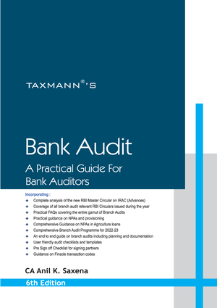



Contact
+91-9839112626
anilk.saxena@agasax.com
@aks_iamhuman
https://www.linkedin.com/in/anil-k-saxena-3240b3b2/
https://www.facebook.com/anilk.saxena.986
CA Anil K. Saxena
  Senior Partner, Agarwal & Saxena
  B.Sc, FCA, DISA (ICAI)
Author of ‘A Practical Guide For Bank Auditors’
Published by Taxmann (6th edition – 2023)

