Slide 1
CA Ashish Chaturmohta

Slide 2
General Disclaimer
The presentation is intended for educational purposes only and does not replace independent professional judgement.
The views expressed herein are based on internal data, publicly available information and other sources believed to be reliable and might be dated. Any calculations made are approximations, meant as guidelines only. The information contained in this presentation is for general purposes only and not an investment advice.
The presentation is given in summary form and does not purport to be complete investment strategy. The presentation does not have regard to specific investment objectives, financial situation and the particular needs of any specific person.
Statements of fact, examples and opinions expressed are those of the individual and might be dated kindly seek an professional advice before Investing.
We may hold some of the Stocks discussed in the presentation and may or may not hold in future based on the investment decision of the portfolio manager, recipient of the presentation should not replicate the same. The same should not be taken as an investment advice.

Slide 3
Our Investment Process
Fundamental Analysis
Technical Analysis
Smart
Money
Psychology

Slide 4


Slide 5
Fundamental Parameters Considered – Quality is Paramount
Robust Business
Pricing Power
Good Management
Good Corporate Governance Policies
Strong Operating Parameters
Low Leverage
Sectoral Tailwind with Barriers to Entry
Good Brand Reputation
Large Industry Size
Innovation
Strategic Assets
Strong Parentage
Significant Promoter Holding (with low pledge)
Good Cash Conversion Cycle
High Cash Flow from Operations
Reasonable ROC and ROE
Good Revenue, EBITDA and PAT growth
Good Business Good Cycle – Buy on dips, Buy on Rallies
E.g. ICICI Bank, Retail sector, IT, FMCG
Good Business Bad Cycle – Be Opportunistic
E.g. Insurance companies, Infra
Bad Business Good Cycle – Buy on every breakout, Sell on first significant reversal
E.g. Graphite, HEG, Rain Industries,
Bad Business Bad Cycle– Don’t touch
E.g. JP Associates, HCC, PSU Banks, BHEL
*Please note the above mentioned stocks are just for illustration purpose and are in no way recommendations to buy or not buy / sell.
Please see important disclosure at the end of this report | Private & Confidential | For Private Clients

Slide 6










Technical Analysis – Finding Winning Trades
Bullish Patterns: Rounding bottom, Multi year breakout, Double Bottom, Inverted Head & Shoulders Pattern, etc.
Comparative strength vs Peers vs Sectors vs Benchmark
Pickup in volumes and delivery %
Stop loss either on time or particular % correction whichever is earlier depending on market cap
Institutional & HNI activity - Increase in Bulk & Block deal
Liquidity, Index inclusion, Portfolio concentration
Buy Value stocks only once momentum sets in otherwise stuck in consolidation
Top Down Analysis
Monthly Charts
Weekly Charts
Identifying
Patterns
Support & Resistance
Other Technical Indicators
Pattern within pattern
Fibonacci Retracements
Daily Charts
Long term trend-line
Volume and Delivery activity
Averages
Indicators
Please see important disclosure at the end of this report | Private & Confidential | For Private Clients

Slide 7
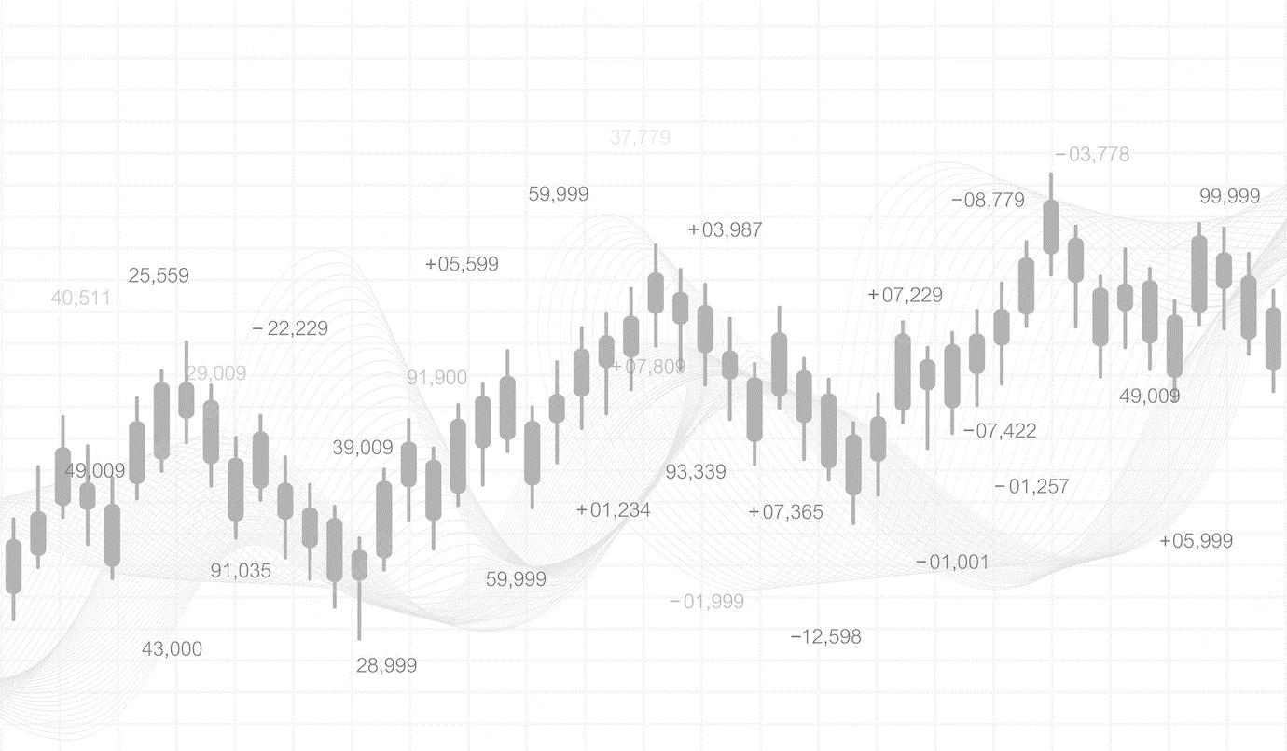
Patterns

Slide 8
Higher Top Higher Bottom
Tata Elxsi– Weekly chart
Higher High
Higher High
Higher High
Higher High
Higher Low
Higher Low
Higher Low
Higher High
Higher Low
Higher High
Higher Low
Higher Low
Higher Low
Source: falcon7
Please see important disclosure at the end of this report | Private & Confidential | For Private Clients

Slide 9
Lower Top Lower Bottom
Sun TV – Weekly chart
Lower Top
Lower Top
Lower Top
Top Bottom
Lower Top
Top Bottom
Lower Top
Lower Top
Top Bottom
Top Bottom
Top Bottom
Top Bottom
Top Bottom
Source: falcon7
Please see important disclosure at the end of this report | Private & Confidential | For Private Clients

Slide 10
Rounding Bottom
Dabur India – Weekly chart
Target = 320 + 60 = 380
320
Height =320-260
=60
Breakout
Retest of breakout level
260
Breakout Volume
Source: falcon7
Please see important disclosure at the end of this report | Private & Confidential | For Private Clients

Slide 11
Cup and Handle
Tech Mahindra – Weekly chart
Target = 290+170 =460
Neckline
Breakout @290
Height
=290-120
=170
HANDLE
Low 120
CUP
Breakout on
High volumes
Source: falcon7
Please see important disclosure at the end of this report | Private & Confidential | For Private Clients

Slide 12
Double Bottom
Tata Motors – Weekly chart
Target = 430+150 = 580
Neckline
430
Momentum Breakout
Height =430-280 =150
280
Bottom#1
Bottom#2
High volume on Breakout
Source: falcon7
Please see important disclosure at the end of this report | Private & Confidential | For Private Clients

Slide 13
Bullish/Inverted Head and Shoulders
Bata India – Weekly chart
Target = 585+205 =790
Neckline
Height =605-400 =205
Breakout
Left Shoulder
Right Shoulder
Head
Volumes on breakout
Source: falcon7
Please see important disclosure at the end of this report | Private & Confidential | For Private Clients

Slide 14
Ascending Triangle
Asian Paints – Weekly chart
Target = 920 + 220 = 1140
Resistance line
920
Momentum Breakout
Height =220
700
Volume Breakout
Source: falcon7
Please see important disclosure at the end of this report | Private & Confidential | For Private Clients

Slide 15
Rectangle
Info Edge – Weekly chart
Target = 1000 + 3000 = 1300
Resumption of uptrend after consolidation
1000
Height =300
Momentum Breakout
Up move
700
Consolidation
Volume Breakout
Source: falcon7
Please see important disclosure at the end of this report | Private & Confidential | For Private Clients

Slide 16
Bullish Falling Wedge
HDFC Bank – Weekly chart
Target = High of wedge
Breakout
Higher Volume
Source: falcon7
Please see important disclosure at the end of this report | Private & Confidential | For Private Clients

Slide 17
Pole & Flag Pattern
Kalpataru Power – Weekly chart
490 Target
80 points
410
FLAG
80 points
POLE
330
Up move
Up move
Consolidation
Source: falcon7
Please see important disclosure at the end of this report | Private & Confidential | For Private Clients

Slide 18
Rising Channel
Titan Company – Weekly chart
Resistance
Resistance
Resistance
Resistance
Support
Support
Source: falcon7
Please see important disclosure at the end of this report | Private & Confidential | For Private Clients

Slide 19
Trend Lines

Slide 20
Rising Trend Line
BEL– Weekly chart
Source: falcon7
Please see important disclosure at the end of this report | Private & Confidential | For Private Clients

Slide 21
Falling Trend Line
Hindalco– Weekly chart
Source: falcon7
Please see important disclosure at the end of this report | Private & Confidential | For Private Clients

Slide 22
Fibonacci Retracement & Extension
Fibonacci Retracement Levels
Fibonacci Extension Levels
23.6%
38.2%
50%
61.8%
100%
100%
138.2%
161.8%
261.8%

Slide 23
Fibonacci Extension
Monthly chart
Source: falcon7

Slide 24
Fibonacci Retracement
Weekly chart
Source: falcon7

Slide 25
Case Study

Slide 26
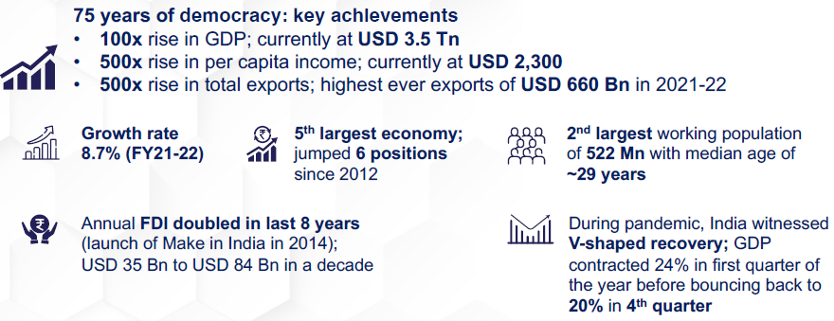
FASTEST GROWING LARGE ECONOMY
Largest and most stable democratic regime

Slide 27
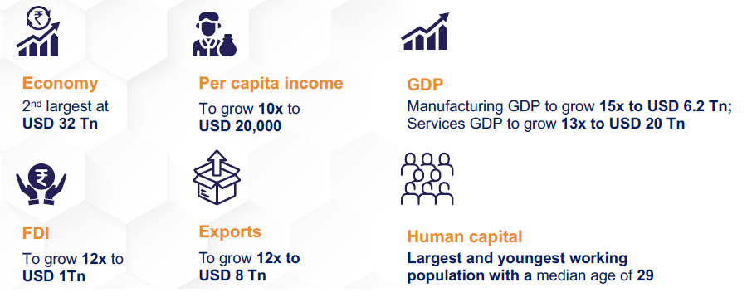
Amrit Kaal – Vision 2047
25 year roadmap for India@100

Slide 28
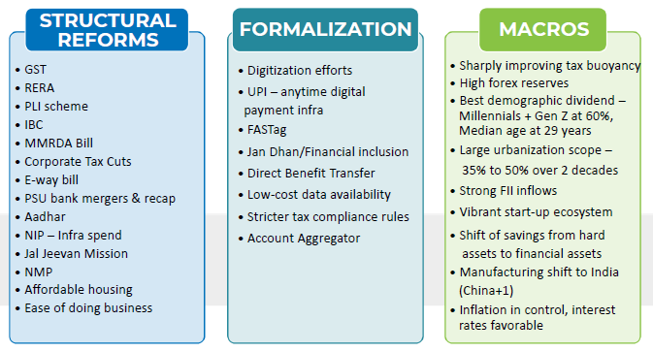
Business Reforms have transformed India’s outlook
Semicon India Mission – Financial incentives worth USD 10 bn to develop semiconductors and display manufacturing ecosystem
Ease of Doing business (EoDB) – 300+ reforms across 72 action points, 40000+ compliances reduced, 79 positions jump over 5 years and featured in top 3 improvers list consecutively for 3 years, among top 5 economies for ease of starting new business

Slide 29
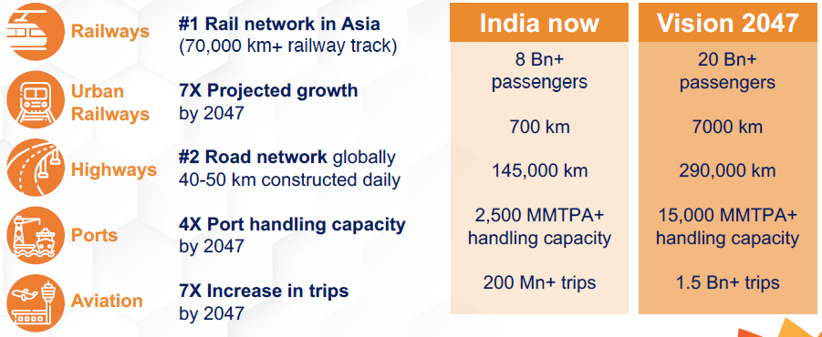
World Class Infrastructure Facilities

Slide 30
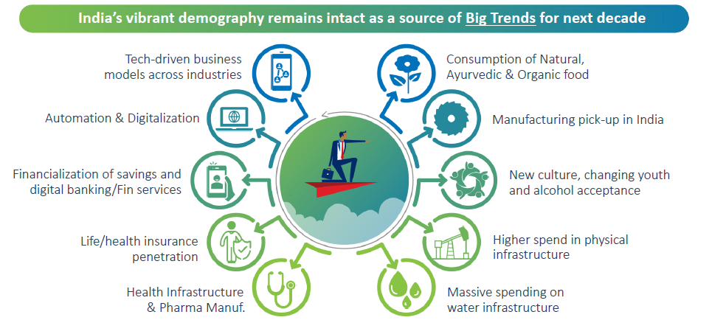
Big trends for the next 5-10 years for India

Slide 31
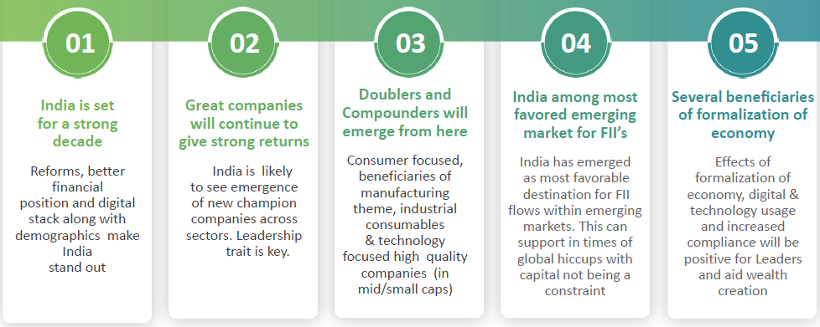
India set to outperform vs others

Slide 32
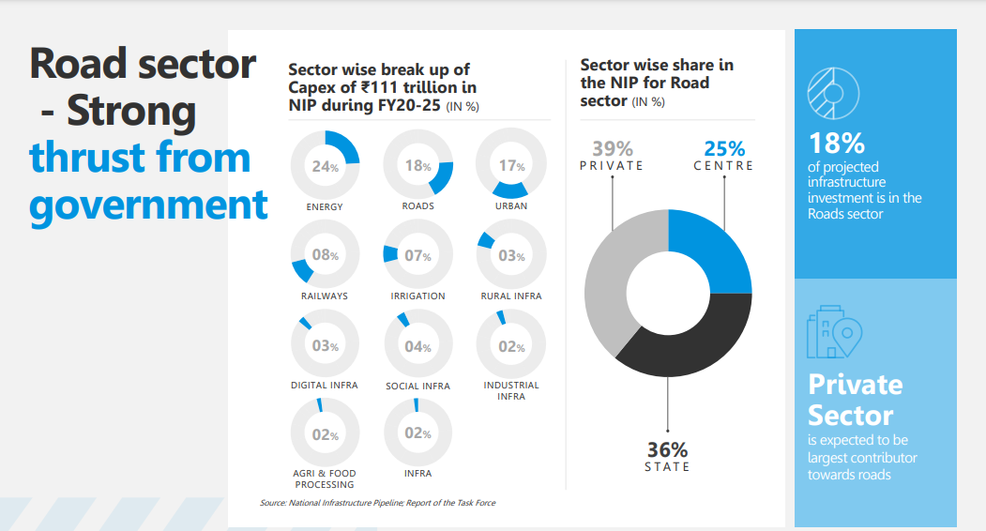
National Infrastructure Pipeline (launched Budget 2019) –
The NIP is a group of social and economic infrastructure projects in India over a period of five years with an initial sanctioned amount of Rs 102 lakh crs, later sized up to Rs 111 lakh crs.
Rs 20.3 lakh crs Capital expenditure to be incurred over FY20 to FY25 for the roads sector alone.

Slide 33
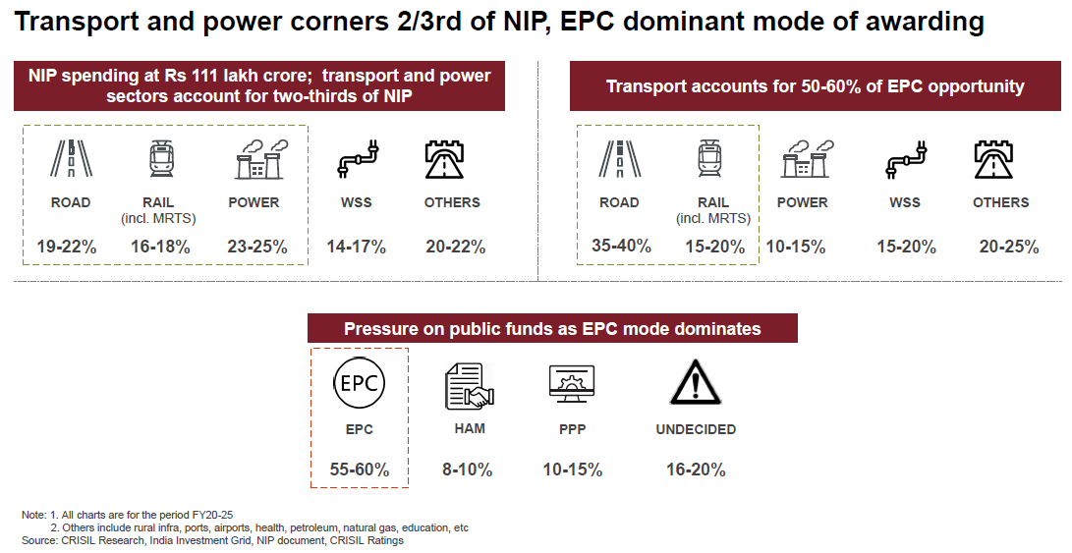
National Infrastructure Pipeline contd.

Slide 34
Capital Expenditure – All stars aligned !
Capex can be broadly divided into 3 parts - Central Capex, State Capex and Private Capex
Central government capex announcements in FY23 are being led by the Railways (~38% of projects by value). Effective central government capex (capex + grants in aid for creation of capital assets) is budgeted to rise to 4.5% of GDP next fiscal, significantly higher than pre-pandemic five-year average of 2.7%. Total outlay, including capex of public sector units, is budgeted at 6.2% of GDP
State Government Capex announcements in FY23 are being led by commercial complexes, compared to road projects, health services and water & sanitation projects during the pandemic.
Private Capex announcements are being led by the Chemicals sector, accounting for ~45% of the total projects by value. Another 35% of projects by value can be attributed to the Renewable Energy sector. The ITES/Data Centre boom seen during the pandemic also seems to be abating now. Capex announcements by the Chemicals sector are being led by green hydrogen and green ammonia projects, accounting for ~65% of the total Chemical sector capex.
Industrial Capex is going to the growth driver as industrial capex will get a push from government policies and new-age opportunities, infrastructure spending will continue to drive 12-16% growth in capex next fiscal.
In the Industrial capex side, overall industrial capex is set to rise to nearly Rs 5.7 lakh crore on average between fiscals 2023 and 2027 compared with Rs 3.7 lakh crore in the past five fiscals. Out of the above PLI and new-age capex account for nearly 15-17% of the total industrial capex. In absolute terms, overall capex averaged Rs 3.75 lakh crore between fiscals 2018 and 2022. We see this number rising to ~Rs 5.75 lakh crore on average between fiscals 2023 and 2027, marking a ~1.5x increase on an annual basis.

Slide 35
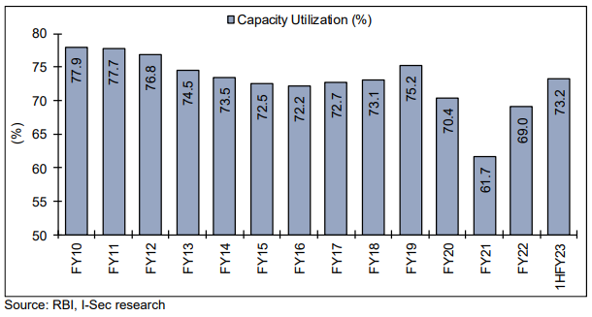
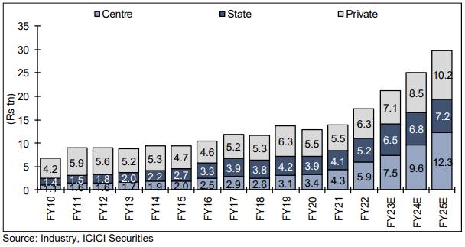
Manufacturing capacity – Increasing investments and utilization
Manufacturing capacity utilization continues to rise after dip due to covid in Fy21
Private capex CAGR of 17% expected over FY22-FY25e – budget gave a big fillip

Slide 36
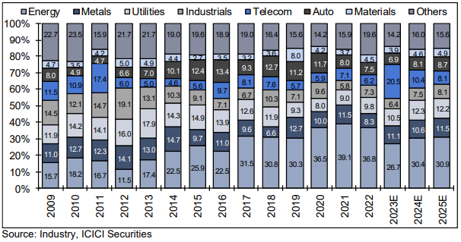
Key sector wise share of private capex in India

Slide 37
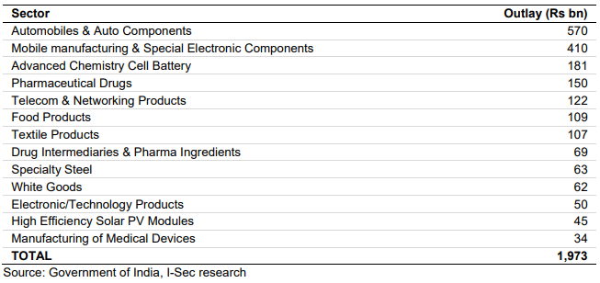
PLI Schemes – Sector wise capex announcements
Government continues to focus on increasing the contribution of manufacturing to the GDP from 17% currently to 25% by 2025. The production-linked incentive (PLI) schemes are likely to encourage private capex in manufacturing. Government has earmarked almost Rs2.5trn for PLI schemes in 13 key sectors with highest allocations to auto, mobile manufacturing, advanced chemistry cell battery, pharmaceutical and telecom.
Kotak Economic Research in a study projects Rs31 tn of sales, Rs11 tn value addition and Rs4.3 tn capex over 5-7 years as result of Rs2.5 tn of financial incentives provided by the government.

Slide 38
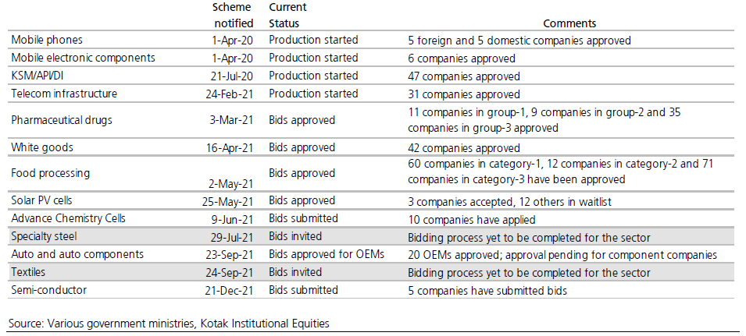
Status of PLI Scheme in various sectors

Slide 39
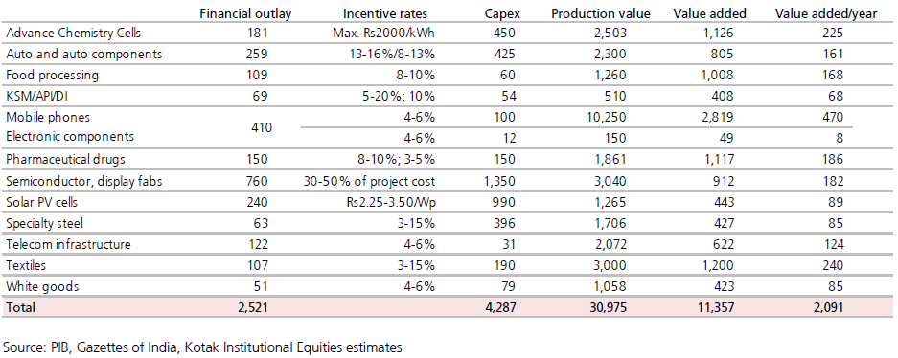
Estimates of capex, production and value addition through key PLI schemes Rs bn

Slide 40
Budget FY24e – Govt capex push to support economy
FY24 budget has continued with the intent of the government to push capex induced growth. While headline capital expenditure shows a growth of 37.4% over FY23(RE), considering the off-balance capex, the growth turns out to be 25% over FY23(RE) excluding FCI allocation. Roads/ highways and railways have seen an increase of 25.4% and 50% respectively YoY. Scheme based capex seems to show major growth in Jal Jeevan Mission, Roads, Railways and Metro. Strong capex push by GOI and private capex revival led by Energy transition, data centres, Defence, PLI will provide strong support to Indian economy in an otherwise slow global outlook. We believe India is on the verge of a big capex cycle recovery which will play out in coming few years.
Steel, Cement, Textiles, Oil and Gas, EV, Solar, chemicals, Food processing will push capex higher
Significant capex requirement to enable energy transition to renewables and smart grid infra
Increasing corporate announcements around manufacturing to increase global sourcing
Infra status to Data centres, PLI for renewables and higher domestic sourcing for defense (2/3rd domestic sourcing)
India remains in a sweet spot with strong domestic demand base, strong demographic dividend, significant self sufficiency in food grain production and strong Infra capex push form the Govt and revival of industrial capex from PLI and Defence segments. We expect markets to consolidate in near term given 1) signs of urban discretionary demand slowdown 2) rising global interest rates and geo political uncertainty and 3) uncertainty regarding the impact of EL Nino on inflation and monsoons. We believe Auto, Capital Goods, Defense, Infra and building materials remain a compelling theme for next 18-24 months.

Slide 41
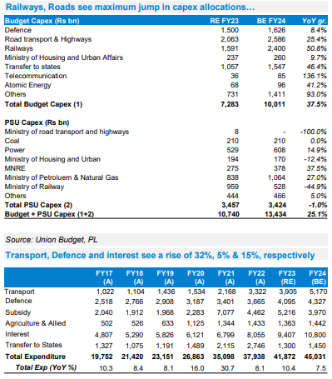
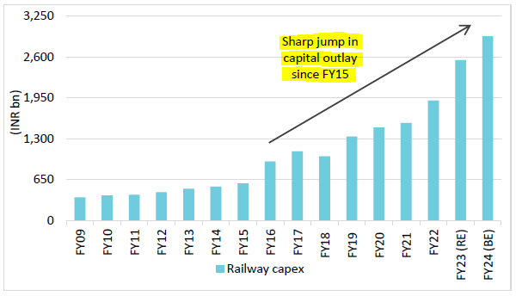
RAILWAYS - Capital expenditure trends
As far as FY24 is concerned, railways would focus on new lines, gauge conversion, Metropolitan Transport Projects and track renewals with capex projected to increase relative to FY23RE; on the other hand, the outlay for doubling and rolling stock is likely to decline YoY though they still remain the highest heads within the railway budget.

Slide 42
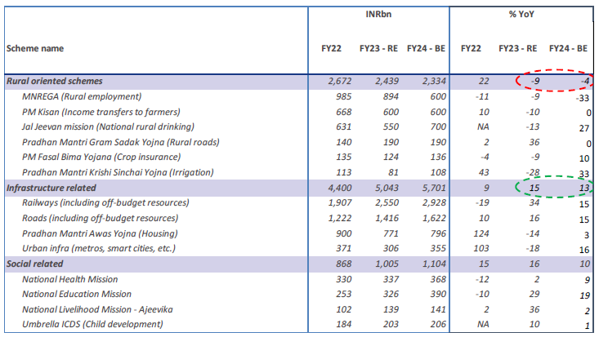
Spending allocation to major schemes – FY24E Budget numbers

Slide 43
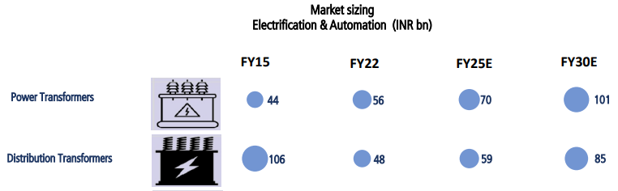
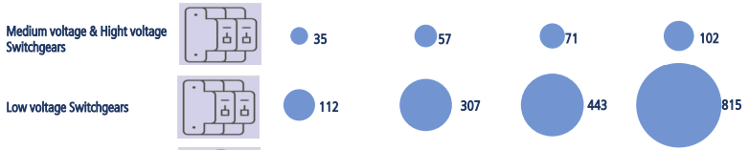
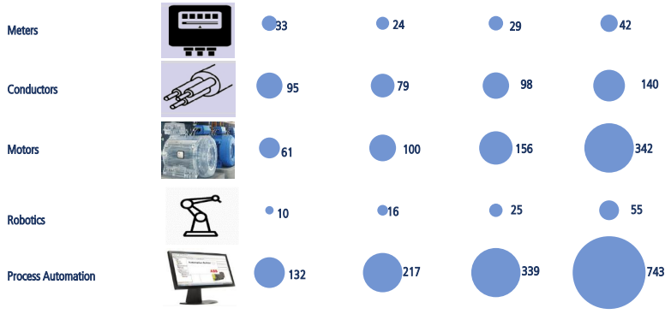
Addressable market opportunity for Cap goods businesses
Revenue/EBIT pools of around US$75bn/US$15bn across electrification, automation and Defence over FY22-30E, implying healthy double digit growth for firms across the value chain
Data centres - expect current data centre capacity (at 870MW, up 3x in three years (FY19-22), to increase by more than 6x in the next eight years, implying a more than 25% CAGR between FY22-30E. We forecast significant growth in LV electrification and a US$4-5bn market opportunity over FY22-30 given the higher intensity of data centers' LV electrification. Total investment in data centres can be around 18 bn usd over fy22-30e period.
Railway capex – Allocation for this sector in the budget was Rs 2.7 trillion and Siemens recently won an order of 9000 HP locomotives worth Rs 26k crs; both of which points out potential order inflow from railways. High speed rails also are an additional business opportunity.
Metros and dedicated freight corridors (DFC) also will form bigger part of industrial capex in times to come. Currently, 3400 kms of DFC is under construction and expected to be completed by Dec 2024 while planning for 3 new routes totaling 5000 kms in the works.

Slide 44
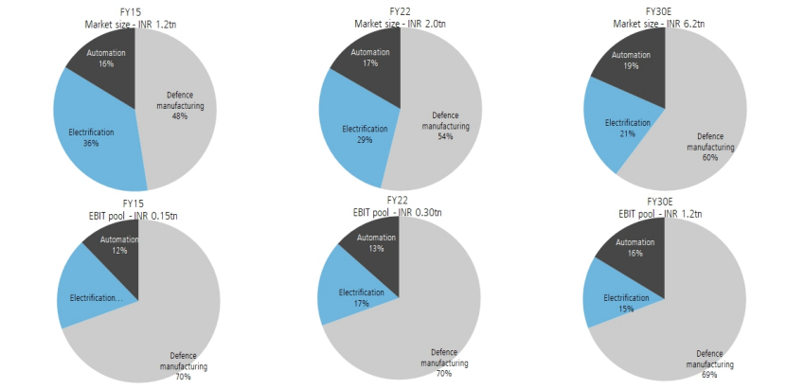
Automation, Defence and Electrification to grow BIG
Market size for above going 5x from Rs 1.2 tn to 6.2tn and EBIT pool 8x from Rs 0.15 tn to 1.2 tn

Slide 45
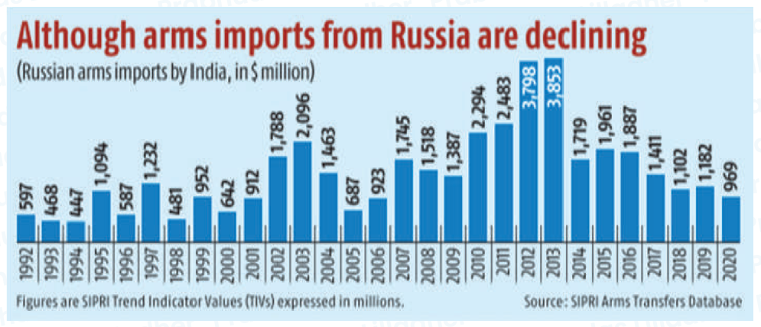
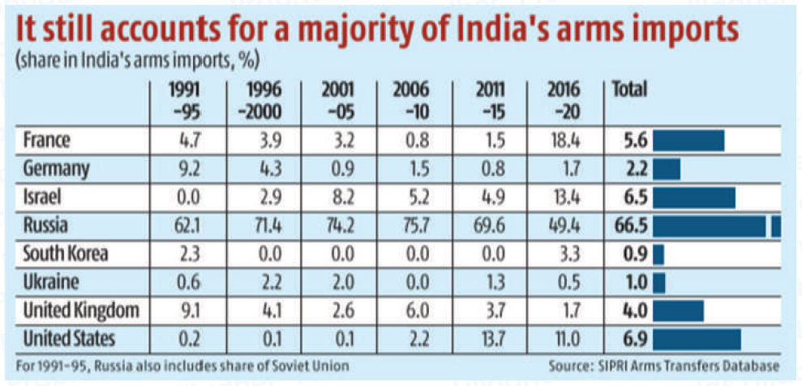
Indian Defence Sector
Opportunity size of Rs 9 lac crs for the next 10 years
For the period 2012-21, India remained the largest importer of defence equipment in the world accounting for 11% of the total global arms sale. Within this period, imports from Russia (47%), France (27%) and United States (12%) together contributed ~85% of defence deals.
However, between 2012–16 and 2017–21, Indian arm imports decreased by 21% and Russian imports, which was the largest supplier of major arms to India, dropped by 47%. During this phase, we have witnessed tectonic shift in defence procurement policy by the Modi Government designed to make India the ‘Defence Manufacturing Hub of the world’.

Slide 46
Indian Defence Sector
Policy changes propelling the Make in India story of defence
Corporatisation of India’s defence production - 41 factories earlier run by the OFB (the Ministry of Defence) combined into 7 new companies
411 indigenization list put out starting May 2019 – these cannot be imported after a set deadline; opportunity for this list as on date stands at Rs 6.1 lakh crs over 6 years across ban lists. Also, 1238 sub-systems/components have also been notified in last two years that will be indigenised in phases over the next five years.
Defence indigenisation – Domestic procurement at 63% of total defence budget in FY22BE from 52% in FY21RE. Walking the talk – indigenisation increased to 63% from 33% in FY16. Assumption is at steady state 65% over capex spends starting Fy22-30, opportunity size is 86250 crs per annum
GoI has enhanced FDI in the defence sector by up to 74% through the automatic route for companies seeking new defence industrial license and up to 100% by Government route, which is likely to result in access to modern technology.
25% of budget earmarked for R&D for industry, start-ups and academia.
Defence offset policy – will help benefit a lot on Indian companies acquiring critical technological capabilities in manufacturing defence products
India’s defence budget which is around Rs 547k cr is expected to be at Rs 750k cr in FY26 and Rs 1125k cr by FY30. Imp to focus on capital expenditure which is around 25% i.e. Rs 135k cr and expected to grow 10% p.a. or 15000 cr additional defence capex budget every year.

Slide 47
BSE Capital Goods
Weekly Chart
Higher
Top
Higher
Top
Higher
Top
Consolidation at all-time high
Higher
Bottom
Higher
Bottom
Breakout from correction
Higher
Top
Higher
Bottom
Higher
Top
Higher
Bottom
Higher
Bottom
Source:F7

Slide 48
Siemens Ltd – CMP – Rs 3259, Mcap Rs 116185 crs
Strong Order inflows - Siemens is having an order backlog of Rs. ~190.3bn. (Order inflows last quarter at 54.5bn)
Order Inflows likely to remain robust across segments.
The company expects to maintain healthy profitability, given cost rationalization measures undertaken and healthy revenue mix.
The company expects traction in mobility segment to increase and it will be key growth driver for the company going forward.
Key areas of growth will be –
Export opportunities to rise as a % of sales from current 30%.
Siemens is increasing its Target Market with wider product suite across low and voltage and mobility than its peers
Large Orders from the Mobility segment such as Pune – Hinjewadi Metro, in 9000 HP electric locomotive project for 1200 units (Siemens emerged as the lowest bidder beating Alstom transport India) etc.
Vande Bharat project the company already has propulsion technology on which company is bidding orders
Investment in energy segment is largely driven by renewable energy capacity addition
Smart Infrastructure growth will be driven by electrification and digital solutions in multiple segments, recently data centres are witnessing a boom as global players are setting up capacity in India,
Focus on increased efficiency in segments like sugar, petrochemical, steel, water, F&B and chemicals will drive growth in digital segment and
Mobility segment ordering pipeline for the segment remains exceptionally strong as the company booked several large value orders in FY22 and the outlook for FY23 remains strong as well.
Thus, Siemens India has witnessed a sharp jump in order inquiries for digitalisation projects from industries like cement (to reduce power intensity), chemicals/F&B (remote monitoring of pumps, valves, etc. and general manufacturing (for remote monitoring of productivity and higher throughput)

Slide 49
Siemens
Weekly Chart
Cmp 3263
Up 25%
Higher
Top
Higher
Top
Consolidation at all-time high
Higher
Top
Consolidation
Higher
Bottom
Higher
Top
Higher
Bottom
Consolidation
Higher
Bottom
Higher
Top
Higher
Bottom
Higher
Bottom
Source:F7

Slide 50
ABB India Ltd – CMP – Rs 3330, Mcap Rs 70565 crs
ABB India, a 75% subsidiary of Switzerland-based ABB Group, is an engineering major that operates primarily in the power and automation-technology segments. It's business segments are as under –
Electrification: Provides a range of digital and connected solutions for low- and medium-voltage applications, including EV infrastructure, solar inverters, modular substations, distribution automation, power protection, wiring accessories, switchgear, enclosures, cabling, sensing and control. Order book stands at Rs15.8bn
Motion: Provides products, solutions and related services that increase industrial productivity and energy efficiency. Order inflow came in at Rs7.7bn led by traction converters and large order wins from Railways. Revenues grew by 23% YoY owing to strong growth in large motor business, traction convertors business and focus on customer engagement.
Process Automation: Provides products, systems and services designed to optimize the productivity of industrial processes. Revenue grew led by backlog execution across all verticals and milestone based execution for project orders. There were large order wins for control systems, rectifiers, instrumentation and orders from paint, steel, energy companies
Robotics and Discretionary Automation: The robotics division offers robots, services and manufacturing solutions primarily focused on discrete sectors like electronics, automotive, aerospace, wind and machine building. Order inflows grew by 213% YoY. Indian companies are increasingly focusing on Industry solutions and enhancing productivity through increased digitization and automation, also for preventive maintenance and plant upkeep. ABB’s electrification and motion portfolios have gradually expanded beyond traditional utilities-related projects.
The Management is confident benefiting from the budgetary announcements on infrastructure, capex, green energy, data centres, etc. and the capital outlay on Railways. The company is penetrating deeper into the tier 3 and 4 regions (contribution has increased from 43% to 48% of the order book) which has helped grow its topline. The company has achieved milestone of Rs100bn of order inflows in CY22 post de‐merger of ABB Power and is confident of achieving revenues of the same quantum. The Cash balance stood at ~Rs36bn out of which ~Rs20bn has been earmarked for inorganic expansion especially in the space of digitization, e‐mobility and energy transition.

Slide 51
ABB India
Weekly Chart
Breakout from correction
Breakout
Consolidation
Consolidation
Source:F7

Slide 52
Cummins India Ltd – CMP – Rs 1665, Mcap Rs 46142 crs
Capex and Order book, both remains strong. Capex for last two years has been ~Rs2.5bn, which primarily consist of: i) Sustenance capex; ii) product development; iii) engineering.
Management expects capex over the next two years to be in the similar range until capacity utilisation increases significantly. Market segments like industrial, commercial realty, data centres, biotechnology and pharmaceuticals are witnessing good demand.
In Q3FY23, the company supplied its largest order of gen-sets for commercial realty, data centres and manufacturing.
Prior price hikes and higher operating leverage will help sustain EBITDA margin: With supply-chain constraints and price lag effect, gross margin was impacted by 120bps YoY. However, higher operating leverage enabled EBITDA margin to remain stable YoY at 15%.
We expect margin to improve gradually with further price hikes and improving supply of key electronics components and spare part.
Data Centres High growth to continue - Data centre orders are lumpy in nature but the segment continues to be of high growth and management expects the growth rate will continue
Parents Support to aid future growth - Cummins Inc. has major manufacturing setups in North America, China and India. For its LHP portfolio, CIL continues to be the sole major supplier. With improving operating efficiency, cost competitiveness and depreciating INR, CIL is able to get a larger share of the parent’s growing business. As per Cummins Inc.’s recent commentary, it expects Indian entities to grow at ~20% in coming years. Cummins Inc. has completed the acquisition of Meritor Inc., which is a leading global supplier of drivetrain, mobility, braking, aftermarket and electric powertrain solutions for commercial vehicle and industrial markets. The acquisition is expected to have limited impact on the CIL entity as its offerings are limited to commercial vehicles. However, CIL is exploring synergy benefits in improving its complete package offering to segments in mining and construction equipment segment.

Slide 53
Cummins India
Weekly Chart
Cmp 1657
Up 35%
Crossed 7 year high
Consolidation
Consolidation
Source:F7

Slide 54
Linde India Ltd – CMP – Rs 3734, Mcap Rs 31864 crs
Established market position in the industrial gases segment: Linde India is one of the largest players in the domestic industrial gas industry. Its strong market position is backed by presence of more than 75 years and diverse product portfolio, comprising industrial, medical, compressed and special gases. Moreover, the company has healthy brand equity and the ability to provide end-to-end solutions to customers in the tonnage segment.
Strong financial, operational and managerial support from the parent: Linde India receives adequate support from Linde Plc. The support from Linde Plc is expected to continue in view of Linde India's strategic importance to its business expansion plans in Asia and other emerging markets.
Large Market Size - In India, market size estimated at Rs 20,000 crores, of which almost 40% is captive generation. The current top line of Linde India is 2100 crores. Hence the opportunity size is 10x. The current market share is close to 11-12%. In India, there are 10+ regional players; 150+ small local players and only 1 pan India player. Pipeline supplies from dedicated plants set up for industrial customers with long term agreements.
Diversified and stable business model - Pipeline supplies from dedicated plants set up for industrial customers with long term agreements.
Main industry sectors – steel, refineries, petrochemicals, glass, non-ferrous metals, fibre optics, electronics
The business segment is divided into - Gases and PED. Onsite Project (50% of sales) - Long Term Agreements with key Customers such as TATA, SAIL, JSL and many other players, Highly Capital Intensive segment.
PGP Industrial products - More than 20 lakh m3 of compressed gases sold per month in more than 150,000 cylinders in circulation; Site Footprints across India. Mainly to healthcare sector. PGP – Special Products - Small focused team dealing in Special gases such as He, Calibration gases, electronic gases. Highly profitable segment, Margins are close to 50%+.
BULK Gas - Strong Supply Chain Management; serves LOX, LIN, LAR as major products to more than 1000 Customers; Sales team heavily supported with Deliver, Customer Service

Slide 55
Surya Roshni Ltd – CMP – Rs 666, Mcap Rs 3622 crs
Incorporated in 1973 as Prakash Tubes Private Limited, Surya Roshni has constantly evolved and emerged into a USD 1 billion organization.
Company’s brands ‘Surya’ (for lighting and consumer durables) and ‘Prakash Surya’ (for steel pipes and strips) enjoy strong customer recall across India as well as over 50 countries worldwide.
India accounts for third-largest production of steel pipe globally, accounting for 8 to 10% of the steel consumption and market size today is Rs 60000 crs. The ERW pipes is considered to be the fastest-growing segment, growing over 5% annually in the past five years and catering to the domestic demand of 8-10 million tons per annum. Within ERW pipes, structural steel tubes segment is expected to grow at a faster pace. Globally, structural steel tubes account for around 10% of total steel consumption. However, India’s share is only 4%, indicating strong growth potential.
India’s refining capacities are expected to reach 298 MT by 2025. The aggressive capacity expansion drive by the state refiners, worth ₹ 2 trillion ($27 billion), shall further translate into a strong demand for O&G pipelines.
The Indian lighting industry witnessed massive growth in the LED lighting and is expected to touch USD 5 billion in the next 5 years.
The company enjoys strong industry leadership by being India’s largest manufacturer of GI pipes and the largest exporter of ERW pipes. The oil and gas products are approved by American Petroleum Institute (API).
Company has emerged as the second-largest lighting company in India. The success is strongly complimented through the R&D facility at Noida that consistently focuses on delivering innovation in the LED segment.
It has consistently created value for its stakeholders on the back of strong brand equity, consistent quality, innovations, robust financials, efficiencies and professional management.
The Company’s strong dealer and distributor network, allow itself to reach across the nation, especially into the tier II, tier III and rural areas
Others include construction and building material, infrastructure like airports, and energy and engineering like city gas distribution, etc.

Slide 56
Surya Roshni
Weekly Chart
Forming long term rounding bottom pattern
High Volumes
Source:F7

Slide 57
Linde India
Weekly Chart
Higher
Top
Higher
Top
Breakout from consolidation
Higher
Top
Higher
Top
Breakout from correction
Higher
Bottom
Higher
Bottom
Higher
Bottom
Source:F7

Slide 58
APL Apollo Tubes Ltd – CMP – Rs 1182, Mcap Rs 32656 crs
APL Apollo Tubes is India’s leading structural steel tubes manufacturer with a capacity of 4.1 mn tpa. The company has 10 plants across India and more than 800 distributors. APAT has pioneered the DFT and Tricoat technologies and has a vast product portfolio.
Its products caters to multiple sectors like urban infrastructure, construction, housing, energy, irrigation, solar plants, etc.
Indian steel pipes and tubes production capacity stands at 21.5 mtpa and the overall industry is valued at Rs 60000 crs and accounts for 8% in the global steel market. ERW pipe market is at 9.5 mtpa. The structural steel (SS) tubes market in India was 4mnt of total steel market size of 90 MnT in 2019 and this projected to be 22 MnT and 227 MnT in 2030e respectively. Thus market share of SS will increase from 4.5% to 10%.
SS tubes market in India is at 4-5% of total steel market vs global average of 9% which speaks about potential market opportunity and growth in India. Steel tube demand will rise from sectors like warehousing and affordable real estate as players focus on lowering costs.
The new Raipur facility with 1.5 mtpa coming in will boost volume growth for the upcoming years and the facility will focus on value added products.
Management focus is on new market development through architect/consultant meets and infra design pitches to highlight significant time and cost advantages.
The company holds 55% market share in the segment and will only consolidate further with launches of new value added products.
APAT has bought 9.9% stake in Shankara Building products and is a deal of strategic value to the company given the latter’s store network in South India. Shankara has been authorized channel partner of APAT for the last 10 years prior to this deal. Stake acquired at Rs 146 crs.
On the back of strong operating cash flows Rs 937 crs pa avg for next 3 years, capex Rs 800-1000 crs cumulative during the same period planned through internal accruals. Any additional greenfield capex if planned can also be completed through internal accruals alone.

Slide 59
APL Apollo
Weekly Chart
Consolidation
High Volumes
Source:F7

Slide 60
Sundram Fasteners Ltd – CMP – Rs 980, Mcap Rs 20600 crs
TVS group company with 5 decades of manufacturing excellence & 15 plants in South India – Rs50bn turnover.
Can manufacture various components and assembly systems for automotive and other applications. Led by Mr. Suresh Krishna and his Daughter
Aarthi Krishna (currently MD) who joined the company in 1990 as an employee on factory floor
Key products – Fasteners, cold extruded parts, hot forged parts, powertrain components, Radiator caps and powder metallurgy
Largest Fasteners manufacturer in India with a market share of 35-40%
Fasteners is US$90bn industry out of which non-auto is 70%. Combined with other products the market opportunity is large (>US$300bn).
Key raw materials used are steel (90% of RM) and other basic materials (10%)
Key business drivers –
Manufacturing critical, high precision engineering components for auto allied industrial sectors
High market share in India but miniscule at global level so opportunity to grow organically remains huge
SFL is looking to increase share of EV products from 4 % in FY22 to 10% by FY25E and 12-15% by FY26E
Non auto revenue share to be increased from 22% in FY22 to 50% in 5-6 years
Export share in standalone business at 35% target to increase to 50% in next 5 years
PLI application approved investments of 350 cr and turnover of 2000 cr targeted over next 5 years (FY 23-27E)

Slide 61
Sundram Fasteners
Weekly Chart
Higher
Top
Higher
Top
Higher
Bottom
Higher
Top
Higher
Bottom
Higher
Top
Higher
Bottom
Higher
Bottom
Higher
Bottom
Source:F7

Slide 62
Hindustan Aeronautics Ltd – CMP – Rs 2727, Mcap Rs 91169 crs
India's only defence aerospace equipment manufacturer, has a large order book of INR 84800 crs, boosted by INR 48000 crs order to make 83 light combat aircrafts (Tejas). Potential orderbook addition of Rs 45000 crs for various new platforms.
Stands to benefit from INR 500000 crs orders over the next decade.
Capabilities across the board – from R&D, manufacturing and repairs and overhaul.
India intends to have additional 10 squadrons (180-240 fighter jets), and IAF is keen to work on it by inducting new aircrafts and fighters.
HAL has been showcasing LCA Tejas to scale up exports and is favourably placed to receive an 18-aircraft order from Malaysia. HAL is also in talks with Argentina, Australia, Egypt, USA, Indonesia, and Philippines for exporting the Tejas aircraft.
Manufacturing contracts contribute ~70% of the total order backlog while ~24% was contributed by repair & overhaul (RoH) activities
India's Defence Ministry has signed an agreement with HAL to procure 70 HTT-40 basic trainer aircraft for Rs 6,800 crore. Other key orders in the pipeline for the next one to one and a half years include 25 advanced light helicopters (ALH) for Army, nine ALH for Indian coast guard, six Dornier aircraft, 12 light utility helicopters (LUH) and 12 Su-30, 240 AL-31 engines (for Sukhoi-30 MKI aircraft) and 80 RD-33 engines (for Mig-29 aircraft)
In the longer term (3-5 years), key orders in the pipeline are 140 Light Combat Helicopters (LCH), 170 LUH, 60 marine ALH, additional 36 HTT-40, 6 squadrons of Medium Weight Fighter (MWF) Tejas MK2.
Apart from Tejas MK2, HAL is undergoing development programmes like twin engine deck based fighter (TEDBF), advanced medium combat aircraft (AMCA), Indian Multi Role Helicopter (IMRH), Combat Air Teaming System (CATS)

Slide 63
Hindustan Aeronautics
Weekly Chart
Higher
Top
Higher
Top
Higher
Bottom
Higher
Top
Higher
Bottom
Higher
Top
Higher
Bottom
Higher
Bottom
Higher
Bottom
Source:F7

Slide 64
Nifty CPSE
Monthly Chart
Daily Chart
Crossed 8 year high
Consolidation at all-time high
Source:F7

Slide 65
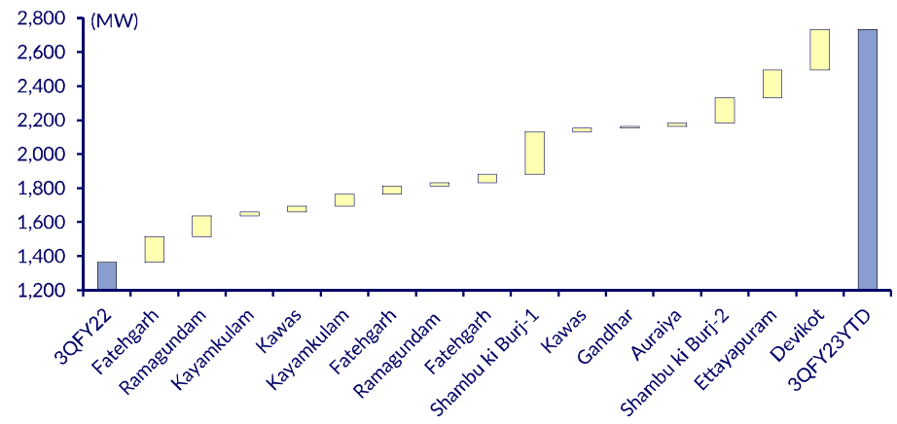
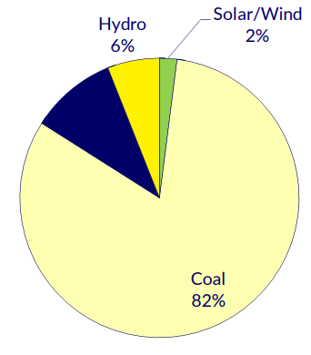
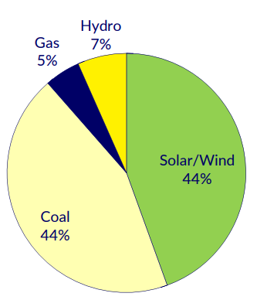
NTPC – CMP – Rs 178 , Mcap Rs 1,73,473 crs
NTPC doubled its solar/wind capacity by 3QFY23 and has achieved 5% of its FY32 vision of 60GW.
India set lofty goals at COP26 including a 3.4x rise in non-fossil energy (NFE) capacity. To decarbonize, it has identified Renewable Energy for power, green hydrogen for industries, and electrification for mobility sectors.
In the meantime, India is likely to kick-start a few fossil plants for a balanced transition, opening up growth for NTPC. It ordered its first fossil plant in five years in 2QFY23 and plans to add 4.8GW to drive growth until FY30. Decarburization offers NTPC a decadal growth opportunity, in our view, making it a play on energy transition. NTPC has a series of under construction thermal power plants that are likely to fructify during FY24 .
NTPC is building India’s biggest 5MW electrolyser in Madhya Pradesh as part of its circular economy initiative to capture carbon and convert it to methanol. This facility would be converted from grey to green hydrogen with power supply from its 5MW small hydro and 500kW rooftop solar. NTPC could become one of the largest exporters of green hydrogen and green ammonia/methanol due to its strategic location
Carbon capture is underway at NTPC’s 500MW coalfired power plant at Vindhyachal Super Thermal Power Station
The decrease in CWIP as a percentage of total fixed assets led ROE to increase so far. ROE to improve sequentially as the proportion of CWIP to total fixed assets declines.
NTPC Fuel Mix FY20 & FY32

Slide 66
NTPC
Monthly Chart
Crossed 11 year high
Stock moving in rising channel
Source:F7

Slide 67
Powergrid
Monthly Chart
Breakout
Consolidation
Source:F7

Slide 68
KPIT Technologies Ltd
Company Description
KPIT is a global technology company with software solutions that will help mobility leapfrog towards autonomous, clean, smart and connected future. With 6000+ Automobelievers across the globe, specializing in embedded software, AI & Digital solutions, KPIT enables customers accelerate implementation of next generation mobility technologies . With development centers in Europe, USA, Japan, China, Thailand and India
Rationale
Net Cash in hand
Net cash (INR mn) | Q2FY23
Gross cash | 9624
Long Term Debt | NIL
Short Term Debt | NIL
Net Cash | 9,624
Shareholding Pattern (%)
Promoter | 40%
Foreign | 16.9%
Domestic Institutions | 13.5%
Public and Others | 29.5%
Promoter Pledge | 0.82%
Global OEM’s R&D expense currently stands at nearly USD 20 billion and is expected to rise to USD 60 billion over the next 5 years as global auto manufactures provide technological enhancement to vehicles & eventually move towards driverless vehicles. KPIT is at the forefront on these. Engineering spend by the OEMs gone up by 10% and specially the CASE (Connected Autonomous Shared and Electric) area gone up by ~20%. Over the years, company has invested heavily in the technologies for automotive companies and continues to maintain its leadership position in this area
In October 2022, KPIT has completed Technica Engineering deal to acquire four Technica Group companies, for a consideration of Rs.640 crores. Technica’s key clients are Volkswagen, Audi, BMW, Volvo, Renault, and Hyundai among others in this space. KPIT has funded the acquisition from internal sources. The objective of the acquisition is to create a one-stop shop for the industry in its transformation towards Software Defined Vehicles (SDV)
KPIT operates in an area which is extremely complex and disruptive, therefore, the entry into such a segment is extremely difficult for new players. KPIT specializes in shared mobility, connectivity, level 2 to level 5 autonomous mobility, and superior vehicle engineering. These areas have extremely high barriers to entry due to its complexity, and thereby, high margin potential.
EBITDA Margins guidance has been improved to 18.5-19% (from 18-19% earlier) which appears achievable, given the strong performance in KPIT Tech.
Management has indicated that it has a healthy pipeline with a couple of mega engagements (for 3-5 years) expected to get closed in the coming 3-4 months. Demand environment is strong as Vehicle makers are investing heavily to develop Software Defined Vehicles (SDVs).
Management upgraded its FY23 organic growth guidance to +23% in CC (from 18- 21% earlier), also guided to overall CC growth of 31-32% and EBITDA Margins guidance of 18.5- 19%. Management sees ACES trends converging into Software Defined Vehicle (SDV), which will require new software architectures where KPIT Tech is becoming the trusted partner of OEMs and winning new business.
Strong Financials
Details | Q2FY23 | Q1FY23 | Q2FY22
Revenue from operations | 7,448.32 | 6,857.24 | 5,908.73
Other Income | 94.90 | 152.89 | 89.37
Total Income | 7,543.22 | 7,010.13 | 5,998.10
Operating Expenses | 6,066.69 | 5,525.51 | 4,868.14
EBITDA | 1,381.63 | 1,331.73 | 1,040.59
Depreciation | 327.41 | 310.23 | 290.93
EBIT | 1,054.22 | 1,021.50 | 749.66
Finance Costs | 70.31 | 63.43 | 38.56
Change in FMV of Investments | (1.92) | 6.12 | 21.39
Profit before exceptional items | 1,076.89 | 1,117.08 | 821.86
Source: Company, Bloomberg
Case studies are an example ideas meeting the quantitative selection criteria and explains how the portfolio entry, exit and incremental actions are initiated depends upon the various momentum indicators shown above. However, these case study ideas not necessarily to be seen as recommendations or part of the portfolio currently.

Slide 69
KPIT Technologies
cmp 873
up by 48%
Buy @587
Short term bottom
Bottom formation
Long term bottom formation
Source: Falcon7
Case studies are an example ideas meeting the quantitative selection criteria and explains how the portfolio entry, exit and incremental actions are initiated depends upon the various momentum indicators shown above. However, these case study ideas not necessarily to be seen as recommendations or part of the portfolio currently.
The presentation is intended for educational purposes only and does not replace independent professional judgement
Source:F7

Slide 70
KPIT Technologies
cmp 873
up by 48%
Buy @587
Source: Falcon7
Source: Falcon7
The presentation is intended for educational purposes only and does not replace independent professional judgement
Source:F7

Slide 71
Tata Elxsi
Gap down and then fail to fill the gap area
Exited at 9300
cmp 6159
down by 33%
Source:F7
Source:F7

Slide 72
KPIT vs Tata Elxsi
Performance since August 2022
KPIT Tech +58%
Tata Elxsi -30%
Exited at 9300
cmp 6159
down by 33%
Source:F7

Slide 73
KPIT vs Tata Elxsi
Exited at 9300
Price movement since August’22
cmp 6159
down by 33%
Source:F7

Slide 74
HG Infra Engineering Ltd – CMP – Rs 775, Mcap Rs 5048 crs
HG Infra is engaged in the business of construction of roads and highways and was incorporated in the year 2003.
The company has desired technical expertise to execute projects of varying complexities supported by acquisition of modern construction equipment and man-power.
Promoters are in the business since 1980’s and have 74.53% holding.
HG Infra started with Rajasthan and has now expanded operations to 9 states and good history of timely completed projects.
60% of the order book is by govt authorities like MoRTH, NHAI and PWD’s of state governments and rest by private players like Adani, IRB, etc. National Infrastructure Plan of Rs 110 lakh crs in which Rs 20 lakh crs have been assigned for roads and highways and Bharatmala Pariyojana Phase I of 34,800 kms provide extended scope of future works. Company expecting to win in railways and water will diversify order book.
The Company has adopted a cluster based approach by winning projects in adjacent states which help in easy logistics and movement of men and materials.
Ebitda margins are 15.5-16% driven by technological and process excellence. Order book as on 3q23 end stands at Rs 12360 crs and order book to bill ratio of 2.80x on TTM basis (61% EPC, 39% HAM)4 HAM projects completed before deadline and annuities from NHAI started; talks on for sale with funds which will free up equity.
Company has continued robust execution which is visible in topline Rs 4400 crs Ganga expressway package win from UP Govt has propelled order book and strong visibility for execution till mid FY25e
Auditor of the company is Big 4 firm - PWC
Source: Company, Bloomberg

Slide 75
HG Infra Engineering Ltd
cmp 774
up by 10%
Breakout
Buy @710
Correction
Rally
Consolidation between 520-670 to form a base
Source:F7

Slide 76
Mrs. Bectors Food Specialities Ltd – CMP – Rs 553, Mcap Rs 3254 crs
Mrs Bectors Food Specialties is a leading player in the Indian branded biscuits and breads market, with brands such as Mrs. Bectors Cremica and English Oven.
It is a leading exporter of biscuits from India. Further, it is the largest supplier of buns to QSR customers in India.
The company has 6 manufacturing facilities in India − at Punjab, Himachal Pradesh, Uttar Pradesh, Maharashtra and Karnataka.
The branded biscuit market grew at 10% CAGR from FY15 Rs 230 bn to Rs 380 bn in Fy20 and is expected to reach Rs 590 bn in Fy25e at CAGR 9.2%.
Premium breads and buns was Rs 400 crs in FY15 grew to Rs 750 crs in FY20 at 13% CAGR and to be Rs 1500 crs in FY25e at CAGR 15%. Indian Bread Market size was Rs. 5000 crs in FY20 of which premium category currently has a share of ~16% and is projected to grow at a rate of 15% for the next 5 years.
QSR chain market in organized food services space is estimated at Rs. 188bn in FY20 and is expected to grow at a CAGR of 23% to reach Rs 524bn by FY25e
Dough based products industry is expected to grow at a CAGR of 23% to reach INR 31 bn in FY25
The company has commissioned the new biscuit line of 12000 tons at Rajpura facility and is looking to add a greenfield biscuit plant in MP.
The company has bought additional land adjacent to the existing facility in Khopoli for breads and bakery segment which will help drive growth in South and West territories for the company.
Expansion of distribution network in domestic market and higher sales in export markets will lead to higher ebitda growth.
Annual OCF for the next 3 years is expected to be Rs 166 crs pa and company plans of Rs 300 crs capex in the next 3 years through internal accruals. Net debt/equity (x) FY22 0.08x and will decrease going forward.
The company is focusing on expansion of distribution network and has deployed Salesforce automation and field access for the same.
Mr. Manu Talwar – new CEO appointed and is ex Lenskart (COO), Viom Networks, Bharti Airtel, Coco- Cola beverages and work experience of 24 yrs.The auditor is a top4 firm.
Source: Company, Bloomberg

Slide 77
Mrs. Bectors Food Specialities Ltd
cmp 552
up by 17%
Correction
Buy @470
Rally
Breakout from consolidation
Consolidation between 520-670 to form a base
Source:F7

Slide 78
Bector Food vs Sapphire vs Devyani
Performance since January 2023
BECTORFOOD +27%
SAPPHIRE -9%
DEVYANI -20%
Source:F7

Slide 79
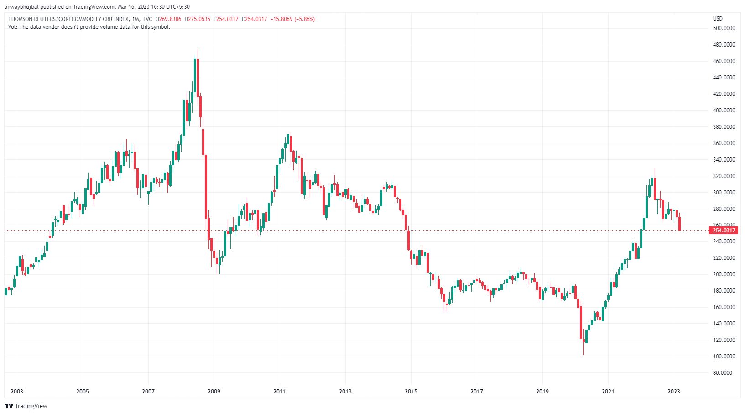
CRB Index – Commodity
Retraced to 61.8% Fibonacci
Source:Investing.com

Slide 80
Lal Path Labs
Stock made high of 4245
Hospital and diagnostics caught traction at the time of covid.
Acquisition of Thyrocare by Pharmeazy, Netmeds by Reliance industries, 1mg by Tata etc
Sector started to see a de-rating, owing to increase in competition, lower growth projection and high valuations
Entry @312
Stock failed to move above breakdown level
270
Exit @3200 after break of support
Volumes on declines
cmp 1867
Down 42% from exit
Source: Falcon7
Case studies are an example ideas meeting the quantitative selection criteria and explains how the portfolio entry, exit and incremental actions are initiated depends upon the various momentum indicators shown above. However, these case study ideas not necessarily to be seen as recommendations or part of the portfolio currently.
The presentation is intended for educational purposes only and does not replace independent professional judgement

Slide 81
Laxmi Organics
Stock made high of 628
Co manufactures Ethyl Acetate, Acetic Acid and Diketene Derivative Products.
During FY20-22, owing to supply chain disruptions, unavailability of raw material, high labour rates etc across the globe, prices of these chemicals skyrocketed.
As the prices cooled down followed by macro QT, the demand scenarios also took a hit, which led to fall in realisations profitability
Entry @312
270
Exit @400
Stock failed to move above breakdown level
cmp 235
Down 41% from exit
Volumes on declines
Source: Falcon7
Case studies are an example ideas meeting the quantitative selection criteria and explains how the portfolio entry, exit and incremental actions are initiated depends upon the various momentum indicators shown above. However, these case study ideas not necessarily to be seen as recommendations or part of the portfolio currently.

Slide 82
Divis Labs
Entry @312
270
Exit @3800 after stock failed to move breakdown level
Volumes on declines
cmp 2801
Down 26% from exit
Source: Falcon7
Case studies are an example ideas meeting the quantitative selection criteria and explains how the portfolio entry, exit and incremental actions are initiated depends upon the various momentum indicators shown above. However, these case study ideas not necessarily to be seen as recommendations or part of the portfolio currently.
Source:F7

Slide 83
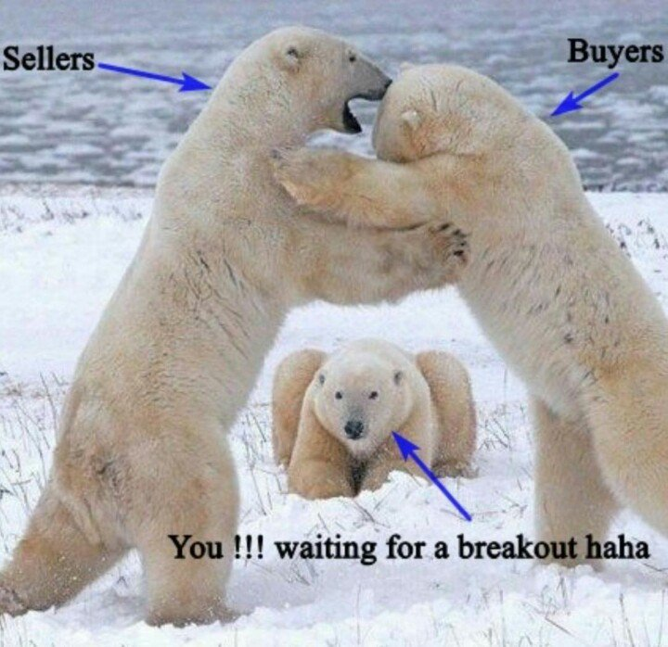
Be opportunistic

Slide 84

“When do you want get diagnosed?”

Slide 85
Edelweiss Financial Services
Consolidation
Support now acting as Resistance
270
Breakdown
Resumption of downtrend
COLD
FEVER
206
ICU
CMP 55
Volumes on declines
Source:F7

Slide 86

Who am I ?

Slide 87
Technical Analysis = Brahmastra
Art of exiting :
Arjun vs Abhimanyu
In Smallcap/high beta/fancy names/new flavours/top newsmakers you have to be Arjun not Abhimanyu

Slide 88
Art of Exit
Info Edge (Star)
Stock made high of 7465
Entry @312
270
Stock failed to move above breakdown level
Exit @5500 on resumption of downtrend
cmp 3425
Down 40% from exit
Volumes on declines
Source: Falcon7
Case studies are an example ideas meeting the quantitative selection criteria and explains how the portfolio entry, exit and incremental actions are initiated depends upon the various momentum indicators shown above. However, these case study ideas not necessarily to be seen as recommendations or part of the portfolio currently.
Source:F7

Slide 89
Vakrangee
High 515
In uptrend forming high forming higher tops and higher bottoms
False Hope
From low recovery of 15%
364
Further confirmation
Now less than 10th value CMP 34
High Volumes
Source:F7

Slide 90
PC Jewelers
High 600
In uptrend forming high forming higher tops and higher bottoms
Intraday
From low recovery of 67%
Close 364
cmp 52
Highest volumes for the stock
Source:F7

Slide 91
Infibeam Avenues
High 242
Recovery from 140 to 225. But failed to move above the highs
First signal
cmp 45
Source:F7

Slide 92

“Avoid falling knives”

Slide 93
Indiabulls Housing Finance
High 242
Breakdown from consolidation range of 1400-1125
Breakdown from consolidation
range of 900-650
cmp 45
Source:F7

Slide 94

“is when kidnapped falls in love with kidnapper. Holding to dicey stocks where promoter ethics is hazy is exactly the same thing. Averaging it when it crashes is one step ahead – actually marrying the kidnapper”

Slide 95
DHFL
Consolidation
Breakdown from consolidation
60% recovery from low of 274 to 438 next day
False Hope
New low
New low
Huge Volumes on declines

Slide 96
Yes Bank
Breakout
383
Breakout failure and Gap down opening at 343
COLD
Again reversal from breakdown level
Consolidation
285
Gap down open at 285
Gap down open at 213
FEVER
ICU

Slide 97


Slide 98

Lower Price + Higher Attraction or
Higher Price + Lower Attraction
RCOM, JP Associates, Suzlon, South Indian Bank
Or
Aarti Industries, 3M India, Godrej Properties

Slide 99

Advisor
Herd Mentality
Understanding risk
Crypto
Small cap
Options

Slide 100
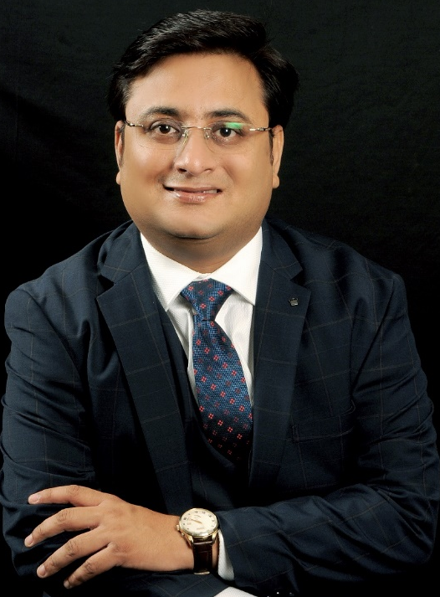
Contact Details
Ashish Chaturmohta
Director, PMS at JM Financial Services Ltd
Qualified Chartered Accountant
Twitter Handle : @Ashishchatur
LinkedIn: https://www.linkedin.com/in/ashishchaturmohta
Email : Ashish.Chaturmohta@jmfl.com

Slide 101
Disclosure
Sebi Registration | INP000000621
Securities | ABB India Ltd, APL Apollo Tubes Ltd, Asian Paints Ltd, Bata India Ltd, Mrs. Bectors Food Specialities Ltd, Bharat Electronics Ltd, Cummins India Ltd, Dabur India Ltd, Devyani International Ltd, Dewan Housing Finance Corporation Ltd, Divi's Laboratories Ltd, Edelweiss Financial Services Ltd, Gland Pharma Ltd, Hindustan Aeronautics Ltd, HDFC Bank Ltd, H.G. Infra Engineering Ltd, Hindalco Industries Ltd, INDIABULLS HOUSING FINANCE Ltd, INFIBEAM AVENUES Ltd, Kalpataru Power Transmission Ltd, KPIT Technologies Ltd, Dr Lal Pathlabs Ltd, Linde India Ltd, Laxmi Organic Industries Ltd, Info Edge(India) Ltd, NTPC Ltd, PC JEWELLER Ltd, POWER GRID CORPORATION OF INDIA Ltd, Sapphire Foods India Ltd, Siemens Ltd, Sundram Fasteners Ltd, SUN TV NETWORK Ltd, Surya Roshni Ltd, Tata Elxsi Ltd, Tata Motors Ltd, Tech Mahindra Ltd, Tech Mahindra Ltd, Titan Company Ltd, Vakrangee Ltd, Yes Bank Ltd
Financial Interest​
Analyst / Fund Manager | No
Analyst's/ Fund Manager Relative | No
Analyst's / Fund Manager’s Associate / Firm | Scrips discussed herein above may be part of investment in the Portfolio Management Services offered by JM Financial Services Ltd (JMFS). JMFS and/or its associates might have provided or may provide services in respect of managing/ co‐ managing offerings of securities, corporate finance, investment banking, mergers & acquisitions, broking, financing or any other services to the company(ies) covered here in above. JMFS and/or its associates might have received during the past twelve months or may receive compensation from the company(ies) covered herein for rendering any of the above services.
Financial Interest of 1% or more
Analyst / Fund Manager | No
Analyst's/ Fund Manager Relative | No
Analyst's / Fund Manager’s Associate / Firm | No

Slide 102
Disclaimer
The investment in securities market are subject to market risks, read all the related documents carefully before investing. The information contained herein are strictly confidential and are meant solely for the information of the recipients and shall not be altered in any way, transmitted to, copied or distributed, in part or in whole, to any other person or to the media or reproduced in any form, without prior written consent of JM Financial Services. (“JMFS”). These are views of JM Financial Services Limited – Portfolio Manager. These views are not specific to any investment approach and may change at any time. The contents of this document are for information purpose only. This document/ communication is not an investment advice and must not alone be taken as the basis for an investment decision. This should not be construed as an offer to sell or buy the securities or other financial instruments and/or to avail any services of JMFS. The recipient of this document must read all the product related documents, Portfolio Management Services (PMS) Agreement/ Disclosure Document including all the risk factors mentioned in the respective documents carefully before making any investment. Investments in securities market including, without limitation, investment through portfolio management services (“PMS”) are highly risky and are subject to market risks including, without limitation, price, volatility, liquidity and capital risks. The investors should not make any investments unless they can afford to take the risk of losing their entire investment. All recipients of this document/ communication must apply their independent judgment based on their specific investment objectives and financial position and using own independent legal and tax consultants, advisors, etc. as to the risks and the suitability of such investment to the recipient’s particular circumstances before making any investment or disinvestment decision. The Investor is solely responsible for any action taken based on this document/ communication. JMFS shall not be liable for any direct or indirect losses arising from the use of the information contained in the document and accept no responsibility for statements made otherwise issued or any other source of information received by the investor and investor would be doing so at his/her/its own risk. The information contained herein should not be construed as forecast or promise or guarantee or assurance of any kind. The investors are not being offered any assurance or guaranteed or fixed returns. In rendering this information, JMFS assumed and relied upon, all the information /details that are available at its disposal and/or that are publicly available. JMFS does not warrant the accuracy, reasonableness and/or completeness of any information mentioned in this document. JMFS takes no responsibility of updating any data/information in this document from time to time. JMFS, its affiliates/associates and any of its directors, officers, employees and any other persons associated with this shall not be liable for any loss, damage of any nature, including but not limited to direct, indirect, punitive, special, exemplary, consequential, as also any loss of profit in any way arising from the use of the information given in this document in any manner whatsoever and shall not be liable for updating the same. Past performance of the Portfolio Manager/Fund Manager/Investment Approach is not necessarily indicative of future performance of the Portfolio Manager/Fund Manager/Investment Approach; the actual returns/performance may materially vary from the past performances. The performance related information provided herein above is not verified by Securities and Exchange Board of India (“SEBI”). The investment objectives, allocation mentioned herein are indicative and there are no assurances/guarantee that the same would be achieved. The securities quoted, if any, are exemplary and are not recommendatory. This document/ communication is not directed or intended for distribution to, or use by, any person or entity who is a citizen or resident of or located in any locality, state, country or other jurisdiction, where such distribution, publication, availability or use would be contrary to law, regulation or which would subject JMFS and/or its affiliated company(ies) to any registration or licensing requirement within such jurisdiction. The securities described herein may or may not be eligible for sale in all jurisdictions or to a certain category of investors. Persons in whose possession this document/ communication may come, are required to inform themselves of and to observe such restrictions.
Note:
The views and opinion shared in this report is formed by the funds management team, based on the publication / research material / public news accessed by the fund management team.
For availing our Portfolio Management Services, you can reach us directly without any intermediation of third party engaged in distribution services, by emailing us at pms.clientservicing@jmfl.com or by calling us on +91 22 5023 7000.
JM Financial Services Limited.
SEBI Registered Portfolio Manager: INP 000000621
Corporate Identity Number: U67120MH1998PLC115415
Corp. Office:5th Floor, Cnergy, Appasaheb Marathe Marg, Prabhadevi, Mumbai 400 025. Tel: No.: (91 22) 6704 0404, Facsimile: (91 22) 6704 3136
Regd. Office: 7th Floor, Cnergy, Appasaheb Marathe Marg, Prabhadevi, Mumbai 400 025. Tel: No.: (91 22) 6630 3030, Facsimile: (91 22) 6630 3223
JMFS Investment Approaches Apex is discretionary portfolio management services (“Managed Account”) offered by the Portfolio Management Services Division of JM Financial Services.

