Slide 1
Exit Methods

Slide 2
Abhimanyu ka Chakravyuh

Slide 3
Best Exit Method
Percentage

Slide 7
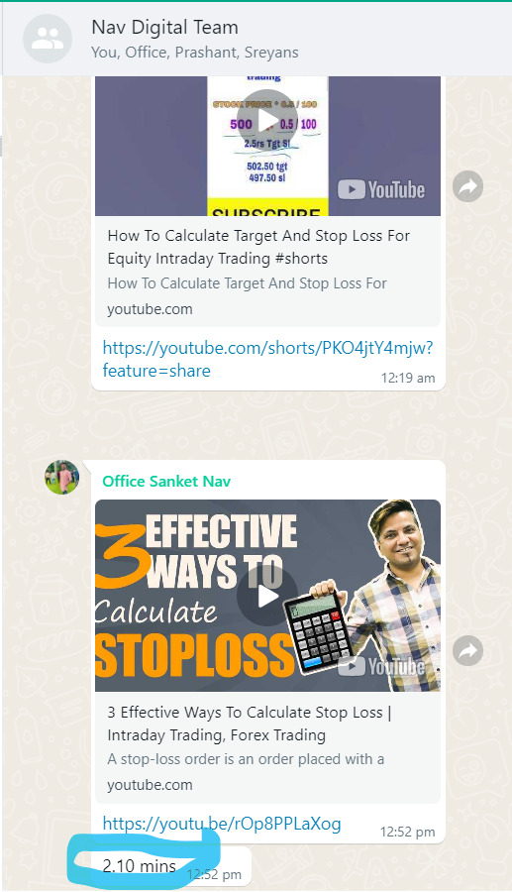

Slide 8
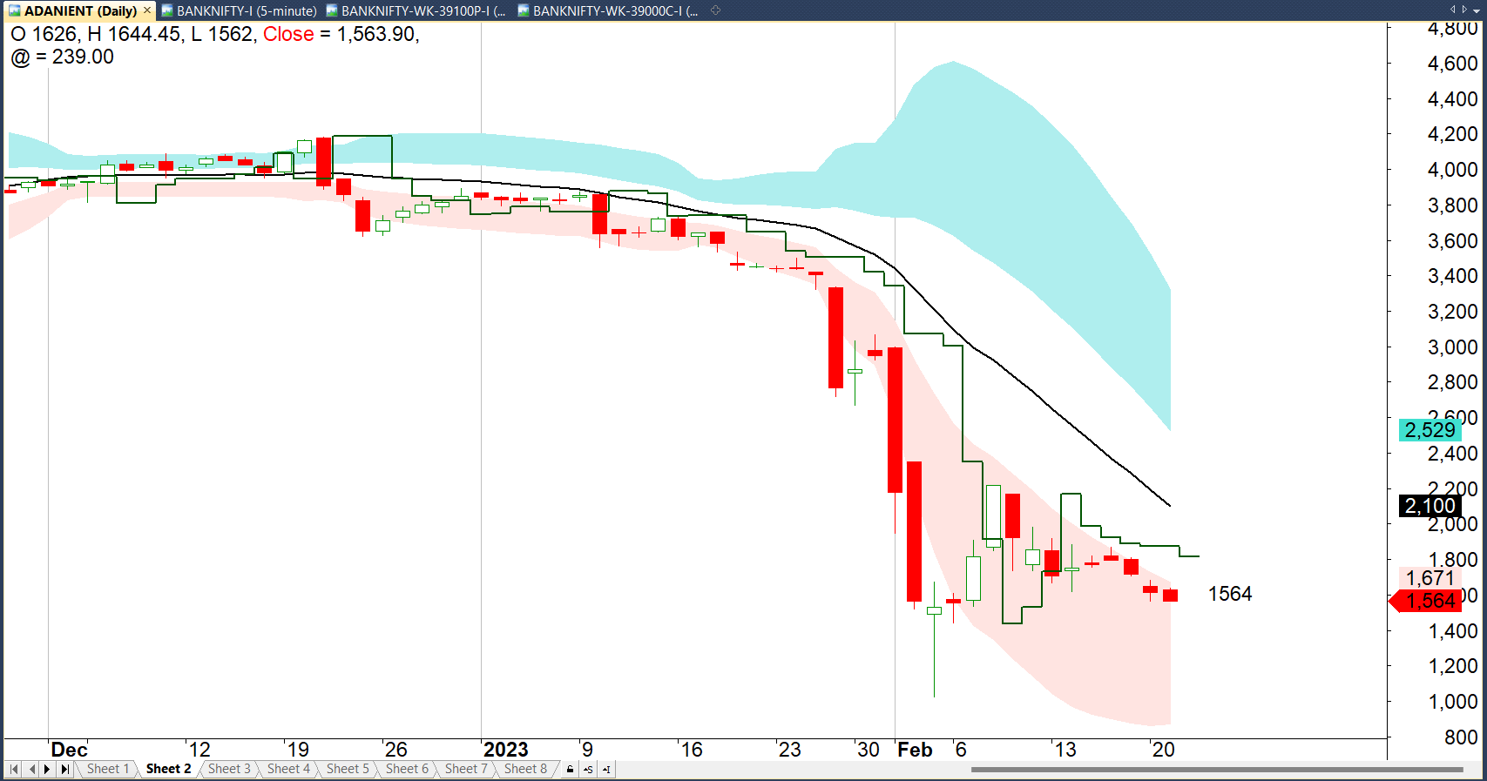
Adani Ent – 21-Feb -2023

Slide 9
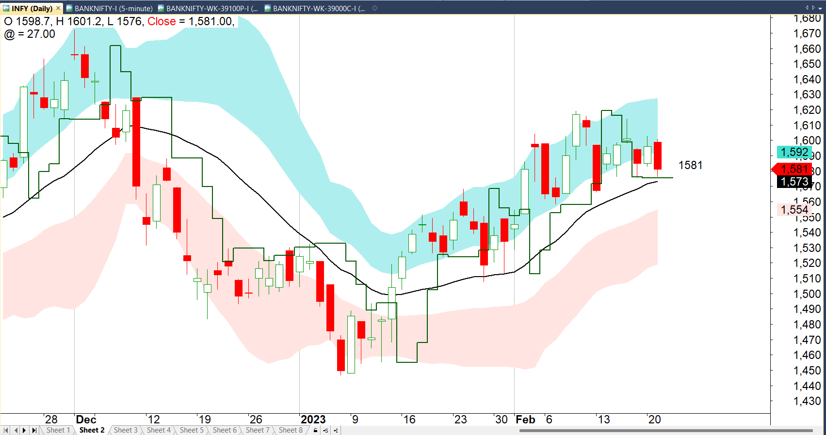
Infosys – 21 Feb 2023

Slide 10
ATR & Super Trend

Slide 11
The average true range (ATR) is a market volatility indicator used in technical analysis.

Slide 12
1. TR = H − L
2. TR = H − C.1
3. TR = C.1 − L
largest value of the 3

Slide 13
ATR is -- period Moving Average of the True Range

Slide 14
Volatility
Entry
Exit
Trend
Stop Loss

Slide 15
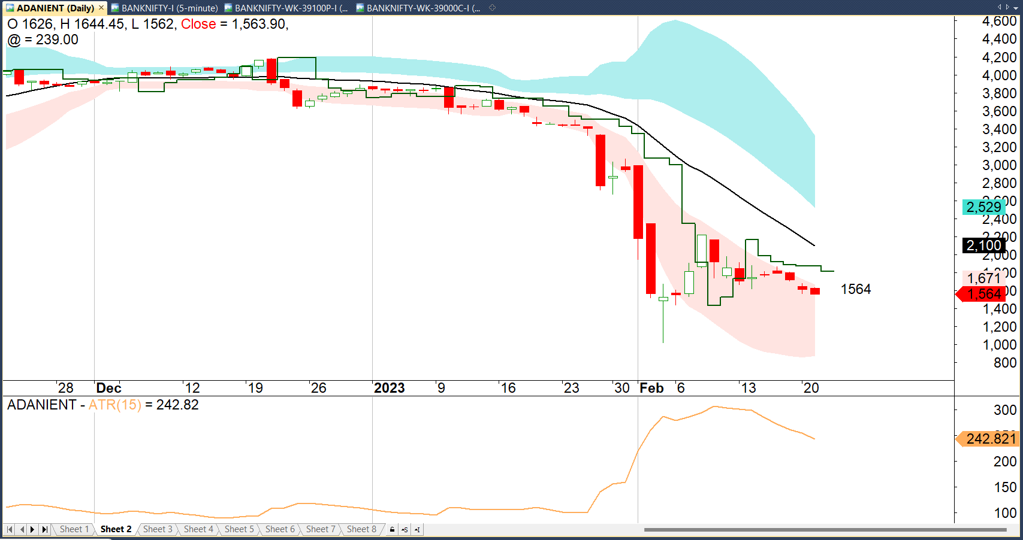
Adani Ent

Slide 16
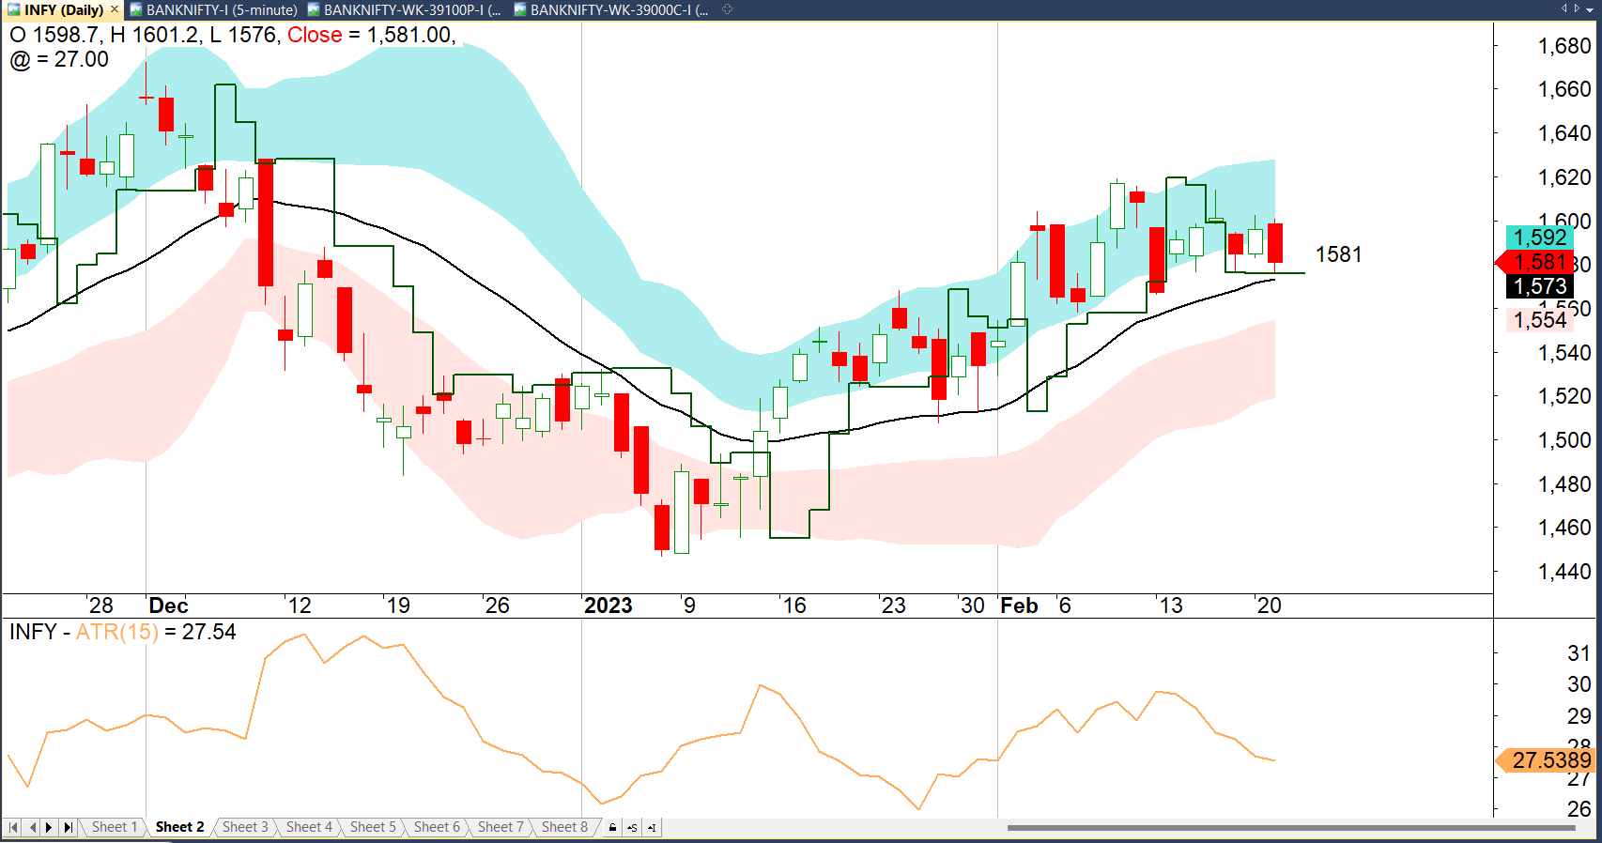
Infy

Slide 17
Parabolic SAR

Slide 18
Uses a trailing stop and reverse method called "SAR," or stop and reverse

Slide 19
Dots are below the candles during the uptrend &

Slide 20
Dots are above the candles during the down trend

Slide 21
PSAR performs best in markets with a steady trend.

Slide 22
In ranging markets, the PSAR tends to whipsaw back and forth, generating false trading signals.

Slide 23
It acts as a trailing stop & Time Stop

Slide 24
It acts as a trailing stop & Time Stop

Slide 25
