Slide 1
TDS Provisions
Latest Amendments
Under the Income-tax Act, 1961
Section 194S
Ashok Guru
ITO, TDS-4, Gandhidham

Slide 2
194S : Deduction of Tax on Payment on transfer of virtual digital asset
The Finance Act 2022 inserted a new section 194S in the Income-tax Act, 1961
to provide for deduction of tax by any person who is responsible for paying consideration to a resident person in respect of the transfer of virtual digital assets (VDAs).
This section has been inserted w.e.f. 1-7-2022.

Slide 3
194S : Deduction of Tax on Payment on transfer of virtual digital asset
VIRTUAL DIGITAL ASSETS:
Any information or code or number or token (Cryptos), which is an alternative form of payment, created using encryption algorithms (Blockchain) such as Bitcoin, Dogecoin etc.
NFT (Non-Fungible Token) and or any other token of similar nature.
Any other digital asset, as the Central Government may, by notification in the Official Gazette specify.
Excludes:
Indian currency or foreign currency (Digital Currency by a central bank, such as Digital Rupee)

Slide 4
194S : Deduction of Tax on Payment on transfer of virtual digital asset
Section 194S of the Income Tax Act, 1961 outlines the tax provisions for payment on transfer of virtual digital assets.
As per the provisions of this section:
any person responsible for paying to any resident, any sum by way of consideration for transfer of a virtual digital asset, shall, deduct an amount equal to one per cent of such sum as income-tax thereon, before releasing the consideration.

Slide 5
194S : Deduction of Tax on Payment on transfer of virtual digital asset
If the consideration for transfer of virtual digital asset is—
(a) wholly in kind or in exchange of another virtual digital asset, where there is no part in cash;
or
(b) partly in cash and partly in kind but the part in cash is not sufficient to meet the liability of deduction of tax in respect of whole of such transfer,

Slide 6
194S : Deduction of Tax on Payment on transfer of virtual digital asset
Then,
the person responsible for paying such consideration shall,
before releasing the consideration,
ensure that tax required to be deducted has been paid in respect of such consideration for the transfer of virtual digital asset.

Slide 7
194S : Deduction of Tax on Payment on transfer of virtual digital asset
Point of Time when TDS to be deducted:
before releasing the consideration.
(at the time of credit of such sum to the account of the resident or at the time of payment of such sum by any mode, whichever is earlier)

Slide 8
194S : Deduction of Tax on Payment on transfer of virtual digital asset
Applicability of Tax Deduction:
Tax deduction is applicable at the time of credit of the sum to the resident's account or payment of the sum, whichever is earlier.
The person responsible for paying consideration must deduct tax even if the transfer of the virtual digital asset is in kind or exchange of another virtual digital asset.
If the transfer is partly in cash and partly in kind, tax deduction is required on the entire sum unless tax is paid on the cash part.
Rate of TDS @ 1% of the consideration

Slide 9
194S : Deduction of Tax on Payment on transfer of virtual digital asset
Who is liable for Tax Deduction:
Person who is responsible for paying the consideration for the transfer of VDA (i.e., the payer) and not of the person who is buying the VDA (i.e., the buyer).
Thus, the payer and buyer of VDA may be a different person.
This generally happens when the VDAs are transferred through an Exchange or Broker.

Slide 10
194S : Deduction of Tax on Payment on transfer of virtual digital asset
Who is liable for Tax Deduction:
Where VDAs are transferred through an Exchange, the buyer would be crediting or making payment to the Exchange (either directly or through a broker). The Exchange would be required to credit or make payment to the owner of VDA (either directly or through a broker).
Since there can be multiple players involved in a transaction taking place through an Exchange, there is a possibility of tax deduction requirement under section 194S at multiple stages.

Slide 11
194S : Deduction of Tax on Payment on transfer of virtual digital asset
Exceptions:
(a) In case of a specified person: the value or aggregate value of such consideration does not exceed fifty thousand rupees during the financial year;
(b) In case of person other than a specified person: the value or aggregate value of such consideration does not exceed ten thousand rupees during the financial year.

Slide 12
194S : Deduction of Tax on Payment on transfer of virtual digital asset
"specified person" means a person:
An individual or a Hindu undivided family, whose total sales, gross receipts or turnover, does not exceed
one crore rupees in case of business or
fifty lakh rupees in case of profession,
during the financial year immediately preceding the financial year in which such virtual digital asset is transferred;
- An individual or a Hindu undivided family, not having any income under the head "Profits and gains of business or profession".]

Slide 13
194S : Deduction of Tax in case of transfer of Virtual Digital Asset
Exclusions:
Consideration paid to a non-resident is not covered under this section.
If the value of VDA does not exceed Rs. 10,000/- during the Financial Year.

Slide 14
194S : Deduction of Tax on Payment on transfer of virtual digital asset
Payer:
Any person other than Individual & HUF.
Ind/HUF required to deduct TDS, if last year Turn Over > Rs. 1 Crore in case of business or Gross Receipts > Rs. 50 Lakhs in case of Profession

Slide 15
194S : Deduction of Tax on Payment on transfer of virtual digital asset
Interplay with Other Provisions:
The provisions of sections 203A (related to TAN allotment) and 206AB do not apply to a specified person.
If a transaction falls under both Section 194S and Section 194-O, tax deduction is required under Section 194S.

Slide 16
194S : Deduction of Tax on Payment on transfer of virtual digital asset
Crediting of Sum to Suspense Account:
If any sum is credited to a Suspense Account or any other account in the books of account of the person liable to pay such sum, it is deemed to have been credited to the account of the payee.
The provisions of Section 194S apply accordingly, and tax deduction is required.

Slide 17
Clarifications:
CBDT Circular No.13 dated 22nd June 2022.
Sub-section (6) of Section 194S authorizes the CBDT to issue guidelines for removal of difficulties
Accordingly, CBDT has issues Guidelines in form of 6 Questions and Answers
Q1 and Q2 of the Guidelines will apply in the cases where transfer of VDA is taking place on or through an Exchange
Q.6 of the Guidelines clarifies that how the limit of fifty thousand (or ten thousand) is to be computed.

Slide 18
Discussion of a few scenario
  Without going into the merit whether VDA is goods or not, it is clarified that once tax is deducted under section 194S of the Act, tax would not be required to be deducted under section 194Q of the Act.
  Exchange may enter into a written agreement with the buyer or his broker that in regard to all such transactions the Exchange would be paying the tax on or before the due date for that quarter.
  it is clarified that the tax required to be withheld under section 194S of the Act shall be on the “net” consideration after excluding GST/charges levied by the deductor for rendering service.

Slide 19
Discussion of a few scenario
  In transactions where payment is being carried out through payment gateways:
  A person ‘XYZ’ is required to make payment to the seller for transfer of VDA. He makes payment of one lakh rupees through digital platform of "ABC“ (Payment Gateway). On these facts liability to deduct tax under section 194S of the Act may fall on both "XYZ" and "ABC”.
  It is clarified that the payment gateway will not be required to deduct tax under section 194S of the Act on a transaction, if the tax has been deducted by the person (‘XYZ’) required to make deduction under section 194S of the Act. .

Slide 20
Discussion of a few scenario
  How the limit of fifty thousand (or ten thousand) is to be computed:
  any sum, representing consideration for transfer of VDA, which has been credited or paid before 1st July 2022 would not be subjected to tax deduction under section 194S of the Act.
  calculation of consideration for transfer of VDA triggering deduction under section 194S of the Act shall be counted from 1st April 2022, if the value or aggregate value of the consideration for transfer of VDA payable by a person exceeds fifty thousand rupees (or ten thousand rupees) during the financial year 2022-23 (including the period up to 30th June 2022).

Slide 21
Technical Aspects related to compliance
The deductor is required to furnish a quarterly statement (in Form No. 26Q) for all such transactions of the quarter on or before the due date prescribed in the Income-tax Rules, 1962.
For specified person Form 26QE has been introduced. Challan-cum-Statement of deduction of tax under section 194S by specify persons.

Slide 22
Technical Aspects related to compliance
Where the Exchange has, agreed to pay tax in relation to a transaction of transfer of a virtual digital asset, owned by it as an alternative to tax required to be deducted by the buyer of such asset under section 194S
The Exchange shall deliver or cause to be delivered, a quarterly statement of such transactions in Form No. 26QF

Slide 23
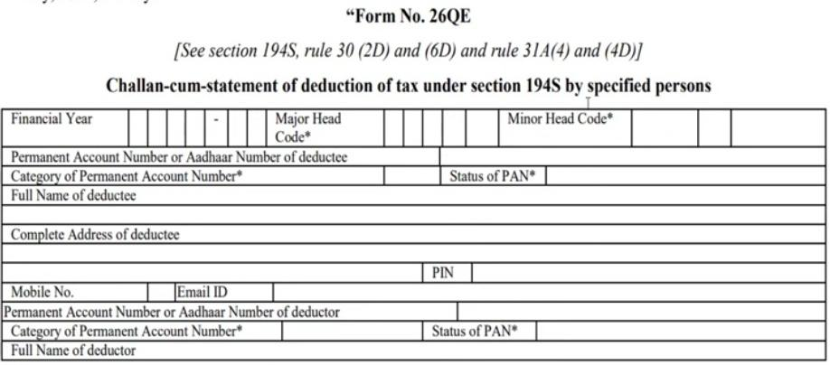
Technical Aspects related to compliance

Slide 24
Troubleshooting
Your Questions?
Please refer to e-tutorial for practical aspect or post your queries in the group.
The Group will remain active for next 24 hours for all persons who want to raise any query.

Slide 25
THANKS FOR YOUR CO-OPERATION

