Slide 1
Private and confidential.
EMPOWERING MSMEs BY MAKING THEM DIGITAL, CREDIBLE, BANKABLE
Support Platform for MSMEs & Opportunities for SMPs
(by AJVA FinTech Private Limited)

Slide 2
MSME Introduction
MSME stands for Micro, Small and Medium Enterprise (MSME), introduced by Government of India in agreement with Micro, Small & Medium Enterprises Development (MSMED) Act, 2006, are entities engaged in the manufacture or production of goods, in any manner or engaged in providing or rendering of any service or services.
Why MSME has special significance for nation
MSMEs contribute nearly ~30% of the country’s GDP. Considered as backbone of Indian economy, contributes substantially to socio-economic development of the country.
Big source of employment generation and works in development of rural & backward areas. [MSME sector has created about 11.10 crore jobs in the country as per National Sample Survey].
Employment opportunities at comparatively lower capital cost than large industries.
~30 million units, manufacturing more than 6,000 products, contributing 45% to manufacturing output and >45% of exports.
Given the national importance of the sector, MSME ministry is helping by way various initiative including in areas of Skill Development, Technology, Credit availability through various schemes, Capital subsidies etc.
Notes:
Currently trading activities are not covered under MSME. Maintenance/repair and trading of motor vehicles included.

Slide 3
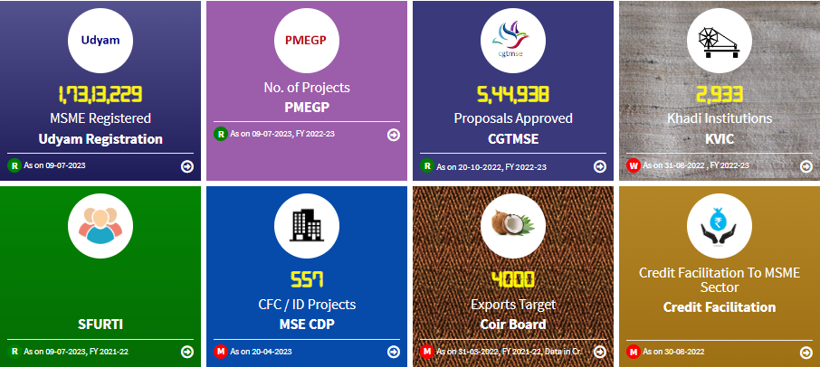
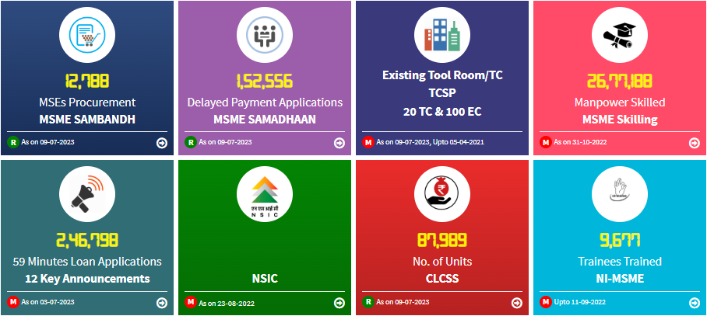
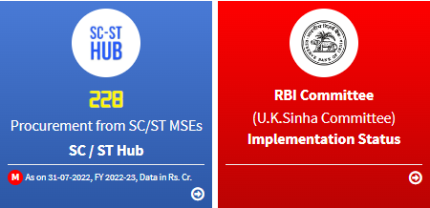
Glimpse MSME Dashboard
As per MSME dashboard - https://dashboard.msme.gov.in,
Notes:
MSME Dashboard

Slide 4
MSME Key Statistics
~2 Cr Udyam Registration till date, 1.94 crore, 5.56 lacs and 52K being Micro, Small and Medium respectively- Maharashtra has highest number of registrations.
CGTMSE – In 22-23, Total 5,44,938 cases have been approved extending guarantee for Rs. 45,921 Cr. Where 27,609 claims have been settled for Rs. 546.08 Cr.
Central Public Sector Undertaking (CPSUs) units to make mandatory procurement of 25% from MSEs and 3% out of this will be from Women Entrepreneurs.
During 2022-23 so far, CPSUs have procured goods and services worth Rs 50,022.12 crore from 1,84,576 MSEs that worth out to be 34.71% of the total procurement.
Out of which goods and services worth Rs 1,475 crore from 9,857 women MSEs that worth out to be 1.02% of the total procurement.
CPSUs to compulsorily be part of Public Procurement Portal GeM- Government e-Marketplace. CPSUs to get their vendors registered on GeM portal
Total 8,52,933 MSE Sellers & Service providers registered on GeM portal.
55.27% of orders value on GeM portal is from MSEs.
As per MSME dashboard - https://dashboard.msme.gov.in,
Govt e Market place - https://gem.gov.in/ , https://dashboard.msme.gov.in/12_nnouncements.aspx
Notes:
MSME Dashboard

Slide 5
MSME Definition
Micro
Small
Medium
Investment in Plant and Machinery or Equipment: Not more than Rs.1 crore and
Annual Turnover ; not more than Rs. 5 crore
Investment in Plant and Machinery or Equipment: Not more than Rs.10 crore and
Annual Turnover ; not more than Rs. 50 crore
Investment in Plant and Machinery or Equipment: Not more than Rs.50 crore and
Annual Turnover ; not more than Rs. 250 crore
Manufacturing Enterprises and Enterprises rendering Services
Ministry of Micro, Small and Medium Enterprises vide Office Memorandum (OM) No. 5/2(2)/2021-E/P & G/Policy dated July 2, 2021, has decided to include Retail and Wholesale trade as MSMEs for the limited purpose of Priority Sector Lending.

Slide 6
MSME Framework – Composite Definition
Composite criteria of investment and turnover for classification
If an enterprise crosses the ceiling limits specified for its present category in either of the two criteria of investment or turnover, it will cease to exist in that category and be placed in the next higher category, but no enterprise shall be placed in the lower category unless it goes below the ceiling limits specified for its present category in both the criteria of investment as well as turnover.
All units with GSTIN listed against the same PAN shall be collectively treated as one enterprise and the turnover and investment figures for all of such entities shall be seen together and only the aggregate values will be considered for deciding the category as micro, small or medium enterprise.
RBI Circular reference RBI/2020-2021/10 FIDD.MSME & NFS.BC.No.3/06.02.31/2020-21
All the enterprises will have to follow this guideline for classification purposes w.e.f. July 1, 2020.

Slide 7
MSME Framework – Identify Investment in Plant and Machinery & Equipment
Calculation of investment in plant and machinery or equipment
The calculation of investment in plant and machinery or equipment will be linked to the ITR of the previous years filed under the Income Tax Act, 1961
In case of a new enterprise, where no prior ITR is available, the investment will be based on self-declaration of the promoter of the enterprise and such relaxation shall end after the 31st March of the financial year in which it files its first ITR.
The expression ‘’plant and machinery or equipment’’ of the enterprise, shall have the same meaning as assigned to the plant and machinery in the Income Tax Rules, 1962 framed under the Income Tax Act, 1961 and shall include all tangible assets (other than land and building, furniture and fittings).
The purchase (invoice) value of a plant and machinery or equipment, whether purchased firsthand or second hand, shall be considered excluding Goods and Services Tax (GST), on self-disclosure basis, if the enterprise is a new one without any ITR.
RBI Circular reference RBI/2020-2021/10 FIDD.MSME & NFS.BC.No.3/06.02.31/2020-21

Slide 8
MSME Framework – Turnover
Exports of goods or services or both, shall be excluded while calculating the turnover of any enterprise whether micro, small or medium, for the purposes of classification.
Information as regards turnover and exports turnover for an enterprise shall be linked to the Income Tax Act or the Central Goods and Services Act (CGST Act) and the GSTIN.
The turnover related figures of such enterprise which do not have PAN will be considered on self-declaration basis for a period up to 31st March 2021 and thereafter, PAN and GSTIN shall be mandatory
RBI Circular reference RBI/2020-2021/10 FIDD.MSME & NFS.BC.No.3/06.02.31/2020-21
Notes:
Export is excluded for turnover definition. Which means you can enjoy MSME benefits if you are entirely on export business, subject to meeting the Plant & Machinery criteria
In case of upward change (movement from Micro to Small and Small to Medium) – prevailing status to continue for one year
In case of downward change (movement from Medium to small or small to micro) – from next financial year from the year it became eligible for changed category

Slide 9
MSME “UDYAM” Registration
Government has organized a system to facilitate the registration of MSMEs. Enterprise registered under the MSMED Act, 2006 will be know as Udyam.
Any person who intends to establish a micro, small or medium enterprise may file Udyam Registration online in the Udyam Registration portal
Registration Process is totally free.
Udyam Registration process is fully online, paperless and based on self-declaration.
On registration, enterprise will be assigned a permanent identity number to be known as “‘Udyam Registration Number”.
There is no renewal required for the certificate
Having PAN & GST number is mandatory from 01.04.2021
PAN & GST linked details on investment and turnover of enterprises will be taken automatically from Government data bases.
For those already having registration as UAM may migrate to Udyam
Udyam Registration is free on - https://udyamregistration.gov.in
Notes:
MSME registration process is fully online, paperless and based on self-declaration.
No documents or proof are required to be uploaded for registering an MSME.
Only Aadhaar Number will be enough for registration.
PAN & GST linked details on investment and turnover of enterprises will be taken automatically from Government data bases.
Our online system will be fully integrated with Income Tax and GSTIN systems.
Having PAN & GST number is mandatory from 01.04.2021.
Those who have EM-II or UAM registration or any other registration issued by any authority under the Ministry of MSME, will have to re-register themselves.
No enterprise shall file more than one Udyam Registration. However, any number of activities including manufacturing or service or both may be specified or added in one Registration.

Slide 10
UDYAM Registration Certificate
Mandate from regulator:
All existing enterprises registered under EM–Part-II or UAM shall register again on the Udyam Registration portal on or after the 1st day of July 2020.
All enterprises registered till 30th June 2020, shall be re-classified in accordance with this notification
The existing enterprises registered prior to 30th June 2020, shall continue to be valid only for a period up to the 30th June 2022. [Gazette notification dated 6th May 2022 no. S.O. 2134 E)
As per para 2 of the said Gazette notification all enterprises are required to register online and obtain ‘Udyam Registration Certificate’. All lenders may, therefore, obtain ‘Udyam Registration Certificate ’from the entrepreneurs.
[RBI/2020-2021/26 FIDD.MSME & NFS.BC.No.4/06.02.31/2020-21]
Notes:
In future all MSME schemes related benefits may be linked directly through this number, hence its must for all MSMEs
Speak about NBFC AA license and data aggregation

Slide 11
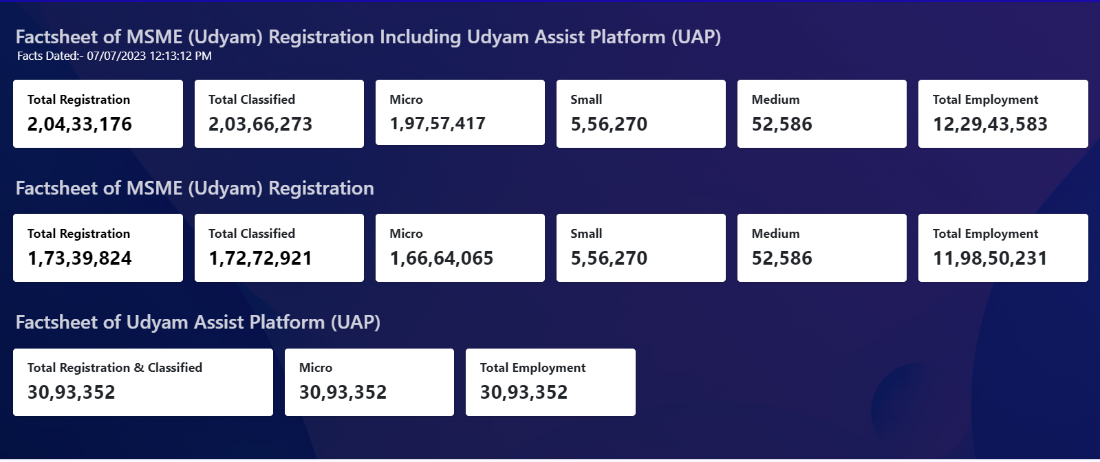
MSME “UDYAM” Factsheet
Udyam Registration is free on - https://udyamregistration.gov.in . Date dated 7th July 2023
Notes:
MSME registration process is fully online, paperless and based on self-declaration.
No documents or proof are required to be uploaded for registering an MSME.
Only Aadhaar Number will be enough for registration.
PAN & GST linked details on investment and turnover of enterprises will be taken automatically from Government data bases.
Our online system will be fully integrated with Income Tax and GSTIN systems.
Having PAN & GST number is mandatory from 01.04.2021.
Those who have EM-II or UAM registration or any other registration issued by any authority under the Ministry of MSME, will have to re-register themselves.
No enterprise shall file more than one Udyam Registration. However, any number of activities including manufacturing or service or both may be specified or added in one Registration.

Slide 12
Benefits of being an MSME
Priority Sector Lending (PSL): Banks, by virtue of the RBI guidelines, have certain earmarked funds that have to mandatorily be given to MSMEs (at present 7.5 per cent of Adjusted Net Bank Credit (ANBC) or Credit Equivalent Amount of Off- Balance Sheet Exposure for Micro Enterprises).
Exemption under Direct Tax Laws: To boost investment, the corporate tax rate for new companies in the manufacturing sector has been reduced to 15% (17% incl SC), concessional rate is available for entities incorporated till 31st March 2024. Tax holiday period of 3 consecutive AY out of first 7 years of incorporation is available at the option of the taxpayer, to an eligible start-up.
Preference in Government procurement: The Public Procurement Policy for Micro and Small Enterprises (MSE) order 2012 has mandated every Central Ministry/Department/PSU to procure minimum 25 per cent of the total annual purchases from the products or services produced or rendered by MSEs.
Subsidy for patent registration: Under various schemes, registered Indian MSME will be provided one-time financial support limited up to:
Upto Rs. 1 lakh- for on grant of domestic patent
Upto Rs. 5 lakh for foreign patent
Upto Rs. 2 lakh for registration under Geographical Indications of Goods Act.

Slide 13
Benefits of being an MSME
Protection against delayed payment
Any buyer purchasing from MSME sellers needs to make payment within 15 days from the date of agreement/delivery, as the case maybe. In any case, a payment due to a MSE cannot exceed 45 days from the due date. In case of failure, the buyer is required to pay compound interest. The penal interest chargeable for delayed payment to a MSME enterprise is three times of the bank rate notified by the Reserve Bank of India [Chapter V of MSMED Act, 2006]
Collateral free loans
Various Schemes are launched by the Government of India to make available collateral-free credit to the micro and small enterprise sector. Both the existing and the new enterprises are eligible to be covered under such schemes.
Easy in getting licenses, approvals and registrations
It has made very easy for enterprises that are registered under MSME to obtain Licenses, approvals and registrations on any field for their business from the respective authorities as they can produce the Certificate of MSME Registration while making application.
Reservation policies to manufacturing / production sector:
Reservation of items for exclusive manufacture in SSI sector statutorily provided for in the Industries (Development and Regulation) Act, 1951, has been one of the important policy measures for promoting this sector. The Reservation Policy has two objectives
Ensure increased production of consumer goods in the small scale sector
Expand employment opportunities through setting up of small scale industries
Contd.

Slide 14
Specialised portals for MSME Support
Udyam Registration Portal: Authorized portal of Government of India for Udyam registration. [https://udyamregistration.gov.in ]
MSME Sambandh: The Public Procurement Policy has mandated every Central Ministry/Department/PSU, with the objective of achieving procurement goal of minimum 25 per cent of the total annual purchases from MSMEs. Sambandh is the dashboard where the government reports the numbers done under this policy. [https://sambandh.msme.gov.in ]
Government e-Marketplace [Government Procurement]
GeM is an Online Market platform to facilitate procurement of goods and services by the government ministries, departments, public sector undertakings (PSU) etc. [ https://gem.gov.in ]
GeM Sahay app – for Proprietors, no buyer consent needed, frictionless financing to serve govt orders (GeM POs), lenders to bid for invoices, no collateral [ https://gem.gov.in/sahay ]
TReDS (Trade Receivables Discounting Scheme) –
There are 3 designate platforms where you can register your entity for invoice discounting. [RXIL, Invoicemart, M1xhcange]. MSMEs can discount their invoices using this platform, this is very effective platform to manage the working capital requirement.
All companies registered under Companies Act having a turnover of more than Rs.500 crores and all Central Public Sector Enterprises are required to onboard a TReDS platform.

Slide 15
Specialised portals for MSME Support
MSME Sampark: The challenge remains for small businesses and entrepreneurs to find the right person for the job with relevant experience and skill-set. The MSME Sampark portal is a digital platform, wherein, jobseekers (passed out trainees / students of 18 MSME Technology Centers) and recruiters, multinational companies register themselves for getting employment and getting right kind of manpower respectively. [ http://sampark.msme.gov.in ]
Champions (Creation and Harmonious Application of Modern Processes for Increasing the Output and National Strength) –
To help the MSMEs facing difficult situations in terms of finance, raw materials, labour, permissions, etc.
To help the MSMEs capture new opportunities in manufacturing and services sectors.
To identify the sparks, i.e., the bright MSMEs who can withstand at present and become national and international champions. [ https://champions.gov.in ]
MSME Samadhaan: Ministry of MSME has taken an initiative to address the issue related to delayed payments and has set up a Delayed Payment Monitoring System wherein the supplier MSE unit can file an online application against the buyer of goods/services, who is delaying the payments, before the concerned Micro and Small Enterprises Facilitation Council of the concerned State/UT. [ https://samadhaan.msme.gov.in ]
MSME Databank: MSME Databank is built to create comprehensive database of MSMEs across the country which will facilitate in policy formulation and Public Procurement Policy of Government of India. [ https://www.msmedatabank.in ]
Notes:
PM on 1st June 2020 launched portal called CHAMPIONS (Creation and Harmonious Application of Modern Processes for Increasing the Output and National Strength) to solve their grievances, encourage, support, handhold and help

Slide 16
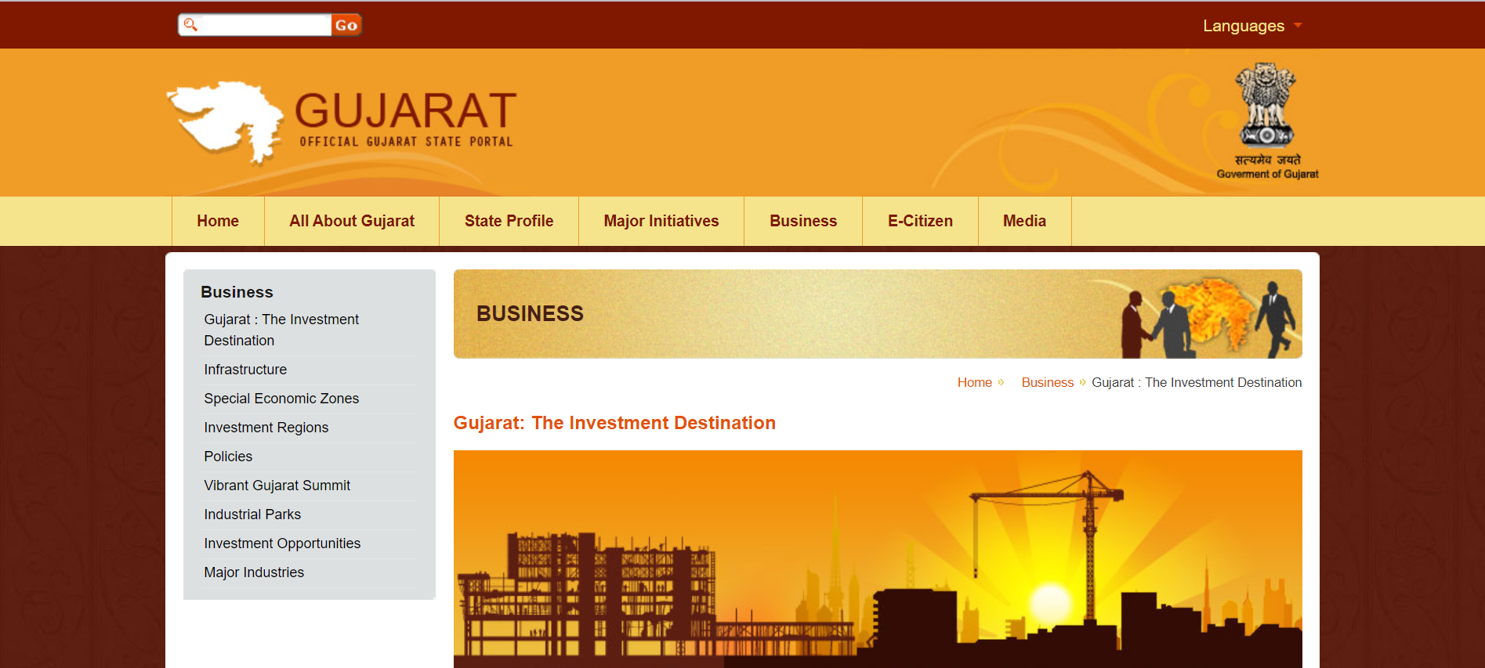
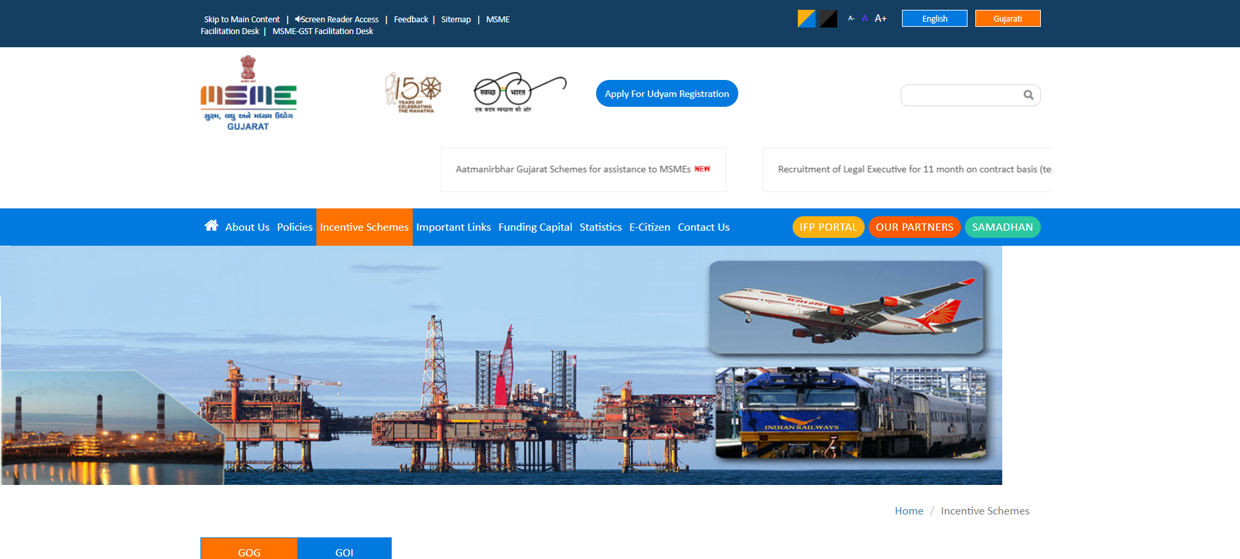
State-level portals for MSME Support
Maharshtra
Telangana
Gujarat
Notes:
PM on 1st June 2020 launched portal called CHAMPIONS (Creation and Harmonious Application of Modern Processes for Increasing the Output and National Strength) to solve their grievances, encourage, support, handhold and help

Slide 17
Union Budget 24 Highlights
Again, proving its focus and thrust on the MSME sector the central government has brought in 4th consecutive MSME favoring budget.
Revamped collateral free loan scheme for MSMEs (CGTMSE Scheme) from 1st April 2023 through infusion of Rs.9,000 crore in the corpus. This will enable additional collateral-free guaranteed credit of Rs.5 lakh crore. Further, the cost of the credit will be reduced by about 1%.
Under Vivad se Vishwas initiative, in cases of failure by MSMEs to execute contracts during the Covid period, 95% of the forfeited amount relating to bid or performance security, will be returned to them by government and government undertakings.
Deduction for expenses incurred and due to MSMEs will be allowed only on actual payment basis. This will help MSMEs in timely recovery of their receivables.
Tax benefits of 3-year tax holiday to registered startups has been extended to include entities that are incorporated and registered as startups till 31st March 2024. Previously, the relaxation applied for losses incurred during the period of 7 years from incorporation of such start-up it has now been increased to 10 years.
The condition of continuity of at least 51% shareholding for setting-off of carried forward losses is relaxed for an eligible start up if all the shareholders of the company continue to hold those shares.
Under the Mission Karmayogi, for enhancing ease of doing business, more than 39,000 compliances have been reduced and more than 3,400 legal provisions have been decriminalized.
Notes:
Simplification of following processes
The KYC process will be simplified adopting a ‘risk-based’ instead of ‘one size fits all’ approach.
One stop solution for identity and address updating using DigiLocker services and Aadhaar
PAN to become a Common Business Identifier
Unified Filing Process - filing of information or return to different government agencies in simplified forms on a common portal.

Slide 18
Five key aspects of facilitating MSMEs
Hon’ble Prime Minister mentioned following aspects while launching outreach initiative for MSME sector on 2nd November 2018
Access to credit
Started with online portal called ‘loan in 59 minutes’, enabling in principal approval of loans
Access to market
25% procurement of CPSU through MSMEs only, with 3% reserved for women entrepreneurs .
Technology upgradation
20 technology hubs across the country, and 100 spokes in the form of tool rooms.
Ease of doing business
Reducing or bundling of regulatory compliances
Social Security for MSME Sector Employees
Jandhan, Provident Fund, Pension and other insurance related scheme
https://pib.gov.in/Pressreleaseshare.aspx?PRID=1551776
Notes:
According to the World Bank, India ranked 63rd in 2022 in ease of doing business across the world among 190 countries, improving its rank from 142 in 2014. Back in 2018, the Modi government also pledged to take the country to the top 50 in EoDB rankings.
India is ranked 40th position out of 132 in the Global Innovation Index (GII) 2022 rankings released by World Intellectual Property Organization (WIPO). Last year India was ranked 46th.

Slide 19
Key MSME Schemes
Credit Guarantee Fund Trust for Micro and Small Enterprises (CGTMSE):
Loan up to a limit of Rs. 5 crore is available collateral free for a MSE on payment of guarantee-fee to bank by the MSE.
Guarantee coverage ranges from 75% (For loans from Rs.5 lacs to 5 Crs) to 85% (For loans to Micro Enterprise up to Rs 5 lakh ). 85% coverage for Women/SC/ST/NER/Zed Certified MSEs and 75% coverage for all other categories (previously, it was only 50% for retail/wholesale traders).
Stand-Up India Scheme:
SC/ST entrepreneurs and/or women entrepreneurs undertaking greenfield projects are eligible for the scheme.
The scheme facilitates bank loans between Rs. 10 lakh to Rs. 1 crore backed by the government guarantee, up to maximum 85% of the project cost inclusive of term loan and working capital loan (Composite loan).
Prime Minister’s Employment Generation Program (PMEGP):
The scheme is applicable for the projects costing more than Rs.10 lakh and less than Rs.50 lakhs in manufacturing and more than Rs.5 lakh and less than Rs.20 lakhs in business/service sector.
Subsidy as % of project cost –
General category - 15% (Urban), 25%(Rural)
Special Category (SC/ ST/ OBC/ Minorities/Women, Ex- servicemen, PH, NER, Hill and Border areas, etc.) - 25% (Urban), 35% (Rural).
Notes:
1. MUDRA scheme covers small loans up to 10 lacs hence not covered

Slide 20
Key MSME Schemes
Interest Equalisation Scheme on Pre & Post Shipment Rupee Export Credit:
The scheme provides for specified interest rate subvention to all MSME exporters exporting any HS line and to merchant and large exporters exporting along the specified lines:
3% subvention for MSME manufacturer exporters exporting under any Harmonized System lines.
2% subvention for manufacturer exporters and merchant exporters exporting under 410 Harmonized System lines (after excluding 6 Harmonized System lines pertaining to Telecom Sector).
Remission of Duties and Taxes on Exported Products (RoDTEP):
Reimbursement of taxes and duties, which are not exempted or refunded under any other scheme in accordance with World Trade Organization (WTO) norms.
Benefit available to all exports except for the list of 9 categories of export items provided in the scheme.
Service Exports from India Scheme (SEIS):
Service providers of eligible services shall be entitled to Duty Credit Scrips (a scrip which can be used for the payment of Customs Duty) at the rate of 3 - 5 % on net foreign exchange earned. The validity of duty credit scrips is 24 months from date of issue.
Notes:
1. MUDRA scheme covers small loans up to 10 lacs hence not covered

Slide 21
Key MSME Schemes
Merchandise Exports from India Scheme (MEIS):
Provides rewards to exporters in form Duty Credit Scripts. These Duty Credit Scrips or goods imported/ domestically procured against the scripts are freely transferable. The Duty Credit Scrips can be used for: payment of basic customs duty and additional customs duty for import of inputs or goods, including capital goods; payment of central excise duties on domestic procurement of inputs or goods.
State Planned Scheme: Strengthening of Export Promotion:
MSMEs in Maharashtra participating in international exhibition/trade fair held in India or abroad are assisted by giving space rent incentive of 50% of the actual space rent paid or a maximum of Rs 1 Lakh, after certification by the India Trade Promotion Organisation, New Delhi or the Export Promotion Councils established by the Central Government.
SIDBI Assistance To Export Oriented MSMEs Under Ubharte Sitaare Programme:
Term loans to Export oriented MSMEs for expansion, modernisation, diversification, technology / capacity upgradation, product R&D, etc, by investment in land and building, machinery and equipment, etc.
Need based facility of Term Loan/Foreign Currency Term Loan (FCTL), subject to maximum of 80% of the project cost.
Notes:
1. MUDRA scheme covers small loans up to 10 lacs hence not covered

Slide 22
saarthi.emsme.com

Slide 23
Opportunity to add MSME sector as your practice
Do you wish add a new stream of business with huge potential for revenues and knowledge?
Consulting a sector which will contribute 50% of India’s GDP by 2025. And be a part in Nation Building
Sector which is Unstructured and mostly physical, requires handholding support.
And do all these using Digital platforms.
Government setting aside annual budgets >15000 Cr. Running more than 500 schemes to support
Come, be a partner with eMSME-Saarthi

Slide 24
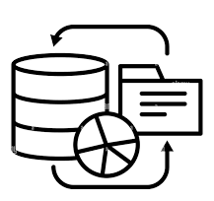
What is eMSME Saarthi platform?
1
Database of pan India MSME schemes – easy to navigate basis business specific criteria
Single source for all MSME Schemes
2
Know the exact amount of benefits, easy process to apply, where to apply
Simplified Information Scheme Discovery Report
3
Apply on eMSME Saarthi platform – our expert will guide on end-to-end benefit fulfilment to your account
Expert Assisted fulfilment
4
Know the list of required registration or certificates basis your business type
Compliance Health Check
One automated platform for all MSME schemes from curated discovery to completed fulfilment

Slide 25
Key benefits of using eMSME Saarthi platform
Real time updated scheme information
Team of experts is updating the scheme database regularly by simplifying the information from more than 100 different sources
Network of MSME experts for fulfilment
We have partnered with experts who can provide customised support in fulfilling the scheme benefits for your clients.
Tie-up with Banks/FI
We are empanelled with Banks/FIs – provide support in availing Banking related MSME schemes
Arrangement with TReDS platform, GeM experts and ZED experts
Expert trainings, seminar, webinar
Team of MSME experts providing training and regular guidance to MSMEs on schemes, various regulation, registration and others.

Slide 26
Proposition for CA partners
1
Generate Scheme Discovery Report
Select the schemes which your client wish to get fulfilment
Generate and print customised scheme discovery report for your MSME client.
Advise client on end-to-end fulfilment using the summary scheme information with process of application
2
Use our network of experts for fulfilment of schemes
You can avail help of our network for fulfilment, do raise request to us, using our partner portal
Your client will be served under your brand by our expert as your agency
You can price the fees as you want
eMSME charges (availment cost) will be fixed and confirmed upfront with TAT
You can also come and join our network of fulfilment experts
3
Use our team for free trainings and awareness on schemes
We provide free educational material and updates during our partnership period
You can ask for customised in-person training program by our experts
Regular guidance on Saarthi platform updates

Slide 27
Packages specifically curated for CA partners
Package type
Package Inclusions
Annual Cost (Rs)
1
Platinum Partners
6 trainings and webinars by our expert teams
Generation of Scheme Discovery Report - 750
3 Fulfilment assistance of scheme by our experts
One annual scheme publication co-branded with partner logo and branding for onward delivery to your MSME clients
Dedicated expert assigned for any real time question/answers
Rs. 45,000
2
Gold Partners
3 trainings programs and webinars by our expert teams
Generation of Scheme Discovery Report - 300
2 Fulfilment assistance of scheme by our experts
Dedicated expert assigned for any real time question/answers
Rs. 25,000
3
Silver Partners
Generation of Scheme Discovery Report - 50
1 Fulfilment assistance of scheme by our experts
Dedicated expert assigned for any real time question/answers
This package can be upgraded within 3 months of subscription
Rs.5,000

Slide 28
Packages specifically curated for CA partners
Package type
Package Inclusions
Annual Cost (Rs)
4
Advance Plan
Generation of Scheme Discovery Report – 25
Dedicated expert assigned for any real time question/answers
Rs. 3,000
5
Basic Plan
Generation of Scheme Discovery Report - 15
Dedicated expert assigned for any real time question/answers
Rs. 2,000
6
Trial Plan
Rs. 0.00
Generation of Scheme Discovery Report - 02
Dedicated expert assigned for any real time question/answers
eMSME Smart Invoicing and e-invoicing software will be free for a limited period to all CA partners

Slide 29
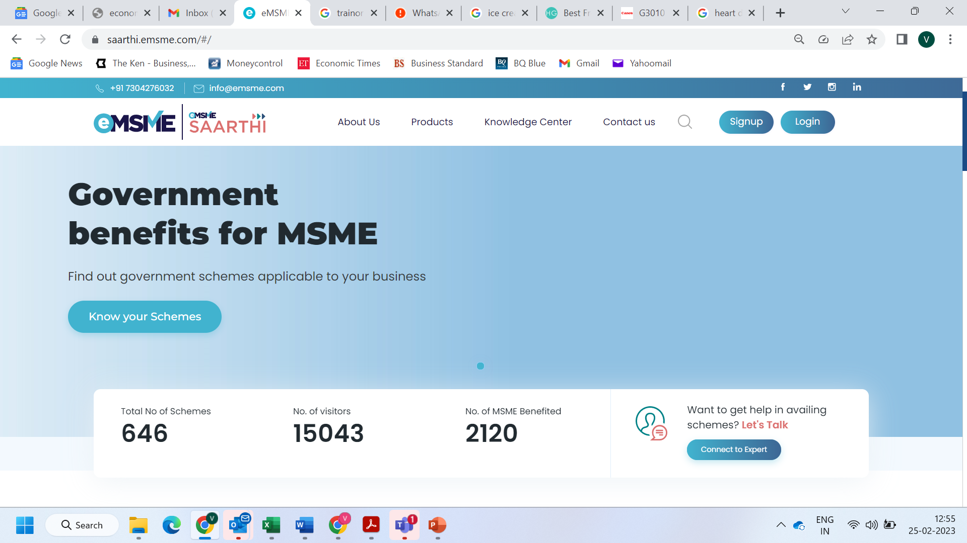
How does Saarthi portal looks? [saarthi.emsme.com]
eMSME Saarthi Platform

Slide 30
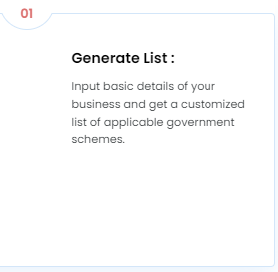
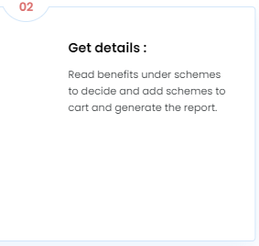
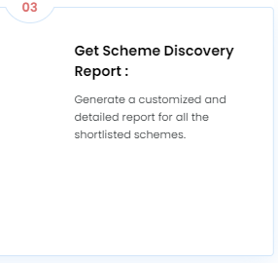
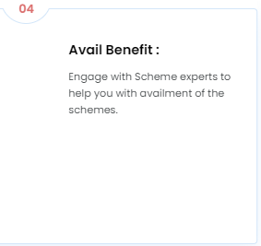
How does Saarthi Work

Slide 31
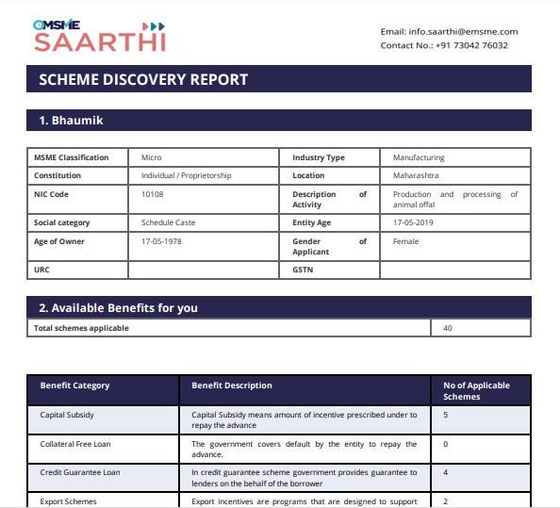
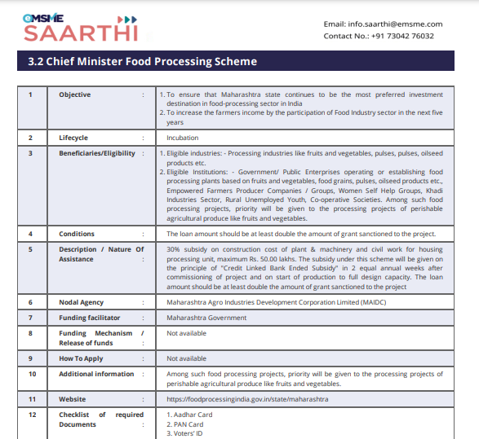
Scheme Discovery Report

Slide 32
Core Values: 4Is
Ethically steward our company and contribute for business success
Customised solutions for recurring need of ever-changing business dynamics
Integrity
Innovation
01
02
03
04
Inclusion
Impact
Catering to the underserved MSME sector to help them avail business solutions at affordable cost
Providing accessibility to one-stop service for a transformational business journey & creating larger community impact

Slide 33
AJVA FINTECH PVT. LTD.
info@emsme.com
407, Lodha Supremus, Off Mahakali Caves Road, Andheri East, Mumbai-400069.
www.emsme.com
73042 76032

