Slide 1
Angel Investing –
Masterclass
TURNING IDEAS INTO ASSETS.

Slide 2
“There are only two ways to make money in startups:
To create something valuable
Or
To invest in the people that are creating valuable things.”
- Jason Calacanis
Confidential - Do not duplicate or distribute without written permission from IA.

Slide 3

Module 1- What, Who, Why
  Landscape/ The Opportunity
  What is Angel Investing
  Who is an Angel Investor
  Reasons to NOT BE and BE an angel investor
  Expectations from Angel Investing
  Capital Allocation

Slide 4
Module 2- How
  How to Hack Angel Investing - Syndicates
  Evaluate Deals
  Make Investments – The Process
  Post Investment Engagement

Slide 5
Indian Startup Ecosystem: A Snapshot
99K+
$180 Bn
108
Indian Startups Launched to Date
Funding Raised by Indian Startups by end of 2023
Indian Startups in the Unicorn Club
4,413
26K+
$340.8 Bn+
Funded Startups in India
Angel Investors in India
Combined Valuation Of Indian Unicorns
1.4K
100+
17
M&As Recorded by end of 2023
Indian Startups in the Soonicorn Club
Indian Internet Companies Listed to Date

Slide 6






WHO IS PARTICIPATING IN THIS WEALTH CREATION & WHO ISN’T?
The Opportunity
Founders
Venture Funds
Angel Investors
US $90 BN ECOSYSTEM VALUATION
Seed Funds
Networks & Syndicates
Accelerators
Confidential - Do not duplicate or distribute without written permission from IA.
Notes:
And this wealth creation is being capitalized early, primarily by the entrepreneurs who are taking advantage of disruptive innovations and by the angel & venture capitalists who are backing them.

Slide 7

What is Angel Investing?
Angel Investing is act of putting money into the earliest rounds of a private business with the goal of getting back more money than you put in.

Slide 8





What do early stage startups look like?
Typically less than 3 years old
Small Team
Early Traction- Few Paid Customers
Trying to find product-market fit

Slide 9
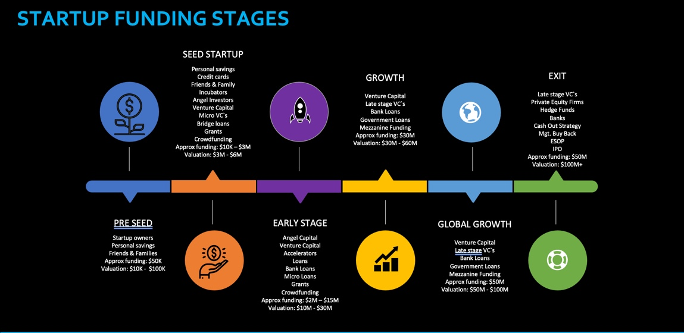

Slide 10
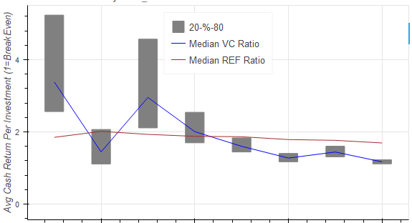
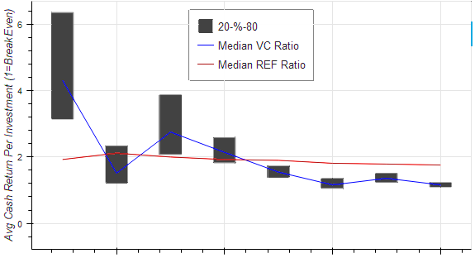
Key finding: Early rounds are the most profitable
Extensive analysis of over 550,000 investment events and outcomes shows that despite high failure rates, valuations in the first four rounds consistently favor the investor compared to later investor rounds
NAV + Cash Return by Funding Round
20th to 80th Percentile Median VC Multiple
Median NASDAQ Return (~9% IRR)
Chart shows results derived from 550,000 VC events (investments, acquisitions, etc) sourced from PitchBook, Crunchbase, Red Seer, Venture Intelligence, Hatcher+ co-investment partners and Hatcher+ proprietary data
Round assignments follow
as per named by data source
Where investments have not yet been realized or written off, an adjusted NAV* based on last funds raised is used
Returns illustrated are gross and do not take into account any fees / carry that may be charged
Average Multiple on Invested Capital
Accelerator / Incubator
Pre-Seed
Angel\Seed
Series A
Series B
Series C
Series D
Series E & Above

Slide 11




Who is an angel investor?
An angel investor is an individual who provides capital for a startup, usually in exchange for convertible debt or ownership equity
Angel investors usually give support to startups as the initial moments (where risk of the startups failing are relatively high) and when most institutional investors are not prepared to back them
Group sport vs Solo sport
And increasing number of angel investors invest online through equity crowdfunding or organize themselves into angel groups or angel networks to share investment capital, as well as to provide advice to their portfolio companies

Slide 12

Why become an angel investor?

Slide 13
Reasons NOT TO BE an angel investor
While it sounds heavenly, it's essential to understand the potential challenges.

Slide 14
Reason 1: The economics of angel investing work against all but a select few

Slide 15
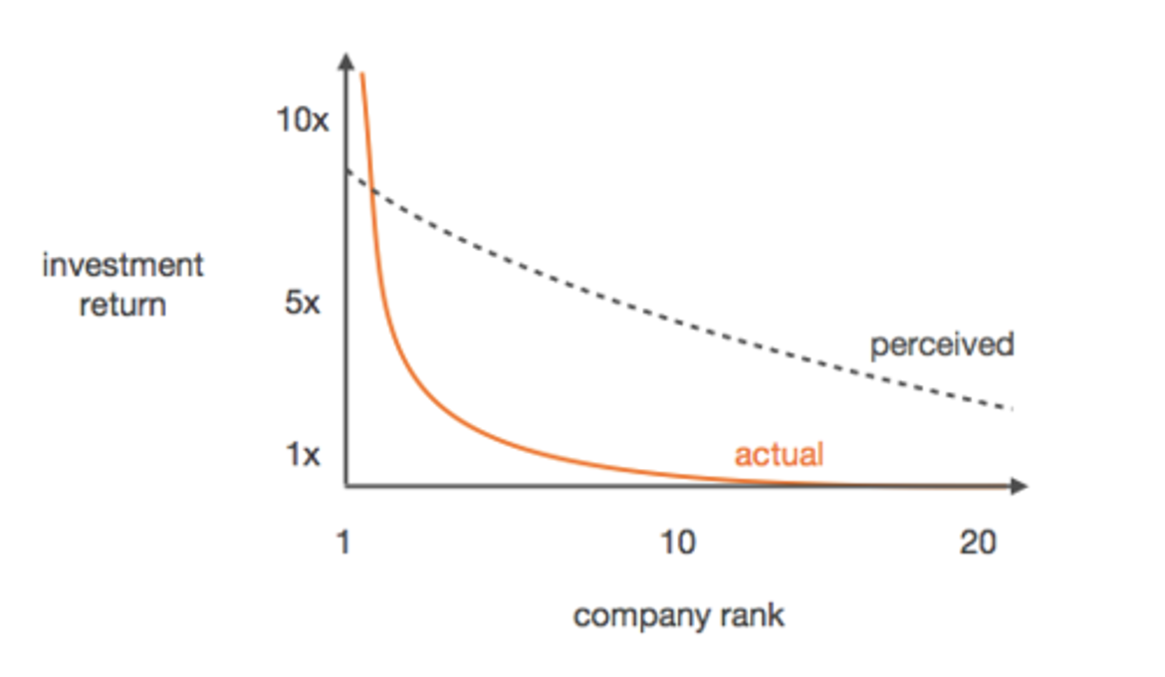
Power Law of Startup Investment Returns

Slide 16
"You only have to be right once."
-Mark Cuban

Slide 17



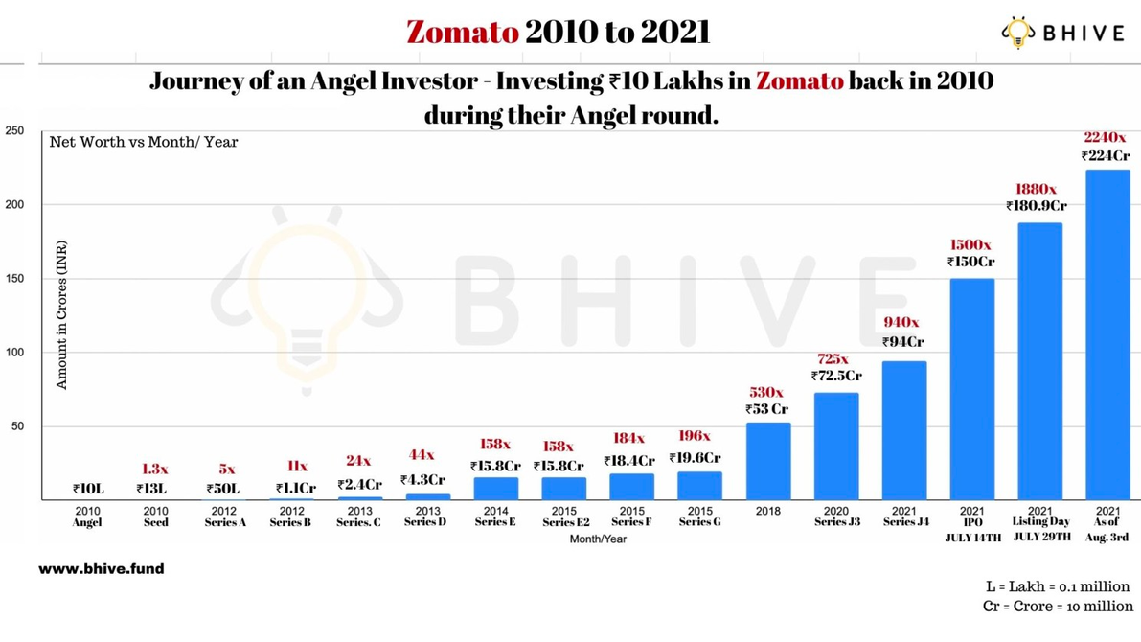
Multipliers of successful Indian startups
Journey of an angel investor who invested INR 10 lakhs in 2010 and got a 2240X return in 2021
₹15 Lakhs investment in Mamaearth in the year 2016 would make ₹ 220 Cr. with 1463x return
Ashish Gupta, who was the first angel investor in Flipkart, will have turned an initial investment of Rs. 10 lakh into a staggering Rs. 130 crore after Flipkart was acquired by Walmart

Slide 18
Real risk is missing out on the HOME RUN!

Slide 19




The Science of Investing
Portfolio theory – Invest in a large number of startups, be patient and be cool with seeing most fail
Initial investment pool, double down your bets - follow on investment pool
Tripling down on that one company that could be the home run!

Slide 20
Reason 2: The structure of angel investing works against all but a select few

Slide 21
  There are very few breakouts.
Number of unicorns from 2021-23:
43
  Predicting the home run is hard!!
23
3 so far
2021
2022
2023

Slide 22




Other Risks
Liquidity/Tranferability: Startup investments often lack immediate liquidity, as they require time to grow and mature
Holding Period: Investing is a marathon, not a sprint. Holding period refers to the time you hold onto an investment before selling it.
Reporting: Regulatory requirements of private companies is not as stringent as listed ones
Principal Loss: Not every venture succeeds, and the possibility of losing your initial investment exist.

Slide 23
Reasons TO BE an angel investor

Slide 24
Reason 1: Can be your highest return asset class, if done right.

Slide 25
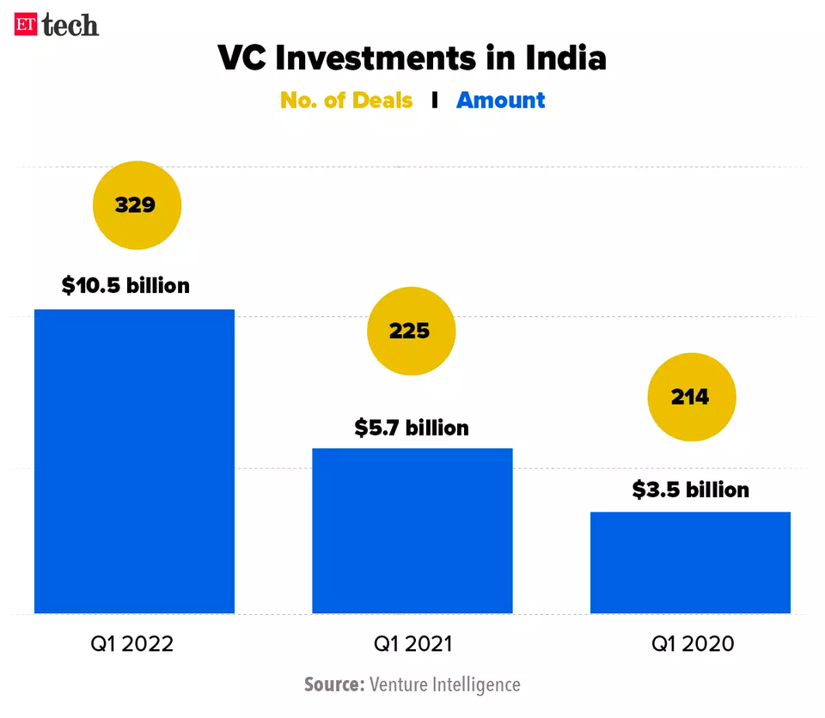




Reason 2: No recession in startup funding
99K+
108
$340 Bn
DPIIT Recognised Startups*
Unicorns
Total Valuation of Unicorns

Slide 26
Reason 3: The median company makes 95% of their gains in valuation before they go public.

Slide 27
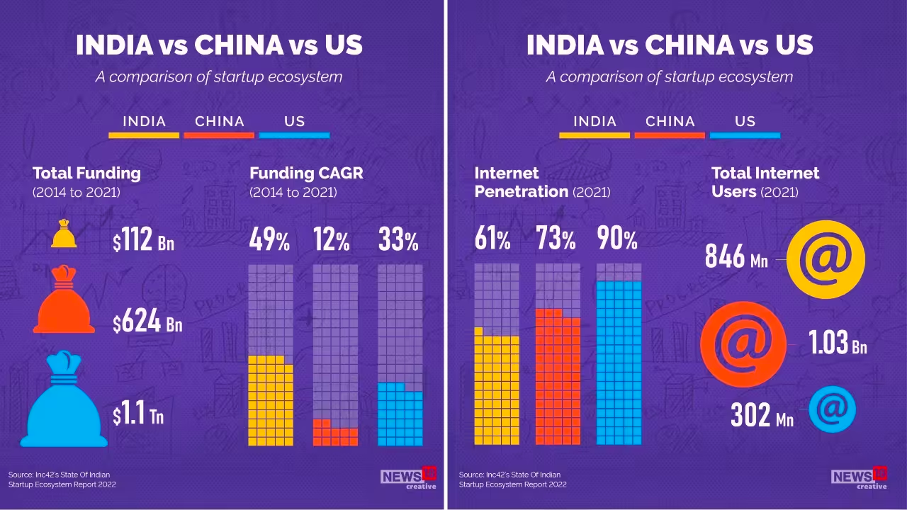
Reason 4: India is a growth story!

Slide 28
Reason 5: Best way to stay relevant and learn.

Slide 29
Reason 6: Building the ecosystem and economy.

Slide 30
FINALLY
Pass on What you have learned - Yoda

Slide 31

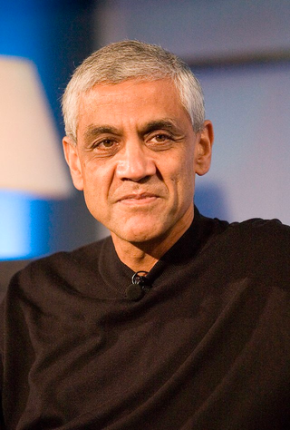




Successful Angel Investors
Mohandas Pai
Vinod Khosla
Ratan Tata
Solid reputation built over a decade (or more) as great people who work hard for the companies they invest in
They have deep and vibrant network in relevant startup fields, built by doing a ton of things for other people – Successful founder/senior employees of successful startups
  Invest through angel networks and get associated with the best of the Accelerators
Kunal Shah
Nithin Kamath
Anupam Mittal

Slide 32
Expectations from angel investing

Slide 33
Power Law of Startup Investment Returns

Slide 34
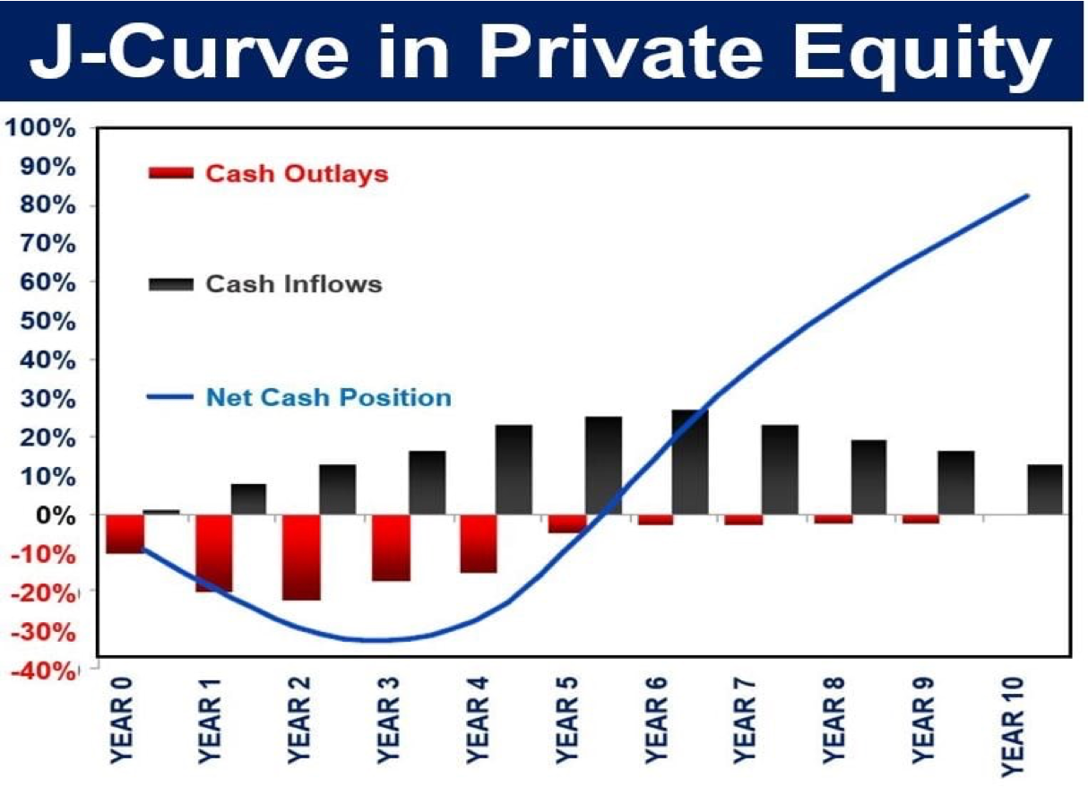
Expectations from angel investing

Slide 35

Wealth Creation- from few, slowly
Good ideas take time to take shape and hence make returns
Bad ideas fail early

Slide 36

Capital Allocation- Questions
How much capital they should expect to invest on an annual basis if they want a diversified portfolio?
How will tax implications affect investment decisions and returns?
What is the magic number? How many startups should one invest in?
Should one invest in a startup in an area beyond their expertise?
When should one exit? When a VC enters?

Slide 37
How successful investors allocate capital
Portfolio strategy that aligns with their financial goals, risk tolerance, and expertise
Thorough due diligence: Analyze various factors
Leverage their networks and relationships to source investment opportunities
Diversification across a range of startups
Prepared to wait for the right exit opportunities and not expect immediate liquidity.
Actively engage with startups, offering strategic guidance, mentorship, and introductions
Collaborate with investment committees or groups to collectively make investment decisions
Work with legal and financial professionals to ensure investments are structured correctly and to manage tax implications

Slide 38
Module 2 –The HOW

Slide 39

How to source deals
01
02
03
04
Thesis-based investing : Boiling the ocean
Conducting thorough research to identify trends, market shifts, emerging technologies, or industries you believe will experience significant growth or disruption.
Network-based Investing/ Opportunistic Investing
Startup events, industry conferences, meetups, and networking functions to expand your network
Understanding Angel Investing Platforms
There are several angel investing platforms that provide a platform for investors to source startup deals, connect with entrepreneurs, and facilitate the investment process
Syndicate
Investing
Let's Invest Together!

Slide 40
How to Evaluate Deals – The 3 Ts
TAM – Total Addressable Market
Timing -
Team – Founder-Market Fit!

Slide 41
Questions to follow
Product uniqueness
Revenue Model
Number of paying customers
New vs Repeat Customers
LTV vs CAC
Burn Rate
Runway
Funding utilisation
Projections
Any unfair advantage
Impact creation
Exit Paths

Slide 42








How to Hack Angel Investing- Syndicates
Access to Deal Flow
Experienced Leadership
Diversification
Learning Opportunities
Lower Ticket Sizes
Streamlined Paperwork
Networking Opportunities
Exit Support

Slide 43
Choose your syndicate wisely
Track Record –
  Number and corpus of investments
  Hit Ratio
  Number and quantum of Exits
  Number of startups that have shut shop
Skin in the game
Experience of the Leadership Team
Strong Process and Communication

Slide 44
The Investment Process
Pitch Phase
investment Phase
Post-Investment Phase
Deal Sourcing
Screening
Termsheet
Legal Documentation
Active Engagement
Advisory
Pitch Session
Due Diligence –
LDD/FDD/Ops DD
Quarterly
Update Calls
Term Sheet
MIS - Monthly
Deep Dive
Review Deck
Preliminary DD
Financial DD
Investment Transfer
Follow-on
Exit Strategy
Talk to fellow investors/
syndicate team
Audited
Financial
Annually
SSHA
Dashboard
Call for Money

Slide 45
Post-Investment Engagement
01
02
03
04
Milestones Tracking
  Depending on your level of involvement, provide advice, mentorship, or guidance to the startup's founders based on your expertise.
  Stay informed about the startup's progress and actively engage with updates and milestones.
Follow-on Investment
If the startup shows promise and requires additional funding rounds to scale, consider participating in follow-on investment rounds to maintain or increase your ownership stake.
Exit & Liquidity
As the startup grows, consider potential exit strategies, such as acquisition, initial public offering (IPO), or secondary market sales, that can yield returns on your investment.
Portfolio Management
Monitor the performance of your investments and actively manage your portfolio to make informed decisions about future investments and divestments.

