Slide 1
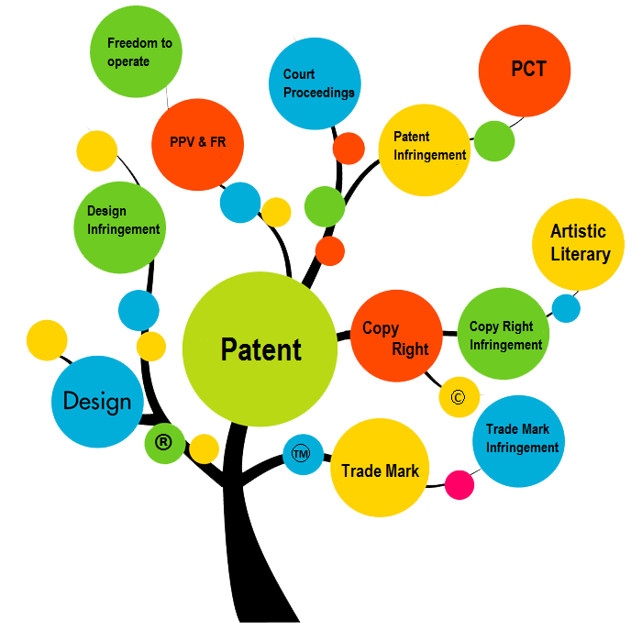
Importance of IPR And Patent Prosecution in India
Parth Sejpal
Registered Indian
Patent Agent(IN/Pa-3256)

Slide 2
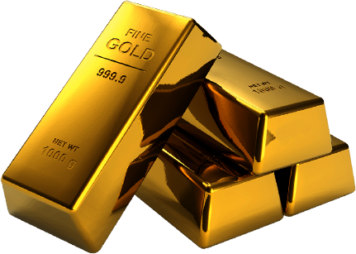
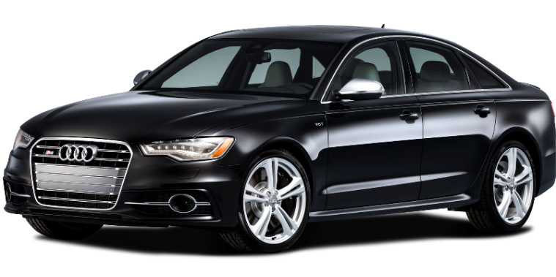
What is the meaning of Intellectual Property
Tangible Property

Slide 3
Intangible Property

Slide 4
Difference Between Tangible and Intangible Property
Tangible
That which can be measured, touched & have physical forms
E.g. Currency, Gold, House, land, industry etc.
Intangible
That which cannot be measured, touched not having any physical forms
Creation of the human mind/intellect
E.g.: Ideas

Slide 5
TYPES of INTELLECTUAL PROPERTIES
IPR
Patent
Trade Mark
Industrial Design
Integrated Circuit Design
Copyright
Trade Secret
Geographical Indication
Plant Varieties Act

Slide 6
IP Evolution
Idea → Expression → COPYRIGHT Idea → Innovation → Invention → PATENT Idea → Quality + Identity → TRADEMARK Idea → Appearance → DESIGN Idea → Keep Confidential,
No Disclosure
→ TRADE SECRETS

Slide 7
Intellectual Property Rights (IPR)
Generate IDEAS….. And Own Them…..IPR !
IP Rights are Territorial in Nature
It usually gives the Creator an Exclusive Right over the Use of his Creations for a Certain Period of Time.

Slide 8
Intellectual Property Rights (IPR)
Intellectual
Capacity, Creative, Idea, Knowledge
Property
Possession, Registered, Owned
Rights
Claimed, Exercised, Exploited

Slide 9
Criteria and Validity of Ipr Protection
Sr. No. | IPR | Criteria | Maximum Protection | Renewal | Act/Rule
1. | Patent | Novelty Non Obvious Useful | 20 years | *Every Year (mandatory) | The Patent Act, 1970 Amended in 2005
II. | Trademark | Distinguish Goods and Services | Life Long | Every 10 years | The Trademark Act,1999 Amended in 2010
III. | Design | Novel Ornamental or Aesthetic appearance of an article | 15 years | After 10 years for next 5 years | The Design Act, 2000 Amended in 2014
IV. | Copyright | Original and Creative | 60 years | Not Required | The Copyright Act, 1957 Amended in 2012
V. | Geographical Indication | Distinguished Product characteristic due to geographical or manpower from specific region | Life Long | After 10 years | The Geographical Indications of Goods(Registration and Protection)Act,1999
*Patents will be ceased and be transferred to public domain if Patents are not renewed within 6 month of expiry of concerned year by paying renewal fees.

Slide 10
Trademark
Protects brand names and logos used on goods and services.
Distinguish the product from other identical or similar products provided by competitors.
A trademark is any name, symbol, figure, letter, word, mark, signature, label, device, ticket, shape or color adopted and used by a manufacturer or merchant in order to designate his or her goods and to distinguish them from those manufactured or sold by others.

Slide 11
Trademark

Slide 12
COPYRIGHT
Copyright is a legal right granted to a creator of an original artistic work by the law of the country, for its use and distribution.
Examples of unique creations include computer software, art, poetry, graphic designs, musical lyrics and compositions, novels, film, original architectural designs, website content, etc

Slide 13
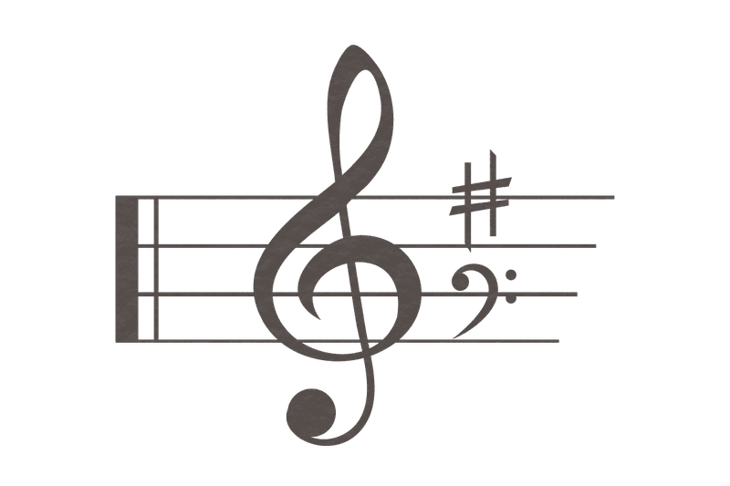
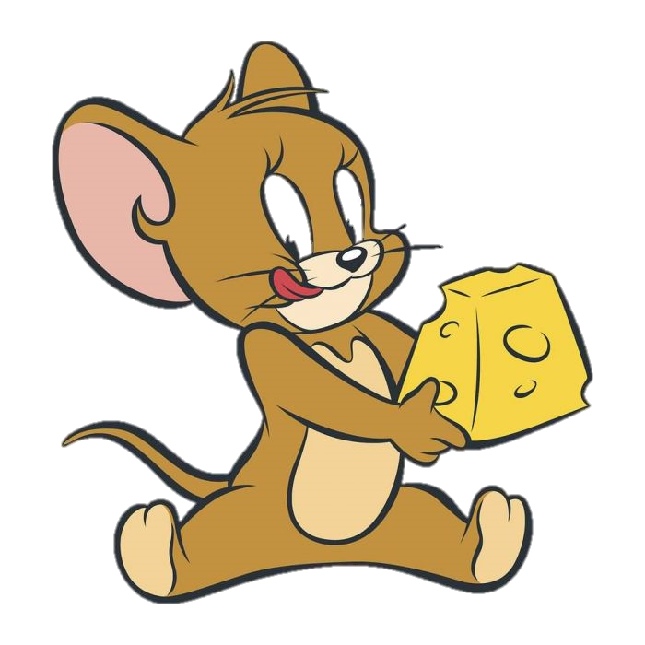
COPYRIGHT

Slide 14
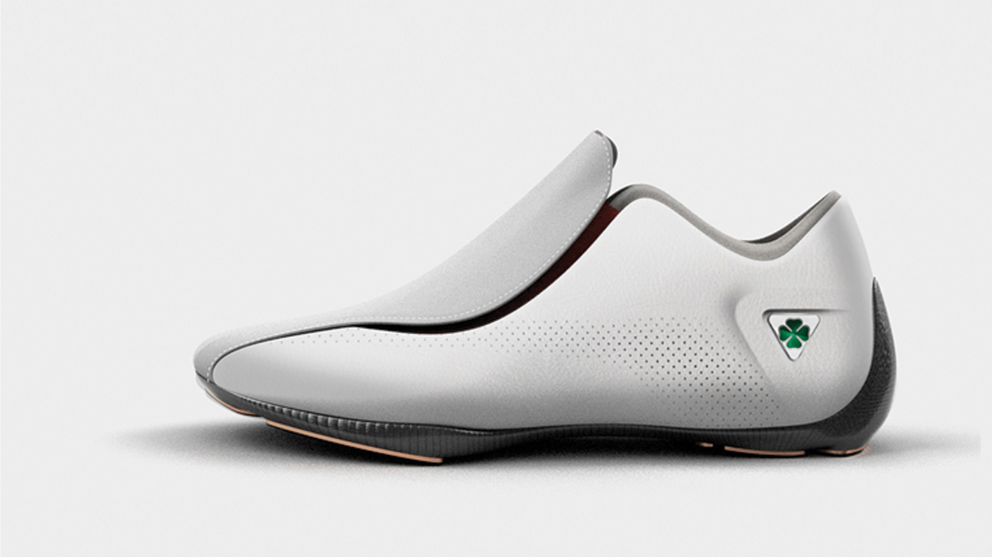
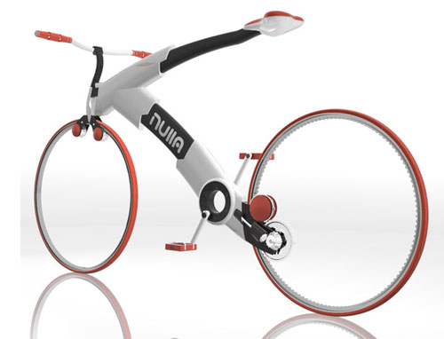
INDUSTRIAL DESIGN
An industrial design may consist of three dimensional features, such as the shape of an article, or two dimensional features, such as patterns, lines or color.

Slide 15
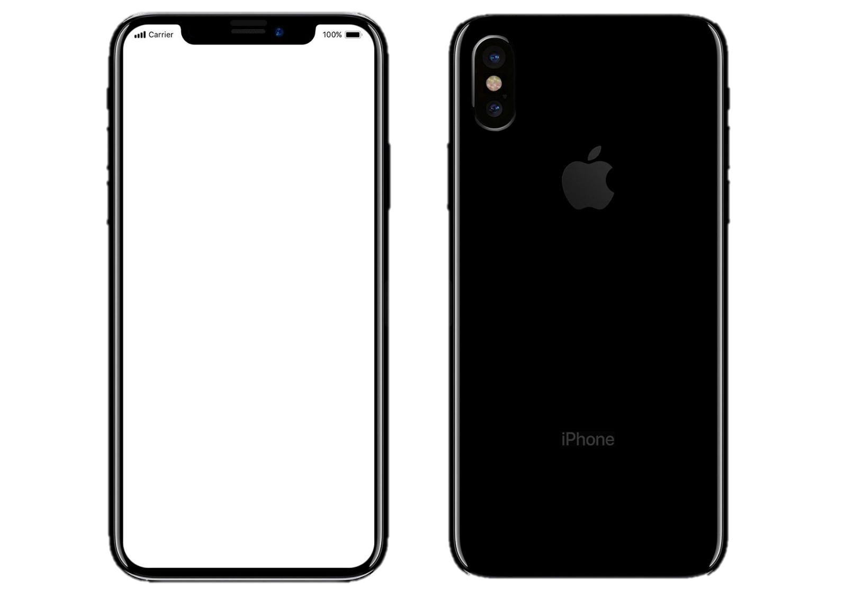
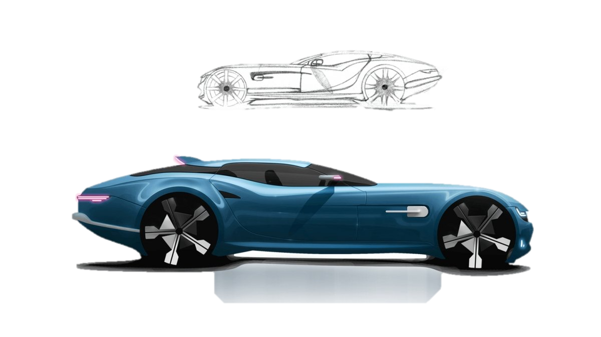
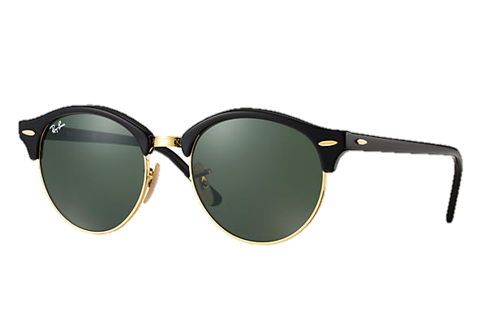
INDUSTRIAL DESIGN

Slide 16
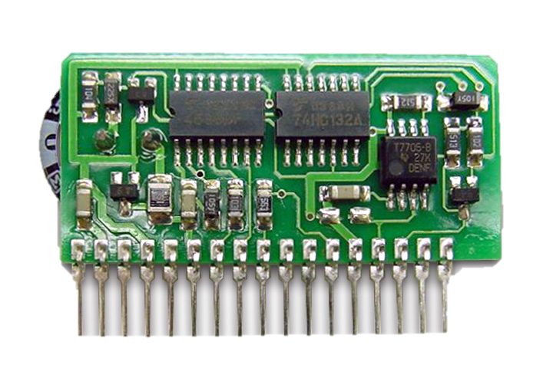
INTEGRATED CIRCUIT Design

Slide 17
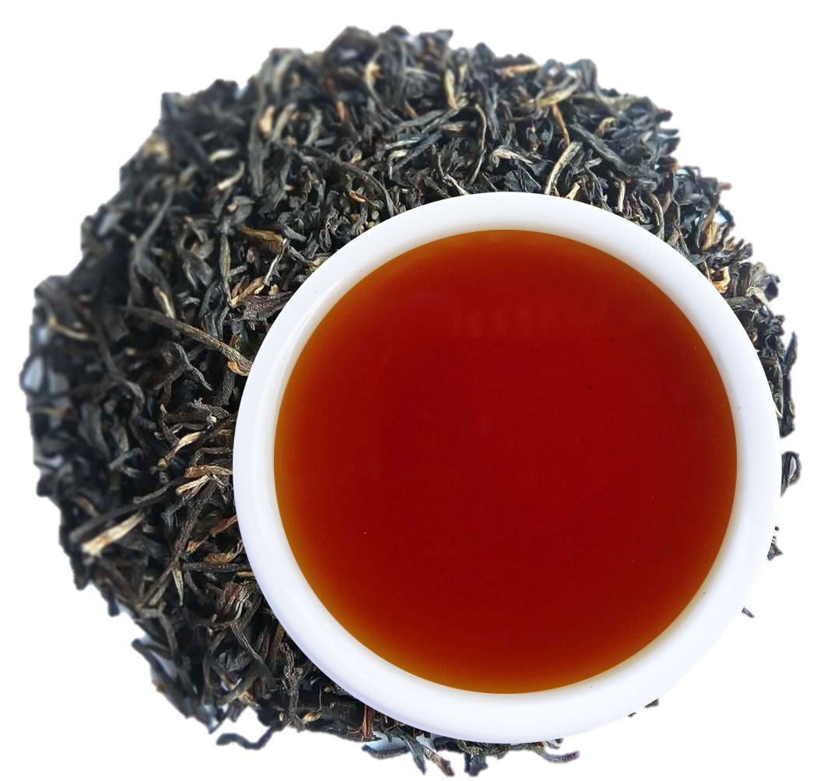
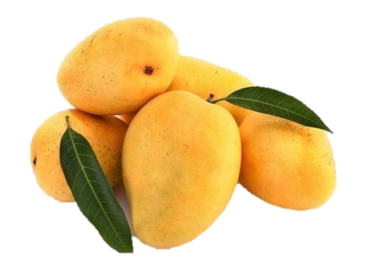
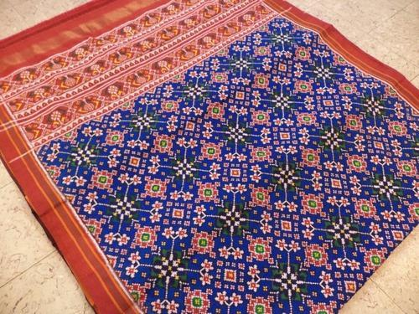
GEOGRAPHICAL INDICATION
Geographical indication (GI) is a sign used on products that have a specific geographical origin and possess qualities or a reputation that are due to that origin
ASSAM TEA
GIR KESAR
PATAN PATOLA

Slide 18
TRADE SECRET
confidential business information which provides an enterprise a competitive edge may be considered a trade secret.
The subject matter of trade secrets is usually defined in broad terms and includes sales methods, distribution methods, consumer profiles, advertising strategies, lists of suppliers and clients, and manufacturing processes.
Trade secrets are essentially of two kinds
do not meet the patentability criteria
would fulfil the patentability criteria and could therefore be protected by patents

Slide 19
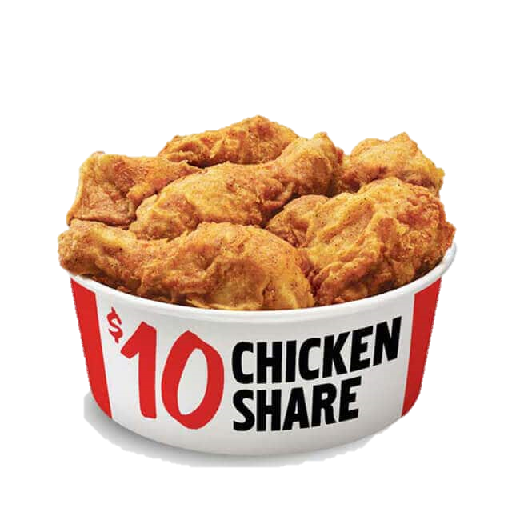
TRADE SECRET
Algorithm of Google
Recipe of KFC Chicken
Formula of Coca Cola

Slide 20
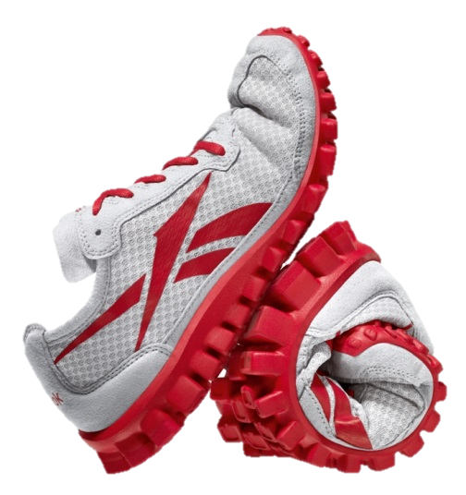
Novel & Inventive
Patent
Brand Name
RealFlex
Copyright
Trademark
Package Insert /
Information Leaflet
Confidential Info
&
Undisclosed Tech
External Appearance
Trade Secret
Design

Slide 21
Why is IP Important
Why is the Apple, the richest company in the world?
As per the research, a 32 GB iPhone 7 having retail value of $649(49k INR) costs Apply only $219.80(16k INR) for components, with manufacturing cost added to 5$(350INR) to the price.
How do they earn rest of the Money!!!
What makes Apple Inc. the biggest brand in the world?
China is far bigger manufacturer
India has more engineers
More resources in Africa
Russia has more natural gas and oil
Still U.S.A. is richer, and a super power, because it has more Intellectual Property than any other country.

Slide 22
Importance of IPR
Secure the rights of inventions
increase revenues through licensing
IP can be a unique selling proposition (USP) of the product or service
Startups get a competitive advantage in the market
Add huge brand value attached to IP, in both the manufacturing and technology sector
Boost their revenues through licensing
Encourage the R&D to ensure continuous innovation
Important asset having higher value than the physical assets to bank on

Slide 23
What is a Patent
A patent is a territorial right and exclusive/negative right granted by government for an invention to its creator for a limited period of time(20 years).
Invention which is a product or a process that provides, in general, a new way of doing something, or offers a new technical solution to a problem.

Slide 24
Negative Right
Permits it’s owner to exclude members of the public from making, using, selling, offering to sell or importing, the claimed invention.
Stops others from making, using, offering for sale, selling or importing patented invention without Permission of owner

Slide 25
Requirement of Patentability (3I)
Novelty ( Innovation)
2. Non Obviousness ( Inventive Step)
3. Usefulness / Industrial Applicability

Slide 26
Novelty, Non obvious, Industrial application
Novelty
A new way of doing something, offering a new technical solution to a problem.
Invention should not be publicly known in any way, anywhere in the world
Invention must be new - it must be different from what has come before
Non Obvious
It means a feature of an invention that involves technical advancement as compared to the existing knowledge or having economic significance or both and that makes the invention not obvious to a person skilled in the art
Invention must be something that represents an represents an improvement over any existing product or process that is already available
It must be not obvious to a person of ordinary skill in the field
Industrial Application
In relation to an invention, it means that the invention is capable of being made or used in an industry

Slide 27
What cannot be patented
opposing to well established natural laws
opposing to morality or injurious to public health (animals/plants) or to environment
Scientific principle or abstract theory
New property or use of a known substance
Mere admixtures (as opposed in synergistic mixtures) and processes thereof
Mere arrangement or rearrangement of known devices each functioning independently of one another in a known way
Method of agriculture or horticulture
Treatment of human being, animals including diagnostic methods
Plants and animals in whole or any part thereof
Essentially biological processes
Mathematical or business methods, computer program per se or algorithm
Literary, dramatic, musical or artistic work
Method of playing games
Presentation of information

Slide 28
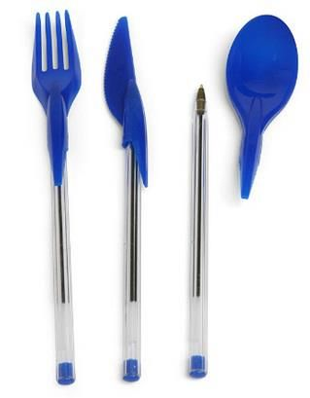
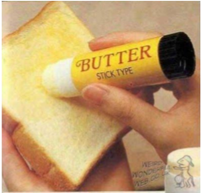
Section 3 (A)
Frivolous inventions
Inventions contrary to well established natural laws
Machine that gives more than 100% performance
Machine that gives output without input (perpetual motion)

Slide 29
Section 3 (B)
Commercial exploitation or primary use of inventions, which is Contrary to public order or Morality
Examples
Gambling machine
Any device, apparatus or machine or method for committing theft/burglary
Any machine or method for counterfeiting of currency notes

Slide 30
Section 3 (C)
Mere Discovery of a Scientific Principle or formulation of an Abstract Theory or discovery of any living thing or discovery of non–living substance occurring in nature.
Examples
Newton’s law
Discovery of micro-organism
Discovery of natural gas

Slide 31
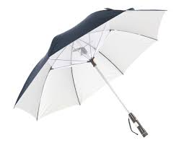
Section 3 (f)
Mere arrangement or re-arrangement or duplication of known devices, each functioning independently of one another in a known way
Examples
A Bucket fitted with torch
An Umbrella with fan

Slide 32
Section 3 (k)
Mathematical method or business method or algorithms or computer program per se
Examples
Computer program by itself
Combination of hardware and software

Slide 33
Section 3 (N)
Presentation of information
Examples
Any manner or method of expressing information whether by
spoken words
Visual display
symbols
diagrams

Slide 34
Section 3 (P)
Traditional Knowledge or an aggregation or duplication of known properties of traditionally known component or components
Examples
Traditional Knowledge already in public domain such as wound healing property of Haldi
Note : Any value-addition using Traditional Knowledge leading to a new process or product ,which is novel with inventive step and industrial applicability, cannot be patented

Slide 35
Section 4
Inventions falling within Section 20(1) of the Atomic Energy Act, 1962 are not patentable
Examples
Inventions relating to compounds of Uranium, Beryllium, Thorium, Plutonium, Radium, Graphite, Lithium and more as notified by Central Govt. from time to time.

Slide 36
Example
PROBLEM
In the case of conventional toothbrushes whose bristles have all needle like tapering tips, the bristles near tips becomes too flexible because they are too thin. On the other hand, in the case of toothbrushes whose bristle ends being rounded or hemispherical, it is difficult to go into the spaces between teeth or boundary spaces between teeth and gums. Thus, it is difficult for conventional toothbrushes to clean up in every nook and corner in the mouth.

Slide 37
Invention
A toothbrush comprising a block head having brush portion, a handle and a neck portion connecting said block head with the handle, wherein a part of said tufts of the brush portion are made up of filament with polygonal cross section, and the rest of the tufts are made up of sheath-core structural filament whose core material is covered with sheath material so that the cross section thereof is concentric circles.

Slide 38
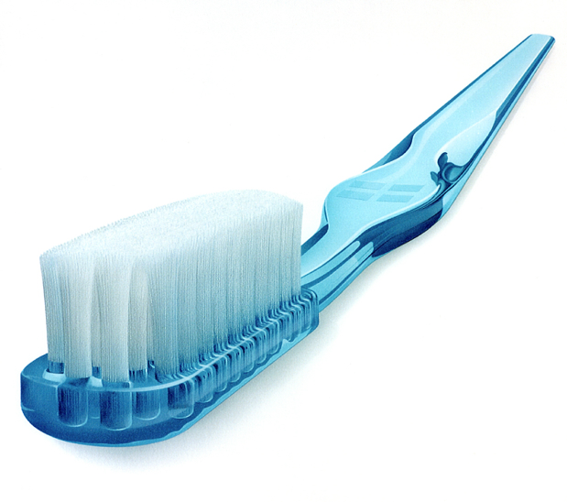
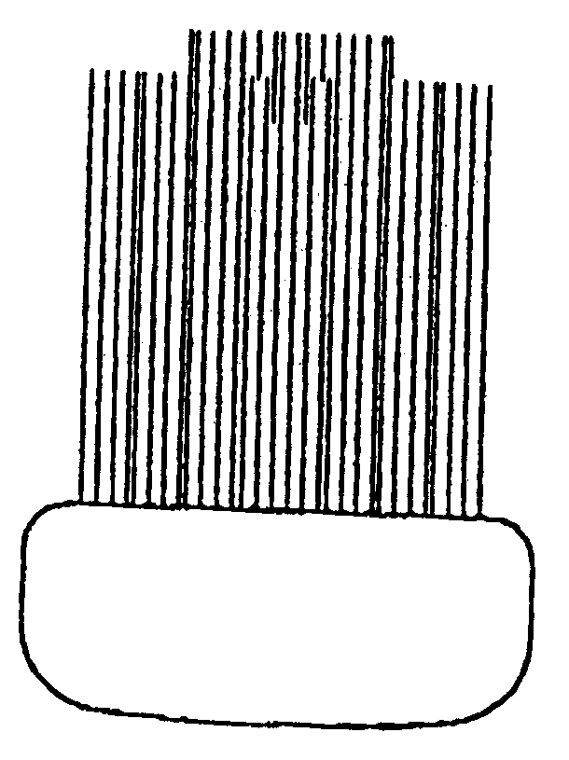
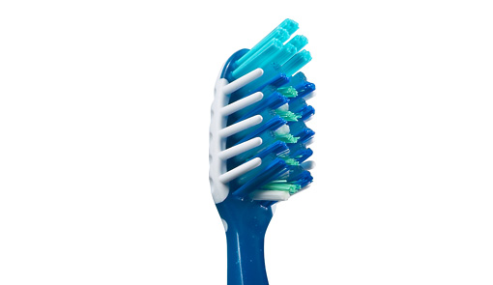
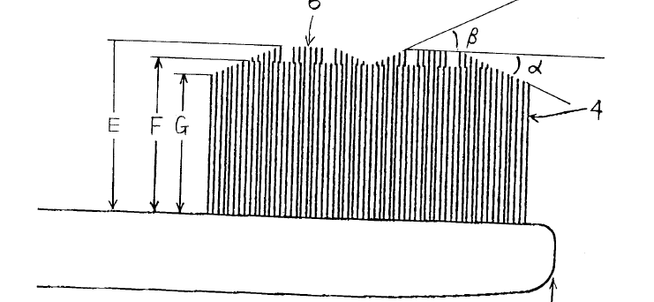

Slide 39
Is It Patentable
i) What problem does the invention address?
➔ It address the problem of improper cleaning of teeth and gums
ii) What is the invention?
➔ A toothbrush comprising of -peripheral filaments with polygonal cross section-sheath-core structural filament whose core material is covered with sheath material so that the so that the cross section thereof is concentric circles.
iii) What does the invention do?
➔ It provides a better cleaning between the teeth and on the teeth surface
FYI : There are total 3074 patents related to Brush in India as on 31 July, 2021
Source: https://ipindiaservices.gov.in/PublicSearch/PublicationSearch/Search

Slide 40
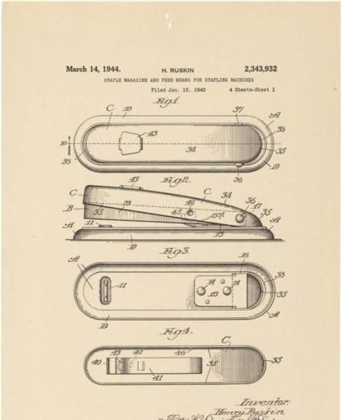
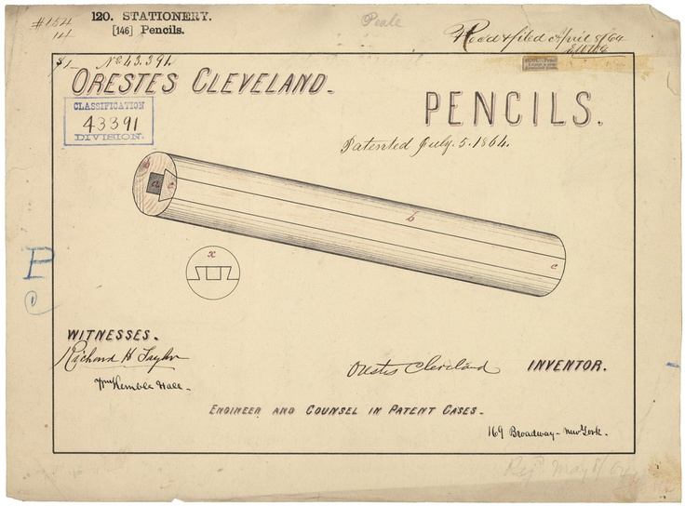
Some patented documents
Pencil 1864
Stapler 1944

Slide 41
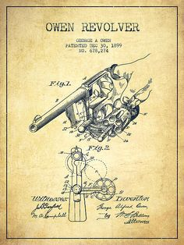
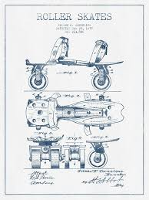
Revolver 1899
Skates 1864

Slide 42
Do you possess Patentable Invention?
Don’t Wait, File the Patent Application “First to File Rule”
DON’T PUBLISH PAPER, GIVE NEWS REPORT, VIDEO UPLOAD ON INTERNET etc.

Slide 43
PRE FILING REQUIREMENTS
Title of invention
Brief description of invention
Detailed description of invention
Claims (may OR may not be req’)
Abstract (may OR may not be req’)
Figures (if any)
Name of inventors
Name of applicants
Right of proof of Assignment (if any)

Slide 44
IPC (International Patent Classification)
SECTION A — HUMAN NECESSITIES
SECTION B — PERFORMING OPERATIONS; TRANSPORTING
SECTION C — CHEMISTRY; METALLURGY
SECTION D — TEXTILES; PAPER
SECTION E — FIXED CONSTRUCTIONS
SECTION F — MECHANICAL ENGINEERING; LIGHTING; HEATING; WEAPONS; BLASTING
SECTION G — PHYSICS
SECTION H — ELECTRICITY

Slide 45
PATENT SEARCH
“Search” means to find out all relevant information related to invention and which is already existed before the date of invention.
“Patent search” is the process by which prior patented inventions are examined, with the goal being to find information that bears close similarity to a given patent or proposed invention.

Slide 46
PRIOR ART SEARCH INCLUDES
Previous patents
Trade journal articles
Publications (including data books and catalogs)
Public discussions (conference and seminar)
Trade shows
Brochures
Products, devices & equipment
Research Papers

Slide 47
WHERE TO SEARCH
Free Databases | Web link | Scope of search
USPTO | http://patft.uspto.gov/ | US Patents only
EPO | http://ep.espacenet.com/ | EP Patents WIPO patents World wide patens
Patent Scope (WIPO) | http://www.wipo.int/pctdb/en/ | WIPO Patents
Indian Patent Office | http://ipindia.nic.in/patent/patents.htm | Indian Patents (Granted as well as 18 month Published Patents)
Google’s Patent Search | http://www.google.com/patents | US patents only
Free Patents Online | http://www.freepatentsonline.com/ | US Patents EP Patents JP Patents WIPO Patents
BigPatent India | http://india.bigpatents.org/ | Indian Patents (Granted as well as 18 month published Patents)
Patent Facilitation Centre (PFC) | http://www.indianpatents.org.in/db/db.htm | Indian Patents (Abstract only)

Slide 48
PAID DATA BASE
Paid Databases | Web link | Scope of search
PatSeer | https://acc.patseer.com/ | World wide patents
Micropatent | http://www.micropatent.com | World wide patents
Derwent | http://www.thomsonreuters.com/products_services/scientific/DWPI | World wide patents
Aureka | http://www.thomsonreuters.com/products_services/scientific/Aureka | World wide patents
Delphion | http://www.delphion.com/ | World wide patents
LexisNexis | http://www.lexisnexis.com/patentservices/priorart/ | World wide patents
Dialog | http://www.dialog.com/ | World wide patents
Hoover | http://www.hoovers.com/free/ | World wide patents
Patent Search Express | http://www.patentsearchexpress.com/ | World wide patents
PatBase & Patent Insight Pro | http://www.patentinsightpro.com/ | World wide patents

Slide 49
FEES
Fees | Form–1 | Form- 2 | Form-3 | Form–5 | Form- 9 | Form-18 | Form 26
Nat. Person(s) | 1600 | No fee | No fee | No fee | 2500 | 4000 | No fee
Small Entity | 4000 | No fee | No fee | No fee | 6250 | 10000 | No fee
Other than small Legal entity | 8000 | No fee | No fee | No fee | 12500 | 20000 | No fee
* Fees Mentioned here is for online payment mode, for offline 10% more fees is to be paid.

Slide 50
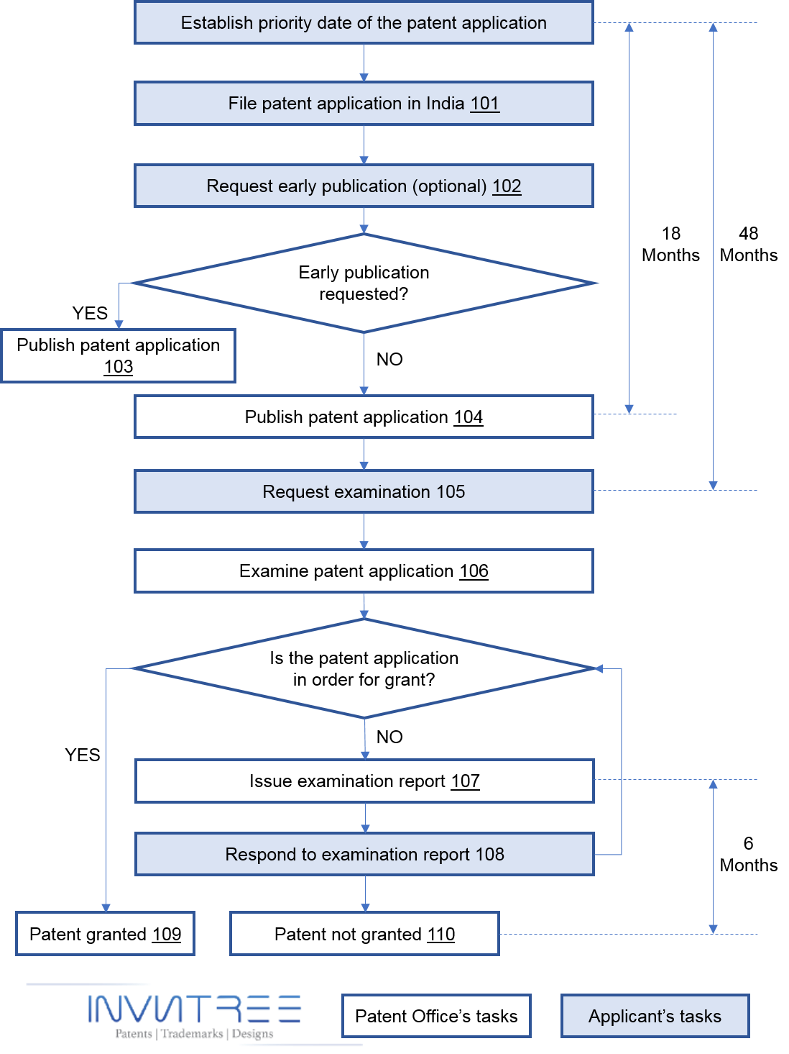

Slide 51
USE of Patent Information
To discover whether or not a particular invention is truly original or if, in fact, it has already been patented.
Competitor tracking
Avoid patent infringement
Learn more about your field of invention
Save the cost of patenting process
Learning more about a new field
For market information
Technology tracking
Getting a general idea of how an application and patent is structured to help in the
preparation of your own application

Slide 52
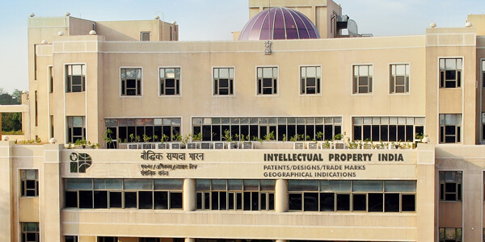
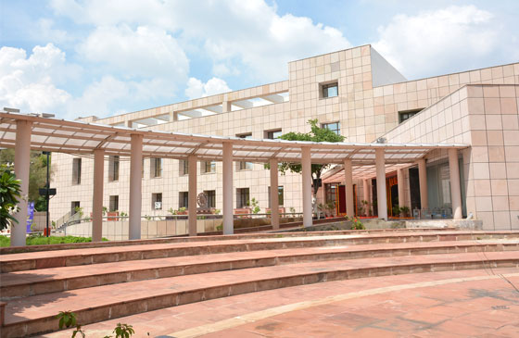
Where to apply?
Patent office, Delhi
Patent office, mumbai
Patent office,
Kolkata
Patent office,
Chennai

Slide 53
FEEL FREE TO COMMUNICATE
Mr. Parth Sejpal parthsejpal725@gmail.com
9913979543

