Slide 1
Future of CA Practice using Automation, Artificial Intelligence and Payroll
CA Kashmira Nirmal

Slide 2
Agenda
Key Trends in Accounting Profession
Overview of AI and Automation in Accounting
Benefits of AI for CA practice in Present and Future
New Opportunities for accounting professionals
Preparing our Firm to become Techno Firm of the future
Leveraging AI and Technology Tools for growing practice

Slide 3
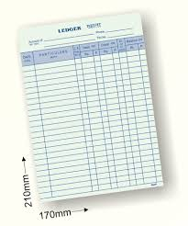
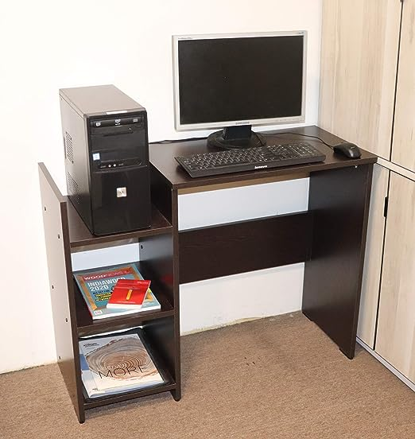
History of accounting
Paper | Desktop computer | Cloud Accounting
Long tedious manual slow entry system | Trial Balance always tallied but still 1 by 1 entry, so definitely slow | Anywhere anytime access of data
Challenge to get tallied Trial Balance | No mobility of data as still data on standalone | No manual entry. Direct input source docs can be imported in bulk, increases speed & accuracy.

Slide 4
Business is changing…

Slide 5
Accounting is changing…

Slide 6
Key Emerging Trends in Accounting
Rapid pace of Technology Adoption among businesses and clients
Use of Artificial Intelligence and Automation in Accounting processes
Role of Accountants moving from Assurance to Advisory Services
Going Global – World as one country
Social Media Influence

Slide 7
Rapid pace of Technology Adoption among Businesses
Opportunities
Providing the businesses with right tools recommendation and implementing them
Challenges
Adopting technology at pace or risk of sinking down or zero growth

Slide 8
Technological Innovation across various Sectors
Category | Food and Hospitality | Mobility | Goods | Real Estate | Banking
Existing Infrastructure | Restaurants | Taxis, autos | General trade stores | Hotels, Resorts, Rental spaces | Retail banks
Utilization of existing infrastructure (key examples)
Transformed user experience | Uniﬁed portal to aggregate restaurants | Standardized and transparent experience | Convenience of shopping, wide selection of products | Services Standardization, Portal to aggregate hotels

Slide 9
2. Artificial Intelligence and Automation in Accounting
Opportunities
Increasing our productivity through AI and automation tools to improve our processes
Challenges
If we do not embrace it, AI tools may take over mundane and repetitive jobs like data entry, reconciliation, etc.

Slide 10
3. Role of Accountant moving from Assurance to Advisory
Opportunities
Provide advisory and strategic finance services like Virtual CFO services, taxation planning, payroll etc.
Challenges
Coming out of our regular work and upskill ourselves with required knowledge to move up in value chain

Slide 11
4. Going Global - One Flat world
Opportunities
Becoming a Global Accountant – Borderless accounting. Geography will become History now
Challenges
Global Partnership will be inevitable.

Slide 12
5. Social Media Influence
Opportunities
Networking with peers within country and across the globe
Challenges
Trust with Social Media and avoiding noises by creating your own authentic voice

Slide 13
Artificial Intelligence - AI
AI is technology that enables computers to perform decision-based tasks previously left to humans.
It shows up in multiple forms, including machine-based learning that can progressively become better at analysis and decisions the more it is used, and speech-based technology that can understand different languages.
ChatGPT, Alexa, Chat Bots, Auto-categorisation of Accounts, Recording of transactions through OCR, Customer/Vendor payable management

Slide 14
Capabilities of AI
Making workflow more efficient for Businesses
Better handling of Data
Better customer experience
Data harvesting for predicting patterns
Turning pattern to actionable insights
Automation of various process based on patterns
Eg : Tax, Audit vouching, AR and AP management

Slide 15
ChatGPT
ChatGPT – Chat generative pre-trained transformer
It is AI chatbot developed by OpenAI. It answers almost everything we can think of.
ChatGPT takes your requests and answers them quickly.
The tool answers using the text databases from the internet.
To be precise, 300bn words are fed into the system.

Slide 16
AI and ChatGPT in our Practice
Automated bookkeeping
Invisible Accounting
Delivering Actionable insights at rapid pace
Process Automation
Compliance Automation
Better communication

Slide 17
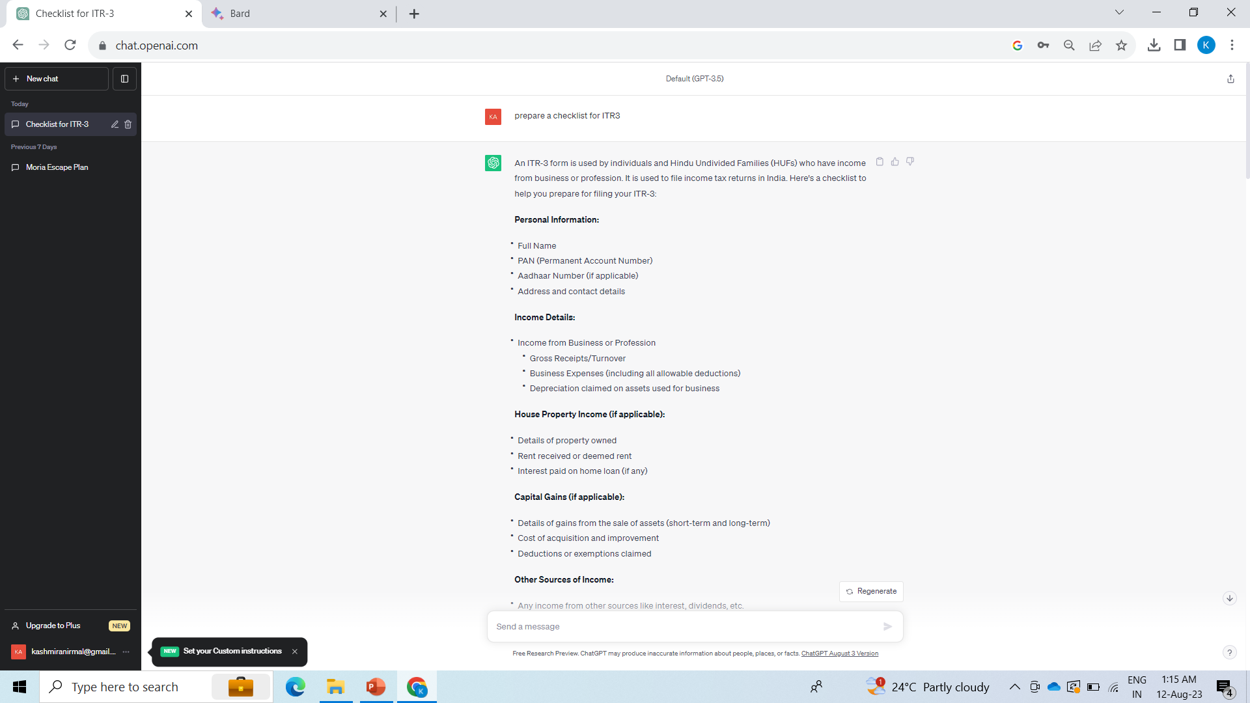

Slide 18
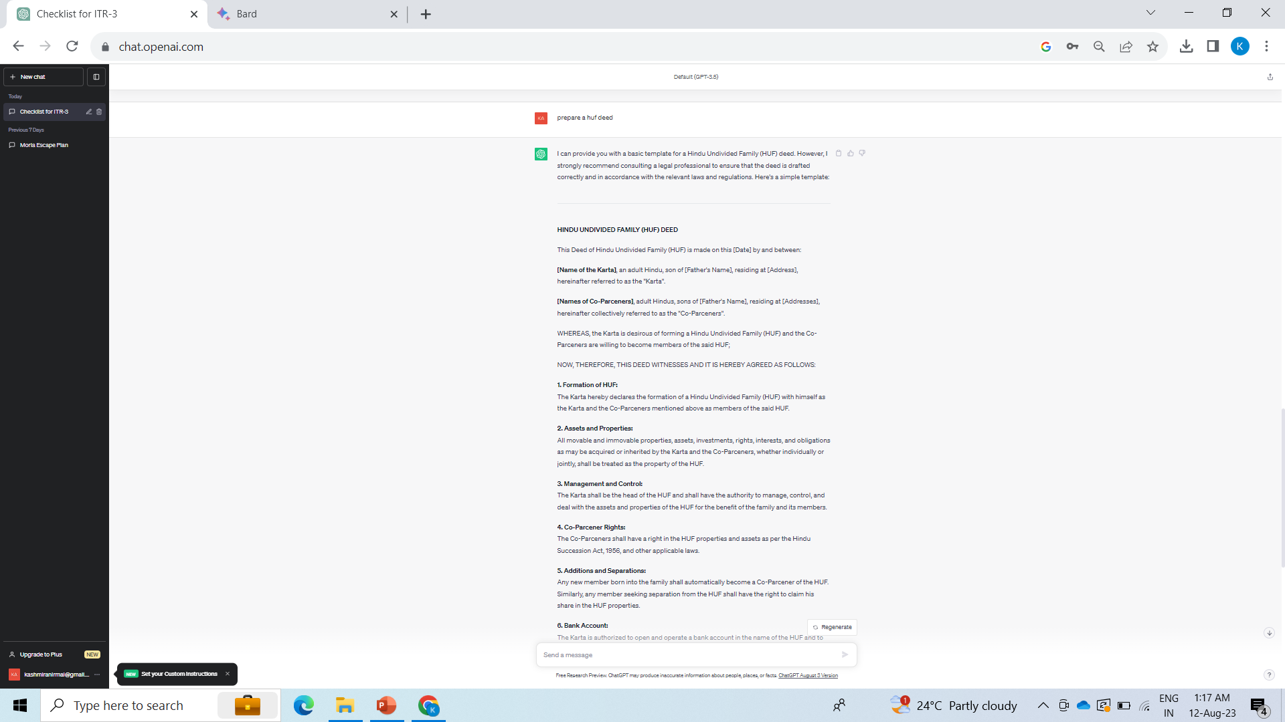

Slide 19
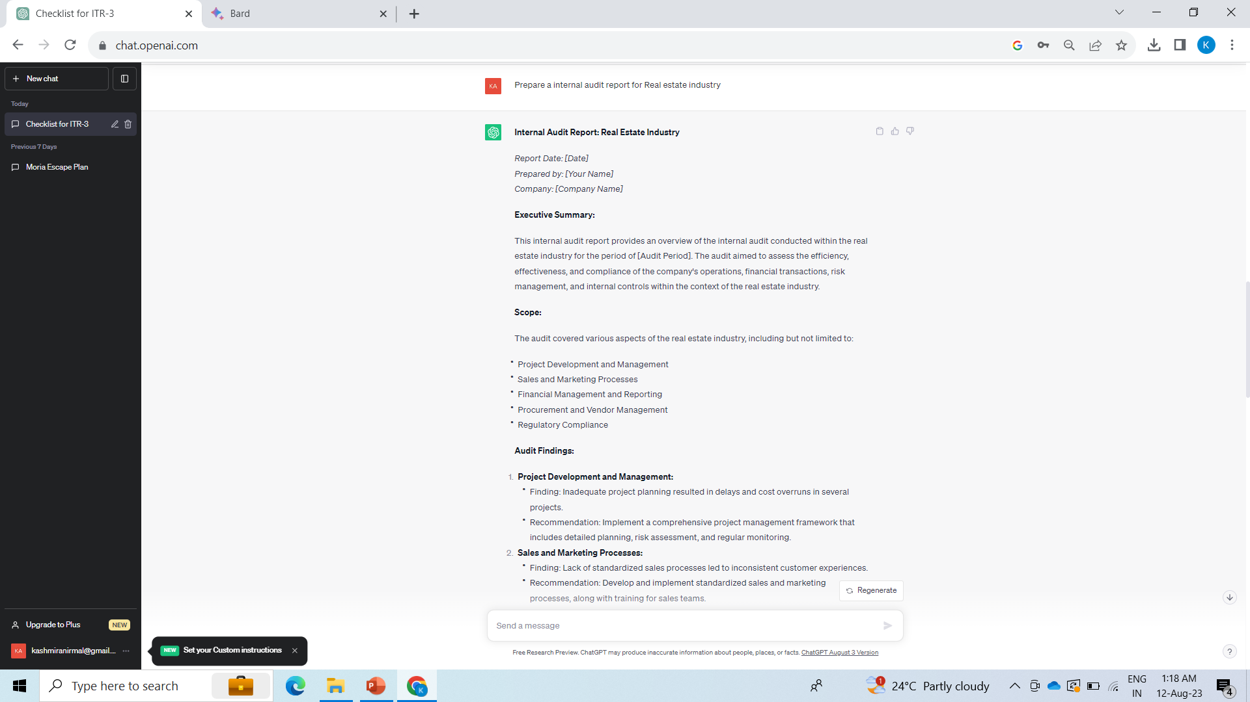

Slide 20
Benefits of AI
Save time by avoiding repeated tasks & elimination of data entry
More accurate in less time
Better Efficiency
Improved Productivity
Increased clientele
Expansion of new service area of Data analysis and advisory

Slide 21
Opportunities for Accounting Professionals
Most of the CA Practice work is here
Big Opportunity
Today’s Discussion
Bookkeeping Services
Accounting and Auditing services
Tax Compliance Services
Payroll Services
Virtual/Digital CFO services
Moving up the value chain but scale is possible only through technology tools available

Slide 22
Payroll Services Overview
Preparing Employees Monthly Payroll
Projected Income tax computation and Deductions
Monthly Payslips
Professional Tax computation and Filing
Provident Fund computation and Filing
Employee State Insurance Filing

Slide 23
Payroll Services Overview
Employee Expense reimbursements
Employee TDS returns
Annual Form 16s of Employees
Group Health Insurance
Employee Wellness
ESOP management and treatment

Slide 24
Why Payroll as new Revenue stream
Low Barrier to Entry
Established client base
Growing Segment
Sticky Service
Monthly revenue

Slide 25
Building a Payroll Practice
Adopt tools for all functions in office including accounting, audit and compliances including payroll
Right Payroll portal, Client Access, Flexibility
Building Proper staff
Bookkeeper staff, Payroll specialist, Team leaders/Managers
Identifying the right client primarily – clear about the type of client which we want to serve
Determining the Pricing Model
Creating awareness among clients about payroll service

Slide 26
Preparing our Firm for Technology wave
Use Cloud Applications for all the functions which will enable us to work anywhere and serve any part of the world
Invest in tools for various functions which will do many unproductive and repeated tasks
Start data analysis using AI tools which will help us provide advisory services to clients

Slide 27
Leveraging Technology Tools
Accounting
Document Management
Communications

Slide 28
Fully Automated Payroll Tools
Notes:
Cloud is a need or wantt

Slide 29
Thank you!
CA Kashmira Nirmal
Phone: 91- 9611066332
Email: kashmira@accotaxglobal.in

