Slide 1
Classification and Exemptions under GST Dt : 6 Oct 2023 CA SHARAD ANADA & CA Ajay Dholariya
Rajkot Branch
of WIRC OF ICAI

Slide 2
Basics of Classification
Goods
Goods ‘treated’ as service or vice versa (Sch II)
Service
Purpose of Classification
Guidance in the law regarding classification
Relevance of trade parlance or dictionary
Relevance of decisions under Customs law

Slide 3
Levy and Collection – Section 9
(1) Subject to the provisions of sub-section (2), there shall be levied a tax called the central goods and services tax on all intra-state supplies of goods or services or both, except on the supply of alcoholic liquor for human consumption, on the value determined under section 15 and at such rates, not exceeding twenty per cent., as may be notified by the Government on the recommendations of the Council and collected in such manner as may be prescribed and shall be paid by the taxable person.

Slide 4
Tariff Notifications - Goods

Slide 5
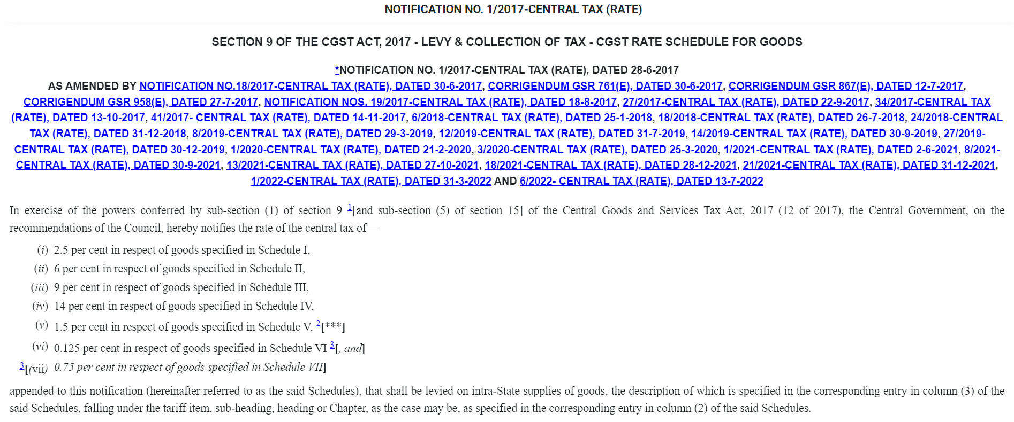
Explanation – for the purpose of this Notification -

Slide 6
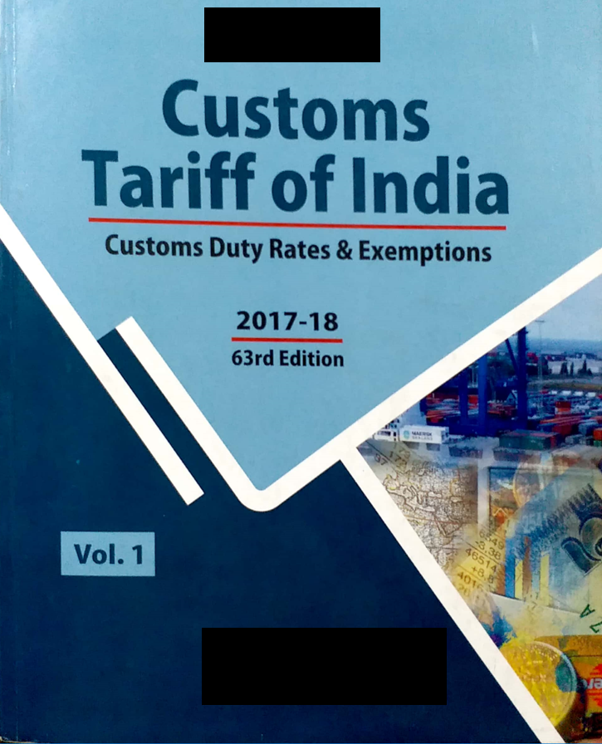
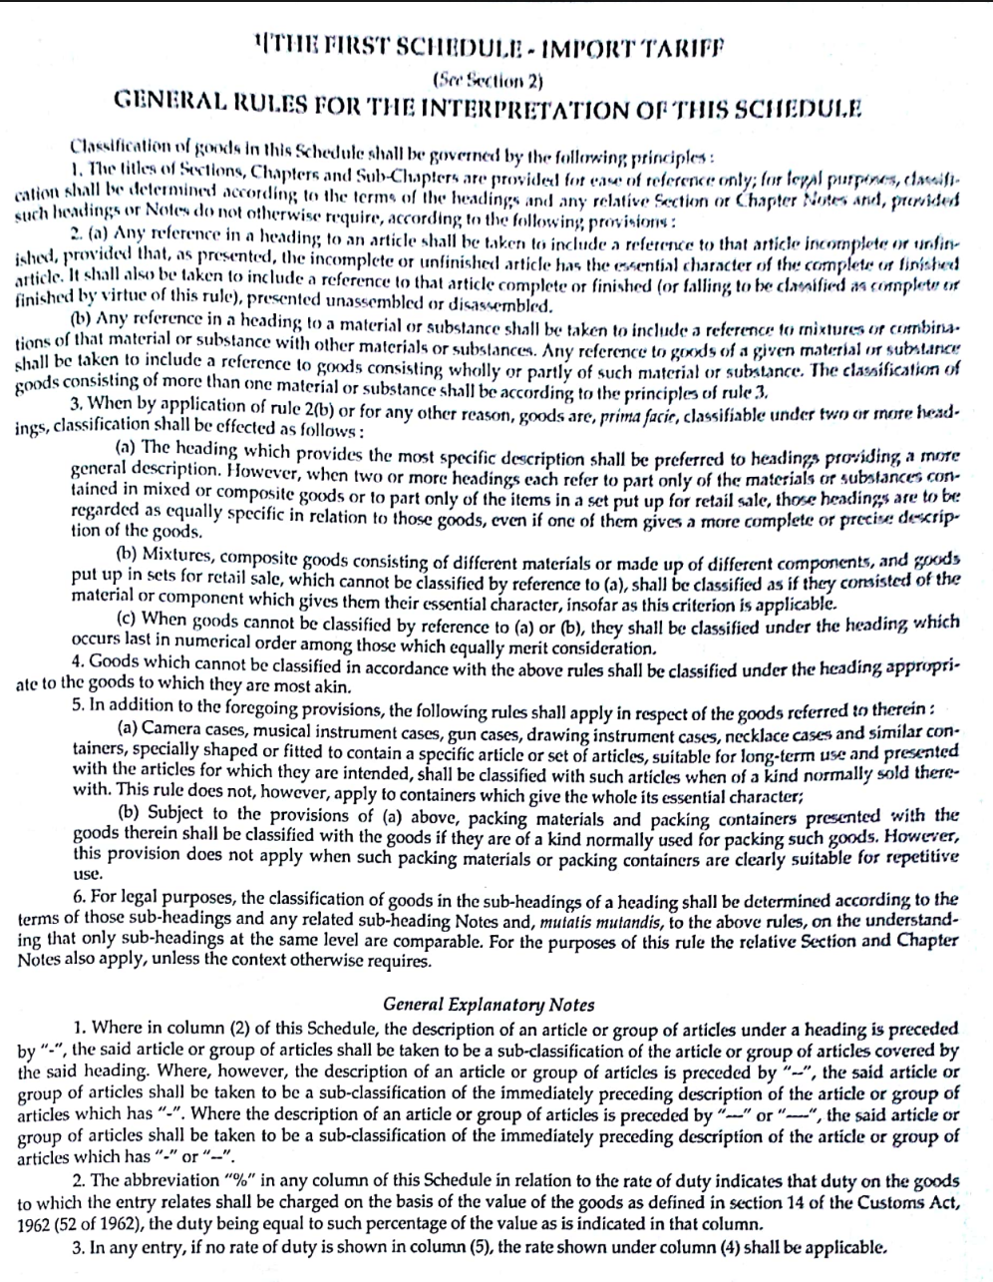
Basics of Classification

Slide 7
Project analysis slide 2
SECTION NOTES
HSN EXPLANATORY NOTES
TOOLS OF CLASSIFICATION OF GOODS
CHAPTER NOTES
GENERAL RULES OF INTERPRETATION
SUPPLEMENTARY NOTES
JUDICIAL PRECEDENTS / THEORIES

Slide 8
HSN EXPLANATORY NOTES
For ensuring uniformity, the World Customs Organization has published various Explanatory Notes to various heading/sub-headings.
They do not form part of the legal provisions of the HS but are the official interpretation of the WCO.
Not exhaustive, unchangeable commentary on the overall scope of the headings and sub-headings.
Gives a better understanding of the tariff headings
5 volumes and amending supplements

Slide 9
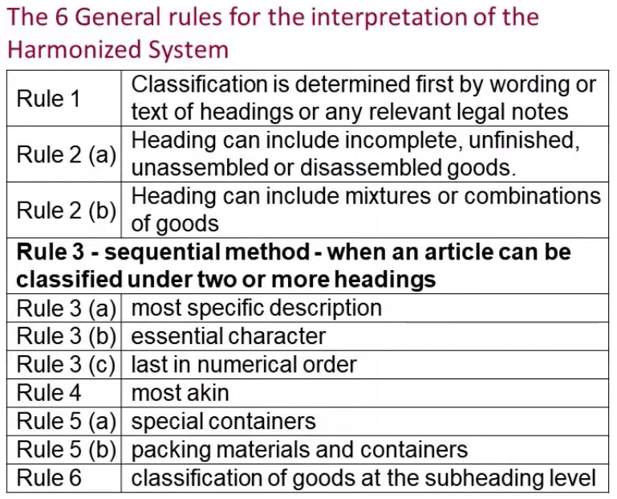
General Rules of Interepretation

Slide 10
GENERAL RULES OF INTERPRETATION – RULE 1
The titles of Sections, Chapters and sub-chapters are provided for ease of reference only; for legal purposes, classification shall be determined according to the terms of the headings and any relative Section or Chapter Notes
The titles of Sections, Chapters do not have any legal force.
Terms of heading read with relevant section or chapter notes are legally relevant for the purpose of classification
The rules of Interpretation need not be resorted to when classification is possible on the basis of description in heading, sub-heading, chapter notes and section notes.
Notes of one Chapter cannot be applied for interpreting entries in other Chapters or Sections.

Slide 11
Section or Chapter Notes
Certain Sections and Chapters are preceded by Notes which form an integral part of the Harmonized System and have the same legal force.
Defines the precise scope and limits of each sub-heading or headings.
Made the drafting of the heading, sub-heading simpler and also defined terms that are essential to avoid confusion
Referred to as the “Legal Notes”

Slide 12
Playing Cards
Classified under Chapter 49 –”product of the printing
industry” or as “Toys/Games” under Chapter 95?
CHAPTER 49
Printed books, newspapers, pictures and other products of the printing industry; manuscripts, typescripts and plans
NOTES :
This Chapter does not cover :
(a) photographic negatives or positives on transparent bases (Chapter 37) ;
(b) maps, plans or globes, in relief, whether or not printed (heading 9023) ;
(c) playing cards or other goods of Chapter 95 ; or
(d) original engravings, prints or lithographs (heading 9702), postage or revenue stamps, stamppostmarks, first-day covers, postal stationery or the like of heading 9704, antiques of an age exceeding one hundred years or other articles of Chapter 97.

Slide 13
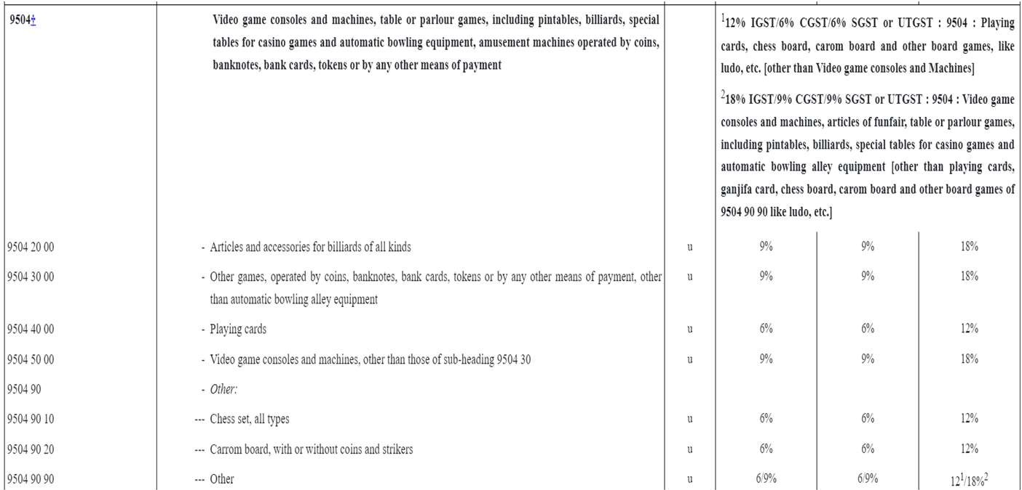

Slide 14
Project analysis slide 2
Children Tricycle
Chapter 87 - VEHICLES OTHER THAN RAILWAY OR TRAMWAY ROLLING-STOCK, AND PARTS AND ACCESSORIES THEREOF ?
Chapter 95 - TOYS, GAMES AND SPORTS REQUISITES; PARTS AND ACCESSORIES THEREOF ?
CHAPTER 87
Vehicles other than railway or tramway rolling-stock, and parts and accessories thereof
NOTES :
1. This Chapter does not cover railway or tramway rolling-stock designed solely for running on rails.
2. For the purposes of this Chapter, “tractors” means vehicles constructed essentially for hauling or pushing another vehicle, appliance or load, whether or not they contain subsidiary provision for the transport, in connection with the main use of the tractor, of tools, seeds, fertilizers or other goods. Machines and working tools designed for fitting to tractors of heading 8701 as interchangeable equipment remain classified in their respective headings even if presented with the tractor, and whether or not mounted on it.
3. Motor chassis fitted with cabs fall in headings 8702 to 8704, and not in heading 8706.
4. Heading 8712 includes all children’s bicycles. Other children’s cycles fall in heading 9503.

Slide 15
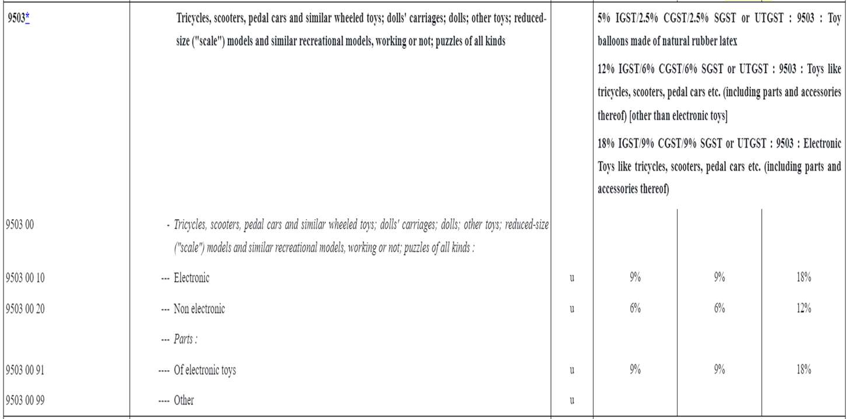

Slide 16
GENERAL RULES OF INTERPRETATION – RULE 2(a)
Any reference in a heading to an article shall be taken to include a reference to that article incomplete or unfinished, provided that, as presented, the incomplete or unfinished articles has the essential character of the complete or finished article. It shall also be taken to include a reference to that article complete or finished (or falling to be classified as complete or finished by virtue of this rule), presented unassembled or disassembled.
Applies only when Rule 1 has failed
Extends the scope of any heading which refers to a particular article to cover not only the complete article but also that article incomplete or unfinished, provided that, as presented, it has the essential character of the complete or finished article

Slide 17
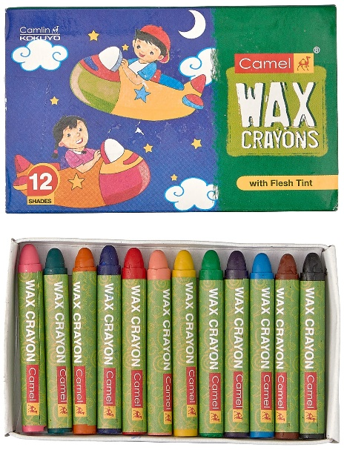
Plastic Crayon Compound
Camlin Limited was manufacturing plastic crayon falling under sub-heading 9609.00 which is chargeable to nil rate of duty, in the manufacture of which an in-process product known as crayplas shapeless plastic crayon (impugned good) comes into being.
It was classifying the same under CETH 9609 00 which covers “pencils, crayons, pencil leads, pastels, drawing charcoals, writing or drawing chalks”, whereas the Department asserted coverage under sub-heading CETH 3204.19 relating to pigments and preparation based thereon other than those in unformulated and unstandardized or unprepared form, not ready for use.” as the same are nothing but plastic crayon compound and are covered under Chapter 32 in view of being a preparation
Camlin Ltd. v. CCE (2003) 155 ELT 138 (CEGAT) [affirmed in (2005)180 E.L.T. 307 (S.C.)]
GIR 2(a) also, allows classification of incomplete or unfinished goods having the essential characteristics of complete or finished goods. In the instant case, the impugned goods only require to be given the shape of crayons before they can be made into finished crayons and as such, they can be considered as incomplete or unfinished goods.

Slide 18
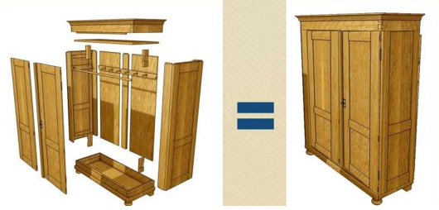
Eg. - Rule 2(a)

Slide 19
GENERAL RULES OF INTERPRETATION – RULE 2(b)
Any reference in a heading to a material or substance shall be taken to include a reference to mixtures or combinations of that material or substance with other materials or substances. Any reference to goods of a given material or substance shall be taken to include a reference to goods consisting wholly or partly of such material or substance. The classification of goods consisting of more than one material or substance shall be according to the principles of rule 3
The term coffee will includes coffee mixed with chicory
Natural rubber will cover mixture of natural & synthetic rubber
Articles of gold will include articles which are made partly of gold

Slide 20
GENERAL RULES OF INTERPRETATION – RULE 3(a)
When by application of rule 2(b) or for any other reason, goods are, prima facie, classifiable under two or more headings, classification shall be effected as follows:
(a) The heading which provides the most specific description shall be preferred to headings providing a more general description.
However, when two or more headings each refer to part only of the materials or substances contained in mixed or composite goods or to part only of the items in a set put up for retail sale, those headings are to be regarded as equally specific in relation to those goods, even if one of them gives a more complete or precise description of the goods

Slide 21
Engine parts made of Steel classifiable under
8409 – “Parts suitable for use solely or principally with the engines of heading 8407 or 8408” OR
7325 – “ Other cast articles of Iron or Steel” Classify under 8409 as it is more specific
Electric Shaving Machine classifiable under
85.10 – Shavers and hair clippers with self-contained electric motors OR
85.09 – Electro-mechanical domestic appliances with self –contained electric motor
Classify under 85.10 as it is more specific
Plastic name plate for motor vehicle is to be classified as “accessory of motor vehicle” and not “other articles of plastic”

Slide 22
GENERAL RULES OF INTERPRETATION – RULE 3(b)
(b) Mixtures, composite goods consisting of different materials or made up of different components, and goods put up in sets for retail sale, which cannot be classified by reference to (a), shall be classified as if they consisted of the material or component which gives them their essential character, in so far as this criterion is applicable

Slide 23
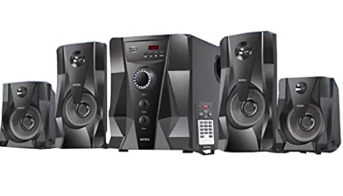
• Multimedia speakers with additional facilities such as USB, SD card and FM radio etc. -whether classified
under
• CTH 8518 - Loudspeakers, whether or not mounted in their enclosures: headphones and earphones,
whether or not combined with a microphone, and sets consisting of a microphone and one or more
loudspeakers: audio-frequency electric amplifiers: electric sound amplifier sets; or under
• CTH 8519 – “Sound recording or reproducing apparatus”
• The Tribunal held that the impugned goods are speakers with added function and the main role of the item, in
question, remains amplifying the sound received from outside source or from inbuilt feature. The Tribunal held
that the product should be classified as speakers only.

Slide 24
GENERAL RULES OF INTERPRETATION – RULE 5
5. In addition to the foregoing provisions, the following rules shall apply in respect of the goods referred to therein:
Camera cases, musical instrument cases, gun cases, drawing instrument cases, necklace cases and similar containers, specially shaped or fitted to contain a specific article or set of articles, suitable for long-term use and presented with the articles for which they are intended, shall be classified with such articles when of a kind normally sold therewith. This rule does not, however, apply to containers which give the whole its essential character;
Subject to the provisions of (a) above, packing materials and packing containers presented with the goods therein shall be classified with the goods if they are of a kind normally used for packing such goods. However, this provisions does not apply when such packing materials or packing containers are clearly suitable for repetitive use.

Slide 25
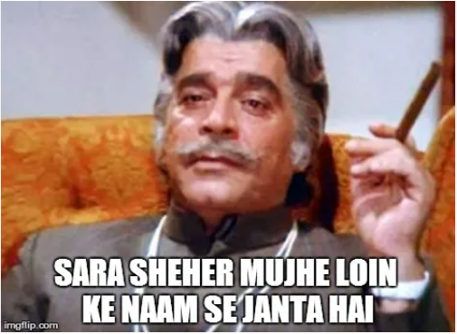
TRADE PARLANCE THEORY
A word in statute should be construed in its popular sense and not in the strict or technical sense, ‘Popular sense’ means that which people conversant with the subject matter with which the statue is dealing would attribute to it.
“Where a word has a scientific or technical meaning and also an ordinary meaning according to common parlance, it is in the latter sense that in a taxing statute the word must be held to have been used, unless contrary intention is clearly expressed by the Legislature.”
The test ignores the technical meaning or scientific meaning if open market exists for the commodities commonly traded.

Slide 26
Eg - Common parlance theory
CCE v. Connaught Plaza Restaurant P. Ltd (2012) 286 ELT 321 (SC)
Assessee was of the view that that “soft-serve” is a product distinct and separate from “ice-cream” since ice-cream is commonly understood to have milk fat content above 8% whereas their product does not contain more than 5%. Hence it cannot be considered as ice- cream.
“Soft-serve”, in the absence of a definition of the term “ice cream”, it is to be construed as per common parlance, even if under the provisions of Food Adulteration Act, it may not fall within the meaning of ice cream.
What matters is the way the consumer perceives the product.

Slide 27
Tariff Notifications - Services

Slide 28
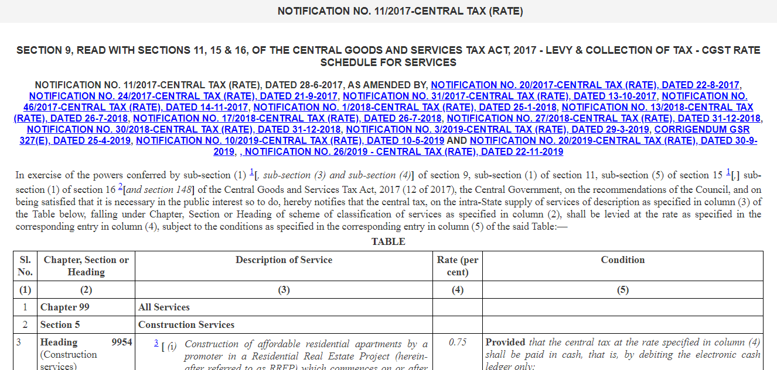
Classification of Services

Slide 29
Tariff Notifications - Services

Slide 30
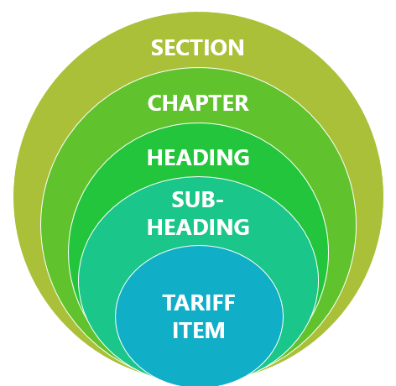
Structural Difference between Tariff of Goods and Services
FIRST SCHEDULE TO CUSTOMS TARIFF ACT, 1975
SCHEME OF CLASSIFICATION OF SERVICES

Slide 31
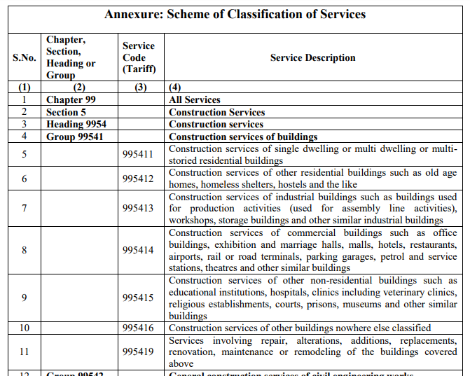
Illustration – Scheme

Slide 32
Illustration – multiple rates!

Slide 33
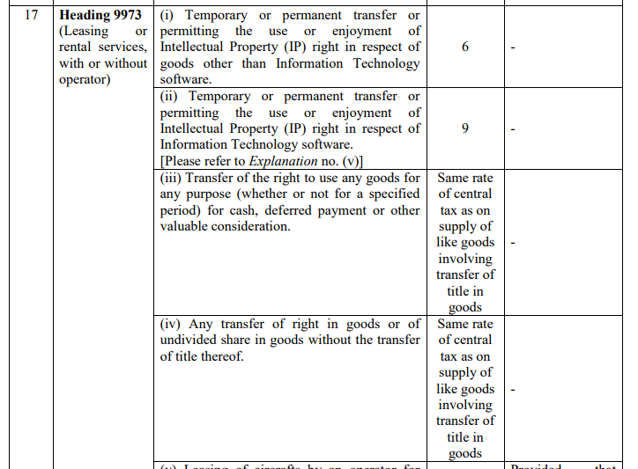
Illustration – right-to-use!

Slide 34
Tariff Notifications - Services

Slide 35
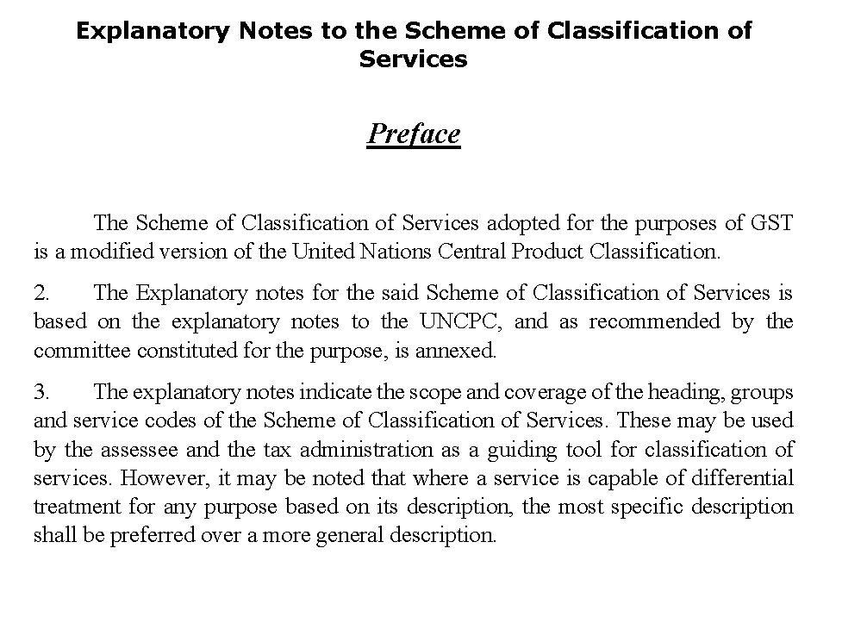
Explanatory Notes

Slide 36
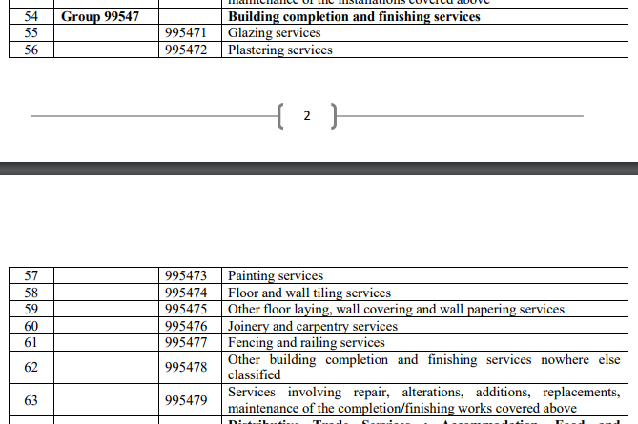
Illustration – missing activities- n.e.c ?

Slide 37
Summarised….
# 1
Find out the most commonly used description of goods or services
# 2
Use ‘dominant ingredient test’ in case of base-materials or articles
Else, try ‘essential function test’ in case of processed articles
# 3
Look for HSN (for goods) corresponding to the above test results
Examine if a more accurate commercial or trade description exists
Look for SAC (for services) corresponding to the above test results

Slide 38
Exemptions under GST

Slide 39
Coverage
Power to grant exemption from tax,
Exemptions – Principles of Interpretation,
Exempt Services – Key Exemptions,
Exempt Goods – Key Exemptions,
Impact on Input tax Credit

Slide 40
Power to grant exemption from tax
Section 11 of the CGST Act :–
Power to exempt generally, either absolutely or subject to such conditions as may be specified,
Mandatory to avail absolute exemptions,
Tax not be collected in case of absolute exemptions ( Expln to S :11),
Exemption can be from the whole or any part of the tax,
Exemption to be granted on the recommendations of the Council,
Exemption by way of notification or order.

Slide 41
Principles of interpretation - Exemptions
C.Cu (Import), Mumbai Vs. Dilip Kumar & Company 2018 (361) ELT 577 (S.C.)
Burden to prove for its entitlement is on assessee claiming exemption.
If there is any ambiguity in exemption Notification, benefit of such ambiguity cannot be claimed by assessee and it must be interpreted in favour of Revenue.
Burden to prove tax liability of an assessee is on Revenue.
In case of any ambiguity in a taxing statute imposing tax liability on the assessee, benefit of doubt to be given to assessee.

Slide 42
Principles of interpretation - Exemptions
Govt of Kerala Vs. Mother Superior Adoration Convent [2021-VIL-43-SC]
It may be noticed that the 5-Judge Bench judgment did not refer to the line of authority which made a distinction between exemption provisions generally and exemption provisions which have a beneficial purpose.
We cannot agree that sub-silentio the line of judgments qua beneficial exemptions has been done away with by this 5-Judge Bench.
It is well settled that a decision is only an authority for what it decides and not what may logically follow from it.
We must first ask ourselves what is the object sought to be achieved by the provision, and construe the statute in accord with such object.
And on the assumption that any ambiguity arises in such construction, such ambiguity must be in favour of that which is exempted.

Slide 43
Principles of interpretation - Exemptions
Conditional Exemptions w.r.t Input Tax Credit
In case of exemption subject to condition of non taking of Cenvat credit, credit taken but before utilisation credit reversed amounts to not taking credit - Exemption is available. [C.C.Ex Mumbai-I V. Bombay Dyeing & Mfg. Co. Ltd. 2007(215) ELT 3 (S.C.)]
Reversal of Cenvat/Modvat credit amounts to non-taking of credit. [C.C.Ex & Cu. V. Precoat Meridian Ltd. 2015(325)ELT 234(S.C.)]
Option to avail the benefit - 2 Notification
When two exemption notifications are available to assessee, he can opt for the most beneficial notification. Department cannot force assessee to opt for a particular exemption. [WINSOME YARNS LTD. Vs. CCX & ST, CHANDIGARH-II (Trib. Delhi)]

Slide 44
Exemption Notification No 12/2017 –CT(R)
Entry No. | Particulars
1 | Services of Charitable Institutions: Services by an entity registered under section 12AA or 12AB of the Income-tax Act, by way of charitable activities.
 | (r) “charitable activities” means activities relating to - (i) public health by way of ,- (A) care or counseling of (I) terminally ill persons or persons with severe physical or mental disability; (II) persons afflicted with HIV or AIDS; (III) persons addicted to a dependence-forming substance such as narcotics drugs or alcohol; or (B) public awareness of preventive health, family planning or prevention of HIV infection;

Slide 45
Exemption Notification No 12/2017 –CT(R)
Entry No. | Particulars
1 | (ii) advancement of religion, spirituality or yoga; (iii) advancement of educational programmes or skill development relating to,- (A) abandoned, orphaned or homeless children; (B) physically or mentally abused and traumatized persons; (C) prisoners; or (D) persons over the age of 65 years residing in a rural area; (iv) preservation of environment including watershed, forests and wildlife;

Slide 46
Exemption Notification No 12/2017 –CT(R)
Sale of various spiritual products such as books, audio CDs, DVDs, statues and calendars for advancement of religious teachings - Covered under definition of ‘business’. [SHRIMAD RAJCHANDRA ADHYATMIK SATSANG SADHANA KENDRA (Maha. AAR)]
Rest house for pilgrims for Rs 1000/- per day
-not run by the Same trust &
-outside precincts of Trust (Nandini Ashram (Guj AAR)Supporting materials\Nandini Ashram ( Guj AAR).pdf
Renting of Accommodation consisting 2 rooms and dormatory with 12 beds having facility of water, ele, bed, pillow, restroom with tiolet - liable for tax . (Acharya Shree Mahashraman Chaturmas Vyvastha Samiti Telengana- AAAR)Supporting materials\KAR_AAAR_16_2019-20_ACHARYASHREE.pdf

Slide 47
Exemption Notification No 12/2017 –CT(R)
Ent No. | Particulars
13 | Services by a person by way of- conduct of any religious ceremony; renting of precincts of a religious place meant for general public, owned or managed by an entity registered as a charitable or religious trust u/s 12AA or 12AB of the Income-tax Act, 1961 or a trust or an institution registered u/s 10 (23C)(v) of the Income-tax Act or a body or an authority covered u/s section 10 (23BBA) of the said Income-tax Act
 | Provided that nothing contained in entry (b) of this exemption shall apply to,- Renting of rooms where charges are one thousand rupees or more per day; Renting of premises, community halls, kalyanmandapam or open area, and the like where charges are ten thousand rupees or more per day; Renting of shops or other spaces for business or commerce where charges are ten thousand rupees or more per month.

Slide 48
Exemption Notification No 12/2017 –CT(R)
Ent No. | Particulars
21 | Services provided by a goods transport agency, by way of transport in a goods carriage of - agricultural produce; *(b) and (c) [___] (d) milk, salt and food grain including flour, pulses and rice; (e) organic manure; (f) newspaper or magazines registered with the Registrar of Newspapers; (g) relief materials meant for victims of natural or man-made disasters, calamities, accidents or mishap; or (h) defence or military equipments. *Omitted w.e.f. 18.07.2022- (b) goods, where consideration charged for the transportation of goods on a consignment transportedin a single carriage does not exceed one thousand five hundred rupees; (c) goods, where consideration charged for transportation of all such goods for a single consignee does not exceed rupees seven hundred and fifty;

Slide 49
Exemption Notification No 12/2017 –CT(R)
Ent No. | Particulars
12 | Services by way of renting of residential dwelling for use as residence 1[except where the residential dwelling is rented to a registered person]. 2[Explanation.—For the purpose of exemption under this entry, this entry shall cover services by way of renting of residential dwelling to a registered person where,— (i) the registered person is proprietor of a proprietorship concern and rents the residential dwelling in his personal capacity for use as his own residence; and (ii) such renting is on his own account and not that of the proprietorship concern.]
Notes:
Where end-use is not for residential purposes, forward charge is applicable. Renting for non-residential purposes results in change of use of building and it will not be ‘dwelling’ unit.
End-use test is important, whether the lease is with business entity or not. End-use if it is not for ‘dwelling’ then forward charge applies.

Slide 50
Exemption Notification No 12/2017 –CT(R)
Ent No. | Particulars
24 | Services by way of loading, unloading, packing, storage or warehousing of rice.
24A | Services by way of warehousing of minor forest produce.
24B | #Services by way of storage or warehousing of cereals, pulses, fruits and vegetables
# Substituted w.e.f. 18th July 2022 before it was:
Services by way of storage or warehousing of cereals, pulses, fruits, nuts and vegetables, spices, copra, sugarcane, jaggery, raw vegetable fibres such as cotton, flax, jute etc., indigo, unmanufactured tobacco, betel leaves, tendu leaves, coffee and tea.

Slide 51
Exemption Notification No 12/2017 –CT(R)
Entry No. | Particulars
54 | Services relating to cultivation of plants and rearing of all life forms of animals, except the rearing of horses, for food, fibre, fuel, raw material or other similar products or agricultural produce by way of- (a) agricultural operations directly related to production of any agricultural produce including cultivation, harvesting, threshing, plant protection or testing; (b) supply of farm labour; (c) processes carried out at an agricultural farm including tending, pruning, cutting, harvesting, drying, cleaning, trimming, sun drying, fumigating, curing, sorting, grading, cooling or bulk packaging and such like operations which do not alter the essential characteristics of agricultural produce but make it only marketable for the primary market; (d) renting or leasing of agro machinery or vacant land with or without a structure incidental to its use;

Slide 52
Exemption Notification No 12/2017 –CT(R)
Entry No. | Particulars
54 | (e) loading, unloading, packing, storage or warehousing of agricultural produce; (f) agricultural extension services; (g) services by any Agricultural Produce Marketing Committee or Board or services provided by a commission agent for sale or purchase of agricultural produce. *(h)[___] “agricultural produce” means any produce out of cultivation of plants and rearing of all life forms of animals, except the rearing of horses, for food, fibre, fuel, raw material or other similar products, on which either no further processing is done or such processing is done as is usually done by a cultivator or producer which does not alter its essential characteristics but makes it marketable for primary market;
*Omitted w.e.f. 18.07.2022- services by way of fumigation in a warehouse of agricultural produce

Slide 53
Pre-Packaged / Labelled Foods
Government has withdrawn exemptions on various food viz., wheat, rice, certain flours, paneer, honey, certain meat, certain fish, etc. (notified products) and introduced exemption for supply of pre-packaged and pre-labelled retail pack as defined in terms of Legal Metrology Act
GST liability on pre-packaged + labelled food + LMA,
Branding is irrelevant,
Liability to arise if wholesale package consists of multiple pre-packaged retail packs
It can be derived that the following are the exclusions from LMR, and the rules made thereunder, meaning that the exemption under GST would be applicable to these packages for the notified goods:
Packages more than 25kg.
Packages more than 50kg in case of agricultural farm produce.
Packages of 10g/ 10ml or less, and
Packages (of whatever quantity) which are meant for industrial consumers or institutional consumers.

Slide 54
Pre-Packaged / Labelled Foods
Nature of packing | GST liability
Items pre-packaged and labelled where weight is 25 kg or less than 25 kg | Taxable
Wholesale package of more than 25kg which contain retail pre-packaged and labelled package inside it | Taxable
Items liable to bear the packaging and declaration as per LMR Act but not declared on it | Taxable
Item is pre-packaged with less than or equal to 25 Kg but is not labelled | Exempt
Items pre-packaged and labelled where weight is more than 25 kg | Exempt
Pre-packaged and labelled item supplied to industrial or institutional consumer | Exempt
Wholesale package of more than 25kg which does not contain any pre-packaged and labelled items inside it | Exempt
Item sold in loose (unpacked, packed in transparent container or bag) in any quantity | Exempt

Slide 55
Impact on Input Tax Credit
Exempt supplies not to be considered for reversal: (Explanation to Rule 43)
Interest income from deposit or lending money.
The value of supply of services by way of transportation of goods by a vessel from the customs station of clearance in India to a place outside India.
Not exempt supplies but to be considered for reversal: [Section 17(3)]
Sale of land and completed building - Schedule III (stamp duty value)
Supplies on which GST is to be paid by the recipient (RCM)
Transactions in securities - Neither goods nor service (1% of the sale value)

Slide 56
THANK YOU
Anada Associates
Chartered Accountants
5th Floor, Star Plaza,
Phulchhab Chowk, Rajkot
Phone : +91 9825765902
E-mail : Sharadanada@gmail.com
KARMA & Co. LLP
Chartered Accountants
2nd Floor, Akshar Annexy,
Off Amin Marg, Rajkot.
Phone : +91 98251 61814
E-mail : ajay@karmallp.in
URL : www.karmallp.in
Rajkot Ahmedabad
Surat Mumbai

