Slide 1
@ Rajkot Branch of WIRC of ICAI
October 16, 2023 - Monday
Project Registration Under RERA and
Important Issues & Clarifications
By CA. Anand H. Doshi
K S D & Associates
Rajkot | Ahmedabad | Gandhidham

Slide 2
Agenda
Important Definitions
Documentation for Registration
Registration Process
Important Issues & Clarifications

Slide 3
OBJECT AND APPLICABILITY
The Real Estate (Regulation and Development) Act, 2016 (RERDA) was passed to protect the rights and interests of consumers and promotion of uniformity and standardization of business practices and transactions in the real estate sector.
From 1st May, 2017, the act has been brought into force by the Central Government (except J&K).

Slide 4
Important Definitions

Slide 5
Section 2(zn) – Real Estate Project
Real Estate Project means
development of building or building consisting of apartments, or
converting an existing building or a part thereof into apartments, or
the development of land into plots or apartment, as the case may be,
for the purpose of selling all or some of the said apartments or plots or building, as the case may be, and
Includes the common areas, the developments works, all improvements and structures thereon, and all easements, rights and belonging thereto;

Slide 6
Section 2(k) – Carpet Area
Carpet Area means
net usable floor area of an apartment, excluding
the area covered by external walls,
area under service shafts,
exclusive balcony or verandah and exclusive open terrace area,
but includes the area covered by the internal partition walls of the apartment
Explanation— For the purpose of this clause, the expression "exclusive balcony or verandah area" means the area of the balcony or verandah, as the case may be, which is appurtenant to the net usable floor area of an apartment, meant for the exclusive use of the allottee; and "exclusive open terrace area" means the area of open terrace which is appurtenant to the net usable floor area of an apartment, meant for the exclusive use of the allottee;

Slide 7
Section 2(zk) – Promoter
Promoter means -
a person who constructs or cause to be constructed an independent building or building consisting of apartments, or converts an existing building or part thereof into apartments for the purpose selling of all or some of the apartments to other persons and includes his assignees; or
a person who develops land into a project, whether or not persons also constructs structures on any plots, for the purpose of selling to other persons all or some of plots in the said project , with or without structures thereon; or
any development authority or any other public body in respect of allottees of –
(a) buildings or apartments, as the case may be, constructed by such authority or body on lands owned by them or placed at their disposal by the Government; or
(b) plots owned by such authority or body or placed at their disposal by the Government, for the purpose of selling all or some of the apartments or plots; or

Slide 8
Section 2(zk) – Promoter
an apex State level co-operative housing finance society and a primary co-operative housing finance society which constructs apartments or buildings for its members or in respect of the allottees of such apartments or buildings; or
any person who acts himself as a builder, coloniser, contractor, developer, estate developer or by any other name or claims to be acting as the holder of a power of attorney from the owner of the land on which the building or apartment is constructed or plot is developed for sale; or
such other person who constructs any building or apartment for sale to the general public.
Explanation - For the purposes of this clause, where the person who constructs or converts a buildings into apartments or develops a plot for sale and the persons who sells apartments or plots are different persons, both of them shall be deemed to be the promoters and shall be jointly liable as such for the functions and responsibilities specified, under this Act or the rules and regulations made thereunder.

Slide 9
Registration
Documentations & Process

Slide 10
Section 3
No promoter shall advertise, market, book, sell or offer for sale, or invite persons to purchase in any manner any plot, apartment or building, as the case may be, in any real estate project or part of it, in any planning area, without registering the real estate project with the Real Estate Regulatory Authority established under this Act:
No Registration of the real estate project shall be required -
area of development does not exceed 500 sq. mtr. or Number of units does not exceed 8 inclusive of all phases.
project which has received completion certificate on or before 01.05.2017. (for ongoing projects only)
renovation, repair, or redevelopment not resulting into selling of any new apartment, plot or building.
any development carried out beyond planning area i.e. TP Scheme, SIR(Special Investment Region) and GIDC – Circular No. 77 dated 26.09.2017.

Slide 11
Rule 3 of Chapter II of Guj RERA Rules, 2017;
The promoter shall furnish the following additional information and documents, along with those specified under the relevant sections of the Act, for registration of the real estate project with regulatory authority;
Rule 3

Slide 12
Documents
for
Registration

Slide 13
Basic Details of Promoter;
KYC, Photos, Mobile Number & Email id of proprietor or all partners or all directors.
ROF & Partnership Deed, Incorporation certificate & MOA & AOA.
Last three year Financials.
Details of projects carried out in the last five years.
Details of Registration with any other state.
Letter of Authority.
Promoter

Slide 14
Details of Project;
Commencement Certificate.
Approved Building Plan with proper drawing of unit-wise carpet area, drainage line and parking layout plan.
Approved Layout Plan.
All NOCs (Fire, NA Order, Airport, Railway, Jail etc.).
Land Purchase Deed, Registered Joint Development, Registered Re-Development Agreement.
Detail of Designated bank account (70% RERA Retention Account) as per guideline issued by the authority.
Draft Brochure of the project.
Project

Slide 15
Details of Project;
Form – B, Form – B1 & Form – B2.
Estimated Cost of Construction.
Project Start and End date.
Covered & Open area of land.
Number of covered & open parking with their area in sq. mtr.
Inventory details like sale price, carpet area, area of balcony, Open Terrace, Verandah etc.
In case of project loan – Sanction letter, Mortgage Deed.
Project

Slide 16
Details of Project;
Zoning Certificate or Area Development plan and if property covered under city survey than part plan.
Property Card, Gam Namuno No. 2, 8 – A about the ownership of land owner.
Title Clear Report from advocate having experience more than 10 years with 30 years history and search for the land.
Non – Encumbrance Certificate.
Draft Allotment Letter.
Draft Agreement for Sale as per format provided by the authority.
Draft Sale Deed.
Legal

Slide 17
Details of Project;
Architect means person who is registered with the Council of Architect having COA number.
Form 1 – Architect Certificate (Showing progress of the project in percentage)
Having Decree of B. Arch & M. Arch.
Name, Address, Mobile Number, Email id, Year of Establishment, Year of Experience, Number of Projects completed.
Certificate from Architect

Slide 18
Details of Project;
Engineer means person who is registered with local municipal authority as an engineer.
Form 2 – Engineer Certificate (Showing progress of the project in terms of estimated cost of construction).
Having Decree of BE. Civil & ME. Civil.
Name, Address, Mobile Number, Email id, Year of Establishment, Year of Experience, Number of Projects completed.
Certificate from Engineer

Slide 19
Details of Project;
Form 3 – Chartered Accountants Certificate (Showing progress of the project in terms of Actual cost of construction incurred and paid).
Actual cost of construction incurred and paid is in accordance with Form-1 or Form-2 or not.
Certificate from Chartered Accountants

Slide 20
Details of Project;
Carpet Area Affidavit.
Drainage Affidavit.
N.A. Affidavit.
Affidavit along with “Kachi Nondh”.
Others

Slide 21
Rule 3(3) of Chapter II of Guj RERA Rules, 2017;
Initially, the promoter shall pay a registration fees at time of application for registration on the area land proposed to be developed by them.
The sub rule 3 of rule 3 has been amended via notification issued on 31.08.2019 – the registration fees shall be pay on the carpet area proposed to be developed by the promoter.
Fees Structure

Slide 22
Fees for Registration of the Project
Housing
Project
Mix
Project
Commercial
Project
Plotting
Project
Rs. 8.00/- Per Sq. Mtr.
minimum Rs. 10,000/-
&
maximum Rs. 10.00 Lacs
Rs. 15.00/- Per Sq. Mtr.
minimum Rs. 12,000/-
&
maximum Rs. 12.00 Lacs
Rs. 20.00/- Per Sq. Mtr.
minimum Rs. 15,000/-
&
maximum Rs. 15.00 Lacs
Rs. 10.00/- Per Sq. Mtr.
minimum Rs. 5,000/-
&
maximum Rs. 5.00 Lacs

Slide 23
Registration
Process

Slide 24
Registration Process
File an application on the Gujrera Portal
Verification by QC Team than Acknowledgment Number
Auto allocation to team for further verification
TP, Finance & Legal Team Verify the documents & details
If any queries, communicated through e-mail
Registration Number Granted
Reply to queries are submitted through e-mail
Once queries are resolved & approved by all teams, forward to every team head
After approval from team head, file forward to higher authority
Forward to Chairperson

Slide 25
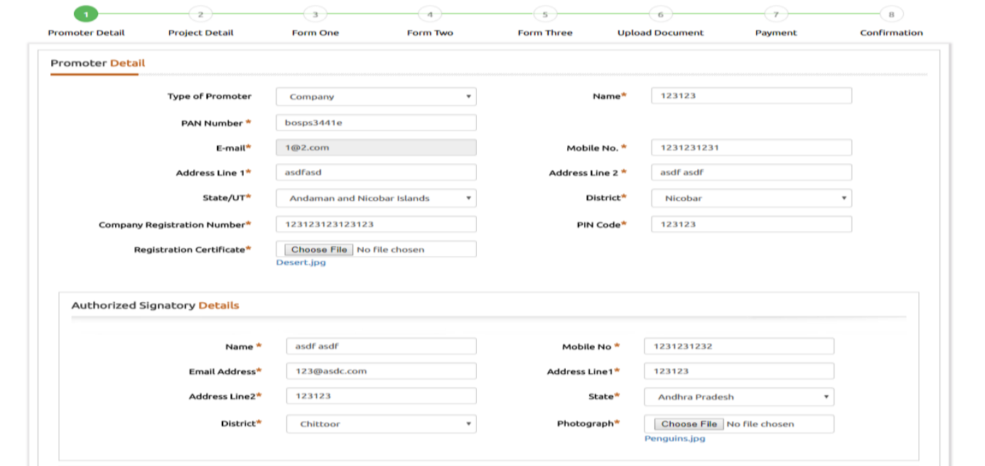
Promoter Details

Slide 26
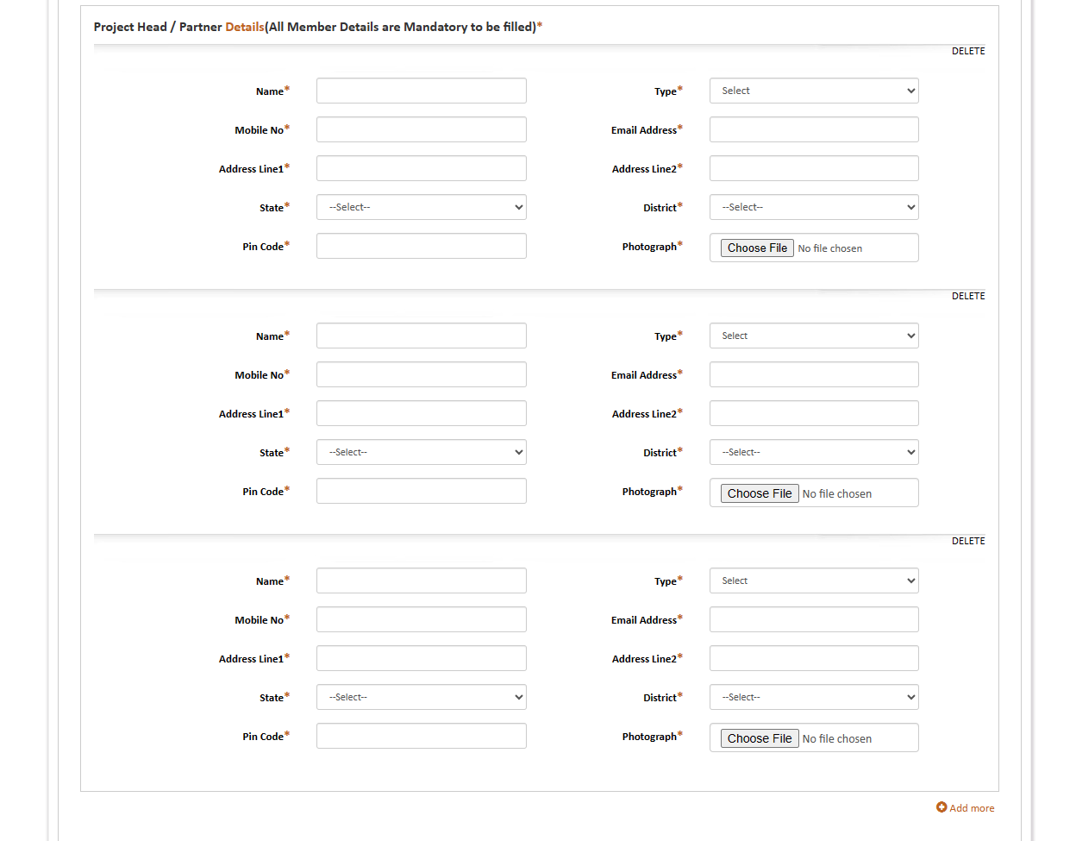
Promoter Details

Slide 27
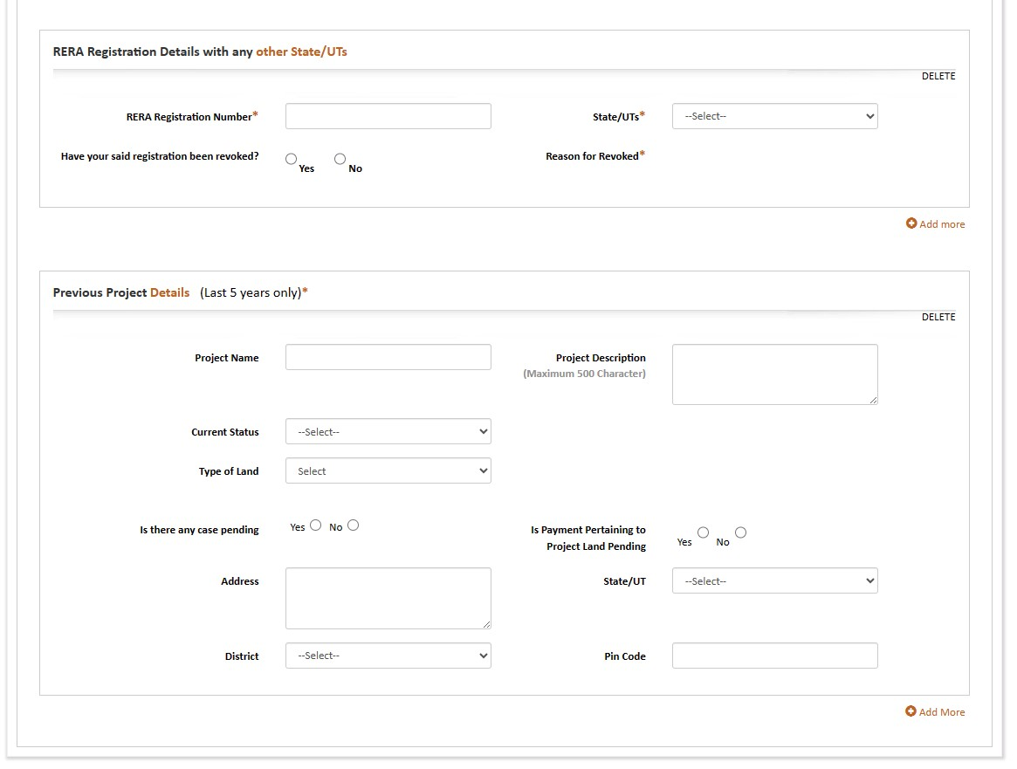
Promoter Details

Slide 28
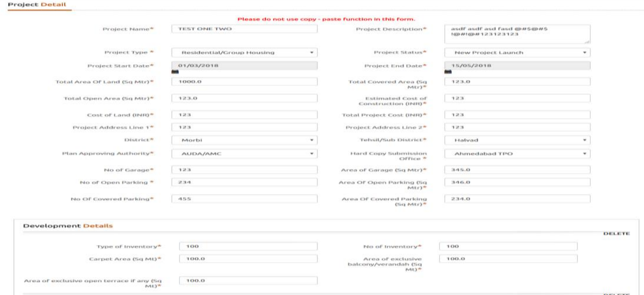
Project Details

Slide 29
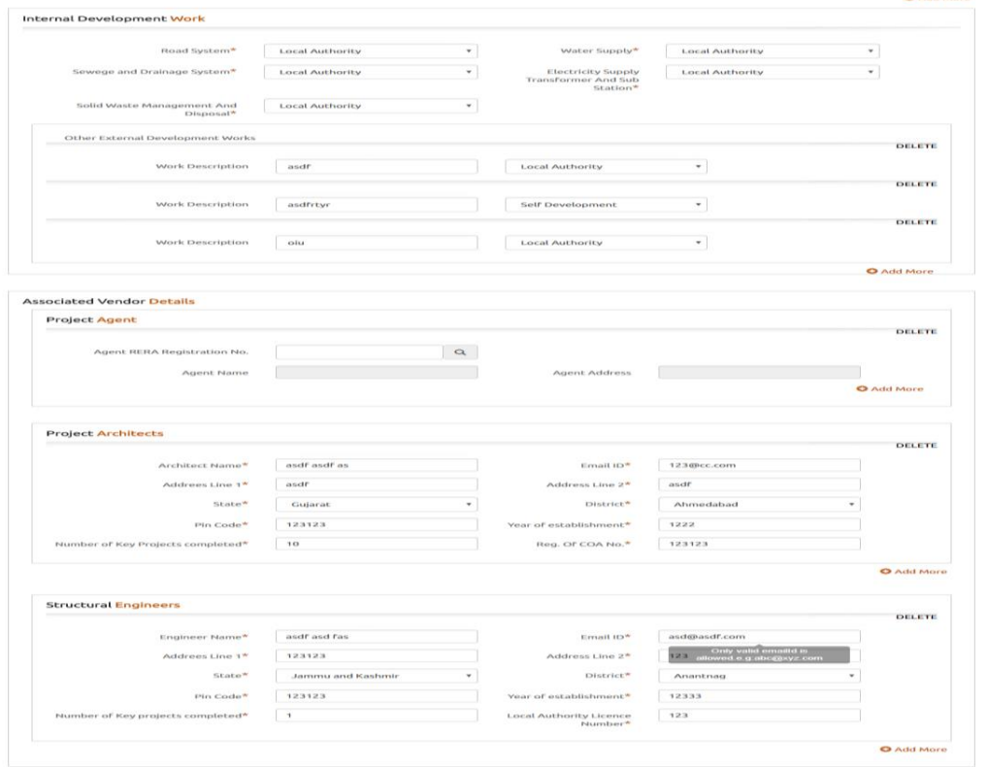
Project Details

Slide 30
Project Details

Slide 31
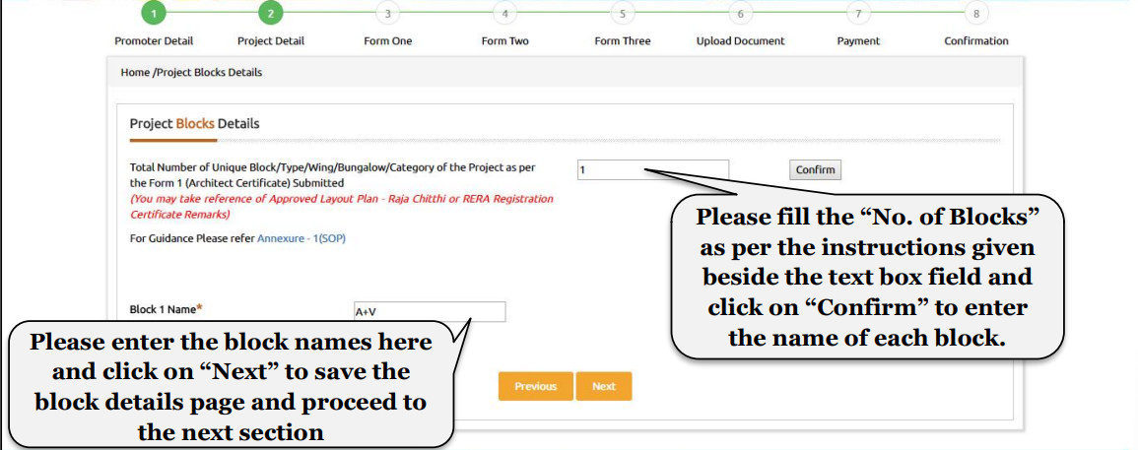
Project Block Details

Slide 32
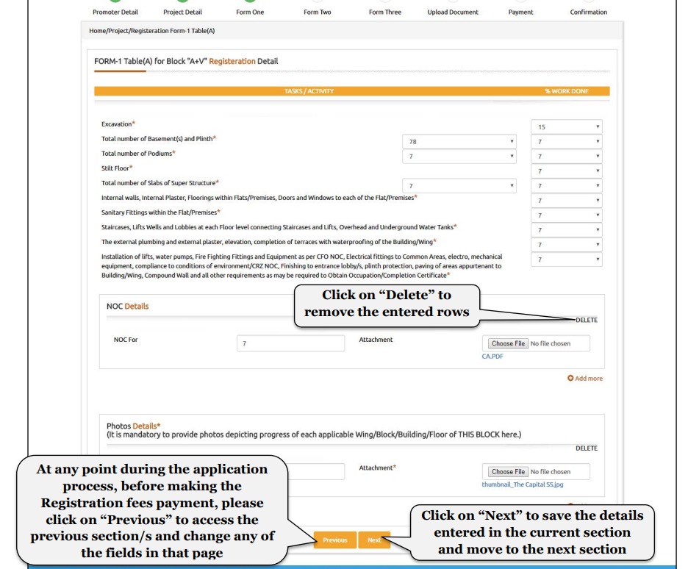
Form 1 – Architect Certificate

Slide 33
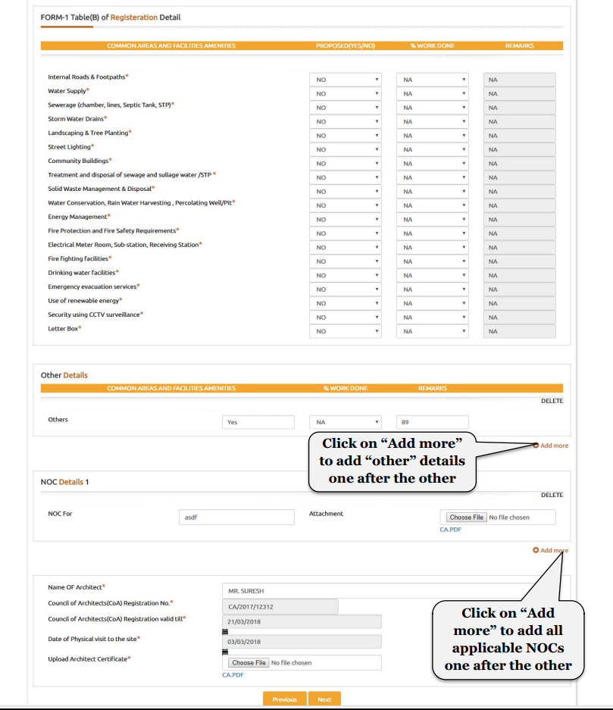
Form 1 – Architect Certificate

Slide 34
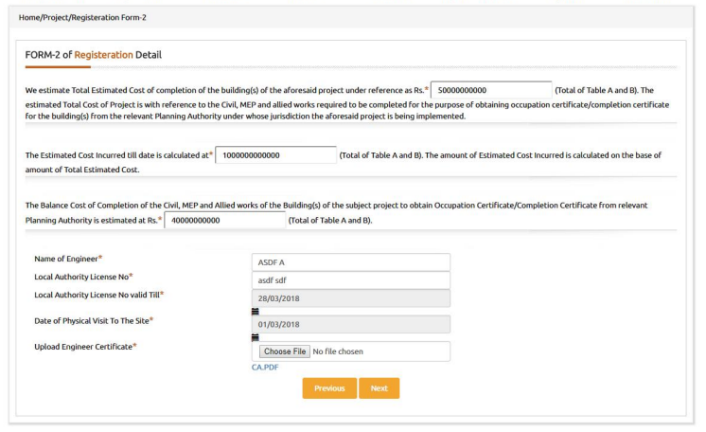
Form 2 – Engineer Certificate

Slide 35
Form 3 – Chartered Accountant Certificate
Form 3A – Excel Template
BLOCK TYPE | FLAT/BUNGLOW/OFFICE | USAGE | CARPET AREA | AREA OF EXCLUSIVE BALCONY | STATUS | UNIT AMOUNT | RECEIVED AMOUNT | DATE OF AGREEMENT OF SALE | ENCUMBRANCE STATUS | ALLOTEE NAME | TYPE OF KYC | KYC ID | MOBILE NUMBER | REDEVELOPMENT
Wing A+B | A-1 | Shop | 36.55 | 0 | UNBOOKED | 2750000 | 0 |  | No Encumbrance |  |  |  |  | NO
Wing A+B | A-2 | Shop | 21.23 | 0 | UNBOOKED | 1750000 | 0 |  | No Encumbrance |  |  |  |  | NO
Wing A+B | A-101 | Residential | 46.63 | 1.71 | UNBOOKED | 1450000 | 0 |  | No Encumbrance |  |  |  |  | NO
Wing A+B | B-201 | Residential | 88.54 | 42.33 | UNBOOKED | 4000000 | 0 |  | No Encumbrance |  |  |  |  | NO

Slide 36
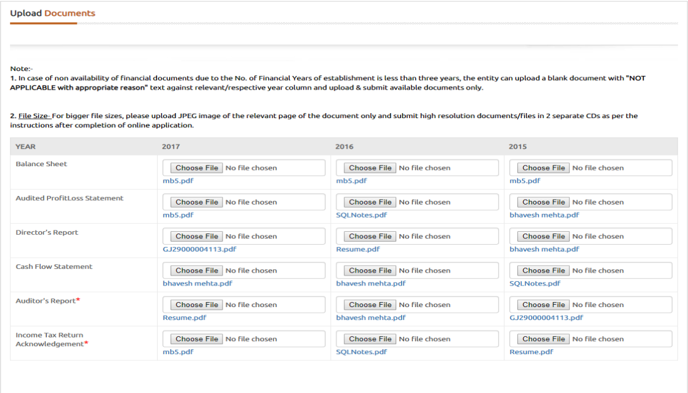
Upload Documents – Financial

Slide 37
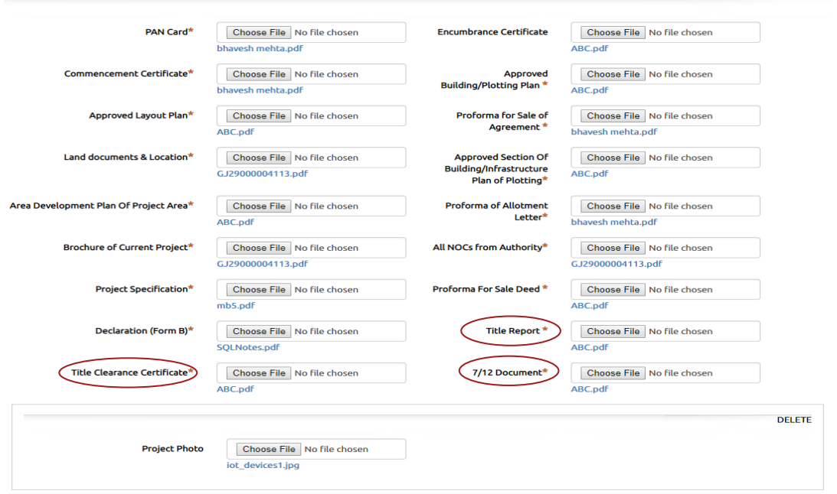
Upload Documents – Project

Slide 38
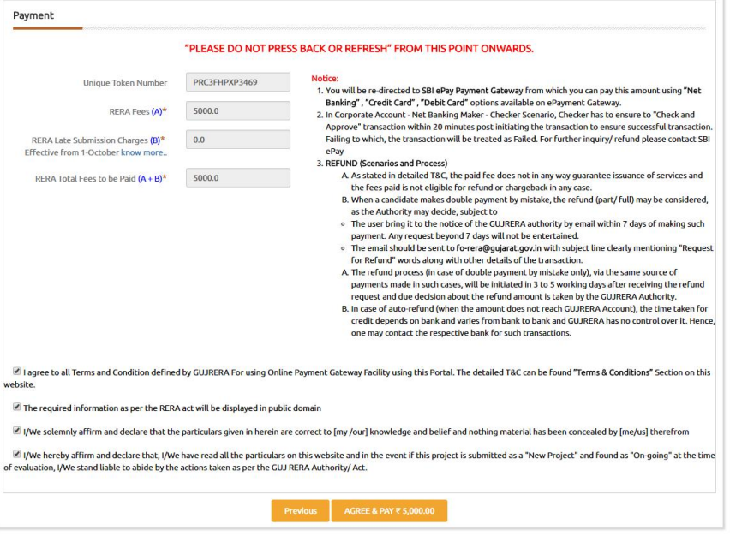
Payment of Registration Fees

Slide 39
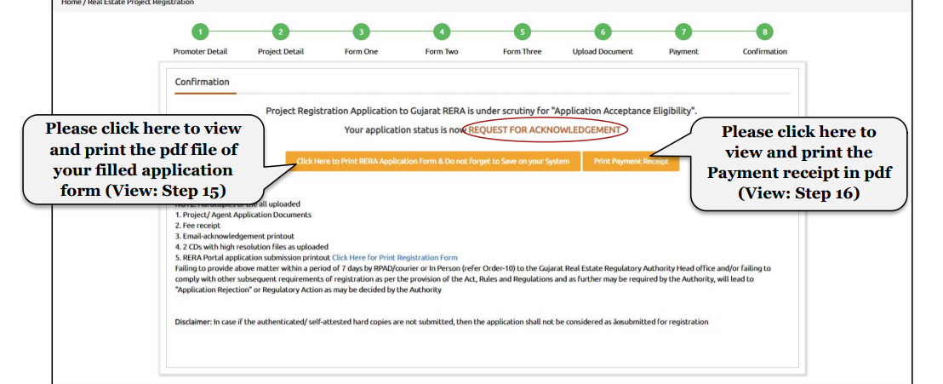
Confirmation

Slide 40
Section – 59 – Penalty for Non - Registration
As per Section 59(1), If any promoter contravenes the provisions of section 3, he shall be liable to a penalty which may extend up to ten per cent. of the estimated cost of the real estate project as determined by the Authority..

Slide 41
Important Issues & Clarifications

Slide 42
Important issues & Clarifications
Unit wise Carpet Area Table in the approved building plan
Drainage Drawing in the approved building plan
Parking Layout with area calculation in the approved building plan
Table B of Form - 1
Purpose of N.A. Order
Draft Sale Deed

Slide 43
Draft Brochure
Property Card, Gam Namuno No. 2 or any other documents showing ownership of land in case of land purchase or long lease from local municipal authority
Registered Joint Development Agreement & Form B, B1 & B2
Change in the Status from Non Encumbrance to Encumbrance
Means of Finance
Important issues & Clarifications

Slide 44
Unit Wise Carpet Area Calculation
As per Order no. 29 dated 07.09.2019, issued by the GUJ RERA that it is compulsory to provide an unit wise carpet are calculation in the approved building plan along with total carpet area calculation.
If not mentioned in the approved building plan, Carpet area plan need to be provided separately duly signed by the Engineer & Promoter of the Project.
Affidavit by the promoter that carpet area details mentioned in the form 3 is in accordance with carpet area plan and notification issued by the urban development & urban housing department.
It is responsibility of the Project Engineer to provide at the time of plan approval process.

Slide 45
Drainage Drawing
As per Order no. 28 dated 22.08.2019, issued by the GUJ RERA that as per GDCR norms it is compulsory to provide in the approved building plan, proper drainage network along with septic tank connection, check pit etc.
If not mentioned in the approved building plan, Drainage plan need to be provided separately duly signed by the Engineer & Promoter of the Project.
Affidavit by the promoter for the drainage plan that it is in accordance of New GDCR 2017.
It is responsibility of the Project Engineer to provide at the time of plan approval process.

Slide 46
Parking Layout Plan
Normally, at present, the RERA Authority raises the query for improper or non availability of parking details as per GDCR.
If Parking FSI calculation is already mentioned in the approved plan then only parking layout need to be submitted duly signed by the engineer & promoter.
If Parking FSI calculation is not mentioned in the approved plan then FSI calculation and parking layout need to be submitted duly signed by plan approval authority.
In case of Shiv Buildcon – Gurunanak Complex, Bhavnagar, Order No. GUJRERA/TP/Team-4/5443/2022, the application rejected due to insufficient parking.

Slide 47
Purpose of Non – Agriculture Order
If the N.A. order is issued for only residential purpose. However, the project is mix or commercial project.
The rera authority will raise the query and will ask to change purpose of N.A. order from residential to multi use purpose.
Affidavit by the promoter about the submission of revised order to the RERA Authority.
The query was raised first time in July, 2021.

Slide 48
Draft Sale Deed
The format of Draft Sale deed is not defined by the authority but there are some points which need to be considered.
Second Schedule of the property, Mention details about the share in land, all the amenities & specification.
Promoter rights about the FSI.
Mandatory to became member of the society or section 8 company or association.
Handover of all common area & amenities after completion certificate.

Slide 49
Table B of Form - 1
Table B of form 1 is related to development of common area and facilities/amenities as per the approved building plan.
At present, the authority is of view that it is mandatory to provide all the facilities to the allottees which are compulsory as per the GDCR Norms.
Illustrative list : Drinking Water, Sewerage, Strom water drainage, Emergency Evacuation Services, Use of Renewal System, Letter Box (in case of building have more than 2 Floors), Landscaping & Tree Planting.

Slide 50
Draft Brochure
The draft brochure provided at time of registration should be in accordance with the approved building plan.
The elevation of the building should be in accordance with the approved building plan.
Units area in sq. mtr.
All the mentioned amenities / facilities should be as per the approved building plan.
Mandatory to mention key-plan (location of the project), complete address, name of the promoter, engineer & architect with their contact number.

Slide 51
Land purchase or Long Lease from the local municipal authority
As per order no. 50 dated 21.05.2021 issued by the Guj RERA that it is mandatory to have either property card, Gam Namuno No. 2 or 8 A in the name of the promoter.
If above mentioned documents are not available, it is mandatory to provide provision entry (Kachi Nondh) in the above document/record along with affidavit for the submission of final entry (Pakki Nondh) in the above document/record to the authority within 30 days from date of acknowledgment number issued.
Registration will not be granted till the submission of the final entry (Pakki Nondh).

Slide 52
Registered Joint Development Agreement & From – B, B1 & B2
As per circular no. 20 dated 13.02.2020 issued by the Guj RERA, the following details are to be mentioned in Joint Development Agreement.
The common area land which is not saleable individually.
FSI rights of land will be transferred to developer.
To mention the consideration to the land owner and time limit of payment of such consideration.
Clarification about the rights, duties & responsibilities of the land owner & developer.
Form – B1 & B2 applicable along with Form – B in such cases.
Form – B1 affidavit cum declaration provided by the promoter.
Form – B2 affidavit cum declaration provided by the promoter and the land owner.

Slide 53
Change in the Status from Non – Encumbrance to Encumbrance
The promoter has mortgaged the project for any finance after the registration of the project.
In such case, it is duty of the promoter to inform about the such changes to the GUJ RERA.
New Form B, Title Clear Report, Encumbrance Certificate, Draft AFS & Sale require to be submitted in the change application.

Slide 54
Mean of Finance
As per latest Circular no. 21/2020 dated 14.02.2020
Applicability - estimated cost of project is Rs. 25.00 Crore or more.
Certified by the chartered accountant as per SA – 3400 – “Report on Examination of Prospective Financial Information”.
All estimations, projection & other details about the project related to construction cost, interest cost, receipts from allottees, Institutional loan, other borrowing, expenses no forming part of estimated cost (Advertisement, Marketing, Administrative & other cost)

Slide 55
Thank You !!
(for any queries you may write @ ahdoshi@ksdassociates.com or contact @ 9427774002

