Slide 1


EXCEPTIONAL ETIQUETTE FOR PROFESSIONALS
CA. DEEPTI SAVJANI
RAJKOT

Slide 2

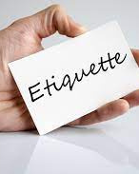
WHAT IS ETIQUETTE ??
  “Etiquette is about being comfortable around people and making people comfortable around you”
  Etiquette - a ticket proving that the bearer knew the rules required for admittance behind closed doors.
  Etiquette still “opens doors”

Slide 3

“Good Manners Will Open Doors That The Best Education Cannot”
Clarence Thomas

Slide 4

Life is more pleasurable and easier when we know
  what to expect from other people
  what they expect of us and
  how to respond in an appropriate way

Slide 5



WHAT IS BUSINESS ETIQUETTE?
Putting to work those soft skills which provide us with the confidence to handle people and situations
with tact, diplomacy and respect in the Business Environment.

Slide 6

Ignorance can be costly!
Many potential businesses and profitable alliances have been lost because of unintentional breach of manners.

Slide 7

PERFECT HANDSHAKE

Slide 8



  Eye contact
  Fore arm parallel to body
  Web to web firm grip
  Clean and dry hands
  Two to three pumps and a ……
  SMILE

Slide 9

What this says about you?

Slide 10

Confident personality
Reliable person
Aware of etiquette
Great first impression

Slide 11


HANDSHAKES TO AVOID

Slide 12


HANDSHAKES TO AVOID

Slide 13


HANDSHAKES TO AVOID

Slide 14

SELF INTRODUCTION

Slide 15
  Stand
  SMILE
  Maintain Eye contact
  Extend your hand for a firm hand shake
  State Full name & Designation
  Listen attentively to the other person’s name & designation
  Repeat your name, if necessary

Slide 16

GROUP INTRODUCTION

Slide 17
  Introduce the person of greatest importance or authority first
  Gender or age is not the deciding factor.
  When a client is involved, mention him or her first.
  A proper business introduction should include complete name - first and last names.

Slide 18
Senior Official | Junior Official | Mr Senior, this is Mr Junior (full name & designation)
A senior professional | A junior professional | Mr President, this is Mr. Rahul Jain, Analyst
A customer | A team of employees | Mr. Customer, meet my sales team Mr. Ram Kumar, Ms. Avantika Jain, Mr. Nitin Shah
A guest | Mr. Host | Mr. Guest, this is the host Mr/Ms full name
Peer from another company | Peer from your company | Mr. Essarite, this is Mr. Vijay Wadhwa, Senior Analyst

Slide 19

BUSINESS CARD

Slide 20
  Business Card is one of the most dominant advertising tools accessible to you and your company.
  Your business card:
Shares contact information
Establishes credibility
Demonstrates professionalism
Cost effective tool for brand promotion/recall

Slide 21
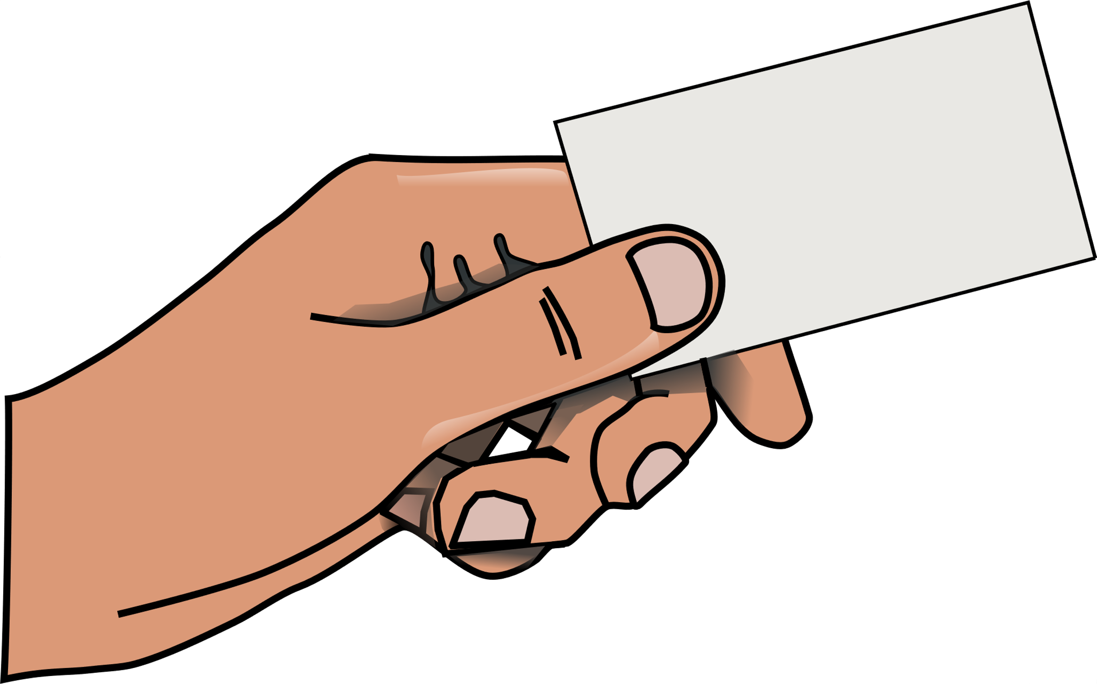
EXCHANGING BUSINESS CARD

Slide 22

  Do:
Use a business card holder.
Always carry sufficient quantity of cards, even on vacation.
Be prepared at all times.
Prioritize readability over creativity.
Keep the information updated.
When you meet someone for first time, it's ok to request a business card from them.
However, If the person is of a higher position, wait for them to offer their card to you.
Treat the business card you receive as you would like your card to be treated by the other person.
  Don’t:
Never handout torn or worn business cards.
Do not scribble anything on the business card.

Slide 23
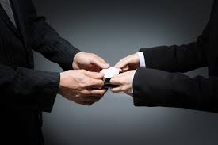
RECEIVING A BUSINESS CARD

Slide 24

  Hold the card by its edge.
  Thank the person and read the card.
  Reading the card -
  - Displays that you are interested.
  - You learn more about the person and the company
  - Helps in leading conversation meaningfully
  Compliment the logo, quality etc
  Ask how they prefer to be contacted
  DO NOT shove it in the pocket without reading
  If you receive a business card before a meeting, lay the card received on the table, in front of you, till end of the meeting. If you receive several, lay them in a row as per order of the persons seated, so you remember names and distinguish who is speaking.

Slide 25
GIVING A BUSINESS CARD

Slide 26
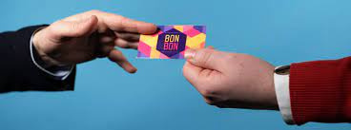
  Offer the card standing up
  Offer holding both the edges or by holding one edge in your right hand
  Present your business card with the receiver’s language facing up, and with the text the right way for them to read it.
  Build rapport before you offer your card.
  Preferably before finishing the conversation, Say, “May I give you my card?”

Slide 27

MEETING ETIQUETTE

Slide 28

  Every day is made up of meetings and greetings.
  Remember the 5 points for self-introduction –
Stand up
Smile
See - make eye contact
Shake hand
Speak clearly and introduce yourself
Remember the names of people and use first names if you have the permission

Slide 29
  Before the Meeting
Be punctual
Dress appropriately
Bring the required material, notes etc
If you need to hold a presentation, make sure that -handouts, PowerPoint slides etc. are ready.
Get organized.
If there is an established seating pattern, accept it. If you are unsure, ask.
Put all communication devices on SILENT mode.

Slide 30
  During the Meeting
  Stay calm. Don't fidget or act distracted – even if you’re bored
  Don’t make and receive calls when you are in a meeting
  If unavoidable, excuse yourself and step out to make or take a call.
  Attend the entire meeting - unless it is absolutely necessary or you have prior permission.
  In discussions, allow more senior figures to contribute first.
  Be brief when speaking and make sure what you say is relevant at an appropriate pace
  Speak clearly but not too loudly
  Face the person you are speaking with and avoid turning your body away
  Don't interrupt the speaker unless he/she has encouraged interaction throughout the meeting.
  When asking a question, raise your hand and wait your turn
  Don't ask long questions – Be as concise as possible.
Listen carefully - you don't want to ask a question that has already been asked.

Slide 31
  After the Meeting
  Complete tasks assigned.
  Circulate the minutes/ information as required.
  Get feedback

Slide 32
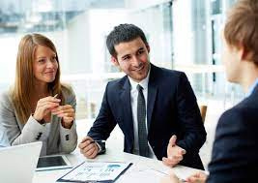
WORK PLACE ETIQUETTE

Slide 33
  Meet, Greet & Treat Others Well
  Your business image starts with the way you present yourself and is reinforced with your personal mannerisms
  Be Dressed to the Occasion
  Don’t be Casual or YOU will be a Casualty
  Always have a Smiling Face
  Maintain Eye Contac
  Talk Positive about People & Situation
  Don't Complain
  Don’t Criticize
  Don’t Condemn
  Find solutions in an amicable manner
Always Acknowledge & Appreciate people & situations

Slide 34
  Be Proactive
  Take initiative
  Anticipate what is required of you
  Do not wait to be called for
  Know what is the need of your internal & external customers
  Follow the Protocol
  Follow the system
  Do not work against it
  Do not breach protocols
  Never bypass your superior
  Remember “Boss is always right”
  Manage your “EGO”
  “I” know it all - Attitude
  Feeling Superior
  Fragile Ego - Anything you say I take it personally.. I get hurt
  Talking down to people
  Feeling good/bad when others suffer
  Pulling others down

Slide 35
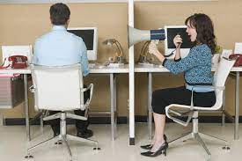
CUBICLE COURTESIES

Slide 36
  Treat each cubicle/desk as if it has a door.
  Respect their space: Do not grab anything without permission
  Respect Privacy: No personal questions. Do not read from their papers or computer screens.
  Keep Noise levels down: Speak at normal levels. Do not call/shout across the cubicles.
  Be reasonable with decorations: Be creative but do not go overboard in decorating with personal items.
  Maintain your hygiene
  Do not wear strong perfume or cologne
  Do not eat smelly food (e.g. fish)
  Do not stand in front of someone’s cubicle and carry on a conversation
  Do not walk into a cubicle when someone is on the phone (leave them a note or email instead)
  Do not come to work if you are sick. Avoid spreading infection.

Slide 37

Q & A

Slide 38

Thank you WYMEC & Rajkot Branch of WIRC of ICAI for this Opportunity..

Slide 39


