Slide 1
Professional Opportunities for CAs in Start-up
0
0
0
0
By:
CA. Kalpesh P. Parekh
FCA, CS, B.com

Slide 2


Slide 3
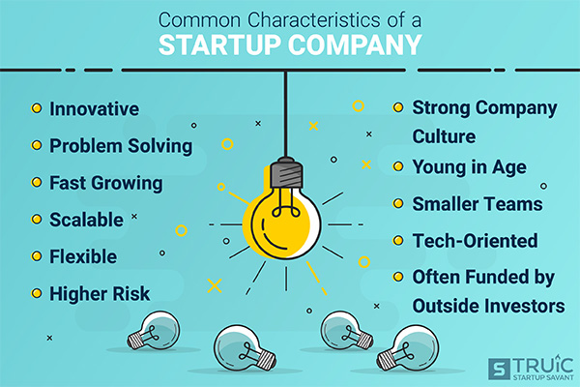

Slide 4
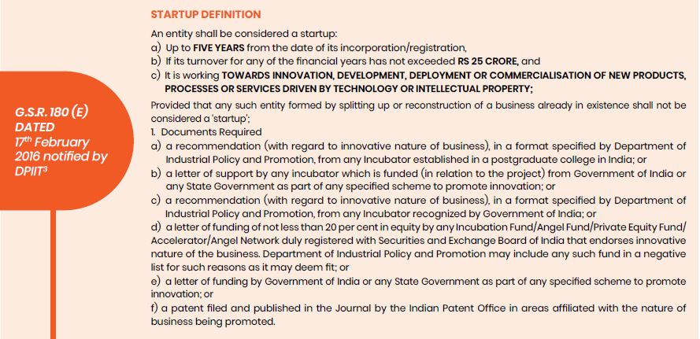
Start-up in India - Information from DPIIT:

Slide 5
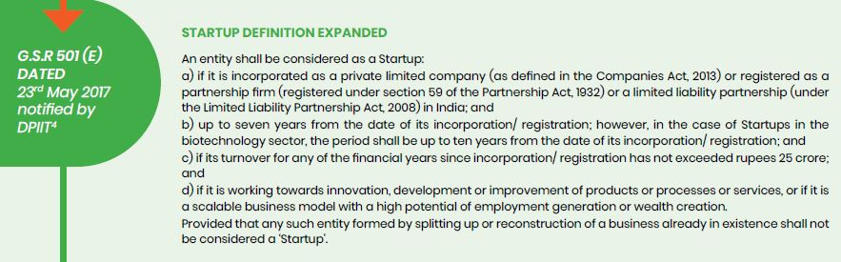
Start-up in India - Information from DPIIT:
Contd…

Slide 6
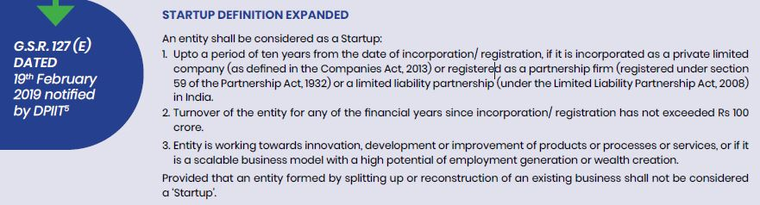
Start-up in India - Information from DPIIT:

Slide 7
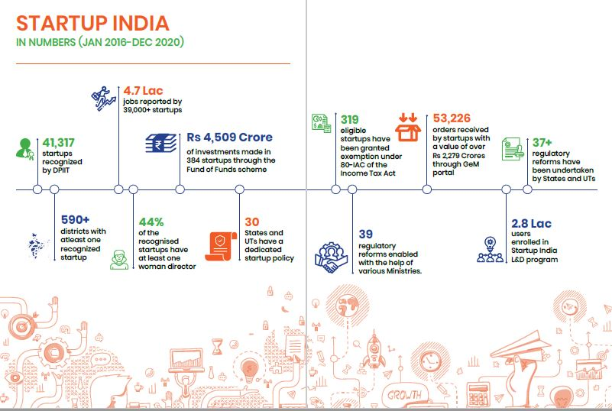
Start-up in India – Historical Data:

Slide 8
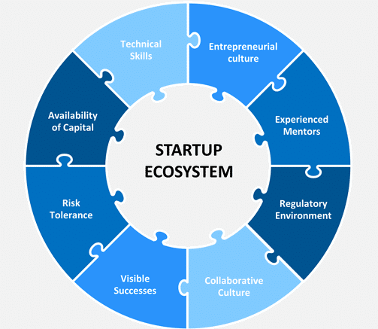
Start-up
Eco System:

Slide 9
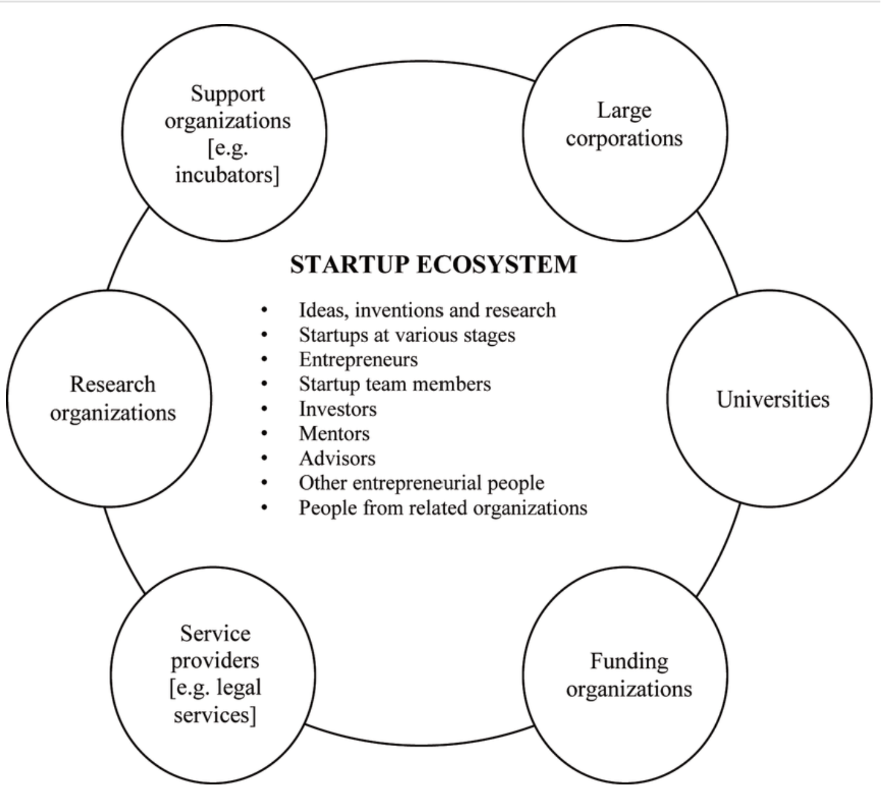
Stakeholders in
Start-up Ecosystem

Slide 10
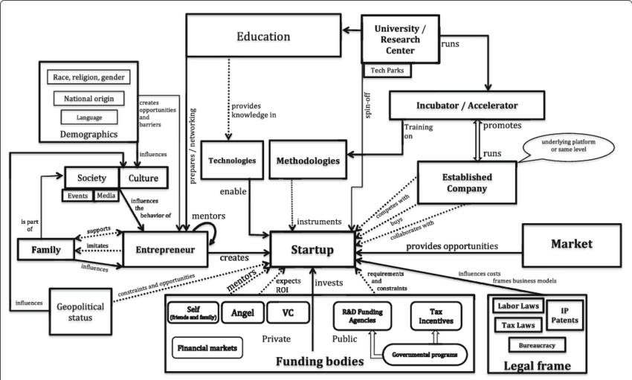
Stakeholders in Start-up Ecosystem

Slide 11
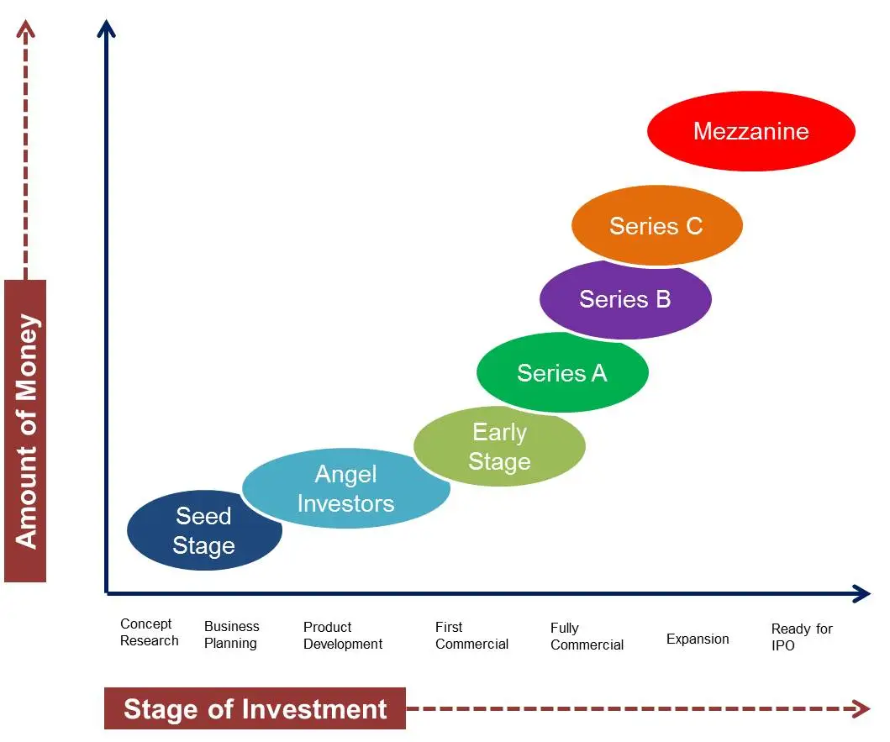
Stages of Start Up:

Slide 12
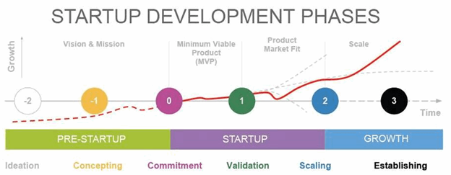
Stages of Start Up:

Slide 13
Why Startups for CAs?

Slide 14

CAs while asking for payment of services like ITR & Audit from client……..

Slide 15
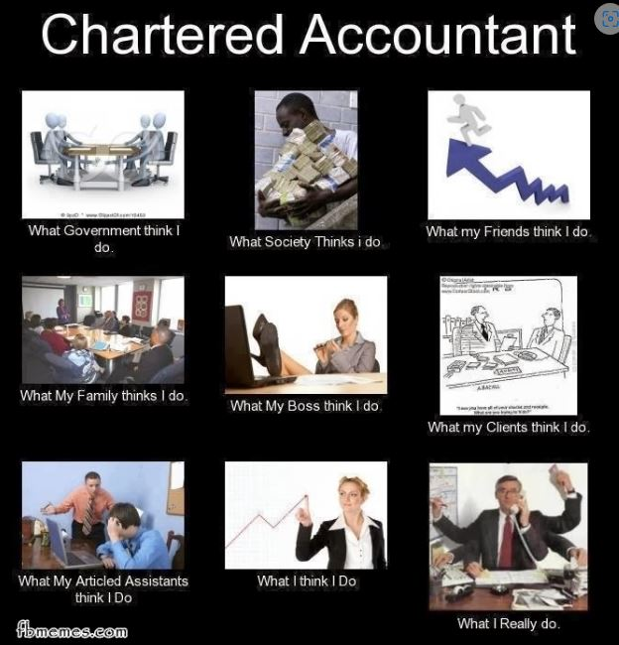

Slide 16
Why Startups for CAs?
Limitations in Existing Practice Areas
  High Competition
  Demanding Workload and Long Hours
  High Level of Responsibility and Accountability
  Ongoing Professional Development and Regulatory Changes
Skills that Cas Possess
  In Depth Understanding of Finance which is Core for Any Startup
  Business Processes and Systems
  Knowledge of Different Industries
  Sincerity and Dedicated Approach

Slide 17
Professional Opportunities For CAs in Start-up:
Consulting
Investment (Angle Investing, V Funds)
Mentor / Accelerator / Advisor
Startup Team Member – CFO / COO
Founder / Cofounder

Slide 18
Professional Opportunities For CAs in Start-up:
  Formation and Legal Compliances
  Registrations
  IPRs
  Tax Exemptions (80IAC, Premium Exemption)
  Tax Structuring
  Legal Drafting and Agreements (Term Sheet)
  Pitch Deck
  Financial Modelling & Projections
  Valuation & Business Model
  Fund Securing – Debt
  Fund Securing – Equity
  IPOs
  Cash Flows and MIS
  Government Grants - Application
  Investment in Startups

Slide 19
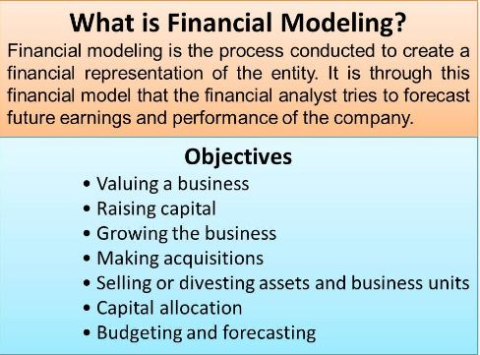
Professional Opportunities For CAs in Start-up Consultancy in various fields: Management Consultancy:

Slide 20
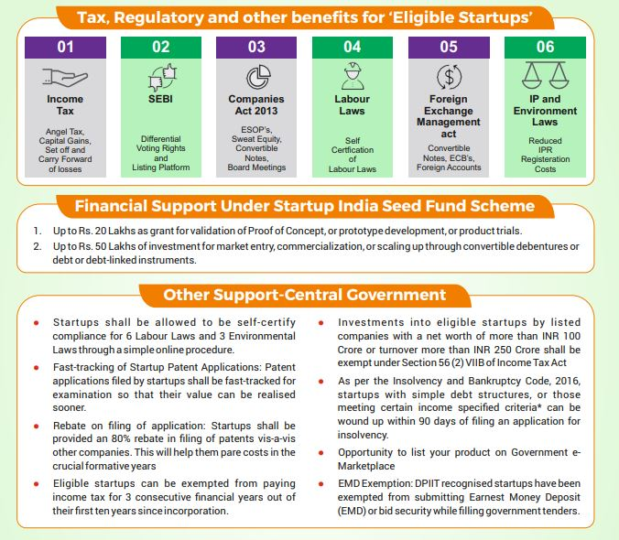

Slide 21
Challenges?

Slide 22


Slide 23
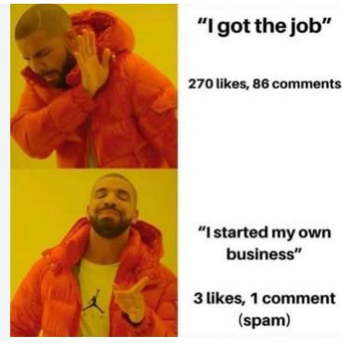

Slide 24

Start-up in India & Statistics

Slide 25
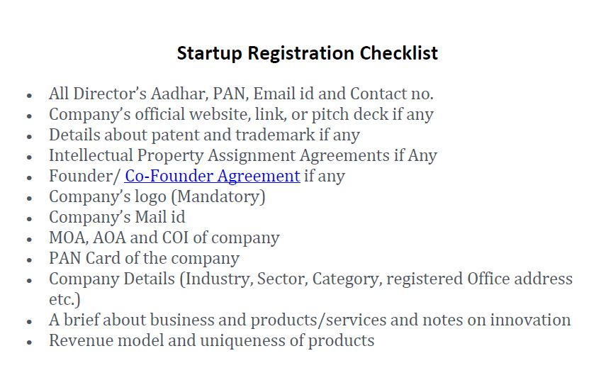
Professional Opportunities For CAs in Start-up Consultancy in various fields: DPIIT Registration:

Slide 26

Professional Opportunities For CAs in Start-up Consultancy in various fields: DPIIT Registration:

Slide 27
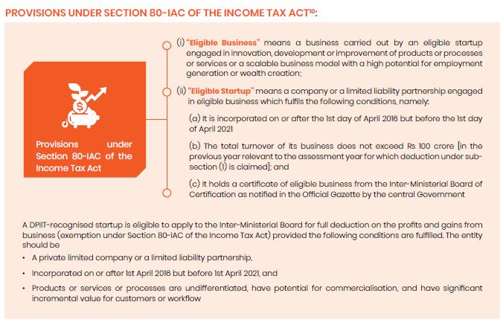
Professional Opportunities For CAs in Start-up Consultancy in various fields: Section 80IAC Exepmtion:

Slide 28
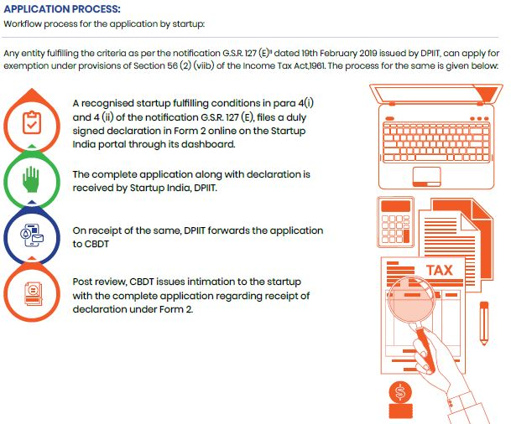
Professional Opportunities For CAs in Start-up Consultancy in various fields: Form 2 Declaration related Compliance:

Slide 29
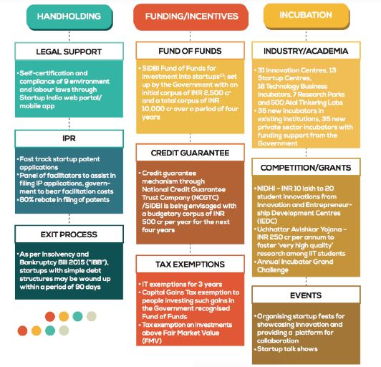
Professional Opportunities For CAs in Start-up Consultancy in various fields:

Slide 30
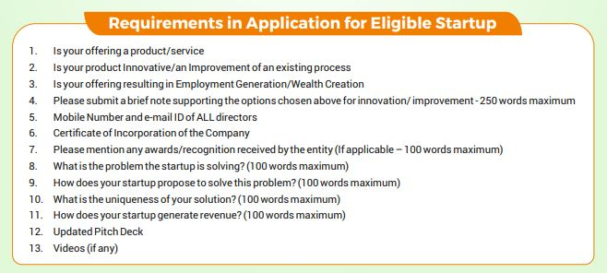
Various Start-up schemes as recognized by ICAI:

Slide 31

Thank You....

