Slide 1
Complaints under
Gujarat rera
-CA BHARGAV DAVDA

Slide 2
The Real Estate (Regulation & Development) Act, 2016

Slide 3
Before we understand complaints under rera
First, we need to understand why Real Estate(Regulation & Development) Act, 2016 was constituted?

Slide 4
The Real Estate (Regulation and Development) Act, 2016 (RERA) was introduced in India to
address critical issues in the real estate sector
Enhanced Accountability
RERA aimed to boost accountability among developers and promoters, prioritising consumer protection.

Slide 5
Few quick question for every one?
HOW MANY YEARS OF RESIDENT?
OWN CONSTRUCTION OR CONTRACTOR OR PURCHASED?
UNDER REGISTER SOCIETY OR INDIVIDUAL?

Slide 6
Complains under rera
Who?
How?
Why?

Slide 7
Who can file complain
Allotee
Promoter

Slide 8
Who is allotTee?

Slide 9
Section 2(d) allottee
(d) “allottee” in relation to a real estate project, means the person to whom a plot, apartment or building, as the case may be, has been allotted, sold (whether as freehold or leasehold) or otherwise transferred by the promoter, and includes the person who subsequently acquires the said allotment through sale, transfer or otherwise
but does not include
a person to whom such plot, apartment or building, as the case may be, is given on rent;

Slide 10
In case of redevelopment, who is allottee?

Slide 11
There are FEW possibilities:
1. The allottee shall solely receive identical construction and units.
2. The allottee will be assigned a unit that differs in terms of unit numbers and area, which may be higher or lower.
Section 3(2) Notwithstanding anything contained in sub-section (1), no registration of the real estate project shall be required—
(c) for the purpose of renovation or repair or re-development which does not involve marketing, advertising selling or new allotment of any apartment, plot or building, as the case may be, under the real estate project.

Slide 12
Who is promoter?

Slide 13
Section 2 (zk)
(zk) “promoter” means,—
(i) a person who constructs or causes to be constructed an independent building or a building consisting of apartments, or converts an existing building or a part thereof into apartments, for the purpose of selling all or some of the apartments to other persons and includes his assignees; or
(ii) a person who develops land into a project, whether or not the person also constructs structures on any of the plots, for the purpose of selling to other persons all or some of the plots in the said project, whether with or without structures thereon; or
(iii) any development authority or any other public body in respect of allottees of—
(a) buildings or apartments, as the case may be, constructed by such authority or body on lands owned by them or placed at their disposal by the Government; or
(b) plots owned by such authority or body or placed at their disposal by the Government, for the purpose of selling all or some of the apartments or plots; or

Slide 14
Section 2(zk)
(iv) an apex State level co-operative housing finance society and a primary co-operative housing society which constructs apartments or buildings for its Members or in respect of the allottees of such apartments or buildings; or
(v) any other person who acts himself as a builder, coloniser, contractor, developer, estate developer or by any other name or claims to be acting as the holder of a power of attorney from the owner of the land on which the building or apartment is constructed or plot is developed for sale; or
(vi) such other person who constructs any building or apartment for sale to the general public.
Explanation.—For the purposes of this clause, where the person who constructs or converts a building into apartments or develops a plot for sale and the person who sells apartments or plots are different person, both of them shall be deemed to be the promoters and shall be jointly liable as such for the functions and responsibilities specified, under this Act or the rules and regulations made thereunder;

Slide 15
Why any one need to complain?

Slide 16
SECTION 2 (K) CARPET AREA
It means the net usable floor area of an apartment,
excluding the area covered by the
external walls,
areas under services shafts,
exclusive balcony or
veranda area, and
exclusive open terrace area,
but includes the area covered by the internal partition walls of the apartment.

Slide 17
Section 2(b)
(b) “advertisement” means any document described or issued as advertisement through any medium and includes any notice, circular or other documents or publicity in any form, informing persons about a real estate project, or offering for sale of a plot, building or apartment or inviting persons to purchase in any manner such plot, building or apartment or to make advances or deposits for such purposes;

Slide 18
Section 2(Zl)
(zl) “prospectus” means any document described or issued as a prospectus or any notice, circular, or other document offering for sale of any real estate project or inviting any person to make advances or deposits for such purposes;

Slide 19
Section 2(zN)
(zn) “real estate project” means the development of a building or a building consisting of apartments, or converting an existing building or a part thereof into apartments, or the development of land into plots or apartments, as the case may be, for the purpose of selling all or some of the said apartments or plots or building, as the case may be, and includes the common areas, the development works, all improvements and structures thereon, and all easement, rights and appurtenances belonging thereto;

Slide 20
Section 12: Obligations of promoter regarding veracity of the advertisement or prospectus.
12. Where any person makes an advance or a deposit on the basis of the information contained in the notice advertisement or prospectus, or on the basis of any model apartment, plot or building, as the case may be, and sustains any loss or damage by reason of any incorrect, false statement included therein, he shall be compensated by the promoter in the manner as provided under this Act:
Provided that if the person affected by such incorrect, false statement contained in the notice, advertisement or prospectus, or the model apartment, plot or building, as the case may be, intends to withdraw from the proposed project, he shall be returned his entire investment along with interest at such rate as may be prescribed and the compensation in the manner provided under this Act.

Slide 21
Section 14: Adherence to sanctioned plans and project specifications by the promoter.
Sub Section(3) In case any structural defect or any other defect in workmanship, quality or provision of services or any other obligations of the promoter
as per the agreement for sale
relating to such development is brought to the notice of the promoter within a period of five years by the allottee
from the date of handing over possession,
it shall be the duty of the promoter to rectify such defects without further charge, within thirty days, and in the event of promoter’s failure to rectify such defects within such time, the aggrieved allottees shall be entitled to receive appropriate compensation in the manner as provided under this Act.

Slide 22
Section 18: Return of amount and compensation.
Section (1) If the promoter fails to complete or is unable to give possession of an apartment, plot or building,—
(a) in accordance with the terms of the agreement for sale or, as the case may be, duly completed by the date specified therein; or
(b) due to discontinuance of his business as a developer on account of suspension or revocation of the registration under this Act or for any other reason,
he shall be liable on demand to the allottees, in case the allottee wishes to withdraw from the project, without prejudice to any other remedy available, to return the amount received by him in respect of that apartment, plot, building, as the case may be, with interest at such rate as may be prescribed in this behalf including compensation in the manner as provided under this Act:

Slide 23
Section 18: Return of amount and compensation
Provided that where an allottee does not intend to withdraw from the project, he shall be paid, by the promoter, interest for every month of delay, till the handing over of the possession, at such rate as may be prescribed.
(2) The promoter shall compensate the allottees in case of any loss caused to him due to defective title of the land, on which the project is being developed or has been developed, in the manner as provided under this Act, and the claim for compensation under this sub-section shall not be barred by limitation provided under any law for the time being in force.
(3) If the promoter fails to discharge any other obligations imposed on him under this Act or the rules or regulations made thereunder or in accordance with the terms and conditions of the agreement for sale, he shall be liable to pay such compensation to the allottees, in the manner as provided under this Act.

Slide 24
Section 19 "Rights and duties of allottees"
(3) The allottee shall be entitled to claim the possession of apartment, plot or building, as the case may be, and the association of allottees shall be entitled to claim the possession of the common areas, as per the declaration given by the promoter under sub-clause (C) of clause (I) of sub-section (2) of section 4.
(4) The allottee shall be entitled to claim the refund of amount paid along with interest at such rate as may be prescribed and compensation in the manner as provided under this Act, from the promoter, if the promoter fails to comply or is unable to give possession of the apartment, plot or building, as the case may be, in accordance with the terms of agreement for sale or due to discontinuance of his business as a developer on account of suspension or revocation of his registration under the provisions of this Act or the rules or regulations made thereunder.

Slide 25
Section 19 "Rights and duties of allottees"
(1) The allottee shall be entitled to obtain the information relating to sanctioned plans, layout plans along with the specifications, approved by the competent authority and such other information as provided in this Act or the rules and regulations made thereunder or the agreement for sale signed with the promoter.
(2) The allottee shall be entitled to know stage-wise time schedule of completion of the project, including the provisions for water, sanitation, electricity and other amenities and services as agreed to between the promoter and the allottee in accordance with the terms and conditions of the agreement for sale.

Slide 26
Section 19 "Rights and duties of allottees"
(5) The allottee shall be entitled to have the necessary documents and plans, including that of common areas, after handing over the physical possession of the apartment or plot or building as the case may be, by the promoter.
(6) Every allottee, who has entered into an agreement for sale to take an apartment, plot or building as the case may be, under section 13, shall be responsible to make necessary payments in the manner and within the time as specified in the said agreement for sale and shall pay at the proper time and place, the share of the registration charges, municipal taxes, water and electricity charges, maintenance charges, ground rent, and other charges, if any.

Slide 27
SECTION 2 (ZA) INTEREST
It means the rates of interest payable by the promoter or the allottee, as the case may be.
Explanation. —For the purpose of this clause—
(i) the rate of interest chargeable from the allottee by the promoter, in case of default, shall be equal to the rate of interest which the promoter shall be liable to pay the allottee, in case of default;
(ii) the interest payable by the promoter to the allottee shall be from the date the promoter received the amount or any part thereof till the date the amount or part thereof and interest thereon is refunded, and the interest payable by the allottee to the promoter shall be from the date the allottee defaults in payment to the promoter till the date it is paid;

Slide 28
Section 31
31. (1) Any aggrieved person may file a complaint with the Authority or the adjudicating officer, as the case may be, for any violation or contravention of the provisions of this Act or the rules and regulations made thereunder against any promoter allottee or real estate agent, as the case may be.
Explanation.—For the purpose of this sub-section “person” shall include the association of allottees or any voluntary consumer association registered under any law for the time being in force.
(2) The form, manner and fees for filing complaint under sub-section (1) shall be such as may be ¹[prescribed].

Slide 29
Is it possible for a promoter to file a complaint?

Slide 30
Refrained from executing any documents
Abstained from making any payments
Has not contributed towards the establishment of a society or section 8 company.

Slide 31
How to file complain
Online
Offline
Form A or Form B
Form A or Form B
Complain
DD
Physical file
Complain
Payment
Physical file

Slide 32
Form a
As per Rule 11 of the 'Gujarat Real Estate Regulat01Y Authority Rules, 2016' complaint would be file for violation or contravention of the provisions of this Act or the Rules and Regulations made thereunder, save as those provided to be adjudicated by adjudicating officer.
Complaint would be filed in Form 'A' along with Fees of Rs. 1,000 by way of DD

Slide 33
Form b
As per Rule 12 (1) of the 'Gujarat Real Estate Regulat01Y Auth01ity Rules, 2016' any aggrieved person may file a complaint with the adjudicating officer for compensation under section 12, 14, 18 and 19.
Complaint would be filed in Form 'B' along with Fees of Rs. 1,000 by way of DD

Slide 34
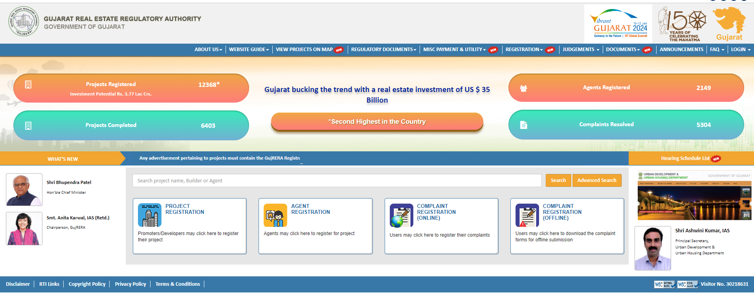
In rera 1.0

Slide 35
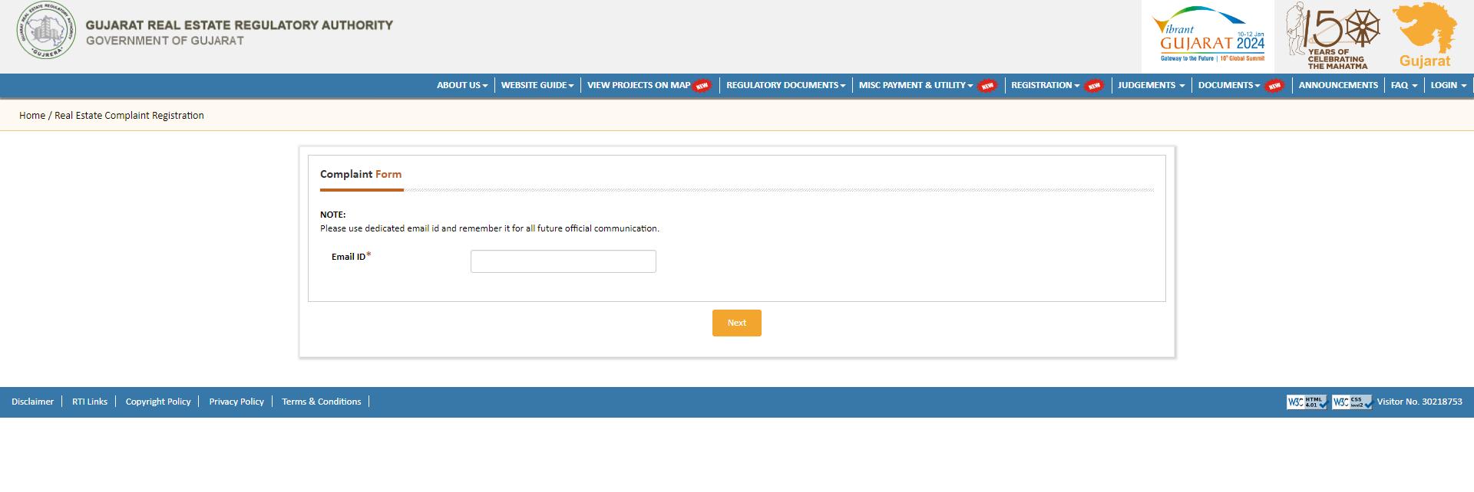
Email id for future communication

Slide 36
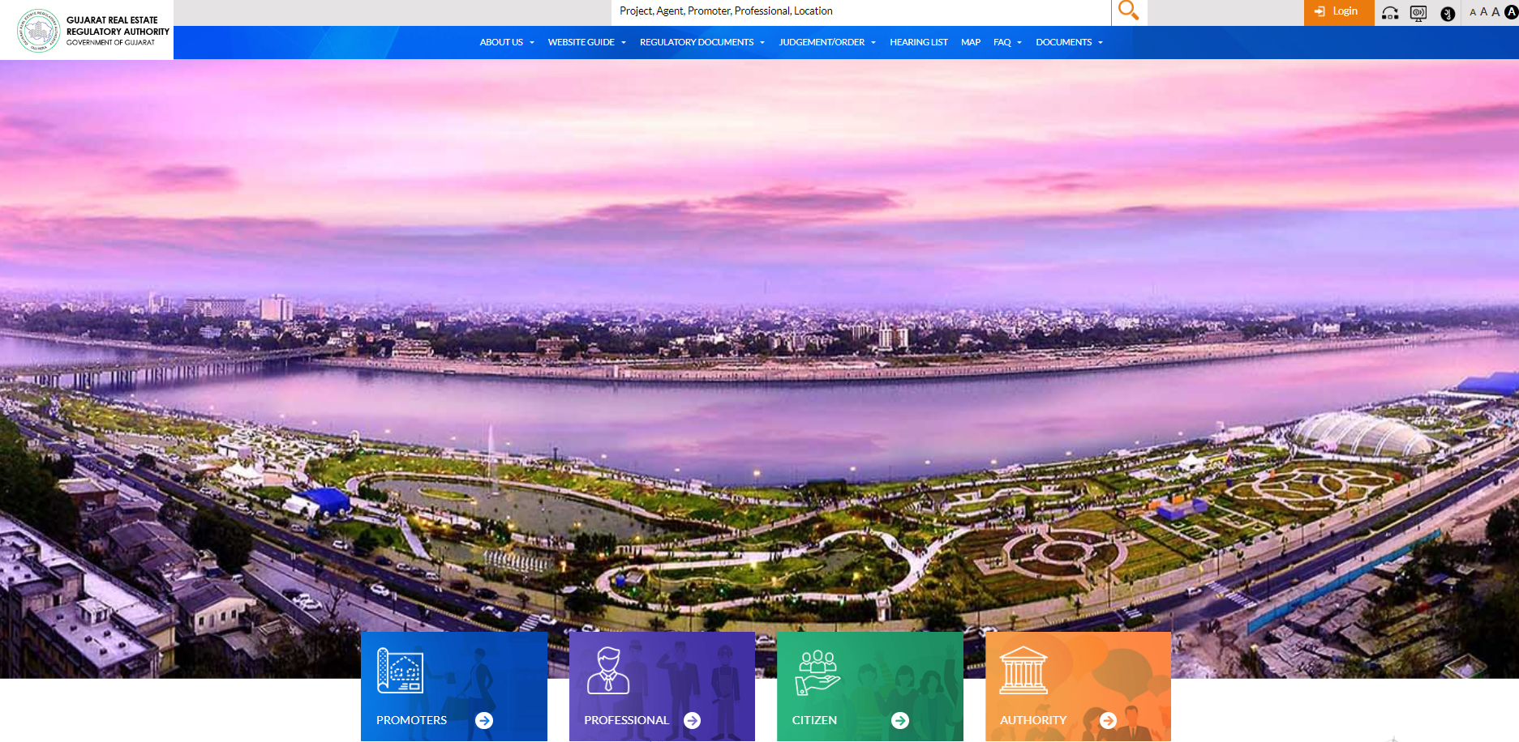
Rera 2.0

Slide 37
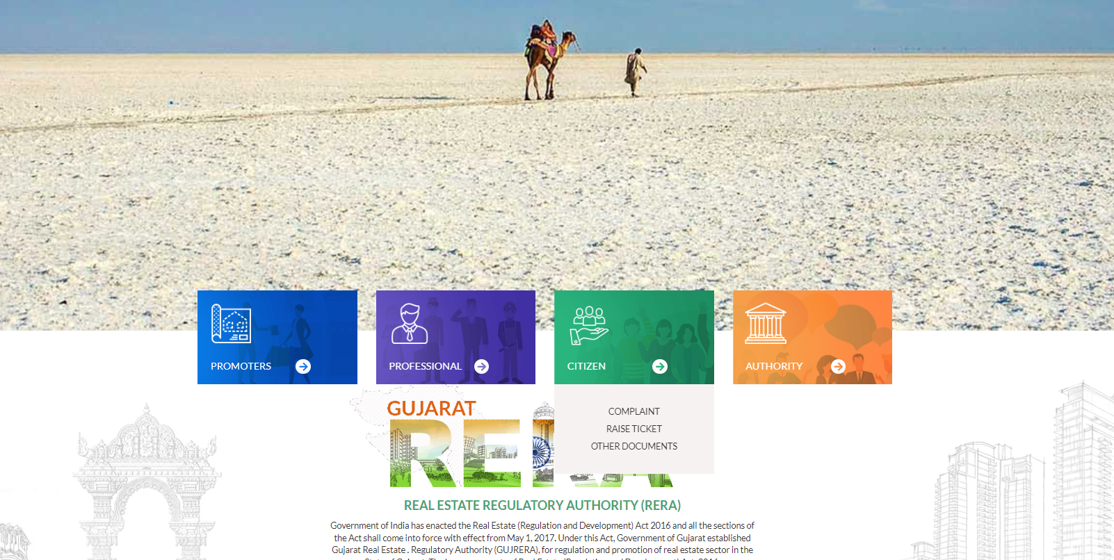
Rera 2.0

Slide 38
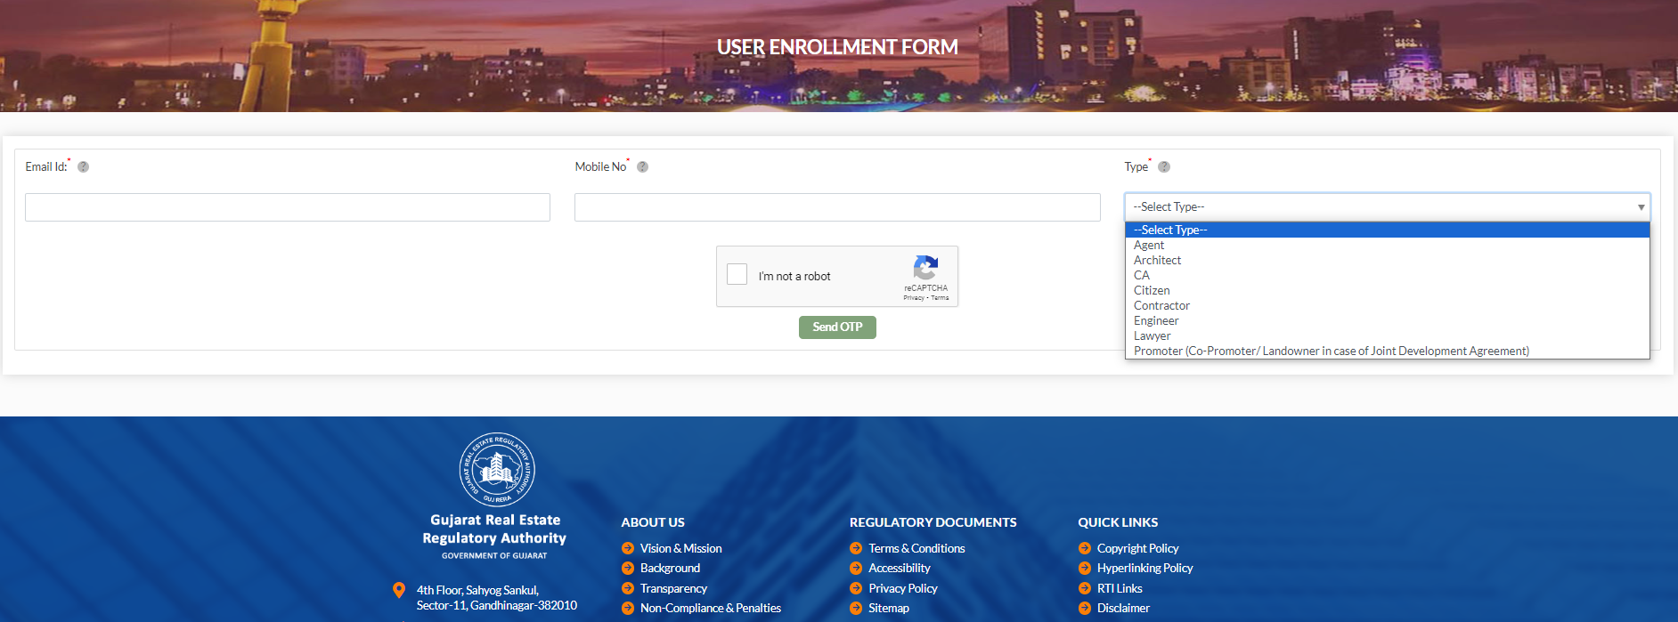
Select citizen and file complain

Slide 39
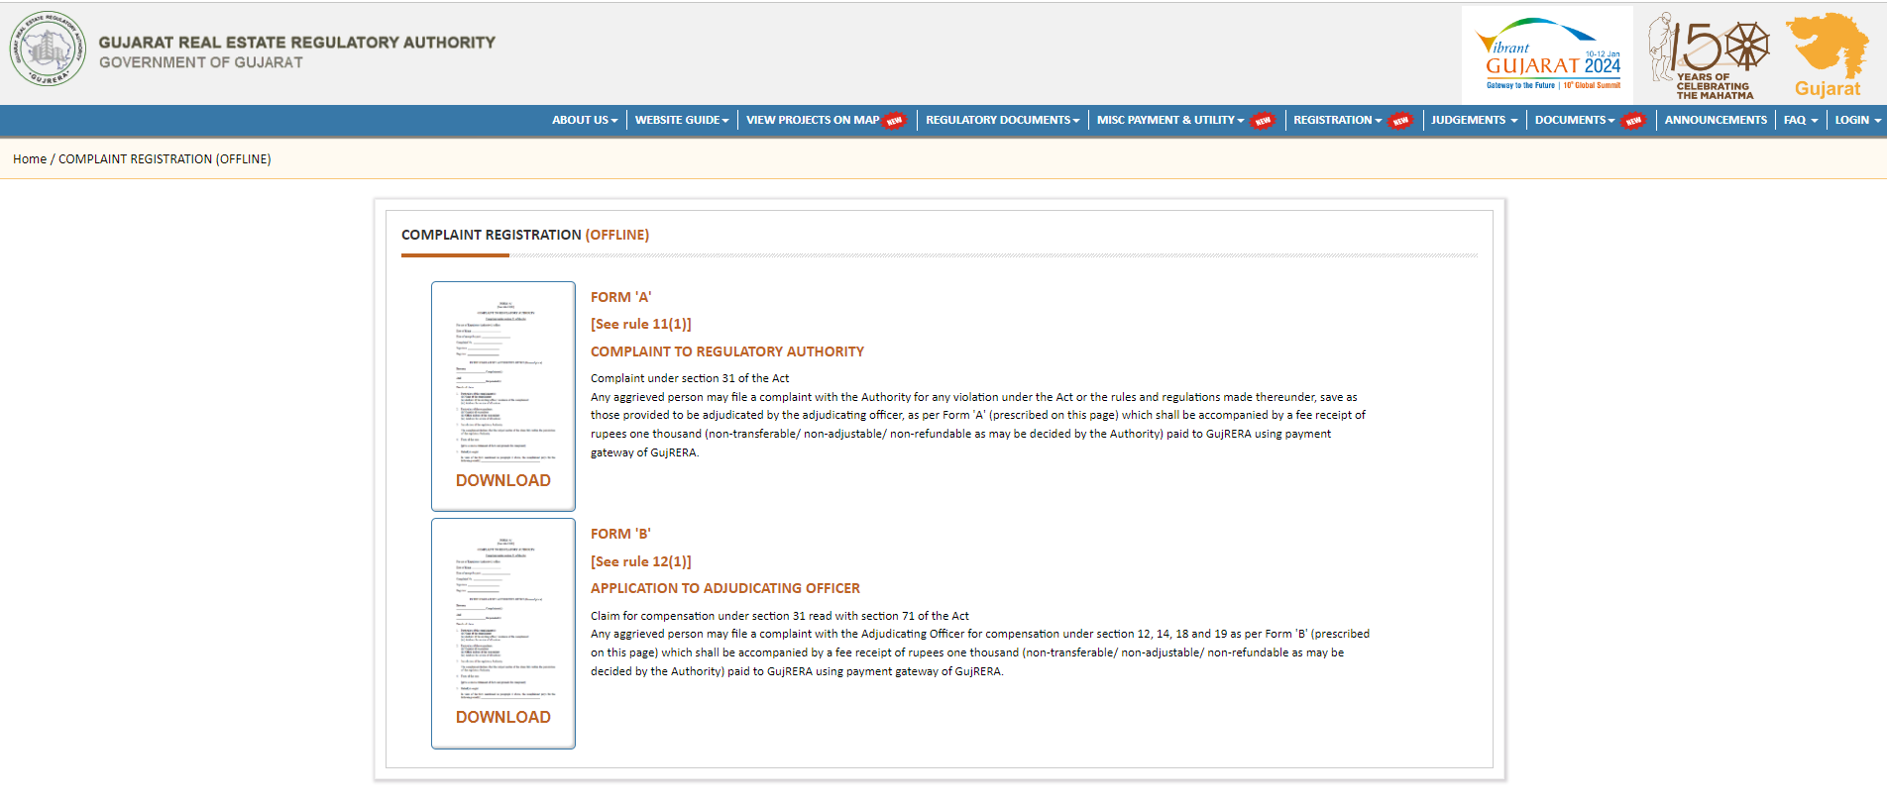
Offline complain

Slide 40
Rule 11: Manner of filing a complaint with the Authority and the manner of holding an inquiry by the Authority
(1) Any aggrieved person may file a complaint with the Authority
for any violation under the Act or the rules and regulations made thereunder,
save as those provided to be adjudicated by the adjudicating officer,
as per Form ‘A’ which shall be accompanied by a fee of rupees one thousand in the form of a demand draft drawn on a nationalized bank in favor of regulatory Authority
and payable at the main branch of that bank at the station where the seat of the said regulatory Authority situated.

Slide 41
Rule 12A
Written Complaint will be filed in 3 Sets- Rule 12A(1)
Complaint shall clearly contain particular of dispute and the relief claimed -Rule 12A(2)
Complaint shall be accompanied by copies of such documents as are necessary to prove the claim-Rule 12A(2)

Slide 42
In case of multiple reliefs
From the Rule 12 read with Rule 12A (1) and Rule 12B (1) as above,
it is significant to note that a Complaint to the Adjudicating Officer, is to be filed, 'through the office of the Authority' and 'only for compensation'.
This appears to have been done, with the purpose of exercising a check, so as to prevent Complaints going directly to the Adjudicating Officer, seeking multiple reliefs including the ones, which as per law, do not fall within the jurisdiction of the Adjudicating Officer.

Slide 43
Where compensation is an ancillary relief to the main relief,
the Authority having jurisdiction to examine the breach to award the main relief, has to deal with and decide the Complaint, to the extent the aspects that fall within the jurisdiction of the Authority.
In case a breach is made out, and the Complainant is held entitled for the main relief, the Complaint has to be sent to the Adjudicating Officer, for adjudication of compensation, as sought in the Complaint, as only the Adjudicating Officer has the necessary jurisdiction, to adjudicate the relief of compensation.
The law does not permit that by merely adding the relief of compensation to the main relief, the jurisdiction to deal with such Complaint, can be vested with the Adjudicating Officer.

Slide 44
Total complains TILL 2021-22

Slide 45
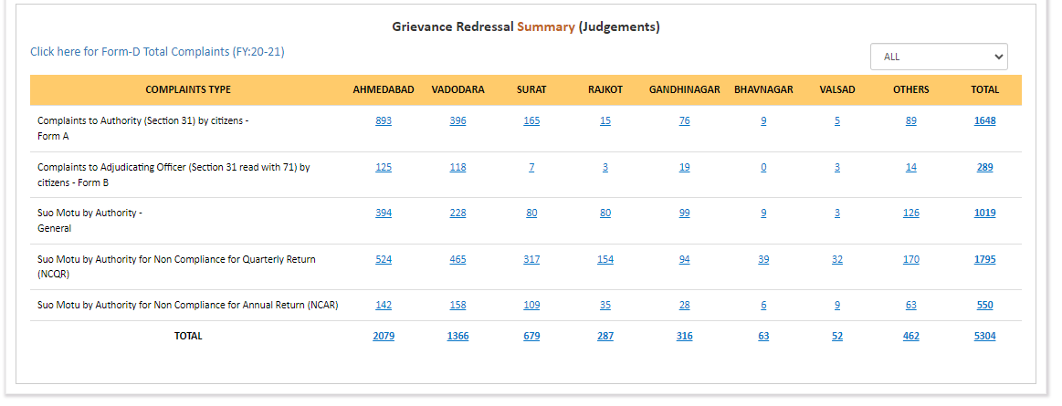
Numbers of judgments available in Gujarat rera website as of 19.10.2023 screenshot from rera website

Slide 46
What is next step ?

Slide 47
Section 44: Application for settlement of disputes and appeals to Appellate Tribunal.
44. (1) The appropriate Government or the competent authority or any person aggrieved by any direction or order or decision of the Authority or the adjudicating officer may prefer an appeal to the Appellate Tribunal.
(2) Every appeal made under sub-section (1) shall be preferred within a period of sixty days from the date on which a copy of the direction or order or decision made by the Authority or the adjudicating officer is received by the appropriate Government or the competent authority or the aggrieved person and it shall be in such form and accompanied by such fee, as may be prescribed
Provided that the Appellate Tribunal may entertain any appeal after the expiry of sixty days if it is satisfied that there was sufficient cause for not filling it within that period.

Slide 48
5) The appeal preferred under sub-section (1), shall be dealt with by it as expeditiously as possible and endeavour shall be made by it to dispose of the appeal within a period of sixty days from the date of receipt of appeal:
Provided that where any such appeal could not be disposed of within the said period of sixty days, the Appellate Tribunal shall record its reasons in writing for not disposing of the appeal within that period.

Slide 49
As per Rule 3(1) and 3(2) of the Gujarat Real Estate Appellate Tribunal Rules, 2016- Appeal Shall be filed in Form "A" along with Fees of Rs. 1,000/- by way of DD and following documents :-
An attested true copy of the order against which the appeal is filed;
Copies of the documents relied upon by the appellate and referred to in the appeal;
An Index of the documents

Slide 50
If still dissatisfied?
Next Step is to HIGH COURT

Slide 51
What precautions should be taken before filing a complaint with RERA?
Aggrieved person- Section 31
Form A or Form B
Complaint as per Rule 11 or Rule 12

Slide 52

Questions?

Slide 53

Thank you
BHARGAV DAVDA & ASSOCIATES
CHARTERED ACCOUNTANTS
CABHARGAV.DAVDA@GMAIL.COM
Disclaimer: The Information contained in this article is general in nature and should not be considered to be legal, tax, accounting, consulting, or any other professional advice. The author is not responsible for any errors or omissions, or for the results obtained from the use of this information. All information on this presentation is provided "as is", with no guarantee of completeness, accuracy, timeliness, or of the results obtained from the use of this information.

