Slide 1
OPPORTUNITIES FOR PROFESSIONALS
UNDER INSOLVENCY AND BANKRUPTCY LAW
ICAI Rajkot Branch
Presented By:
CA Ramchandra D. Choudhary
Chartered Accountant & Insolvency Professional
Sun Resolution Professionals Private Limited (An Insolvency Professional Entity registered with IBBI) | R. Choudhary & Associates ) Branch offices: Mumbai | Delhi-NCR | Ahmedabad | Vadodara| Surat| Bhinmal| Palanpur| Deesa| Mehsana| Pune
www.sunresolution.in | www.ca-rca.com

Slide 2
OBJECTIVES OF IBC
01
Ease of doing business
02
Promote Entrepreneurship
03
Improve Availability of Credit at low mark-up
04
Balance the interest of all stakeholders
05
Maximisation of the value of assets

Slide 3
QUALIFICATION & EXPERIENCE
01
02
03
04
Graduates having 10 years of experience in the field of law or Masters’ Degree holders/Post-Graduate Diploma holders, in management, having 10 years of managerial experience
Professionals (Chartered Accountant, Company Secretary, Cost Accountant or an Advocate) having 10 years of experience
Young Professionals, having less than 10 years of experience- Graduate Insolvency Programm
Graduates having 15 years of managerial experience

Slide 4
STEPS TO BECOME INSOLVENCY PROFESSIONAL

Slide 5
Insolvency and Bankruptcy Board of India
LIMITED INSOLVENCY EXAMINATION
For Syllabus : w.e.f 1st July 2023

Slide 6
SYALLABUS
The Insolvency and Bankruptcy Code, 2016 (Code)
All Rules and Regulations under the Code
Business Laws
General Laws
Finance and Accounts
General Awareness
Case Laws
Case Studies
-04
-06
-04
-07
-02
-02
-05
-70

Slide 7
MAJOR FOCUS : REGULATIONS
Case study on Corporate Insolvency Resolution Process : 20
Case study on Liquidation Process : 20
Case study on Pre-Packaged Insolvency Resolution process : 08
Case study on Individual Insolvency Resolution and Bankruptcy : 08
Case study on Business and General Laws : 08
Case study on Business and Professional Ethics : 06

Slide 8
Qualities one must possess as an Insolvency Professional
Maintain integrity by being honest, straightforward and forthright in all professional relationship
Good communication skills.
Maintain complete independence without external influence.
Shall take Reasonable care and diligence is expected while doing the process
The role is challenging but rewarding also
Should be good at running businesses
Skill to construing and negotiating deals
Investigating into affairs of Corporate Debtor to find diversions, frauds, objectionable transactions
Understand viability of business, sustainable debt, etc.

Slide 9
OPPORTUNITIES FOR INSOLVENCY PROFESSIONAL
REGISTERED WITH IBBI
Interim Resolution Professionals - (for initial appointment up to 40 days during CIRP)
Resolution Professionals - (for CIRP period of 180 days or extended up to 270 days)
Under Liquidation
Liquidator - (the assignment may be for two years or till the sale of all assets)
Voluntary Liquidator - (For Voluntary Liquidation of Corporate Persons under Chapter V of the Code)
Bankruptcy
A. Bankruptcy Trustee - (For bankruptcy Process of Individuals, Proprietorship Concerns & Partnership Firms - Just like Liquidator for Corporates)
Resolution Professional for PPIRP (consultancy Role with the CD)
Representative of a creditor in Committee of Creditors - {Under Sec. 21(6)(c)}
Representative of a class of creditors - {Under Sec. 21(6A)(b)}
Under Pre-pack
Resolution Professional for PPIRP (Pre-appointment Role)
Resolution Professional for PPIRP (Post appointment Role of RP)
Under CIRP

Slide 10
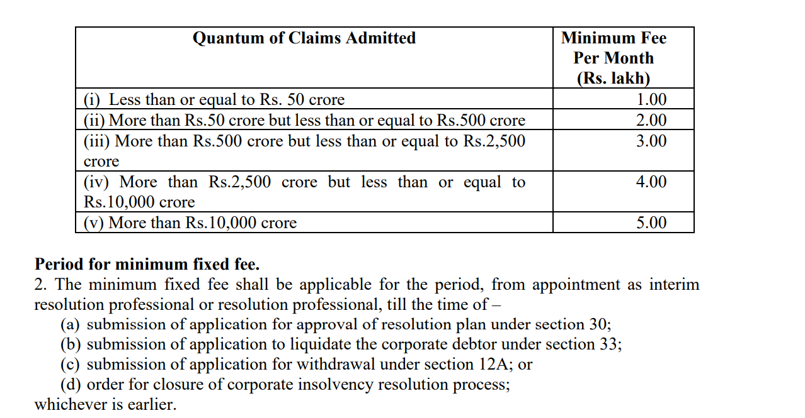
PROFESSIONAL FEES AS IRP/RP

Slide 11
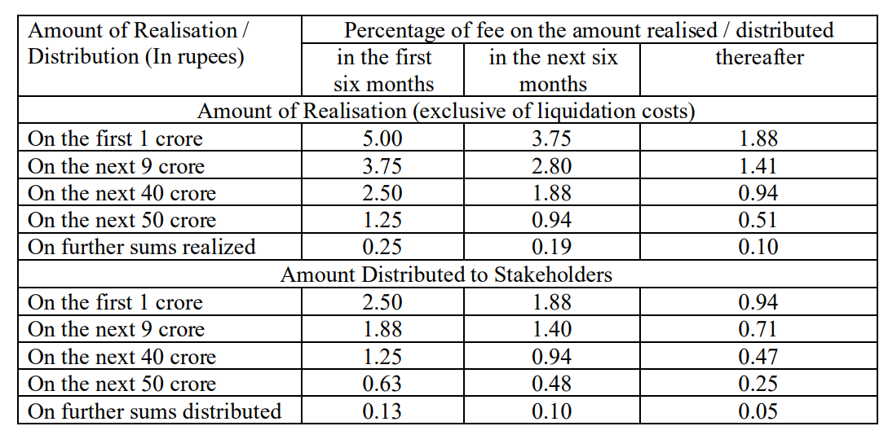
PROFESSIONAL FEES AS LIQUIDATOR

Slide 12
PROFESSIONAL FEES AS AUTHORIZED REPRESENTATIVE

Slide 13
Interim Resolution Professional
(for an initial period of CIRP up to 40 days)
Take over control and custody of the Corporate Debtor as a going concern
To understand financial position of Corporate Debtor including fund flow and asset – liability mis-match.
To understand the formation, objective, sustenance, reasons for default of Corporate Debtor
Takeover control and operations of all the bank accounts of Corporate Debtor
Public announcement of CIRP and inviting claims
Receiving, collating, verification of claims from secured or unsecured financial creditors, operations creditors, government dues, workers, employees and other stakeholders.
Constitution of Committee of Creditors
Appoint representatives of class of creditors, if required
Preparation of reports for submission to National Company Law Tribunal
Convening of meetings of Committee of Creditors

Slide 14
Resolution Professional
(up to 180th day of CIRP or up to 270th day, if extended or up to the date of handing over to resolution applicant or up to the date of liquidation order)
To continue the operations of the Corporate Debtor as a going concern and manage the entire business including fund flow, accounting, assessments, litigations, etc.
Preparation of Information Memorandum
Getting the valuation of assets done from registered valuers
Convening and chairing Committee of Creditors meetings for various approvals, appraisals and directions
Preparation of Bid Evaluation Matrix, Request for Resolution Plan (RFRP)
Invite Expression of Interest and developing resolution applicants for submission of resolution plans
Appoint transaction auditors or forensic auditors for identification of transactions u/s 43, 45, 50 & 66 of IBC
Examination of all the resolution plans, verification of eligibility criteria, eligibility u/s 29A and
presentation before COC
To comply with all the statutory compliances including stock exchanges, SEBI, RBI, direct and indirect taxes, labour laws, etc.

Slide 15
Representative of a Member of Committee of Creditors (Sec 21(6)(c)
Member of COC can appoint an IP only as representative for attending the meetings
The participant of meeting can either be an employee of member or a qualified IP (unless allowed by COC)
Role is to understand the proceedings and protect the interest of member
To prepare a report on the meeting and keep the member fully appraised

Slide 16
Voluntary Liquidator
(For Voluntary Liquidation of Corporate Persons under Chapter V of the Code)
To verify that no default is committed by the Corporate Debtor
To complete all the documentations, approvals, resolutions, etc. for initiating the process of Voluntary Liquidation
To liquidate all the assets by way of sale or realisation
To distribute the sale proceeds to creditors
Application to Adjudicating Authority for liquidating the Corporate Debtor

Slide 17
Liquidator
(from the date of liquidation order till the assets are disposed off or recovered and proceeds are distributed to stakeholders – expected to be completed in 2 years)
To continue the operations in case it helps faster or higher recovery
To make a public announcement for inviting claims
To receive, collate, verify and admit claims of all the stakeholders i.e. secured or unsecured creditors,
operational creditors, statutory liabilities, workmen, employees or other stakeholders.
To complete all the books of account, operate the bank account of the Corporate Debtor
To get the valuation of the assets from the registered valuers
To prepare and submit various reports to NCLT i.e. Preliminary Report, Progress Report, Asset
Memorandum, Asset Sale Report, etc.
To prepare complete description of assets and all terms and conditions for e-auction of assets
To sell fixed and current assets either on e-auction or physical auction or private treaty.
To recover all debts of the Corporate Debtor i.e. sundry receivables, advances, refunds, claims, etc.
To do all compliances as applicable during liquidation
To do the closure process and file closure report after all the assets are sold or realised and proceeds are distributed to claimants

Slide 18
Bankruptcy Trustee
(For bankruptcy Process of Individuals, Proprietorship Concerns & Partnership Firms - Just like Liquidator for Corporates)
Preparation of application for Bankruptcy on behalf of a creditor or debtor himself
Appointment as Bankruptcy Trustee for conducting the bankruptcy Process
Take control and custody of Bankruptcy Estate of the debtor
Invite claims from creditors, register the claims, list of creditors
Summoning a meeting of creditors and conducting the meeting
Realise the value of all items of Bankruptcy Estate by sale of assets or otherwise by way of realisation of debts and claims.
Finding Undervalued, Preferential, Extortionate and fraudulent transactions and making an
application to Adjudicating Authority for obtaining appropriate order.
Divide and disburse the value realised to claimants /creditors
Closure of Bankruptcy Process, preparation of closure report and apply for discharge order.

Slide 19
REGISTERED VALUERS
No valuation services can be rendered under the Companies Act without the registration certificate from IBBI after 30th September 2018
The registered valuer may conduct the valuation services under other laws under these rules, however, the same is not mandatory unless notified by that other law.

Slide 20
Opportunity as an Insolvency Professional
As an IRP/RP/Liquidator
or as an assisting Professional to the IPE team
Advisory Service
Advisory to Resolution Applicants, Financial due diligence, 29 A Report, SFA valuation, Forensic Auditor, Statutory Auditor, Negotiation Specialist, etc.
Pre- CIRP Advisory, Resolution Plan Implementation Advisory, Restructuring, Settlements, etc.
Fund Syndications, Management of Operations in going concern
Upcoming Scope in Advisory
Assessing Cross Border Insolvency transactions
Personal Insolvency
Partnership Insolvency

Slide 21
OPPORTUNITIES FOR PROFESSIONALS OTHER THAN
AN INSOLVENCY PROFESSIONAL
Support Services to Insolvency Professionals
Advisor to SBOD
Advisor to Resolution Applicants for taking over Companies
Consultations to Entities under Financial Stress (including options and threats under IBC)
Protection against ‘Insolvency attacks’ and recovery of business debtors and
advances thru IBC
Transactions Audit or Forensic Audits
Services of a Registered Valuer

Slide 22
SUPPORT SERVICES TO INSOLVENCY PROFESSIONALS
Preparation of Information Memorandum
Preparing a report on business and financial operations of Corporate Debtor for the previous two years
Claim Verification Process
Evaluation of assets and liabilities as at the date of commencement of CIRP
Examination of Resolution Plans submitted to Resolution Professional
Internal audit during CIRP at the instance of RP with special focus on fund flow and leakage of funds during CIRP
Stock audit during CIRP as RP is responsible for protection of assets while the business is being run by KMPs
Statutory audits in case RP wants to change the auditor and COC approves it
Audit of Income and Expenditure of Corporate Debtor during liquidation process
All compliances of Corporate Debtor during CIRP for which RP will appoint professionals

Slide 23
ADVISOR TO SUSPENDED BOARD OF DIRECTORS
Strategy for dealing with the Corporate Insolvency Resolution Process
Compiling all the information required by Resolution Professional
Preparation, submission and discussion on Resolution Plan, if they are permitted u/s 29A to submit
Advisor to SBOD for getting the comments on forensic /transaction audit conducted
Identifying and evaluating reasons for financial stress of the Corporate Debtor

Slide 24
ADVISOR TO RESOLUTION APPLICANTS
Guiding clients for acquiring companies under IBC through Resolution Plan
Study of Sustainable/ Non-sustainable debts
Business Evaluation (Technical as well as Financial)
Due Diligence of the Project (including valuation, litigations, financials, etc.)
Complete advisory services for strategy, preparation documents, process, submission of Resolution Plan and implementation to take over a Corporate Debtor
Preparation of Resolution Plan with sustainable debt and restructuring of debt and equity
Arrangement of funds for taking over companies under IBC
Consultancy for acquisition funding under IBC
Propose Tax Planning, such as merger, de-merger scheme, carry forward, set off losses
Representing the Resolution Applicant before RP and COC

Slide 25
ADVISORY TO EXISTING CLIENT
Advisory Service
Merger, De-merger and such other restructuring through resolution plan becomes faster in comparison with other laws
Takeover of company having huge tax losses without any liabilities (clean slate)
Acquisition of Listed company, and back door listing of unlisted companies through reverse merger without going through IPO process
Reliefs under Resolution Plan
Opportunity of quick business expansion with deferred payment structure
Acquisition of assets at discounted market value through court orders and no stamp duty
Benefit of Moratorium

Slide 26
CONSULTATIONS TO ENTITIES UNDER FINANCIAL STRESS (INCLUDING OPTIONS AND THREATS UNDER IBC)
Identifying and evaluating distressed companies for restructuring and rescue planning.
Working out a detailed plan for restructuring the business from all angles.
Assessment of distressed assets, cash position, due diligence and turnaround feasibility.
Advice on the utilization of resources to the optimum level.
Drafting insolvency petitions
Representation before the National Company Law Tribunal and National Company Law Appellate Tribunal for clients
Negotiating settlements with banks and other creditors
Advising for merger or acquisition or takeover.
Advisory services to management on an ongoing basis.

Slide 27
NCLT OPTION FOR COMPANIES UNDER FINANCIAL STRESS

Slide 28
WHEN A CORPORATE DEBTOR SHOULD SUO MOTO GO TO NCLT
Section 10 empowers a corporate applicant to file an application for CIRP
Corporate Applicant means:
Corporate Debtor
Member or partner, who is authorised under constitutional document
An individual who is in charge of managing the operations and resources of the Corporate Debtor
A person who has the control and supervision over the financial affairs of the Corporate Debtor

Slide 29
WHEN A CORPORATE DEBTOR SHOULD SUO MOTO GO TO NCLT
Section 29A: Persons not eligible to be Resolution Applicant
Undischarged insolvent
Wilful defaulter
NPA account of more than one year or the entire overdue amounts are paid with interest.
Convicted for any offence for 2 years or more for any acts under 12th schedule or 7 years or more
Disqualified to act as director under the Companies Act, 2013
Prohibited by SEBI from trading or accessing in securities market
Promoter of any Corporate Debtor where avoidable transactions u/s 43, 45, 50 & 66 are found an order has been obtained from Adjudicating Authority
Guarantors to any Corporate Debtor under CIRP and the guarantee has been invoked by creditor and remains unpaid
Any such disability corresponding to above clauses any other jurisdiction outside India.
Has a connected person who is ineligible under these clauses

Slide 30
Justification for Corporate Debtor going to National Company Law Tribunal
Restructuring of stress at the initial stage before CD become ineligible for submission of Resolution Plan
Situation can be controlled before the business is getting adverse impact by way of losing credibility, loss of customer trust, loss of human resources
Corporate Debtor with too many litigations, statutory liabilities, high financial and operational debt but is having a good business model. Can be transferred to genuine business buyers without depleting further value. This may fetch best value for the business as the liabilities would be waived, which otherwise would not have been possible.
Voluntary Liquidation u/s 59 of IBC for closely held companies for sale of properties. The properties can be transferred to shareholders in voluntary liquidation
Earlier option with the promoters was either make the company as ‘Zombie Company’ and drag it along
unlawfully.
Other option was to start ‘Phoenixing’ and indulge in unlawful activities.
Both these options may not be available now as anyone can take you to CIRP including workers, employees, shareholders, suppliers of goods or services, government departments against their dues, unsecured loans, depositors and financial creditors

Slide 31
Justification for Corporate Debtor going to National Company Law Tribunal...Contd.
Banks were not doing any restructuring in the last 2 to 3 years and financial stress worsened further
NPA classification was being delayed in connivance with banks and other
professionals, however the priorities of banks have changed now.
It is better that CD goes to NCLT before any other person make an application.
RBI Circular dated 12th February 2018 has not taken off yet for restructuring of cases.
Pre-packaged sale of running businesses

Slide 32
TRANSACTIONS AUDIT OR FORENSIC AUDITS
Investigations, analysis and determination of transactions under section 43, 45, 50 and 66 of IBC
Preferential Transactions (Sec. 43 & 44) – while CD has paid to one creditor and not to other having same priority under IBC
Undervalued Transactions (Sec. 45, 46, 47, 48 & 49) – Gifts, transfer of assets at value significantly less than sale consideration taken by Corporate Debtor
Extortionate Credit Transactions (Sec 50 & 51) – Receipt of financial or operational debt which requires exorbitant payments
Fraudulent Transactions (Sec 49, 66, 67, 69) – all transactions with the intent of defrauding the creditors
IBA registration is being preferred by PSBs
Complete independence and a character and profile which is not influenced by external pressure is required

Slide 33
OPPORTUNITIES AS REGISTERED VALUER
ICAI Registered Valuers Organisation, New Delhi
ICSI Registered Valuers Organisation, New Delhi
ICMAI Registered Valuers Organisation, New Delhi
The Indian Institution of Valuers, Pune
Institution of Estate Managers and Appraisers, Kolkata
IOV Registered Valuers Foundation, New Delhi
PVAI Valuation Professional Organisation, Mumbai
CVSRTA Registered Valuers Association, Mumbai
THE COMPANIES (REGISTERED VALUERS AND VALUATION) RULES, 2017
(Amended up to 13/06/2018)
These rules are made by Central Government in exercise of the powers conferred by section 247 read with sections 458, 459 and 469 of
the Companies Act, 2013 (18 of 2013)
INSOLVENCY AND BANKRUPTCY BOARD OF INDIA
(Authority under the Companies (Registered Valuers and Valuation) Rules, 2017)

Slide 34
OPPORTUNITIES FOR PROFESSIONALS
under
PPIRP
Banks and FIs would be interested in restructuring under this structure because of committee approach and market value approach
Lenders will prefer this approach as most of the times the PPPIRP cost would be borne by CD
CD would also prefer this route as it is less expensive, less intensive, lower stigma, less disruptive, faster and quicker
Proper checks and balances have been built in the
Process
CD will prefer this process to circumvent pressure of multiple applications u/s 7 and 9

Slide 35
OPPORTUNITIES FOR PROFESSIONALS UNDER PPIRP
RP will get fee from CD for the pre-appointment role also
RP will work on Base Resolution Plan and Preliminary Information Memorandum
Professionals other than Insolvency Professionals can also take up the assignment and appoint an IP after in principle decisions are taken by FCs
Mergers and Acquisitions of those companies with some financial stress can be handled under PPPIRP
Sale of business can be routed through PPPIRP

Slide 36
ROLE OF CAs UNDER IBC AND AS AUDITOR OF COMPANIES UNDER FINANCIAL STRESS

Slide 37
ROLE OF CAs PARTICULARLY STATUTORY AUDITORS
IRP is having the authority to access the books of accounts, records and other relevant documents of CD available with statutory auditors, accountants, government authorities -Sec 17(2)(d)
Punishment for falsification of books of CD – Sec 71 of IBC – any person alters or falsifies any books, papers or securities or makes any false or fraudulent entry in any books with the intent of defrauding the creditors – 3-5 years imprisonment or fine 1 Lakh to 100 Lakh or both
Sec 147 of the Companies Act, 2013 – Punishment for contravention – fine 25K to 500K or 4 times of fee – for
wilful and with the intent to deceive the creditors, shareholders – fine 50K to 2500K or 8 times of fee –
Imprisonment for 1 year
Sec 147 further provides that the auditor will refund the remuneration taken from the Company and pay compensation and damages to members, creditors and Govt authorities
National Financial Reporting Authority (NFRA) has been set up with vast powers and there is a possibility of complaints against erring CAs to NFRA and the powers are very large. NFRA is having powers u/s 132 of the Companies Act, 2013 to fine 1 Lakh to 5 Lakh – 5 time to 10 times of fee – debarring from practice for 6 months to 10 years
All depends upon the regulator – like IBBI if complainant will get response – everyone will file a complaint; if NFRA would be responsive – more complaints would be filed by creditors, government authorities, IPs (based on forensic audit report)

Slide 38
PRACTICAL TIPS ON WHAT PROFESSIONALS’ OVERLOOK FROM REPORTING POINT OF VIEW WHEN AN ACCOUNT SHOWS
Signs of diversion of Bank Loan – deceiving other parties for personal gains – is classified as fraud
DBR.No.CID.BC.22/20.16.003/2015-16 dated 1st July 2015 titled as Master Circular on Wilful Defaulters has provided that in case Statutory Auditor has not reported such diversion, then the banks are required to report to:
ICAI
RBI (Department of Banking Supervision, Central office) for records and sharing the information with banks and CAG & MCA
IBA for records and circulating the information with banks for caution and removal from panels, if any
Standard on Auditing- 240 “The Auditor’s Responsibilities Relating to Fraud in an Audit of Financial Statements” puts the
onus on the auditors to report the fraud w.e.f. 1st April 2014
Section 143 of the Companies Act, 2013 puts an onus on the auditor to report any fraud and also report any non-compliance of Standards on Auditing
CARO clauses (a) & (b) also require auditor to qualify or modify the audit report if any losses or litigation is foreseeable
Clause 41 of the Listing Agreement fraud reporting to Central Government is required by auditors

Slide 39
Business cycle starts increasing
Business cycle starts increasing with higher inventory of RM, WIP & FG and higher credit period extended to customers.
That means losses are being parked in current assets to deceive the creditors and present a rosy picture
‘Zombie Company’ scenario means carrying the corpse duly decorated with the objective of defrauding the creditors
Diversion of funds out by padding up the purchase for the purpose of personal use of funds
Increasing the closing stock to declare profit
Not recording rejections, debit notes issued by customers, not recording purchase bills and amount paid is being
shown as advances.
Swelling of fixed assets without corresponding increase in capacity and business. That means loading losses to Capital Assets by higher capitalisation or by raising fake bills for fixed assets.
Quantitative records of inventory is not satisfactory or complete or there is no records of inflow, outflow, consumption, yield, shortage, burning loss, wastage on each process and closing stock for each process or stage of inventory.
Asset verification is primary duty of the auditor and in case not verifiable, it has to be reported.
Auditors responsibility in reporting is the same as discussed earlier

Slide 40
Outstanding balances are not squared/ reconciled up bill to bill
When Corporate Debtor requires more funds to meet out old known liabilities or demands enhancement of Fund or Non-Fund limits to fulfil its obligations
Bill to bill reconciliation is very important
Third party confirmation is also necessary
Asset verification is primary duty of the auditor and in case not verifiable, it has to be reported.
Auditors responsibility in reporting is the same as discussed earlier
Evergreening: means the debt never comes down, repaid in one account, fresh loan in another account.
Business cycle continuously going up, inventory is going up and credit extended to customer is also going up.
Third party confirmations of receivables are not obtained

Slide 41
PRINCIPLES OF PUTTING *RED FLAGS* OR ISSUING GUARDED WARNINGS TO THE BANKERS & THE STAKE HOLDERS

Slide 42
RED FLAGS
Evergreening: means the debt never comes down, repaid in one account, fresh loan in another
account.
Business cycle continuously going up, inventory is going up and credit extended to customer is also going up.
Third party confirmations of receivables are not obtained
Physical verification of inventory or fixed assets is not allowed or not liked
Market credit is also increasing constantly.
Regular Capex in the same existing unit with little increase in the capacity or sales
Always take suggestions about how to raise further loans
Offers higher interest rates to friends and relatives
Living beyond one’s means, luxurious life to display that his business is doing well
Unusually close association with vendor or customer, regular parties with creditors
No delegation of authority in the accounts department
The director will directly interact with you and will not allow the accountant to speak to you

Slide 43
GUARDED WARNING TO BANKERS AND CREDITORS
First is warning to himself as auditor and start detailed due diligence and comply with all auditing standards
Report all facts and observations in audit report or CARO after seeking clarification from the auditee
Comply with RBI Master circular dated 1st July 2015
Comply with SA 240 all duties u/s 143 of the Companies Act, 2013
Must verify the financial statements submitted to banks and other creditors and also uploaded on MCA website

Slide 44
TIPS FOR PROFESSIONALs
Avail the professional opportunity under IBC and if not IP then should practice as consultant for the benefit of clients
Should also adopt the profession of registered valuer as the opportunities are increasing under IBC, Companies Act, SEBI, Income tax, business transactions, Ind AS.
Multiple sources of income will reduce your dependence on auditees and you can afford to achieve auditor’s independence
Early detection of stress and default regime
Insolvency attacks on companies by operational creditors, workers and government authorities

Slide 45
THANK YOU
CA Ramchandra D. Choudhary
+91- 9909903614
rdc_rca@yahoo.com
www.sunresolution.in

Slide 46
Domain experience and expertise
Resolution Professional Profile – CA Ramchandra D. Choudhary
Founder & Managing Director, Sun Resolution Professionals Pvt. Ltd. - IPE
Founding Partner of R. Choudhary & Associates- CA Firm
IBBI/IPA-001/IP-P00157/2017-018/10326 AFA Valid till: 15-Nov-23
Within the IBC framework, Mr. R. D. Choudhary has handled complex CIRPs/Liquidations:
46 cases where appointed as an IRP/RP/Liquidator under IBC
As IRP Total: 17
As RP Total: 21
As Liquidator Total: 8
Handled cases with debt size of INR 17612.18 crore in CIRP and Liquidation
09 Cases with Resolution Plan successfully approved by COC. (Includes – 02 Cases Sale as going Concerns)
Education
M. Com, F.C.A.,IP, FAFD(ICAI)
Areas of Experience
Restructuring
Corporate finance advisory
M&A
Industrial operations
Fund Raising
Due Diligence
Strategic consulting
Concurrent Audit
Transaction / Forensic Audits
Government Audits
Management consulting
Business Process Designing

