Slide 1
Ind AS 36 IMPAIRMENT OF ASSETS
24th October 2023
Tuesday
5 PM to 8 PM
Faculty
CA Bhavesh M. Gondhiya

Slide 2
IND AS 36 : IMPAIRMENT OF ASSETS
Ind AS Course ICAI

Slide 3
AGENDA
Ind AS Course ICAI
1
2
3
4
5
6
7
8
Objective and Scope
Impairment Indicators
Impairment Test
Cash Generating Unit
Specific Asset Tested for Impairment
Reversal of Impairment loss
Significant Disclosure
Key Differences (IND AS 36 vs. AS 28)

Slide 4
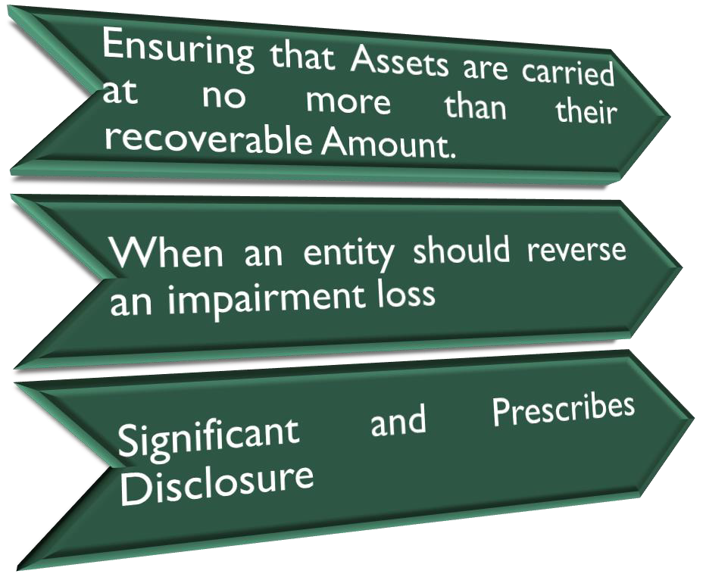
OBJECTIVE AND SCOPE
Ind AS Course ICAI
IND AS 36

Slide 5
OBJECTIVE AND SCOPE
Ind AS Course ICAI
Subsidiaries, as defined
in Ind AS 27
Inventories (see Ind AS 2 Inventories)
Consolidated Separate Statements
and Financial
Contract Asset and assets arising from costs to obtain or fulfill a contract (IND AS 115)
Deferred tax assets (Ind AS 12 Income Taxes)
Associates, as defined in Ind AS 28 Investments in Associates
Assets arising from employee benefits (Ind AS 19 Employee Benefits)
Financial assets that are within the scope of Ind AS 109 Financial Instruments: Recognition and Measurement;
Biological assets related to agricultural activity that are measured at fair
value less costs to sell (Ind AS 41 Agriculture)
Joint ventures, as
defined in Ind AS 111
Deferred acquisition costs, intangible assets, arising from an insurer’s Contractual rights under insurance contracts ( Ind AS 104 )
Interests in Joint Arrangement
Non-current assets (or disposal groups) classified as held for sale in accordance
5
with Ind AS 105 Non-current Assets Held for Sale and Discontinued Operations

Slide 6
IMPAIRMENT INDICATORS
Ind AS Course ICAI
6

Slide 7
CASE STUDY : IDENTIFY INDICATION OF IMPAIRMENT
Ind AS Course ICAI
Vin Co manufactures auto engines. After the reporting date, Vin Co's board decides and announces its intention to close the operations in UK. Closure will take two years to complete. The plant and machinery will only have a remaining life of two years, and thereafter will have to be scrapped. Whether the decision after the reporting date is an indication of impairment?
Facts
The decision after the reporting date to close the operations in UK is an indication of impairment. The assessment of recoverable amounts should be based on the conditions and contractual obligations existing at the reporting date. Although, the decision to close the operations in UK may have been made after the reporting date, the decision may have resulted from conditions that existed at the reporting date (e.g. poor demand for Vin Co's engines). Recognition of an impairment loss may be required to reflect those conditions that existed at the reporting date.
Response
7

Slide 8
CASE STUDY : IDENTIFY INDICATION OF IMPAIRMENT
Ind AS Course ICAI
XYZ Limited (the company) purchased 40 laptops of Brand A costing INR 100,000 each. These laptops were capitalized as fixed assets in its financial statements. Shortly afterwards, laptops manufactured by company B (with similar features) are launched in the market. Due to competition, the price of Brand A laptops was reduced to INR 80,000 each. Does the decline in the market price of the laptops imply that their value was impaired and the company should recognize an impairment loss on them?
Facts
In the case given above, the fact that the market price of the laptop has dropped significantly indicates the possibility of impairment. However, determination of whether there is impairment, which needs to be recognized in the financial statements of the company, depends on the recoverable amount computed.
Response

Slide 9
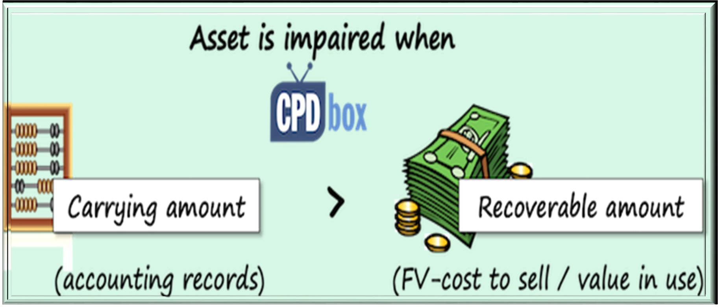
IMPAIRMENT TEST
Ind AS Course ICAI
TEST
Higher of :

Slide 10
IMPAIRMENT LOSS
Ind AS Course ICAI
IF
Impairment Test
Carrying Value
Recoverable Value
THEN
Impairment Loss
Carrying Value
Recoverable Value

Slide 11
RELEVANT DEFINITION
Ind AS Course ICAI
Carrying Amount
It is the amount at which an asset is recognized after deducting any accumulated depreciation
(amortization)
Fair value Less Cost to Sell
Fair Value is the price that would be received to sell an asset or paid to transfer a liability in an orderly transaction between market participants at the measurement date. Cost to Sell are direct incremental costs to bring an asset into condition for its sale (For Eg. Legal costs, Stamp duty or other transaction taxes, Costs of removing the asset and any direct incremental costs of getting the asset into saleable condition)
Value in use
It is the present value of the future cash flows expected to be derived from an asset or cash-
generating unit
11

Slide 12
PRACTICAL QUESTIONS
Ind AS Course ICAI
Uttaranchal Industries Ltd. gives the following estimates of cash flows relating to fixed asset
on 3 l-12-2005.The discount rate is 15%.
Year | Cash flow (Rs. in lakhs)
2006 | 2000
2007 | 3000
2008 | 3000
2009 | 4000
2010 | 2000
Calculate – 31.12.2005
Carrying amount
Value in use
Recoverable amount
Impairment loss
Revised carrying-amount
Depreciation - 2006
Residual value at the end of 2010 Fixed Asset purchased on 1-1-2003 for Useful life
= 500 Lacs
= 20,000 Lacs
= 8 Years
Residual value estimated 500 lakhs at the end of 8 years. Net selling price 10,000 lakhs
12

Slide 13
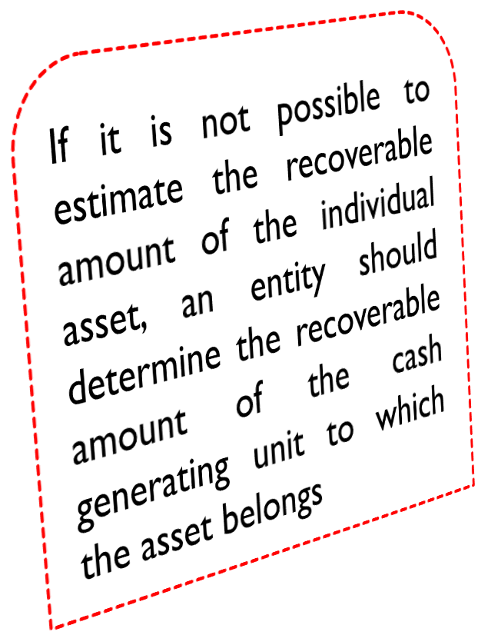
CASH GENERATING UNIT
Ind AS Course ICAI
13

Slide 14
EXAMPLE - CASH GENERATING UNIT
Ind AS Course ICAI
A hotel has several restaurants, rooms, conference halls, health club and other facilities since each of these facilities are not capable of generating revenues independently the entire hotel and not the individual facilities would be treated as a CGU
A huge multiplex has a bowling alley, theatres, hotel shopping mall since each of these facilities are not capable of
generating revenues independently the entire multiplex and not the individual units would be treated as a CGU
A Company is installing a second manufacturing line to manufacture the same product. If the cash flows generated by the two manufacturing lines are not independent, customer base is common and there is operational proximity and dependence the two manufacturing lines would form part of tne CGU
An enterprise has several retail stores spread across various locations that are centrally managed in terms of purchases, pricing, advertising, each of these stores would be a separate CGU since they are in different locations and probably have different customer bases. Though the stores are managed centrally, each of them generate cash inflows that are largely independent.
14

Slide 15
SPECIFIC ASSET TESTED FOR IMPAIRMENT
Ind AS Course ICAI

Slide 16
HOW GOODWILL IS TESTED FOR IMPAIRMENT ??
Ind AS Course ICAI
Step 1
Allocate Goodwill to respective CGU on reasonable and consistent basis
First = Asset/CGU * Life (Years) { At the time of Acquisition}
Secondly = Carrying Value * Remaining
Life (years) { On the date of impairment}
Any Loss on Impairment then first
allocate to goodwill
Then balance loss if any will be allocated to respective CGU to which it belongs
Step 2
Step 3

Slide 17
PRACTICAL QUESTIONS
Ind AS Course ICAI
On 31-3-2009 NDA Industries Ltd. acquired Induga Ltd. for 600 lakhs. Induga Ltd. has three- cash-generating unit X, Y & Z with net fair values of 240 lakhs, 160 lakhs and 80 lakhs respectively. NDA Industries Ltd. recognizes goodwill of 120 lakhs for the accounting year ended 31-3-2009. X unit incurred substantial losses its recoverable amount is estimated to be 270 lakhs. Carrying amount of different cash-generating units are as under:-
X | 260 Lacs
Y | 240 Lacs
Z | 160 Lacs
Goodwill | 24 Lacs
Calculate the impairment loss to be recognized in financial statement if goodwill can be allocated
on reasonable and consistent basis to cash-generating unit.
17

Slide 18
GOODWILL IS NOT ALLOCABLE AND TESTED FOR IMPAIRMENT ??
Ind AS Course ICAI
Any Loss on Impairment then first allocate to Goodwill
The balance loss if any will be allocated to respective CGU to which it belongs in their Carrying Amount
18

Slide 19
PRACTICAL QUESTIONS
Ind AS Course ICAI
On 31-3-2009 NDA Industries Ltd. acquired Induga Ltd. for 600 lakhs. Induga Ltd. has three- cash-generating unit X, Y & Z with net fair values of 240 lakhs, 160 lakhs and 80 lakhs respectively. NDA Industries Ltd. recognizes goodwill of 120 lakhs for the accounting year ended 31-3-2013. X unit incurred substantial losses its recoverable amount is estimated to be 270 lakhs. Carrying amount of different cash-generating units are as under:-
X | 260 Lacs
Y | 240 Lacs
Z | 160 Lacs
Goodwill | 24 Lacs
The goodwill cannot be allocated on reasonable basis to case generating unit X. The recoverable amount of all the three cash-generating unit which is immediately larger cash-generating unit to which goodwill can be allocated is 680. Calculate impairment loss. 19

Slide 20
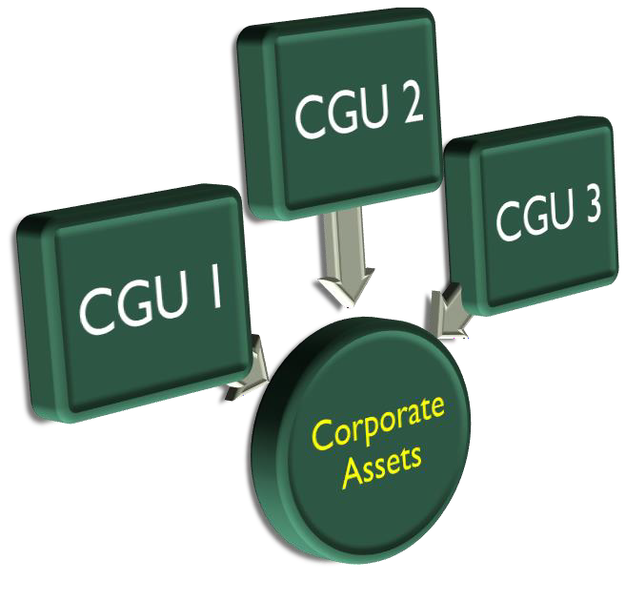
HOW CORPORATE ASSET IS TESTED FOR IMPAIRMENT ?
Ind AS Course ICAI
Step 1
Allocate Corporate Assets to respective CGU on reasonable and consistent basis
Step 2
Carrying Value * Remaining Life (years) {On the date of impairment}
Any Loss on Impairment then has to be allocated to Corporate Asset and Respective CGU in their respective carrying amount
Step 3

Slide 21
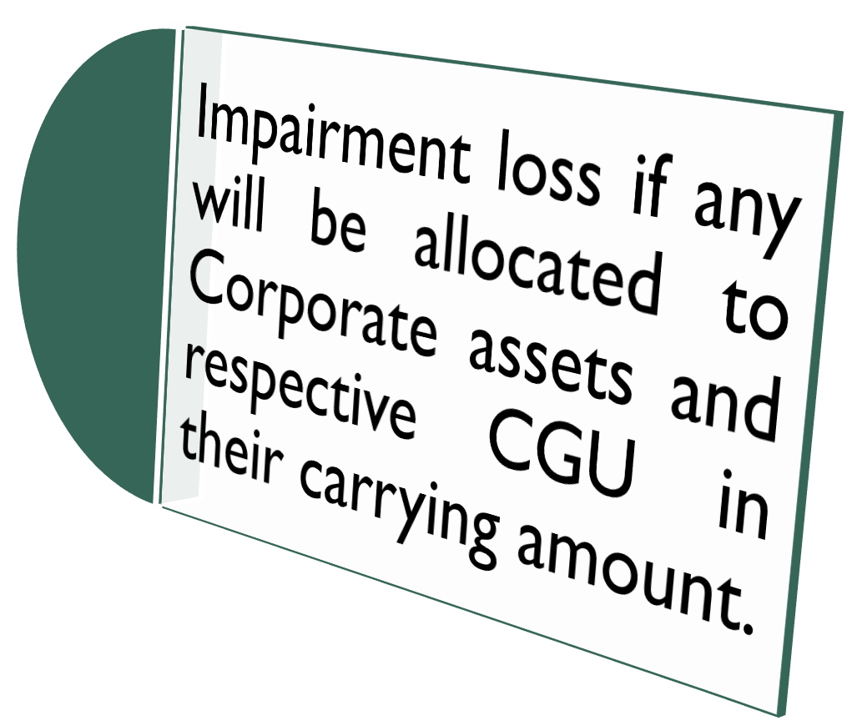
CORPORATE ASSET IS NOT ALLOCABLE AND TESTED FOR IMPAIRMENT
Ind AS Course ICAI

Slide 22
PRACTICAL QUESTIONS
Ind AS Course ICAI
Uttaranchal Industries Ltd. has three cash generating units X Y and Z. Carrying amount on
31.03.2010 of X,Y and Z is 400 Lakhs, 600 Lakhs and 800 Lakhs respectively.
Due to adverse technological changes effecting Uttaranchal Industries Ltd., the company
conduct impairment test of each of its cash generating unit on 31.03.2010.
Company has corporate assets as head office building of 600 Lakhs and Research and development centre of 200 Lakhs. Carrying amount of Building can be allocated on reasonable basis but R&D centre cannot be allocated on reasonable basis to X, Y and Z cash generating units, the remaining useful life of X unit is 10 Years and Y and Z is 20 Years. The HO assets are depreciated on straight line basis.
22

Slide 23
PRACTICAL QUESTIONS
Ind AS Course ICAI
Net Selling Price of each cash generating unit is not determinable. Hence recoverable
amount is based on value in use 15 % discount rate fairly indicate time value of money.
Calculate impairment loss to be recognised in financial statement for the year ended 31.03.2010 and allocation of impairment loss. Also calculate the revised carrying amount of asset of all cash generating unit.
Present Value of Future cash flow for X,Y and Z and for Uttaranchal Industries Ltd. as a whole at the end of 31.03.2010 is below (Rs. In lacs):
X | Y | Z | Company
803 | 654 | 1088 | 2877

Slide 24
REVERSAL OF IMPAIRMENT LOSS
Ind AS Course ICAI
Impairment Loss will be reversed (Maximum is Minimum of the three Conditions)
Impairment Loss Charged earlier to the Income Statement
OR
Post Reversal Carrying Amount should not exceed Current recoverable Amount
OR
Amount to be increased to the extent if no Impairment provided since beginning
OR
Under No Circumstances reversal of goodwill will be allowed

Slide 25
PRACTICAL QUESTIONS
Ind AS Course ICAI
At the end of 2006, X Ltd. were having the following assets at their carrying amount:
Identifiable asset
Goodwill
600 Lakhs
100 Lakhs
The goodwill is being amortised @ 25 Lakhs per annum and identifiable assets are being depreciated @ 25% p.a. WDV. The recoverable amount of these assets at the end of 2006 is estimated 550 Lakhs. The X Ltd. recognised the impairment loss in 2006 as per IND AS 36. However at the end of 2010, X Ltd. re estimate the recoverable amount due to favourable condition for the business, the recoverable amount was estimated at 250 lakhs
Required:
Calculate the impairment loss to be recognised in 2006 and allocation thereof.
Calculate the reversal of impairment loss in 2010 and its allocation.
25

Slide 26
SIGNIFICANT DISCLOSURE
Ind AS Course ICAI
Impairment losses recognized/ reversed in profit or loss
Estimates for measuring recoverable amounts of CGU containing goodwill/ Impairment
Events or circumstances leading to impairment
By each class of assets
Discount rate used and Description of CGU
Disclosures when impairment losses are material for an individual asset
Information on basis used for determining recoverable amount

Slide 27
KEY DIFFERENCES (IND AS 36 VS. AS 28)
Ind AS Course ICAI

Slide 28
KEY DIFFERENCES (IND AS 36 VS. AS 28)
Ind AS Course ICAI

Slide 29
Faculty Contact Details: CA Bhavesh Gondhiya
E mail : Bgondhiya@gmail.com
9429617541

