Slide 1
OVERVIEW OF BASICS OF ACCOUNTING
CA KALPESH P. PAREKH
CA, CS, B.COM, M.COM
PAST CHAIRMAN, RAJKOT BRANCH OF WIRC
COMMITTEE ON PUBLIC AND GOVERNMENT FINANCIAL MANAGEMENT, ICAI

Slide 2
History of Accounting in world and India
Luca Pacioli, an Italian monk, published Summa de Arithmetica, a book that introduced the double-entry system for bookkeeping and laid the groundwork for the future of accounting.
Accounting practices that took place during the overall historic periods within this time frame include the following:
Stone age — Marking ticks on cave walls and mountains, and in the jungle to record goods collected and loaned
Primitive — Noting symbols on walls and making rope knots to designate transactions
Barter — Recording deals made through barter for agricultural or other property
Currency — Tracking monetary transactions, originally in Europe, related to transactions that bank loans financed.

Slide 3
History of Accounting in world and India
Due to industrial development and manufacturing-based economy, accounting method evolved.
Industrial revolution — Required tracking the large amounts of capital involved in establishing new corporations and railroads
Joint-stock companies — Added complexity to doing business, with the financial concerns of shareholders and other business partners becoming factors
Government regulation — Led to the development of uniform accounting practices to accommodate tax laws
The history of the accounting industry in India can be traced back to the early 20th century when the country's first chartered accountancy firms were established.
However, accounting practices in India could be traced back to a period when twenty three centuries ago, Kautilya, a minister in Chandragupta’s kingdom wrote a book named Arthashasthra, which also described how accounting records had to be maintained.

Slide 4
Basic structure of Accounting and its Standards
The Institute of Chartered Accountants of India (ICAI), being a premier accounting body in the country, took upon itself the leadership role by constituting the Accounting Standards Board (ASB) in 1977.
Consideration of the final draft of the proposed standard by the Council of the ICAI and if found necessary, modification of the draft in consultation with the ASB is done.
ICAI in consultation with ASB, with Generally Accepted Accounting Principles (GAAP), issues Accounting standards, which provide the framework for more detailed and comprehensive accounting rules.

Slide 5
Generally Accepted Accounting Principles (GAAP)
Principle of Regularity: strictly adhere to established rules and regulations.
Principle of Consistency: Consistent standards are applied throughout the financial reporting process.
Principle of Sincerity: committed to accuracy and impartiality.
Principle of Permanence of Methods: Consistent procedures are used in the preparation of all financial reports.
Principle of Non-Compensation: All aspects of an organization's performance, whether positive or negative, are fully reported with no prospect of debt compensation.
Principle of Prudence: Speculation does not influence the reporting of financial data.
Principle of Continuity: Asset valuations assume the organization's operations will continue.
Principle of Periodicity: Reporting of revenues is divided by standard accounting periods, such as fiscal quarters or fiscal years.
Principle of Materiality: Financial reports fully disclose the organization's monetary situation.
Principle of Utmost Good Faith: All involved parties are assumed to be acting honestly.

Slide 6
Generally Accepted Accounting Principles (GAAP)

Slide 7
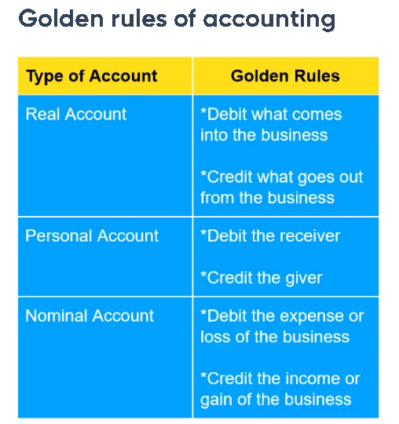
Fundamental (Golden Rules of Accouting)
A nominal account is a general ledger containing the transactions of a business, namely – expenses, incomes, profits and losses.
You can think of a personal account as a general ledger that relates to people, associations and companies.
A Real account is also a general ledger, but it contains transactions related to the liabilities and assets of a company.

Slide 8
Meaning of Financial Reporting & Framework of the same in India
‘Financial reporting is a systematic process of recording and representing a company’s financial data.
The reports reflect a firm’s financial health and performance in a given period.
Management, investors, shareholders, financiers, government, and regulatory agencies rely on financial reports for decision-making.’
(નાણાકીય અહેવાલ એ કંપનીના નાણાકીય ડેટાને રેકોર્ડ કરવા અને રજૂ કરવાની વ્યવસ્થિત પ્રક્રિયા છે. અહેવાલો આપેલ સમયગાળામાં પેઢીના નાણાકીય સ્વાસ્થ્ય અને કામગીરીને પ્રતિબિંબિત કરે છે. મેનેજમેન્ટ, રોકાણકારો, શેરધારકો, ફાઇનાન્સરો, સરકાર અને નિયમનકારી એજન્સીઓ નિર્ણય લેવા માટે નાણાકીય અહેવાલો પર આધાર રાખે છે.)
Financial reports include financial statements, notes to accounts, cash flow statements and such other requisition by MCA for complying with the same in case of company. These reports are crucial for strategizing the future growth and sustainability of a firm.
(નાણાકીય અહેવાલોમાં પાકું સરવૈયું, નફા નુકસાન ખાતું, રોકડમેળ અને અન્ય સલંગ્ન નોંધોનો સમાવેશ થાય છે.)

Slide 9
Meaning of Financial Reporting & Framework of the same in India
The Institute of Chartered Accountants of India (ICAI), being a premier accounting body in the country, took upon itself the leadership role by constituting the Accounting Standards Board (ASB) in 1977. The ICAI has taken significant initiatives for the issuance of Accounting Standards to ensure that the standard-setting process is fully consultative and transparent.
(ICAI એ નાણાકીય ચોપડાઓ સંબંધી જરૂરી માળખા ઉભા કરવાની જવાબદારી પોતાના પર રાખી અને તેના અનુસંધાનમાં અલગ અલગ એકાઉન્ટિંગ સ્ટાન્ડર્ડ્સના રેફેરેંસ પેપર્સ પબ્લિશ કર્યા છે. જે રોજ બરોજના એકાઉન્ટિંગ કામકાજ માટે એક માર્ગદર્શનનું કામ કરે છે.)

Slide 10
Major Components of the Financial Reporting
Balance Sheet (પાકું સરવૈયું) portrays value of economic resources controlled by an enterprise. It also provides information about liquidity and solvency of an enterprise which is useful in predicting the ability of the enterprise to meet its financial commitments as they fall due. (પાકું સરવૈયું પેઢીની વર્ષના અંતે બાકી રહેતી જવબદારીઓ અને લેણાં દર્શાવી ધંધાની સઘ્ધરતાને દર્શાવે છે.)
Statement of Profit and Loss (નફા નુકસાન ખાતું ) presents the result of operations of an enterprise for an accounting period, i.e., it depicts the performance of an enterprise, in particular its profitability. (નફા નુકસાન ખાતું પેઢીની નફાકારકતા બતાવે છે.)
Cash Flow Statement (રોકડમેળ) shows the way an enterprise has generated cash and the way they have been used in an accounting period and helps in evaluating the investing, financing and operating activities during the reporting period. (રોકડમેળએ પેઢીની ટૂંકા ગાળાની આર્થિક સદ્ધરતા અને રોકડ ચુકવણીની પરિસ્થિતિ બતાવે છે.)

Slide 11
Major Components of the Financial Reporting
Notes and other statements (અન્ય સલંગ્ન નોંધો) present supplementary information explaining different items of financial statements. For example, they may contain additional information that is relevant to the needs of users about the items in the balance sheet and statement of profit and loss. They include various other disclosures such as disclosure of accounting policies, segment reporting, related party disclosures, earnings per share, etc.(પાકાં સરવૈયા અને નફા નુકસાન ખાતાની એવી વિગતો કે જે નાણાકીય હિસાબો જોનાર માટે જરૂરી છે અને તેના વપરાશકર્તાને અને પેઢીને અસરકર્તા છે તે બાબતોને દર્શાવે છે.)

Slide 12
Components of Balance Sheet: Assets & Liability
Equity & Liabilities
Shareholders funds
Share Capital
Reserves & Surplus
Non-Current Liabilities
Long-term Borrowings
Long term Provisions
Other LT Liabilities
Current Liabilities
Trade Payables
Short-Term Borrowings
Other Current Liabilities
Short-Term Provisions

Slide 13
Components of Balance Sheet: Assets & Liability
Assets
Non-Current Assets
Fixed Assets
Current Assets
Tangible Assets
Capital Work-in-Progress
Non-Current Investments
Long Term Loans & Advances
Intangible Assets under Development
Current Investments
Inventories
Trade Receivables
Cash & Cash Equivalents
Short Term Loans & Advances
Intangible Assets

Slide 14
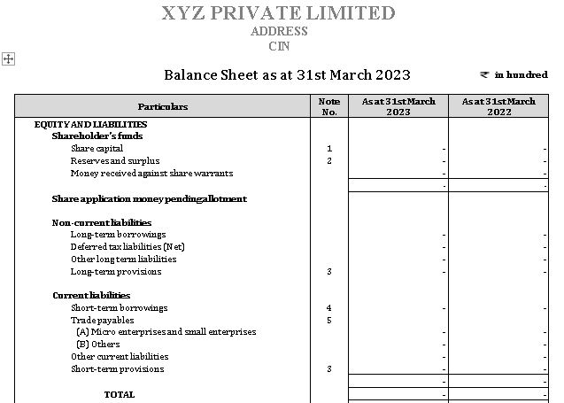
Components of Balance Sheet (Performa of Balance Sheet as per Schedule-III)

Slide 15
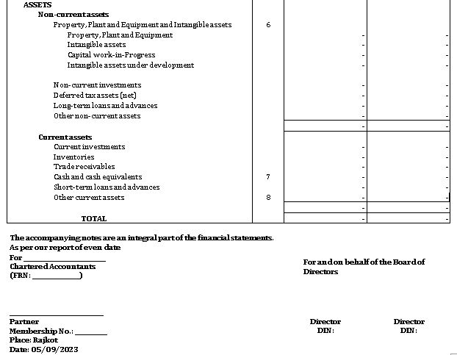
Components of Balance Sheet (Performa of Balance Sheet as per Schedule-III)

Slide 16
Meaning of Various terms
Income
Inflow
(આવક)
Expense
Outflow
(જાવક)

Slide 17
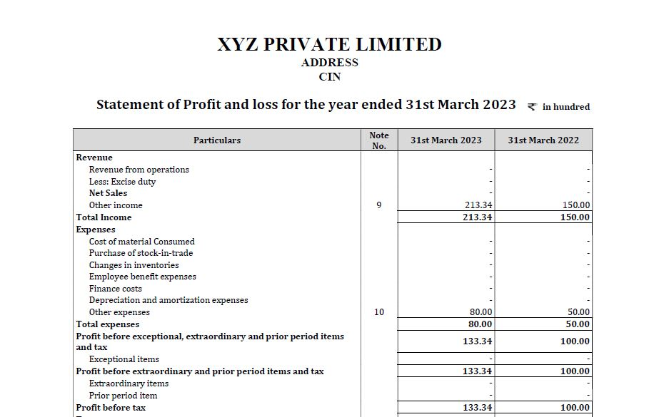
Components of Profit & Loss Statement (Performa of P&L as per Schedule-III)

Slide 18
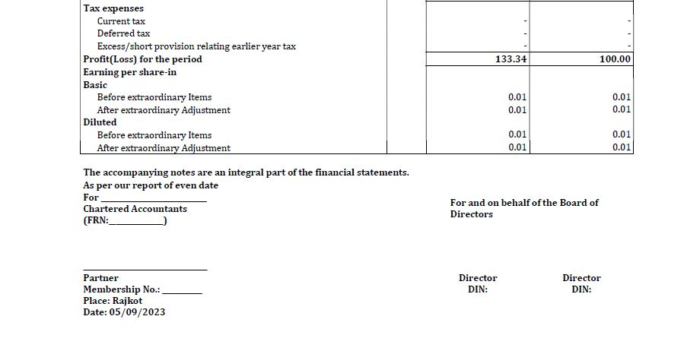
Components of Profit & Loss Statement (Performa of P&L as per Schedule-III)

Slide 19
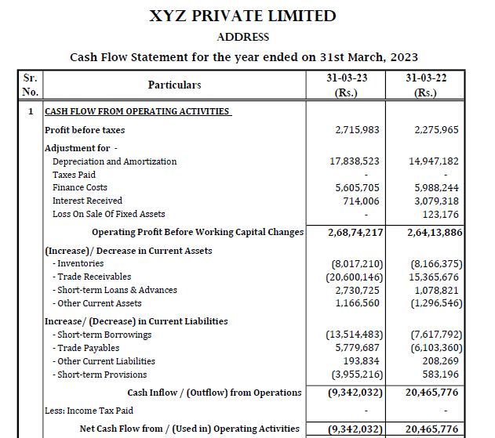
Components of Cash Flow Statement (Performa)

Slide 20
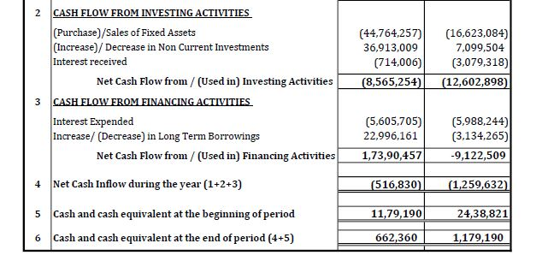
Components of Cash Flow Statement (Performa)

Slide 21
Interpretation of Financial Statement
Interpretation of Financial Statements
Profitability Ratios
GP Margin
NP Margin
Liquidity Ratio
Current Ratio
ROCE
Net Asset Turnover
Limitations
Window Dressing
Limited information available
Quick Ratio
Investors Ratio
EPS
P/E Ratio
Related Party Transaction
Historical Coast Accounting

Slide 22
Interpretation of Financial Statement
Particulars of Ratio | Formula of Ratio
Gross Profit Ratio (કાચા નફાનો ગુણોત્તર) | Gross Profit/Net Sales (કાચો નફો/ ચોખ્ખુ વેચાણ )
2) Net Profit Ratio (પાકા નફાનો ગુણોત્તર) | Net Profit/Net Sales (કુલ (પાકો) નફો/ ચોખ્ખુ વેચાણ )
3) Current Ratio (ચાલુ ગુણોત્તર) | Current Assets/Current Liabilities (ચાલુ મિલ્કતો/ ચાલુ જવાબદારીઓ)
3) Inventory Turnover Ratio (માલ વેચાણનો ગુણોત્તર) | Closing Inventory/Net Sales (આખરનો સ્ટોક/ ચોખ્ખુ વેચાણ)
4) Debt to Equity Ratio (જવાબદારીનો મૂડી સાથેનો ગુણોત્તર) | Total Liabilities/Shareholder’s fund (કુલ જવાદારીઓ/ શેરહોલ્ડરનું ભંડોળ)
5) Earning per Share (શેરદીઠ કમાણી) | Net Profit (Net Earnings)/Total Shares outstanding (ચોખ્ખો નફો/ કુલ શેર)

Slide 23
Interpretation of Financial Statement
Gross Profit= Net Sales (Sales- Sales Return)- Purchase- Direct Expense- Opening Stock+ Closing Stock (કાચો નફો= ચોખ્ખુ વેચાણ (વેચાણ- વેચાણપરત)- ખરીદી- ખરીદીને લગતા ખર્ચ- ખૂલતો સ્ટોક+ આખરનો સ્ટોક)
2. Net Profit= Gross Profit- Indirect Expense+ Indirect Income (ચોખ્ખો નફો= કાચો નફો- ધંધાને લગતા અન્ય ખર્ચ+ અન્ય આવકો)
3. Current Assets are those assets which can be realized in cash or cash equivalent within a period of 12 Months and for the Current liabilities vice-versa. (ચાલુ મિલ્કતો એટલે ટૂંકા ગાળાની એવી મિલ્કતો કે જે ૧૨ મહિના કરતા ઓછા સમયગાળામાં રોકડ અથવા રોકડ સમકક્ષમાં રૂપાંતરણ પામી શકે અને ચાલુ જવાબદારીઓ એટલે તેનાથી વિરુદ્ધ કે જેનું ચુકવણું કરવું પડે.)

Slide 24
Bank Reconciliation Statement
‘Bank reconciliation is
- The process of comparing the balance as per the cash book with the balance as per the passbook (bank statement).
- The very purpose of reconciling the bank statement with your business’ books of accounts is to identify any differences between the balance of the two accounts.’
('બેંકસિલેકમેળ એ પાસબુક (બેંક સ્ટેટમેન્ટ) મુજબ બેલેન્સ સાથે કેશ બુક મુજબની બેલેન્સની તુલના કરવાની પ્રક્રિયા છે. તમારા બિઝનેસના બુક્સ ઑફ એકાઉન્ટ્સ સાથે બૅન્ક સ્ટેટમેન્ટનું સમતુલા કરવાનો મૂળ હેતુ એ જ છે કે બે ખાતાંઓની બેલેન્સ વચ્ચે કોઈ પણ તફાવત હોય તો તેને ઓળખી શકાય.’)

Slide 25
Bank Reconciliation Statement
To reconcile a bank statement with your business' books of accounts, you need to follow the steps below:
(ધ્યાનમાં રાખવાના મુદ્દા:)
Match each of the deposits recorded in your books of accounts to the ones reflected in your bank statement.
There might be a possibility that your bank might have denied accepting a cheque within a collection of deposited cheques or might have recorded an incorrect cheque amount.
In case this happens, you should add back the amount of rejected cheques to the bank’s closing cash balance.
(બેંકમાં જમા થયેલ નાણાં સાથે એકાઉન્ટમાં પડેલ એન્ટ્રી એકવાર વેરીફાય કરવી. આ સમયે જો એવું કંઈપણ એમાં જોવા મળે છે કે જેના લીધે બેંક દ્વારા ડિપોઝિટ કરાયેલ રકમ જમા લેવામાં નથી આવી તો તે બેંક સિલકમાં ઉમેરીને જમા લેવી.)

Slide 26
Bank Reconciliation Statement
Next, prepare a list of cheques that have not been cleared by the bank. Cheques presented but not cleared are reconciling items and need to be deducted from the bank’s closing cash balance for your account.
(આગળ દર્શાવેલ મુદ્દા કરતા વિરુદ્ધમાં જો કોઈ ચુકવણી ચોપડે નોંધાયેલ છે અને બેંકમાં નથી નોંધાયેલ તો બેંક સિલકમાંથી તેને બાદ કરી નાખવી.)
Then, check the miscellaneous debits and credits listed on your bank statement and add or subtract the same from the reconciliation.
(અન્ય નાના મોટા ખર્ચાઓ જેવા કે બેંક ચાર્જિસ, ઇન્સ્યોરન્સ પ્રીમિયમ વગેરે અને અન્ય નાની મોટી આવકો જેવી કે વ્યાજની આવકો વગેરે જો એકાઉન્ટ્સમાં નોંધાયેલ ન હોય તો એને ઉમેરવા કે બાદ કરવા.)
Finally, add or subtract all the items marked as reconciling items from your bank’s closing cash balance. Once you have identified all the differences and prepared a bank reconciliation statement, attach the bank reconciliation statement with the rest of your accounting records for future reference.
(એકવાર બધા વ્યવહારોની બેંકસિલેકમેળમાં નોંધ થયા પછી જે રોકડમેળ મુજબની બેંક સિલક મળે છે તેને એકાઉન્ટ્સ સાથે મેચ કરી ભવિષ્યના રેફરન્સ માટે તેને બેંક ફાઈલ સાથે જોડી દેવા.)

Slide 27
Bank Reconciliation Statement
Example: From the Following Particulars of M/s. Zen Enterprise prepare Bank Reconciliation Statement as on 31/03/2023.
Particulars | Amount in Rupees
Overdraft as per passbook | 20,000
Interest on overdraft | 2,000
An insurance premium paid by the bank | 200
Cheques issued but not presented for payment | 6,500
Cheques deposited but not yet cleared | 6,000
Wrongly debited by the bank | 500

Slide 28
Bank Reconciliation Statement
Answer:
Bank Reconciliation Statement as on March 31, 2023
Particulars | Amount Rs.
Overdraft as per passbook | (20,000)
Add: Interest on overdraft | 2,000
Add: An insurance premium paid by the bank | 200
Less: Cheques issued but not presented for payment | (6,500)
Add: Cheques deposited but not yet cleared | 6,000
Add: Wrongly debited by the bank | 500
Overdraft balance as per cash book | (17,800)

Slide 29
Thank You

