Slide 1

CORPORATE Financial statements UNDER AS
PRESENTED BY : JITEN MAHENDRABHAI TRIVEDI
FCA (Gold medalist) ,
CS (AIR) ,
LLB ( Uni. Topper ) ,
M.Com (Gold Medalist)
Date of Presentation : 01.06.2024

Slide 2
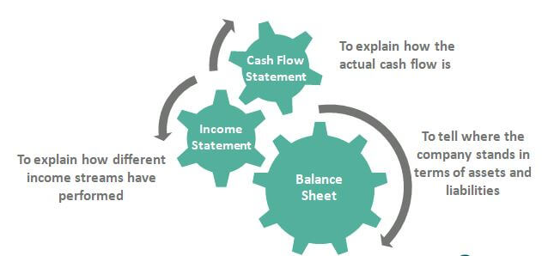
Generating financial statements
What is a Financial Statement?
A financial statement is a quantitative way of showing how a company is doing.
Three different ways of representing the financial state of a company:
Cash Management (can the company meet its obligations?)
Profitability (Is it making money?) - the income statement
Assets versus Liabilities (what is the value of the company? Who owns what?) - the balance sheet
Each one of these questions is answered by our Financial Statements.

Slide 3
Balance Sheets
  How much debt do I have? How large are my assets? This sheet tells you the answer to these questions.
Income Statements
  This is the financial sheet that tells you if your company is profitable or not.
Cash Flow Statements
  These answer the important managerial question “do I have enough cash to run my business”
  Statement of Retained Earnings
  A statement of retained earnings is a financial statement that shows the changes in a company's retained earnings balance over a specific accounting period.
  Notes to Financial Statement
  Notes to the financial statements disclose the detailed assumptions made by accountants when preparing a company's: income statement, balance sheet, statement of changes of financial position or statement of retained earnings.

Slide 4
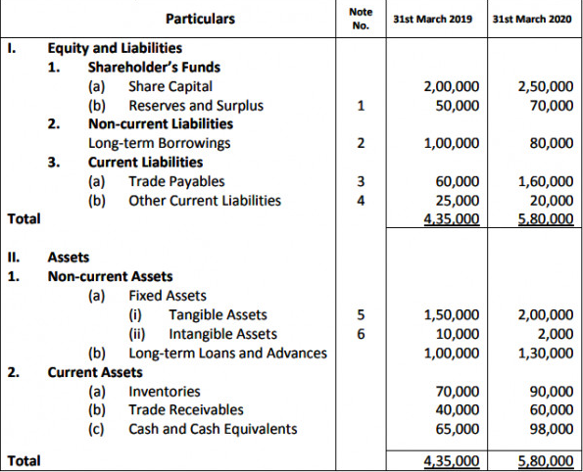
DIVISION-I BALANCE SHEET (APPLICABLE TO THE ENTITIES FOLLOWING AS)

Slide 5
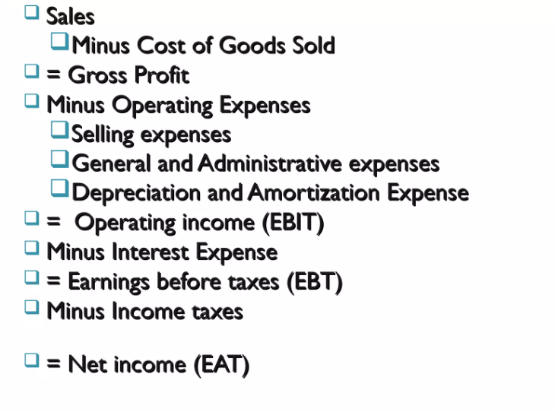
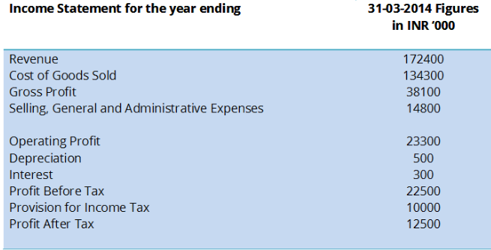
AN INCOME STATEMENT
SAMPLE INCOME STATEMENT

Slide 6

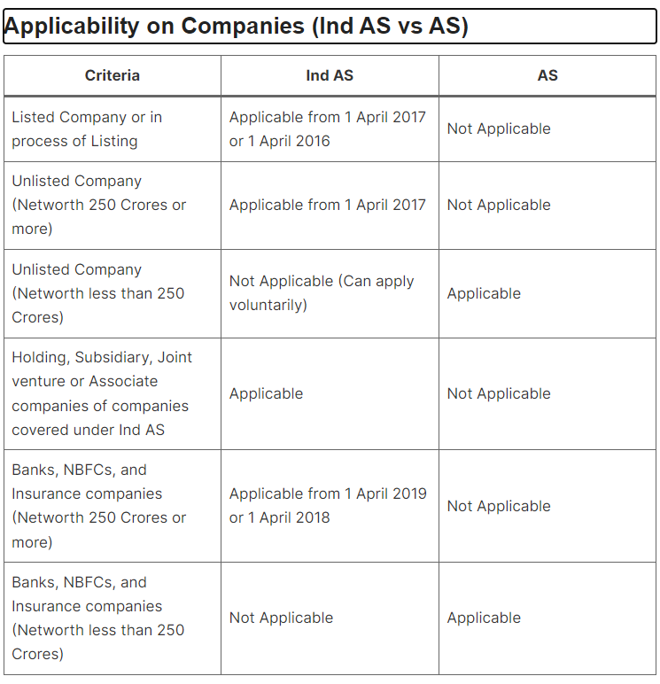



Slide 7
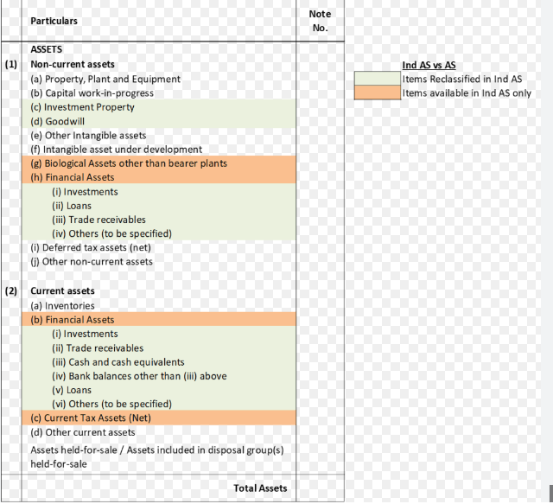
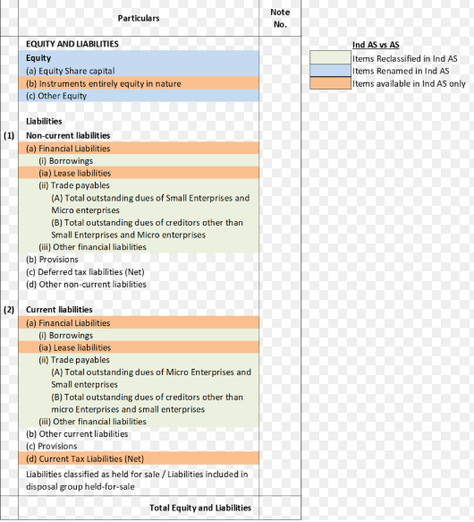
DIVISION-II BALANCE SHEET (APPLICABLE TO THE ENTITIES FOLLOWING IND AS)

Slide 8

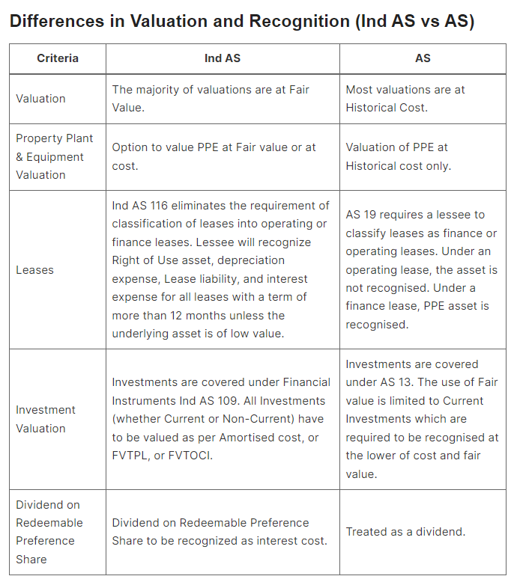


Slide 9
Differences in Disclosures in Schedule III (Ind AS vs AS)
Criteria | Ind AS (Division II) | AS (Division I)
Quantity of Disclosures | Enhanced Disclosures. | Moderate Disclosures.
Balance Sheet Format | Assets are disclosed before Equity and Liabilities | Assets are disclosed after Equity and Liabilities
Investment Property | Disclosure of Investment Property separately. There is a separate Ind AS on Investment Properties. | Disclosed under Non-Current Investments. No separate AS for Investment Property.
Goodwill | Disclosure of Goodwill separately from Other Intangibles. | Goodwill is shown under Intangible Assets.
Biological Assets | Disclosure of Biological Assets other than bearer plants separately. There is a separate Ind AS on Agriculture. | Biological Assets are shown along with other Property Plant and Equipment. No separate AS.
Right of Use Assets / Lease Liabilities | Separate disclosure of Right of Use (ROU) assets in PPE. Separate disclosure of Lease Liabilities under Current or Non-Current Financial Liabilities. | ROU asset is not recognised. Assets under finance lease are specified under each class of asset. Finance Lease obligations are shown under Long term borrowings / other current liabilities.
Financial Assets / Liabilities | Disclosure of separate heads of Financial Assets & Financial Liabilities. Ind AS 109 for Financial Instruments is mandatory and its disclosure requires Financial Assets & Liabilities to be shown separately. | Accounting Standards on Financial Instruments (AS 30, 31, 32) are withdrawn, so they are not disclosed in the Balance Sheet.
Investment classification | Apart from basic disclosures, additional disclosure is required for Investments at amortized cost, Investments at FVOCI, and Investments at FVTPL. | Basic disclosures like quoted/unquoted, subsidiary/associate/joint-venture, and type of instrument, is only required.
Name of the company in which investment is made | If invested in a subsidiary, joint venture or associate then only the name of the company has to be given otherwise no requirement to give the name of the company. | Details shall be given of the names of the company for all the investments.
Bank Deposits | Bank Deposits maturing after more than 12 months are shown under Other Financial Assets instead of Cash and Cash Equivalents as they are Non-Current Assets. | All Bank Deposits are shown under Cash and Cash Equivalents under Current Assets.

Slide 10
Differences in Disclosures in Schedule III (Ind AS vs AS)
Criteria | Ind AS (Division II) | AS (Division I)
Loans and Advances | Loans are shown as financial assets as they are recoverable in cash. Only those Advances which are recoverable in cash are shown under financial assets. Advances recoverable in kind in the form of goods or services are shown as Other assets. | All Loans and advances whether recoverable in cash or kind are shown under the same head, Loans and advances.
Current Tax Assets / Liabilities | Disclosure of Current Tax Assets / Liabilities (Net) on the face of the Balance Sheet. | (Provision for Tax + Advance Tax + TDS) is a net liability, then shown under Provisions otherwise shown as Loans and advances.
MAT Credit | Grouped with Deferred Tax in P&L. Grouped with Deferred Tax Assets (net) in the Balance Sheet. A separate note is provided for the amount of MAT Credit at both places. | Presented as a separate line item by a reduction from the Current tax in P&L. Shown under Short-term / Long-term loans and advances in the Balance Sheet.
Share Capital | Share Capital is renamed to Equity Share capital. Share Capital in Ind AS comprises only Equity share capital. Redeemable Preference shares are disclosed as Financial Liability and Equity. | Share Capital can be Equity or Preference Shares both.
Reserves and Surplus | Reserves and Surplus are replaced with Other Equity under Equity and Liabilities. | Reserves and surplus are shown as separate head in Equity and Liabilities.
Share Application Pending Allotment | Share Application Pending Allotment clubbed with Other Equity. | Share Application Pending Allotment is shown as a separate head in Equity and Liabilities.
Statement of Changes in Equity | Requires the financial statements to include a Statement of Changes in Equity to be shown as a part of the balance sheet. | No such disclosure
A separate line item for Income & Expense | Separate disclosure of any item of income or expenditure which exceeds 1% of the revenue from operations or Rs.10,00,000, whichever is higher. | AS prescribes disclosure of expenditure on various line items but no percentage of revenue is defined.
Extraordinary Item | Prohibits presentation of any item as an Extraordinary Item in the statement of profit and loss or in the notes. | No such prohibition
Other Comprehensive Income (OCI) | Other comprehensive income (OCI) is disclosed separately. | No concept of OCI
EPS | Disclosure of EPS for continuing operation and discontinuing operation separately. | Combined EPS disclosure.

Slide 11
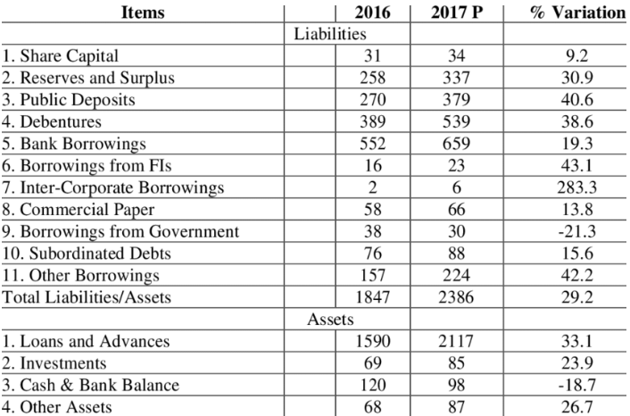

DIVISION-III BALANCE SHEET (APPLICABLE TO THE NBFC)

Slide 12



Thank you
CA JITEN M. TRIVEDI
(PARTNER AT JKSS & ASSOCIATES)
9924248092
OFFICES @ Ahmedabad,
Bengaluru, Bhopal, Bhubhaneshwar,
Chennai, Chandigarh, Delhi, Faridabad,
Guwahati, Hyderabad, Jaipur, Kolkata,
Kanpur & Mumbai
jiten.trivedi@jksco.in

