Slide 1
RATIONALE,SIGNIFICANCE,REVIEW PROCEDURES, REPORTING and AQMM Importance in PEER REVIEW
Presentation For: ICAI WIRC RAJKOT : 11-05-2024
Presented By :
CA. Ashok Kumar Pradhan

Slide 2
OVERVIEW
RATIONALE OF PEER REVIEW
• At Profession’s Level:
To strengthen public confidence in financial reporting and effectiveness of audit process.
To increase the basis of reliance placed by users of financial statements for economic decision making.
To ensure better quality and consistency in auditing services across cross-section of auditing firms.

Slide 3
OVERVIEW
RATIONALE OF PEER REVIEW
At Firm’s Level :
To maintain and enhance quality of assurance services
To provide guidance to members to improve their performance
To ensure adherence to various statutory and other regulatory requirements

Slide 4
NEED FOR PEER REVIEW
Expectation of service Receiver to receive quality service
Gap between minimum quality of service and actual service rendered.
Failure of Few service providers.
Restoration of public confidence

Slide 5
Present Peer Review System In India
Supervisor Within Institute of Chartered Accountants of India
Chinese Wall between Peer Review process and Disciplinary Mechanism has been removed as per the revised statement on Peer Review(Disciplinary action if deficiency in services of Auditor is found.)
Audit of accounts after 1st April’ 2002 only covered
Peer Reviewers are Individual Members of the Institute.

Slide 6
Paras in Statement on Peer Review
1.Introduction
2.Objectives
3.Definitions
4.Authority of the statement on Peer review
5.Powers of the Council
6. Powers of Peer Review Board
7.Scope of Peer Review
8. Functions of the Board
9. Compliance with the Statement on Peer Review
10. Eligibility to be a Reviewer
11. Practice Units subject to review

Slide 7
Paras in Statement on Peer Review
12. Obligation of the practice Unit/ Peer Reviewer
13. Periodicity of Peer Review
14. Cost of Peer Review
15. Review Framework
16. Referral of Disputes and Appeals
17. Immunity
18. Confidentiality
19. Procedural departures
20. New Changes

Slide 8
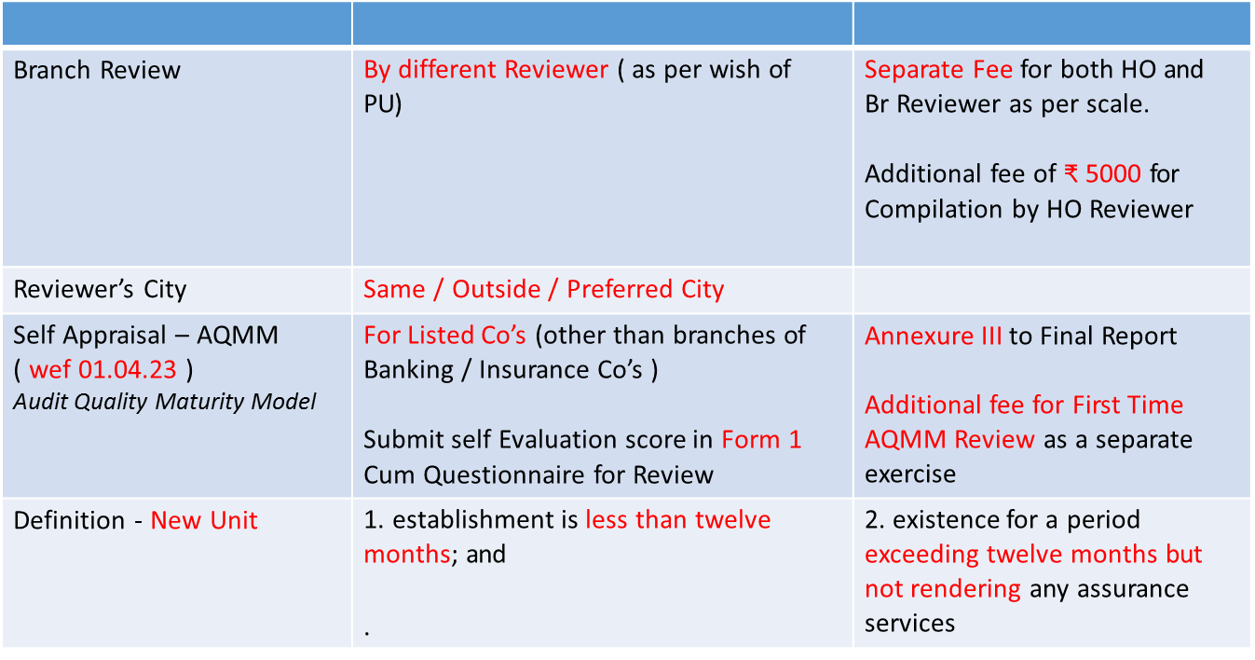
NEW CHANGES Guidelines To Replace Statement on Peer Review ( wef 01.10.2022 )

Slide 9
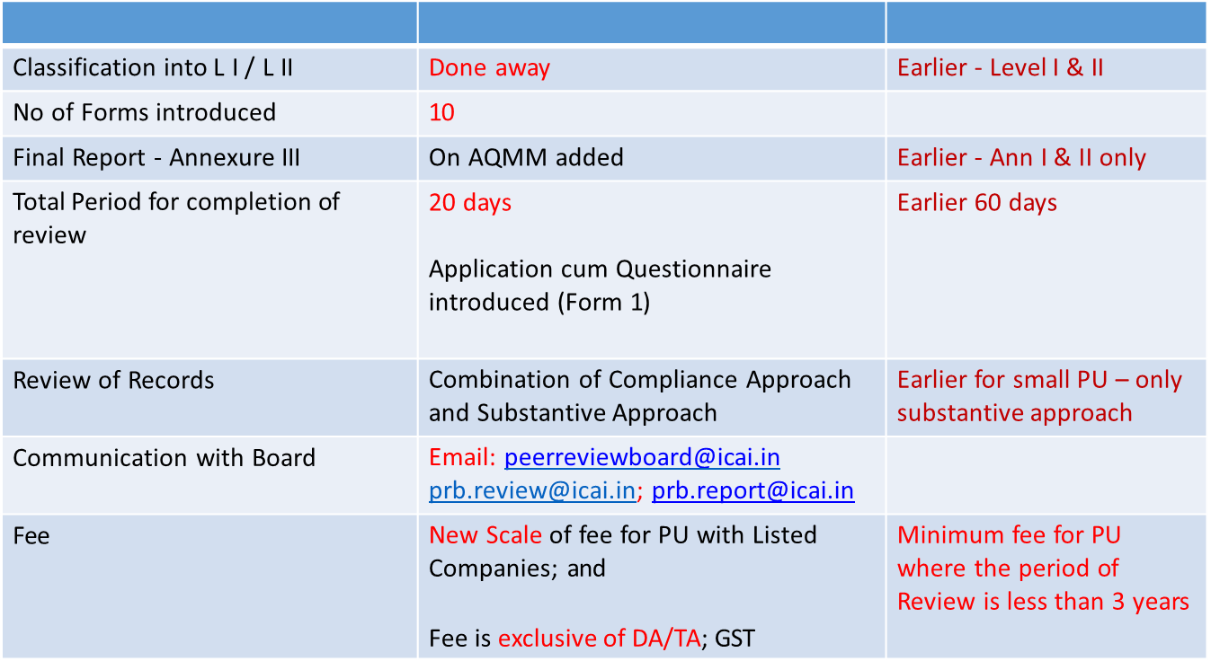
NEW CHANGES Guidelines To Replace Statement wef 01.10.2022
Validity of Certificate | 3 years for all firms; unless the Board otherwise decides for certain category of firms

Slide 10
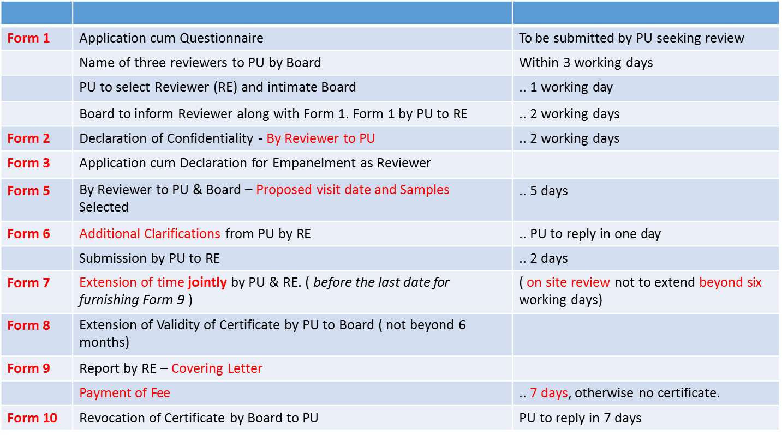
CHANGES in Guidelines To Replace Statement wef 01.10.2022

Slide 11
Peer Review Future Applicability
Phase I: Statutory Audit of Enterprises whose Equity or Debt are Listed – wef 01.04.22
Phase II: Applicable wef 01.07.2024 Statutory Audit of Unlisted Enterprises whose Paid-up Capital not less than 500 cr; or Turnover not. less than 1000 cr; or Outstanding loan/debenture/deposit not less than 500 cr as at 31st March of immediate preceding year.
Firms having 5 or more partners - For these Practice Units, there is a pre-requisite of having Peer Review Certificate before accepting any Statutory audit. Practice Units which accept Statutory audits on or before 31.03.2024 should ensure that they have a valid Peer Review Certificate at the time of signing.

Slide 12
Peer Review Future Applicability
Phase III:
Statutory Audit of Enterprises who have Raised funds of over 50 cr or which are covered under Public Interest Entity – wef 01.01.25
Firms having 4 or more partners -wef 01.01.25
Firms conducting audit of branches of Public Sector Banks – wef 01.04.25
Firms having 3 or more partners -wef 01.04.25

Slide 13
Objective of Peer Review
The purpose of the Peer Review statement is to provide a framework for, planning, performing, reporting and administration of the Peer Review process.
Peer Review process is intended to Review the quality control framework of the Practice Unit as well as proper and consistent application of such control frameworks across engagement samples selected for Review.
The statement provides the terms of reference of such Reviews and the roles and responsibilities of the parties concerned.

Slide 14
Scope of Peer Review
The Review shall cover:
Compliance with Technical, Professional and Ethical Standards:
Quality of reporting.
Systems and procedures for carrying out assurance services.
Training Programmes for staff (including articled and audit assistants) concerned with assurance functions, including availability of appropriate infrastructure.

Slide 15
Scope of Peer Review
Compliance with directions and / or guidelines issued by the Council to the Members, including Fees to be charged, Number of audits undertaken, register for Assurance Engagements conducted during the year and such other related records.
Compliance with directions and / or guidelines issued by the Council.

Slide 16
SIGNIFICANCE OF PEER REVIEW
There is a statutory requirement by SEBI whereby a listed Company’s Statutory Audit and Limited Review can be done only by Peer Reviewed Audit firm.
SEBI has also mandated that any report or prospectus issued by any Corporate has to be given only by a Peer Reviewed Audit firm.

Slide 17
SIGNIFICANCE OF PEER REVIEW
Comptroller and Auditor General of India (C&AG) – upto 25 Additional Points for Peer Reviewed Firms.
Comptroller & Auditor General (CAG) has mandated that only Peer Reviewed CA Firms will be given PSU and Government Company Audits.
Multiple Empanelment Form (MEF) cannot be completed without giving Peer Review Certificate Date. Thus Bank Audits eligibility depends on Peer Review.

Slide 18
SIGNIFICANCE OF PEER REVIEW
The issuance of an unqualified Peer Review Report will avoid Disciplinary action by ICAI.
The Peer Review could reduce the vulnerability under RTI Act and Consumer Protection Act.
This Review would definitely lead to knowledge improvement for both the Reviewed Firm as well as the Reviewer.

Slide 19
SIGNIFICANCE OF PEER REVIEW
The Peer Review would definitely lead to experience sharing between the Peer Reviewer and the Peer Reviewed. This may lead to exchange of best practices.
The Peer Review brings fellow professionals in close contact with each other. This results in networking and recognition of mutual strengths for collaboration.

Slide 20
Scope of Peer Review
System & Procedure carried out during the period under review.
Check Records for three completed financial years (records required to be maintained for 7 years by a PU)
Focus on:
Compliance with Technical Standards
Compliance with directions/guidelines of council for Members and Articles
Quality of Reporting
Office Systems and Procedures
Training Program for Staff (including Articled and Audit assistants)
Appropriate infrastructure for assurance services

Slide 21
Sample Selection Criteria
Representative of total population
Highest Turnover
At least 5 samples in total (in case less than 5 then 100% population) must be selected from the category ‘Statutory Audit’ of Listed entities, Central/ State Public Sector Undertakings and Central Cooperative Societies
At least 1 sample each from CSA audit of Banks and Insurance Company, (if any). CSA will be substituted by SBAs in case PU does not undertake CSA.
Sample must include `each type of assurance engagement’ (Statutory / Internal / Concurrent / Tax / GST etc.)
Sample from Service provided through tender

Slide 22
Sample Selection Criteria
Sample must from the assurance clients which contribute 15% or more to the total revenue of the firm
Sample must be selected from each of the locations where the PU is rendering Assurance services. However, in case branch has a listed client, then that is mandatorily required to be included in the sample
There must be at least one sample from assurance service rendered by each partner of the PU.
Sample must be picked from each year under review.
Sample must necessarily include those clients in respect of whom advisory has been issued by QRB, FRRB or any regulator ( Ref: Quest Part B II-Ethics, S.No 14).

Slide 23
Sample Selection Criteria
Other points to select sample representative:
Original equipment manufacturer (OEM)
Unique Product Line (UPL)
Highly customised product (HCP)
Highest fee.

Slide 24
Questionnaire .. PART A
Disciplinary proceedings if any
Client obtained through the process of tendering
Details of the assurance clients ( S.No 23 ) in format for Head office and branch separately for the period of review year wise – Below format for reference.
*Serial No A to K ( Total 11 categories + Tender )
**Type of engagement (1) Central Statutory Audit (CSA), (2) Statutory Audit (SA), (3) Tax Audit (TA),
(4) Internal Audit (IA), (5) GST Audit (6) Others

Slide 25
Questionnaire .. PART A
Period Covered: details of assurance clients where report / certificate has been signed during the period under review i.e. means three financial years preceding the year in which the Practice Unit is selected or such other period or any period as may be prescribed by Board for conducting a Peer Review in a specific case.
Part A – Firm information, 22 points, with Annexure A for List of attestation Services

Slide 26
Questionnaire .. PART A
Part B – on General Controls based on SQC with VI sub parts:
Leadership Responsibilities For Quality Within The Firm ( 10 points )
Ethical Requirements ( 15 points )
Acceptance and Continuance of Client Relationships and Specific Engagements (7 points)
Human Resources ( 10 points )
Engagement Performance (20 points )
Monitoring ( 6 points )
Part C on AQMM with 3 Sections:
Practice Management
Human Resource Management
Practice Management – Strategic/Functional

Slide 27
Audit Quality Maturity Model - Version 1.0 (AQMM v1.0)
Evaluation Matrix
To enable audit firms to self-evaluate their current level of:
Audit Maturity
Identify areas where competencies are good or lacking
Develop a road map for upgrading to a higher level of maturity
AQMM v1.0 would be recommendatory with exceptions.
Level 1 depicts that the firm is very nascent, Level 4 indicates that the firm has made significant adoption of standards and procedures.

Slide 28
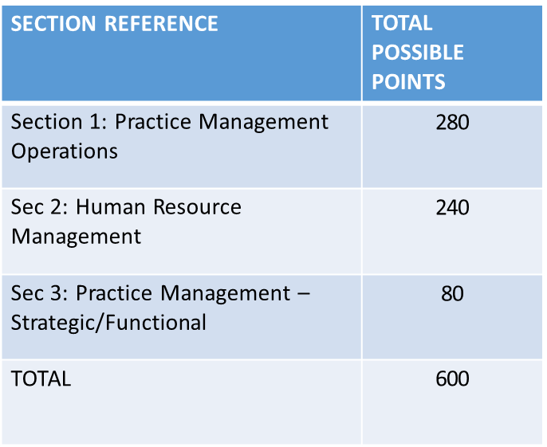
AUDIT QUALITY MATURITY MODEL (AQMM) – Self Evaluation of Firm
Upto 25% in each Section | Level 1 Firm | Very Nasty – Immediate Steps Required
Upto 25% to 50% in each Section | Level 2 Firm | Firm made some Progress
Upto 50% to 75% in each Section | Level 3 Firm | Firm made substantial progress
Upto 75% to 100 % in each Section | Level 4 Firm | Significant adoption of Standards and Procedures

Slide 29
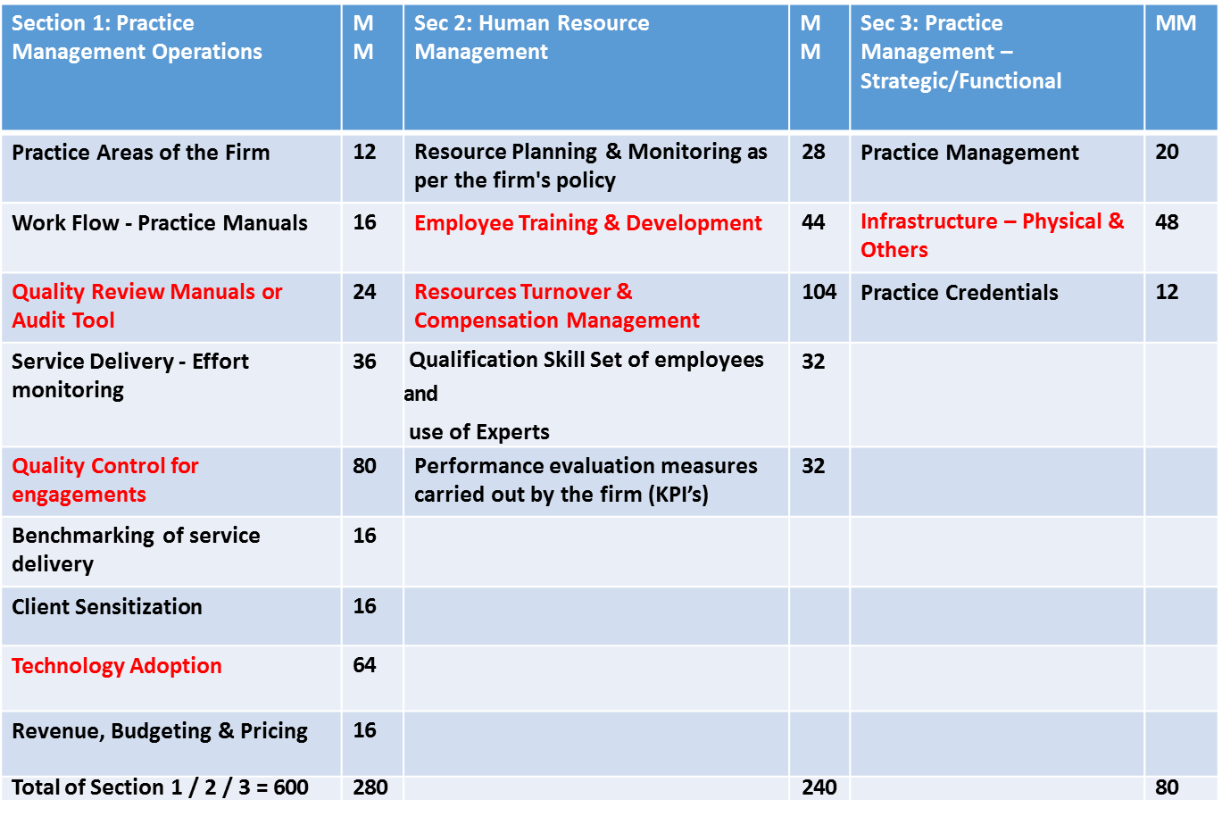
AUDIT QUALITY MATURITY MODEL (AQMM) – Self Evaluation of Firm

Slide 30
Limitations of Peer Review
Review would not necessarily disclose all weaknesses in compliance of technical standards.
Any system of quality control has certain inherent limitations – Departure from system may occur & may not be detected ( Collusion, Human Error, Sample Size, Management Override etc.. )
Projection of any evaluation of system of quality control to future periods is subject to risk.

Slide 31
RATIONALE AND SIGNIFICANCE OF PEER REVIEW
Thank You.
Email Id : akpradhan@cvk-ca.com
Phones : 022-24468717; 2446 6139; 2445 1488.
Presented By
Ashok Kumar Pradhan

