Slide 1
Accounting Standards for Non-Corporate Entities
PRESENTED BY : JITEN MAHENDRABHAI TRIVEDI
FCA (Gold medalist) ,
CS (AIR) ,
LLB ( Uni. Topper ) ,
M.Com (Gold Medalist)
Date of Presentation : 01.06.2024

Slide 2
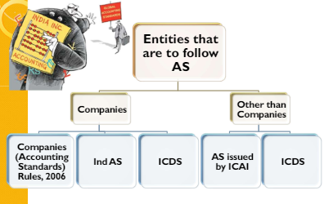
Introduction
Non-Corporate Entities :
Entities not incorporated under Companies Act or under any other regulations.
Examples : Partnership, LLP, Trust, NPO, etc.
Applicability of Accounting Standards
Applicability depending on the size of the business.
Level –I, II, III and IV entities – as classified by ICAI
Level I – All AS is applicable.
Level II, III, and IV – AS is applicable with certain exemptions on measurement and disclosure.

Slide 3
ICAI Announcement dated 31.03.21
Background
ICAI Council at its 400th meeting held on March 18-19, 2021 considered scheme for applicability of Accounting Standards to NCEs (Enterprises)
Effective in respect of accounting periods commencing on or after April 1, 2020
This announcement supersedes earlier announcements of ICAI on:
“Harmonization of various differences between the Accounting Standards issued by ICAI and Accounting Standards notified by the Central Government” issued in Feb, 2008 to the extent applicable to NCEs
“Revision in the criteria for classifying Level II non-corporate entities” issued in Jan 2013.
NCEs have been classified into four categories – Level I–Large, Level II-Medium, Level III–Small and Level IV- Micro
Level I entities have to comply with all accounting standards as applicable to Companies
Certain exemptions/ relaxations provided to Level II, Level III and Level IV entities
This announcement is not relevant for NCEs who may be required to follow Ind-AS as per relevant regulatory requirements applicable to such entities

Slide 4
Level I Entities Non-company entities which fall in any one or more of the following categories, at the end of the relevant accounting period, are classified as Level I entities: (i) Entities whose securities are listed or are in the process of listing on any stock exchange, whether in India or outside India. (ii) Banks (including co-operative banks), financial institutions or entities carrying on insurance business. (iii) All entities engaged in commercial, industrial or business activities, whose turnover (excluding other income) exceeds rupees two-fifty crore in the immediately preceding accounting year. (iv) All entities engaged in commercial, industrial or business activities having borrowings (including public deposits) in excess of rupees fifty crore at any time during the immediately preceding accounting year. (v) Holding and subsidiary entities of any one of the above.
Level II Entities
Non-company entities which are not Level I entities but fall in any one or more of the following categories are classified as Level II entities:
All entities engaged in commercial, industrial or business activities, whose turnover (excluding other income) exceeds rupees fifty crore but does not exceed rupees two-fifty crore in the immediately preceding accounting year.
(ii) All entities engaged in commercial, industrial or business activities having borrowings (including public deposits) in excess of rupees ten crore but not in excess of rupees fifty crore at any time during the immediately preceding accounting year.
Holding and subsidiary entities of any one of the above.
Level III Entities
Non-company entities which are not covered under Level I and Level II but fall in any one or more of the following categories are classified as Level III entities:
(i) All entities engaged in commercial, industrial or business activities, whose turnover (excluding other income) exceeds rupees ten crore but does not exceed rupees fifty crore in the immediately preceding accounting year.
(ii) All entities engaged in commercial, industrial or business activities having borrowings (including public deposits) in excess of rupees two crore but does not exceed rupees ten crore at any time during the immediately preceding accounting year.
(iii) Holding and subsidiary entities of any one of the above.
Level IV Entities
Non-company entities which are not covered under Level I, Level II and Level III are considered as Level IV entities.

Slide 5
Criteria for Classification of NCEs – Old vs New (Amount in INR)
Level | PY Turnover (Excluding Other Income) (In the immediately preceding year) |  |  | Borrowing (Including Public Deposits) (At any time during PY)
 | Existing | Revised |  | Existing | Revised
I (Large) | >50 Crores | >250 Crores |  | >10 Crores | >50 Crores
II (Medium) | >10 to 50 Crores | >50 to 250 Crores |  | >1 to 10 Crores | >10 to 50 Crores
III (Small) | Up to 10 Crore | >10 to 50 Crores |  | Up to 1 Crore | >2 to 10 Crores
IV (Micro) | - | Up to 10 Crores |  | - | Up to 2 Crores

Slide 6
Applicability Matrix – Standard-wise
AS | AS Description | Level I | Level II | Level III | Level IV
AS 1 | Disclosure of Accounting Policies | □ | □ | □ | □
AS 2 | Valuation of Inventories | □ | □ | □ | □
AS 3 | Cash Flow Statements | □ | □ | □ | □
AS 4 | Contingencies and Events Occurring After the Balance Sheet Date | □ | □ | □ | □
AS 5 | Net Profit or Loss for the Period, Prior Period Items and Changes in Accounting Policies | □ | □ | □ | □
AS 7 | Construction Contracts | □ | □ | □ | □
AS 9 | Revenue Recognition | □ | □ | □ | □
AS 10 | Property, Plant & Equipment | □ | □ | Disclosures Exemptions | Disclosures Exemptions
AS 11 | The Effects of Changes in Foreign Exchange Rates | □ | □ | Disclosures Exemptions | Disclosures Exemptions

Slide 7
Applicability Matrix – Standard-wise
AS | AS Description | Level I | Level II | Level III | Level IV
AS 12 | Accounting for Government Grants | □ |  |  | 
AS 13 | Accounting for Investments |  |  |  | Disclosures Exemptions
AS 14 | Accounting for Amalgamations |  |  |  | ❒
AS 15 | Employee Benefits |  | Certain Exemptions | Certain Exemptions | Certain Exemptions
AS 16 | Borrowing Costs |  |  |  | 
AS 17 | Segment Reporting |  | ❒ | ❒ | ❒
AS 18 | Related Party Disclosures |  |  | ❒ | ❒
AS 19 | Leases |  | Disclosures Exemptions | Disclosures Exemptions | Disclosures Exemptions
AS 20 | Earnings Per Share |  | ❒ | ❒ | ❒

Slide 8
Applicability Matrix – Standard-wise
AS | AS Description | Level I | Level II | Level III | Level IV
AS 21 | Consolidated Financial Statements |  | ❒ | ❒ | ❒
AS 22 | Accounting for Taxes on Income |  |  |  | Current Tax Provisions
AS 23 | Accounting for Investments in Associates in Consolidated Financial Statements |  | ❒ | ❒ | ❒
AS 24 | Discontinuing Operations |  |  | ❒ | ❒
AS 25 | Interim Financial Reporting |  | ❒ | ❒ | ❒
AS 26 | Intangible Assets |  |  |  | Disclosures Exemptions
AS 27 | Financial Reporting of Interests in Joint Ventures |  | ❒ | ❒ | ❒
AS 28 | Impairment of Assets |  | Disclosures Exemptions | Disclosures Exemptions | Disclosures Exemptions
AS 29 | Provisions, Contingent Liabilities and Contingent Assets |  | Disclosures Exemptions | Disclosures Exemptions | Disclosures Exemptions

Slide 9
Applicability Matrix – In Numbers
Applicability | Level I | Level II | Level III | Level IV
Fully applicable | 27 | 16 | 12 | 8
Partially applicable – AS 22 | - | - | - | 1
Not applicable | - | 7 | 9 | 11
Applicable with exemptions in AS 15 | - | 1 | 1 | 1
Applicable with disclosure exemption | - | 3 | 5 | 6
Total | 27 | 27 | 27 | 27
* AS 6 - Depreciation Accounting and AS 8 – Accounting for Research & Development stands withdrawn

Slide 10
List of Accounting Standards applicable to All 4 categories of Non-company entities:
Sr. No. | Accounting Standard
1. | AS 1 Disclosures of Accounting Policies
2. | AS 2 Valuation of Inventories
3. | AS 4 Contingencies and Events Occurring After the Balance Sheet Date
4. | AS 5 Net Profit or Loss for the Period, Prior Period Items and Changes in Accounting Policies
5. | AS 7 Construction Contracts
6. | AS 9 Revenue Recognition
7. | AS 12 Accounting for Government Grants
8. | AS 16 Borrowing Cost

Slide 11
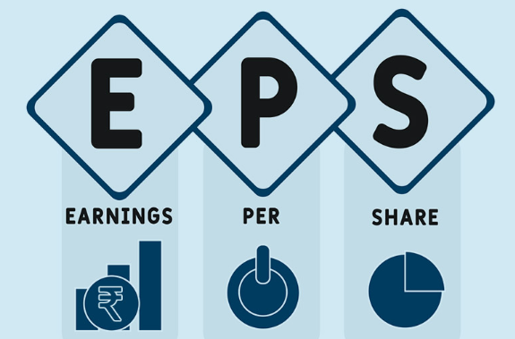
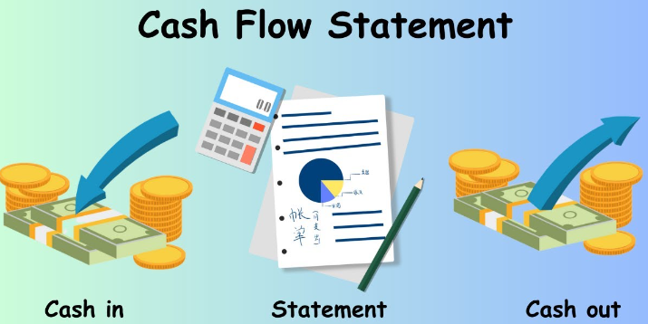
List of Accounting Standards entirely not applicable to Level II, III and IV categories of NCEs
Accounting Standard
1. AS 3 Cash Flow Statement
2. AS 17 Segment Reporting
3. AS 20 Earnings Per Share
4. AS 21 Consolidated Financial Statements
5. AS 23 Accounting for Investments in Associates in
Consolidated Financial Statements
6. AS 25 Interim Financial Reporting
7. AS 27 Financial Reporting of Interests in Joint Venture

Slide 12
Exemptions available for different AS
Exemption | AS | AS Description | Level I | Level II | Level III | Level IV
Disclosure | 10 | Property, Plant and Equipment | - | - | Yes | Yes
Disclosure | 11 | The Effects of changes in Foreign Exchange Rate | - | - | Yes | Yes
Disclosure | 13 | Accounting for Investment | - | - | - | Yes
Recognition, Measurement, Presentation and Disclosure | 15 | Employee Benefits | - | Yes | Yes | -
Disclosure | 19 | Leases | - | Yes | Yes | -
Disclosure | 22 | Accounting for Taxes on Income | - | - | - | Yes
Disclosure | 26 | Intangible Assets | - | - | - | Yes
Measurement | 28 | Impairment of Assets | - | Yes | Yes | -
Disclosure | 28 | Impairment of Assets | - | - | Yes | -

Slide 13
Additional Requirements
MSMEs to disclose the Level to which it belongs with a note that it has complied with the prescribed standards
Level upgrade – To forego exemptions/ relaxations no more applicable from CY, need not revise PY comparative
Level downgrade – Cannot claim new exemptions/ relaxations for 2 consecutive years
Foregoing exemptions/ relaxations – The fact to be disclosed by way of a note, comply with relevant standards
Partially foregoing exemptions/ relaxations – Should not be misleading
In case Level IV entity enters into any transaction in relation to amalgamation, jointly controlled operations and assets, interests in joint ventures, such entity shall have to apply the requirements of relevant standards
In case NCEs, though not required, but elects to prepare and present Consolidated Financial Statements for Subsidiaries, Associates or Joint Ventures and Interim Financial Statements, such entity shall have to apply the requirements of relevant standards.

Slide 14
Thank You!
CA JITEN M. TRIVEDI
(PARTNER AT JKSS & ASSOCIATES)
9924248092
jiten.trivedi@jksco.in
OFFICES @ Ahmedabad,
Bengaluru, Bhopal, Bhubhaneshwar,
Chennai, Chandigarh, Delhi, Faridabad,
Guwahati, Hyderabad, Jaipur, Kolkata,
Kanpur & Mumbai

