Slide 1
Attention CAs: New Financial Statement Formats Applicable for Non Corporate Entity Effective Today
Date: April 1, 2025
(Not an April Fool’s joke, this is serious!)

Slide 2
Goodbye Old-School, Hello Standardization!
Rajkot Branch of Western India Regional Council of
The Institute of Chartered Accountants of India
DATE OF PRESENTATION: 16/04/2025
Time : 05:00 PM to 07:00 PM

Slide 3
QUALITIES OF A FINANCIAL STATEMENT
The qualities (or characteristics) of a good financial statement are essential for ensuring that the information it provides is useful to users like investors, creditors, management, and regulators.
U – Understandability :
Information should be clearly presented.
Users with reasonable financial knowledge should be able to
comprehend it.
No unnecessary complexity.
R – Relevance :
Information must be useful in decision-making.
It should have predictive value (future insights) or confirmatory
value (past performance).

Slide 4
R – Reliability
Information must be accurate, complete, and unbiased.
It should faithfully represent what it claims to show.
Free from material errors or misstatements.
C – Comparability
Enables users to compare:
- Financial statements across different periods.
- Between different companies.
Consistent accounting methods should be used.
It helps investors, creditors, and other stakeholders to
make informed decisions.

Slide 5
Background
A financial reporting system supported by strong governance, high quality standards, and firm regulatory framework is the key to economic development. The sound financial reporting emphasises the trust that investors and other stakeholders like lenders, grantors, etc. place in financial reporting information. Thus, it is very essential that financial reporting of an entity should be comparable, transparent, complete and unbiased.
Accounting Standards contain wholesome principles of accounting and can be viewed as standardised language of business to communicate high quality information in financial statements based on principles of transparency, consistency and also comparability and reliability. Accounting standards are a set of principles which entities follow while preparing the financial statements providing a standardized way of describing the entity’s financial position and financial performance.

Slide 6
Users or primary users of financial information
In case of corporate entities, the users or primary users of financial information are
shareholders,
regulators,
potential investors,
lenders,
creditors and
other stakeholders.
These users need financial information of the reporting entities to make various economic decisions. Formats for financial statements of companies are specifically provided under Schedule III of the Companies Act, 2013.

Slide 7
Criteria for classification of Non-Company entities for applicability of Accounting Standards
Level – 1
Level – 2
Level – 3
Level – 4
MSME
Large

Slide 8
MSME means Non-company entities which fulfills the following conditions, at the end of the relevant accounting period
(i) Entities whose securities are not listed or are not in the process of listing on any stock exchange, whether in India or outside India.
(ii) Entity which is not a Bank, financial institution or and insurance company.
(iii) Whose turnover (excluding other income) does not exceed rupees two-fifty crore in the immediately preceding accounting year.
(iv) Which does not have borrowings in excess of rupees fifty crore at any time during the immediately preceding accounting year.
(v) Which is not a Holding or subsidiary of an entity which is not a MSME.

Slide 9
AS Applicability Summary
 | Large | MSME
Listed | Yes | -
Banks, FI, Insurance | Yes | -
Turnover | > 250 Cr. | Upto 250 Cr.
Borrowings | > 50 Cr. | upto 50 Cr.
Holding or Subsidiary of any one of above | Yes | -

Slide 10
Applicability of Accounting Standards to NCEs
AS | Particulars | Large | MSME
1 | Disclosure of Accounting Policies | Yes | Yes
2 | Valuation of Inventories | Yes | Yes
3 | Cash Flow Statements | Yes | NA
4 | Contingencies and Events Occurring After the Balance Sheet Date | Yes | Yes
5 | Net Profit or Loss for the Period, Prior Period Items and Changes in Accounting Policies | Yes | Yes
7 | Construction Contracts | Yes | Yes
9 | Revenue Recognition | Yes | Yes

Slide 11
AS | Particulars | Large | MSME
10 | Property, Plant and Equipment | Yes | Yes (R)
11. | The Effects of Changes in Foreign Exchange Rate | Yes | Yes (R)
12 | Accounting for Government Grants | Yes | Yes
13 | Accounting for Investments | Yes | Yes
14 | Accounting for Amalgamations | Yes | Yes
15 | Employee Benefits | Yes | Yes (RE)
16 | Borrowing Costs | Yes | Yes
17 | Segment Reporting | Yes | NA
18 | Related Party Disclosures | Yes | Yes (CE)
19 | Leases | Yes | Yes (R)
20 | Earnings Per Share | Yes | NA

Slide 12
AS | Particulars | Large | MSME
21 | Consolidated Financial Stat. | Yes | NA *
22 | Accounting for Taxes on Income | Yes | Yes (RE)
23 | Accounting for Investments in Associates in Consolidated FS | Yes | NA *
24 | Discontinuing Operations | Yes | NA
25 | Interim Financial Reporting | Yes | NA *
26 | Intangible Assets | Yes | Yes (R)
27 | Financial Reporting of Interests in Joint Ventures | Yes | NA *
28 | Impairment of Assets | Yes | Yes (C)
29 | Provisions, Contingent Liabilities and Contingent Assets | Yes | Yes (RE)

Slide 13
Compliance with Accounting Standards
The Accounting Standards will be mandatory from the respective date(s) mentioned in the Accounting Standard(s). The mandatory status of an Accounting Standard implies that while discharging their attest functions, it will be the duty of the members of the Institute to examine whether the Accounting Standard is complied with in the presentation of financial statements covered by their audit.
In the event of any deviation from the Accounting Standard, it will be their duty to make adequate disclosures in their audit reports so that the users of financial statements may be aware of such deviation.
Ensuring compliance with the Accounting Standards while preparing the financial statements is the responsibility of the management of the enterprise.
In view of the above, the auditors are required to examine compliance with AS while discharging their attest function.

Slide 14
Audit of Financial Statements
For non-corporate entities, if audit of financial statements is required under a statute, the Auditor shall conduct the audit and issue the Auditors’ Report in accordance with the Standards on Auditing issued by the ICAI. For the purpose of tax audit, the auditor should issue a report taking into consideration the "Guidance Note on Tax Audit under Section 44AB of the Income-tax Act, 1961” issued by the ICAI.
In case of tax audit under section 44AB of the Income-tax Act, 1961, it is pertinent to note that the auditor is required to conduct audit of financial statements to give a true and fair view thereon and report the same in Form 3CB. Along with the Report in Form 3CB, they have to state true and correct view of particulars annexed in Form 3CD.

Slide 15
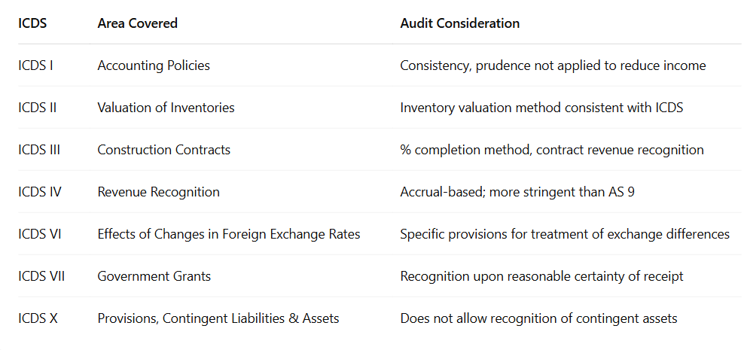
Key ICDS Provisions That May Require Auditor Attention

Slide 16
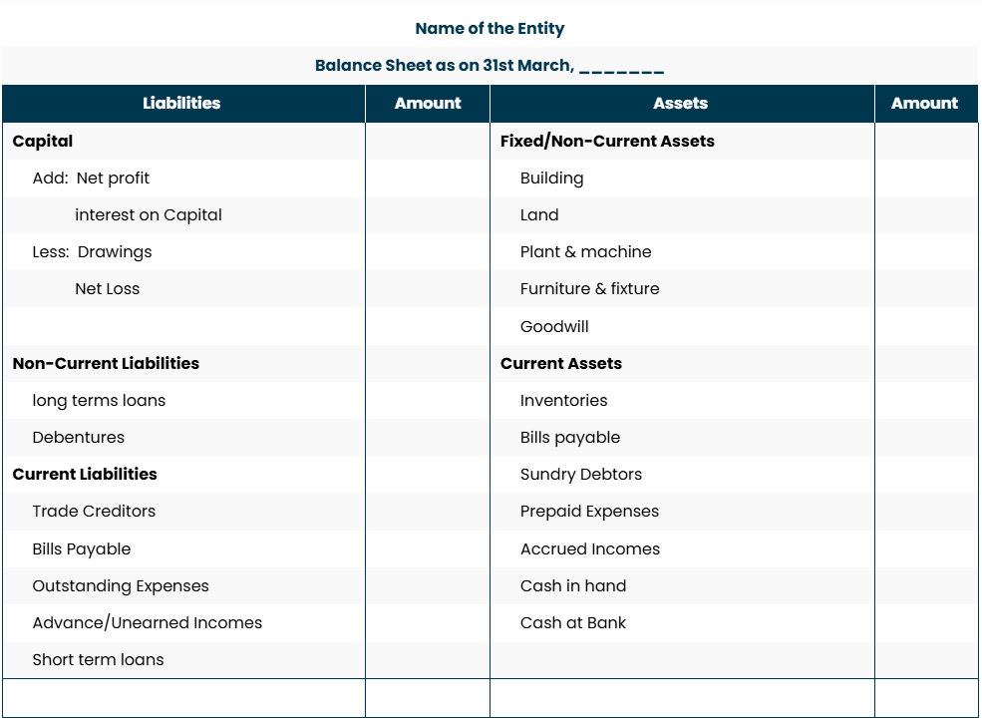
Old Format

Slide 17
Old Formats No Longer Acceptable
The traditional T-format Balance Sheet & P&L are no longer allowed.
ICAI mandates a standardized structure for all non-corporate entities.
Why?
Consistency – Ensures comparability across financial statements.
Transparency – Enhances clarity for banks, tax authorities, and investors.
Missing Comparative Figures – A Major Compliance Breach!
ICAI now mandates the inclusion of comparative figures for the previous year.
What happens if you skip it?
❌ Statements will be deemed incomplete.
❌ May fail audits and face rejection from authorities.
"Using T-format in 2025 is like using an abacus for accounting—completely outdated!"
One Year Alone Tells Half the Story!

Slide 18
ICAI is Not Suggesting, It’s Mandating!
This is NOT a choice. You must comply.
ICAI has issued a guidance note, which means:
Mandatory compliance
Not following = Professional misconduct
Expect ICAI monitoring and enforcement via peer reviews, tax audits, and compliance checks

Slide 19
The New Financial Statement Structure – An Overview
The new ICAI guidance mandates a uniform structure for all non-corporate entities.
Key components:
✅ Balance Sheet – Standardized format, proper classification
✅ Statement of Profit & Loss – Comparative figures required
✅ Cash Flow Statement (if applicable) – Direct/Indirect
Method
✅ Notes to Accounts – Comprehensive disclosures
✅ Significant Accounting Policies – Entity-specific

Slide 20
Who is Affected?
The new format applies to ALL non-corporate entities, including:
01 | Sole proprietorships
02 | Hindu Undivided Family
03 | Partnerships
04 | LLPs
05 | Trusts & Societies
“ In accounting, there are two rules: 1. Follow ICAI. 2. If in doubt,
refer to Rule 1."

Slide 21
The New Uniform Format – What’s Changing?
ICAI has standardized financial statement
formats for all non-corporate entities.
T-format (horizontal format) is no longer allowed—only the vertical presentation is acceptable.
Must follow a structured format similar to corporate financial statements.
Single-year reporting is not permitted anymore.
Accounting policies must be explicitly disclosed and aligned with the latest guidance.

Slide 22
Comparative Figures – Now Mandatory!
A Financial Statement w/o comparatives is like a movie w/o a sequel – there is no story
You must present previous year’s figures alongside the current year.
You must present previous year’s figures alongside the current year.
No more single-year reporting – comparatives are a must-have now.
This improves financial trend analysis and decision-making.

Slide 23
Before vs. After: The New vs. Old Format
Feature | Old Format | New Format
Balance Sheet | T-format | Standardized Format
P&L | Single-year reporting | Comparative figures required
Notes | Limited disclosures | Detailed breakdown required
Assets/Liabilities | No strict classification | Must be current/non-current
Related Parties | Minimal disclosure | Mandatory AS 18 compliance

Slide 24
Consequences of Non-Compliance
If you don’t follow the new format, you
risk:
Financial statements rejected by banks, tax authorities, and lenders.
- ICAI disciplinary action for professional misconduct.
- Clients losing trust in your expertise.
- Your credibility taking a hit in the CA community.

Slide 25
ICAI considers its announcements and guidance notes as “technical standards”, especially when a CA signs financial statements.
Possible Disciplinary Actions by ICAI
If a CA is found guilty, the Board of Discipline or Disciplinary Committee of ICAI may take action, including:
Reprimand
Monetary Penalty (up to ₹1,00,000 or more)
Temporary removal of name from Register of Members
Permanent removal (in serious cases)

Slide 26
GENERAL INSTRUCTIONS FOR PREPARATION OF BALANCE SHEET AND STATEMENT OF PROFIT AND LOSS OF A NON-CORPORATE ENTITY
1.(a)
These formats shall apply for preparation of Balance Sheet and Statement of Profit and Loss of a non-corporate entity.
Where compliance with the requirements of the relevant statute including Accounting Standards as applicable to the Non-Corporate entity require any change in treatment of disclosure including addition, amendment, substitution or deletion in the head or sub-head or any changes, inter se, in the financial statements or statements forming part thereof, the same shall be made and the formats shall be modified accordingly.

Slide 27
In Continuation to previous slide
(b)
However, certain non-corporate entities may need to amend the descriptions used for particular line items in the formats of financial statements and for the financial statements themselves,
e.g., Association of Persons may need to use terminology
“members’ funds” instead of “owners’ funds”.
2. The disclosure requirements specified in the formats are in
addition to and not in substitution of the disclosure
requirements specified in the Accounting Standards issued
by the Institute of Chartered Accountants of India.
Additional disclosures specified in the Accounting Standards and all other disclosures required by the relevant statute shall be made in the notes to accounts.

Slide 28
In Continuation to previous slide
3. (i) Notes to accounts shall contain information in addition to
that presented in the Financial Statements and shall
provide where required
(a) narrative descriptions or disaggregations of items
recognised in those statements; and
(b) information about items that do not qualify for recognition in
those statements.
(ii) Each item on the face of the Balance Sheet and
Statement of Profit and Loss shall be cross-referenced to
any related information in the notes to accounts.

Slide 29
In Continuation to previous slide
4. (i) Depending upon the Total Income of the Non-
Corporate entity, the figures appearing in the
Financial Statements may be rounded off as given
below:—
(ii) Once a unit of measurement is used, it should be used
uniformly in the Financial Statements.
Total Income | Rounding off
(a) less than one hundred crore rupees | To the nearest hundreds, thousands, lakhs or millions, or decimals thereof.
(b) one hundred crore rupees or more | To the nearest lakhs, millions or crores, or decimals thereof.

Slide 30
In Continuation to previous slide
5. Except in the case of the first Financial Statements
prepared by the Non-Corporate entity (after its
incorporation) the corresponding amounts
(comparatives) for the immediately preceding reporting
period for all items shown in the Financial Statements
including notes shall also be given.
6. For the purpose of this format, the terms used herein
shall be as per the applicable Accounting Standards.

Slide 31
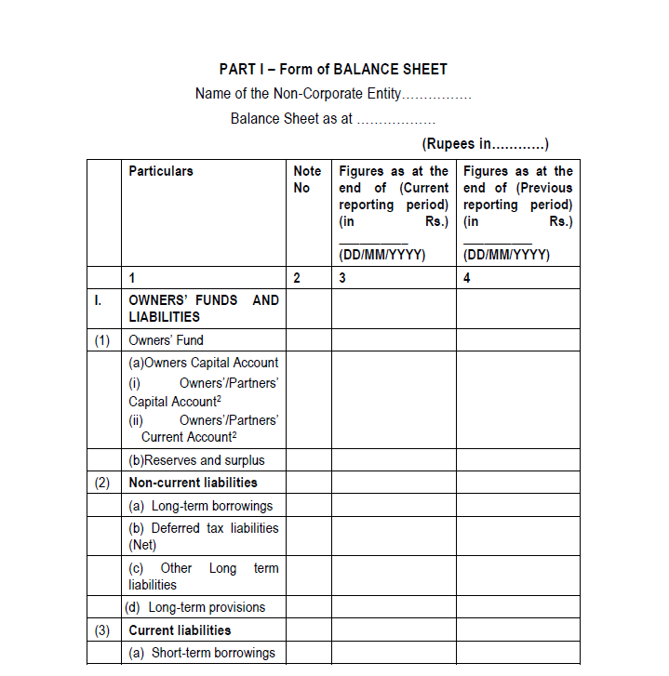
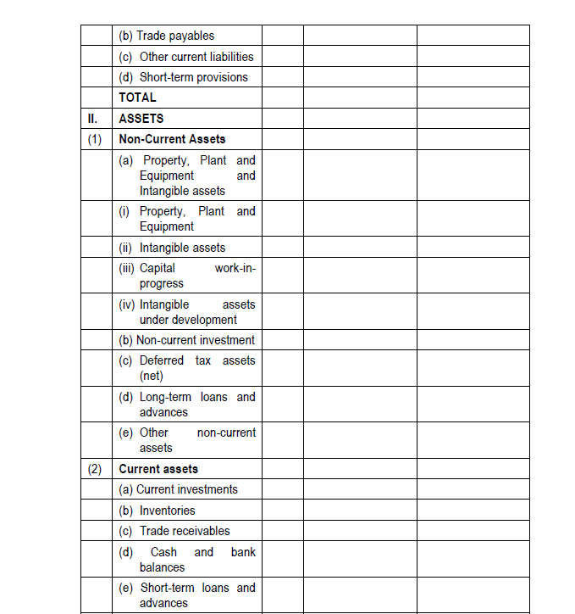
New Format

Slide 32
Classification of Assets & Liabilities
How? It is expected to be realized in, or is intended for sale or consumption in, the company’s normal operating cycle; An operating cycle is the time between the acquisition of assets for processing and their realization in cash or cash equivalents. Where the normal operating cycle cannot be identified, it is assumed to have a duration of 12 months. Current = < 12 months* Non-current > 12 months*
All assets and liabilities must be categorized as current or non-current.
Better liquidity Analysis
Why?
Improved transparency for stakeholders
"Not classifying assets properly? That’s like mixing up debit and credit!"

Slide 33
(A) Owners’ Funds For each owner capital/current account, following items for the year to be disclosed separately: (a) opening balance; (b) capital Introduced/Contributed during the year; (c) remuneration for the year; (d) interest for the year; (e) withdrawals during the year; (f) share of profit or loss for the year (share in % and amount); (g) closing balance.
Detailed Presentation of each item of Balance Sheet

Slide 34
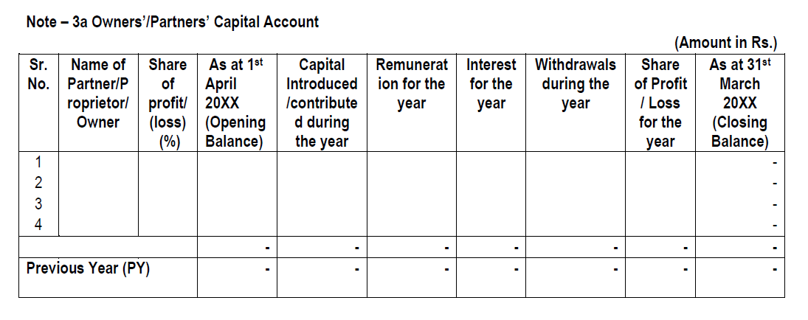
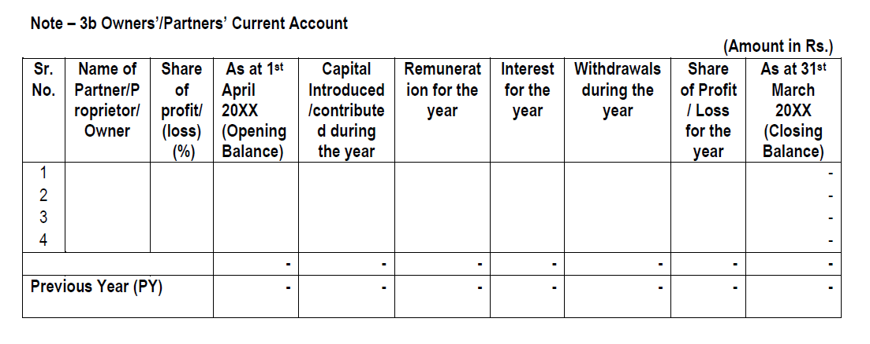
Owner’s fund Schedule

Slide 35
(B) Reserves and Surplus (i) Reserves and Surplus shall be classified as: (a) Capital Reserves; (b) Revaluation Reserve; (c) Other Reserves – (specify the nature and purpose of each reserve and the amount in respect thereof); (d) Undistributed Surplus i.e. balance in Statement of Profit and Loss. (ii) Debit balance of statement of profit and loss shall be shown as a negative figure under the head ‘Undistributed Surplus’. Similarly, the balance of ‘Reserves and Surplus’, after adjusting negative balance of surplus, if any, shall be shown under the head ‘Reserves and Surplus’ even if the resulting figure is in the negative.

Slide 36
(C) Long-Term Borrowings (i) Long-term borrowings shall be classified as: (a) Term loans From banks From other parties (b) Deferred payment liabilities. (c) Loans and advances from related parties. (d) Long term maturities of finance lease obligations (e) Other loans and advances (specify nature). (ii) Borrowings shall further be sub-classified as secured and unsecured. Nature of security shall be specified separately in each case. (iii) Where loans have been guaranteed by partners/proprietor/owners or others, the aggregate amount of such loans under each head shall be disclosed. (iv) Terms of repayment of term loans and other loans shall be stated.

Slide 37
(D) Long-Term Provisions The amounts shall be classified as: (a) Provision for employee benefits. (b) Others (specify nature). (E) Short-term borrowings (i) Short-term borrowings shall be classified as: (a) Loans repayable on demand - From banks - From other parties (b) Loans and advances from related parties. (c) Other loans and advances (specify nature). (ii) Borrowings shall further be sub-classified as secured and unsecured. Nature of security shall be specified separately in each case. (iii) Where loans have been guaranteed by partners/proprietor/ owners or others, the aggregate amount of such loans under each head shall be disclosed. (iv) current maturities of Long term borrowings shall be disclosed separately

Slide 38
(F) Trade Payables
The following details relating to Micro, Small and Medium Enterprises shall be disclosed in the
notes:-
(a) the principal amount and the any supplier at the end of
each accounting year;
(b) the amount of interest paid by the buyer in terms of section
16 of the Micro, Small and Medium Enterprises
Development Act, 2006, along with the amount of the
payment made to the supplier beyond the appointed day
during each accounting year;
(c) the amount of interest due and payable for the period of
delay in making payment (which have been paid but
beyond the appointed day during the year) but without
adding the interest specified under the Micro, Small and
Medium Enterprises Development Act, 2006;
(d) the amount of interest accrued and remaining unpaid at
the end of each accounting year; and
(e) the amount of further interest remaining due and payable
even in the succeeding years, until such date when the
interest dues above are actually paid to the small
enterprise, for the purpose of disallowance of a deductible
expenditure under section 23 of the Micro, Small and
Medium Enterprises Development Act, 2006.
(G) Other current liabilities
The amounts shall be classified as:
(a) Current maturities of finance lease obligations;
(b) Interest accrued but not due on borrowings;
(c) Interest accrued and due on borrowings;
(d) Income received in advance;
(e) Other payables (specify nature);
(H) Short-term provisions
The amounts shall be classified as:
(a) Provision for employee benefits.
(b) Others (specify nature).

Slide 39
Property, Plant and Equipment
(i) Classification shall be given as:
(a) Land.
(b) Buildings.
(c) Plant and Equipment.
(d) Furniture and Fixtures.
(e) Vehicles.
(f) Office equipment.
(g) Others (specify nature).
(ii) Assets under lease shall be separately specified under each class of Asset.
(iii) A reconciliation of the gross and net carrying amounts of each class of assets at the beginning
and end of the reporting period showing additions, disposals acquisitions through
business combinations, amount of change due to revaluation (if change is 10% or more
in the aggregate of the net carrying value of each class of Property, Plant and Equipment)
and other adjustments and the related depreciation and impairment losses/reversals shall
be disclosed separately.

Slide 40
Intangible assets
(i) Classification shall be given as:
(a) Goodwill.
(b) Brands /trademarks.
(c) Computer software.
(d) Mastheads and publishing titles.
(e) Mining rights.
(f) Copyrights, and patents and other intellectual property rights, services and operating rights.
(g) Recipes, formulae, models, designs and prototypes.
(h) Licenses and franchise.
(i) Others (specify nature).
(ii) A reconciliation of the gross and net carrying amounts of each class of assets at the beginning
and end of the reporting period showing additions, disposals, acquisitions through business
combinations, amount of change due to revaluation (if change is 10% or more in the aggregate
of the net carrying value of each class of intangible assets) and other adjustments and the
related amortisation and impairment losses or reversals shall be disclosed separately.

Slide 41
Non-current investments
(i) Non-current investments shall be classified as trade investments and other investments and
further classified as:
(a) Investment property;
(b) Investments in Equity Instruments;
(c) Investments in preference shares;
(d) Investments in Government or trust securities;
(e) Investments in debentures or bonds;
(f) Investments in Mutual Funds;
(g) Investments in partnership firms;
(h) Other non-current investments (specify nature)
(ii) Investments carried at other than at cost should be separately stated
specifying the basis for valuation thereof.
(iii) The following shall also be disclosed:
(a) Aggregate amount of quoted investments and market value thereof;
(b) Aggregate amount of unquoted investments;
(c) Aggregate provision for diminution in value of investments

Slide 42
Long-term loans and advances
(i) Long-term loans and advances shall be classified as:
(a) Capital Advances;
(b) Loans and advances to related parties (giving details thereof);
(c) Other loans and advances (specify nature).
(ii) The above shall also be separately sub-classified as:
(a) Secured, considered good;
(b) Unsecured, considered good;
(c) Doubtful.
(iii) Allowance for bad and doubtful loans and advances shall be disclosed separately.
Other non-current assets
Other non-current assets shall be classified as:
(i) Security Deposits;
(ii) Bank deposits with more than 12 months maturity;
(ii) Others (specify nature).

Slide 43
Current Investments
(i) Current investments shall be classified as:
(a) Investments in Equity Instruments;
(b) Investment in Preference Shares;
(c) Investments in government or trust securities;
(d) Investments in debentures or bonds;
(e) Investments in Mutual Funds;
(f) Investments in partnership firms;
(g) Other investments (specify nature).
(ii) The following shall also be disclosed:
(a) The basis of valuation of individual investments;
(b) Aggregate amount of quoted investments and market value thereof;
(c) Aggregate amount of unquoted investments;
(d) Aggregate provision made for diminution in value of investments.
Inventories
(i) Inventories shall be classified as:
(a) Raw materials;
(b) Work-in-progress;
(c) Finished goods;
(d) Stock-in-trade (in respect of goods acquired for trading);
(e) Stores and spares;
(f) Loose tools;
(ii) Goods-in-transit shall be disclosed under the relevant sub-head of
inventories.

Slide 44
Trade Receivables
(i) Aggregate amount of trade receivables outstanding for a period exceeding
six months from the date they are due for receipt shall be stated separately.
(ii) Trade receivables shall be sub-classified as:
(a) Secured, considered good;
(b) Unsecured considered good;
(c) Doubtful.
(iii) Allowance for bad and doubtful debts shall be disclosed separately.
Cash and bank balances
(i) Cash and cash equivalents shall be classified as:
(a) Balances with banks;
(b) Cheques, drafts on hand;
(c) Cash on hand;
(d) Others (specify nature).
(ii) Other bank balances shall be classified as
(a) Bank Deposits - Earmarked balances with banks.
(b) Margin money or deposits under lien shall be disclosed separately.
(c) Bank deposits with original maturity for more than 3 months but less than 12 months
from reporting date.
(d) others (specify nature)

Slide 45
Short-term loans and advances
(i) Short-term loans and advances shall be classified as:
(a) Loans and advances to related parties (giving details thereof);
(b) Others (specify nature).
(ii) The above shall also be sub-classified as:
(a) Secured, considered good;
(b) Unsecured, considered good;
(c) Doubtful.
(iii) Allowance for bad and doubtful loans and advances shall be disclosed
under the relevant heads separately.
Other current assets (specify nature).
This is an all-inclusive heading, which incorporates current assets that do not
fit into any other asset categories.
Contingent liabilities (to the extent not provided for)
(i) Contingent liabilities shall be classified as:
(a) Claims against the non-corporate entity not acknowledged as debt;
(b) Guarantees;
(c) Other money for which the non-corporate entity is contingently liable.

Slide 46
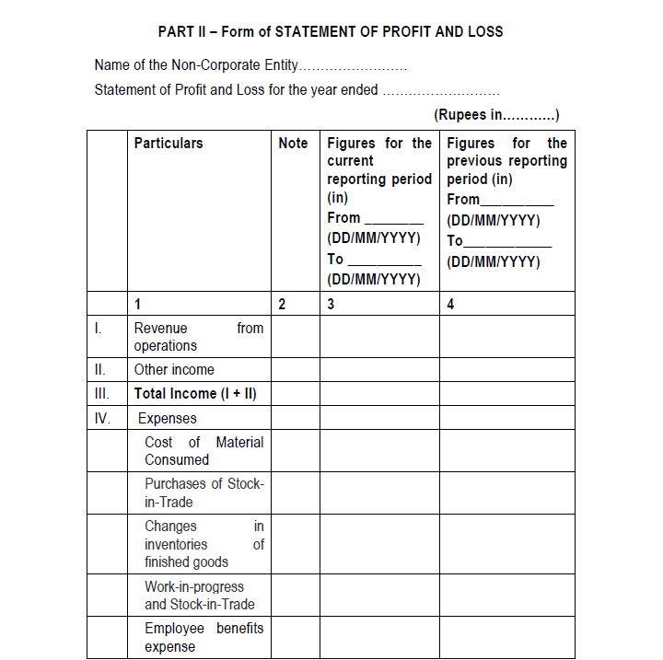
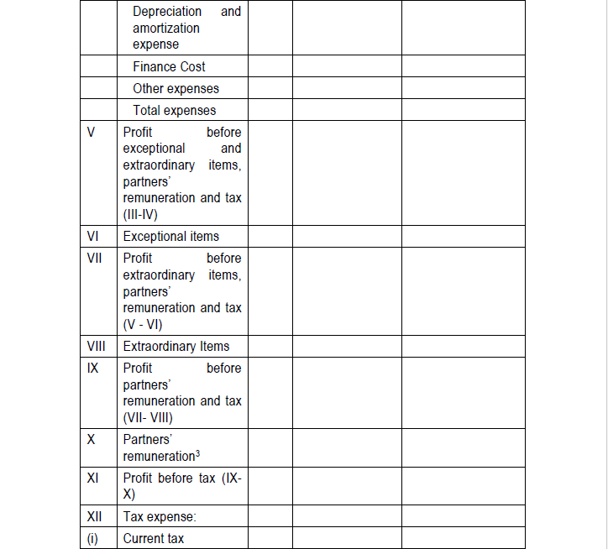
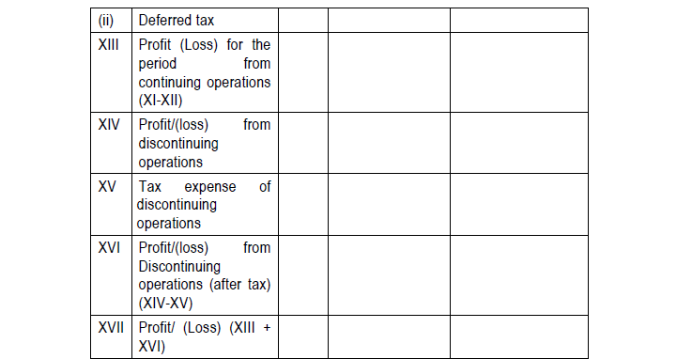
New Format

Slide 47
1. The provisions of this Part shall be applied to the income and expenditure account in like manner as they apply to a statement of profit and loss. 2. (A) Revenue from operations shall disclose separately in the notes revenue from – (a) Sale of products; Less: Excise duty (b) Sale of services; (c) Other operating revenues; (B) In respect of a finance Non-Corporate entity, revenue from operations shall include revenue from – (a) Interest; and (b) Other financial services.
General Instructions for Preparation of Statement of
Profit and Loss

Slide 48
3. Finance Costs Finance costs shall be classified as: (a) Interest expense (other than interest on partners’/members’ capital); (b) Interest on partners’/members’ capital; (c) Other borrowing costs; (d) Applicable net gain/loss on foreign currency transactions and translation. 4. Other Income Other income shall be classified as: (a) Interest Income; (b) Dividend Income; (c) Net gain/loss on sale of investments; (d) Other non-operating income (net of expenses directly attributable to such income).

Slide 49
5. Following shall be disclosed by way of notes regarding aggregate expenditure and income on the following items:— (i) (a) Employee Benefits Expense showing separately (i) salaries and wages, (ii) Contribution to provident and other funds, (iii) staff welfare expenses; (b) Any item of income or expenditure which exceeds one per cent of the revenue from operations or Rs.1,00,000 whichever is higher; (c) Adjustments to the carrying amount of investments; (d) Net gain or loss on foreign currency transaction and translation (other than considered as finance cost); (e) Details of items of exceptional and extraordinary nature; (f) Prior period items. (ii) Expenditure incurred on each of the following items, separately for each item: — (a) Consumption of stores and spare parts; (b) Power and fuel; (c) Rent; (d) Repairs to buildings; (e) Repairs to machinery; (f) Insurance; (g) Rates and taxes, excluding, taxes on income; (h) Miscellaneous expenses.

Slide 50
Using Generic or Outdated Accounting Policies
Many firms copy-paste generic accounting policies year after year.
This is now a major non-compliance issue.
ICAI requires accounting policies to be:
✅ Entity-specific (tailored to the business)
✅ Aligned with current ICAI guidance
✅ Disclosed in detail under Notes to Accounts
Common Mistakes:
❌ Copying standard policies from previous years
❌ Using vague wording that doesn’t match actual business practices
❌ Omitting key policies like revenue recognition, depreciation, and
financial instruments
Example:
Old Policy: "Revenue is recognized when deemed appropriate.“
New Policy: "Revenue is recognized upon transfer of risks and
rewards in accordance with AS 9."

Slide 51
Skipping or Summarizing Required Disclosures
What should be disclosed in detail?
✅ Basis of Preparation – Explaining key judgments and estimates
✅ Contingent Liabilities (AS 29) – Pending lawsuits, tax disputes,
guarantees
✅ Related Party Transactions (AS 18) – Exact amounts, nature of
relationship, balances outstanding
✅ Significant Accounting Policies – Tailored and specific to the entity
Common Mistakes:
❌ Skipping disclosures to keep financial statements “short”
❌ Summarizing related party transactions instead of listing them
❌ Not explaining assumptions behind financial estimates
Example of Bad Disclosure:❌ “Company has some pending litigations.”
Example of Proper Disclosure:✅ "As of March 31, 2025, the company is involved in a pending lawsuit with ABC Ltd. Amount claimed: ₹5,00,000. Management has assessed the risk as moderate."

Slide 52
Mixing Tax and Accounting Figures Without Proper Reconciliation
Many CAs prepare financials solely for tax filing, but that’s a big mistake!
The new format requires a clear distinction between:
✅ Accounting Profit (per financial statements)
✅ Taxable Profit (as per Income Tax Act, with
adjustments)
Common Errors to Avoid:
❌ Mixing tax and accounting depreciation figures without
reconciling
❌ Using tax provisions as "expense" in financial
statements
❌ Presenting tax-oriented financials instead of GAAP–
based statements
Example:
✅ Accounting Profit: ₹10,00,000
✅ Add: Disallowed Expenses
₹50,000
✅ Less: Allowed Deductions
₹20,000
✅ Taxable Income: ₹10,30,000

Slide 53
Notes to Accounts – More Details Required!
More transparency means more details in Notes to Accounts.
Required disclosures include :
Related party transactions
Contingent liabilities
Accounting estimates & judgments
A financial statement without proper notes is like a balance sheet without a balance!

Slide 54
Significant Accounting Policies – Mandatory Disclosure
Disclosures are like footnotes in a thriller novel – they reveal the real story.
Each entity must disclose its specific accounting policies.
Key areas include:
Revenue recognition (AS 9)
Depreciation & Amortization (AS 10/26)
Inventory valuation (AS 2)

Slide 55
Revenue Recognition (AS 9) – Align with ICAI Guidelines
When should revenue be recognized?
Sale of goods = When risks/rewards are transferred
Services = When rendered
Interest, royalties, dividends = As per accrual basis
*Avoid early revenue recognition – it can distort
financials.

Slide 56
Revenue Recognition – AS 9 Compliance
ICAI requires strict compliance with AS 9:
✅ Goods Sold: Recognize revenue when risks & rewards are transferred.
✅ Services Rendered: Recognize based on service completion.
✅ Interest & Dividends: Recognize on an accrual basis.
Example of Correct Recognition:
✅ Revenue from a sale recorded only when ownership is transferred.
Expense Classification
New ICAI Guidelines Require:
✅ Clear distinction between Direct & Indirect Expenses
✅ Depreciation & Amortization to be separately disclosed
✅ Finance Costs to be listed explicitly
Common Mistakes to Avoid:
❌ Clubbing all expenses under ‘Miscellaneous’
❌ Failing to disclose depreciation rates clearly

Slide 57
Related Party Transactions (AS 18) – New Disclosure Norms
ICAI now mandates full disclosure of related party transactions.
Must include:
Nature of relationship
Amounts involved
Outstanding balances
Who does this impact? Partners, directors, key managerial personnel, and relatives.

Slide 58
Basis of Preparation & Key Judgments – Required Disclosure
Entities must disclose the basis of preparation & key estimates.
Key areas:
Depreciation rates
Provision for bad debts
Fair value adjustments
Fun Quote: "Estimations in accounting are like salt in food—too much or too little can ruin everything!"

Slide 59
Cash Flow Statement – Key Changes
Mandatory for larger non-corporate entities.
Three sections:
✅ Operating Activities: Day-to-day cash movements
✅ Investing Activities: Asset purchases/sales
✅ Financing Activities: Loans, capital withdrawals,
dividend payments.
Why It’s Important:
✅ Helps businesses manage liquidity better
✅ Shows actual cash position, not just
accounting profits
"Cash flow statements tell you whether your business is running or just jogging in place!"

Slide 60
One Format for All – No More Creativity!
ICAI has provided a uniform format—USE IT!
DO NOT:
❌ Use the old T-format
❌ Mix tax and accounting figures
❌ Present only current-year numbers without comparatives
Best Practice:
✅ Use ICAI’s sample templates for reference.
✅ Ensure figures are classified properly.

Slide 61
Why Compliance Matters?
The new ICAI financial statement format is NOT optional—it’s mandatory. Failure to comply may result in:
❌ Rejection by tax authorities, banks,
or lenders
❌ ICAI disciplinary action
❌ Loss of professional credibility
Compliance ensures:
✅ Standardization & transparency
✅ Better acceptance by financial
institutions
✅ Trust & confidence from clients
"Financial statements should be like clean tax returns—accurate, detailed, and audit-proof!"

Slide 62
What Happens If You Don’t Comply?
Consequences of non-compliance:
Rejection by tax authorities, banks, and financial institutions
ICAI disciplinary action & penalties
Loss of credibility and client trust
Legal consequences in case of misreporting
"Skipping compliance is like skipping audits—sooner or later, it WILL catch up with you!”
"Losing your CA license over a
missed format? That’s like getting
fired for wearing the wrong tie!"
"A rejected financial statement is like a bounced cheque—both hurt your credibility!"

Slide 63
How to Implement the New Financial Statement Format?
Step 1: Download and study ICAI’s prescribed format.
Step 2: Ensure comparative figures are available and correctly
classified.
Step 3: Update accounting policies as per ICAI guidelines.
Step 4: Properly classify assets/liabilities into current and non
current.
Step 5: Include all mandatory disclosures (related parties, contingent
liabilities, etc.).
Step 6: Review the final financial statements to ensure full
compliance.

Slide 64
Thank you for your time and attention!
Remember: Compliance with ICAI’s new financial statement format is not just a requirement—it’s a commitment to professional excellence.
Stay updated, stay compliant, and ensure financial integrity!
For any questions, feel free to reach out.

Slide 65
CA Jiten M. Trivedi
(PARTNER AT JKSS & ASSOCIATES)
Professional Qualification & Achievements :
FCA (Gold Medalist), CS (AIR),
LLB (Uni. Topper), M.Com (Gold Medalist)
jiten.trivedi@jksco.in
9924248092
Ahmedabad office Address :
610, Iscon Emporio, Near Star Bazaar, Satellite,
Ahmedabad – 3800155
Having Branches at @ Ahmedabad, Bengaluru, Bhopal,
Bhubhaneshwar, Chandigarh,
Chennai, Delhi, Faridabad ,
Guwahati, Hyderabad, Jaipur
Kanpur, Kolkata,
Mumbai, Raipur.

