Slide 1

Unlock Professional Opportunities in Gulf Countries
CA. Nirlep Bhatt - Past Chairperson – Doha Chapter of ICAI
CPE Event for Rajkot Branch of WIRC of ICAI
Date:- 7th August 2025

Slide 2
Agenda
Introduction & Background
Key facts, Taxation Regine & economic landscape of six countries
Outsourcing assignments
New Avenues
Opportunities in overseas employments
Requirements of Skill-sets
Conclusion

Slide 3
Gratitude
Mata ji
Matrubhumi
Matru Sanstha

Slide 4

Overseas Expansion Strategy – Self Assessment
Conduct Market Research
Expansion Model
Local Regulations
Risk Management
Availability of Talent

Slide 5
India – Qatar Multi-faceted Relationship
Government to Government (G2G) | Business to Business (B2B) | People to People (P2P)
50 years of diplomatic relationship in 2023 | More than 8,000 Indian firms with Joint Venture, 50 fully owned | 800,000 Indian Community (30% of Population)
Elevation to strategic Partnership – since February 2025 – Possibility to explore CEPA | February 2024 - long-term agreement US$ 78 Bn. to export 7.5 Mn tonnes of Qatar’s LNG to India annually for 20 years, starting 2028. | Source of foreign exchange reserve – USD 750 Million remittances
USD 10 Bn. Inv. Pledged by Qatar to fastest growing major economy | Pledge to double bilateral trade to USD 28 Bn by 2030. | India largest expatriate group
India – 2nd largest exporter of Qatar & 3rd largest importer for Qatar | L&T its biggest order from Gulf from QatarEnergy – 15k Crore Rs. | 2019 – India – Qatar Year of Culture, endorsement to IYD
UPI in QNB Point of Sales and QNB office in GIFT city | Sovereign wealth fund investment in $ 1 Bn reliance retail, $ 500 Mn adani green | Strong Cultural ties & historical roots

Slide 6
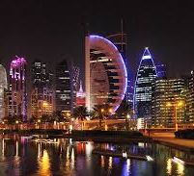
Qatar – Key Facts
Qatar Investment Authority – Sovereign Wealth Fund AUM USD 500 Billion – 9th largest Sovereign Wealth Fund globally
2nd largest exporter of LNG, 3rd largest producer of LNG
51 companies listed on QSE
79th Start-up eco system globally
Qatar export from India USD 2 Billion, import to India USD 17 Billion
Population – 3 million, GDP Per capita 8th in the world

Slide 7
Qatar – Economic Overview
 | 2020 | 2021 | 2022 | 2023 | 2024 | 2025 (E)
GDP (USD Bn.) | 144 | 180 | 236 | 234 | 216 | 220
GDP Growth (%) | -18.1 | 24.5 | 31.2 | -0.8 | -7.7 | 1.9
GDP Per Capita (USD) | 52,316 | 66,859 | 80,573 | 78,696 | 71,580 | 71,652

Slide 8
Qatar GDP sectoral Growth Year-on-year – 2023

Slide 9
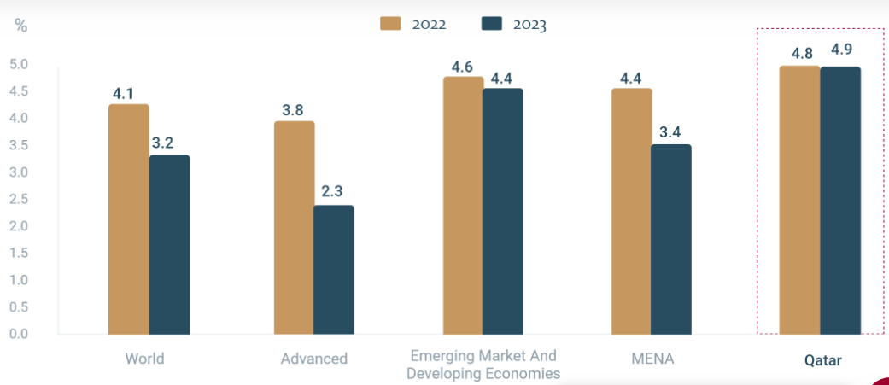
Qatar GDP – Comparison to Region & World (source world bank - global economic prospectus 2022)

Slide 10
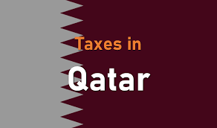
Taxation in Qatar (Law no. 24 of 2018) & other provisions
No Personal Income Tax – on both citizens & expatriates
No Value Added Tax – Anticipated tax rate is 5% in near future
Excise Tax @ 100% on tobacco & products, energy drinks, alcohol & 50% on carbonated drinks
Corporate Income Tax 10% only on non-Qatari’s income
Custom Duty 5% (basic food items are exempted)

Slide 11
Taxation in Qatar (Law no. 24 of 2018) & other provisions
Mandatory Audit – Capital exceeds QAR 200,000 OR Revenue exceeds QAR 500,000
Mandatory Return filling – when income exceeds QAR 1,000,000
Witholding Tax – 5% for payment made to non-resident for royalty, fees & technical services, regardless of place of service
Contract Declaration –
With non-resident – No threshold limit, for all contract for service & supply
With resident – QAR 200,000 for service and QAR 500,000 for supply

Slide 12
Taxation in Qatar (Law no. 24 of 2018) & other provisions
Double Taxation Avoidance Agreement between India & Qatar – Reduced rate of 10% TDS on dividend income, effective 15 January 2020
Transfer Pricing – Article 56 of Executive Regulations – turnover OR assets is more than QAR 10 million AND the entity is associated with any entity outside Qatar
TP Disclosure Form – turnover or asset is more than QAR 10 million
Local & Master File - turnover or asset is more than QAR 50 million

Slide 13

Professional Opportunities for CAs
Auditing
Accounting Services
Taxation & Transfer Pricing
Company Formation
Valuation
Feasibility Studies
Internal Controls & Risk Management
Other Advisory & Consultancy work

Slide 14
In-Country Value Certification
Contribute back to the country to support localization
Considers Goods & Services, Workforce Training, Fixed Assets Investment & Supplier Development
Weightage is given if supplier is also ICV registered
More preference to bidder who are ICV registered with higher score
Score is published and certificate to be renewed annually
Practicing CA can be ICV Certifier

Slide 15
Setting up Audit & Consultancy firm in Qatar
Require a Qatari National Partner (51% share)
Qatari Partner should also be University Degree Holder
Apply to Ministry of Commerce & Industry
Obtain Incorporation Documents
Qualify for exams for auditing services

Slide 16
Licensing under Qatar Financial Center
QFC is onshore business & financial center incorporated under law no. 7 of 2005
100% foreign ownership & 100% repatriation of profit are permitted
10% tax on local profit
Single online application
Office needs to be with-in QFC designated premises
Parallel but separate legislation from Qatari law

Slide 17


Memorandum of Understanding between ICAI and QFC (under renewal)
The ICAI and QFC signed Memorandum of Understanding in June 2021 to create more opportunities for accountants, promote & facilitate set up of Indian firms, participate in QFC & ICAI events and arrange technical training programs & research etc.

Slide 18

Memorandum of Understanding between ICAI & Qatar Financial center
ICAI & members will provide technical training & impart knowledge to employees of the QFC & ministries.
QFC to support ICAI’s members in setting up practices for providing professional services.
QFC may participate in ICAI Conferences or events.
ICAI members will be invited to attend QFC events.
ICAI & QFC will explore the opportunities for Indian businesses in Qatar via roundtables, networking events
Collaboration in the fields of technical research, issues for SMPs & CPD

Slide 19
Permitted Activities by 100% overseas investment by Ministry of Commerce & Industry (Law no. 1 of 2019)
Manufacturing F&B, Papers & Textiles
Construction & allied services
Whole-sale & retail trade
Import of raw materials, machineries, equipment’s
Transportation, warehousing & storage
Other Service Activities

Slide 20
Qatar Free Zone
Two free zones – Umm Al Houl 3,000-hectare area near airport & Ras Bu Fontas 400-hectare area near airport
100% foreign ownership, 100% repatriation, Zero custom duties & 20 years tax holidays
No restriction on employee’s nationality
Operate in one of the target’s sectors
Plan to use Qatar as a destination to trade in international market
Demonstrate financial capabilities to undertake mega projects

Slide 21
Qatar Free Zone – Permitted Activities
Cluster Activities | Examples
Industrial Products & Services | Projects supplying products to identified sectors, chemicals, plastic, rubbers, metals, paper & packaging
Pharmaceuticals, life science & medical services | Healthcare, medical devices, biotechnologies
Energy & Environmental Technologies | Alternative or renewable energy, recycling
Construction & Real Estate | Construction materials, machineries & equipment
Food, Beverages & consumer products | All Food, beverages, consumer electronics & accessories
Marine activities & services | Port related activities & services
Information & Communication Technologies | Electronics, Software, IT services

Slide 22
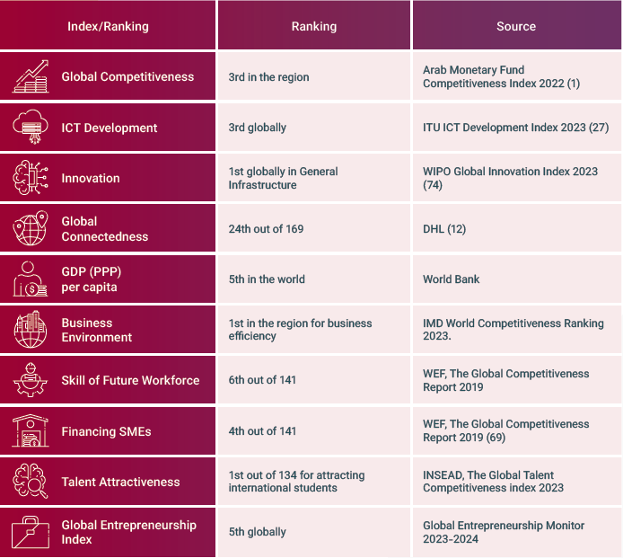
Start-up Eco-system in Qatar (source – invest Qatar report)
High ICT Penetration (99%)
Ease of Doing Business (rank # 77)
Gateway between East & west (2.5 billion people worth $8.5 trillion in combined GDP all within 3,000 km)

Slide 23
Indian Chartered Accountants in Qatar

Slide 24

Competitive & Business Scenario
Audit & Advisory sector dominated by big four or other bigger firms
Other accounting professionals viz. ACCA, CMAs & CPAs
More than 400 Indian Chartered Accountants
There is enough room to grow for firms of all size & scale, due to strong legal/compliance ecosystem, pricing factor, not over crowded market & some areas are in nascent stage

Slide 25
UAE – Economic Overview
 | 2020 | 2021 | 2022 | 2023 | 2024 | 2025 (E)
GDP (USD Bn.) | 349 | 415 | 507 | 504 | 527 | 550
GDP Growth (%) | -16.4 | 18.8 | 22.1 | -0.1 | 3.97 | 4.36
GDP Per Capita (USD) | 37,644 | 43,430 | 52,620 | 51,909 | 53,916 | 55,781

Slide 26
India UAE Comprehensive Economic Partnership Agreement (CEPA)
CEPA came into force from 1st May 2022, likely to surge bilateral trade of goods to USD 100 billion & trade in services to USD 15 billion.
CEPA includes over 11 sectors, including Professional Services
TEI, TEP & TR (Tariff Elimination Immediate, Phased & Reduction)
Open environment & market access to cross-border trade of services
Exports from India - Gems & Jewellery, Drugs & Pharmaceuticals and fruits & vegetables have increased respectively 64%, 39% & 35%

Slide 27
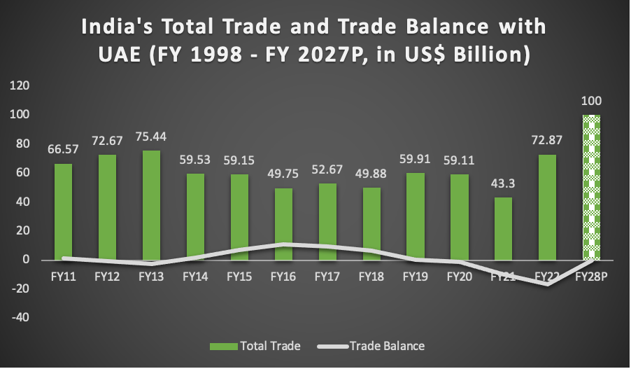
India – UAE Bilateral Trade Snapshot
Steady increase in Bilateral trade
Likely to reach USD 100 Billion with Balance of trade projected to be turning neutral, in India’s favor

Slide 28
UAE – Corporate Tax (CT) (Federal Law no. 60 of 2023)
Income | Tax Rate
Effective Date 1st June 2023
Taxable Income upto AED 375,000 | 0%
Qualifying Income of FZP
Taxable Income exceeding AED 375,000 | 9%
Non-Qualifying income of FZP
Top Up Tax on MNE (details awaited) | 15%
Audit of books of accounts turnover limit (or FZP) | AED 50 Million
Due date of return filing for FY 2024 | 30th September 2025

Slide 29
UAE – Other Taxes
VAT, implemented from 1st July 2018, threshold limit AED 375,000, voluntary registration AED 187,500
No Personal Income Tax
Custom Duty 5%
Excise Tax – 100% on tobacco & its products, electronic smoking devices & and energy drinks, 50% on carbonated & sweetened drinks
Municipality Tax – 5% on rental value (for residential properties) & 2.5% of rental value (for commercial properties)
No Stamp Duty

Slide 30

Startup eco system in UAE
Ranked 23rd Globally, target to produce 30 unicorns by 2030.
Careem, first unicorn of region outside Israel
Digital Economy to reach USD 140 Bn in 2031, from USD 40 Bn.
Flexible Visa Rule, Talent Availability, Globally competitive taxation
Abu Dhabi – fastest growing startup hub with 28% growth, 6th fastest growing in the world
UAE, ranked 16th in Ease of Doing Business

Slide 31
Types of Services a CA can render
VAT Consulting Services
Internal Audit, External Audit, Forensic Audit
IT Advisory, IT Audit & Cyber Security
M&A, Feasibility Study
Company Formation, Business Setup services
Outsourcing, CFO services
Corporate Taxation
Advisory & Specialized Services

Slide 32
Saudi Arabia – Economic Overview
 | 2020 | 2021 | 2022 | 2023 | 2024 | 2025 (E)
GDP (USD Bn.) | 734 | 874 | 1107 | 1067 | 1017 | 1044
GDP Growth (%) | -12.4 | 19.1 | 26.8 | -3.7 | -4.9 | 2.65%
GDP Per Capita (USD) | 23,256 | 28,390 | 34,410 | 32,514 | 27,018 | 27,206

Slide 33
Taxation in Saudi Arabia
Corporate Income Tax 20% on net adjusted profits
Zakat 2.5% on zakat base for Saudi Nationals & GCC citizens
Standard VAT Rate 15% (from 5%, with effect from 1 July 2020)
Withholding Tax 5% on interest & dividends to 15% for royalty
Social Insurance Contributions (GOSI) – 21.75% for Saudi Nationals & 2% employer’s contributions for expatriates

Slide 34
Startup eco system in Saudi Arabia
Startup ecosystem ranked 65th Globally
In 2023, Venture Capital funding rose by 33% YoY to USD 1.4 Bn
Saudi Vision 2030 – Diversify Economy with small business contributions to increase from 20% to 35%
100% foreign investment – Minimum Capital SAR 500,000
High Penetration of ICT – 97% is ideal for fintech
By 2024, Saudi internet users is expected to increase to 34 Million, 42% increase from 2019

Slide 35
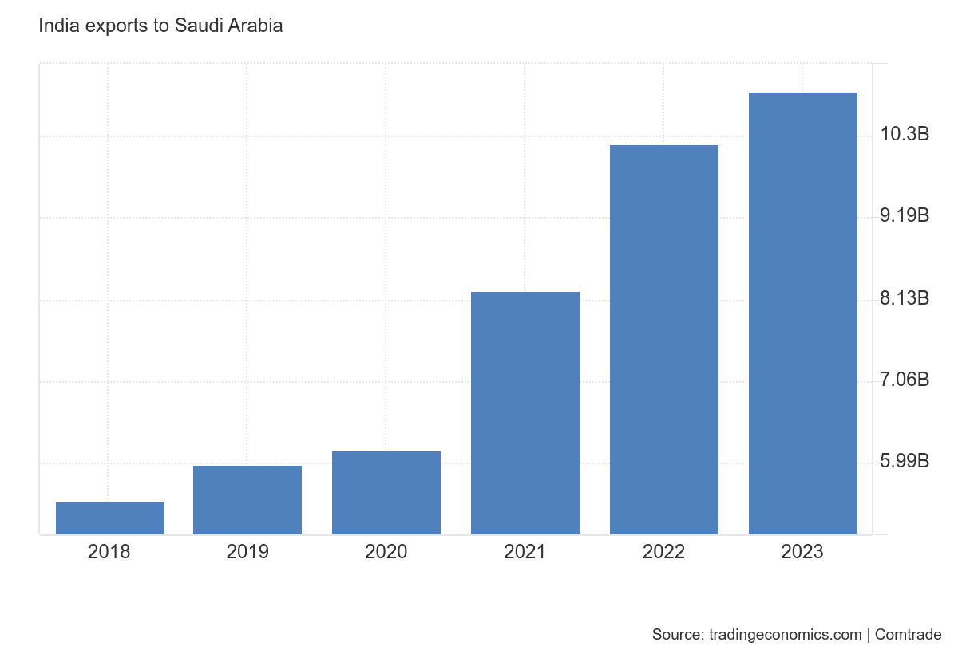
India’s Export to Saudi Arabia – Cementing Trade Ties
2018-19 – Bilateral Trade 34 Bn
2022-23 – Bilateral Trade 53 Bn
Indian Companies in Saudi – L&T, TATA Motors, Ashok Leyland, TCS
Saudi Companies in India – SABIC invested USD 100 Mn. in technology & Innovation center in Bengaluru (GCC)
Sovereign Fund invested in Reliance Jio & Reliance Retail
Investment in FirstCry, Delhivery, OYO, PayTM, Policybazar

Slide 36
Key Facts – Saudi Arabia
World’s 17th largest & one of the fastest growing economies
Key oil producers with 15% of world’s oil proven reserves
Prependamic level is achieved in almost all economic parameters
Intensified revenue-stream diversification from hydrocarbon sources
Sweeping Reforms in line with Vision 2030, Good improvement in EoDB
Young population & rising inclusion of women
Dependency on foreign workers is a challenge

Slide 37
Tax Exemption to Sovereign Wealth Funds & Pension Funds
Section 10 (23FE) – Eligible categories – sovereign wealth funds, pension funds & any other notified funds
Objective:- to attract long-term foreign capital & provide longer window for global funds to evaluate & commit investment
Conditions:- No loans or borrowing for Invest in India, Foreign Govt. directly or indirectly owns & regulates SWF, Income will be credited to foreign govt., regular audit
Holding Period:- for minimum period (usually 3 years) with specified AIFs or cos. Engaged in infrastructure activities
Extension of exemption:- Deadline of qualifying investment extended from 31st March 2025 to 31st March 2030

Slide 38
Oman – Economic Overview
 | 2020 | 2021 | 2022 | 2023 | 2024 | 2025 (E)
GDP (USD Bn.) | 76 | 87 | 112 | 109 | 102 | 104
GDP Growth (%) | -14 | 15 | 29 | -4 | 6 | 2
GDP Per Capita (USD) | 16,785 | 19,403 | 23,666 | 21,550 | 20,994 | 18,970

Slide 39
Oman – Key Facts
Highest FDI inflows as % of GDP, compared to other GCC countries
Relative Diversification of economy – to manufacturing, tourism & logistics (non-hydrocarbon sectors)
Social Security Contribution 20.5% for Omani nationals, 12.5% from employers and 8% from employees - 1% for work-related injuries
Strong tourism Potential
Strategic geographic location & insulated from trade disruptions
Omanisation – Preference to locals in many job roles

Slide 40
Taxation system in Oman
Registered Capital less than OMR 50,000 Gross Income does not increase OMR 100,000 No. of employees less than 25 Activities to exclude specified activities & sectors | 3% reduced rate of taxation
Corporate Income Tax, other than above | 15% rate
Value-Added Tax (VAT) | 5% rate effective from 1st April 2021
First Country in Gulf to introduce Personal Income Tax | 5% rate effective from 1st January 2028 for those whose annual income exceeds OMR 42,000 (USD 109,000)

Slide 41

Bahrain – Key Facts
Value Added tax 10% with effect from 1st January 2022.
No Corporate Tax (except oil & gas companies 46%)
Prone to political instability & turbulence
More diversified economy, compared to others (Banking & Tourism)
India’s export to Bahrain USD 1 Bn. Grown at 9.8% CAGR for 5 years
Social insurance rate is 25% for local employees (17% employer; 8% employee) and 4% for expatriate employees (3% employer; 1% employee)

Slide 42
Bahrain – Economic Overview
 | 2020 | 2021 | 2022 | 2023 | 2024 | 2025 (E)
GDP (USD Bn.) | 36 | 41 | 47 | 46 | 47 | 49
GDP Growth (%) | -11 | 14 | 15 | -1 | 1 | 3
GDP Per Capita (USD) | 24,323 | 27,148 | 30,616 | 29,219 | 29,678 | 28,860

Slide 43
Bahrain Economy landscape
Financial Service Industry – second highest contributor to GDP at 18%
MENA’s first & largest fintech hub – Bahrain Fintech Bay
FinHub 973 – Collaborator between Financial Institutes & Fintech Startups
Annual labour costs for a financial services tech hub in Bahrain are up to 24% more competitive than the GCC. Entities can save substantially on annual business and licensing fees and enjoy 60% better value for office space rental. (Source: EY Report)

Slide 44
Kuwait – Economic Overview
 | 2020 | 2021 | 2022 | 2023 | 2024 | 2025 (E)
GDP (USD Bn.) | 111 | 148 | 184 | 164 | 159 | 165
GDP Growth (%) | -21 | 34 | 24 | -11 | -3 | 3%
GDP Per Capita (USD) | 25,236 | 34,044 | 40,077 | 33,730 | 32,289 | 32,433

Slide 45
Kuwait – Key Facts
Corporate Income Tax 15%
No Value-Added Tax
No Personal Income Tax
Social Security Benefits with 11.5% employer’s and 8.5% employer’s contributions, upto KWD 2750 per month – for Kuwiati employees
Wealthy Sovereign fund being world’s key oil producers
India’s export to Kuwait USD 2.5 Bn. Grown at 10% CAGR for 5 years
Lower Geopolitical risk as improved tie with neighbors

Slide 46
Overseas Outsourcing Assignments
BPO is projected to grow by 9% every year
Accounting, Book-keeping, Taxation, Tableau, Power BI
Skill Development in Diverse Areas
Be Transparent & maintain Trust Always
Be Value Creators
Understand Cultural differences

Slide 47
Overseas Outsourcing Assignments
Invest Technology & Talent
Proper Due Diligence & reference check
Draft comprehensive proposal & maintain quality of deliverables
Legal & Compliance issues in different countries
Understand cost dynamics & advantages to clients
Networking with international forms & professionals

Slide 48

Overseas Expansion Strategy
Economic Environment
Alignment with domain expertise
Cultural & language barriers
Political stability
Competition Scenario

Slide 49
Overseas Employment - Sources
Website of leading corporates
LinkedIn
Employment Consultants & Head- Hunters
ICAI Overseas Campus placement & E-kit
ICAI overseas chapters in respective countries (Sahaytaa campaign)
Bayt.com, Gulftalent.com, Naukrigulf.com

Slide 50
Skills required for overseas employment
Sector Specific Knowledge
Customize your resume
Employment Consultants & Head- Hunters
Cost of Living
Visa Requirements (validity of visa, changing an employer, nature of contract)
Social life, Community & family bonding

Slide 51
Sunrise Domains
Areas | Skills Required | Business Knowledge
Valuation | Analytical & number crunching skills Technological Skills (esp. spreadsheet) | Sector-specific knowledge Insights into macro economics
Risk Management & GRC | Report writing & Presentation skills Financial Story-Telling & Innovation skill | Cross-functional knowledge
Data Science | Technological Skills Use of statistical Models | Predictive Analysis, Sensitivity Analysis Cross-function knowledge
Artificial Intelligence | Coding Moderate Research & Innovation | Ethical Implication & Compliance
Forensic Accounting & Fraud Detection | Critical thinking skill Daya Analytics | Knowledge of Cyber Laws

Slide 52
Global Career Growth (NEST)
Networking
Education
Soft-Skills
Technological Skills

Slide 53

Networking in Organizations
Serve on “Special Purpose Committees”
Volunteer in cross-functional task force & learn different domains
Represent organization in sector specific events
Attend special days conducted by the organization
Attend Family meet up
Ask for feedbacks from Peers & Team-members and collaborate
Mentor, Train & Help your Team members

Slide 54

Networking in Profession
Attend event or conferences of Professional Organizations (ICAI central committees, regional councils, branches & chapters)
Collaborate & contribute on projects or initiatives of above
Participate or serve in other associations (Tax Practitioners or CA Associations)
Participate in industry-specific events by trade bodies, business councils
Collaborate with connects with e-newsletter or regular updates
Serve & Lead on community-based or religious organizations

Slide 55

Networking in Community
Members of social clubs
Specific learning activity (e.g. Toastmasters club for public speaking)
Finance Head, Advisor or Auditor to various NGOs/NPOs
Financial literacy & impart knowledge to different sections
Career guidance & mentor students at various schools
Develop a hobby and participate in hobby-specific clubs (e.g. arts)

Slide 56
Storytelling Skill - A New-Aged Skill
Overload of Data
Interpretation of Numbers
Diverse Set of Stakeholders
Internal Customers
Cascading of Information
Humanizing Finance

Slide 57
Overseas Journey of ICAI
54 overseas chapters
14 chapters in USA
4 chapters in UAE
4 in Australia
2 in Canada, 3 in Saudi Arabia

Slide 58
Functioning of an overseas chapter
ICAI Embassy in the respective jurisdictions
Work in close liaison with the Indian Embassy
Collaborates with other stakeholders
CPE events & Annual Conferences as per the guidelines
Examination Center for CA exams under supervision of Indian Embassy
Career Counseling events, with Indian Schools
CSR, family events and financial literacy events

Slide 59
Summary
Economic landscape, Business Scenario & taxation landscape
Start-up eco-system of key countries
Outsourcing Opportunities
Sun-rise domains globally
Skill-sets requirement to propel your career
Overseas Journey of ICAI

Slide 60
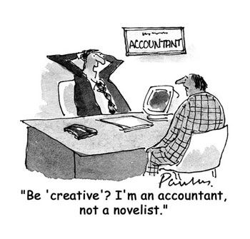

Slide 61

Cell. No.:- +974-55578173
ca.nirlep@gmail.com
https://www.linkedin.com/in/nirlepbhatt/
Thank you

