Slide 1

INDIA – UK Comprehensive Economic and Trade Agreement (CETA)
DGFT RAJKOT
DEPARTMENT OF COMMERCE MINISTRY OF COMMERCE AND INDUSTRY GOVERNMENT OF INDIA

Slide 2
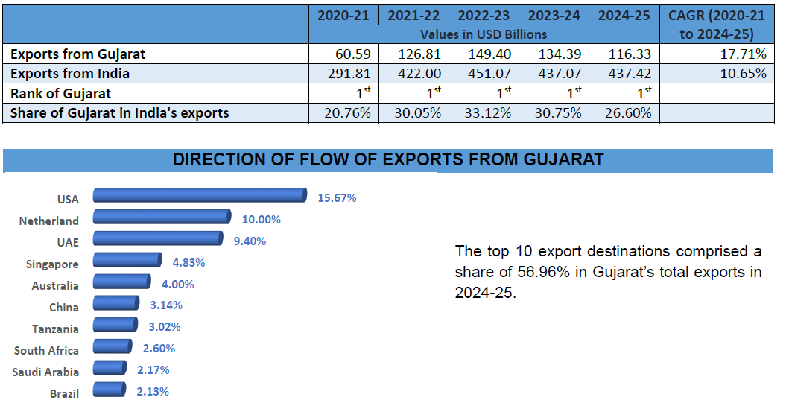
Export Performance of Gujarat: Last 5 FYs

Slide 3
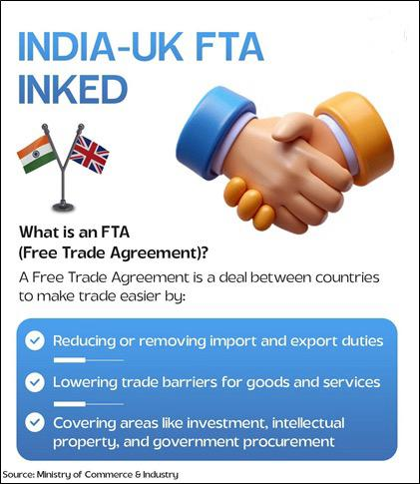
India-UK Comprehensive Economic and Trade Agreement (CETA)
Most comprehensive Free Trade Agreement negotiated by India.
The agreement was signed by Honorable Commerce and Industry Minister Shri Piyush Goyal and UK Secretary of State for Business and Trade Mr. Jonathan Reynolds in the presence of Honorable Prime Minister Shri Narendra Modi and UK Prime Minister Sir Keir Starmer on 24th July, 2025

Slide 4
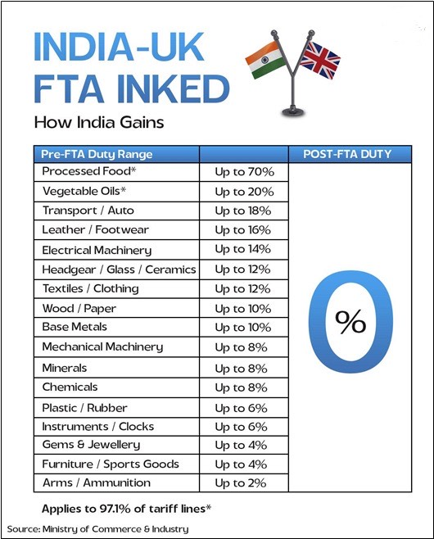
India-UK Comprehensive Economic and Trade Agreement (CETA)- Key Highlights
For Indian exports – Duty elimination of 99% tariff lines, covering nearly 100% of trade values.
In key labor-intensive sectors, duties have been reduced to zero from previously high levels — up to 20% on marine products, 12% on textiles and clothing, 8% on chemicals, and 10% on base metals.
Agriculture and allied sectors stand out as a major beneficiary, with Indian farmers gaining market access for high-value products like vegetables, fruits, basmati rice, cereals, animal products, beverages, oil seeds, and dairy
The marine sector, particularly Indian fishermen, will benefit from access to a UK market valued at over USD 5.4 billion
MSMEs are poised for a strong uplift through duty-free access in labour-intensive sectors such as leather, textiles, gems & jewellery, furniture, and sports goods—areas where UK imports exceed USD 23 billion.

Slide 5
India-UK Comprehensive Economic and Trade Agreement (CETA)- Key Highlights
This is the most comprehensive FTA negotiated with Chapters on Trade in Goods and Services , Trade Remedies, Custom Trade Facilitation , SPS & TBT , Trade in Services, IPR , Government Procurement and Digital trade and many others.
This is the first FTA with Standalone Chapter on “Labour” ,”Trade and Gender equality” and “Innovation”.
FTA provides for Dispute Settlement through consultation , and if the same fails a complaining party may request for establishment of Panel.

Slide 6
India-UK Comprehensive Economic and Trade Agreement (CETA)
(value in USD Million)
YEAR | EXPORTS | YoY Growth | IMPORTS | YoY Growth | TRADE SURPLUS
2024-25 | 14550 | 12.08 | 8607 | 2.29 | 5943
2023-24 | 12982 | 13.3 | 8414 | -6.1 | 4568
2022-23 | 11458 | 9.13 | 8961 | 27.69 | 2497
Over the past three financial years (2022–2025), India’s trade with the United Kingdom has shown an overall positive trajectory in exports with fluctuations in imports, indicating a shift toward a more favorable trade balance for India.
From 2022–23 to 2024–25, exports increased by 27% cumulatively.
India has consistently maintained a trade surplus with the UK, and this surplus has more than doubled in the last three years.
The growing trade surplus strengthens India’s position to negotiate non-tariff barriers, services liberalization, and investment flows under the agreement.

Slide 7

UK - Our trading partner of choice
India-UK bilateral trade crossed $55 billion in 2024, an increase of more than 10% from 2023.
India’s total merchandise trade with the UK was USD 23.15 billion in 2024-25.
UK was India’s 16th largest trading partner in 2024-25.
India and the UK rank as the 4th and 6th largest economies of the world respectively.
India’s total services trade with the UK stood at USD 28.88 billion in 2023.

Slide 8
UK’s Goods Offer to India
UK is offering 98.80% of its tariff lines covering 99.56% of India’s exports.
Immediate tariff elimination is on 98.71% tariff lines.
Tariff Rate Quota (TRQ) on electric vehicles, which comprises 0.09% of its tariff lines.
Major commodities of India’s exports to the UK:
Smartphones;
Textiles;
Chemicals;
Pharmaceuticals;
Gems and Jewellery;
Electric Machinery and Equipment;
Leather and Footwear,etc.

Slide 9
Immediate Duty Free Goods and Benefits
Immediate Duty Free (Indicative)
Benefit
Textile and Clothing
Chemicals and Allied
Pharmaceutical goods
Engineering and Electrical Goods
Live animals
Carcases or half-Carcases of bovine animals, fresh or chilled
Dairy products- Milk and cream, Yogurt, Buttermilk, Whey, natural milk constituents, Natural butter;
Fresh or chilled bovine meat, boneless
Fresh/chilled lamb/sheep/goat carcases and half-carcases
Meat of bovine animals, salted
Boneless meat of bovine animals
The CETA ensures comprehensive market access for goods across most sectors, fully addressing India’s export interests.
The CETA will make Indian goods more competitive compared to UK’s other major sources of imports such as China (12.1%), US (11.3%) and Germany (9.4%), among others.

Slide 10
India’s Goods Offer to UK
India is offering 89.54% of its tariff lines covering 91.06% of UK’s exports.
Immediate tariff elimination is on 64.08% tariff lines | Phased tariff elimination is on 21.03% tariff lines.
Tariff Reduction is on 4.08% tariff lines.
Tariff Rate Quota (TRQ) on internal combustion engine (ICE) and electric vehicles, which comprises 0.36% of its tariff lines.
Major commodities of UK’s exports to India:
Automotives;
Electrical Circuits and High-end Optical Products;
Medical Devices;
Cosmetics;
Whisky;
Electric Machinery and Equipment; etc.

Slide 11
India’s Goods Offer to UK
No offer has been made on sensitive agri products like dairy, apples, oats, edible oils.
No offer on sensitive industrial products like precious metals, smartphones, optical fibres etc.
Aligning the consumer needs with Make in India program, only duty reduction from 6th year (no elimination) offered on Medical Devices coming under PLI.

Slide 12
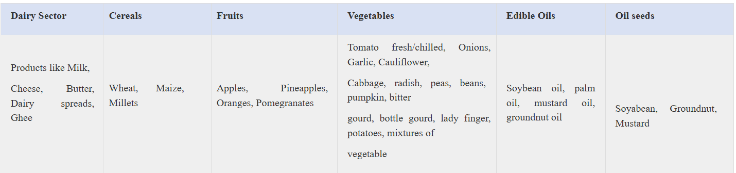
Key exclusions/protection ensured for Indian stakeholders

Slide 13
Sectors with the Most Gains
Textile
Zero Duty market access for the textiles and clothing sector.
Sectors Poised for Exponential Growth includes RMG, Home Textiles, Carpets, and Handicrafts,
The removal of duties creates immediate and substantial competitive advantages
Increases competitiveness of Indian textile exports vis-à-vis exports of Bangladesh, Pakistan and Cambodia.
Handicrafts, home textiles and carpets are also expected to have substantial competitive advantages.

Slide 14
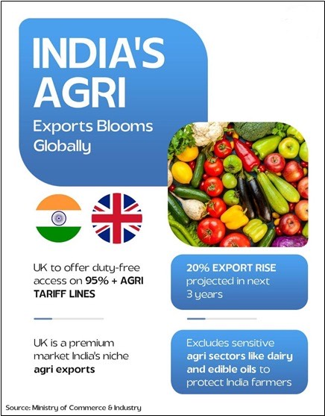
Sectors with the Most Gains
Agricultural Products
Agriculture and allied sectors stand out as a major beneficiary.
India to outcompete major global players in crucial agricultural and marine products.
With ‘Zero duty’ on entry into force on more than 95.0 % tariff lines related to agriculture and processed food products, the CETA will strategically position India to outcompete major global players in crucial segments such as Fresh/Chilled Vegetables, Preserved Vegetables, Fruits, and Nuts and spices, among others.

Slide 15

Sectors with the Most Gains
Marine Products
UK tariffs on Indian shrimp ranging between 4.2–8.5%, the FTA’s tariff elimination are expected to unlock rapid growth, particularly in shrimp, tuna, fishmeal, and feeds.
Coastal states like Kerala, Andhra Pradesh, Gujarat, Tamil Nadu, and Odisha stand to benefit significantly from export-led job creation.
Reduction of technical standards and regulations under the CETA leads to increased ease of doing business.
Clear disciplines for rules of origin help agri-business to benefit from reduced tariffs and greater integration into global value chains.

Slide 16
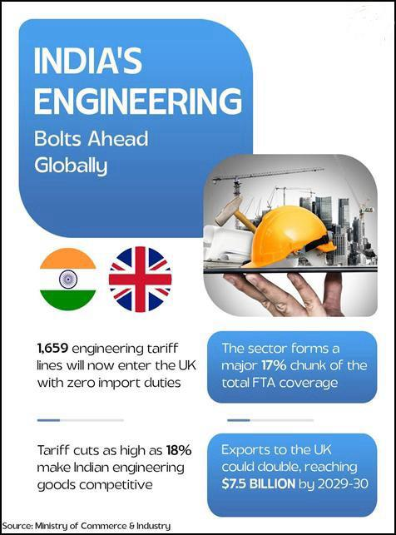
Sectors with the Most Gains
Engineering Goods
UK is India's 6th largest engineering export market.
The engineering goods sector has the highest share among the listed sectors with 1,659 tariff lines, making up 17.0% of the total.
With tariff elimination (as high as 18%) under the FTA, engineering exports to the UK could nearly double in the next five years
This directly supports India’s broader target of achieving USD 300 billion in engineering exports by 2030, solidifying the UK’s position as a critical partner.

Slide 17

Sectors with the Most Gains
Chemicals and Pharmaceutical Sectors
The zero tariff provisions under the FTA are expected to significantly enhance the competitiveness of Indian generics in the UK market - India’s largest pharmaceutical export destination in Europe.
India exports USD 23.31 billion globally and the UK imports nearly USD 30 billion, but Indian pharma accounts for under USD 1 billion, indicating significant headroom for growth.
Significant share of medical devices like surgical instruments, diagnostic equipments, ECG machines, X-Ray systems will not attract any duty.
Indian manufacturers are poised to emerge as a favored, cost-effective alternative, especially with zero-duty pricing for medical devices, compared to competitors like China.
For Chemical, The CETA is anticipated to trigger a dramatic 30%-40% increase in India's chemical exports to the UK (an estimated USD 650-750 million for the year 2025-26.

Slide 18
Sectors with the Most Gains
Gems and Jewellery
India’s total G&J exports to UK are valued at USD 941 million, with USD 400 million coming from Jewellery.
Tariff relaxations under the FTA are projected to double India’s gems and Jewellery exports to the UK within the next 2-3 years.
The CETA will generate substantial employment opportunities in India’s design, manufacturing, and artisan sectors, and invigorate traditional craftmanship, fostering inclusive economic growth.

Slide 19
India – UK CETA: Boosting Trade in Services – shorten to specific bullets
Under the Market Access offer, the UK has offered 137 sub-sectors to India and India has offered 108 sub-sectors to the UK.
Broad commitments in the UK’s offer includes areas of India’s interest such as IT/ITeS, Financial Services, Professional Services, Other Business Services and Education Services.
Ambitious UK commitments for Software and IT-enabled Services to unlock new markets, drive job creation, and enhance export potential for Indian software firms.
Projected growth of 15-20% annually for software and IT services.
India has also offered market access in areas such as Professional Services, Business Services, Financial Services and Environmental Services which will facilitate investments into India.
It will support the expansion of GCCs that serve U.K.-headquartered businesses — or leverage British expertise to serve global markets from India (India is already home to more than 1,700 GCCs, employing over 1.9 million people)

Slide 20
India – UK CETA: Boosting Trade in Services
The UK has offered mobility commitments in 36 sub-sectors such as Computer Related Services, Business services under Contractual Service Suppliers.
The commitments go beyond traditional services and includes Yoga instructors, classical musicians and Chef de cuisine
Independent professionals engaged in computer and related services, and research and development services will also benefit from the larger mobility commitments.
The CETA aims for better income generation for Indian professionals living in the UK through the Double Contributions Convention (DCC).
The DCC will enter into force at the same time as CETA.
To this end, the DCC will exempt Indian detached workers, and their employers from paying national insurance in the UK for 3 years.

Slide 21


Benefits to Sections of Society
Farmers and Fisherfolk
The CETA takes fully into account the interests of Indian producers of sensitive agricultural products like dairy products, vegetables, apples, edible oils, oats, etc. by keeping those tariff lines under sensitive list.
UK’s USD 37.52 billion agricultural market gives Indian farmers a direct route to a high-value global customer base and achieve better returns for their goods. This directly supports India’s ambitious goal of achieving USD 100 billion in agricultural exports by 2030.
The CETA benefits Indian seafood exporters, particularly those supplying high-demand products such as shrimp and other seafood.
The CETA will strengthen India's fisheries exports and contribute to the welfare and livelihoods of fishermen of Andhra Pradesh, Gujarat, Karnataka, Odisha, and Maharashtra
The CETA recognizes the importance of forests for providing livelihoods and job opportunities to forest dependent communities.

Slide 22


Benefits to Sections of Society
Women and Youth
For the first time in India's trade history, gender inclusion is embedded in the framework of international trade - ensuring targeted support for women-led enterprises and workers, representing a bold and strategic step toward gender-equitable globalization.
It includes progressive provisions designed to break down barriers and promote greater participation in international trade, digital innovation, and government procurement for women.
The CETA is poised to expand high-quality employment pathways for Indian youth by easing services market access, and facilitating short-term mobility for talent in IT, healthcare, finance, and creative sectors.

Slide 23
Benefits to Sections of Society
Small and medium enterprises (SMEs) and Businesses
SMEs are a vital part of India's economy, contributing around 30.1% of India's GDP in 2022-23 and 45.8% in India’s total export in 2024-25.
India’s MSMEs, from weaving units and apparel manufacturers in Tirupur to artisanal clusters in Panipat, Bhadohi, and Agra—form the backbone of India’s textile and leather exports. The CETA benefits these MSMEs by opening duty-free access for these sectors—levelling the playing field for Indian exporters against our Asian competitors
SMEs benefit from various provisions of the CETA, including through provisions on faster processing at customs, agreements to recognise and facilitate digital systems and paperless trade, and a dedicated chapter to help SMEs.
SMEs will also benefit from the cooperation between India and the UK on best practices regarding trade education and finance, digital skills, business infrastructure and other important areas.
Other than lower tariffs and market access for Indian goods and services, the CETA offers ease of doing business with the UK through simplified and streamlined customs and trade facilitation processes,
The CETA serves as a strategic catalyst for Indian enterprises operating within the UK.

Slide 24
Benefits to Sections of Society
Workers and professionals
The immediate removal of duties on Indian products from labour intensive sectors boost employment and benefit Indian workers.
Women workers, in particular, will gain from provisions on non-discrimination and gender equality in the workplace.
Qualified professionals such as architects, engineers and medical professionals will be able to take advantage of the enhanced market access under the CETA and provide services in the UK
The benefits of CETA goes beyond the traditional services commitments. Indian chefs, yoga instructors and classical musicians.
The CETA aims at income generation for round 75,000 detached workers will benefit from the Double Contribution Convention (DCC).
This exempt Indian workers who temporarily move to the UK and their employers from contributing to the National Insurance Contribution for three years

Slide 25
Overall Economic Impact
This CETA is projected to significantly boost bilateral trade, doubling the current trade volume by 2030.
The trade deal aligns with India's vision of "Viksit India 2047" and complements the growth aspirations of both countries.
It will foster deeper economic interdependence, strengthen supply chain resilience, and promote technological collaboration

Slide 26
Strategic Significance
This CETA is projected to significantly boost bilateral trade, doubling the current trade volume by 2030.
In an increasingly complex global landscape, this FTA underscores the commitment of India and the UK to a rules-based international order and free and fair trade.
It strengthens the strategic partnership between two major democracies and opens new avenues for cooperation on global issues.
This agreement sets a new benchmark for equitable and ambitious trade deals and will serve as a gold standard for India's future trade engagements.

Slide 27
THANK YOU

