Slide 1



Overview of Startup Ecosystem: Ideas and opportunities
Jay Joshi, Program Head
Gujarat Student Startup and Innovation Hub (i-Hub)
Education Department, Government of Gujarat

Slide 2


Startup India
Action Plan 2016
19 Action Points
16th Jan’16
Simplification & Handholding
Funding Support & Incentives
Industry-academia partnerships & incubation

Slide 3
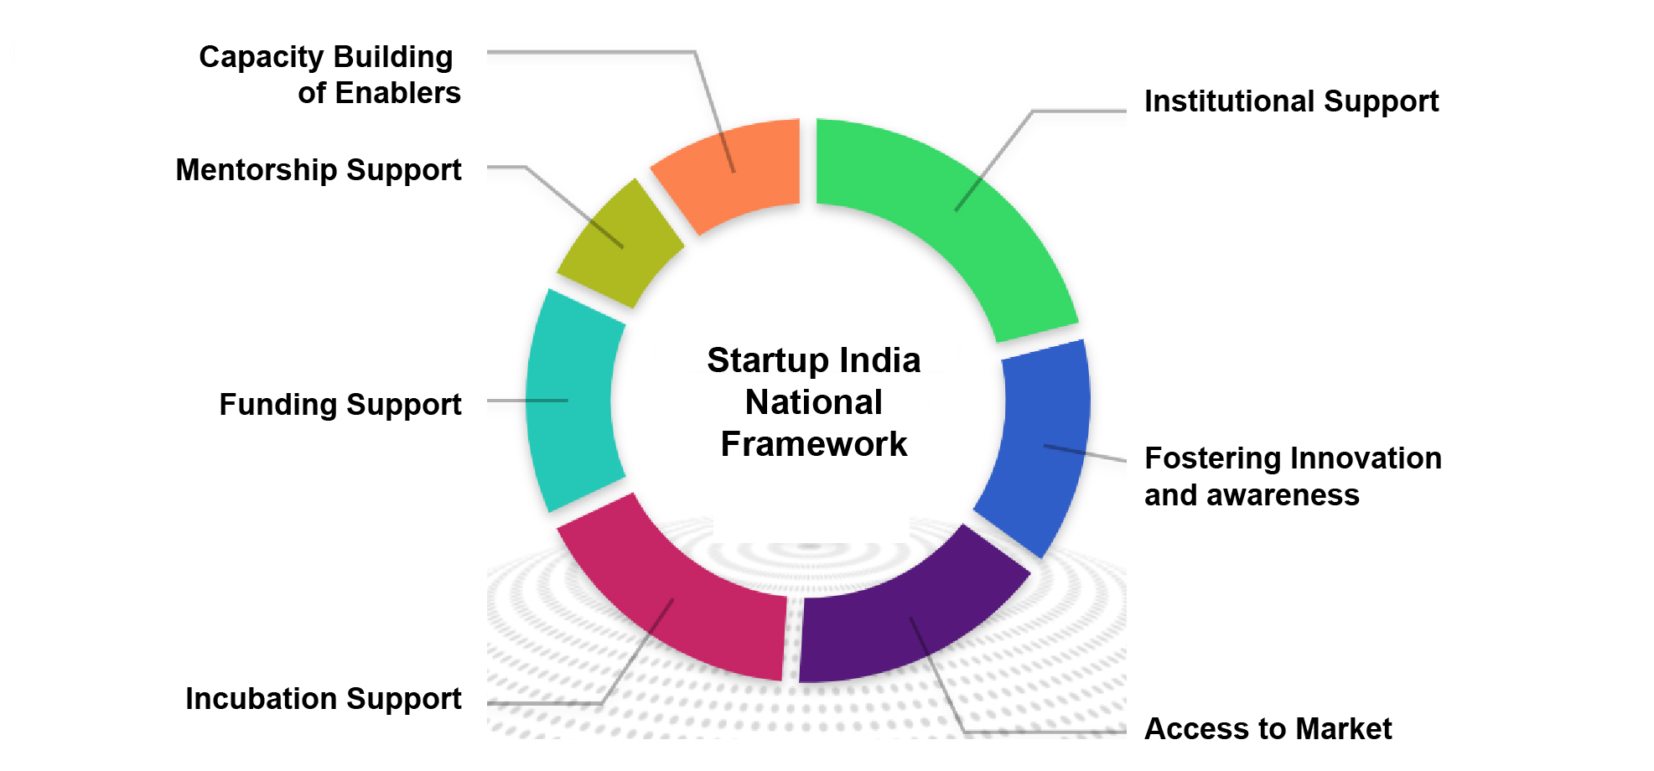
Startup India National Framework

Slide 4






14x
The Journey So Far..
159000+
2025
14x
13x
112
6500+
19x
$ 155 bn
7x
7x
700+
30 States
2016
500
8
490
$ 8 bn
100
4 States
Startups
Unicorns
Investors
Funding
Incubators
Policy
Notes:
https://inc42.com/datalab/presenting-the-state-of-indian-startup-ecosystem-report-2020/#:~:text=As%20per%20our%20analysis%2C%20till,849)%20are%20venture%20capital%20firms.%E2%80%8Bhttps://yourstory.com/2020/07/startup-incubation-advisories-rise-impact-trends-covid-19#:~:text=startup%20growth%20puzzle.-,The%20number%20of%20incubators%20is%20considered%20as%20a%20good%20indicator,has%20over%20500%20startup%20incubators.

Slide 5
Global Scenario of startups
Total funding chart of top 3 countries.
The Graph shows a glimpses of top 3 countries in startups ecosystem with a comparative figure of 8 years
Further showing the growth in India in terms of increased CAGR

Slide 6
Evolution of Ecosystem: 4 Waves of Evolution
1995-2005 : Global Capital & Global Teams , (league of Google and FB)
2005-2015 : Global Capital & Local Teams , (league of Flipkart)
2015-2025 : Local Capital & Local Teams , ( Contemporary Phase)
2025- 2035 : Local Capital & Global Teams , ( India showing the way !)

Slide 7
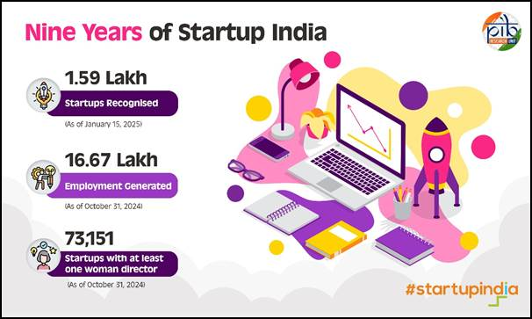
Indian Startup Ecosystem on its 9th year

Slide 8




WHAT IS A STARTUP?
Private Limited Company
Limited Liability Partnership
Registered Partnership
10 years from date of incorporation
Must not exceed
₹100 Cr. in any fiscal year
Innovation
Scalability
Job creation
Wealth creation
STARTUP INDIA
DEFINITION OF STARTUP – NOTIFIED 19th FEBRUARY 2019

Slide 9
Number of Gujarat Startup Ecosystem
As per Start-up India data, 174596 startups are DPIIT recognized.
Gujarat has 29005 startups out of which a total of 15044 are DPIIT-recognized in Gujarat.
Key sectors that entrepreneurs are categorized in 56 industries as per the data
City | DPIIT recognised
Ahmedabad | 4542
Surat | 1632
Vadodara | 1166
Rajkot | 1025

Slide 10
Indian Start-up Ecosystem on its 9th year
2016: 500
2025: 174,000+
656+ Districts

Slide 11
Startup Support System Value Chain in Gujarat
Innovation & Early stage hub and spoke Start-up ecosystem Development (Since 2017)
Incubation Infrastructure
(Since 2012)
Seed Support Grant
(Since 2015)
Investment
(Since 1990)
A B C D E F
A: SSIP, Education Department (Since 2017)
Financial Support for large universities: up to INR 5 Cr in 5 yrs;
Financial Support for others: up to INR 2 Cr for others in 5 yrs
For PoC: up to INR 2,50,000 through Grantee Institute
Domestic Patent: INR 75,000;
PCT: INR 1,50,000
C: Start-up policy, IT & DST, GoG (Since 2015)
Domestic Patent: INR 2,00,000;
PCT: INR 5,00,000
Seed Funding: Up to INR 50 Lakh
Operational Assistance for incubator: INR 1 Crore
Outreach Support: INR 2L per event
Marketing Support: INR 1L per Start-up
E: Start-up policy, IMD, GoG
(Since 2015)
Domestic patent: INR 50,000;
PCT: Up to INR 2,00,000
Seed Funding: Up to INR 30 Lakh (for social ventures INR 40L)
For Mentoring: up to 1,00,000
Exposure programs: INR 3,00,000
Events: Up to INR 5L per event
F: GVFL & IMD, GoG (Since 1990)
Start-up Fund: INR 5 Cr to 15 Cr
B: Institutional Support, i-Hub
(Since 2019)
For PoC up to INR 10 Lakhs
Incubation & Acceleration
Flagship Programmes for Early stage start-ups
D: i-Create (Since 2012)
Incubation Centre for Entrepreneurship & Technology
Seed Fund: Up to INR 50 Lakhs

Slide 12
Policy Interventions & Benefits for Startups
Pre-Incubation | Incubation & Seed Support | Venture Finance & Risk Capital
INR 75,000 Domestic and 1.5 Lakhs IPR Support for international. INR 20,000 for Per POC/Prototype/ Innovation (School) INR 2.5 Lakhs for Per POC/Prototype/ Innovation (Higher and Technical Education) INR 10 Lakhs Under Start-up Srujan Seed Support Upto INR 5 Crore to setup Incubation Centers in Universities/Colleges 2000 seats subsidized for incubation | INR 30 lakhs seed support with additional INR 10 lakhs Sustenance Allowance(SA) of INR 20,000/Month and INR 25,000/Month to women led startups for a year INR 1 lakh each per startup for training in soft skills, POC Development(through Outsourcing) and Marketing INR 3 lakh for participation in national/ international recognized acceleration program) INR 5 lakh Per Year for Mentoring Assistance for Incubators | GVFL Prarambh Fund - INR 50 lakh to INR 3 Crore for mid-level Pre-Series A funding GVFL Startup Fund – Upto 10 Crore GVFL Growth Fund – Upto 20 Crore
Back to Agenda

Slide 13
Chartered As Founders
Chartered Accountant entrepreneurs in India
CA Radhe Shyam Agarwal, Co-Founder, Emami
CA Nirmal Jain, Founder, India Infoline Group
CA Rajesh Magow, Founder of Make My Trip.
CA Dhruv Shringi, Founder of Yatra.com
CA Aman Gupta , Founder of BOAT

Slide 14
Accelerating
Access to Finance in Gujarat
Startup integration
Fund integration
Making of AIF’s , planning for instrument to be used and round planning.
Startups incorporated by Chartered, clients who wants to create startup.
Chartered Accountant
Planning exit strategies for startups, investors , founders
Funds from family offices , HNI’s and angel investors.
Angel investing
Exit strategies & Planning

Slide 15
Role of CA as Advisory
For Startups:-
Evaluation of the startup
Supporting in Grants, Compliances, Planning etc.
Networking, Connections and Business Integration.
Finance Management and Budgeting.
Strategizing new round of Investment and plan for runway of the fund.
Valuation advice

Slide 16
Role of CA as Advisory
For Investors/Investment:-
Scouting of Opportunities to Invest.
Planning and Implementing the investment.
Advising on the Investment.
Due Diligence & compliances.
Exit strategies.
Re-Investing.
Sourcing Co-Investment opportunities.
Fund management
Valuation services

Slide 17
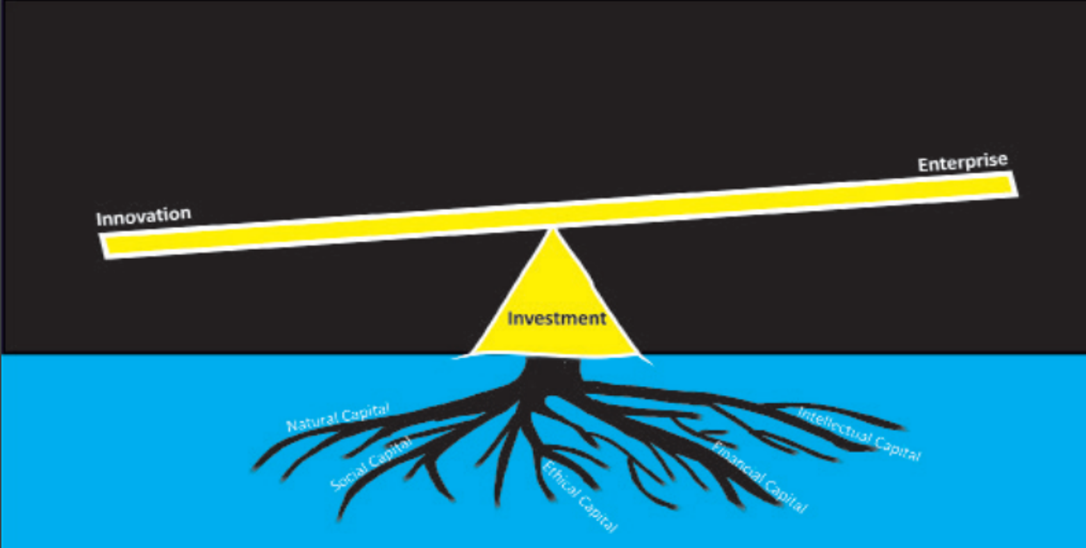
Mind to Market : The “Start-up” Saga

Slide 18
Vast pool of young minds
Value creation through innovation/start-ups
Mind to market
Conversion
Identify
Support
Develop
Promote
Knowledge
Ideas
Innovations
Financial
Technical
Strategic
Managerial
Moral
Other
IPR
Prototype
Product
Start-up
Brand Building
Success Stories
Linkages
Change Agents
Benefit to Innovators

Slide 19
i-Hub
i-Hub is a Section 8 company under the Companies Act 2013, incorporated on 16th May 2019
i-Hub has been established as a common resource centre to nurture early stage innovation
key enabler for all Startup from “Mind-to-Market” across sectors.
Hub and spoke facility for best possible pre-incubation, incubation and acceleration support.
Extending value-added services, viz. legal, financial, technical and IP to startups.
Groom 1500 Student Startups and Upscale existing startups.
Support 500 startups through seed grants in 5 years
Set-up a State level innovation Hub with 1.5 lakh sq ft incubation space.

Slide 20
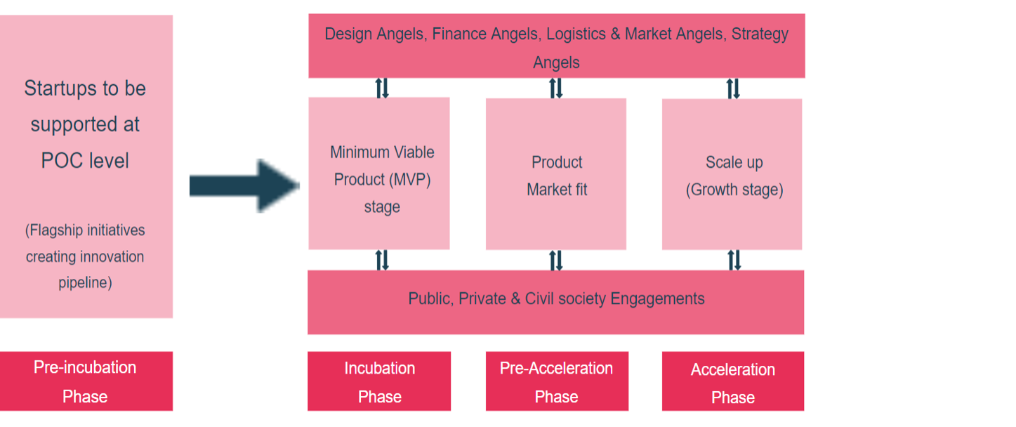
i-Hub Framework

Slide 21
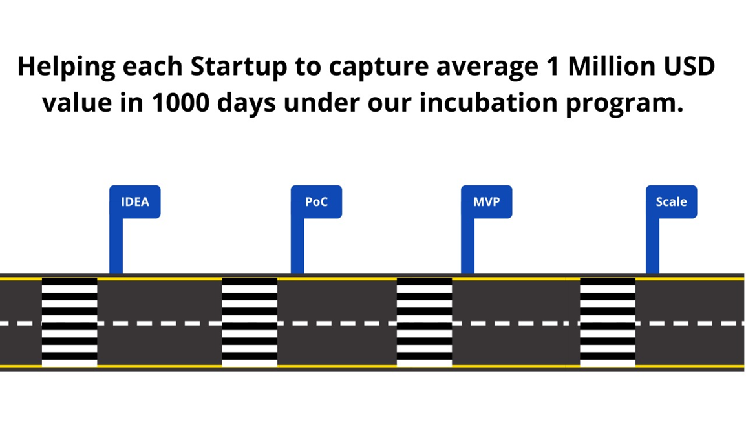
Our Pedagogy @ i-Hub
0 Day
1000 Day

Slide 22
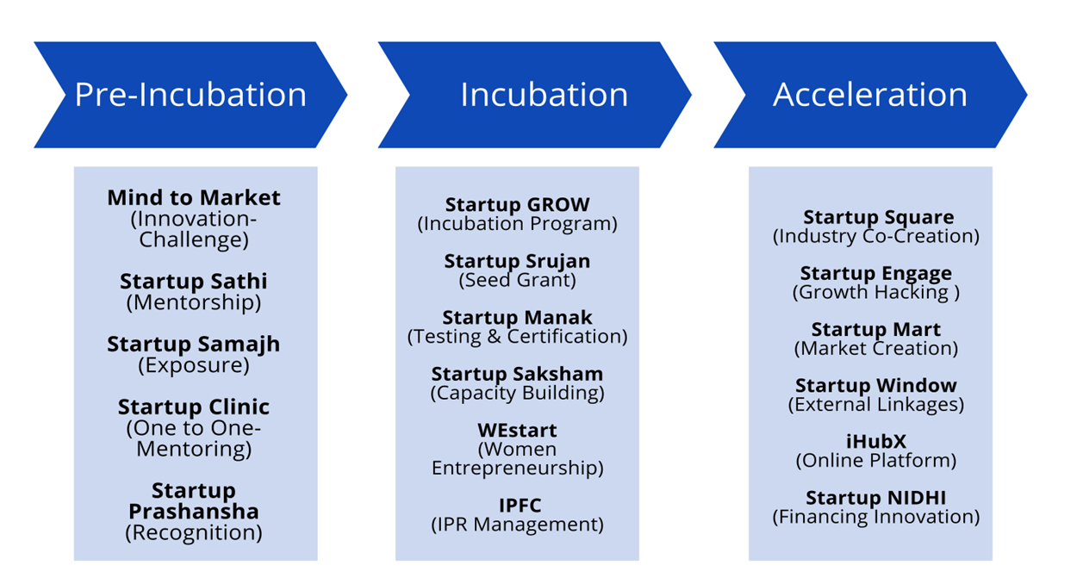
Flagship Initiatives at i-Hub

Slide 23
i-Hub in Past Five Years (2020-2025)
620
Startups
INR 459 crore
investments facilitated
4000 skilled employment generated
5000 students/innovators trained on Innovation
INR 3569 crore value of startup
270 Mentors Onboarded
INR 690 crore
total revenue
620 startups mentored.
MAGIC connect for 288 startups through 50 Demo Days.
INR 23 crore grant committed to 350+ startups/
innovators
4+ Lakhs youth outreached

Slide 24
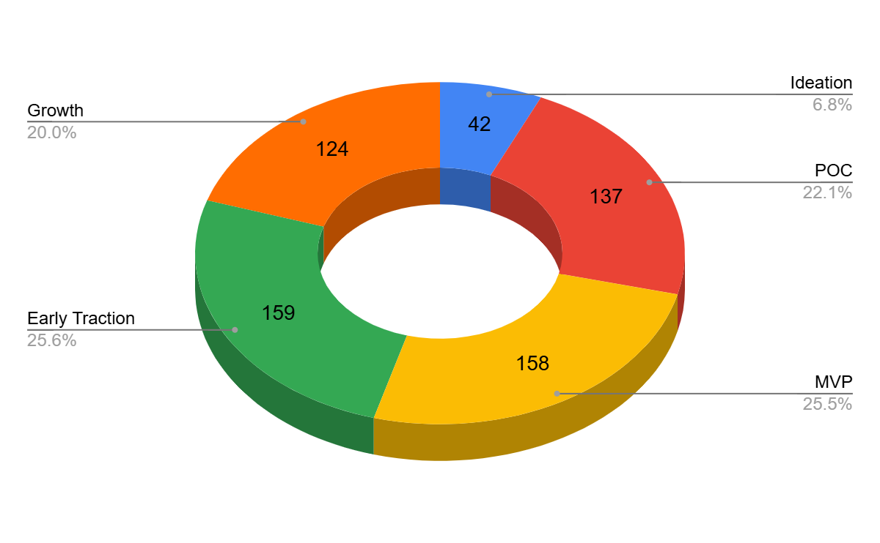
Startups Incubated at i-Hub in Past Four Years
620
Out of 620 startups, 173 were led or co-led by Women Founder
Back to Agenda

Slide 25
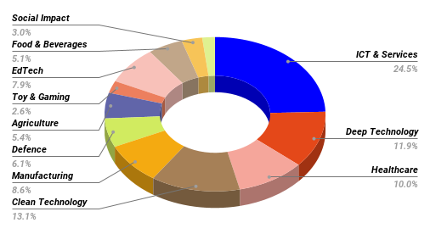
Startups Incubated at i-Hub in Past Four Years
12
620
12

Slide 26
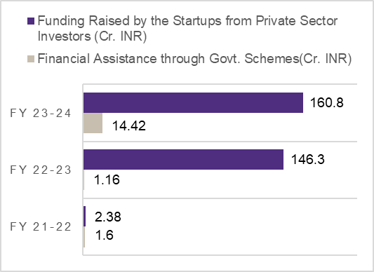
Significant financial impact of i-Hub's initiatives
Significant financial impact of i-Hub's initiatives, highlighting a substantial increase in funding raised by startups Government scheme and Private sector investors
Back to Agenda

Slide 27
Nodal Agencies under the State and Central Government
Approved to establish Atal Incubation Centre (AIC) under Atal Innovation Mission (AIM)
In-principle approval from NIDHI Seed Support System (SSS) by DST, Govt of India
Nodal Institute to disburse Startup India Seed Fund Scheme (SISFS) by Startup India
Host Institute for MSME Scheme of Seed Support, Govt of India
State-level Intellectual Property Facilitation Centre (IPFC) for startups
Nodal Institute under Scheme for Assistance for Startups/Innovations under Gujarat Industrial Policy 2020
Back to Agenda

Slide 28
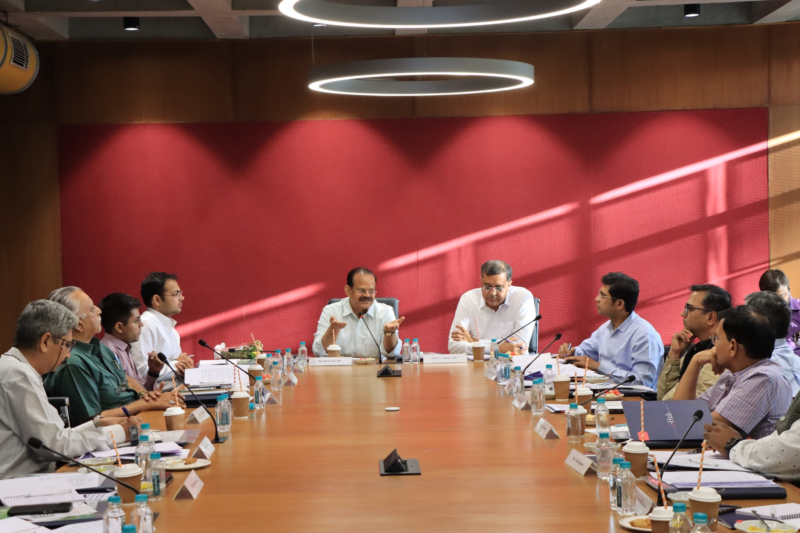
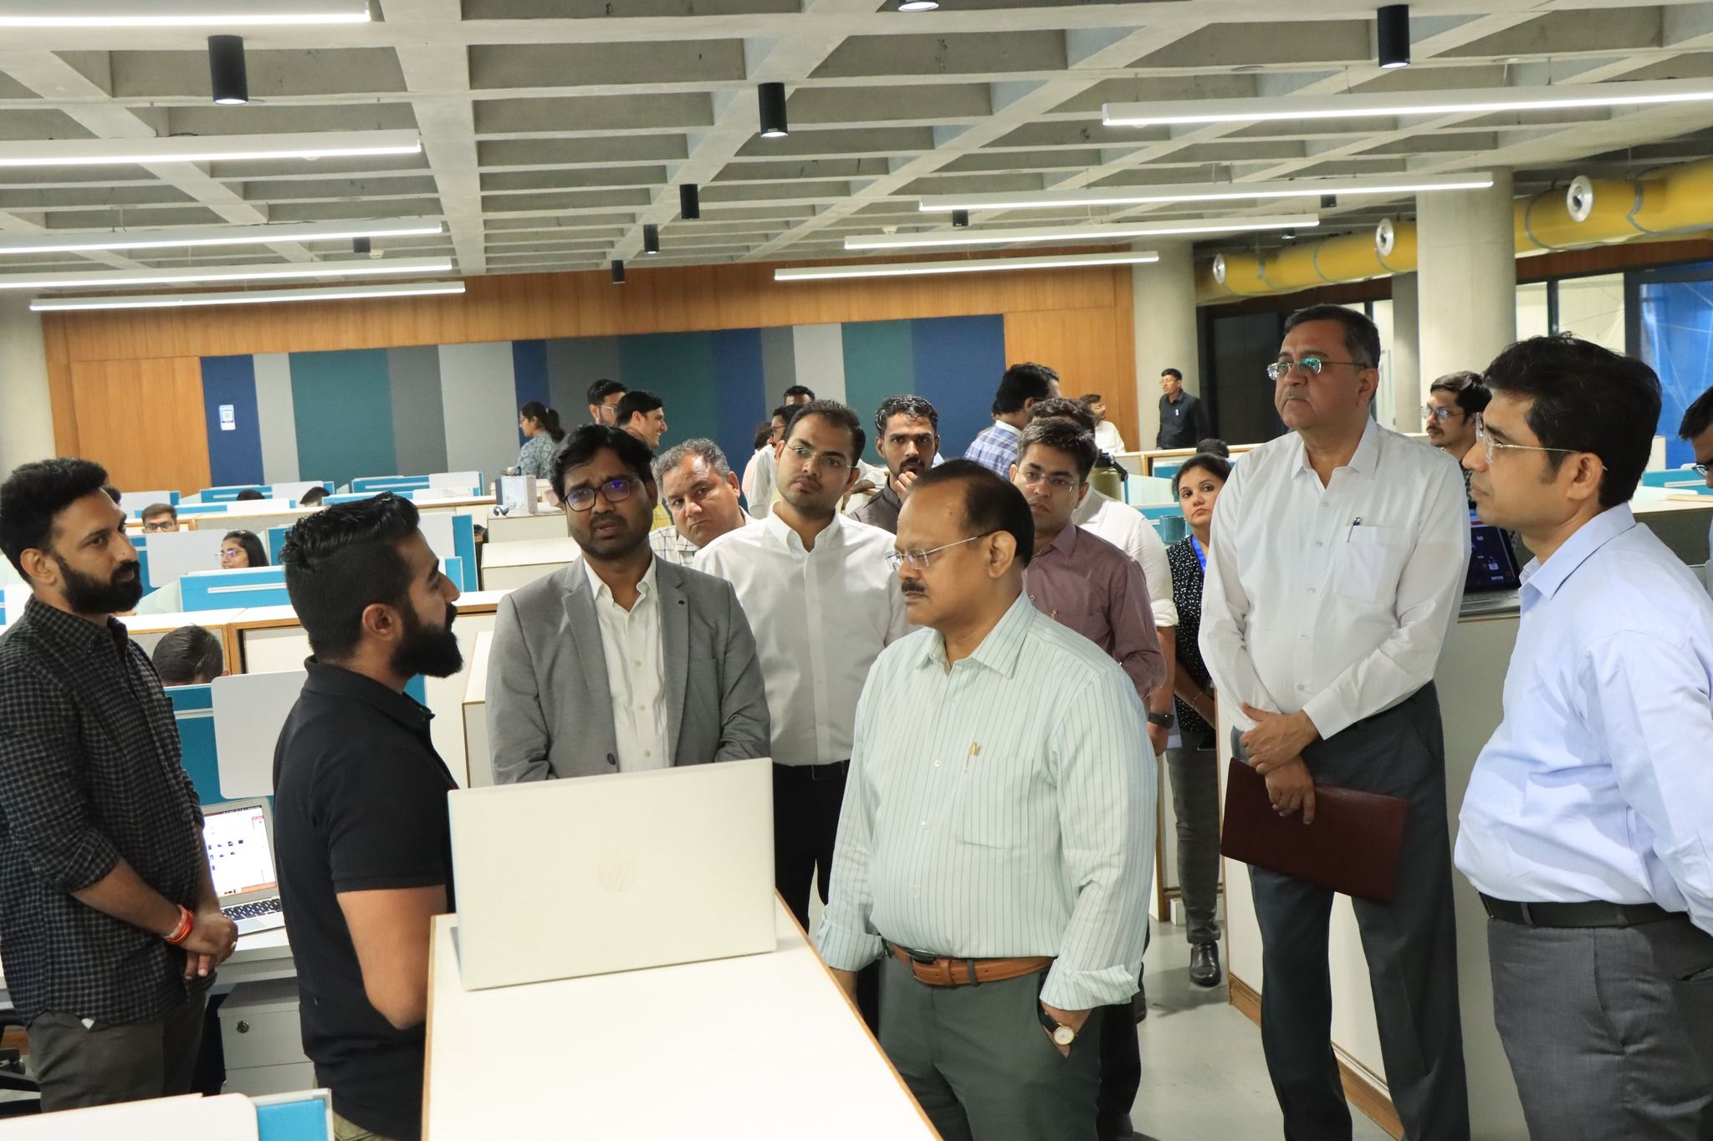
Startup Policy Round Table Discussion
Under the chairmanship of Shri Raj Kumar, IAS, Chief Secretary, GoG
Policy recommendations:
Market Access and Networking
To provide easy market access and strong networking for startups
Funding and Market Growth
Improve fund accessibility and emphasize market growth
Government and Industry Support
Mentors to facilitate government approvals
Address manpower and R&D challenges through partnerships and centralized labs
Strategic Initiatives
Branding of Unicorns, youth entrepreneurship, and quality mentoring
Create a unified platform for incubators, mentors, and startups
Capacity building of Startups
To focus on custom designed acceleration programs for startups from early to growth stage startups.
Back to Agenda

Slide 29
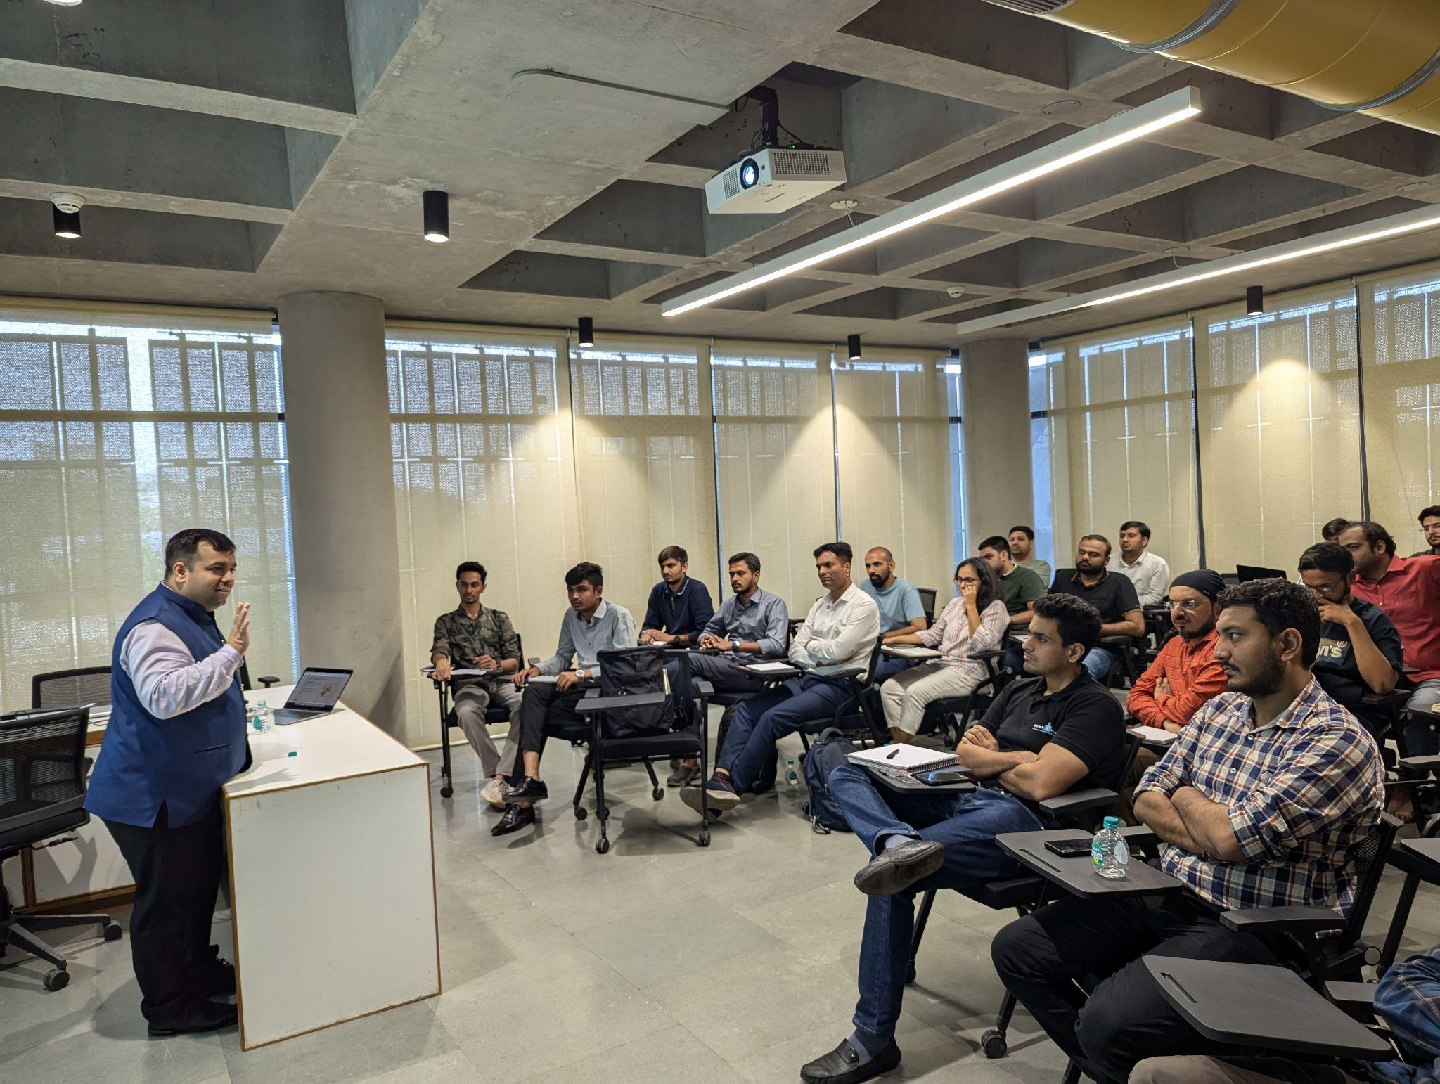
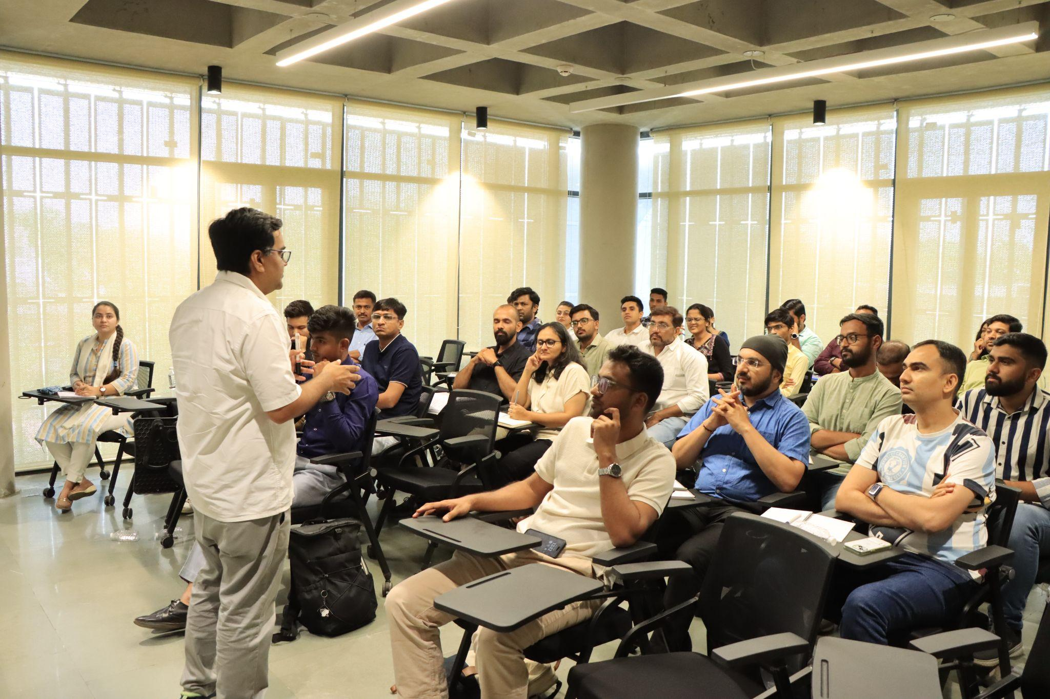
Startup Saksham Acceleration Program
Based on the recommendation of Honorable Chief Secretary we have started the acceleration program
About Program
In collaboration with Indian Acceleration, we have designed “Startup Saksham” Acceleration program for our Startup Srujan Grantees. This Hybrid mode program started on 17th July 2024 and ended on 06th July 2024. This program is fully focused on Go-to-Market Strategy.
Highlights:
57+ Startup Srujan Grantees participated
20+ Knowledge Session by Industry experts
60+ Mentorship Session Conducted by 15+ Mentor
12+ Investor participated in Demoday 30+ Startups Pitching
Back to Agenda

Slide 30
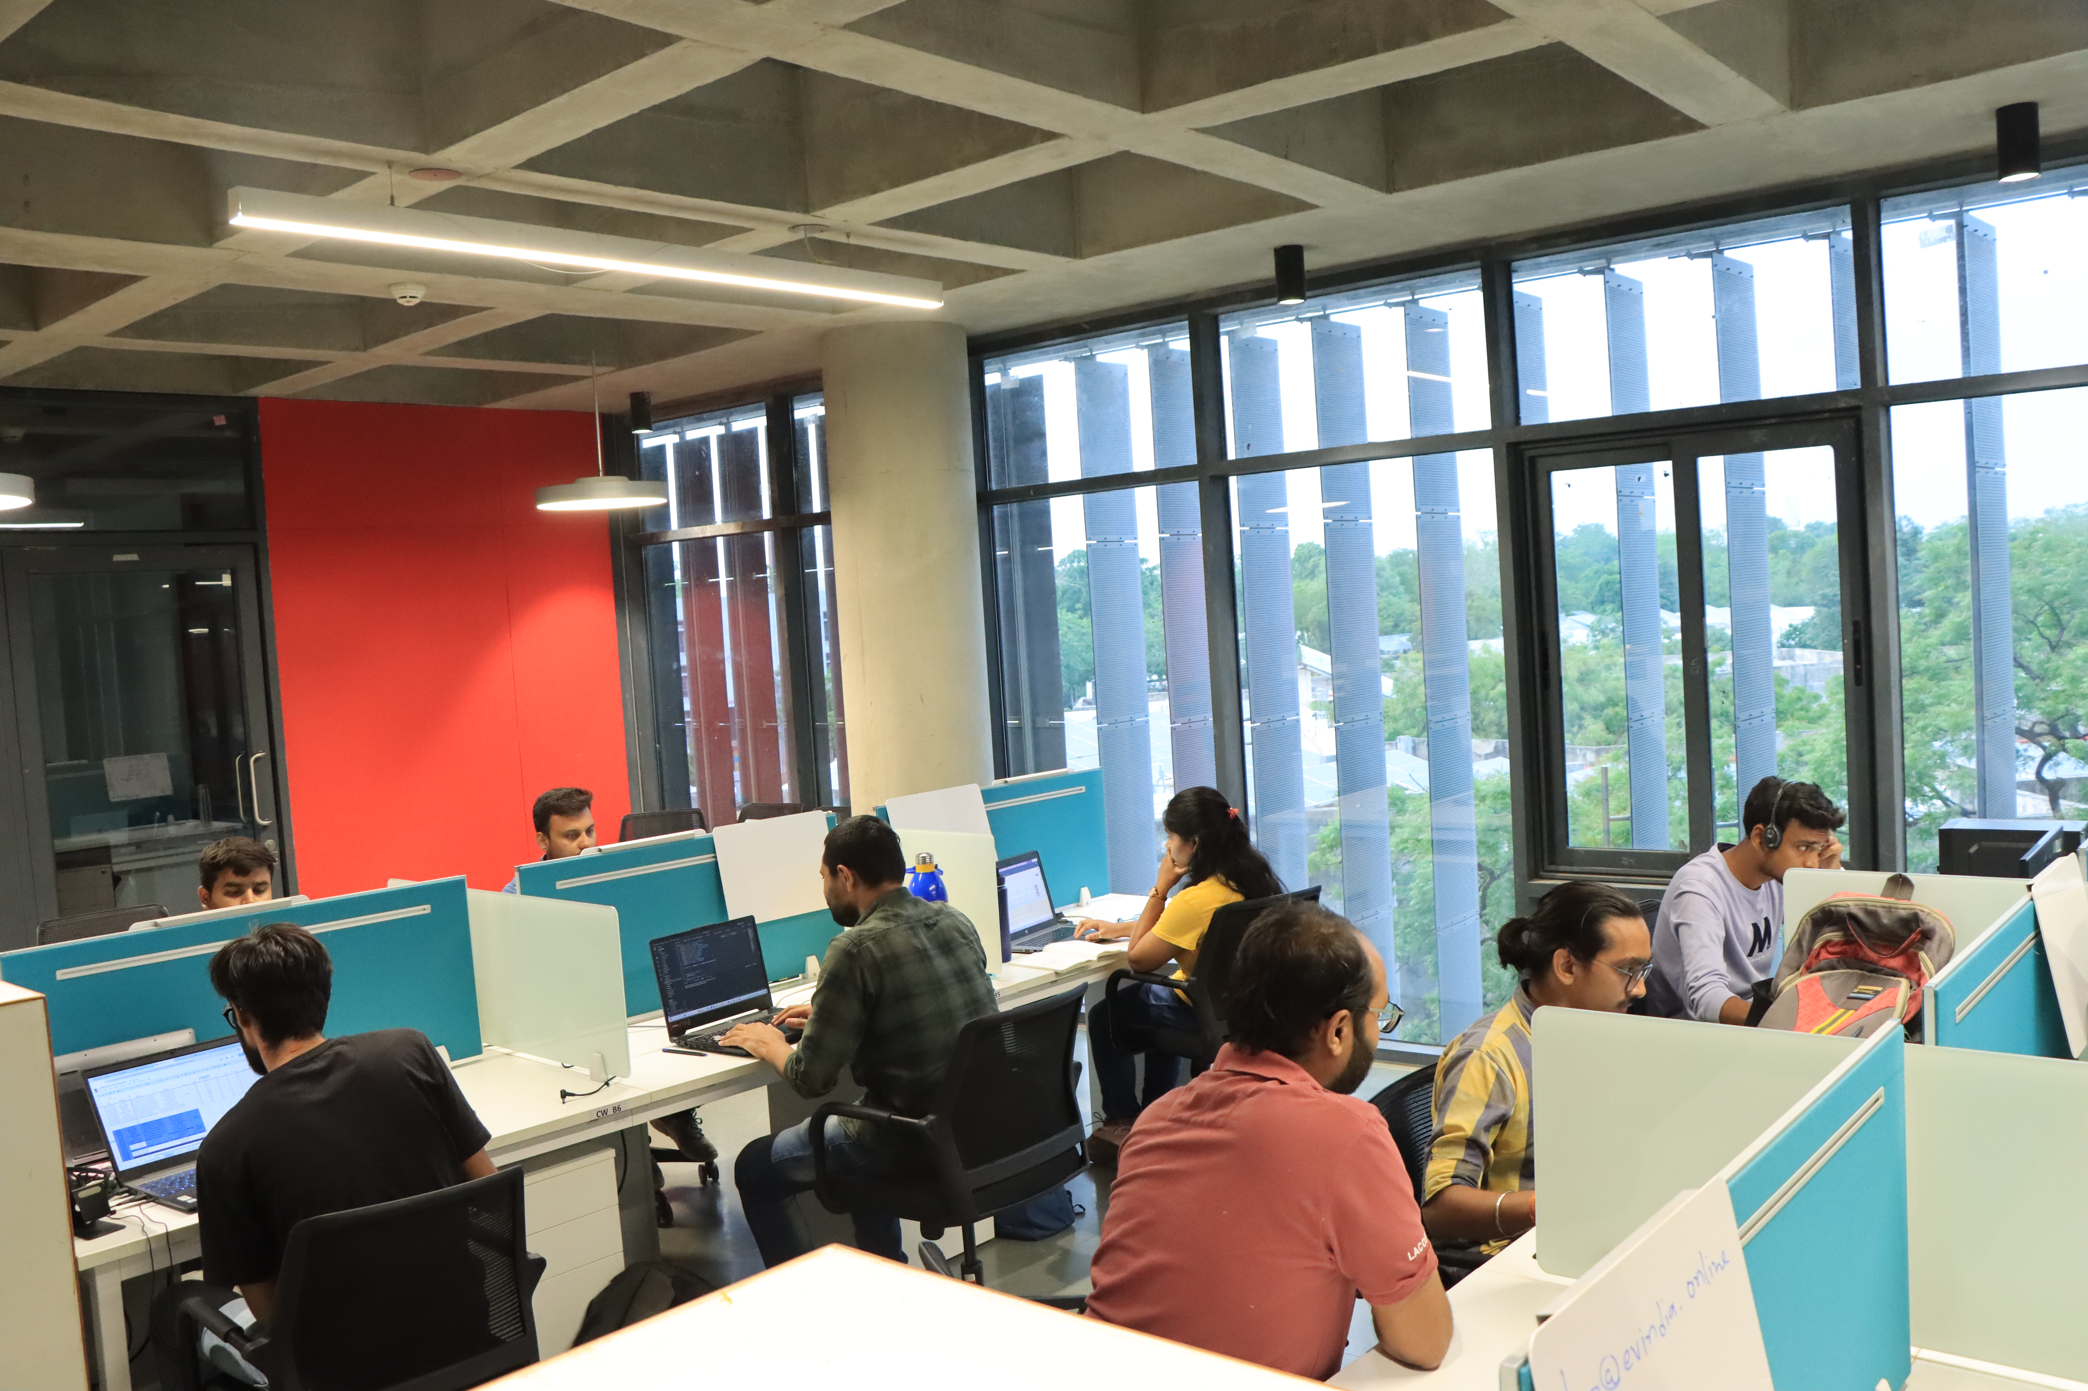
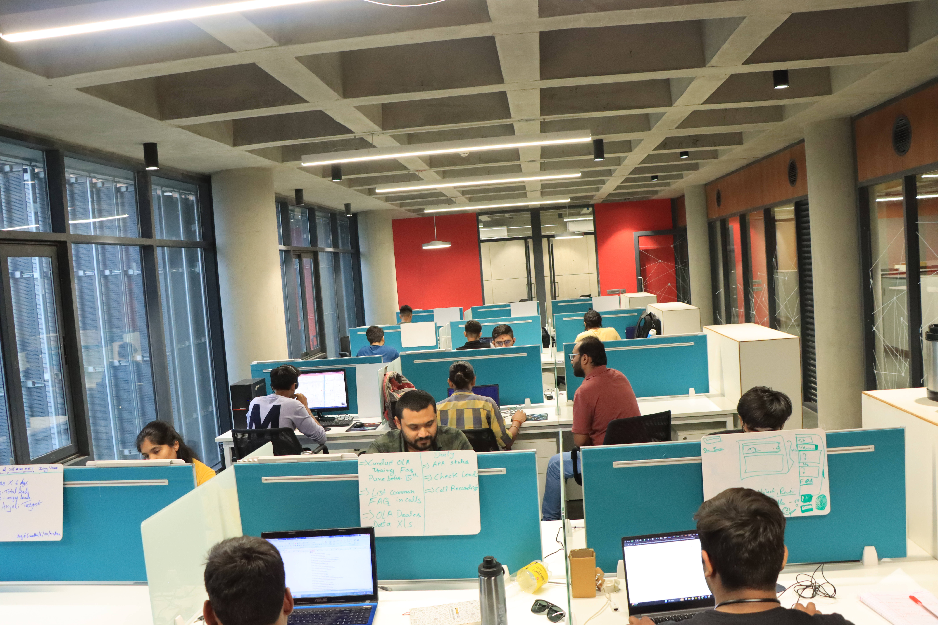
Co-working Space at i-Hub
A total 411 Seats is available for startups
Charges per seat ₹ 3000 per month plus Government taxes.
Startup is allowed to take space at i-Hub for maximum period of 2 years & up to 10 seats.
Cohort | Received Application | No of Startups Selected | No of Seats allocated
Cohort - 1 | 68 | 48 | 159
Cohort - 2 | 39 | 22 | 82
Cohort - 3 | 65 | 42 | 154
Total | 172 | 112 | 395
Back to Agenda

Slide 31
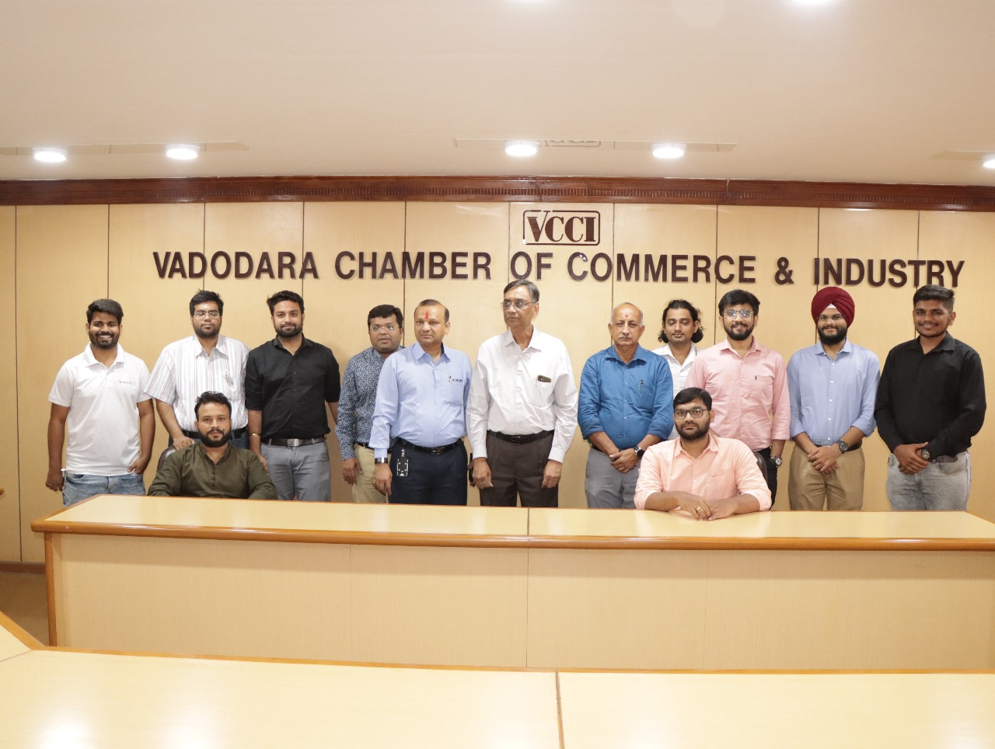
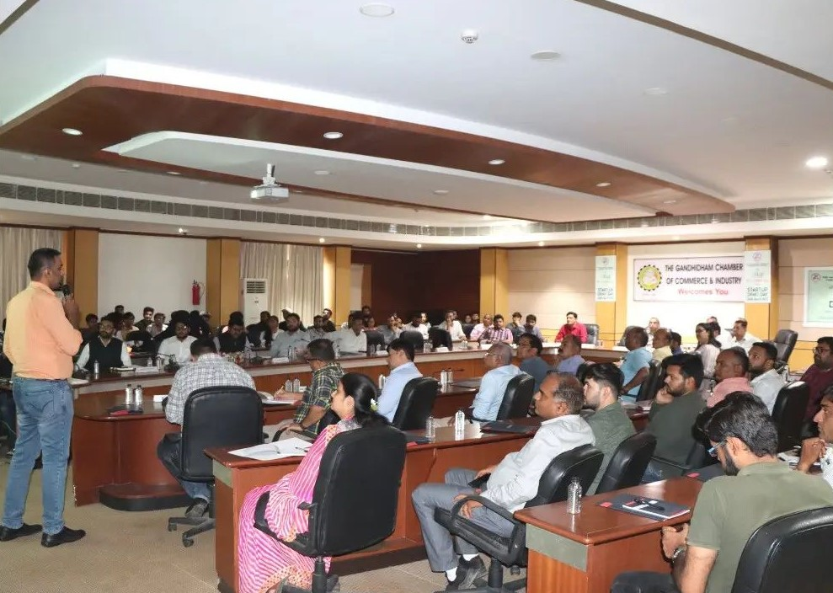
Industry Startup Co-Creation
Demo Days conducted so far: 50
Startups Participated: 250
Sectors Covered:Healthcare, Deep Tech, Agriculture, Clean Tech, Climate Change, Construction Tech
Collaboration with different Industries for Demo Days:
Gujarat Chamber of Commerce and Industry (GCCI)
Vadodara Chamber of Commerce and Industry (VCCI)
The Southern Gujarat Chamber of Commerce and Industry (SGCCI)
Confederation of Indian Industry (CII)
Federation of Indian Chambers of Commerce & Industry (FICCI)
The Gujarat Institute of Civil Engineers & Architects (GICEA)
Institute of Company Secretaries of India (ICSI)
Institute of Chartered Accountants of India (ICAI)
TiE Surat, Ahmedabad, Vadodara
Back to Agenda

Slide 32
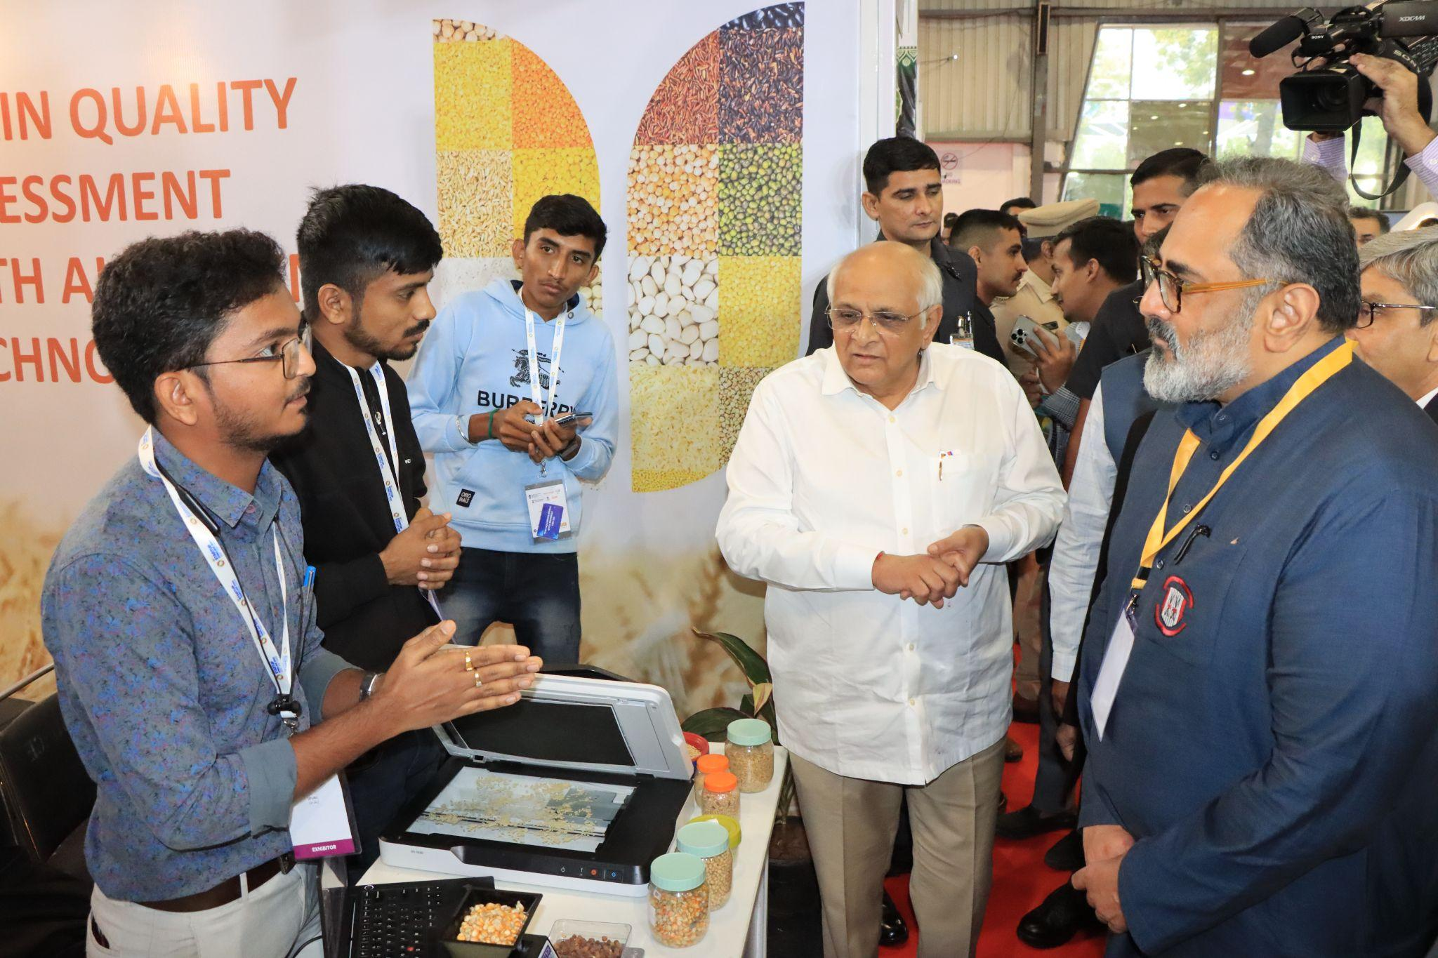
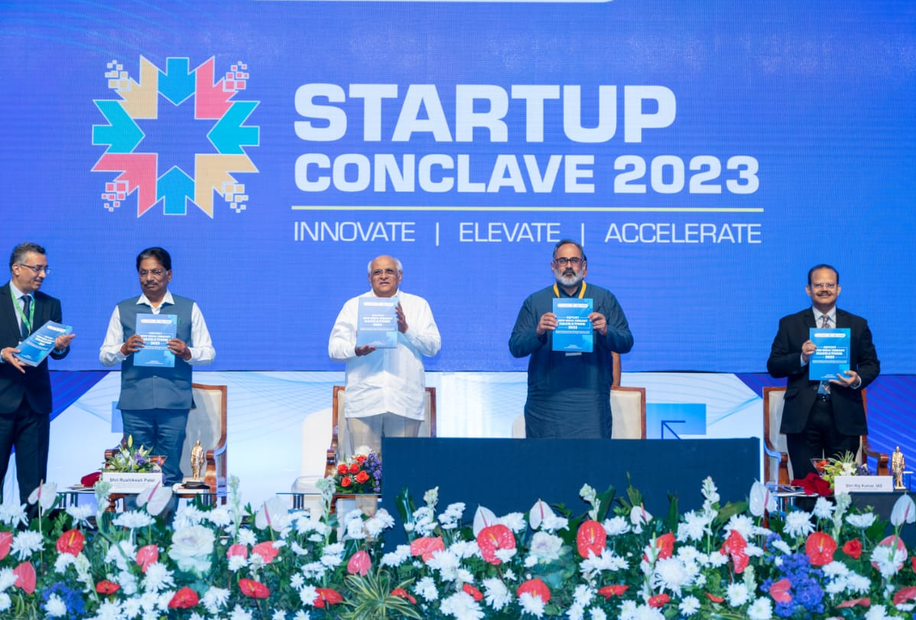
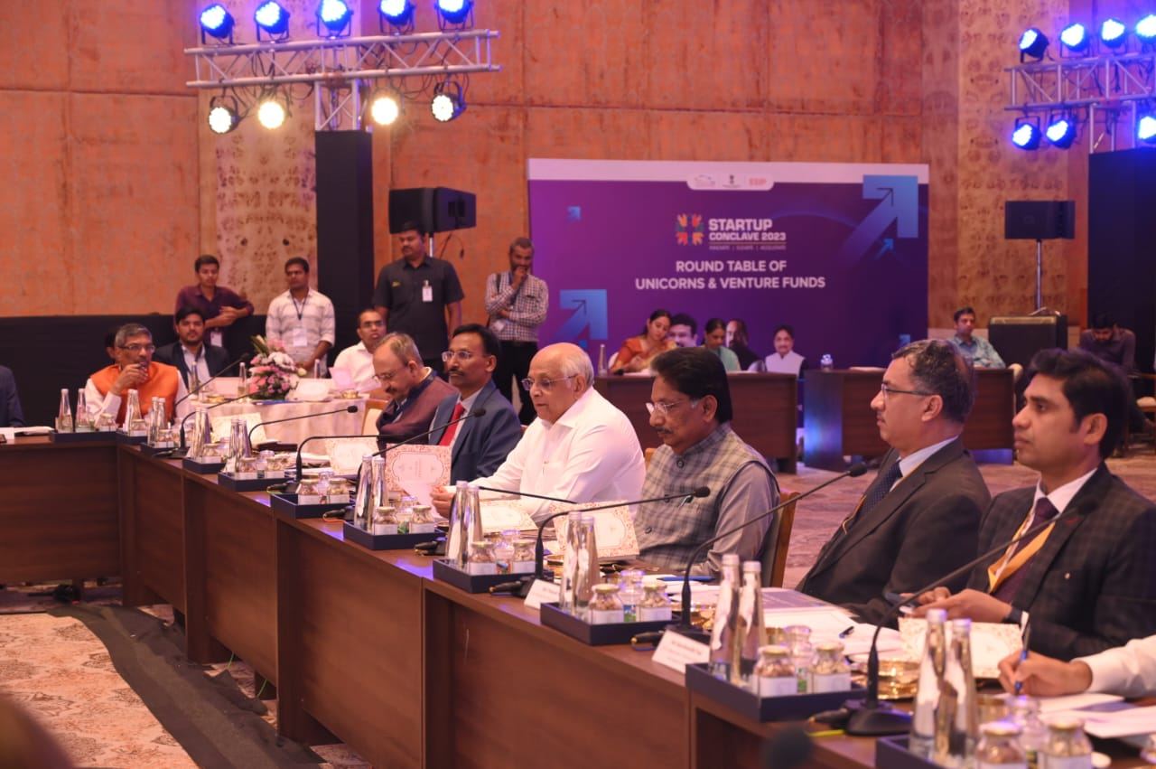
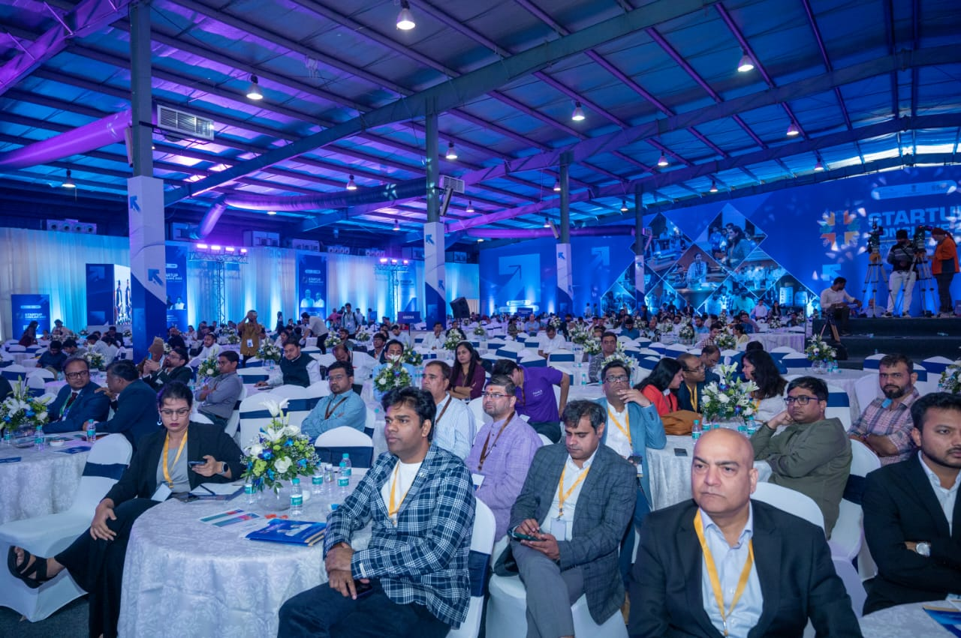
Startup Conclave 2023: A Landmark Event
Startup Conclave 2023 was organized by GKS and i-Hub with the objective to facilitate market connect, private funding and network.
Event Highlights:
Applications Received: 343
Startups Facilitated: 54
Total Investment: INR 146.35 crore through cheques and Letters of Intent (LoI)
Participants: 6 Unicorns, 56 VC funds, 7 Global Accelerators
MoU done with 50 VC funds
No of Startup Exhibited: 250 plus
Unicorn & VC Roundtable Meeting
Investor Pitching – Startup RISE
Startup Conclave Plenary sessions

Slide 33
Investment Partners associated with i-Hub Startups
Maharashtra 9 Unicorns Accelerator Fund Artha Fund Arthaayan Avaana Capital Callapina Capital Cornerstone Venture Partners Equanimity Ventures Indian Angel Network Inflection Point Ventures IvyCap Ventures Trust Lead Angels Menterra Social lmpact Fund Mumbai Angels Piper Serica Unicorn India Ventures | Gujarat Awfficacy Capital Brew VC Cognosent Ventures Desai Family Office Dev X Gujarat Venture Finance Limited iRoller Capital Kathiyawad Ventures Shuru up IVY Growth Pure Capital We Founder Circle | Rajasthan Realtime Angel fund Rajasthan Angels TiE Angels Marwadi catalyst | Chennai Anicut Angels Anicut Capital Artha99 Beej Network Enlighten VC The Chennai Angels | Delhi India Accelerator Physis Capital Fluid Ventures Hostel Fund | Bengaluru NinjaKart Ventures Transition VC Arali Ventures Seafund Clay Capital Campus Fund Lets Venture

Slide 34
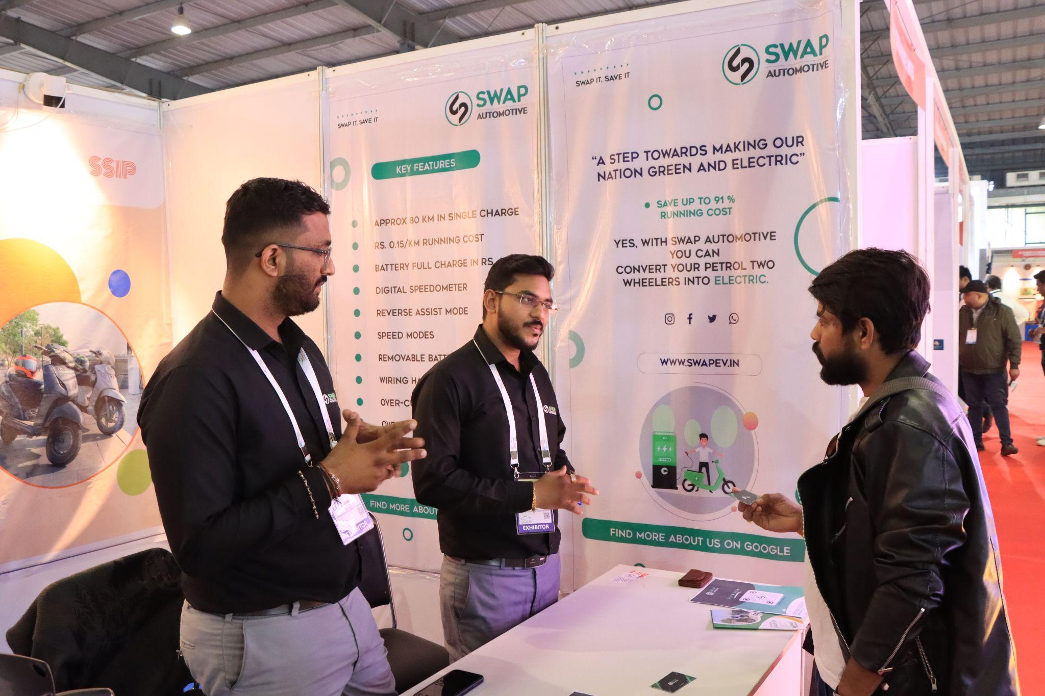
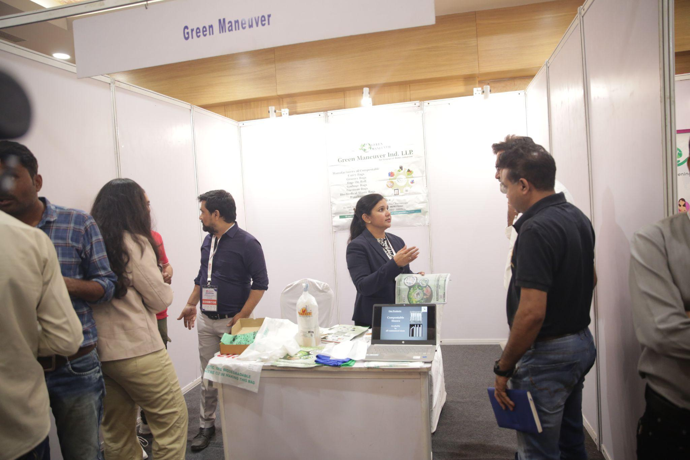
Startups Showcase via Exhibitions
In the past two years, we have showcased over 200+ startups across 32+ exhibitions.
Benefits of Exhibition
Networking opportunity with investors
Marketing and brand building
Interaction with different stakeholders
Connect with different industry personal
Exposure to vibrant network of allied industries
Back to Agenda

Slide 35
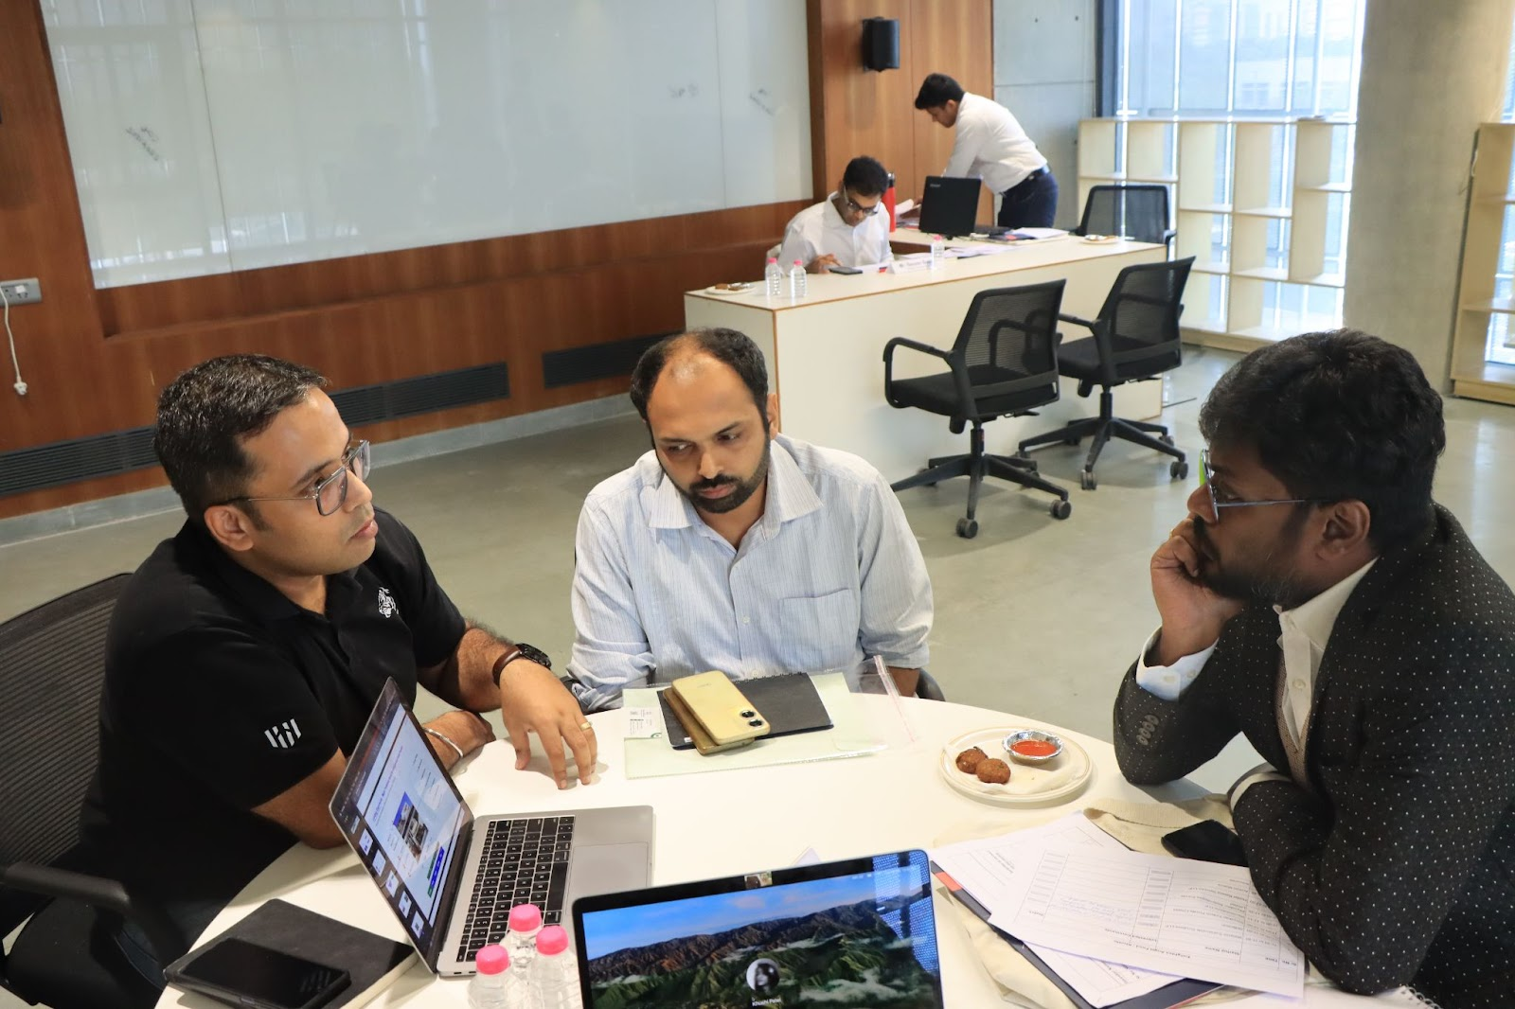
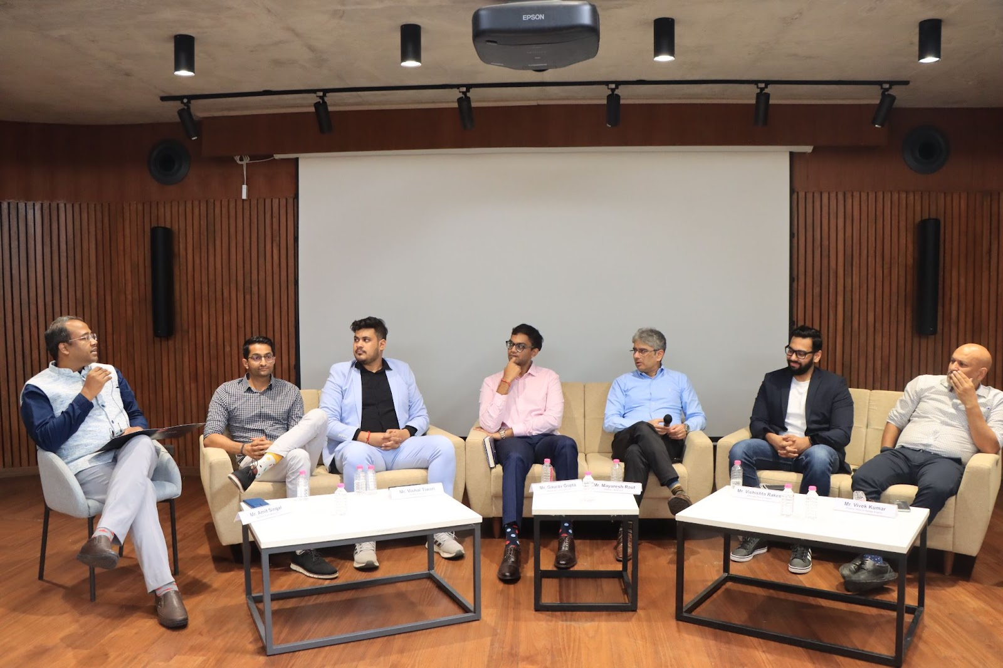
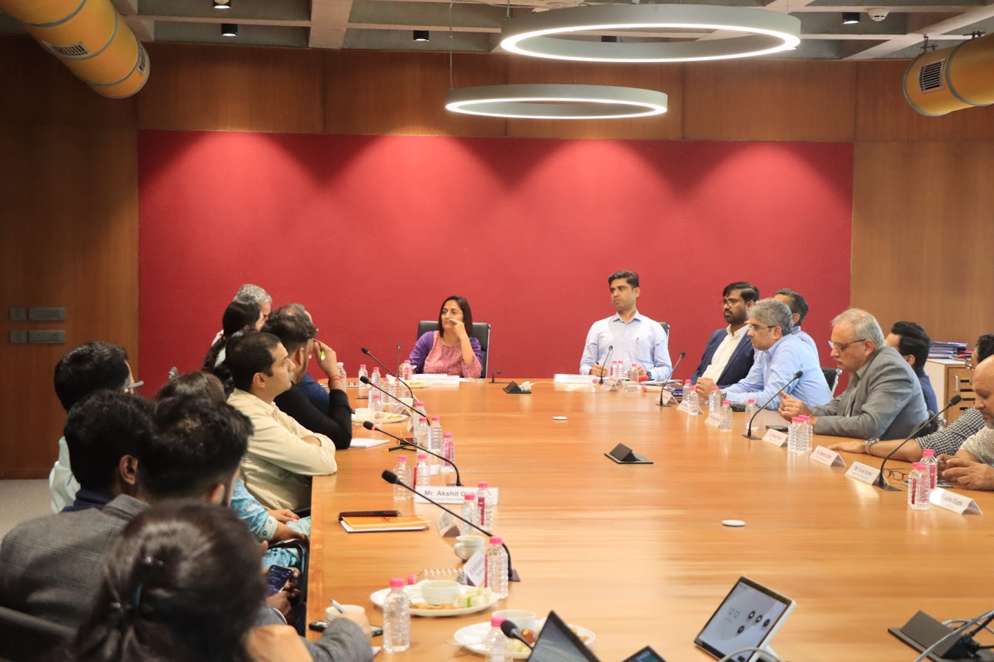
Flagship Initiative to support Agritech startups: Startup Samvardhan
Event Overview:
In September 2024, i-Hub organized “Startup Samvardhan,” a sector specific event focusing on early-stage startups of Agritech.
Participants:
24 Investors
20 Agri Based Startups
Event Highlights:
One on One Pitching Sessions
Deep Dive Sessions
Roundtable Discussions with Govt. Officials
Panel Session
Back to Agenda

Slide 36
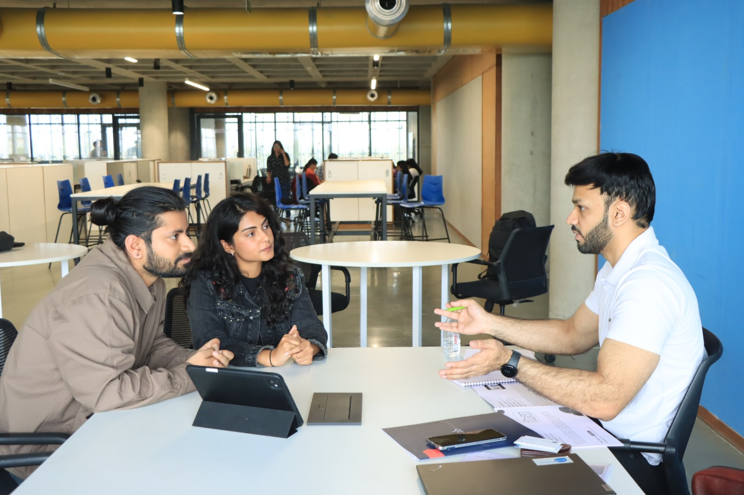
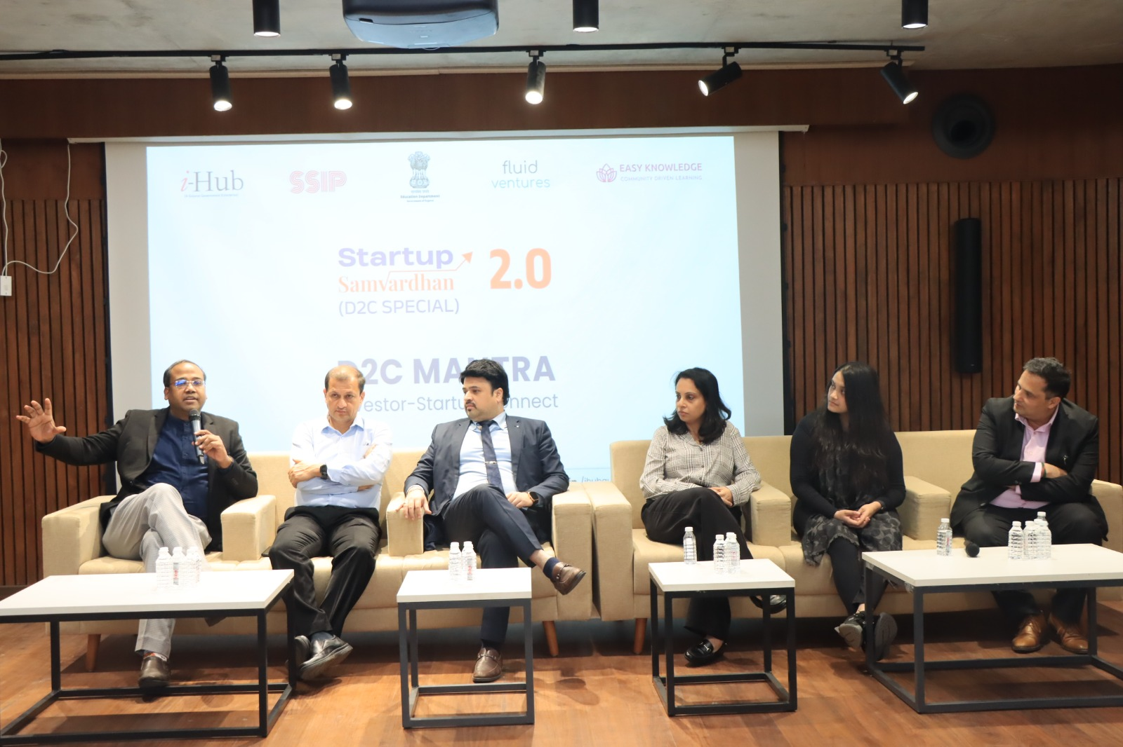
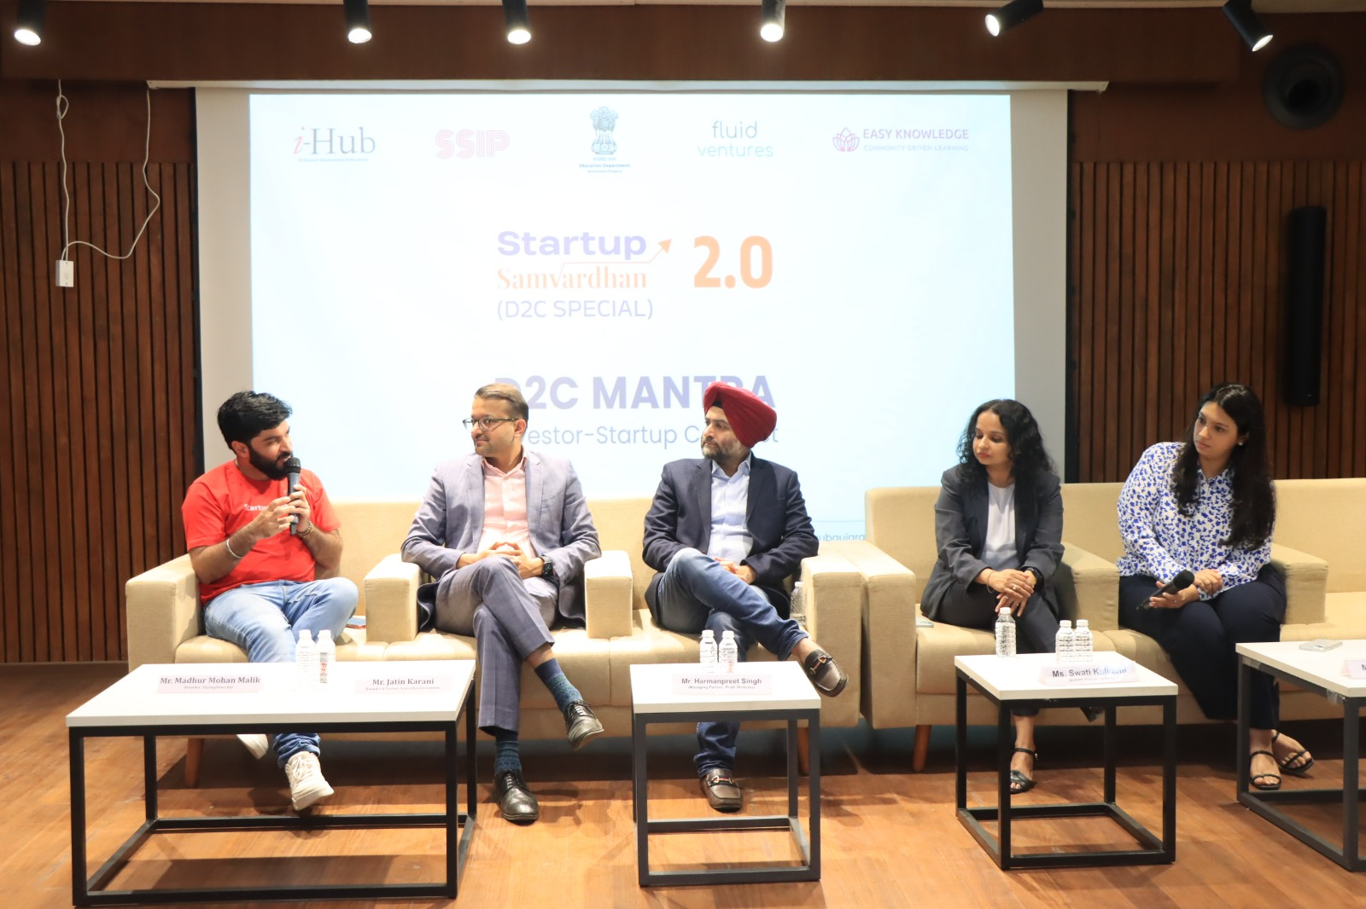
Flagship Initiative to support Social Impact startups: Invest for Impact
Event Overview:
In November 2024, i-Hub organized “Invest for Impact,” a sector specific event focusing on early-stage startups with high social, environmental, and economic impact.
Participants:
25 Investors
26 Impact Based Startups
Event Highlights:
One on One Pitching Sessions
Deep Dive Sessions
Roundtable Discussions with Govt. Officials
Panel Session
Back to Agenda

Slide 37
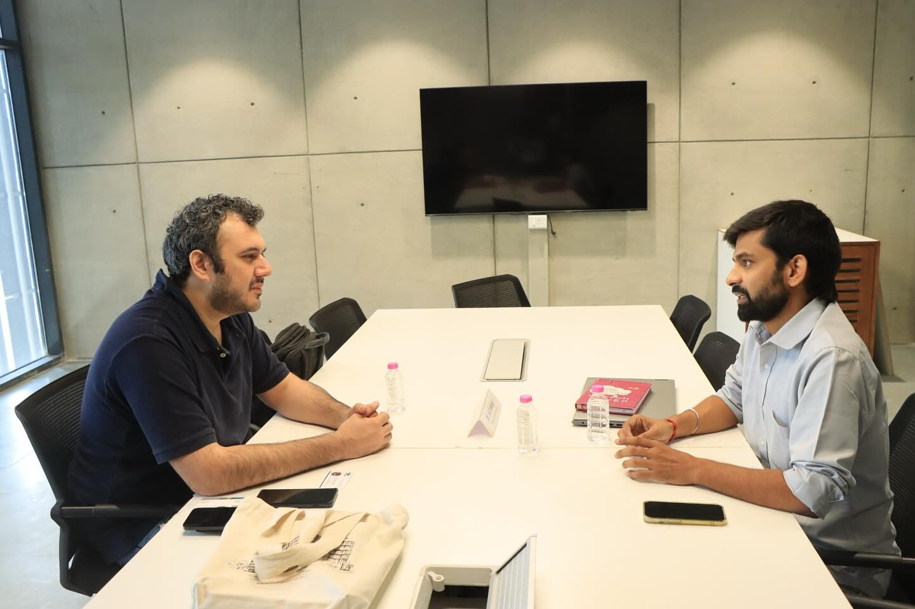
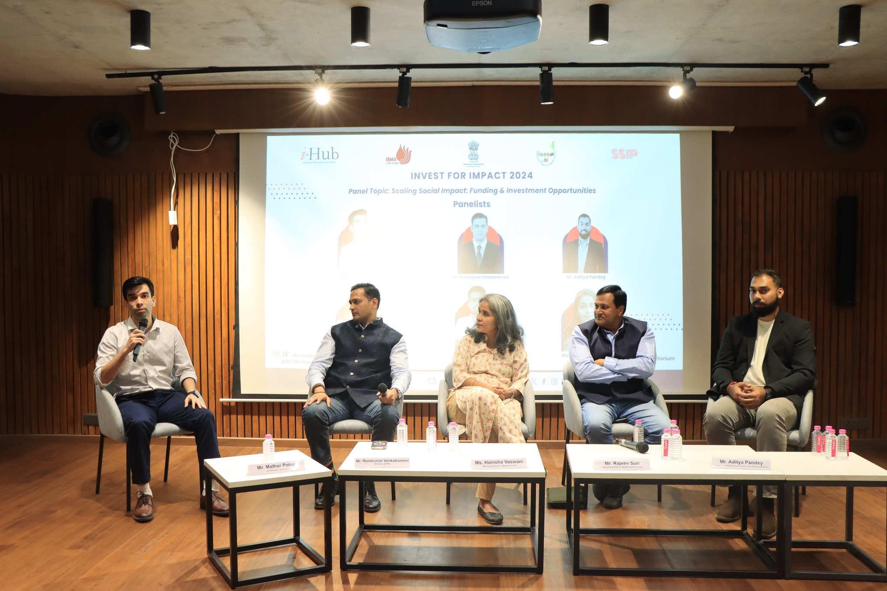
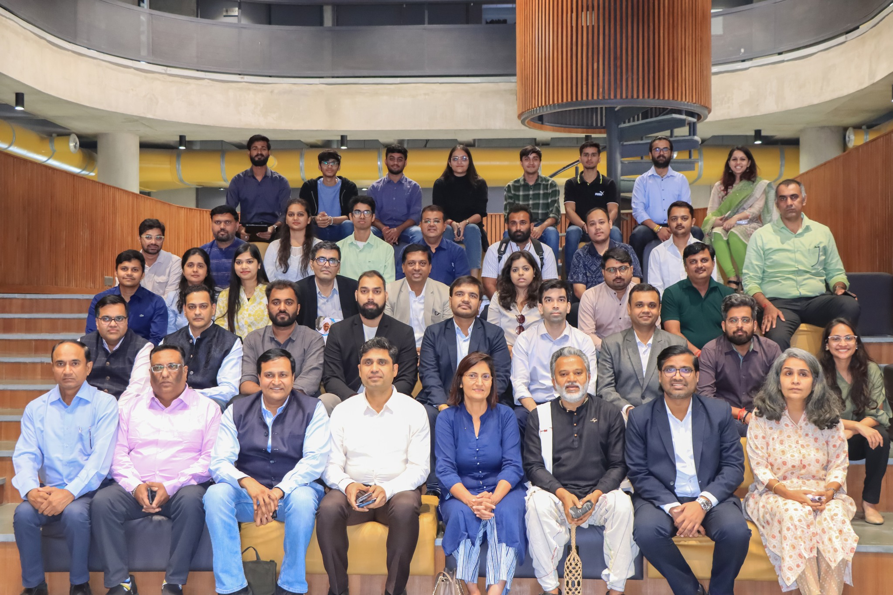
Flagship Initiative to support D2C startups: D2C Mantra
Event Overview:
In February 2025, i-Hub organized “D2C Mantra,” a sector specific event focusing on early-stage startups are in direct-to-consumer space.
Participants:
16 Investors
18 D2C Based Startups
Event Highlights:
One on One Pitching Sessions
Deep Dive Sessions
Roundtable Discussions with Govt. Officials
Panel Session
Back to Agenda

Slide 38
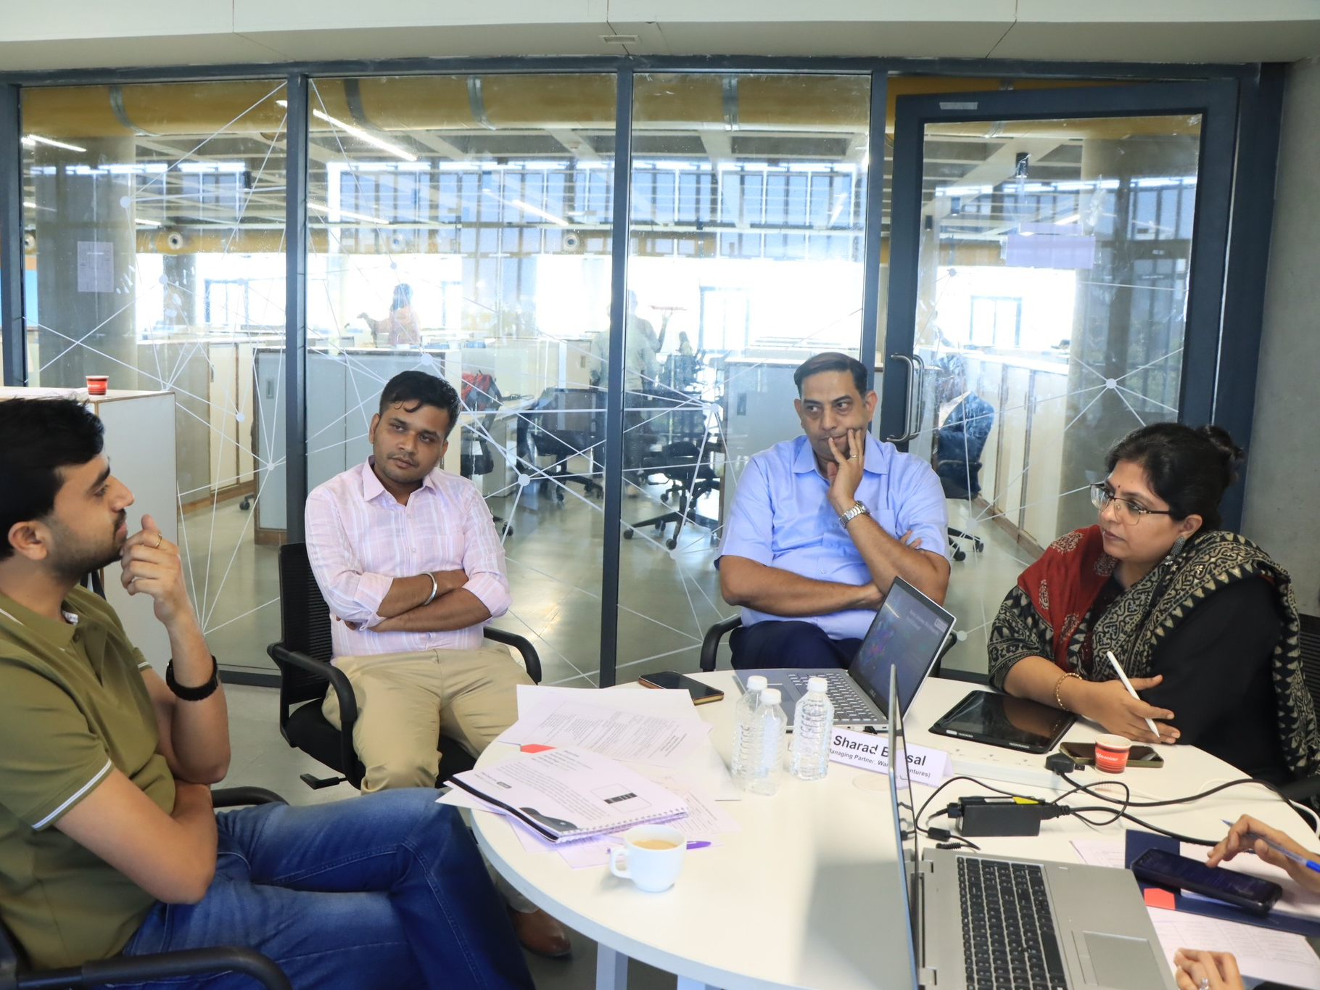
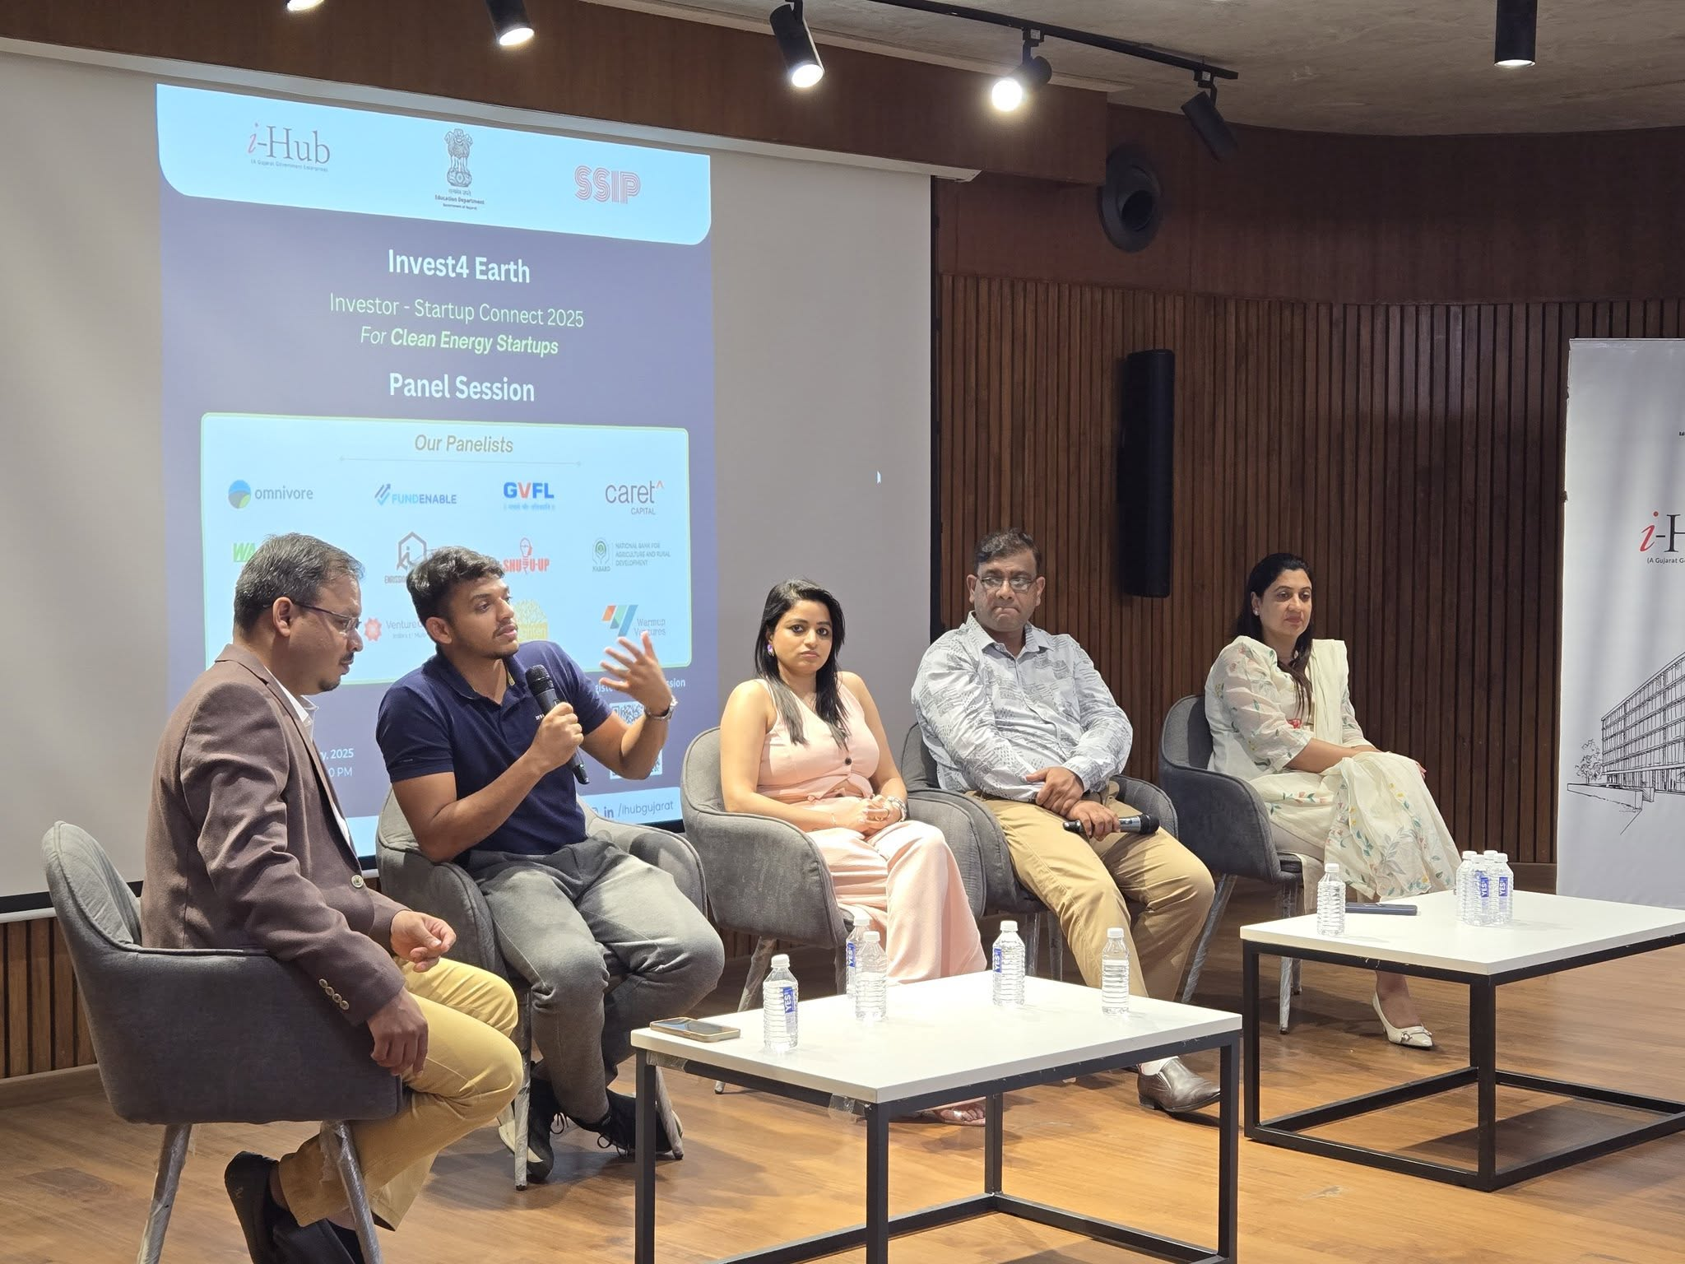
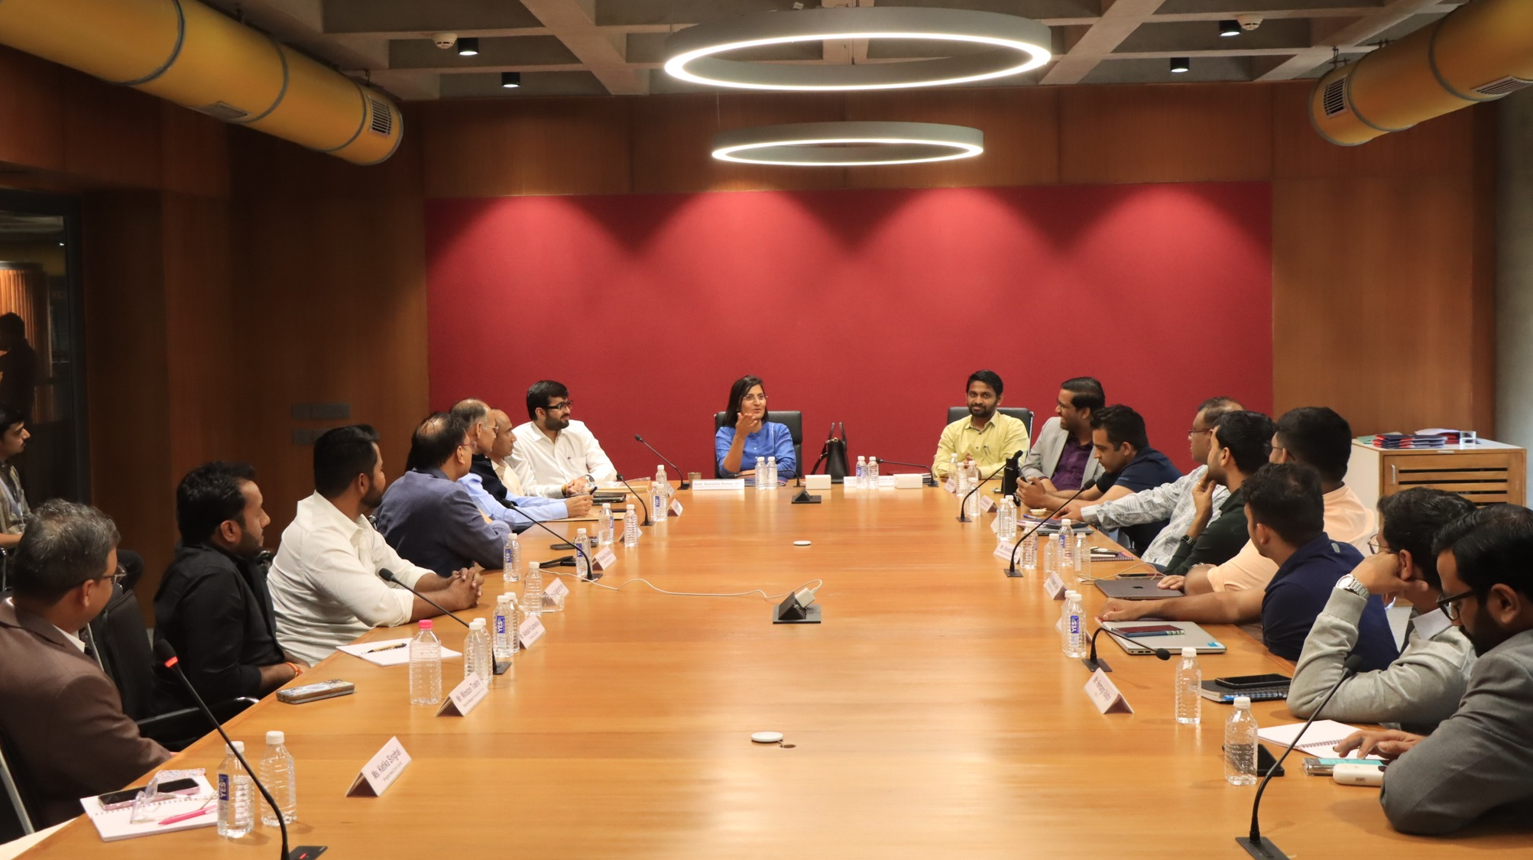
Flagship Initiative to support Cleantech startups: Invest4Earth – Cleantech Startups
Event Overview:
i-Hub Gujarat organized “Invest4Earth 2025 | Investor-Startup Connect”, on 17th and 18th of February 2025 in Ahmedabad.
Participants:
20 Investors
19 Startups
Event Highlights:
One-on-One Pitching Sessions
Deep Dive Sessions
Roundtable Discussions with Govt. Officials
Panel Session
Back to Agenda

Slide 39
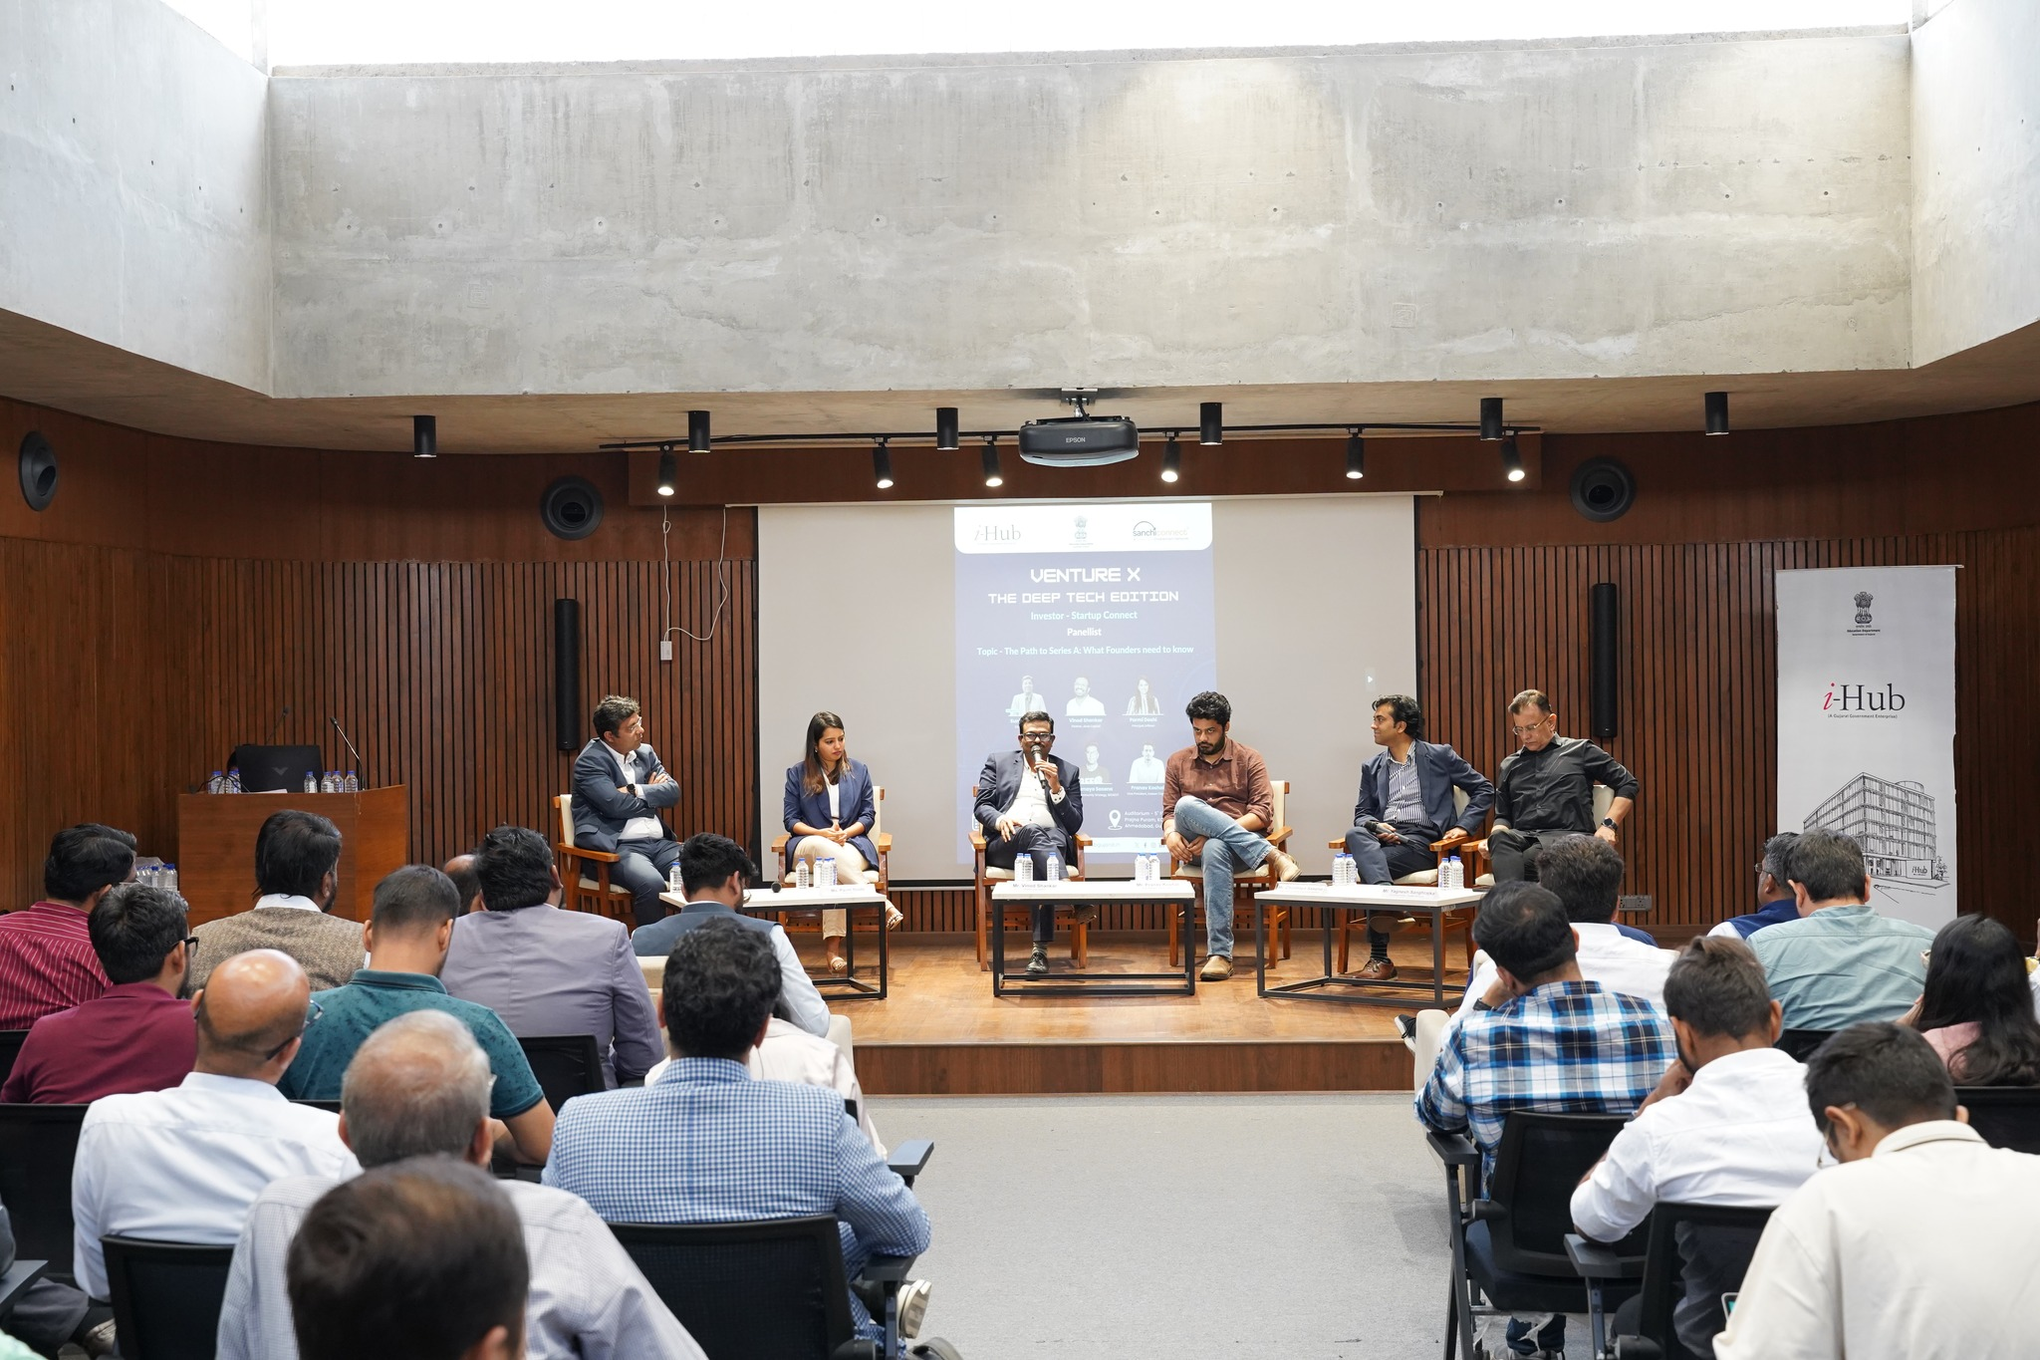
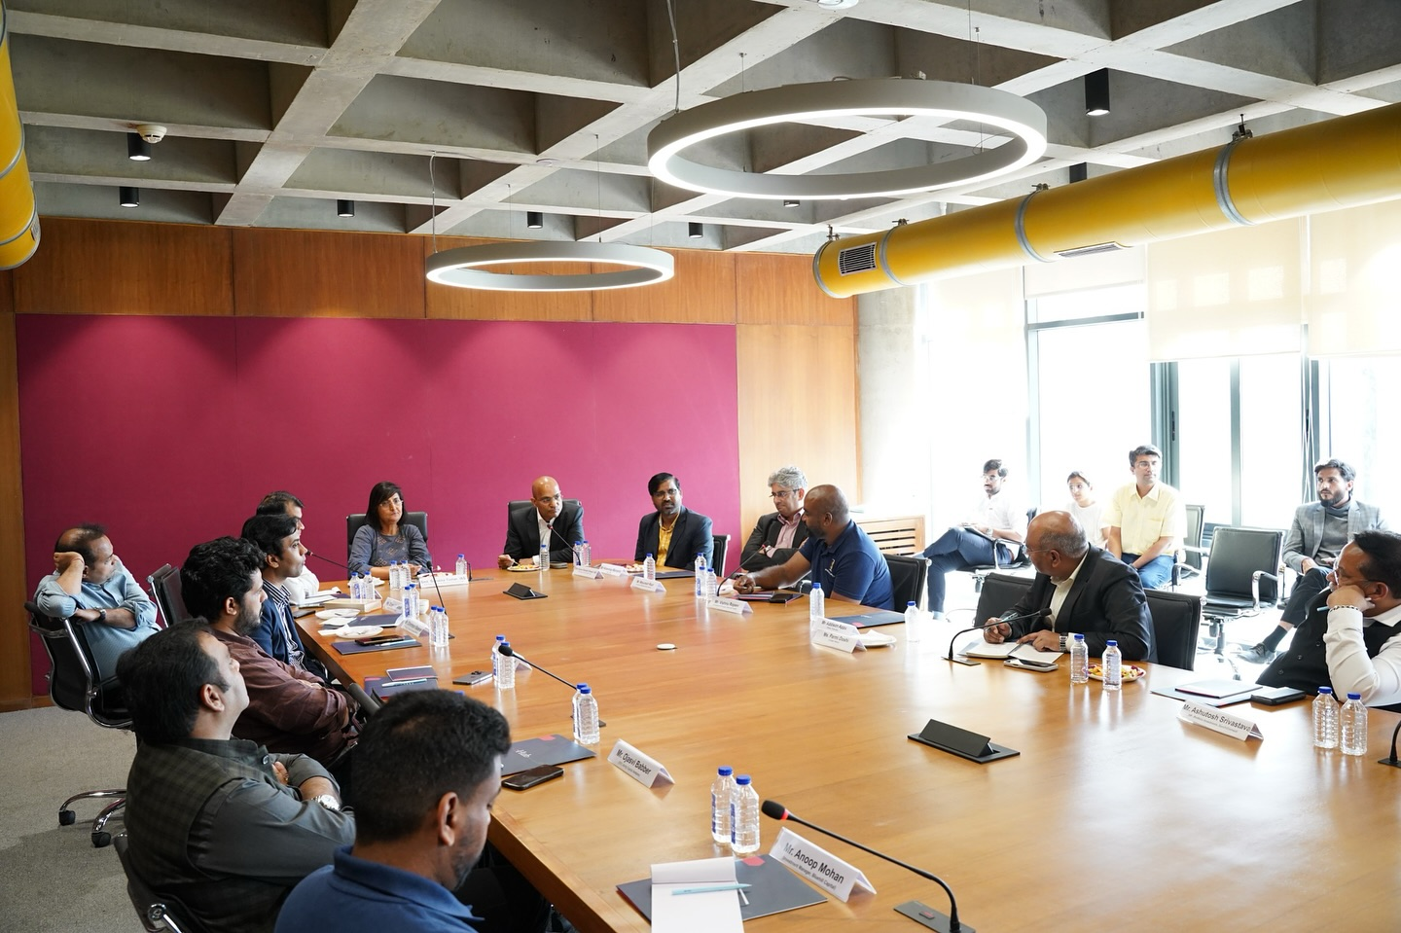
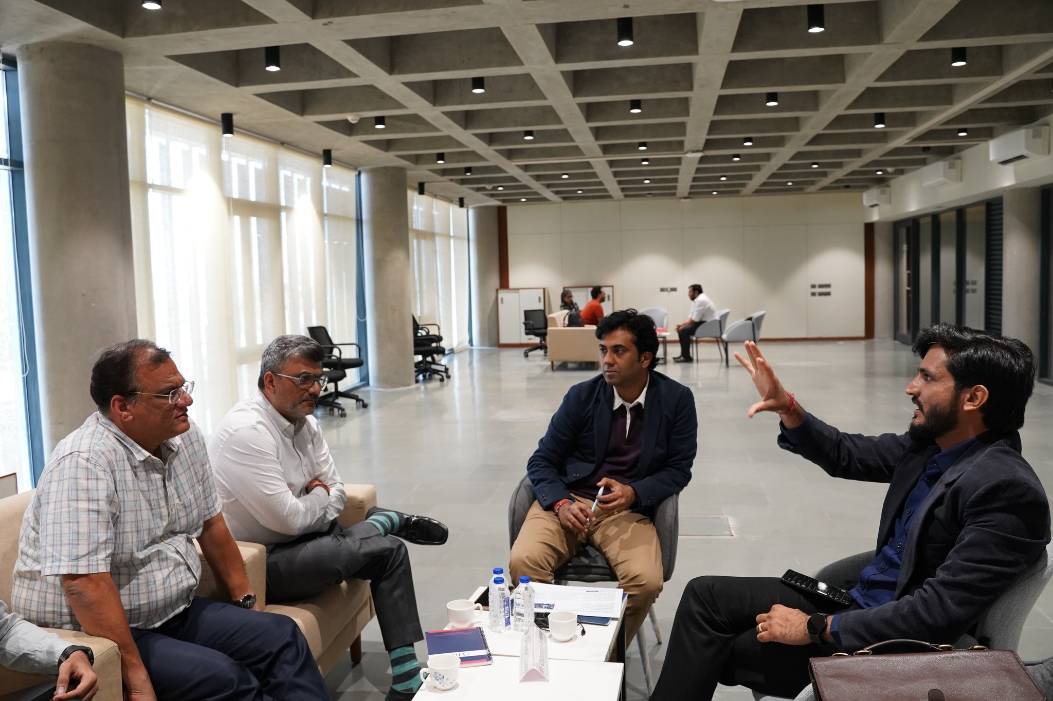
Flagship Initiative to support Deeptech startups: VentureX - The Deeptech Edition
Event Overview:
i-Hub Gujarat organised VentureX - The Deeptech Edition | Startup- Investor Connect on the 5th & 6th of March 2025 in Ahmedabad.
Participants:
19 Investors
26 Startups
Event Highlights:
One-on-One Pitching Sessions
Deep Dive Sessions
Roundtable Discussions with Govt. Officials
Panel Session
Back to Agenda

Slide 40




i-Hub Supported Startups featured in Shark Tank India
Startup Name | Funded Valuation
Wehear | INR 250 Crore
Solance tec Pvt Ltd | INR 40 Crore
Joyspoon | INR 20 Crore
Kibo | INR 10 Crore
Karigar Clinic Pvt Ltd | INR 4 Crore
Honey veda | INR 2.5 Crore
Prahantam Pvt Ltd | INR 1.5 Crore
Back to Agenda

Slide 41
Working with different departments to support startups
Gujarat Urja Vikas Nigam Limited (GUVNL)
48 problem statements shared with researcher/innovator/startup;
12 ideas funded with M2M Open Innovation grant
Helped them in designing procurement policy for startups
Gujarat Livelihood Promotion Company Limited (GLPC)
We are helping GLPC for formulation of policy to support startups who are working in social impact and allied sectors
State Health System Resource Centre (SHSRC-G)
Demo days healthcare startups with medical faculties to nurture Healthcare Startup ecosystem
Sensitised the students of Medical Colleges
Established Hand-holding of Healthcare startups for piloting of the product/services
Gujarat Agro Industries Corporation
We are helping GAIC for easy execution of State Government sponsored Food Processing Policy for Agri and Food allied startups
Back to Agenda

Slide 42

Thank You

