Slide 1
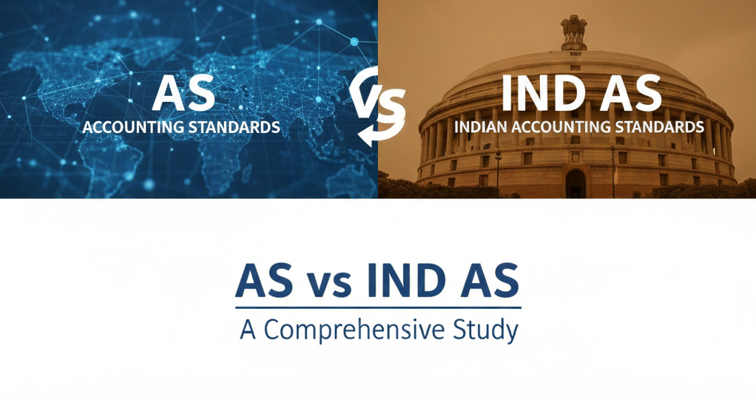
CA RUSHABH SHAH
RAJKOT

Slide 2
WHAT IS IND AS?
IFRS-converged standards issued by MCA
Setting up global financial language
Principle based approach as against rule based approach of AS
Notes:
Why is it here? (The 3 Cs)
Capital: To allow Indian companies access to global capital markets (lower cost of funds).
Comparability: To make an Indian Balance Sheet comparable with a German or US Balance Sheet.
Credibility: To enhance transparency through stricter disclosures and "Fair Value" accounting.
Feature Traditional AS (Indian GAAP)Ind AS (IFRS Converged)
Primary Focus
P&L Focused (Prioritizes matching revenue and expenses to determine Net Profit.)
Balance Sheet Focused (Prioritizes accurate valuation of Assets and Liabilities; changes in value flow to P&L or OCI.)
Valuation Base
Historical Cost (Transactions are recorded at the price paid and rarely re-measured.)
Fair Value (Assets and liabilities are often re-measured to reflect current market value (e.g., Investments, Derivatives).)
Substance
Legal Form Prevails (Accounting often follows the legal contract (e.g., Operating Lease was off-balance sheet).
Economic Substance Prevails (Accounting follows the economic reality (e.g., Leases are capitalized as "Right of Use" assets).)
Time Value of Money
Ignored (Long-term items are often recorded at face value (e.g., Interest-free loans).)
Critical (Future cash flows must be discounted to Present Value (e.g., Security Deposits, Decommissioning Liabilities).)

Slide 3
Failure to make provision for Expected Credit Loss (ECL) – Non Compliance with IND AS 109.
Failure to provide depreciation on assets for non operating company – Non Compliance with IND AS 16.
These errors cost Rs. 2 lakhs in fine and 2 years of debarment for auditor and audit firm from conducting audit
Vikas Proppant and Granite Limited

Slide 4
IND AS APPLICABILITY
Listed Companies
Every Listed company except listed in SME
Unlisted Companies
Net worth 250 Cr or more
NBFC & Insurance Companies
Net worth 250 cr or more
*Also applicable to Holding, Subsidiary, Associate and JV of above
**Net Worth = Share Capital + Reserves created out of profit + Security Premium – Accumulated losses – Deferred Expenditure – Misc Exp not w/off.

Slide 5
Why should we know about INDAS?
Global Comparability
Enhanced Transparency and Reliability
Improved Decision-Making
Regulatory Compliance
Access to Capital
Consistency Across Industries
Operational Efficiency for Multinationals
Notes:
Key Importance of Ind AS
1. Global Comparability:
Ind AS enables comparison of Indian companies' financial statements with international counterparts, aiding global investors and attracting cross-border investments to India.
2. Enhanced Transparency and Reliability:
The standards promote trust among stakeholders by ensuring financial statements accurately reflect a company's position and by requiring detailed disclosures that reduce misstatement risks.
3. Improved Decision-Making:
Reliable and standardized financial information is essential for stakeholders like investors and banks to make informed decisions.
Regulatory Compliance:
Adherence to Ind AS helps companies comply with corporate governance requirements from regulatory bodies like the MCA and SEBI.
5. Access to Capital:
Compliance with global standards boosts a company's credibility, simplifying access to domestic and international funding.
6. Consistency Across Industries:
Ind AS provides a uniform accounting framework across Indian industries, making auditing and performance assessment easier.
7. Operational Efficiency for Multinationals:
Multinational companies in India benefit from reduced complexity and cost in preparing financial statements due to the IFRS-converged framework.

Slide 6

NFRA Penalties

Slide 7
Penalty Not on company, but on auditor
Debarment From 6 months to 10 years
Notes:
Monetary Penalty:
The fine is a minimum of ₹1 lakh and can extend up to five times the professional fees received. The fine is a minimum of ₹5 lakh and can extend up to ten times the professional fees received for CA Firm.
Debarment:
The CA can be debarred from being appointed as an auditor or internal auditor, or from undertaking any audit in respect of financial statements of any company or body corporate, for a period ranging from six months to ten years.

Slide 8
Sanwaria Consumer Limited
Key audit failures noticed by NFRA:
Ind AS 2 – Inventories
Ind AS 36 - Impairment of Assets
Ind AS 110 - Consolidated Financial Statements and Ind AS 28 - Investments in Associates
Ind AS 115 - Revenue Recognition
Ind AS 24 - Related Party Transactions
Penalties Imposed
NFRA imposed a monetary penalty of ₹5 lakh and a one-year debarment on Chartered Accountant Santosh Deshmukh for his misconduct during the audit of Sanwaria Consumer Limited for the financial year 2017-18.
Notes:
Ind AS 2 - Inventories: The auditor, CA Santosh Deshmukh, failed to verify the existence and valuation of Sanwaria Consumer's inventory, leading to a significant overstatement of soya seed and paddy inventories.
Ind AS 36 - Impairment of Assets: Deshmukh failed to perform proper impairment testing of the company's investments in its loss-making subsidiaries and associate companies, such as Sanwaria Energy Limited (SEL) and Shreenathji Solvex Limited (SSL). These investments were carried at cost despite the subsidiaries' poor financial performance and negative net worth, and NFRA determined their recoverable value was reduced to zero.
Ind AS 110 - Consolidated Financial Statements and Ind AS 28 - Investments in Associates: The auditor was found to be negligent in evaluating and reporting non-compliance related to the consolidation of financial statements, as well as the accounting for investments in associates.
Revenue Recognition: The NFRA also noted that the auditor did not perform adequate procedures to address the risk of misstatement in revenue recognition.
Related Party Transactions: The audit lacked sufficient evidence and proper procedures for related party transactions.

Slide 9
Man Industries (India) Limited
Key audit failures noticed by NFRA:
Ind AS 110 - Consolidated Financial Statements
Ind AS 24 - Related Party Disclosures
Ind AS 107 - Financial Instruments: Disclosures
Penalties Imposed:
A monetary penalty of ₹30 lakh each on both CA Devang Dalal and M/s. M H Dalal & Associates, totaling ₹60 lakh.
Notes:
Ind AS 110 - Consolidated Financial Statements: The company failed to consolidate the financial statements of its wholly-owned subsidiary, Merino Shelters Pvt. Ltd. (MSPL), for six consecutive years (FY 2015-2021). This resulted in an overstatement of profits in MIIL's standalone accounts and concealed the group's actual financial position.
Ind AS 24 - Related Party Disclosures: There were pervasive misrepresentations and inadequate disclosures regarding transactions with related parties. The company failed to report related party loans and transactions on a gross basis, instead using net figures, which understated the true volume of these dealings. The conversion of a large loan into a capital advance without proper approval or disclosure also violated this standard.
Ind AS 107 - Financial Instruments: Disclosures: The company and its auditors failed to provide accurate and sufficient disclosures regarding the credit risk profile and exposure of trade receivables

Slide 10
KEY CONCEPTS AND DIFFERENCES

Slide 11
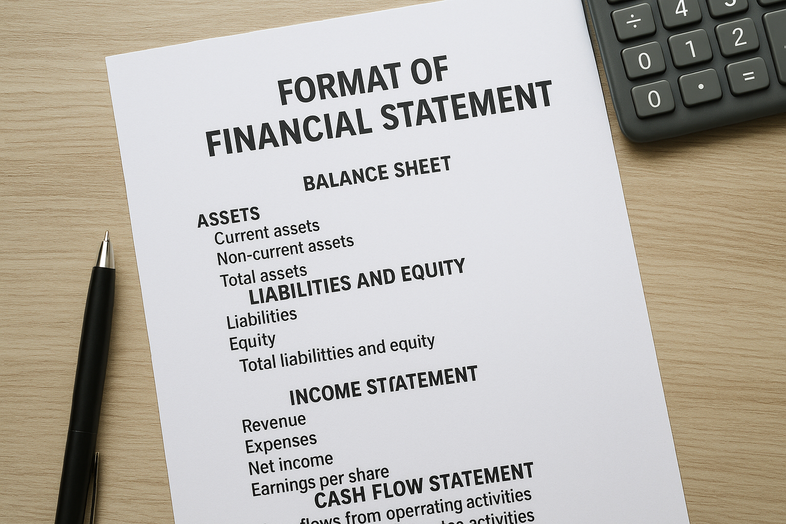
FORMAT OF FINANCIAL STATEMENTS
Notes:
Ind AS 113 provides a single, comprehensive framework for how to measure fair value when other Ind AS standards require or permit it.
Moves away from historical cost by widely applying fair value measurement to assets and liabilities, reflecting their current market value
Explicitly defines fair value as an exit price: the price to sell an asset or transfer a liability in an orderly transaction between market participants
Ind AS 109 requires various financial instruments to be measured at fair value through profit and loss (FVTPL) or through other comprehensive income (FVTOCI), based on their business model and cash flow characteristics.
List of Items to be stated at Fair value in Ind AS:
Financial Instruments
Property, Plant & Equipment (PPE)
Investment Property
Biological Asset
Asset Acquired in Business Combinations

Slide 12
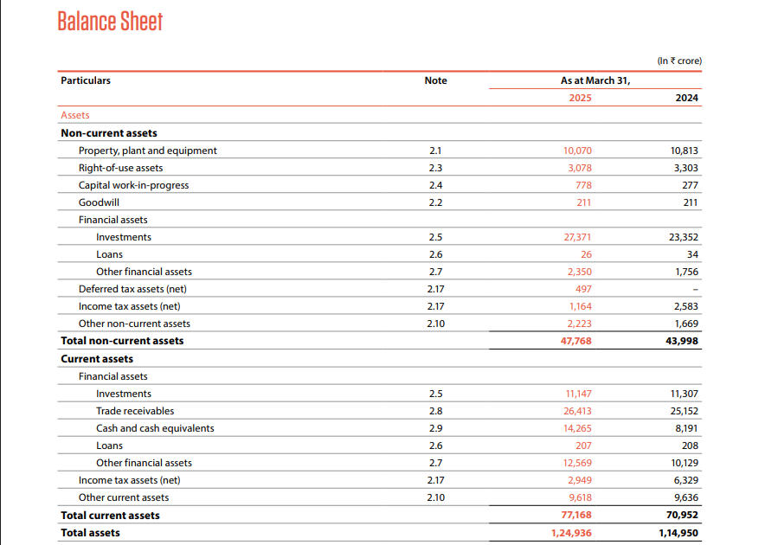
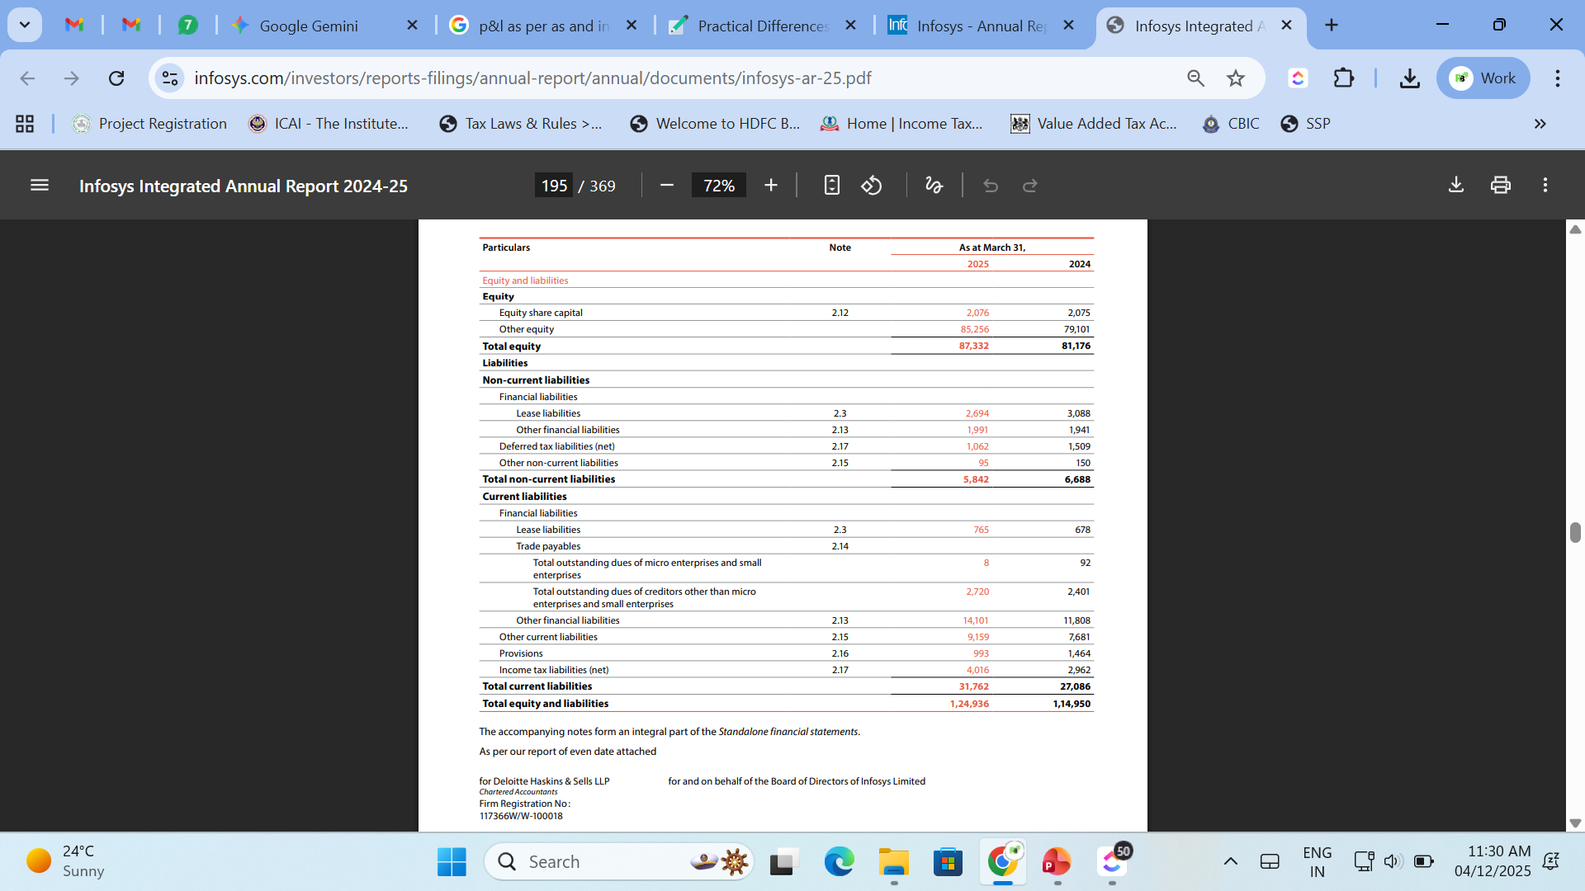
BALANCE SHEET AS PER IND AS

Slide 13
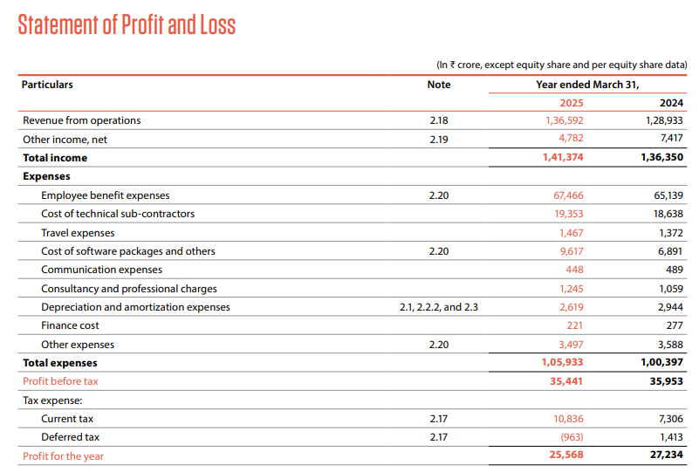
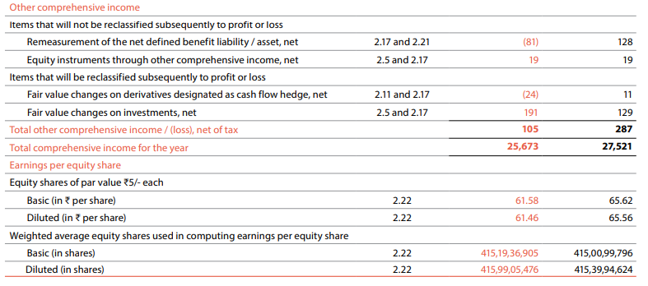
STATEMENT OF PROFIT AND LOSS AS PER IND AS

Slide 14
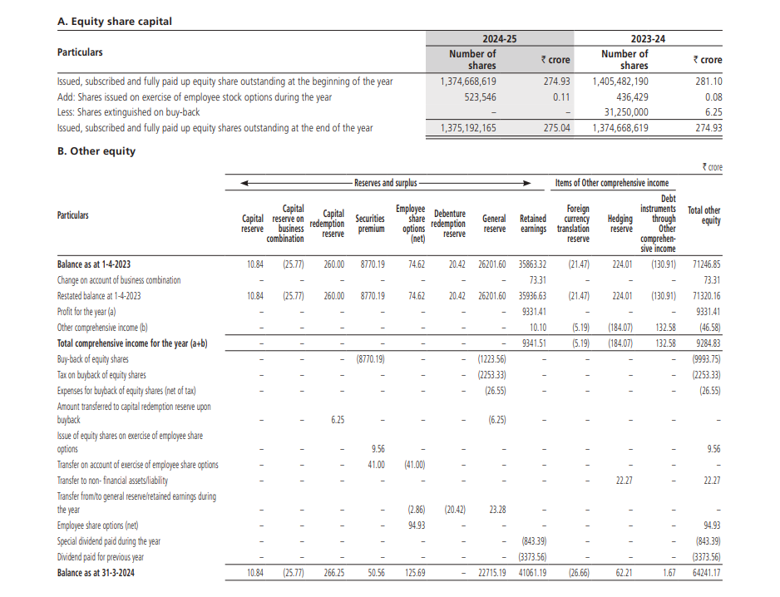
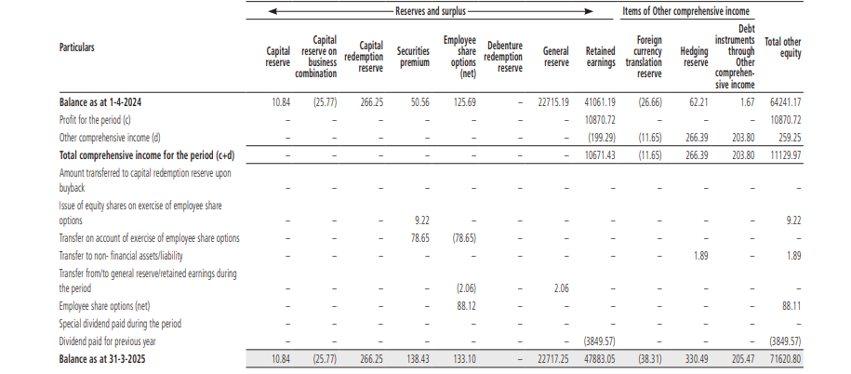
STATEMENT OF CHANGES IN EQUITY AS PER IND AS

Slide 15
FAIR VALUE MEASUREMENT
Fair value is the price that would be received to sell an asset or paid to transfer a liability in an orderly transaction between market participants at the measurement date.
Exit Price
Independent, knowledgeable and willing buyer and seller
Standard market transaction, not distressed sale
Current market expectations
Notes:
Ind AS 113 provides a single, comprehensive framework for how to measure fair value when other Ind AS standards require or permit it.
Moves away from historical cost by widely applying fair value measurement to assets and liabilities, reflecting their current market value
Explicitly defines fair value as an exit price: the price to sell an asset or transfer a liability in an orderly transaction between market participants
Ind AS 109 requires various financial instruments to be measured at fair value through profit and loss (FVTPL) or through other comprehensive income (FVTOCI), based on their business model and cash flow characteristics.
List of Items to be stated at Fair value in Ind AS:
Financial Instruments
Property, Plant & Equipment (PPE)
Investment Property
Biological Asset
Asset Acquired in Business Combinations

Slide 16
LEVELS OF FAIR VALUE
USES OF FAIR VALUE
Financial Instruments
Property, Plant & Equipment (PPE)
Investment Property
Biological Asset
Asset Acquired in Business Combinations
Investments
Level 1
Level 2
Level 3
Quoted Prices
Observable Inputs
Unobservable Inputs
Notes:
Level 1
Quoted Prices – Share Prices, Quoted NAV of MF
Level 2
Observable Inputs – Bond Valuation, RBI Reference rates, comparable transactions
Level 3
Unobservable Inputs – DCF Valuation- higher disclosures

Slide 17
OTHER COMPREHENSIVE INCOME (OCI)
Category A: Items that will NOT be reclassified to P&L | Category B: Items that WILL be reclassified to P&L
("Once in OCI, always in Equity") | ("Parked in OCI now, moved to P&L later")
1. Revaluation Surplus (Ind AS 16): Gain on revaluation of PPE. (Transferred directly to Retained Earnings upon disposal). | 1. Debt Instruments at FVTOCI (Ind AS 109): Gains/Losses on Bonds/Debentures held for both collecting interest and selling. (Recycled to P&L upon sale).
2. Equity Instruments at FVTOCI (Ind AS 109): Strategic investments in shares where irrevocable option is exercised. (e.g., Strategic stake in a vendor). | 2. Cash Flow Hedges (Ind AS 109): Effective portion of gain/loss on hedging instruments. (Recycled to P&L when the hedged transaction affects P&L).
3. Actuarial Gains/Losses (Ind AS 19): Remeasurements of defined benefit plans (Gratuity/Pension). | 3. Foreign Operations (Ind AS 21): Exchange differences on translating financial statements of a foreign subsidiary. (Recycled upon disposal of subsidiary).

Slide 18

REVENUE
[AS 9 V/S IND AS 115]
Notes:
AS 9
Based on the "transfer of significant risks and rewards" to the buyer. Revenue is recognized when this transfer occurs.
Provided clear guidance for simpler transactions but was less equipped to handle modern, complex business arrangements
Measured at the nominal amount of consideration receivable. Allowed the use of both the "percentage of completion method" and the "completed service contract method".
Does not exclude real estate revenue.
IND AS 115
Based on the "transfer of control" over a good or service to the customer. Control is defined as the ability to direct the use of and obtain the benefits from the good or service, Provided clear guidance for simpler transactions but was less equipped to handle modern, complex business arrangements
Requires more judgment and uses a five-step model for revenue recognition, designed to handle modern business complexities.
Measured at the fair value of the consideration received or receivable.
Mandates the "percentage of completion method" for services rendered over a period of time.
Real estate revenue is specifically not covered under IND AS 18 (which IND AS 115 replaced

Slide 19
Scenario: A telecom company sells a customer a new mobile handset and a 12-month service plan for a single bundled price of ₹24,000. The standalone price of the handset is ₹12,000, and a 12-month service plan alone would be ₹15,000.
Under AS 9:
The entire ₹24,000 might have been recognized immediately, often as a single lump sum, because the risks and rewards of the handset were transferred, and there was no specific guidance for unbundling components. This could overstate initial period revenue.
Under Ind AS 115:
The transaction price is allocated to each distinct performance obligation (handset delivery and monthly service) based on their relative standalone selling prices. The handset revenue (apportioned amount, e.g., ₹11,294) is recognized immediately upon delivery (transfer of control of the phone), while the service revenue (e.g., ₹12,706) is deferred and recognized monthly over the 12-month contract period.
Particulars | As per AS | As per IND AS
Revenue from operation | 24,000 | 15,000
Total Expense | 12,500 | 12,500
Net Profit | 11,500 | 2,500

Slide 20
Scenario: A real estate developer sells apartments in a new building under construction.
Under AS 9:
Revenue could often be recognized using the percentage of completion method.
Under Ind AS 115:
Revenue is recognized when sale deed is executed, i.e. risks and rewards transferred.
Particulars | As per AS | As per IND AS
Sales Revenue | 10,00,00,000 | 10,00,00,000
POCM Revenue | 25,00,00,000 | 0
Total Revenue | 35,00,00,000 | 10,00,00,000
Total Expense | 15,00,00,000 | 15,00,00,000
Net Profit | 20,00,00,000 | -5,00,00,000

Slide 21

Leases [AS 19, IND AS 116]
Notes:
Single model: Nearly all leases must be recognized on the balance sheet as a "right-of-use" (ROU) asset and a corresponding lease liability
"Control" of the underlying asset for a period of time is the fundamental basis
Increases reported assets and liabilities (debt-to-equity ratio increases).
Operating expenses are replaced with depreciation (on the ROU asset) and interest expense (on the lease liability)
Optional exemptions for short-term leases (12 months or less) and leases of low-value assets.
Lessor accounting largely remains unchanged and still uses the finance vs. operating lease classification.
Requires significantly enhanced and more detailed quantitative and qualitative disclosures

Slide 22
Scenario: ABC Ltd. leases office space for 5 years with annual payments of ₹10 lakh, paid at the end of each year. The fair value of the property is ₹1 crore, and its useful life is 25 years. The implicit interest rate is 8%. ABC Ltd. does not opt for any exemptions under Ind AS 116.
Impact | Accounting Standard 19 | Indian Accounting Standard 116
Initial Balance Sheet Impact | No Asset/Liability recognised | ROU Asset: ₹39,92,700 Lease Liability: ₹39,92,700
P&L Year 1 Expense Profile | Straight-line Rent Expense: ₹10,00,000 | Depreciation Expense: ₹7,98,540 Finance (Interest) Cost: ₹3,19,416
Total P&L Expense Year 1 | ₹10,00,000 | ₹11,17,956 (Higher in early years)
P&L Year 5 Expense Profile | Straight-line Rent Expense: ₹10,00,000 | Depreciation Expense: ₹7,98,540 Finance (Interest) Cost: ₹74,074 (Lower in later years)
Total P&L Expense Year 5 | ₹10,00,000 | ₹8,72,614
Key Financial Metric Impact | No impact on EBITDA or Debt/Equity Ratio | Increases Debt/Equity Ratio; increases EBITDA (rent expense becomes D&A/Interest)

Slide 23
BALANCE SHEET AT YEAR END
STATEMENT OF PROFIT AND LOSS FOR THE YEAR
Particulars | As per AS | As per IND AS
ROU Asset | 0 | 31,94,160
Reserve and Surplus | 25,00,000 | 23,82,044
Lease Liability | 0 | 33,12,116
Particulars | As per AS | As per IND AS
Revenue from Operation | 55,00,000 | 55,00,000
Depreciation Expense | 5,00,000 | 12,98,540
Finance Cost | 3,00,000 | 6,19,416
Other Expense | 35,00,000 | 25,00,000
Net Profit | 12,00,000 | 10,82,044

Slide 24

PROPERTY PLANT & EQUIPMENT
[AS 10, IND AS 16]
Notes:
Requires an initial estimate of the costs of dismantling, removing, and restoring the site to be included in the cost of the related PPE. The liability is created at its present value at the time the asset is acquired or constructed, in accordance with Ind AS 37.
The liability is increased each year by "unwinding the discount," which is recognized as an interest expense in the profit and loss statement. Changes to the provision are accounted for depending on whether the asset is under the cost or revaluation model.
The initial capitalization of the liability increases the carrying amount of the PPE, which is then depreciated over the asset's useful life. Changes in the liability under the cost model are adjusted against the asset's carrying value.
The accounting for decommissioning provision is guided by both Ind AS 16 and Ind AS 37

Slide 25
Scenario: A company builds a factory on leased land, costing ₹1 crore. Per the lease agreement, the company is contractually obligated to dismantle the factory and restore the site at the end of the 10-year lease term. The present value of the estimated dismantling costs is calculated as ₹5,00,000 (Implicit Interest Rate – 9%)
Particulars | Accounting Standard 10 | Indian Accounting Standard 16
Initial Recognition | Does not explicitly require the capitalization of dismantling costs as part of the asset cost. These were often expensed in the year incurred. | The PV of the dismantling liability must be capitalized as part of the PPE cost.
Initial Asset Value | ₹1,00,00,000 (Cost to construct) | ₹1,05,00,000 (Cost + PV of dismantling liability)
Subsequent Accounting | Liability recognised later or expensed when paid. | The liability amount is "unwound" over time (interest expense recognized in P&L), and the higher asset value is depreciated over 10 years
Expense recognized every year | ₹10,00,000 (Depreciation) | ₹10,50,000 - Depreciation ₹45,000 – Interest Cost

Slide 26
Particulars | As per AS | As per IND AS
Fixed Asset (AS); Property Plant and Equipment (IND AS) | 90,00,000 | 94,50,000
Initial Recognition | 1,00,00,000 | 1,05,00,000
Less: Depreciation | 10,00,000 | 10,50,000
Closing Value | 90,00,000 | 94,50,000
Reserves and Surplus
-Retained Earnings | 15,00,000 | 14,05,000 [15,00,000 + 10,00,000 – 10,50,000 – 45,000]
Decommissioning Liability (Under Other Non-Current Liabilities) | NA | 5,45,000

Slide 27
Scenario: A company owns building with a historical cost of ₹50,00,000. It is revalued to its fair value of ₹80,00,000. Remaining useful life of building is 10 years from current year end. SLM Depreciation is ₹ 1,00,000.
Particulars | Accounting Standard 10 | Indian Accounting Standard 16
Revaluation Entry | Revaluation increase of ₹30,00,000 credited to Revaluation Reserve. | Revaluation increase of ₹30,00,000 credited to Other Comprehensive Income (OCI) and accumulated in the Revaluation Surplus equity line.
Subsequent Treatment | Revaluation reserve remains until disposal of asset. | Revaluation surplus can be transferred to Retained Earnings over the useful life of the depreciable asset (e.g., building).
P&L Impact | Revaluation decreases (after previous increases) can be routed to P&L. | Transfers from revaluation surplus to retained earnings do not go through the P&L; they are direct movements within equity.

Slide 28
Particulars | As per AS | As per IND AS
Fixed Asset (AS); Property Plant and Equipment (IND AS) | 72,00,000 | 72,00,000
Initial Recognition (After Revaluation) | 80,00,000 | 80,00,000
Less: Depreciation | 8,00,000 | 8,00,000
Closing Value | 72,00,000 | 72,00,000
Reserves and Surplus | 45,00,000 | 45,00,000
-Retained Earnings | 15,00,000 | 18,00,000 [15,00,000 + 3,00,000]
-Revaluation Reserve | 30,00,000 | 27,00,000 [30,00,000 – 3,00,000]

Slide 29

NON CONTROLLING INTEREST VS MINORITY INTEREST
Notes:
Presented as a separate intermediate item, outside of the parent company's equity and liabilities sections
Measured at the minority's proportionate share of the subsidiary's identifiable net assets.
If the minority's share of losses exceeded their equity in the subsidiary, the excess was typically absorbed by the parent
Presented within the total equity section, but separately identified from the equity attributable to the owners of the parent
An accounting policy choice: can be measured at the proportionate share of net assets, or at fair value (which includes a share of goodwill).
Treated as an equity transaction (a transaction with owners). The difference between the consideration paid and the NCI share is adjusted in the "Other Equity" section, bypassing the P&L
Losses are allocated to the NCI even if it results in the NCI balance becoming negative (a deficit).
Acquiring more shares from minority holders id often treated as an acquisition step, potentially recognizing gains or losses in the P&L account

Slide 30
Feature | Minority Interest (AS 21) | Non-Controlling Interest (Ind AS 110)
Balance Sheet Presentation | Outside Equity: Presented separately from liabilities and the parent’s equity. It is often shown as a distinct line item between Equity and Liabilities | Inside Equity: Presented within Equity, but separately from the Parent's Equity. It is treated as a part of the group's total shareholder funds.
Initial Measurement | Proportionate Share Only: Measured at the minority’s share of the historical Net Asset Value (NAV) of the subsidiary. | Fair Value Option: Can be measured either at Proportionate Share of Net Assets OR at Fair Value (Full Goodwill method), based on Ind AS 103.
Treatment of Losses | Stops at Zero: Losses are allocated to MI only until the MI balance becomes zero. Excess losses are absorbed by the Parent, unless MI has a binding obligation to pay. | Can be Negative: Losses are attributed to NCI even if it results in a deficit (negative) balance. The NCI continues to share in losses regardless of its balance.
Partial Disposal (No loss of control) | Profit/Loss: If a parent sells a portion of shares but retains control, the difference between proceeds and carrying value of MI is recognized in P&L. | Equity Transaction: Treated as a transaction between owners. The difference is adjusted directly in Equity (Retained Earnings/Capital Reserve), with no P&L impact.

Slide 31

INVESTMENTS
(AS 13, IND AS 109)
Notes:
Classification is based on management's intent: Current (held for < 1 year) vs. Long-Term (held for > 1 year).
Current Investments Carried at the lower of cost or fair value.
Long Term Investments Carried at cost; a provision is made only for a decline that is "other than temporary”
Classification depends on the entity's business model for managing financial assets and their contractual cash flow characteristics (SPPI test)
Investments are measured at: Fair Value Through P&L (FVTPL), Fair Value Through OCI (FVOCI), or Amortized Cost.
Current Investments Measured at FVTPL, with gains/losses in P&L
Long Term Investments Generally measured at FVOCI or FVTPL (for equity); Amortized Cost for debt if conditions met
Gains/ Losses Depends entirely on classification (P&L for FVTPL, OCI for FVOCI without recycling for equity)
P&L for current investments; gains/losses on long-term investments generally went to capital reserve or P&L.

Slide 32
Scenario: A company holds an investment in the shares of Company X (listed) and Company Y (unlisted).
Company X (Listed): Cost ₹50/share; Current Market Price ₹60/share.
Company Y (Unlisted): Cost ₹25/share; DCF Model Valuation ₹20/share.
Impact | Accounting Standard 13 (AS 13) |  | Indian Accounting Standard 109 & 113
Initial Recognition | Cost: ₹5,00,000 (Company X) Cost: ₹2,50,000 (Company Y) |  | Cost: ₹5,00,000 (Company X) Cost: ₹2,50,000 (Company Y)
Year-End Measurement | Cost remains unchanged. Assumes no "other than temporary" diminution. |  | Fair Value Measurement. • Company X: ₹6,00,000 (Level 1 input). • Company Y: ₹2,00,000(Level 3 inputs).
P&L Impact (Year-End) | IF CURRENT INVESTMENT: ₹0 for Company X (Unrealized gains are ignored). ₹50,000 Loss on Company Y (P&L) | IF NON CURRENT INVESTMENT: ₹0 for Company X and Y (Unrealized gains/losses are ignored). | ₹1,00,000 Gain on Company X (FVTPL or OCI). ₹50,000 Loss on Company Y (FVTPL or OCI). [To P&L if held for trading, to OCI if held as long term investment]
Balance Sheet Value (Year-End) | ₹5,00,000 (Company X) ₹2,00,000 (Company Y) | ₹5,00,000 (Company X) ₹2,50,000 (Company Y) | ₹6,00,000 (Company X) ₹2,00,000 (Company Y)
Impact on metrics | Improved Return on Investment Ratios
Notes:
AS13 for non current investments- at cost
For current investments- at nrv

Slide 33
Scenario: On April 1, 20X1, Entity F purchases a ₹10,00,000, 2-year, 8% annual coupon bond for ₹10,05,000 (including ₹5,000 transaction costs). The effective interest rate is 7.72%
Impact | Accounting Standard 13 (Long-Term Investment Cost Method) | Indian Accounting Standard 109 (Amortised Cost / EIR Method)
Initial Recognition Value | ₹10,05,000 (Historical Cost) | ₹10,05,000 (Fair Value + Transaction Cost)
P&L Entry Year 1 (Interest Income) | Straight-line Interest Income: ₹80,000 (Based on coupon received) | Effective Interest Income: ₹77,724 (₹10,05,000 * 7.72%)
Balance Sheet (End of Year 1) | Investment value remains at ₹10,05,000 | Investment value adjusted to ₹10,02,724 (Amortised Cost)
P&L Entry Year 2 (Interest Income) | Straight-line Interest Income: ₹80,000 | Effective Interest Income: ₹78,000
Treatment of Premium/Discount | Premium/Discount (₹5,000) is adjusted only upon maturity/sale via a P&L Gain/Loss on Disposal. | Premium/Discount is systematically amortised to the P&L over the life of the bond using the EIR method (adjusting the B/S value yearly).

Slide 34

INTEREST FREE LOAN
(IND AS 109)

Slide 35
Scenario: On April 1, 20X1, a parent company provides its subsidiary with an interest-free loan of ₹1,00,000, repayable in full at the end of 5 years. A market interest rate for a similar loan would be 8%
Year 0 (Initial Recognition: April 1, 20X1)
Particulars | Accounting Standard (AS) | Indian Accounting Standard (Ind AS)
Initial Recognition | Loan recognized at face value: ₹1,00,000 | 1. Calculate Fair Value: Present Value of ₹1,00,000 payable in 5 years at 8% PV = ₹1,00,000 / (1.08)^5 = ₹68,058 2. Record Loan: Loan to Subsidiary Dr. ₹68,058 Bank Cr. ₹1,00,000 Investment in Subsidiary Dr. ₹31,942

Slide 36
Subsequent Measurement (Year 1: March 31, 20X2)
Particulars | Accounting Standard (AS) | Indian Accounting Standard (Ind AS)
Loan Balance | ₹1,00,000 (Remains at face value) | ₹73,503 (₹68,058 + 8% interest)
Interest Income | ₹0 | ₹5,445 (8% of ₹68,058)
P&L Impact | ₹0 | ₹5,445 (Interest Income)
Balance Sheet Movement
Year | Opening Balance | Interest @ 8% | Closing Balance
1 | ₹68,058 | ₹5,445 | ₹73,503
2 | ₹73,503 | ₹5,880 | ₹79,383
3 | ₹79,383 | ₹6,351 | ₹85,734
4 | ₹85,734 | ₹6,859 | ₹92,593
5 | ₹92,593 | ₹7,407 | ₹1,00,000

Slide 37

FOREIGN EXCHANGE RATE DIFFERENCES
(AS 11, IND AS 21)
Notes:
Exchange Differences on Long-Term Items Generally recognized in profit or loss, except when treated as borrowing costs under Ind AS 23 for qualifying assets
Translation differences for foreign operations are recognized in Other Comprehensive Income (OCI) and accumulated in a currency translation reserve
Utilizes the functional currency concept for preparing financial statements, separate from the presentation currency
Hedge Accounting Applied in conjunction with Ind AS 109 (Financial Instruments

Slide 38
Scenario: An Indian company takes a USD 100,000 loan on April 1, 20X1, to purchase a depreciable asset, repayable after 5 years.
Exchange Rates:
April 1, 20X1 (Loan Date): USD 1 = INR 75.00
March 31, 20X2 (Year-End): USD 1 = INR 78.00
Metric/Accounting Entry | Accounting Standard 11 (AS 11) | Indian Accounting Standard 21 (Ind AS 21)
Initial Recognition (Asset/Liability) | Asset: ₹75,00,000 Loan: ₹75,00,000 | Asset: ₹75,00,000 Loan: ₹75,00,000
P&L Impact (Year 1) | ₹0 (Forex loss capitalized to asset) | ₹3,00,000 (Forex loss charged to P&L)
Balance Sheet Impact (End of Year 1) | Asset: ₹78,00,000 Loan: ₹78,00,000 | Asset: ₹75,00,000 Loan: ₹78,00,000
Treatment of Exchange Difference | Exchange loss on long-term monetary item is capitalized to the cost of the asset. | Exchange difference on the long-term monetary item is charged to the P&L.
Depreciation for next year | Charged on asset value of 78,00,000 | Charged on asset value of 75,00,000

Slide 39
Scenario: Derivative (Forward Contract)
Details: On April 1, 20X1, an Indian company enters a forward contract to sell USD 100,000 in 3 months (June 30, 20X1) at a contracted forward rate of INR 80.00.
Balance Sheet Date (April 30, 20X1): The new market forward rate for June 30 is INR 79.50. The contract has a negative fair value (liability) for the company
Metric/Accounting Entry | Accounting Standard (AS 11) | Indian Accounting Standard (Ind AS 109)
Initial Recognition | No entry. Derivatives are typically off-balance sheet items under AS, often treated as executory contracts. | The derivative is recognized on the balance sheet as an asset or liability at fair value (₹0 initially).
B/S Date Measurement | No revaluation required on an ongoing basis for a hedging contract. | The contract is marked to market. A liability is created because the company must sell USD at ₹80, but the market rate is now ₹79.50 (loss of ₹0.50/USD).
B/S Liability (Apr 30) | ₹0 (Off-balance sheet) | ₹50,000 Liability (USD 100k * ₹0.50)
P&L Impact | No impact until the settlement date. Gain/loss is booked on settlement as an adjustment to the underlying transaction. | ₹50,000 loss booked in P&L (unless classified as an effective hedge, in which case it may go to OCI).

Slide 40
KEY CHALLENGES IN AS VS. IND AS FRAMEWORKS
Complexity and Interpretation
Fair Value Accounting
System and Process Overhaul
Training and Manpower
Impact on Financial Metrics
Increased Disclosure Requirements

Slide 41
OPPORTUNITIES IN IND AS
Global Comparability and Investment Appeal
Access to Capital Markets
Streamlined Mergers & Acquisitions (M&A)
Enhanced Transparency and Governance
Enhanced Transparency and Governance
Improved Internal Decision-Making
Operational Efficiency for Multinationals

Slide 42
NFRA Circular on Ind AS Non-Compliance (March 2023)
AutCircular (Ref: NF-25011/1/2023-O/o Secy-NFRA) (p. 1)
Date: 29 March 2023
Subject: Instances of non-compliance with Ind AS on Accounting Policies for measurement of Revenue from Contracts with Customers (Ind AS 115) and Trade hority: National Financial Reporting Authority (NFRA)
Receivables (Ind AS 109). (p. 1)
Key Observation:
Many companies are incorrectly stating that revenue and trade receivables are measured at "fair value" in their accounting policies. (pp. 1-2)
Required Treatment (as per NFRA):
Revenue (Ind AS 115): Must be measured at the "transaction price" (net of variable consideration), not fair value. (pp. 1-2)
Trade Receivables (Ind AS 109): Must be initially measured at their "transaction price", unless they contain a significant financing component. (p. 2)
Action Required:
Listed companies and their auditors are advised to ensure strict compliance with Ind AS 115 and Ind AS 109 provisions. (p. 3)

Slide 43
NFRA Circular on Ind AS Non-Compliance (March 2023)
Authority: National Financial Reporting Authority (NFRA)
Circular (Ref: NF-25011/5/2022-O/o Secy-NFRA)
Date: 20 October 2022
Subject: Non-Accrual of interest on borrowings by the companies in violation of Indian Accounting Standards (Ind AS). (p. 1)
Key Observation:
Companies were found to be discontinuing the accrual/recognition of interest expense on bank borrowings classified as Non-Performing Assets (NPA) by lenders. (p. 1)
This unilateral action by the borrower is a violation of Ind AS 109, as the debt liability and interest payable remain a legal obligation. (pp. 1-2)
3. RBI guidelines only permit banks to stop recognizing interest income in their accounts; they do not release the borrower from their contractual liability. (pp. 1-2)

Slide 44
NFRA Circular on Ind AS Non-Compliance (March 2023)
Required Treatment (as per NFRA and Ind AS 109):
Financial liabilities (borrowings) must be accounted for at amortized cost using the Effective Interest Method (EIM). (p. 1)
A financial liability shall be removed from the Balance Sheet only when it is extinguished (i.e., the borrower is legally released from the primary responsibility). (p. 2)
Discontinuing interest expense recognition based solely on expectations of a loan waiver or concession is non-compliant. (p. 2)
Action Required:
All companies required to follow Ind AS and their audit committees are advised not to discontinue the recognition of principal or interest merely because borrowings are declared NPA. (p. 2)
Auditors are required to ensure strict compliance with this circular. (p. 2)

Slide 45
MCQs
Under which standard is the use of the revaluation model for measuring Property, Plant, and Equipment (PPE) after initial recognition generally permitted?
(a) Accounting Standards (AS) (b) Indian Accounting Standards (Ind AS) (c) Both (a) and (b) (d) Neither (a) nor (b)
Answer: (b) Indian Accounting Standards (Ind AS)

Slide 46
MCQs
2. Which standard mandates that the present value of a decommissioning cost should be capitalized as part of the initial cost of the PPE asset?
(a) Accounting Standards (AS) (b) Indian Accounting Standards (Ind AS) (c) Both (a) and (b) (d) Neither (a) nor (b)
Answer: (b) Indian Accounting Standards (Ind AS)

Slide 47
MCQs
3. Which impairment model is used under Ind AS 109 for financial assets like trade receivables?
(a) Incurred Loss Model (b) Permanent Diminution Model (c) Expected Credit Loss (ECL) Model (d) Fair Value Model
Answer: (c) Expected Credit Loss (ECL) Model

Slide 48
MCQs
4. Which standard requires a long-term interest-free loan to be initially recognized at its transaction amount (face value), without mandatory discounting to fair value?
(a) Accounting Standards (AS) (b) Indian Accounting Standards (Ind AS) (c) Both (a) and (b) (d) Neither (a) nor (b)
Answer: (a) Accounting Standards (AS)

Slide 49
MCQs
5. Under Ind AS 36, how often must goodwill acquired in a business combination be tested for impairment?
(a) Only if a triggering event occurs (b) At least annually (c) Every five years (d) Never, it is amortised
Answer: (a) Accounting Standards (AS)

Slide 50

True/ False Statements
Statement:
Ind AS emphasizes the legal form of a transaction, whereas AS emphasizes its economic substance.

Slide 51

True/ False Statements
Statement:
Ind AS allows for the use of fair value measurement more broadly than AS

Slide 52
True/ False Statements
Statement:
AS are primarily principles-based standards, requiring significant management judgment in application.

Slide 53
True/ False Statements
Statement:
Ind AS financial statements automatically meet all requirements for full IFRS compliance internationally.

Slide 54
True/ False Statements
Statement:
The core objective of adopting Ind AS was to align Indian financial reporting with global best practices and enhance comparability.

Slide 55


Slide 56


Connect with me:
rushabh@rbshah.co.in | www.linkedin.com/ca-rushabhshah | +91 73838 76074

