Slide 1
CODE OF ETHICS
CA. Deepak M. Rindani
At SEMINAR by Rajkot Branch of WIRC of ICAI FOR NEWLY Qualified members
December 03, 2025
Disclaimer – this is a general-purpose broad presentation used only during the seminar interaction; needed references may be made to icai publications and applicable law

Slide 2
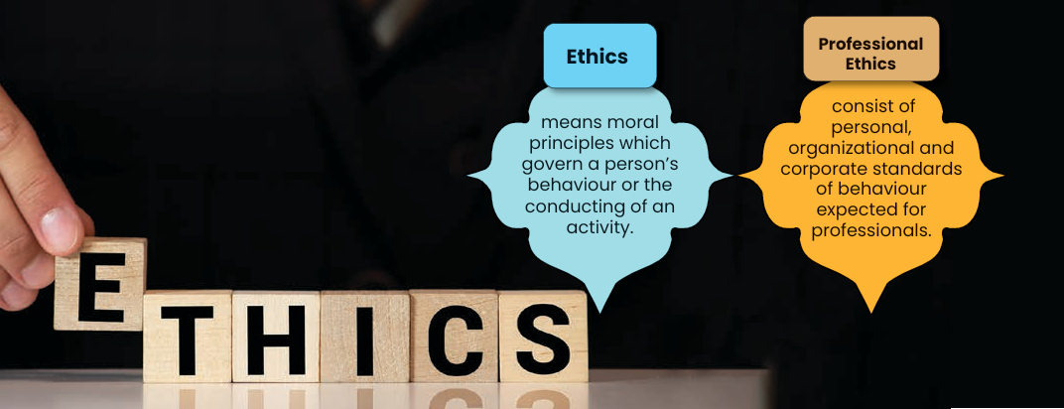

Slide 3
BROAD STATISTICS
Total firms just over 1 lakh
Over 70% firms are proprietorships
25% - 2 to 5 partners
> 20 partners : 120 firms

Slide 4
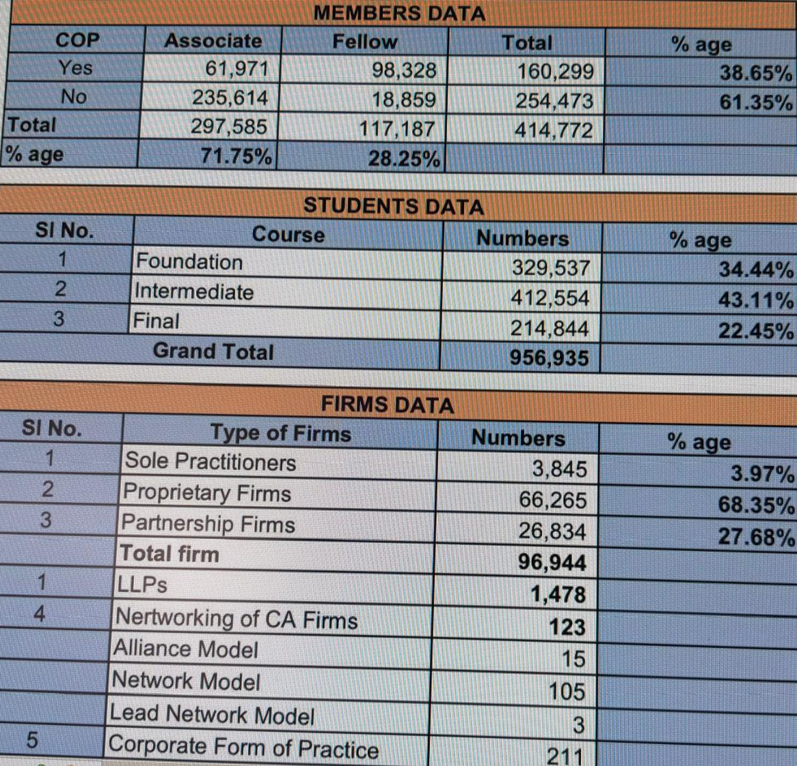

Slide 5
PROFESSIONAL ETHICS 2 Is & 3Cs
Competence
Conduct
Confidentiality
Independence
Integrity

Slide 6
PILLARS OF PROFESSIONAL ETHICS
Codified
Self-made

Slide 7
Professional Approach
Virtues
of a
Good
Professional
INDUSTRY
(Hard work)
INTEGRITY
(Honesty to
cause)
DUTY TOWARDS
LAW & ICAI
CLIENT

Slide 8
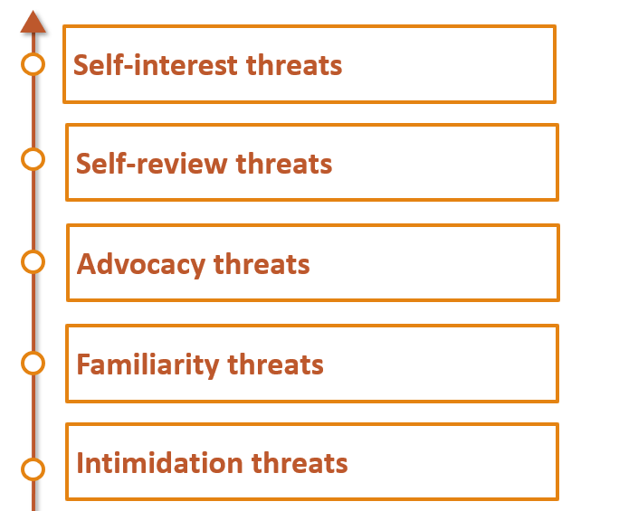
THREATS IN COMPLIANCE OF ETHICS

Slide 9
SOCIALISING AND SOLICITATION – THIN LINE
Whether a member in practice or a Firm may give link of its website on a social networking site ?
Yes; But, under “Pull” model not “Push” model
Whether a messaging application can be used by a member in practice to send messages to make people aware about their new practice and mention the services provided therein ?
No

Slide 10
SOCIALISING AND SOLICITATION – THIN LINE
Whether a member in practice can list themselves with online application-based service provider aggregators ?
No, as per Council Guidelines for Advertisement, 2008
Whether a member in practice/firm of Chartered Accountants register themselves on GeM Portal (Government e-marketplace)?
Yes, ensure compliance with the tender guidelines issued by the Institute while participating in tender or bid floated through GeM Portal.

Slide 11
SOCIALISING AND SOLICITATION – THIN LINE
Whether a member can appear on television, films, internet and broadcast in the Radio or give lectures at forums?
Yes, Council direction under Paragraph 2.14.1.7(x) under Clause (7) of Part I of the First Schedule to the Act;
- may give his name and describe himself as chartered accountant.
- Special qualifications or specialized knowledge directly relevant to the subject matter of the programme may also be given.
- Firm name may also be mentioned
- any exaggerated claim or any kind of comparison is not permissible.
- must not be promotional of him or his firm but must be an objective professional view of the topic under consideration.

Slide 12
SOCIALISING AND SOLICITATION – THIN LINE
Professional Updates:
Members in practice or the firm of Chartered Accountants are generally permitted to send professional updates containing information of professional relevance.
may send the same in his individual name and without mentioning firm name
may be sent in the form of newsletter or emails etc.
may also include articles, professional information, bulletin boards, professional updation and other matters of larger importance or of professional interest on their website as per the website guidelines issued by the Institute.
Should not be in nature of solicitation of services provided by him/her

Slide 13
SOCIALISING AND SOLICITATION – THIN LINE
Can a member in practice indicate in a book or an article, published by him, association with any firm of Chartered Accountant ?
No, as per para 2.14.1.6(iv)D under clause (6) of Part-I of First Schedule, However, he may indicate designation “Chartered Accountant”

Slide 14
SOCIALISING AND SOLICITATION – THIN LINE
Whether CA in practice can give public interviews and also whether he can furnish details about himself or his firm in such interviews ?
Yes, he can give public interviews, as per para 2.14.1.6(iv)O under clause (6) of Part-I of First Schedule. However, it should not highlight their professional attainments and any details given must be only as a response to specific question, and of factual nature only.
Whether CA in practice can upload educational videos on internet ?
Yes, as para 2.14.1.6(iv)Q under clause (6) of Part-I of First Schedule. No reference to CA firms, contact details or website address.

Slide 15
SOCIALISING AND SOLICITATION – THIN LINE
Can a Chartered Accountant in practice / Firm of Chartered Accountants post the particulars of himself/ itself on a website ?
Yes, as per detailed guidelines of the Council
Whether a Firm of Chartered Accountants can use catchwords/ catchphrases on its website, Letter heads and visiting cards ?
No, as per clause (6) & (7) of Part-I of First Schedule

Slide 16
SOCIALISING AND SOLICITATION – THIN LINE
Whether member in practice can respond to Tenders, Advertisements and Circulars ?
Not respond to any tender issued by an organization or user of professional services in areas of services which are exclusively reserved for Chartered Accountants, such as audit and attestation services.
Restriction shall not apply where
minimum fee of the assignment is prescribed
or where the areas are open to other professionals along with the Chartered Accountants

Slide 17
SOCIALISING AND SOLICITATION – THIN LINE
Whether a designation “Chartered Accountant” along with the name of Chartered Accountants Firm can be used on the greeting cards or invitations?
Yes

Slide 18
SOCIALISING AND SOLICITATION – THIN LINE
Whether it is permissible for a firm of Chartered Accountants to sponsor an event ?
No, However can sponsor event conducted by Programme Organization Unit (PoU) of ICAI, provided such event has prior approval of CPE Directorate of ICAI.
Can a member publish a change in partnership or change in address of practice and telephone numbers ?
Yes

Slide 19
CAN A CA BE A DIRECTOR IN A COMPANY?
A member in practice permitted generally to be a ‘Director Simplicitor’, which includes Independent Director
Not MD or WTD (only after specific and prior permission of the Council)
Required only in Board Meetings of Company
Not paid remuneration except for attending such meetings
Cannot operate accounts of the Company
Can sign FS and other documents of Company
Specific permission not required
Can be MD, WTD, Manager of Management Consultancy Company, registered with the ICAI

Slide 20
OTHER BUSINESS ACTIVITIES
Whether members in practice are allowed to transact in commodity derivatives?
permissible for a member in practice to engage in derivative transactions in his personal capacity, but not in professional capacity i.e for clients.
allowed to transact only in future and options derivatives, equity and currency derivatives
not permissible for members in practice to transact in commodity derivative transactions.
Members in practice are not allowed to transact in derivatives in the name of his proprietary firm or partnership firm.
no restriction for members not holding Certificate of Practice to transact in Derivatives transaction on his own account or on behalf of others.

Slide 21
CAN A CA BE A PARTNER?
Can a member in practice be sleeping partner in family business concern ?
Yes, provided he takes prior and specific permission from the Council

Slide 22
OTHER BUSINESS ACTIVITIES
Whether a member in practice can take the class as guest lecturer and receive honorarium based on per class basis. (June, 2016)
“Visiting Lecturer‟ is someone engaged on a regular basis (not necessarily daily );
however, “Guest Lecturer”, as the name suggests, is someone who is only occasionally invited, and as such, cannot be said to be included under “Other Business and Occupation” under Clause (11) of Part I of the First Schedule to the Chartered Accountants Act, 1949.
Accordingly, it was clarified that there would be no bar to a member being a “Guest lecturer”.

Slide 23
OTHER BUSINESS ACTIVITIES
Whether a member may provide Virtual CFO Services?
It was noted that nomenclature being same, the services of Virtual CFO in common parlance would partake the nature of services of CFO (under Companies Act, 2013) as it cannot be contradistinguished in the eyes of general public.
It was clarified that the services of Virtual CFO be not permitted to be undertaken by a member in practice.

Slide 24
NON-AUDIT SERVICES
Can a Chartered Accountant provide `Portfolio Management Services' (PMS) as part of CA practice?
No, the Explanation to Clause (xix) of the definition of 'Management Consultancy and other Services' as appearing in Appendix-3 expressly bars the activities of broking, underwriting and Portfolio Management.

Slide 25
NON-AUDIT SERVICES
Can a chartered accountant in practice work as a ‘Collection Agent/ Recovery Agent’ ?
No. However, he can act as Recovery Consultant in the banking sector as provided in clause (xxv) of ‘Management Consultancy and other Service’.
Can a Management Consultancy Company advertise its services or using a logo ?
No, as per the Guidelines for Corporate Forum of Practice

Slide 26
NON-AUDIT SERVICES
Whether a practicing Chartered Accountant can agree to select and recruit personnel, conduct training programme and work studies for and on behalf of a client ?
Yes
Whether a member in practice can provide payroll services ?
Yes. However, it is not permissible if member is statutory auditor.

Slide 27
NON-AUDIT SERVICES
Due diligence services ?
Yes
Whether a statutory auditor can accept the system audit of same entity ?
Yes

Slide 28
NON-AUDIT SERVICES
Can an auditor write the books of accounts of the auditee ?
No, as per Council directions under Para 2.15.1.4(xi) under clause (4) of Part-I of the Second Schedule; self-review threat
Whether a member in practice can provide equity research service, and publish retail research report ?
No, as per clause (11) of Part-I of First Schedule (However, he can be an equity research adviser)

Slide 29
AUDIT SERVICES
Can a member in practice express his opinion on financial statements of any business or enterprise in which he, his relative, his firm or a partner in his firm has a substantial interest ?
No, as per clause (4) of Part-I of Second Schedule
However, as per S. 141(3)(d)(i) of Companies Act, 2013, member cannot accept audit even if he or his partner holds a single share.
Also relative of an auditor cannot hold security or interest in company of face value in excess of Rs. 1,00,000/-

Slide 30
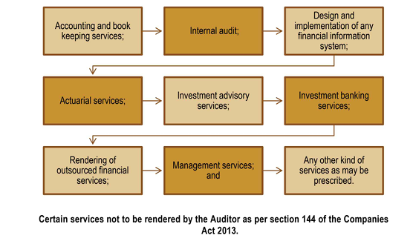
RESTRICTIONS AS COMPANY AUDITOR (Direct as well as Indirect)

Slide 31
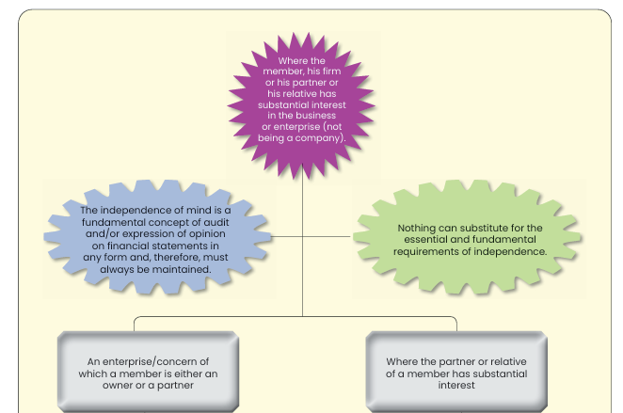
RESTRICTIONS AS AUDITOR (For all Audit Assignments)

Slide 32
CHARTERED ACCOUNTANT IN SERVICE - MISCONDUCT
Paying to any person any share in the employment emoluments
Accepting fees, profits or gains from any other person by way of commission or gratification
Disclosure of employer information without consent
Providing false information to the Institute
Embezzlement of money received in Professional capacity

Slide 33
CHARTERED ACCOUNTANT IN SERVICE
The members are required to follow the five fundamental principles, which are common for all chartered accountants, whether in service, or in practice.
if a member who is in employment of listed entity and is a senior professional accountant, If, in the course of carrying out professional activities, becomes aware of information concerning non-compliance or suspected non-compliance with laws and regulations (NOCLAR), the accountant shall obtain an understanding of the matter, address the matter and take appropriate steps as contained in the section
Senior professional accountants in service (“senior professional accountants”) refers to Key Managerial Personnel. They are directors, officers or senior employees able to exert significant influence over, and make decisions regarding, the acquisition, deployment and control of the employing organization’s human, financial, technological, physical and intangible resources.

Slide 34
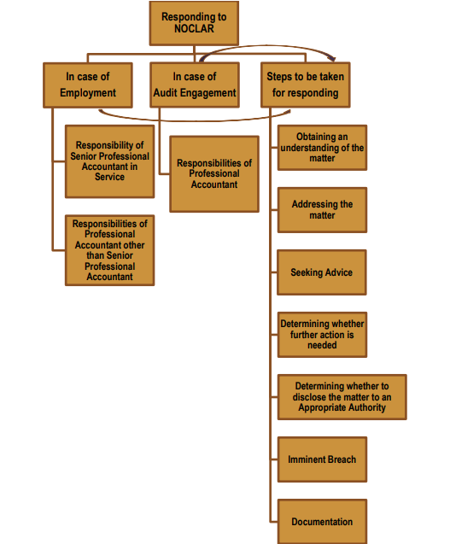
NOCLAR (Non-Compliance with Laws and Regulations)

Slide 35
CHARTERED ACCOUNTANT IN SERVICE
Can a Chartered Accountant in Service accept or agree to accept any part of fees, profits or gain from a lawyer, a CA or broker engaged in such company, firm or person or agent or customer of such company, firm or person by way of commission or gratification ?
No, as per clause (2) of Part-II of First Schedule

Slide 36
MEMBER IN PRACTICE
Can a Chartered Accountant in practice disclose information acquired in the course of his professional engagements?
No, as per clause (1) of Part-I of Second Schedule; Confidentiality
Whether the member in practice can permit his name or the name of his firm to be used in connection with an estimate of earnings contingent upon future transactions in a manner which may lead to belief that he vouches for the accuracy of the forecast ?
No, as per clause (3) of Part-I of Second Schedule

Slide 37
MEMBER IN PRACTICE
Can a Chartered Accountant in practice pay to any person any share, commission or brokerage in the fees or profits of his professional business ?
No, clause (2) of Part-I of First Schedule prohibits to share, to any person other than a member of the Institute or a partner or a retired partner or legal representative of the deceased partner or member of any other professional body or with such persons have qualifications as may be prescribed in or outside India

Slide 38
MEMBER IN PRACTICE
Can Chartered Accountant in practice accept original professional work emanating from the client introduced to him by another member ?
No, as para 2.14.1.6(iv)N under clause (6) of Part-I of First Schedule
Can a practicing Chartered Accountant secure any professional business through the services of a person who is not his employee or partner ?
No, as per clause (5) of Part-I of First Schedule

Slide 39
MEMBER IN PRACTICE
Can a Chartered Accountant in practice enter into partnership with a practicing Chartered Accountant of a recognized foreign professional body for sharing fee of their partnership within India ?
Yes, clause (4) of Part-I of First Schedule permits partnership either by the Central Government or the Council of the Institute by virtue of either under S. 29(2) of the Act or under regulation 53B(2) provided they share fees of partnership business both within and outside India.

Slide 40
MEMBER IN PRACTICE
Whether a practicing Chartered Accountant can be a partner or designated partner in a LLP, which is not doing professional work, but is in the commercial activities ?
No, as per para 2.14.1.4(ii) under clause (4) of Part-I of First Schedule

Slide 41
MEMBER IN PRACTICE
Can a Chartered Accountant in practice use expression like Income Tax Consultant, Cost Accountant, Company Secretary, Cost Consultant or a Management Consultant ?
No
Can a CA in practice / firm give advertisement in press ?
No, however, may advertise through a ‘Write-Up’, subject to Advertisement Guidelines of the Council

Slide 42
MEMBER IN PRACTICE
Can a member in practice be part of Association of persons (AOP), with other members, or other professionals?
No, only Firms and LLPs are the two modes of practice, apart from practicing in individual capacity.
Whether a member in practice is permitted to respond to announcement for empanelment for allotment of audit and other professional work and quote fees for enquiries being received?
It is clarified by the council that if announcements are made for empanelment by the Government, Corporations, Courts, Cooperative Societies, Banks and other similar institutions, the members may respond to such announcements provided the existence of panel is within their knowledge. The council has further clarified that quotations of fees can be sent, if enquiries are received by members in this regard.

Slide 43
MEMBER IN PRACTICE
Whether a member in practice can quote fees on % of utilization amount of an educational Institute for certifying the amount (utilization) spent by an educational Institute out of grant ?
Yes

Slide 44
MEMBER IN PRACTICE
If there is a change of auditor but the predecessor auditor is aware of an act or suspected act of NOCLAR that has not yet been addressed, does the predecessor auditor have to communicate information concerning the NOCLAR to proposed to a proposed auditor ?
Yes, the predecessor auditor on request of proposed accountant shall provide all relevant facts and other information

Slide 45
MEMBER IN PRACTICE
Can a CA in practice use/fix a monogram of the Institute on any column/wall located inside the office or on professional documents ?
No, as per Council directions under clause (7) of Part-I of First Schedule
Whether a CA in practice also practice as an Advocate ?
Yes, as per Council directions under para 2.14.1.7(v) under clause (7) of Part-I of First Schedule subject to permission of Bar Council and should not use the designation ‘Chartered Accountant’ and ‘Advocate’ simultaneously

Slide 46
MEMBER IN PRACTICE
Whether the information contained in the website of the Chartered Accountants and or Chartered Accountant firms can be circulated on their own or through e-mail or by any other mode or technique ?
Para 3.3.3 and 3.3.4 of Council Guidelines for Advertisement, 2008 states that none of the information contained in website be circulated except a specific “pull” request.
Whether the names of clients or fees charges be mentioned on the website of Chartered Accountant or Chartered Accountant firms ?
No, except required by regulator and made only till such period that member works under purview of such regulator / such requirements of the regulator are in force.

Slide 47
FEES
Recommended level of fees provided by the ICAI
There is no bar for members in practice for taking the fees in advance for services, except for audit since self-interest threat
where an audit client is not a public interest entity and for two consecutive years, the total gross annual professional fees (“total fees”) from the client and its related entities represent more than 40% of the total fees received by the firm - disclose to the Institute the fact
For Public Interest Entity – threshold is of 20%

Slide 48
ETHICS IN THE EMERGING ERA OF AI
Data Source and its Integrity / Reliability
Transparency
Disclosure of process of decision making through AI
Taking responsibility through AI-generated results
Dilemma of disclosure of client data to AI sources
Overriding importance of Human judgement

Slide 49
MULTI-DISCIPLINARY FIRM OR LLP (NOT A COMPANY)
SPECIFIED PROFESSIONALS: Regulations 53B prescribes following specified professionals’ who can become a partner under MDP provisions: –
(a) Company Secretary;
(b) Cost Accountant;
(c) Advocate.
(d) Engineer;
(e) Architect;
(f) Actuary

Slide 50
MULTI-DISCIPLINARY FIRM OR LLP (NOT A COMPANY)
A Chartered Accountant partner of MDP Firm can become partners in other firms or engage in other occupations as agreed among the partners as per their partnership deed.
MDP Firm can accept other engagement like Bank Audit, audit of Co-operative society
MDP Firm can undertake Tax Audit assignments.
MDP Firm can do Networking, subject to conditions prescribed in Guidelines the Networking issued by Council
MDP Firm is required to comply with the provisions of the CA Act, CA Regulations, and Rules framed thereunder.
Statutory Audit – only if majority partners CA holding COP

Slide 51
ICAI PUBLICATIONS AND WEBSITES
Professional Opportunities for Members
Network of Firms
Multi-disciplinary Firms / LLPs
Post qualification courses
Ethical Standards Board
Peer / Quality Review Board

Slide 52
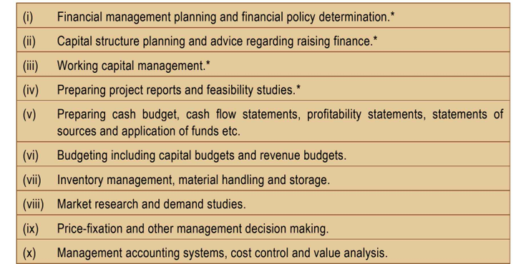
MANAGEMENT CONSULTANCY AND OTHER SERVICES (Permitted Activities)

Slide 53
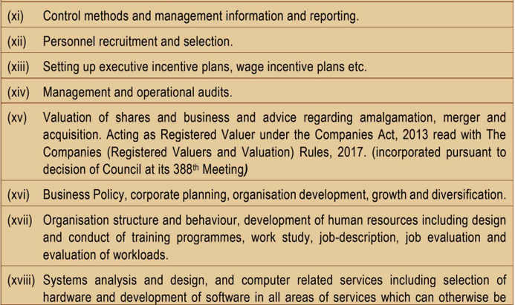
MANAGEMENT CONSULTANCY AND OTHER SERVICES

Slide 54
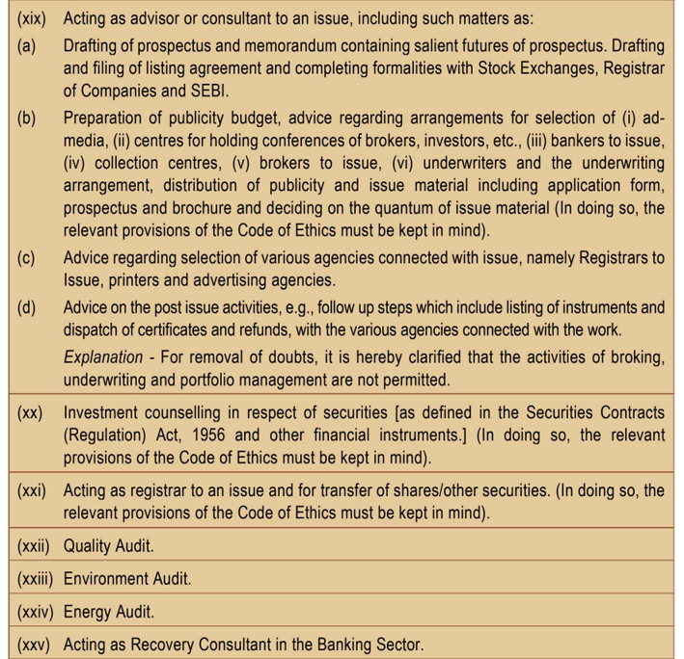
MANAGEMENT CONSULTANCY AND OTHER SERVICES

Slide 55
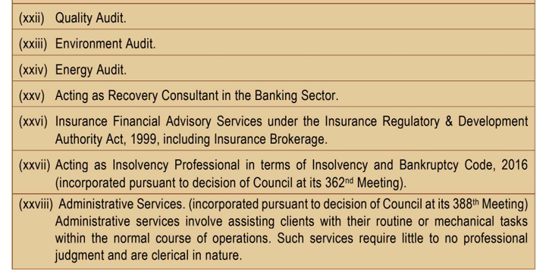
MANAGEMENT CONSULTANCY AND OTHER SERVICES

Slide 56
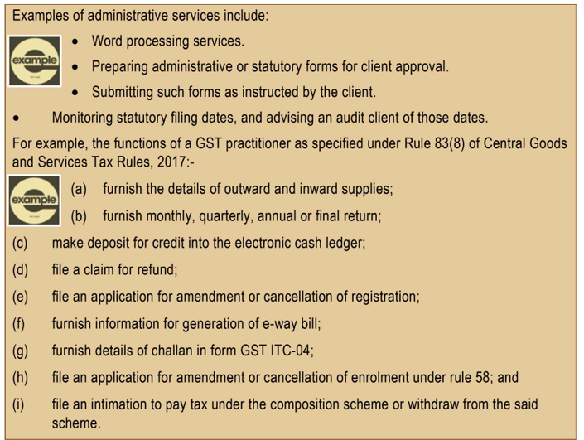
MANAGEMENT CONSULTANCY AND OTHER SERVICES

Slide 57
Choosing a Client
Client attitude and culture
Expectations
of Client to match with your skill set
Merits & Demerits
of Engagement

Slide 58
Why clients move away?

Slide 59
Economics of client management
Cost of acquiring new client
Cost of winning back lost client
Cost of retaining current client
Increasing

Slide 60
Education begins when schooling ends!
Mark twain

