Slide 1

PREPARING FOR AN IPO
Navigating the legal landscape of listings
JANAK BATHIYA (ADVOCATE, CA,CS)
ICAI National Conference on Capital Markets
29/11/2025

Slide 2
DECIPHERING INTENT
Why IPO?
Value unlocking
Efficient Resource Raising
Image enhancement
Lower cost of capital
Corporate Governance and Discipline
No Personal Guarantees
ESOPs
Improving balance sheet
Separating control from management

Slide 3
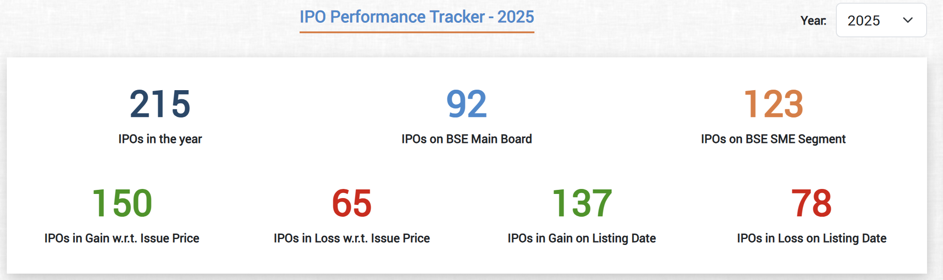
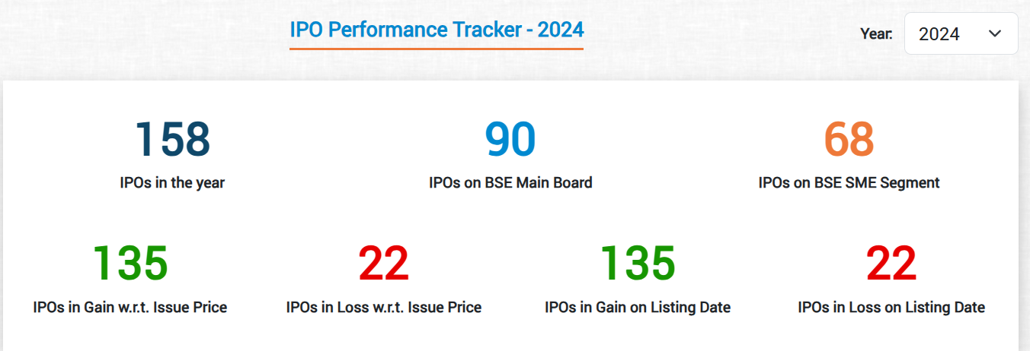
WHEN

Slide 4
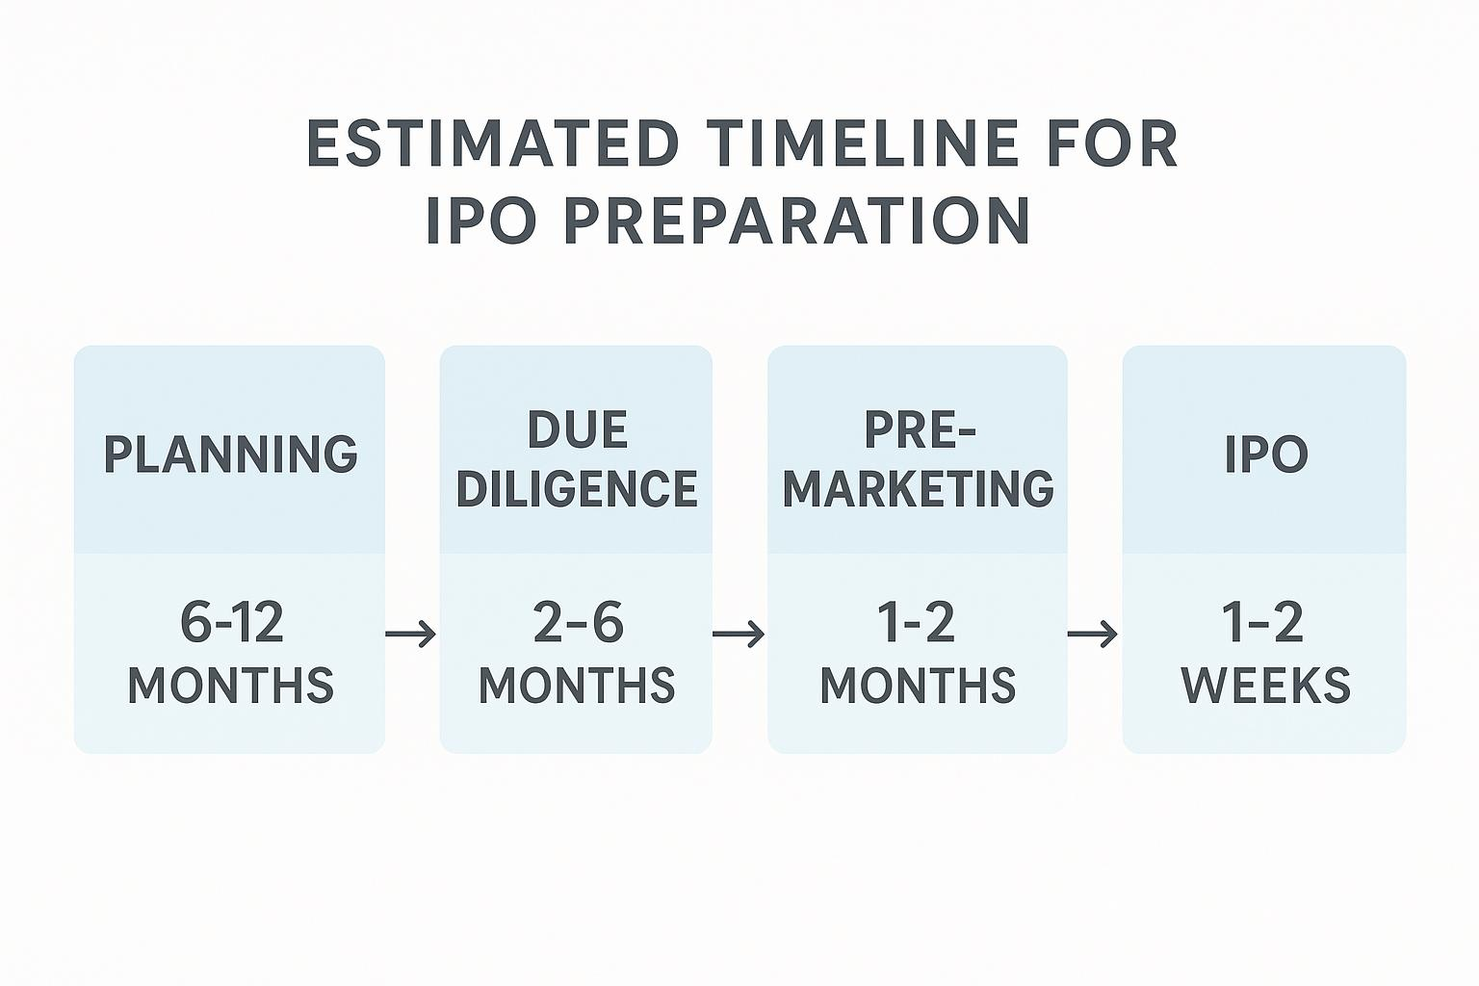
PREPARATION PHASES

Slide 5
KEY ACTIVITIES INVOLVED IN IPO – Chapter II
Months
Key Activities
1
Data collection and analysing / internal restructuring
3
Pre-IPO Activities / Diligence
Appointing MB/Intermediaries
6
DRHP
9
SEBI/SE Approval
Underwriting
Roadshow
Price Discovery
12
RHP
Issue Opening
Allotment/Listing

Slide 6
KEY ACTIVITIES INVOLVED IN IPO- Chapter IIA- Confidential Filing
Months
Key Activities
1
Data collection and analysing / internal restructuring
3
Pre-IPO Activities / Diligence
Appointing MB/Intermediaries
Select QIB discussions
6
Prefiled DRHP
9
SEBI/SE Approval
Underwriting
Roadshow
Price Discovery
12
RHP
Issue Opening
Allotment/Listing
Updated DRHP 1 for public comments

Slide 7
ELIGIBILITY (crores)
Criteria | IPO 6(1) | IPO 6(2) | SME BSE | SME NSE
Consolidated
Net worth | 1 cr. (3 yrs) | X | 1 cr. for 2 years | Positive
Net tangible assets | 3 cr. (3 yrs) | X | 3 cr. last year
NTA Monetary* | 50% of above (3 yrs) | X
Operating Profit | 15 cr. Average (3 yrs) | X | 1cr. in 2 out of 3 (including last year) | 1 cr. for any 2 out of 3 years
Free Cash Flow |  |  |  | Positive FCF for 2 out of 3 FY
Standalone
Post Issue Capital | More than 10 cr. | More than 10 cr. | Less than 25 cr. | Less than 25 cr.
Leverage Ratio |  |  | 3:1

Slide 8
ELIGIBILITY (crores)
Criteria – book-built issue | IPO 6(1) | IPO 6(2) | SME BSE
QIB | 50 % (5% for MF) 30% can be for anchor | 75% (5% for MF) | 50 % (5% for MF) 30% can be for anchor
Retail | 35% | 10% | 35%
Non-institutional | 15% 1/3rd for 2 to 10 lakhs 2/3rd for 10 plus | 15% | 15% 1/3rd for 2 to 10 lakhs 2/3rd for 10 plus

Slide 9
MINIMUM PROMOTER CONTRIBUTION AND LOCK IN
Criteria | Main Board | SME
Identified Promoter | 20% Post Issue Capital | 20%
No Identified Promoter | 0% | 0%
Lock in (MPS) | 18 months | 3 years from commercial production of project
Lock in (Non MPS-Promoter) | 6 months | 50% for 2 years 50% for 1 year
If End Use is Capex- Promoter Lock in | 12 months
Lock in (pre ipo others) | 6 months | 12 months
Lock in not to apply for
1. ESOPS
2. Shares held pursuant to ESOPs
3. Shares help by AIF I and II for six months

Slide 10
KEY DIFFERENCES

Slide 11
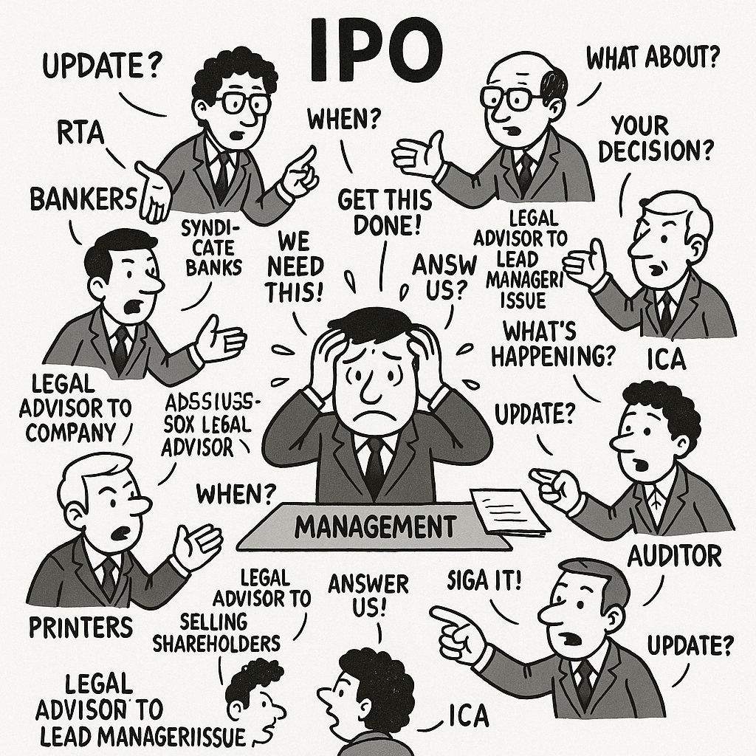
AGENCIES INVOLVED
Lead Managers
RTA
Bankers
Brokers
Syndicate Banks
Legal Advisor to the Company
Legal Advisor to Selling Shareholders
Legal Advisor to the Lead Manager/Issue
International Counsel
Advertising Agency
Printers
Auditors
ICA
PCS
Credit Rating
Monitoring Agencies
Industry Report agency
Independent litigation search

Slide 12
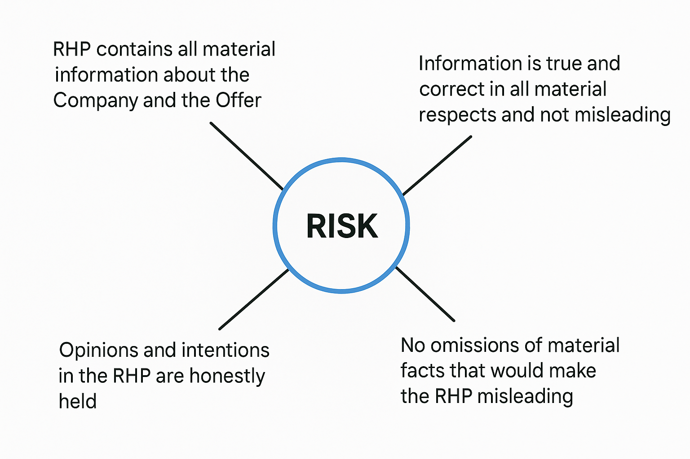
IPO Risk Responsibilities: Prospectus Page 1

Slide 13
ATTACKING THE LONG LEAD ITEMS
Bonus
Dividend
Buyback
Peer review auditor
Split or consolidation
Independent Directors
Succession, Transmission, HUF
ESOPs
Regulation 56. Restriction on further capital issues- permitted in pre-filed DRHP- 59E
Remove real estate?

Slide 14
ATTACKING THE LONG LEAD ITEMS
Internal Transfers
Restructuring and clubbing of numbers in financial statements
Name change in last 12 months
Weighted average cost of acquisition
Senior Management Personnel
Authorized share capital increase
Exemption Applications- Promoter Group identification
KPI identification and data availability
The KPIs disclosed have been used historically by Company
IndAS Conversion
Material foreign Subsidiary - counsel opinion-STB, RFS

Slide 15
PRE-IPO CAPITAL STRUCTURING ISSUES
Objectives
Offer for sale through IPO
Value unlocking
Better valuation than a private equity firm who is after the company
Pre-IPO exit to friends and family

Slide 16
PRE-IPO CAPITAL STRUCTURING ISSUES
Issues at hand
Tax
Reinvestment of OFS gains and retaining long term nature
Stamp Duty
Conversion of larger firm into company 47(xiii)
Slum Sale u/s 50B
Commercial
Exit to family and friends before IPO
Larger company should be on top
Legal
Stamp Duty
Converted shares can be transferred in OFS?
Accounting
Whether consolidation of subsidiary being a firm can have line by line effect under IndAS
Bonus issuance

Slide 17
COSTS INVOLVED
Lead Manager
SEBI Filing Fees
Listing Fees
BSE NSE Processing Fees
Book Building Software Fees
Authorized Capital increase cost
Registrars
Legal Counsels- Domestic
Legal Counsels- International
Auditors
ICA
Advisors
Advertisements
Printing
PCS
Chartered Engineers
Monitoring agency fees
Industry Report Provider
3% to 12%- OFS and primary sharing?

Slide 18
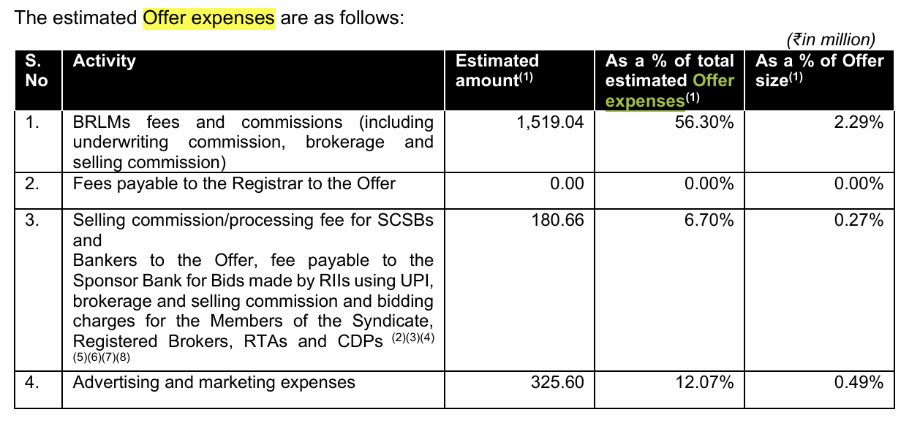
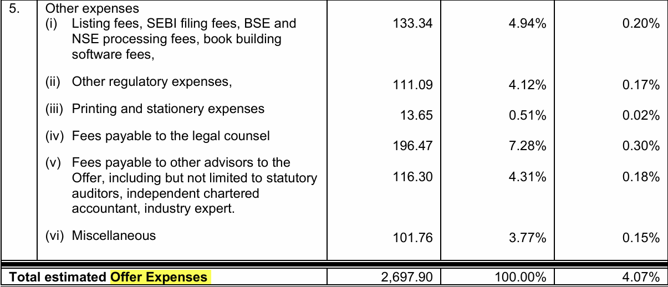
6000 cr

Slide 19
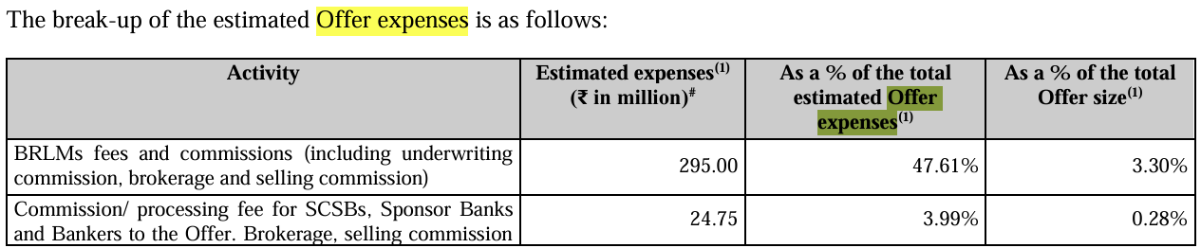
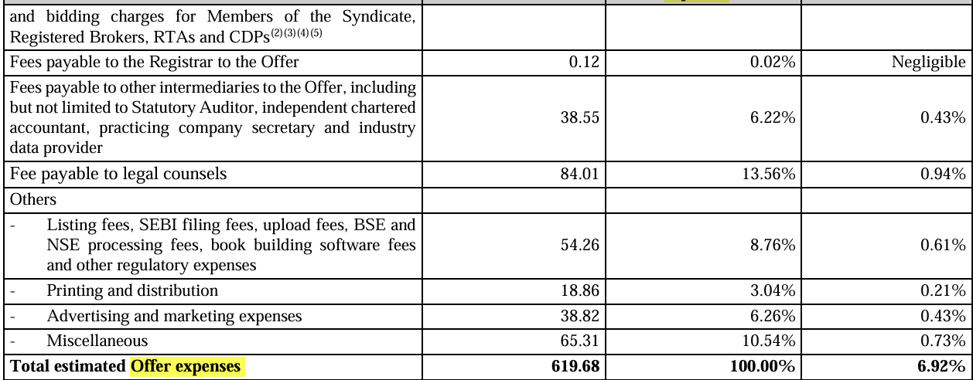
1000 cr

Slide 20
LAST MINUTE EXTERNAL THREATS
Date | Event | Description / Remark | Source
22 December 2023 | Filing of Draft Red Herring Prospectus (DRHP) | Ola Electric filed its draft red herring prospectus with SEBI to initiate its IPO process. | IPO Platform
29–30 July 2024 | MapMyIndia legal notice to Ola Electric | MapMyIndia (CE Info Systems) sent a legal notice alleging Ola Electric copied proprietary map data and breached a 2021 licensing agreement. | Forbes India
2 August 2024 | IPO opens for public subscription | Public bidding for Ola Electric’s IPO opened. | IPO Hub
6 August 2024 | IPO closes | Final day for investors to subscribe to the IPO. | IPO Hub
7 August 2024 | Basis of share allotment | Allocation of shares to investors completed. | IPO Hub
8 August 2024 | Refunds & credit to Demat accounts | Refunds initiated and allotted shares credited to investors’ Demat accounts. | IPO Hub
9 August 2024 | Listing on stock exchanges (BSE & NSE) | Ola Electric shares listed and commenced trading. | IPO Hub

Slide 21
LEARNING FROM MISTAKES
SEBI may return draft offer documents if:
• Disclosures lack clarity, simplicity, or visual representation.
• Language is complex, ambiguous, or overly technical.
• Risk factors are not clearly articulated.
• Substantial revisions or regulatory clarifications are needed.
• Information is not understandable without referring to regulations.
• Other regulators raise material concerns.
• Pending litigation affects eligibility under ICDR Regulations

Slide 22
STRUCTURING CONSIDERATIONS
Conversion of firm to Company
Slump sale
Scheme of arrangement
Stamp duty
Intellectual Property Arrangements
Consolidation of all entities in the group
Private Company to Public company conversion
Ideal Price Band
Pre-IPO issuances to promoters or employees- others
Existing shareholders agreements
End use purposes- acquisitions not identified

Slide 23
STRUCTURING CONSIDERATIONS
Convertible securities
MoA/AoA Amendment-object, Authorized capital,
Special rights (SR)
Transfer by way of gift?
End use purposes- acquisitions not identified
18 months validity of SEBI approval– 59E instead of 12 months after board observations

Slide 24
STRUCTURING CONSIDERATIONS
Disclosure in Groww prospectus
Exceptional Item (taxes) We recorded a one-time tax expense under exceptional item (taxes) of ₹13,396.84 million in Fiscal 2024 compared to nil in Fiscal 2025 in relation to the business combination between our Company and Groww Inc. The merger of Groww Inc. (Groww) with Billionbrains Garage Ventures Private Limited is subject to a US “Outbound” merger Tax wherein Groww Inc. would have to recognize the gain in its assets (i.e. difference between the fair market value of such assets and the U.S. tax basis in such assets), which would be subject to a U.S. tax at the rate of 21%. Hence, we created an estimated tax liability of ₹13,396.84 million on account of the U.S. taxes applicable on the “Outbound” merger as of March 31, 2024.

Slide 25
Project Management Office
Board Compositions
Directorships
Committee formations and term of reference
Independent Directors
Audit committee
Stakeholders Relationship Committee
Nomination and Remuneration Committee
Compliance Officer
Insider Trading Regulations –silence period- board resolution
Website
RFS

Slide 26
Project Management Office
Mindset change
Remuneration
Code of conduct
Policies
Litigations
Related Party Transactions
RFS Readiness
Consent management
Data Pipeline
Subsidiary companies and material identification
Vigil Mechanism
Code of conduct
Archival and preservation of documents

Slide 27
INDICATIVE LIST OF POLICIES TO BE IMBIBED (1/2)
Policies | Regulations under LODR and section under Companies Act 2013
Policy on Preservation of Documents | Regulation 9
Policy for Determining Material Subsidiaries | Regulation 16(1)(c)
Code of Conduct for Board Members and Senior Management | Regulation 17(5) and Section 149(8) and Schedule IV of Companies Act, 2013
Remuneration Policy of Directors, Key Managerial Personnel and Other Employees | Section 178(3) and Regulation 19 read with Part D of Schedule II of SEBI [LODR], 2015
Risk Management Policy | Regulation 17(9)(b), Regulation 21 & Section 134(3)(n)
Vigil Mechanism / Whistle Blower Policy | Section 177 (9) of the Companies Act, 2013 & Regulation 22(1) SEBI [LODR] Regulations, 2015

Slide 28
INDICATIVE LIST OF POLICIES TO BE IMBIBED (2/2)
Policies | Regulations under LODR and section under Companies Act 2013
Policy on Dealing with Related Party Transactions and Disclosure of materiality of Related Party Transactions | Section 188 and Regulation 23(1)
Policy on Determination of Materiality of Events and Information | Regulation 30(4)(ii)
Archival Policy | Regulation 30(8)
Dividend Distribution Policy | Regulation 43A(2)
CSR Policy | Section 135(3)(a)
Code of Fair Disclosure and Conduct | Regulation 8 and 9
Familiarization Programme for Independent Directors | Regulation 25(7)

Slide 29
OBJECTS OF THE ISSUE
New Projects, Expansion, Diversification, Forward and Backward integration
Long-term working capital requirements
Acquisition of business, companies, brands and other assets
Investments in subsidiaries
Repayment of liabilities
General Corporate Purposes
Meeting expenses of the issue
Capex?

Slide 30
OBJECTS OF THE ISSUE
Objects | IPO |  | SME IPO
Objects where investor has not identified acquisition target | 25% of issue size | 35% of issue size | 25% of issue size | 35% of issue size
General Corporate Purposes | 25% of issue size |  | 15% or 10 cr. whichever is less
Size of OFS |  | For 6(2) - 10% of pre issue offered by existing shareholders | Not to exceed 20% of total issue size Not to exceed selling shareholders 50% of the pre issue shareholding
Selling Shareholders holding more than 20% in OFS shall continue |  | For 6(2) - Large shareholders At least 50%
Repayment of Promoter or RPT Loan directly or indirectly |  |  | Not Permitted

Slide 31
Room for creativity
Triple Option Convertible Debentures
Warrants along with IPO
Convertible securities IPO
Bonus CCPS
Many more…

Slide 32
Thank You
Janak.bathiya@bathiyalegal.com
+919820075833
bathiyalegal.com
Bathiya Legal
Mumbai | Bengaluru | Ahmedabad | Vadodara | Hyderabad | Pune | Delhi | Vapi | Chennai

