Slide 1

Understanding Market Trends through Technical Analysis
Presented By:
Bharat Tharwani CFTe, CMT
Technical analyst

Slide 2

ABOUT ME
TECHNICAL ANALYST AND PROFESSIONAL TRADER.
Have obtained the CFTe Designation from the International Federation of Technical Analysts (IFTA).
Have cleared all three levels of CMT (Chartered Market Technician Designation) from USA and serve as an affiliate member and volunteer with CMT Association. AIF member.
Skills: Deep understanding of charts, patterns, indicators, Behavioural finance, Data interpretation, Sectoral analysis and Risk management.

Slide 3
DISCLAIMER
NO FINANCIAL ADVICE - The Information in this presentation is provided for education and informational purposes only. The Information is not intended to be and does not constitute financial advice, investment advice, trading advice or any other advice. The Information in this material is general in nature, educational and is not specific to you the viewer or anyone else.
YOU SHOULD NOT MAKE ANY DECISION, FINANCIAL INVESTMENTS, TRADING OR OTHERWISE, BASED ON ANY OF THE INFORMATION PRESENTED ON THIS MATERIAL WITHOUT UNDERTAKING INDEPENDENT DUE DILIGENCE AND CONSULTATION WITH FINANCIAL ADVISOR.
RISK STATEMENT - The trading of stocks, futures, commodities, index futures or any other securities has potential rewards, and it also has potential risks involved. Trading may not be suitable for all viewers of this material. Anyone wishing to invest should seek his or her own independent financial advice.

Slide 4
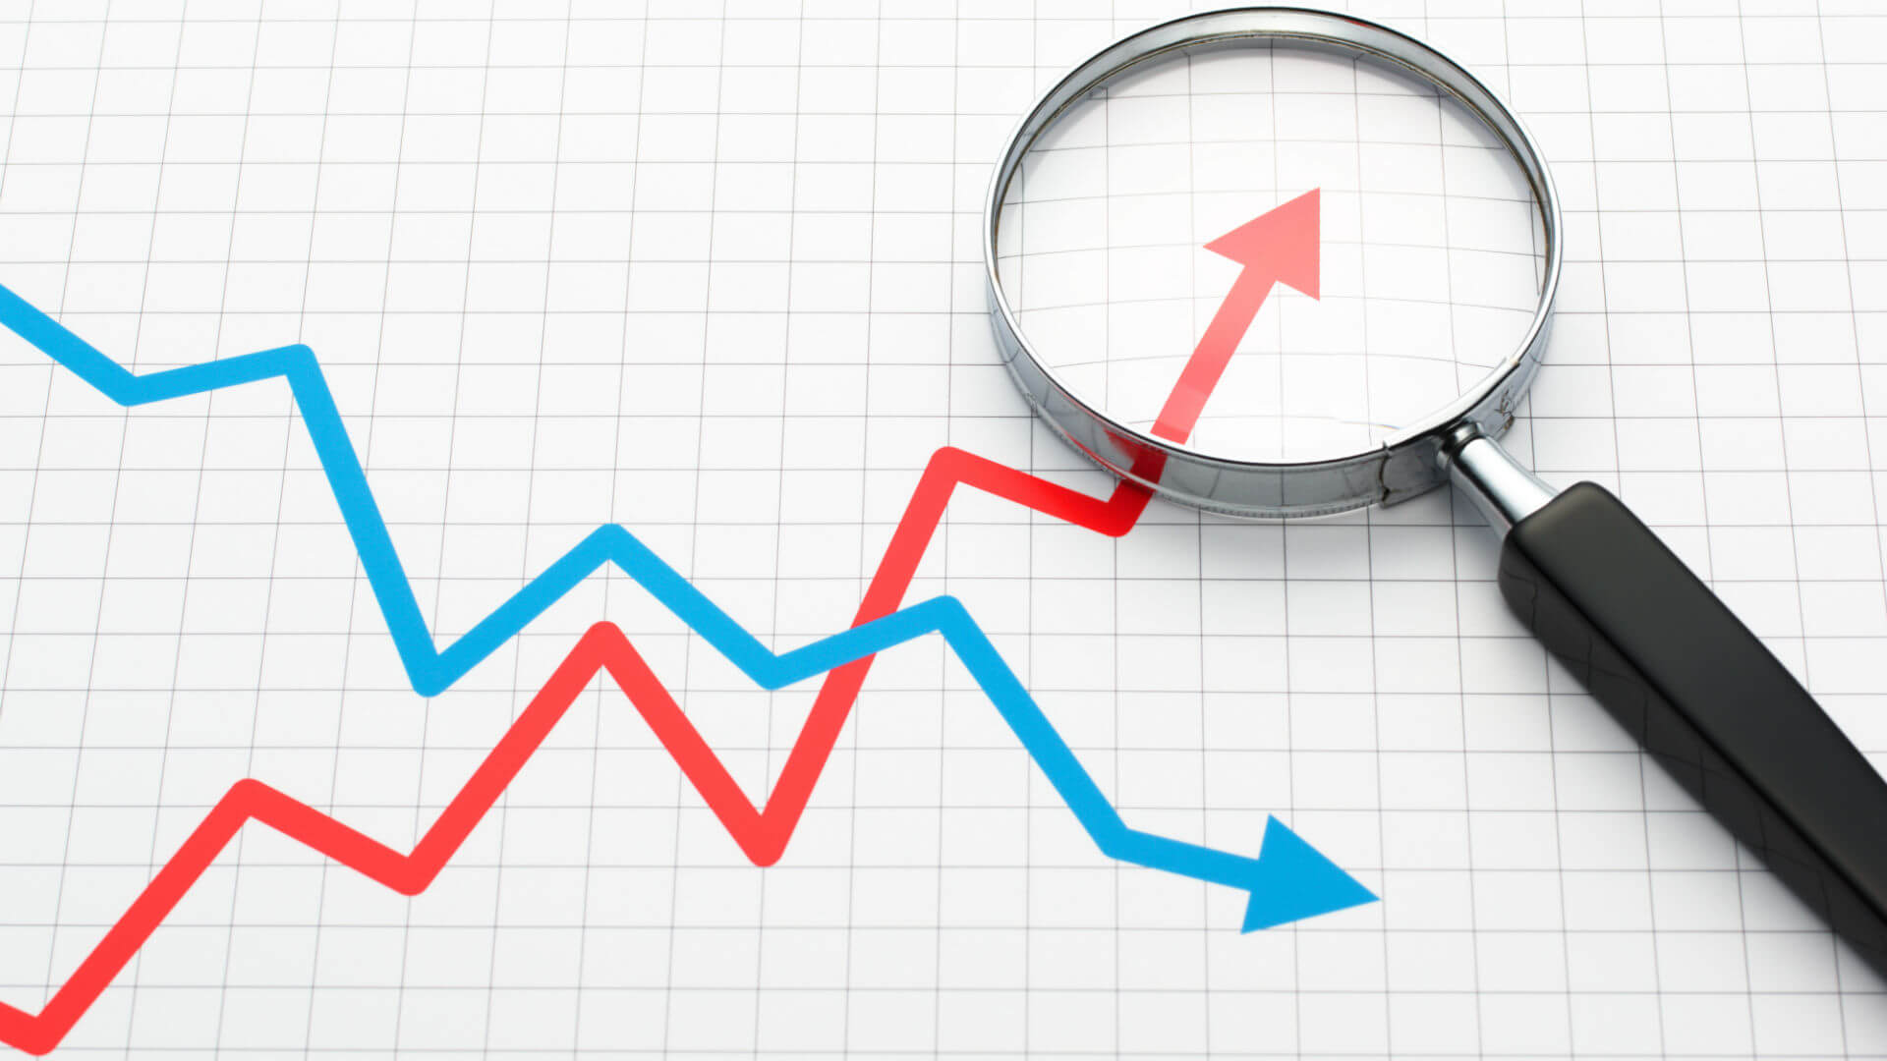
How to benefit from Technical Analysis?
Technical Analysis is used to determine the trend, when is it changing, when it has changed, when to enter a position, when to exit an position and when the analysis is wrong and position must be closed.
The change in price is due to change in supply and demand.
Supply and demand is affected by emotions of investors.

Slide 5

The concept of TREND is basis for Technical Analysis
All major moves in the market are an outcome of trend.
Trends are fractal in nature.
We want to see action of market participants in form of stock charts.
Human nature does not change, neither does the law of supply and demand.
When we have the past trading data, it helps to interpret the future price action.
Our primary goal should be to identify entry and exit points.
Our second goal should be to identify patterns in these charts which in turn help us identify trading opportunities.

Slide 6
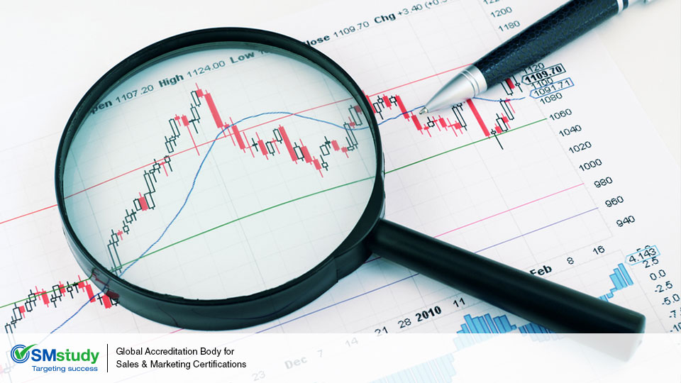
ARMAMENTARIUM FOR TREND ANALYSIS
Gauging Sector Outperformance
Trend Lines, Patterns & Candlesticks
Volume Analysis
Moving Averages and MACD
Bollinger Bands
RSI
Sentiment Measures
Open Interest Analysis
Exit Strategies (Stop Loss)
IDENTIFICATION
CONFIRMATION
DETERMINIG TREND STRENGTH
EXITS

Slide 7

Identifying Sector Outperformance
See charts of various Sectoral Indices, identify strong and weak sectors.
Use of Relative Rotation Graphs(RRG’s).
Identify big structural changes in an Industry.

Slide 8
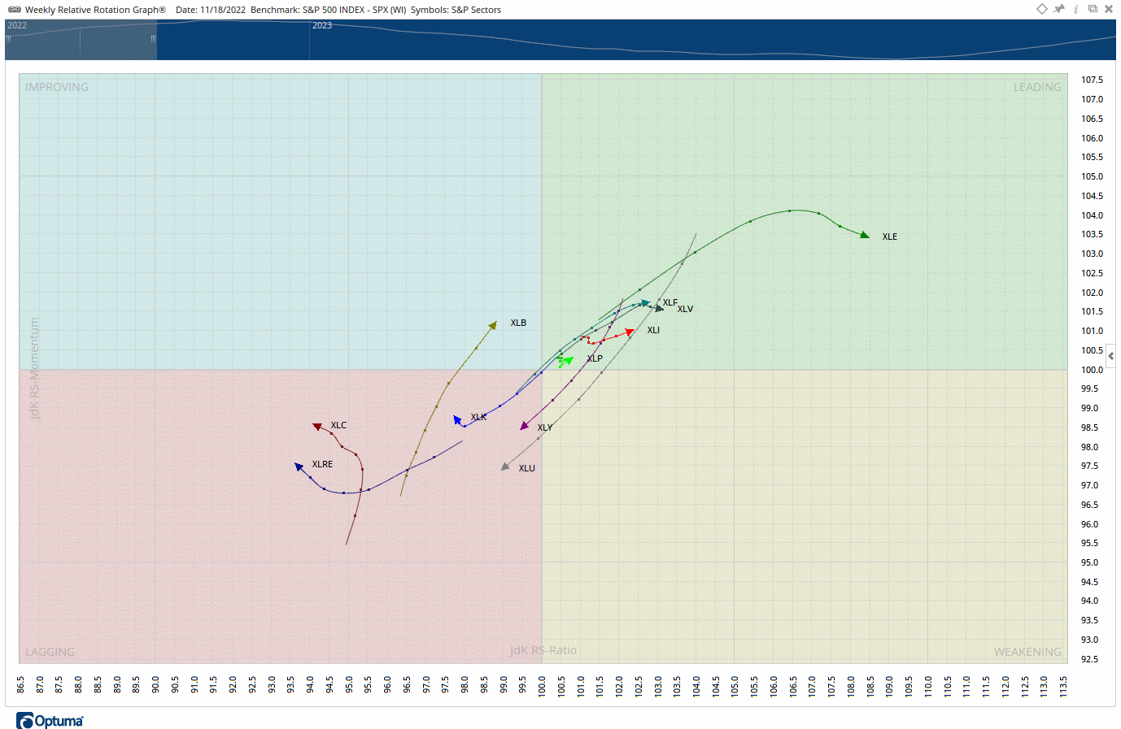
What is a RRG?
Relative Rotation Graphs (RRG®) are a unique charting tool that help visualize the relative performance of different securities or asset classes.
RRGs allow you to quickly identify emerging trends and shifts in the market.
They display trend along with momentum in a unique way to determine relative strength of multiple securities or an index against a benchmark and against each other.

Slide 9
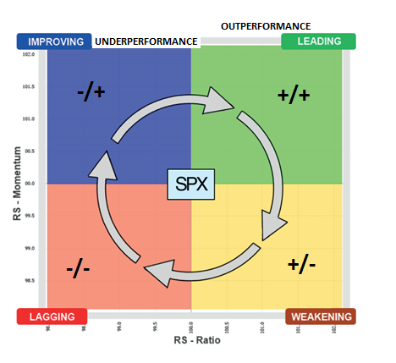
RRG CHART
Leading Quadrant: Strong relative strength and positive momentum.
Weakening Quadrant: Strong relative strength but weakening momentum.
Lagging Quadrant: Weak relative strength and weak momentum.
Improving Quadrant: Weak relative strength but positive momentum.

Slide 10
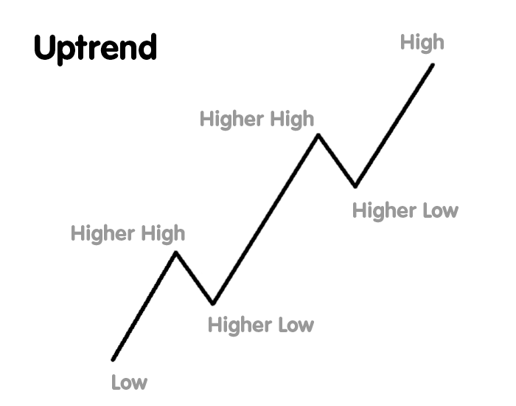
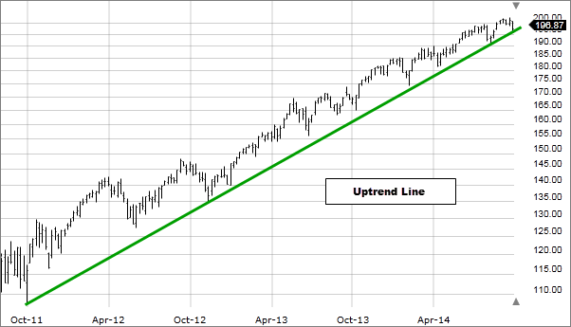
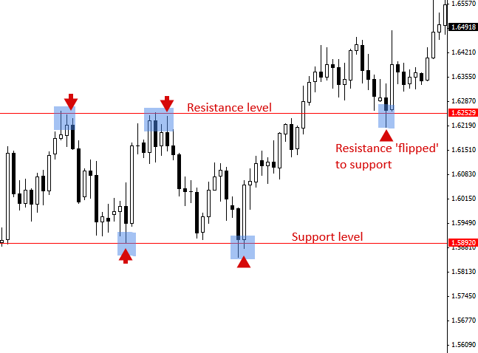
Simple ways to determine a trend
By looking at peaks and troughs.
Drawing Trend lines.
Looking at breach of support and resistances levels.
Looking for breakouts and chart patterns.

Slide 11
Trend lines
Trend lines are important tools in TA for trend identification and confirmation.
They serve as support and resistance levels.
Use trend lines in conjunction with candlesticks, MACD and RSI.
patterns
Pattern analysis is universal and independent of time.
Know the continuation, reversal and high-performance patterns.
Like trends, patterns are also fractal in nature.
Recognizable patterns form within trends.

Slide 12
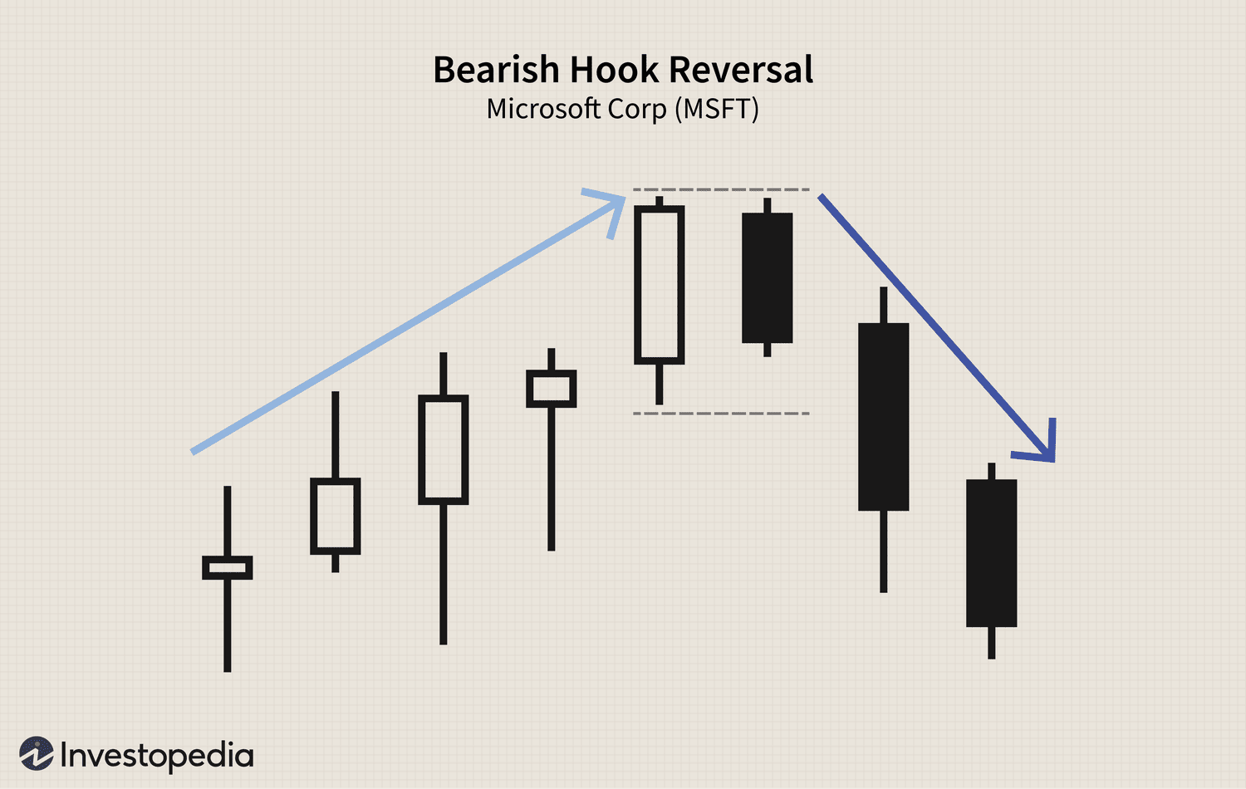
CANDLESTICKS
Candle charts indicate early trend reversal. Every candle has a story to tell about market’s moods and manners.
When analysing candlesticks, look at both real bodies and shadows.
Use at least two time frames to get a feel of market’s direction.
Convergence Concept:
The more the technical signals that emerge at Support and Resistance, the higher the likelihood of reversal.
Time Frame | Purpose
Weekly | For Trend Identification
Daily | To see breakouts
5min/30 min candles | For entries and exits

Slide 13
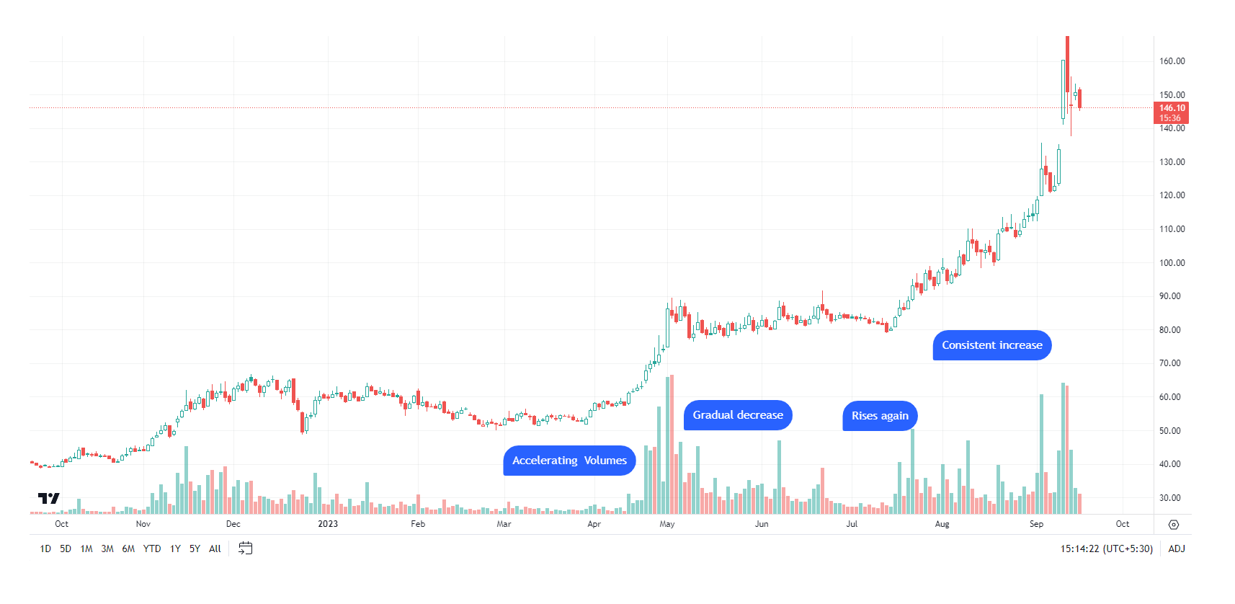
VOLUME:AN important indicator of trend strength
Remember: Volume precedes price. Look for big accelerating volumes on prior uptrends.
Volume can help us identify whether a stock is under accumulation or distribution.
Big volumes at key points is indispensable.
Exit when new highs are on low volume and price starts to approach below 50-day MA.

Slide 14
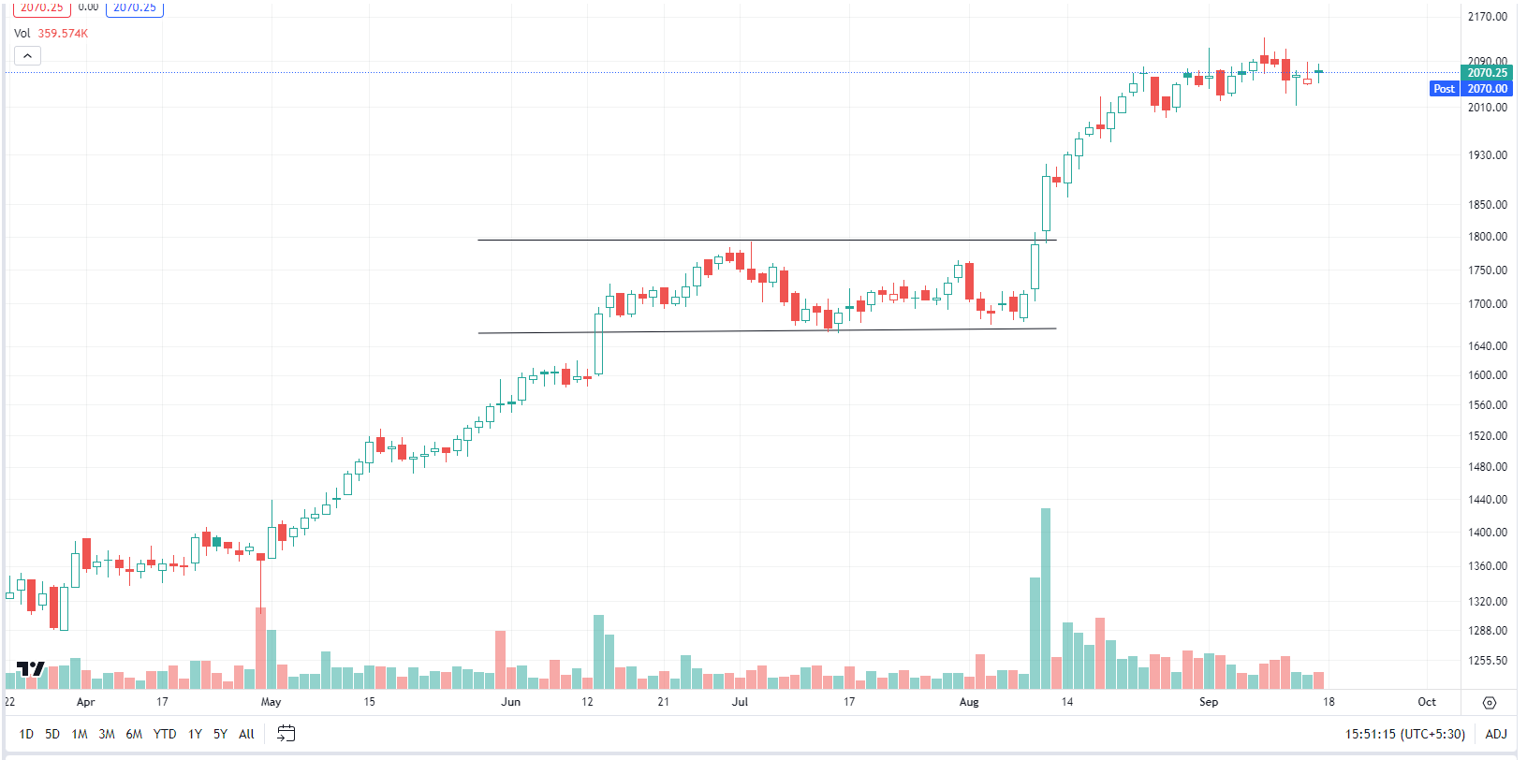
High volumes on breakouts suggests that move is going to sustain. It confirms the trend.

Slide 15
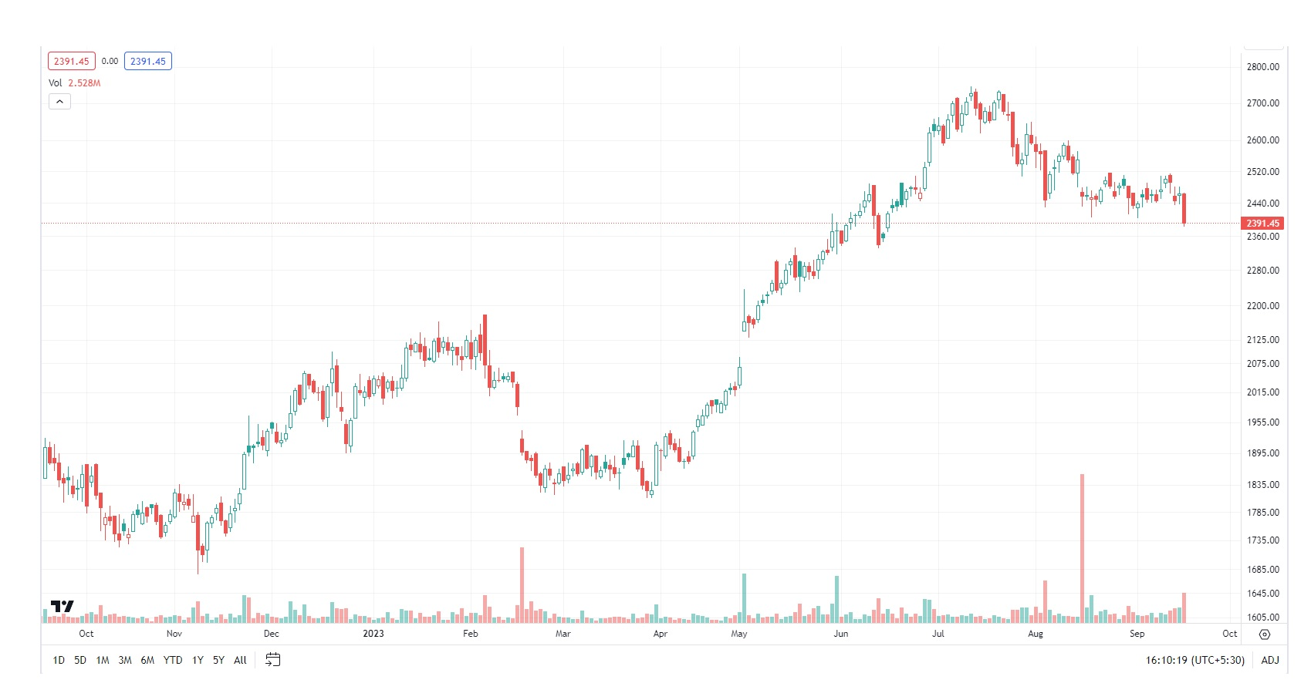
VOLUME:AN important indicator of trend strength
If breakout is on low volumes, there is less conviction, it contradicts the trend.

Slide 16
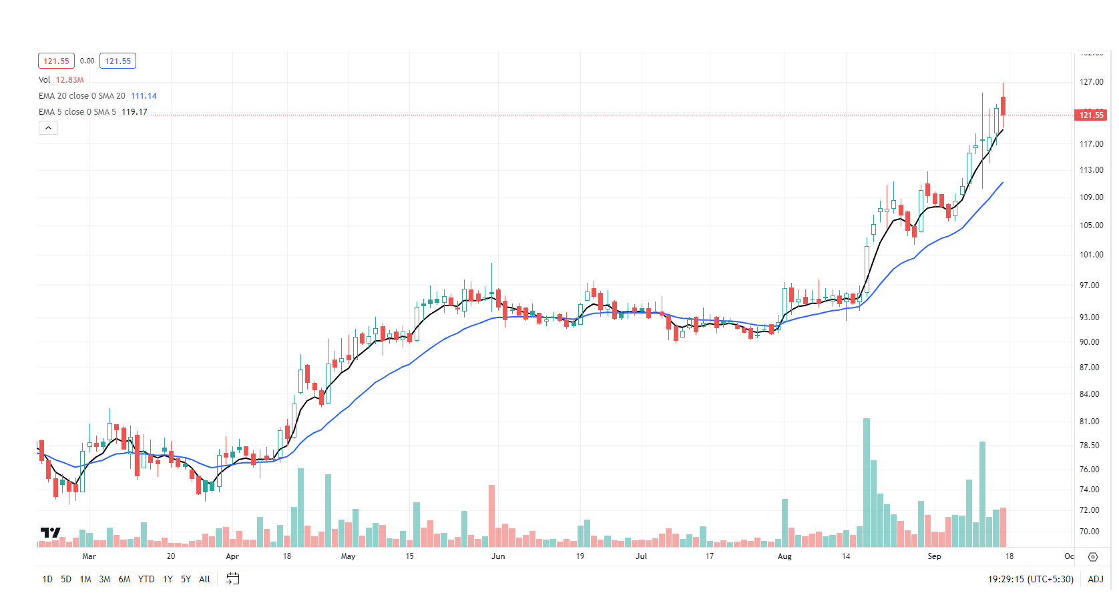
Moving averages: Best way to identify trends
Determining the Trend
Determining Support and Resistance
To give specific trading signals like crossovers
Determining price extremes

Slide 17
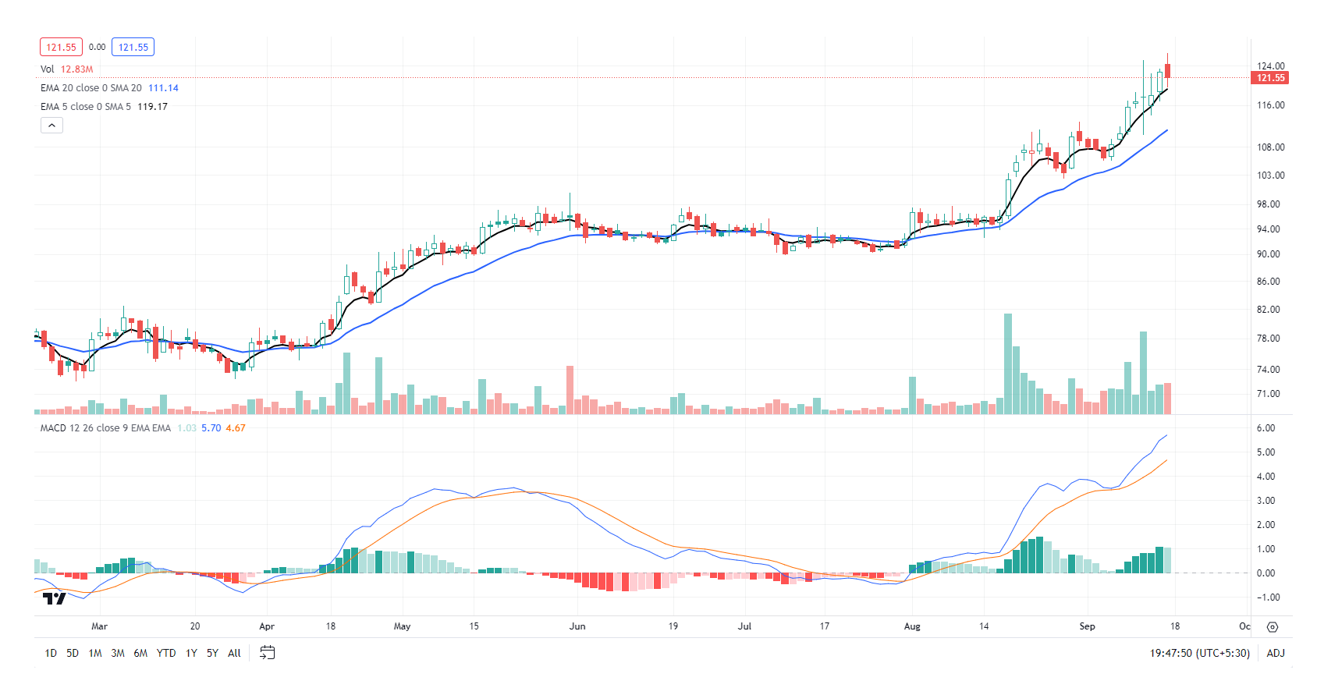
MOVING AVERAGE CONVERGENCE DIVERGENCE (MACD)
It encompasses both momentum and trend and is a useful trend following indicator.
Buy: When MACD line crosses from below to above the signal line.
Sell: When MACD line crosses from above to below the signal line.
The MACD Line is higher in uptrend and lower in downtrend.

Slide 18
PRICE VOLUME RELATIONSHIP
 | Price | Volume | Meaning | Implication
1 | Rising | Rising | Increasing Demand | Bullish
2 | Rising | Falling | Decreasing Demand | Bearish
3 | Falling | Rising | Increasing supply | Bearish
4 | Falling | Falling | Decreasing Supply | Bullish

Slide 19
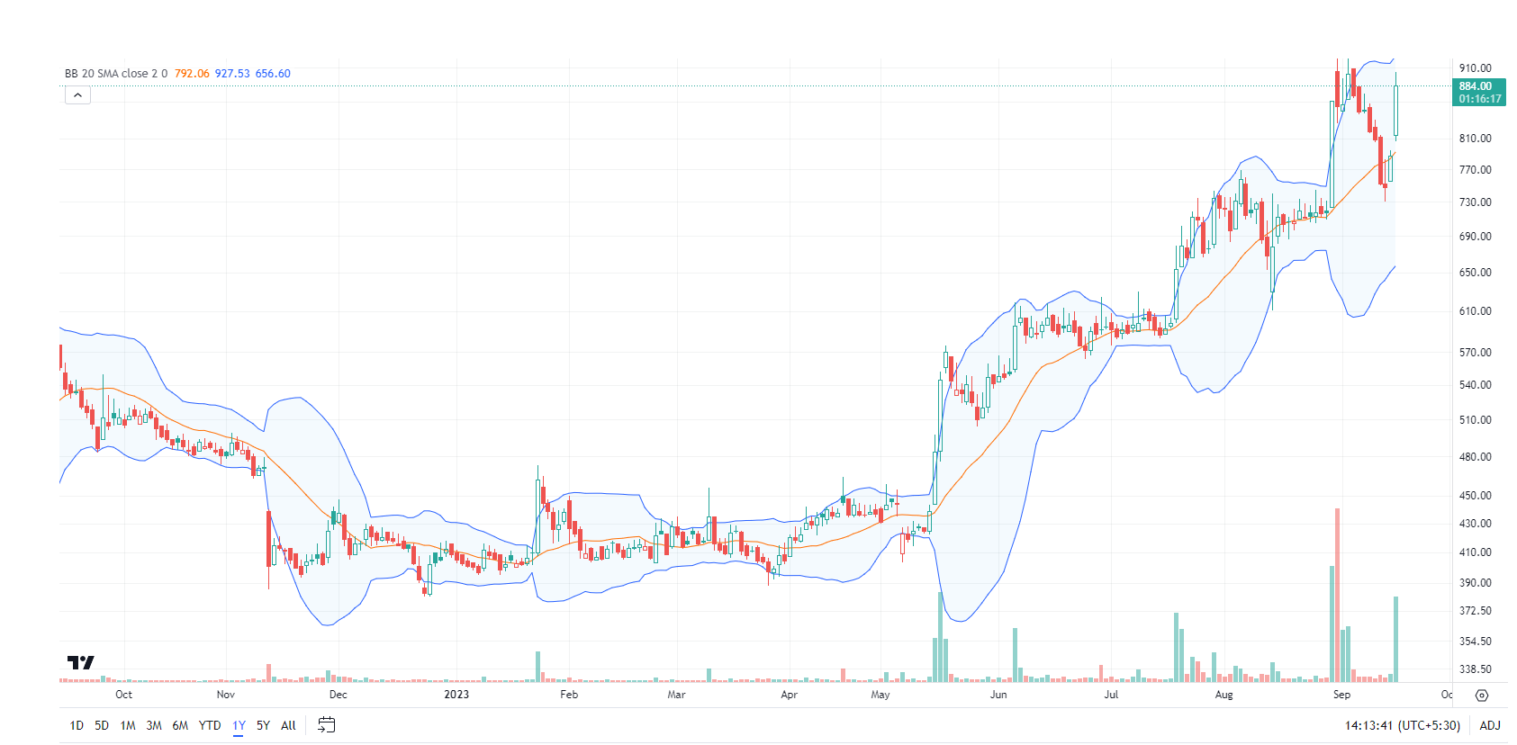
BOLLINGER Bands: A Unique Blend of Trend and Volatility
The closes outside the Bollinger Bands are continuation signals, not reversals.
The central concept is that “when volatility has fallen to a very low level, that its very lowness anticipates increased volatility”.
Many trends are born in trading range when Bandwidth is quite narrow.
“A breakout from trading range accompanied by sharp expansion in bandwidth marks the beginning of sustainable trend.”

Slide 20
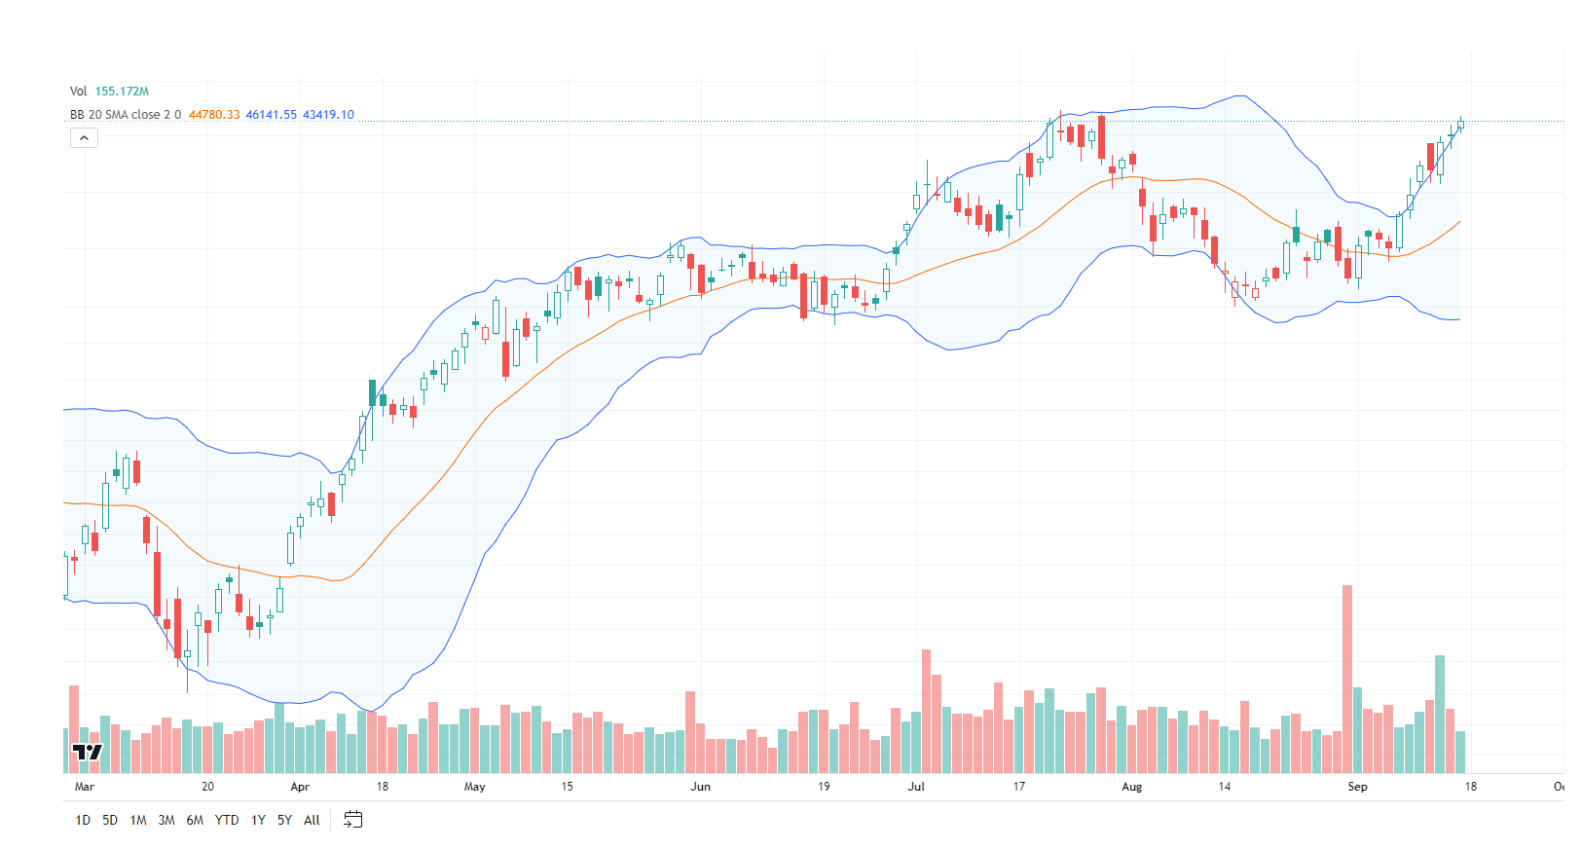
ARE WE IN A STRONG TREND?

Slide 21
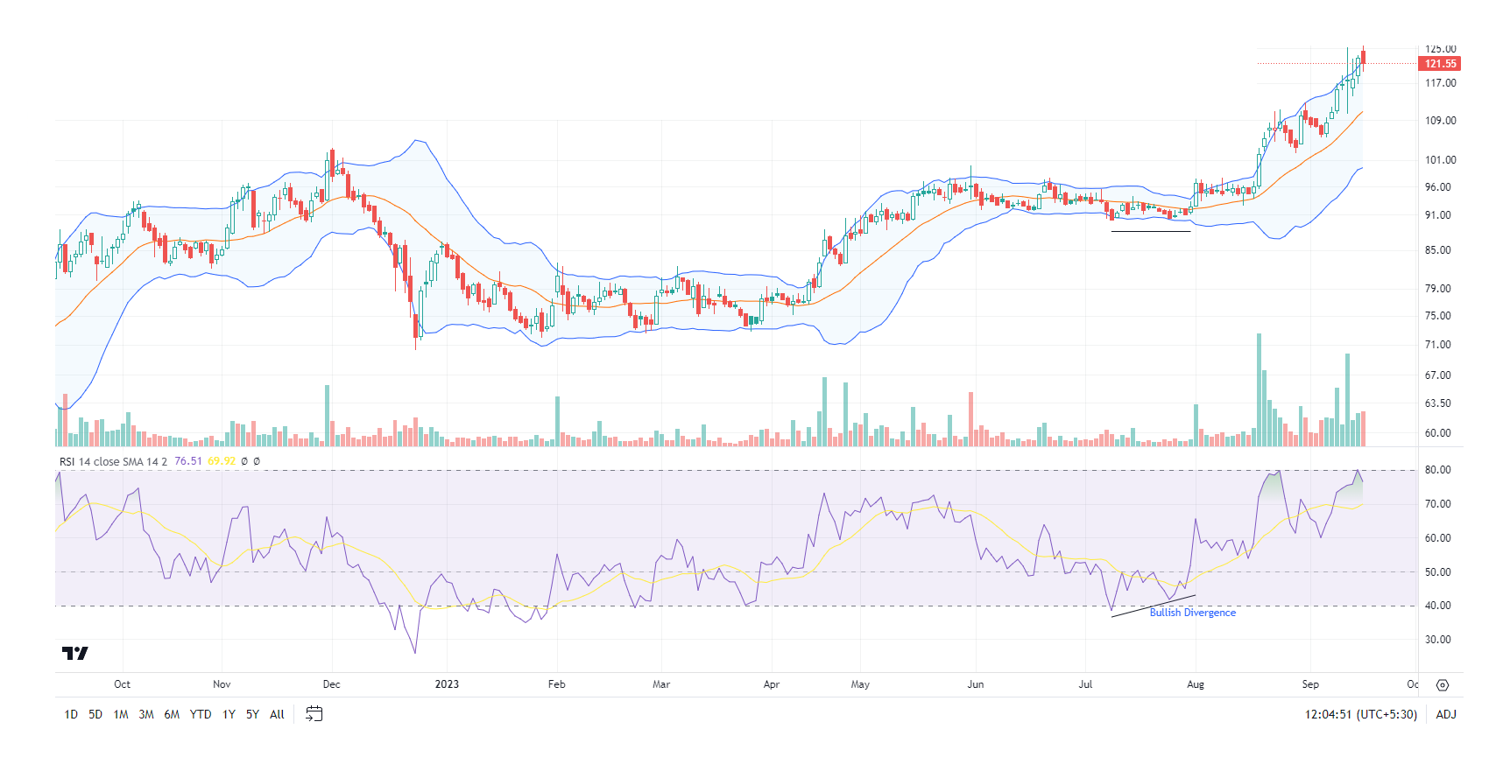
RSI (Relative strength index)
Momentum oscillator that measures speed of price change.
It can help us validate trends and trend reversals.
Strategies:
Modify RSI levels to fit trends.
Look for Divergences.
You can apply trend lines, S&R concept to RSI.

Slide 22
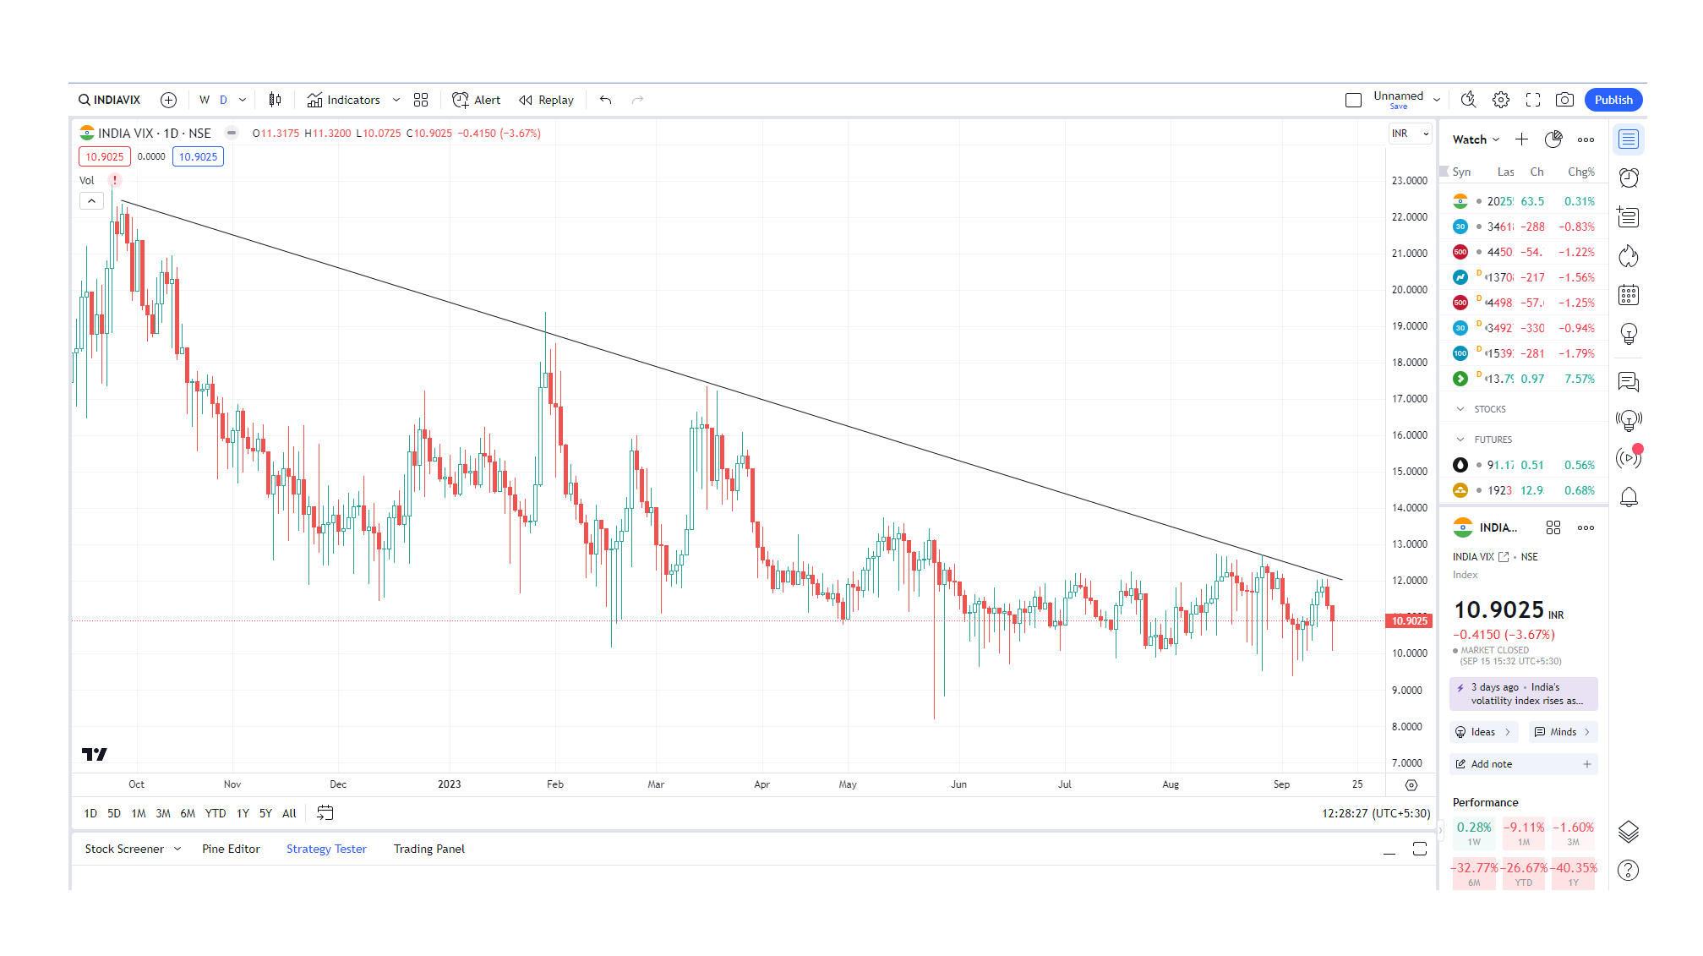
SENTIMENT MEASURES FROM MARKET DATA
Futures open Interest (Increase or decreasing)
Put call ratio (PCR)
India VIX

Slide 23
PRICE-VOLUME-open interest RELATIONSHIP
OPEN INTEREST
It is the total number of futures or options contracts that have not been exercised or closed.
It represents difference of opinion amongst Bulls and Bears.
 | Price | Volume | Open Interest | Implication
1 | Rising | Rising | Rising | New Buyers
2 | Rising | Falling | Falling | Short covering Rally
3 | Falling | Rising | Rising | New shorts
4 | Falling | Falling | Falling | Bottoming

Slide 24
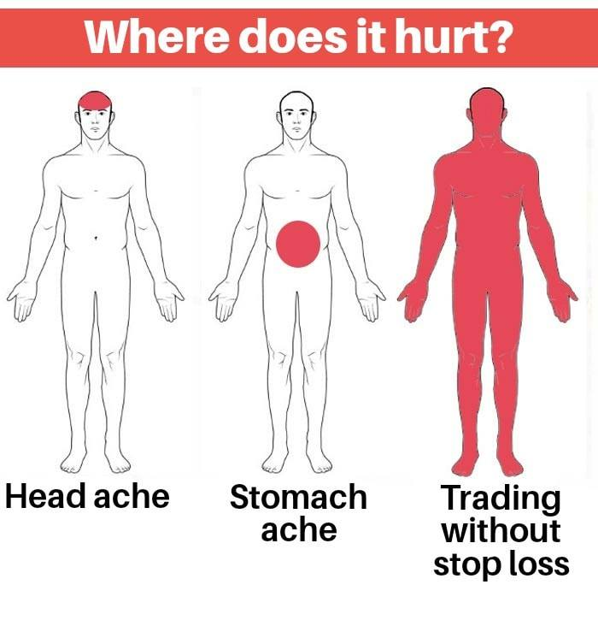
STOPS/Exit strategies
Primary exits from trends are stops.
Exit stops are used to protect capital from further loss (protective stops) or protect profits from getting deteriorated (Trailing stops).
Cut every single loss when it is 7-8% below your purchase.
Cutting losses is like buying an insurance policy. Take losses quickly, and profits slowly.
The protective stop loss should never be cancelled or changed against the trend of security.
Trail SL only in direction of the trend, not against it.
Methods for Trailing Stop Loss:
Trend line based
Moving Average based
Parabolic SAR
ATR based (Super trend)
Percentage Gain based
Time and Money stops

Slide 25
SUMMARY-KEY TAKEAWAYS
There is no easy magic formula for wealth. Build a system and follow it.
In financial markets, long term equilibrium is rarely reached. Prices change constantly. Nothing is perfectly stable or constant in markets.
From time-to-time market will shift its emphasis from small caps to large caps and vice-versa.
Buy fundamentally sound companies when they are emerging from sound consolidated bases and are close to making new highs on increases volumes.
Look for companies with low float.
Learn to sell quickly when you have a small loss rather than waiting or hoping they will come back.
Extremes in sentiment mark the end of trend.
Average upwards, not downwards.
Look for abnormal strength on a weak day.
Always prefer strong stocks in strong sectors in upward trending market.

Slide 26
SUMMARY-KEY TAKEAWAYS
Profits are made by riding the trend. Oscillators and indicators should only be used as secondary evidence to confirm the trend.
Its excellent to buy a trending stock at its support levels.
Markets are mostly chaotic, within these chaos, periods of order and structure appear. The essence of market analysis is for the trader to have discipline and recognize when these periods appear and courage to trade them.
In trending markets, the oscillators may remain in overbought conditions for a prolonged period.
What is more important in market fluctuations are not the events themselves, but human reaction to these events. That is why it becomes very important to gauge the emotional aspect of markets, which is done by Technical Analysis.
Buy the Leaders, avoid Laggards.
“MAKE USE OF YOUR OPPORTUNITIES”.

Slide 27
THANK YOU!!
My Email: bharattharwani756@gmail.com

