Slide 1

Opportunities for Young Chartered Accountants
In Today's Dynamic, Digital & Disruptive Business World
Presented by: CA Brijen Sampat
Rajkot Branch of WIRC of ICAI- 3rd December, 2025
"Chartered Accountancy is the only profession where numbers speak — sometimes loudly like a tax notice!"

Slide 2

Opening Thought
• Numbers speak. Sometimes they shout — like a TAX notice! But they also whisper opportunities everywhere.
• The CA profession today is less about tallying and more about translating — business strategy, data intelligence, AI integration, and financial Planning.
• Let's move
From compliance to impact,
From local to global, and
From traditional accounting to strategic leadership roles that shape the future of business.
3rd December, 2025
Presented by CA Brijen Sampat
Page 1

Slide 3



Why This Topic Matters
India's Economic Rise
Global and Local Demand Surge
Evolved Expectations
India is the fastest-growing large economy globally, creating unprecedented opportunities for finance professionals who understand both local compliance and international standards.
Skilled finance professionals are in high demand worldwide. Organizations seek CAs who bring technical expertise combined with strategic business acumen and digital fluency.
Today's CAs are expected to understand business models, navigate AI tools effectively, and serve as strategic partners to leadership — not just compliance experts.
We don't just balance books anymore — we balance ambition and accountability, innovation and integrity, growth and governance.
Presented by CA Brijen Sampat
Page 2
3rd December, 2025
Presented by CA Brijen Sampat

Slide 4




The Big Shift in the CA Role
Yesterday
Today
Tomorrow
• Audit
• Tax
• Accounting
• Strategy
• Tech
• Advisory
• Leadership
• ESG
• Automation
• Compliance-focused work, manual processes, traditional financial reporting
• Business partnering, digital transformation, value creation through insights
• C-suite roles, sustainability integration, AI-augmented decision making
Old joke: CAs were bean counters.
New reality: We decide in which country the beans should be taxed! 😄
The modern CA is a business architect, not just a financial historian.
We're moving from recording what happened to shaping what happens next.
Page 3
Presented by CA Brijen Sampat
P
3rd December, 2025
Presented by CA Brijen Sampat

Slide 5
AUDIT
AUDIT IS DISAPPEARING. ARE WE READY?
India is about to exempt companies up to ₹1 crore turnover from statutory audit.
Another audit category… gone.
Look at the pattern:
✔ GST Audit vanished
✔ Tax Audit limit at ₹10 crore — majority gone
✔ Bank Audits shrinking
✔ Now… Statutory Audits on the chopping block
A former president of the Institute of Chartered Accountants of India already warned: We are heading toward a compliance vacuum.
If MSMEs won’t need tax audit, GST audit, bank audit, or statutory audit…
👉 Who checks financial truth?
👉 Who ensures governance?
👉 Who protects transparency?
THE NEW PARADIGM SHIFT
Because the future of the profession isn’t ticking boxes,
It is:
• Internal Audit
• Forensic Audit
• MIS Reporting
• Working Capital Management
• Process Design
• SOP Frameworks
• Compliance Systems
• CFO as a Service
• Performance Dashboards
• Monthly review mechanisms
• Fraud Detection
• Cost Control
• Data Analytics
Presented by CA Brijen Sampat
Page 4
3rd December, 2025
Presented by CA Brijen Sampat

Slide 6
NEW OPPORTUNITIES
Business Advisory
Tech+AI+Digital finance
Capital markets and Mergers & Acquisitions
Startup CFO & Strategic Roles
Sustainability & ESG
Government and Public Finance
7. Wealth Advisory
8. Succession planning and Business Continuity
Presented by CA Brijen Sampat
Page 5
3rd December, 2025
Presented by CA Brijen Sampat

Slide 7
Business Advisory
The world is your office. Indian CAs are increasingly becoming the go-to advisors for complex international business structures, cross-border transactions, and global compliance frameworks.
1
2
International Tax Structuring
FEMA & Cross-Border Compliance
Navigate BEPS (Base Erosion and Profit Shifting) frameworks and Pillar II global minimum tax rules. Help multinationals optimize their tax positions while maintaining full compliance with evolving international standards.
Expert guidance on Foreign Exchange Management Act, External Commercial Borrowings (ECB), and Overseas Direct Investments (ODI). Enable seamless international capital flows for growing enterprises.
3
4
Remote CFO Services
Transfer Pricing & Reorganizations
Provide global accounting and strategic CFO services remotely to international businesses. Leverage India's cost advantage and deep CA expertise to serve clients worldwide.
Design and defend transfer pricing policies. Structure group reorganizations that optimize tax efficiency while meeting regulatory requirements across multiple jurisdictions.
Made in India ➜ Served to the World 🌍
Presented by CA Brijen Sampat
Page 6
3rd December, 2025
Presented by CA Brijen Sampat

Slide 8



Tech + AI + Digital Finance
AI Audits & Automation
SaaS Financial Models
Cyber Compliance & Governance
Leverage AI for :
• continuous auditing,
• ERP automation, and
• Power BI dashboards that transform raw data into strategic insights.
• Annual Recurring Revenue (ARR),
• Customer Acquisition Cost (CAC),
• Lifetime Value (LTV), and
• Churn analysis.
• Navigate data privacy laws,
• Implement cybersecurity frameworks, and
• Ensure digital governance meets global standards.
Remember: "AI won't replace CAs. But CAs using AI will replace those who don't."
Presented by CA Brijen Sampat
Page 7
3rd December, 2025
Presented by CA Brijen Sampat

Slide 9
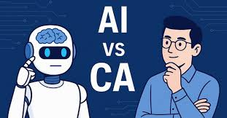
Artificial Intelligence (AI) VS CA
How AI Helps the Profession:
• Automates Bookkeeping and reconciliation tasks.
• Perform OCR, GST matching, and Invoice extraction
• Enhance forecasting and analytics
• Saves times on routine works
Limitation of AI:
• Lacks contextual and Legal interpretation
• Depends heavily on data quality
• Cannot ensure ethical or judgement based decisions
• Cannot replace professional accountability
Why CAs will continue to play a key role:
• Audit and compliance require human oversight
• Legal interpretation cannot be automated
• Advisory requires trust
• Strategic decision-making remains human-driven
How CAs can upgrade skills:
• Use AI tools to eliminate repetitive work.
• Develop analytics, automation and advisory capabilities
• Shift focus to value-added strategic services
AI Will not replace CA; it will replace:
• Slow and outdated CAs
• CAs who don’t evolve
3rd December, 2025
Presented by CA Brijen Sampat
Page 8

Slide 10



Capital Markets and Mergers & Acquisition
IPO Readiness
Due Diligence & Valuations
Deal Advisory
Prepare companies for –
• Public listing
• Draft DRHP (Draft Red Herring Prospectus)
• Coordinate with investment bankers
• Ensure regulatory compliance for successful market entry.
Conduct:
• Comprehensive financial due diligence
• Tax due diligence
• Legal due diligence
• Perform business valuations using DCF, comparable company analysis, and precedent transactions.
• Structure mergers, acquisitions, and strategic investments.
• Negotiate deal terms, model financial scenarios, and guide clients through complex transaction processes.
The SME IPO Boom
The surge in SME IPOs is creating unprecedented opportunities for young CAs to gain early-stage CXO-level exposure. These smaller listings provide hands-on experience with the entire IPO lifecycle, from preparation to post-listing compliance.
India = Deal Street. Young CAs = Deal Engineers.
Presented by CA Brijen Sampat
Page 9
3rd December, 2025
Presented by CA Brijen Sampat

Slide 11
SME IPO LISTING ELIGIBILITY CRITERIA
BSE SME
• Post issue paid up capital at face value should not be more than Rs.25 crores.
• Net worth of at least Rs.1 crore for 2 preceding full financial years.
• Net tangible Asset of at least Rs.3 crores in last preceding full financial year.
• Track record of at least three years*
• The company/proprietorship concern/registered firm/ LLP should have operating profit (earnings before interest, depreciation and tax) from operations for 2 out of 3 latest financial years preceding the application date.**
• Leverage ratio of not more than 3:1
• There should not be any change in the promoters of the company in preceding one year from date of filing the application to BSE for listing under SME segment.
• The Company has not been referred to NCLT under IBC.
• There is no winding up petition against the company, which has been admitted by the court.
NSE EMERGE
• Post issue paid up capital at face value should not be more than Rs. 25 crores.
• Net-worth should be positive
• Track record of at least three years***
• The company should have operating profit (earnings before interest, depreciation and tax) from operations for at least any 2 out of 3 financial years preceding the application.
• The applicant company has not been referred to erstwhile Board for Industrial and Financial Reconstruction (BIFR) or No proceedings have been admitted under Insolvency and Bankruptcy Code against the issuer and Promoting companies
• The company has not received any winding up petition admitted by a NCLT / Court
• No material regulatory or disciplinary action by a stock exchange or regulatory authority in the past three years against the applicant company
* Where the applicant company has taken over a proprietorship concern/ registered partnership firm/ LLP, then the track record together with such proprietorship concern/ registered firm/ LLP should be atleast3 years. Provided, the applicant company seeking listing should have a track record of operations for at least one full financial year and audited financial results for one full financial year
** The company should have operating profit (earnings before interest, depreciation and tax) from operations for one full financial year preceding the application date
*** i. the applicant seeking listing; or ii. the promoters****/promoting company, incorporated in or outside India or iii. Proprietary / Partnership firm and subsequently converted into a Company (not in existence as a Company for three years) and approaches the Exchange for listing.
****Promoters mean one or more persons with minimum 3 years of experience in the same line of business and shall be holding at least 20% of the post issue equity share capital individually or severally.
Presented by CA Brijen Sampat
Page 10
3rd December, 2025
Presented by CA Brijen Sampat

Slide 12

Startup CFO & Strategic Roles
•
Fundraising Support
•
ESOP Structures
•
MIS & Cost Control
•
Unit Economics
"Where cash is burning… there's a CA asking: Boss, ROCE kitna hai?" 😄
Presented by CA Brijen Sampat
Page 11
3rd December, 2025
Presented by CA Brijen Sampat

Slide 13

Sustainability & ESG
Finance Meets Purpose
Environmental, Social, and Governance (ESG) reporting is no longer optional — it's essential. Investors, regulators, and stakeholders demand transparency on sustainability metrics, and CAs are uniquely positioned to lead this transformation.
This isn't just about compliance; it's about creating long-term value while protecting our planet and society.
BRSR Reporting
Master Business Responsibility and Sustainability Reporting frameworks mandated by SEBI. Help companies disclose ESG performance metrics accurately and meaningfully.
ESG Audits & Assurance
Provide independent assurance on sustainability disclosures. Verify carbon emissions data, social impact metrics, and governance practices to build stakeholder confidence.
Finance + Purpose = Fulfilling Career ♻️
Presented by CA Brijen Sampat
Page 12
3rd December, 2025
Presented by CA Brijen Sampat

Slide 14




Government & Public Finance
India's digital public infrastructure is globally admired, and CAs are the architects behind this success. From ONDC to UPI, from GST systems to fraud detection, public finance offers young CAs the opportunity to work on nation-building projects at scale.
Digital Infrastructure leveraged by Fintechs
Work on transformative platforms like ONDC (Open Network for Digital Commerce), UPI (Unified Payments Interface), and GSTN (Goods and Services Tax Network). These systems process billions of transactions and are setting global benchmarks for digital governance.
.
PSU Audits & Fraud Detection
Conduct statutory audits of Public Sector Undertakings, implement fraud detection mechanisms, and ensure accountability in public spending. Your work directly impacts transparency and governance.
Scheme Evaluation & Policy Impact
Assess the effectiveness of government schemes, measure policy outcomes, and provide data-driven recommendations that shape future public finance decisions.
India’s RegTech is globally admired — and CAs drive it!
Presented by CA Brijen Sampat
Page 13
3rd December, 2025
Presented by CA Brijen Sampat

Slide 15

Wealth Advisory
• These services can include financial planning, investment management, tax planning, and estate planning, and are delivered by advisors who help manage a client's assets, risk, and overall financial situation.
• The specific offerings vary, but they are designed to provide comprehensive solutions for high-net-worth individuals.
• While China’s wealth rise was powered by industrialization.
• India’s next decade of wealth creation is expected to be led by technology, services, manufacturing scale-up, entrepreneurship, and global capital inflows—setting the stage for a rapidly expanding wealth management industry.
Presented by CA Brijen Sampat
Page 14
3rd December, 2025
Presented by CA Brijen Sampat

Slide 16
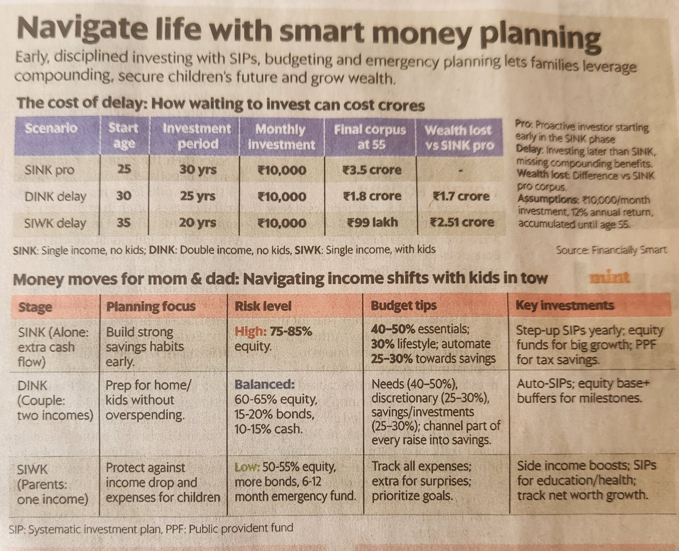
Financial Hack for Newly Minted Chartered Accountants
Presented by CA Brijen Sampat
Page 15
3rd December, 2025
Presented by CA Brijen Sampat

Slide 17





Succession Planning and Business Continuity
Benefits of Family Succession Planning:
It helps resolve family ownership and family business leadership issues
Family and Business remain integrated and synchronized
Family Wealth is protected and managed well
Family and Business are able to create legacies
Presented by CA Brijen Sampat
Page 16
3rd December, 2025
Presented by CA Brijen Sampat

Slide 18



Skills Every Young CA Needs to Thrive
Master ERP systems, business intelligence tools, and AI applications. Technology isn't optional—it's your competitive advantage in a data-driven world.
Clients crave clarity, not jargon. Translate complex financial concepts into actionable insights that stakeholders can understand and trust.
Build your LinkedIn presence intentionally. Your professional network is currency—invest in relationships that open doors and create opportunities.
Tech Fluency
Communication Excellence
Strategic Networking
Commercial Judgment
Entrepreneurial Instinct
Develop business acumen beyond compliance. Understand industry dynamics, market forces, and how financial decisions impact overall strategy.
Think like a business owner, not just an advisor. Spot opportunities, take calculated risks, and create value proactively.
You're not just a CA—you're a financial athlete 🏅 competing in the global marketplace.
Presented by CA Brijen Sampat
Page 17
3rd December, 2025
Presented by CA Brijen Sampat

Slide 19


Practice vs Industry: Both Paths Are Open
Practice Path
Industry Path
Niche Tax Advisory: Specialize in international taxation, GST consulting, or transfer pricing
Startup CFO: Shape financial strategy in high-growth entrepreneurial environments
Forensic Accounting: Fraud investigation, litigation support, and financial forensics
FP&A Leadership: Drive financial planning, analysis, and business intelligence initiatives
Virtual CFO Services: Provide strategic financial leadership to multiple companies remotely
PE/VC Roles: Evaluate investments, conduct due diligence, and support portfolio companies
Audit Innovation: Leverage AI and data analytics to transform traditional audit practices
Corporate Finance: Lead M&A transactions, treasury operations, or investor relations
Great news? You can switch paths anytime.
Your career is a chessboard with infinite moves, not a railway track with a predetermined destination.
Each experience builds transferable skills that open new possibilities.
Presented by CA Brijen Sampat
Page 18
3rd December, 2025
Presented by CA Brijen Sampat

Slide 20

❌
What to Stop Doing
Stop Waiting for Someone to Hire You
Stop Staying in the Back Office
Stop Thinking CA = End of Learning
Stop Living in Your Comfort Zone
Presented by CA Brijen Sampat
Page 19
3rd December, 2025
Presented by CA Brijen Sampat

Slide 21





✅
What to Start Doing
Build Visibility (LinkedIn = Resume 2.0)
Speak at Branch Forums
Say Yes to Challenges
Learn AI Tools (Even ChatGPT 😄)
Be the CA clients remember—not just for accurate work,
but for strategic thinking,
proactive communication, and
genuine partnership in their success.
Presented by CA Brijen Sampat
Page 20
3rd December, 2025
Presented by CA Brijen Sampat

Slide 22
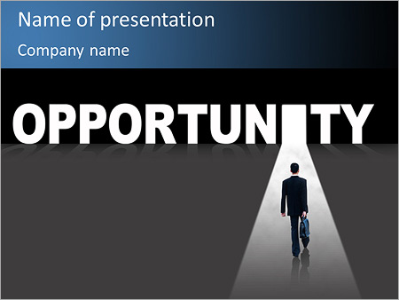
The Opportunity Landscape: Perfect Storm for CAs
🚀 Fastest-Growing Economy
💻 Tech + Finance Convergence
💰 Startup and Capital Market Boom
🌍 Compliance Shortage
Perfect storm = Perfect opportunity.
Presented by CA Brijen Sampat
Page 21
3rd December, 2025
Presented by CA Brijen Sampat

Slide 23

Recommendation of Someone Who Matters
“ READ 500 PAGES EVERY DAY. THAT’S HOW KNOWLEDGE WORKS. IT BUILDS UP, LIKE COMPOUND INTEREST. ALL OF YOU CAN DO IT, BUT I GUARANTEE NOT MANY OF YOU WILL DO IT.” – WARREN BUFFET
Presented by CA Brijen Sampat
Page 22
3rd December, 2025
Presented by CA Brijen Sampat

