Slide 1
National Conference on GST
Rajkot Branch of WIRC of ICAI
Exemptions and RCM
By Jatin Harjai
Advocate

Slide 2
Agenda
Charge of tax on RCM basis !
Nature of Exemption !
Retrospective Application of Exemption !
GST 2.0 – Impact of Exemption/ Reduction
Authority of Board to issue Circular for clarification of exemption
Interpretation of exemption notification on the basis of HSN/ SAC
Revenue Neutrality
Notes:
Sec. 2(24) Commissioner

Slide 3
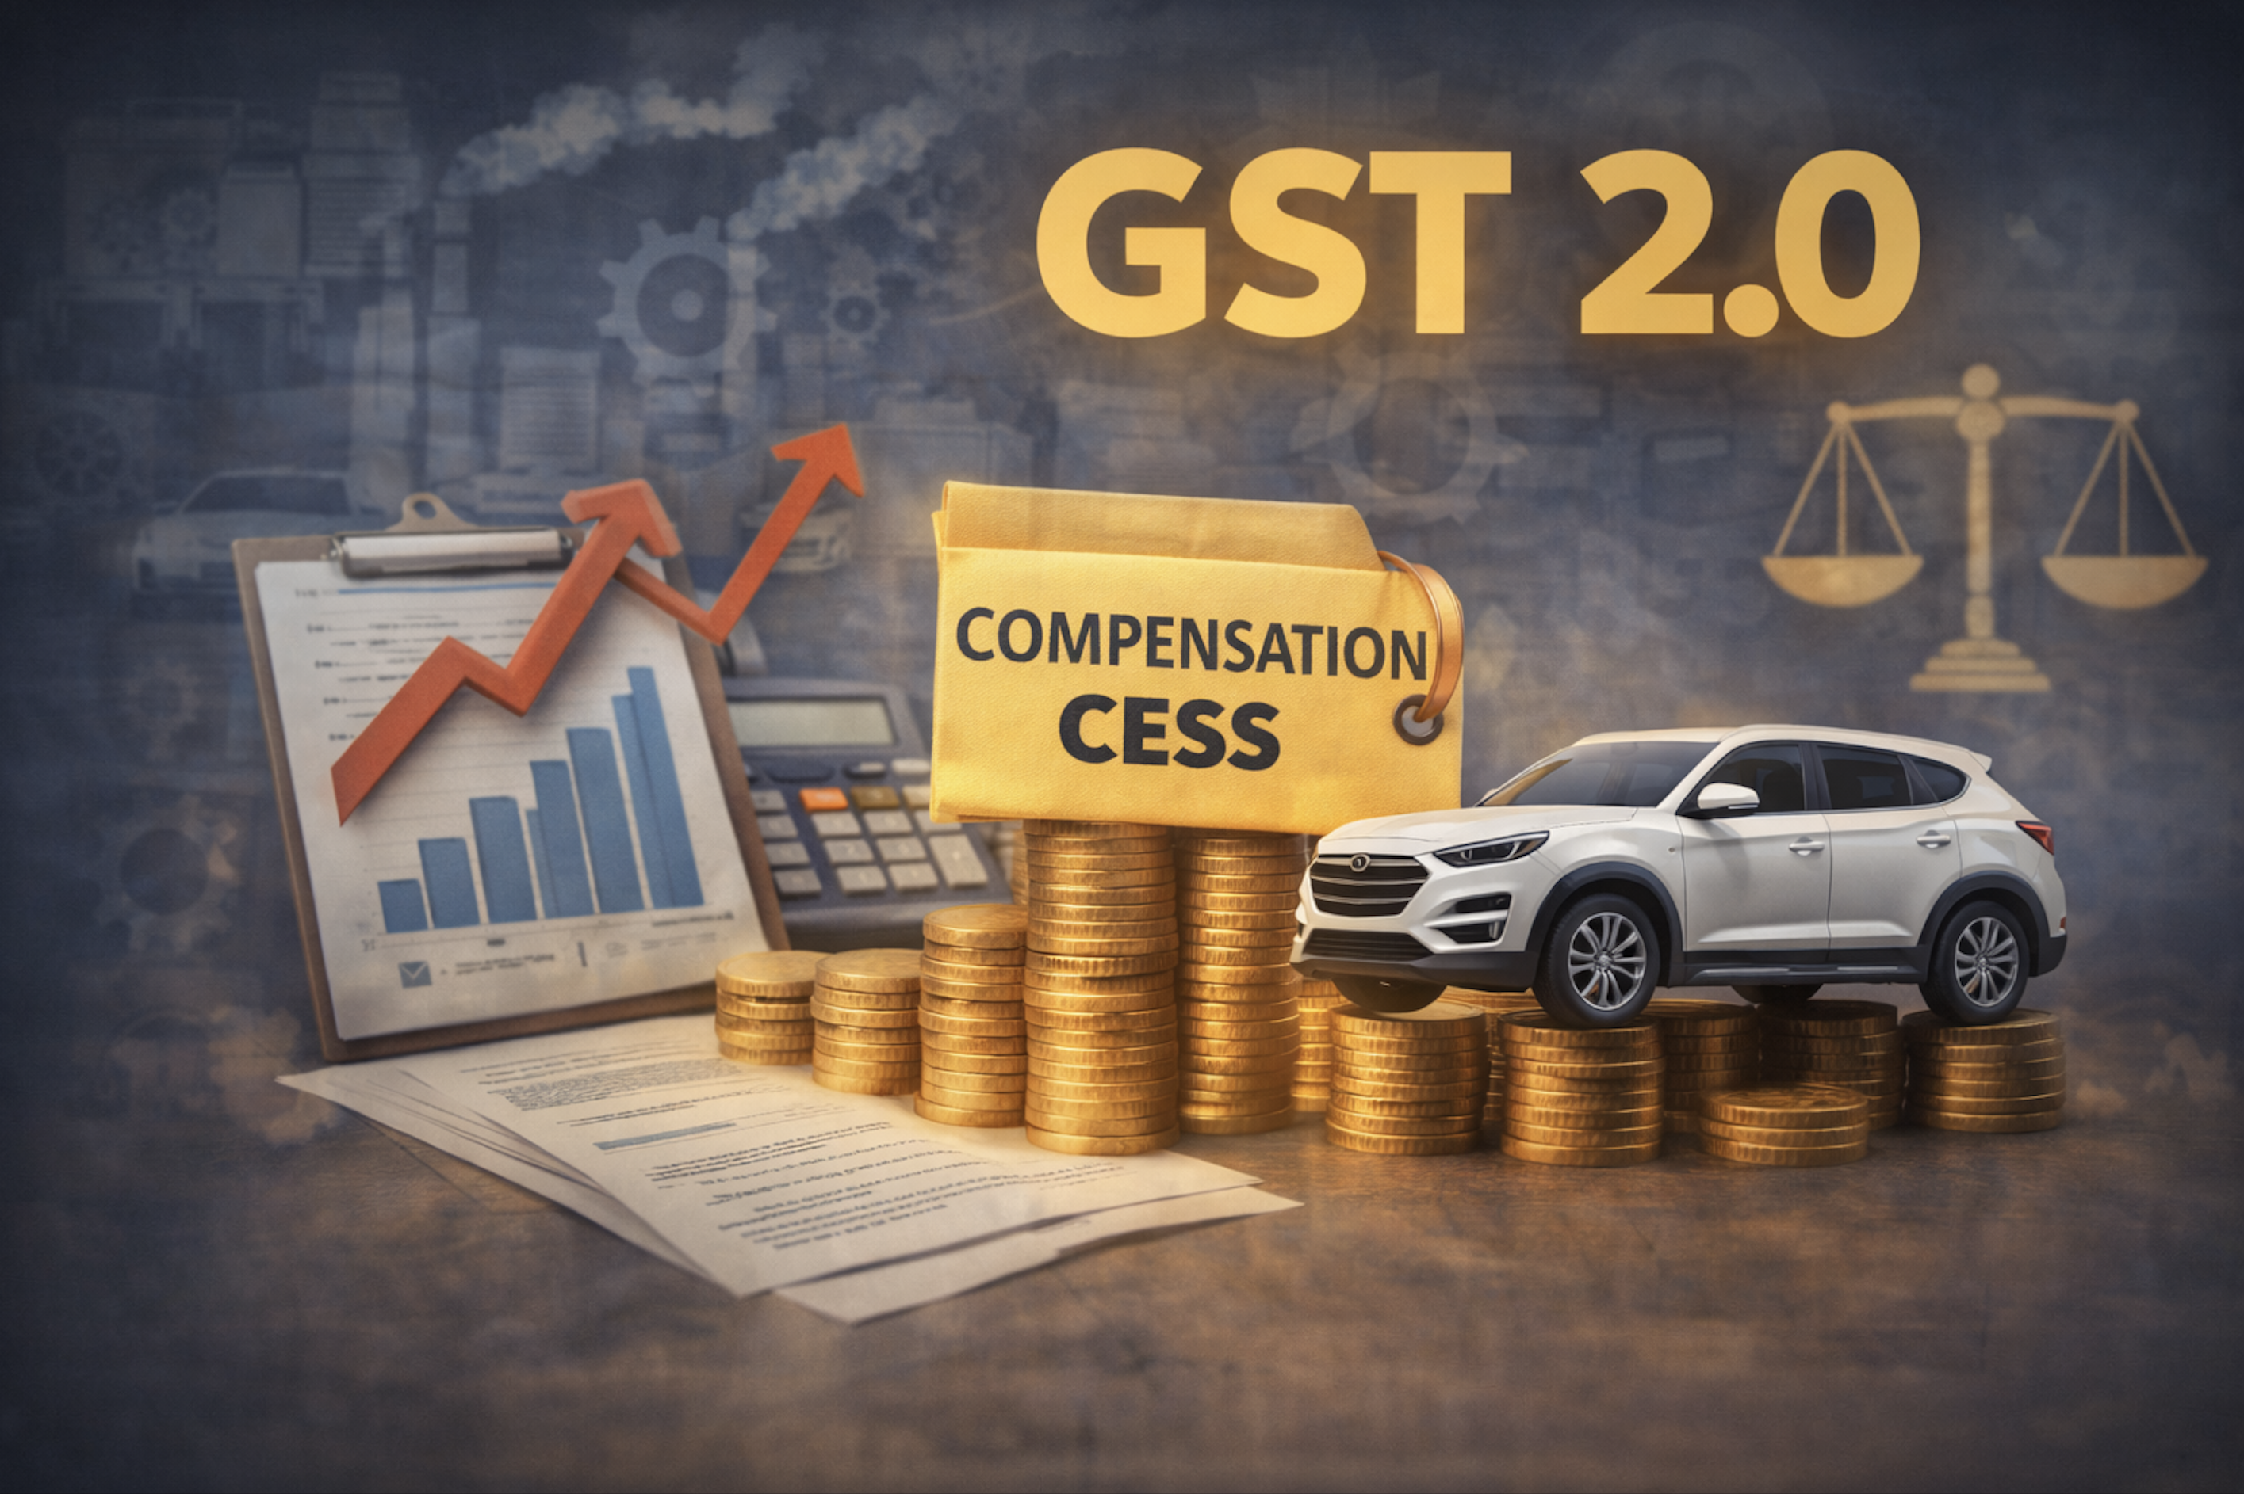
3
Notes:
21- Recovery of wrongly distributed credit from Recipient

Slide 4
GST Ecosystem
IGST
CGST
GST2.0
SGST
IGST
CGST
SGST
C. Cess

Slide 5
From Statute
NOTIFICATION NO. 2/2025-COMPENSATION CESS (RATE)
In exercise of the powers conferred by sub-section (2) of section 8 of the Goods and Services Tax (Compensation to States) Act, 2017 (15 of 2017), the Central Government, on the recommendations of the Council, hereby makes the following further amendments in the notification of the Government of India, in the Ministry of Finance (Department of Revenue), No. 1/2017-Compensation Cess (Rate), dated the 28th June, 2017, published in the Gazette of India, Extraordinary, Part II, Section 3, Sub-section (i), vide number G.S.R. 720(E), dated the 28th June, 2017, namely :-
In the said notification,
in the SCHEDULE, —
(i) against S. No. 2, for the entry in column (4), the entry "Nil" shall be substituted;
(ii) against S. No. 3, for the entry in column (4), the entry "Nil" shall be substituted;
(iii) against S. No. 4, for the entry in column (4), the entry "Nil" shall be substituted;
(iv) against S. No. 4A, for the entry in column (4), the entry "Nil" shall be substituted;
(v) against S. No. 4B, for the entry in column (4), the entry "Nil" shall be substituted;
(vi) against S. No. 39, for the entry in column (4), the entry "Nil" shall be substituted;
(vii) against S. No. 40, for the entry in column (4), the entry "Nil" shall be substituted;
(viii) against S. No. 41, for the entry in column (4), the entry "Nil" shall be substituted;
(ix) against S. No. 42, for the entry in column (4), the entry "Nil" shall be substituted;
(x) against S. No. 47, for the entries in column (4), the entry "Nil" shall be substituted;
(xi) against S. No. 48, for the entries in column (4), the entry "Nil" shall be substituted;
(xii) against S. No. 50, for the entries in column (4), the entry "Nil" shall be substituted;
(xiii) against S. No. 51, for the entries in column (4), the entry "Nil" shall be substituted;
(xiv) against S. No. 52, for the entries in column (4), the entry "Nil" shall be substituted;
(xv) against S. No. 52A, for the entries in column (4), the entry "Nil" shall be substituted;
(xvi) against S. No. 52B, for the entries in column (4), the entry "Nil" shall be substituted;
(xvii) against S. No. 53, for the entries in column (4), the entry "Nil" shall be substituted;
No transition mechanism
No specific lapsing/ reversal mandate

Slide 6
Input Tax of C. Cess !
Violation of vestee right in accrued Input Tax Credit of Cess !
Arbitrary and violative of Article 14 !
Violation of Article 19(1)(g) !
Violation of Article 265 !
Violation of Article 300A !
Violation of Doctrine of legitimate expectation !
Breach of the Value Added Principle !
Notes:
Definition clause in both laws:
- Unless the context otherwise requires.

Slide 7
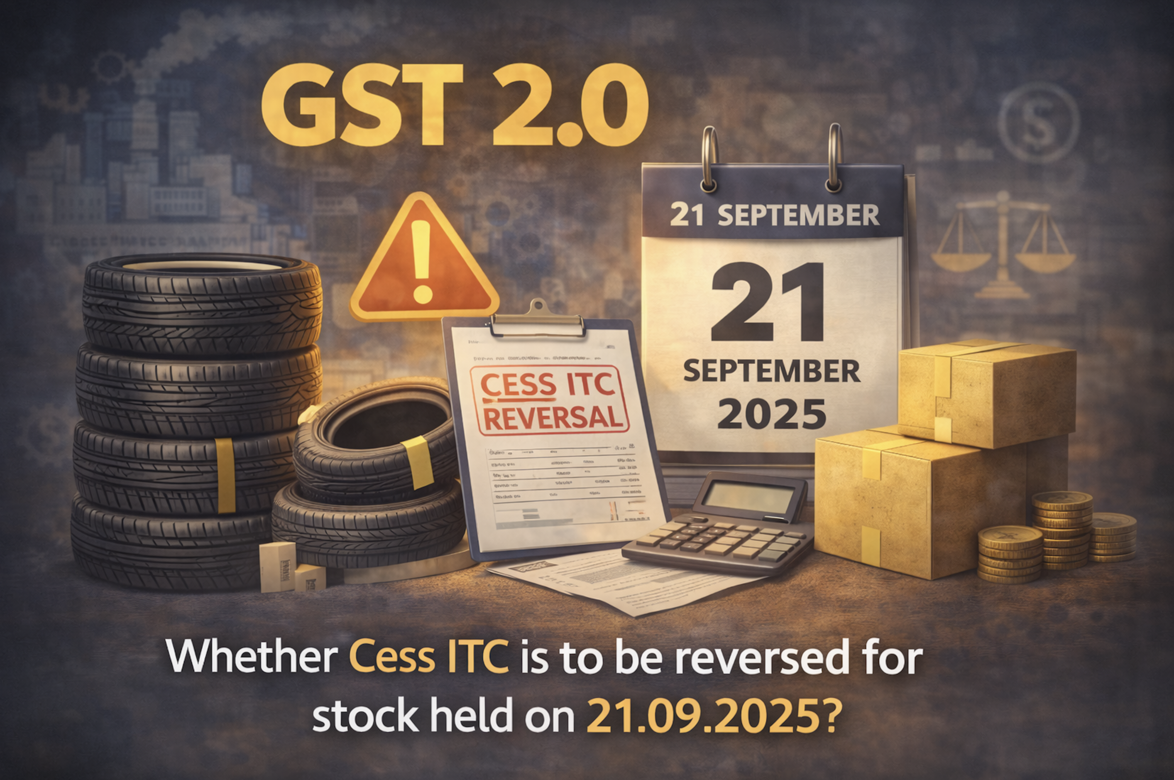
Notes:
Definition clause in both laws:
- Unless the context otherwise requires.

Slide 8
GST – Reversal of Input Cess !
Sec. 18(4) of CGST Act:
If Supplies becomes wholly exempt, supplier has to reverse ITC already availed on:
Inputs in Stock;
Inputs contained in semi-finished or finished goods;
Capital goods
Sec. 2(47) of CGST Act:
Exempt supply" means supply:
Nil Rated;
Wholly exempt u/s 11;
Wholly of any goods or services or both which attracts nil rate of tax or which may be wholly exempt from tax under section 11, or under section 6 of IGST Act, and includes non-taxable supply
Sec. 11 of C. Cess Act:
The provisions of the CGST Act, and the rules made thereunder, including those relating to assessment, input tax credit ……., shall, as far as may be, mutatis mutandis, apply, in relation to the levy and collection of the cess leviable under section 8 on the intra-State supply of goods and services, as they apply in relation to the levy and collection of central tax on such intra-State supplies under the said Act or the rules made thereunder.
Notes:
Definition clause in both laws:
- Unless the context otherwise requires.

Slide 9
GST 2.0 – Whether C. Cess Exempted or Subsumed !
Product | Prevailing GST Rate (%)
Aerated Water | 28% GST + Applicable Cess = 40%
Medium-Size Cars | 28% GST + Applicable Cess = 45%
Large Cars | 28% GST + Applicable Cess = 48%
SUVs | 28% GST + Applicable Cess = 48%
GST 2.0 Rate (%)
40% (No Cess)
40% (No Cess)
40% (No Cess)
40% (No Cess)
FAQ 38. ? Why is 40% rate referred as ‘Special Rate’ ? What is the basis for subjecting goods to special rate? – Govt.
The special rate is applicable only on few select goods, predominantly on sin goods and few luxury goods and therefore is a special rate. Most of these goods attracted Compensation Cess in addition to GST. Since it has been decided to end the Compensation Cess levy, the Compensation Cess rate is being merged with GST so as to maintain tax incidence on most goods. On other goods and services, the special rate has been applied as these were already attracting the highest GST rate of 28%.

Slide 10
Food For Thought
Exempted or Sub-subsumed !
Enabling provision under Compensation Cess Act for Exemption !
Whether Supply of Vehicles has become “Wholly Exempt” Under GST !
Mechanism or Reversal of Cess !
Sec. 2(2) of Cess Act – Words used and not defined !
10
Notes:
Mechanism – Rule 44

Slide 11

11

Slide 12
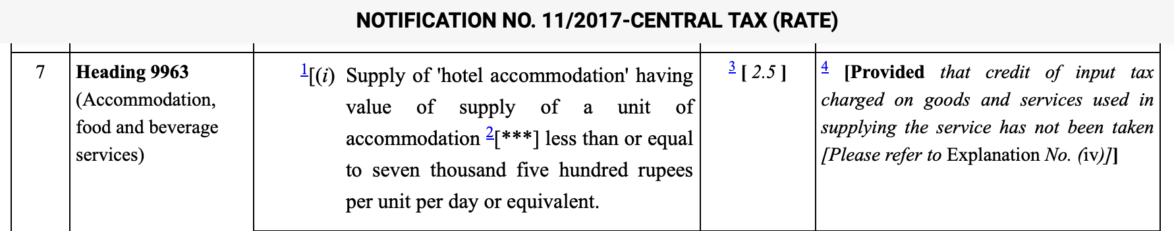
Rate of Tax WEF 22.09.2025
Explanation.—For the purposes of this notification
Wherever a rate has been prescribed in this notification subject to the condition that credit of input tax charged on goods or services used in supplying the service has not been taken, it shall mean that,—
credit of input tax charged on goods or services used exclusively in supplying such service has not been taken; and
credit of input tax charged on goods or services used partly for supplying such service and partly for effecting other supplies eligible for input tax credits, is reversed as if supply of such service is an exempt supply and attracts provisions of sub-section (2) of section 17 of the Central Goods and Services Tax Act, 2017 and the rules made thereunder.
12
Notes:
Linkage with Sec. 18(4) – First

Slide 13
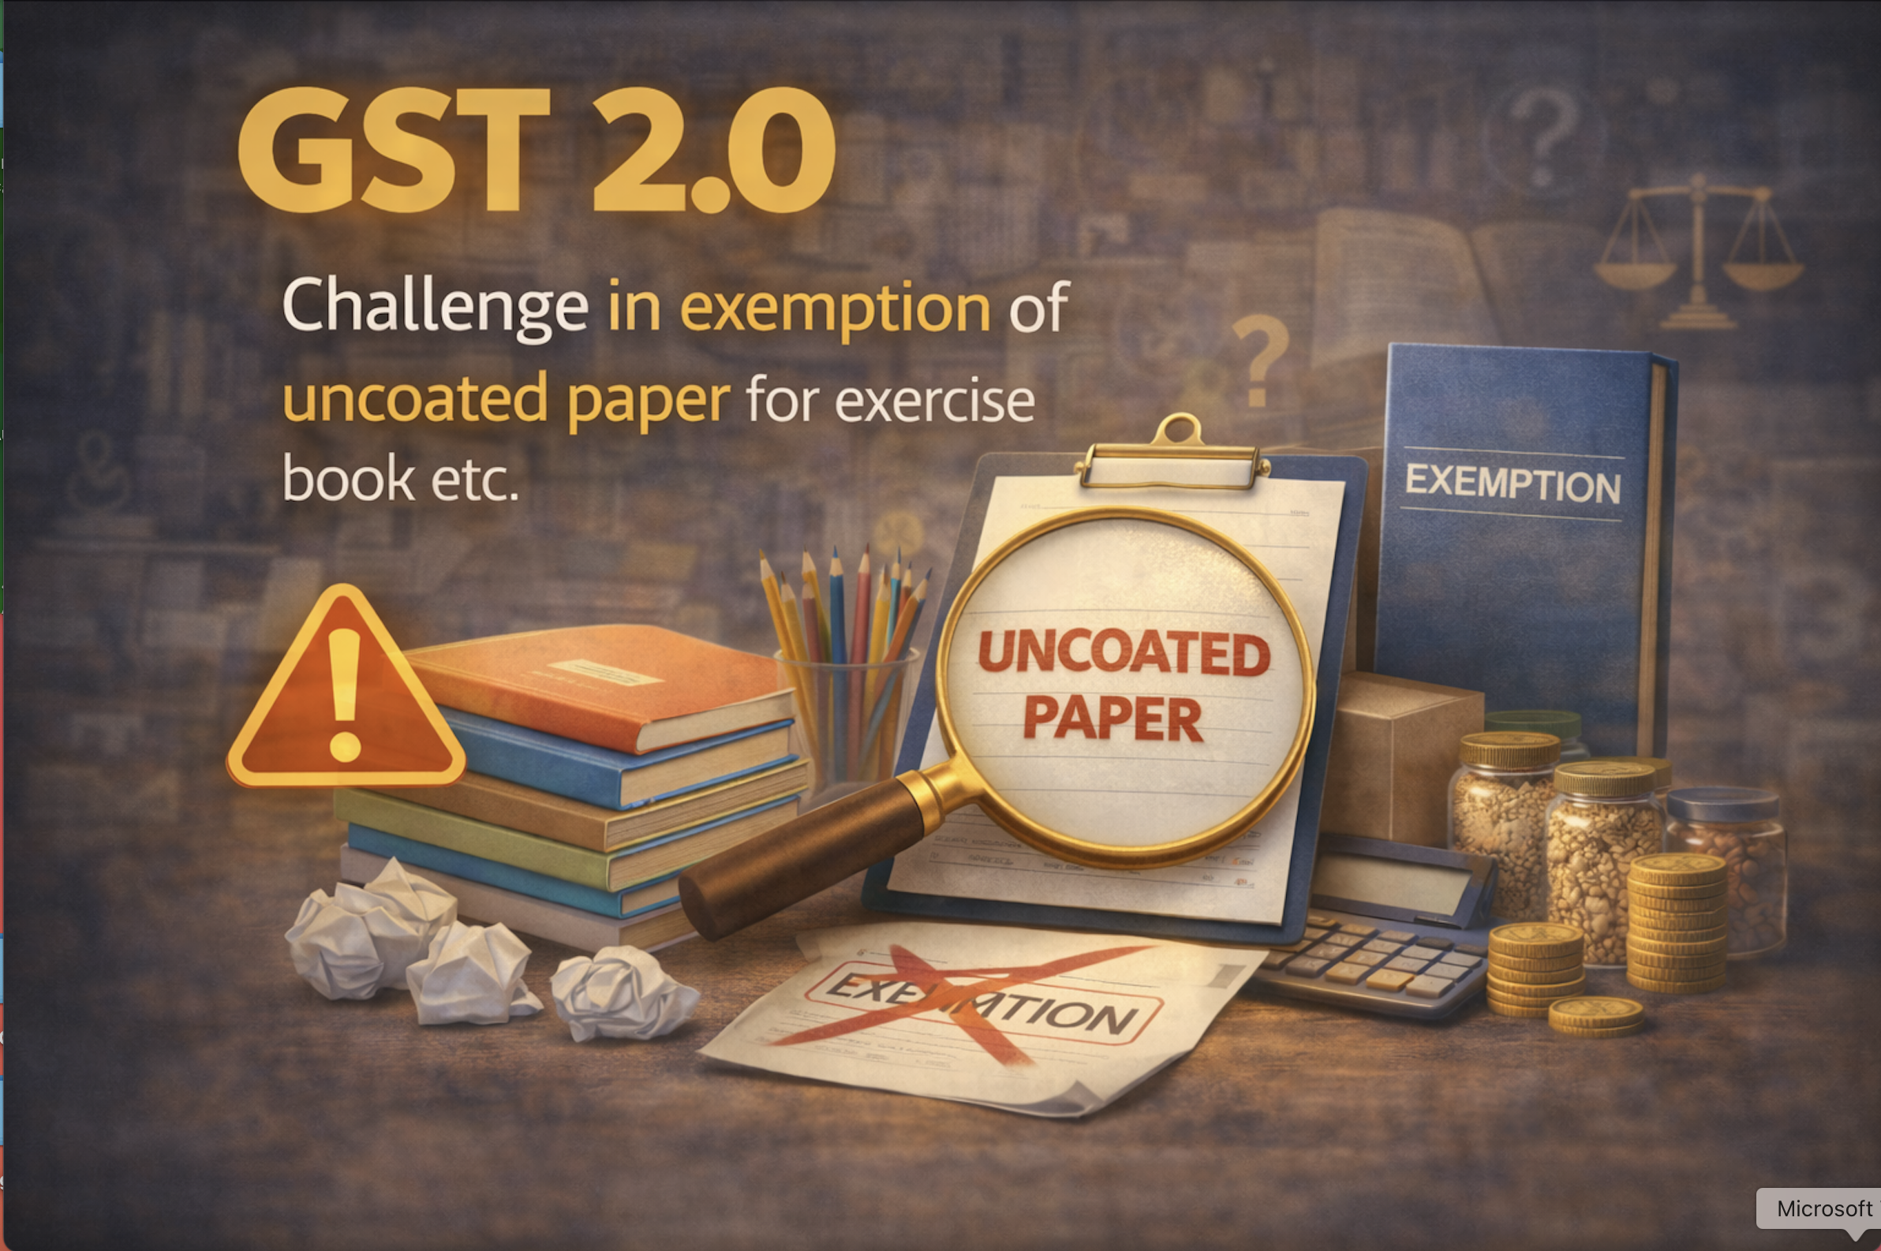
13

Slide 14
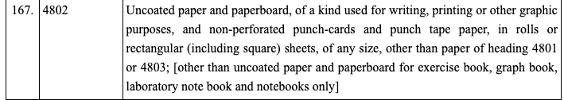

Rate of Tax & Exemption WEF 22.09.2025
Rate Notification:
Exemption Notification:
14
Notes:
Linkage with Sec. 18(4) – First

Slide 15
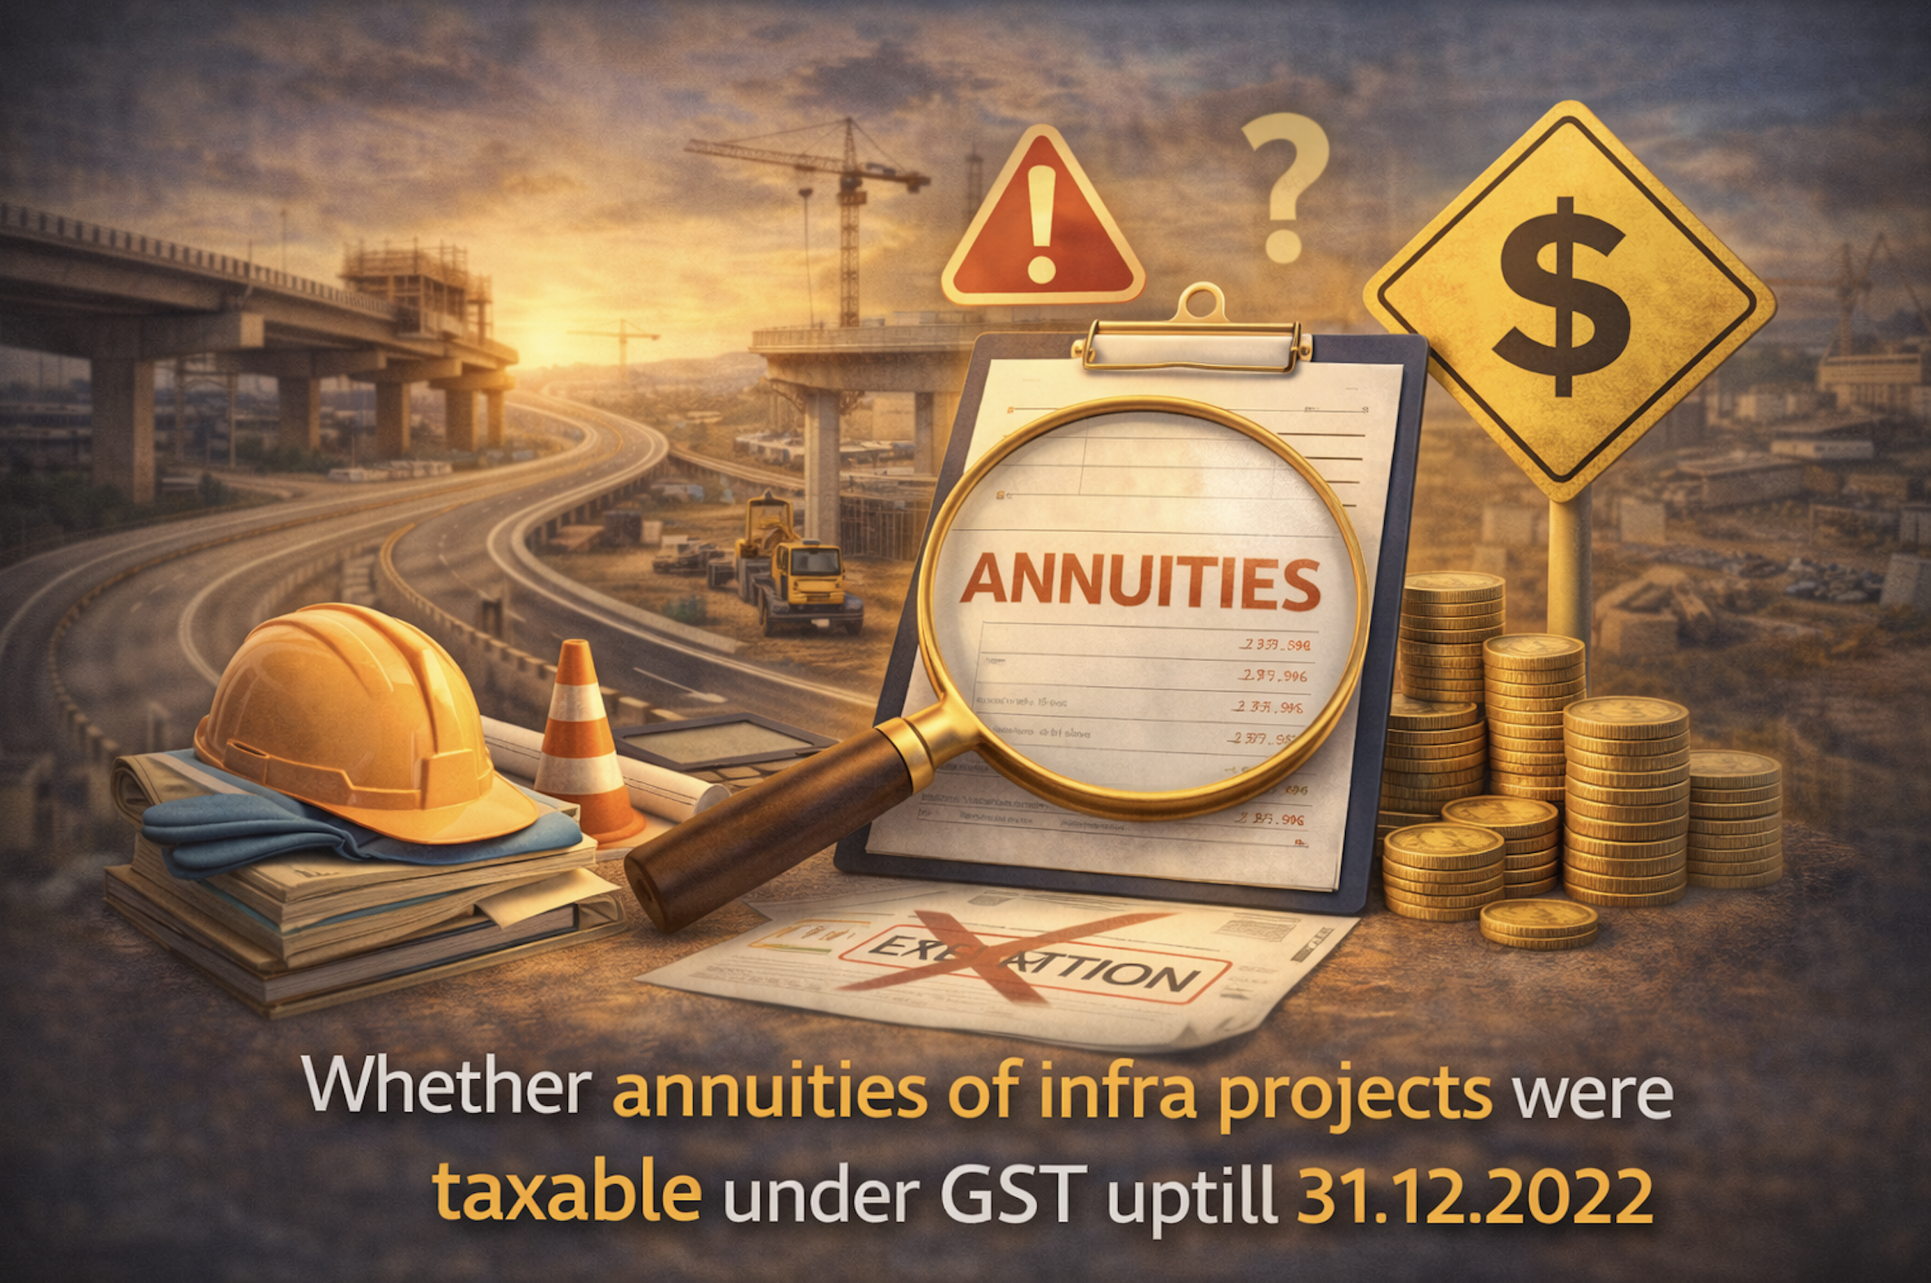

Slide 16
Pre-GST Provisions
NN 25/2012, Dt. 20.06.2012
Mega Exemption Notification
13. Services provided by way of construction, erection, commissioning, installation, completion, fitting out, repair, maintenance, renovation, or alteration of,-
(a) a road, bridge, tunnel, or terminal for road transportation for use by general public;
SECTION 66D. Negative list of services.
The negative list shall comprise of the following services, namely :
(h) service by way of access to a road or a bridge on payment of toll charges;

Slide 17




PPP Model – HAM
P
Investment
Public/ Govt.
Concessionaire
EPC Contractor
- Execution
Upfront payment – By COD
Annuity – After COD
Rights Transfer at conclusion
Toll – Right with Govt.
Notes:
Commercial Operation Date

Slide 18
GST Exemption Notification (As Original)
NN 12/2017 CT(R) Dt. 28.06.2017
S. No. | HNS | Description of Services | Rate | Condition
23 | Heading 9967 | Service by way of access to a road or a bridge on payment of toll charges. | Nil | Nil

Slide 19
Agenda – 22nd GST Council Meeting
Agenda Item 13 (iv) - Issue of Annuity being given in Place of Toll Charges to Developers of Public Infrastructure-exemption there on
Toll is exempt from GST. In service tax it was in the Negative List.
There is a difference between toll and annuity. While toll is a payment made by users of road to concessionaires for usage of roads, annuity is an amount paid by National Highways Authority of India (NHAI) to concessionaires for construction of roads. In other words, annuity is a consideration for the service provided by concessionaires to NHAI.
The works contract services by way of construction of road was exempt from service tax. However, service tax was leviable only on the service component of such works contract (40%). The material or goods component of the works contract was leviable to VAT. However, it was subject to State VAT (composition rate).
Construction of roads is now subject to 12% GST. EPC contractor (Engineering, Procurement and Construction) pays 12% GST on the service of road construction to the concessionaire.
In view of the above, there is a free flow of ITC from EPC Contractor to the concessionaire and thereafter to NHAI. As a result, the GST of 12% leviable on the service of road construction provided by concessionaire to NHAI would be paid partly from the ITC available with him.

Slide 20
GST Exemption Notification (As Amended – 13.10.2017)
NN 12/2017 CT(R) Dt. 28.06.2017
S. No. | HNS | Description of Services | Rate | Condition
23 | Heading 9967 | Service by way of access to a road or a bridge on payment of toll charges. | Nil | Nil
23A | Heading 9967 | Service by way of access to a road or a bridge on payment of annuity. | Nil | Nil

Slide 21
Circular No. 150/06/2021 Dt. 17.06.2021
Sub–Clarification regarding applicability of GST on the activity of construction of road where considerations are received in deferred payment (annuity)-reg.
2. This issue has been examined by the GST Council in its 43rd meeting held on 28th May, 2021.
2.1 GST is exempt on service, falling under heading 9967 (service code), by way of access to a road or a bridge on payment of annuity [entry 23A of notification No. 12/2017-Central Tax]. Heading 9967 covers “supporting services in transport” under which code 996742 covers “operation services of National Highways, State Highways, Expressways, Roads & streets; bridges and tunnel operationservices”.Entry23ofsaidnotificationexempts “service by way of access to a road or a bridge on payment of toll”. Together the entries 23 and 23A exempt access to road or bridge, whether the consideration are in the form of toll or annuity [heading 9967].
2.2 Services by way of construction of road fall under heading 9954. This heading inter alia covers general construction services of highways, streets, roads railways, airfield runways, bridges and tunnels. Consideration for construction of road service may be paid partially upfront and partially in deferred annual payments (and may be called annuities). Said entry 23A does not apply to services falling under heading 9954 (it specifically covers heading 9967 only). Therefore, plain reading of entry 23A makes it clear that it does not cover construction of road services (falling under heading 9954), even if deferred payment is made by way of instalments (annuities).
3. Accordingly, as recommended by the GST Council, it is hereby clarified that Entry 23A of notification No. 12/2017-CT(R) does not exempt GST on the annuity (deferred payments) paid for construction of roads.

Slide 22
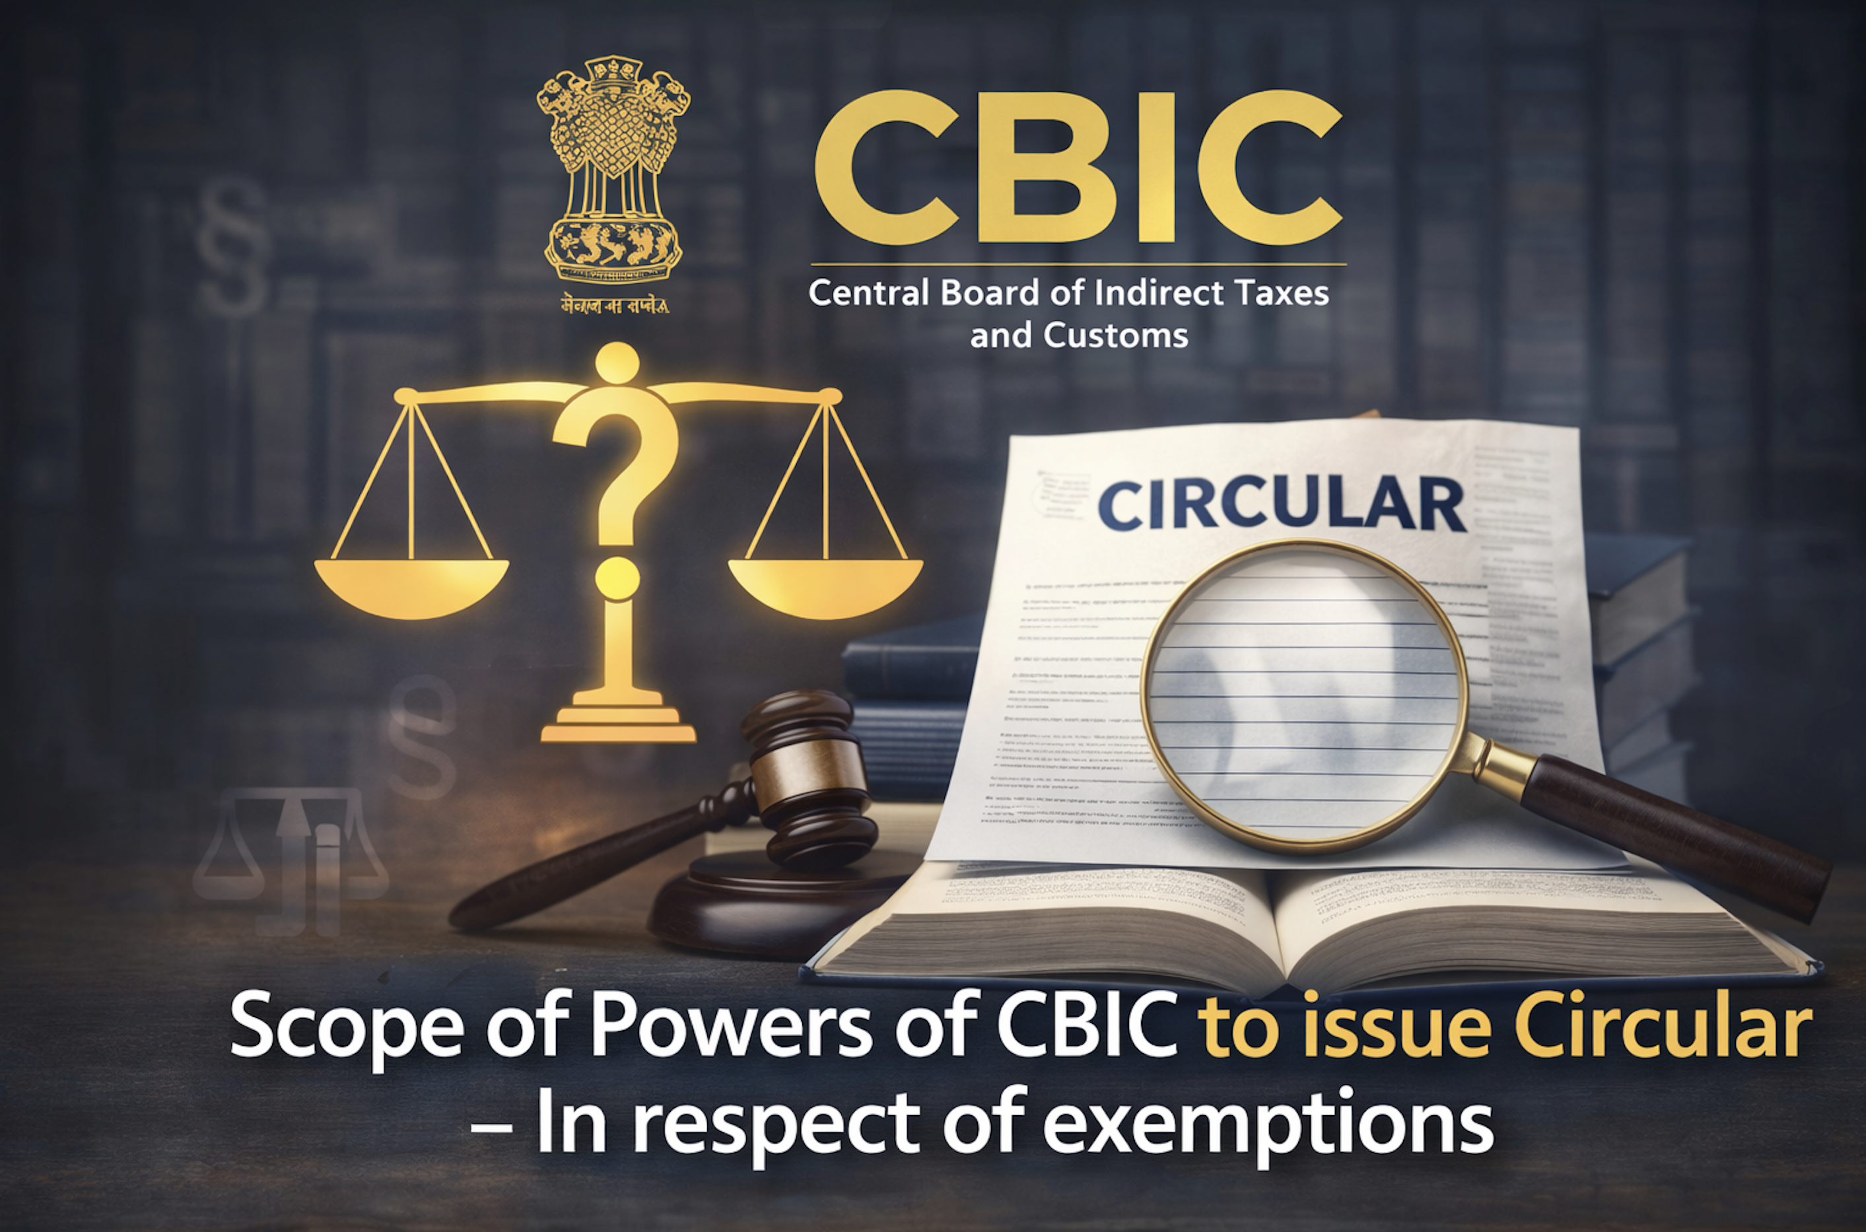

Slide 23
From Statute – CE Act, 1944
Sec. 37B: Instructions to Central Excise Officers.
The Central Board of Excise and Customs constituted under the Central Boards of Revenue Act, 1963 (54 of 1963), may, if it considers it necessary or expedient so to do for the purpose of uniformity in the classification of excisable goods or with respect to levy of duties of excise on such goods or for the implementation of any other provision of this Act, issue such orders, instructions and directions to the Central Excise Officers as it may deem fit, and such officers and all other persons employed in the execution of this Act shall observe and follow such orders, instructions and directions of the said Board.

Slide 24
Jurisprudence
Bengal Iron Corporation Vs. Commercial Taxes Officers
[1994 Supp. 1 SCC 310]
So far as clarifications/circulars issued by the Central Government and/or State Government are concerned, they represent merely their understanding of the statutory provisions. They are not binding upon the courts. It is true that those clarifications and circulars were communicated to the concerned dealers but even so nothing prevents the State from recovering the tax, if in truth such tax was leviable according to law. There can be no estoppel against the statute. The understanding of the Government, whether in favour or against the assessee, is nothing more than its understanding and opinion. ….. While acting in quasi-judicial capacity, they are bound by law and not by any administrative instructions, opinions, clarifications or circulars. Law is what is declared by this Court and the High Court — to wit, it is for this Court and the High Court to declare what does a particular provision of statute say, and not for the executive. Of course, the Parliament/Legislature never speaks or explains what does a provision enacted by it mean.

Slide 25
Jurisprudence
Sirpur Paper Mill Limited vs. The Commissioner of Wealth Tax
[1971 SCR (1) 304]
It enacts that no orders, instructions or directions shall be given by the Board so as to interfere with the discretion of the Appellate Assistant Commissioner of Wealth Tax in the exercise of his appellate functions. It does not, however, imply that the Board may give any directions or instructions to the Wealth Tax Officer or to the Commissioner in exercise of his quasi-judicial function. Such an interpretation would be plainly contrary to the scheme of the Act and the nature of the power conferred upon the authorities 'invested with quasi-judicial power. The Commissioner appears, in our judgment,' to have wholly misapprehended the true character of the jurisdiction with which he is by the Act entrusted and has surrendered his judgment to the directions of the Board of Revenue.
Notes:
On Wealth Tax

Slide 26
From Statute
Sec. 168: Power to issue instructions or directions.
The Board may, if it considers it necessary or expedient so to do for the purpose of uniformity in the implementation of this Act, issue such orders, instructions or directions to the central tax officers as it may deem fit, and thereupon all such officers and all other persons employed in the implementation of this Act shall observe and follow such orders, instructions or directions.
The Commissioner specified in clause (91) of section 2, sub-section (3) of section 5, clause (b) of sub-section (9) of section 25, sub-sections (3) and (4) of section 35, sub-section (1) of section 37, sub-section (6) of section 39, 79[79a[section 44], sub-sections (4) and (5) of section 52,] 79b[sub-section (1) of section 143, except the second proviso thereof], clause (l) of sub-section (3) of section 158 and section 167 shall mean a Commissioner or Joint Secretary posted in the Board and such Commissioner or Joint Secretary shall exercise the powers specified in the said sections with the approval of the Board.

Slide 27
Jurisprudence
Surana Telecom Ltd v. Government of India (AP High Court, 22-09-2004)
Brief Facts:
Petitioners imported fixed wireless phones that:
  Worked on GSM / CDMA cellular technology
  Were wireless, not connected to landline exchange
  Looked like landline instruments, not handheld mobiles
Concessional Duty @ 5% for - “Cellular Phones and Radio Trunking Terminals.”
The Department issued Circular 57/2003 stating:
  “Cellular phone” commercially and traditionally means handheld mobile phones only, excluding fixed wireless phones.
Order of Hon’ble HC:
If this circular is applied by the authorities who are supposed to make assessments under the Customs Act, there is no discretion left with those authorities to decide whether a particular phone was a cellular phone or not.
In our view, the 1st respondent has no such power to issue such directions which were to decide quasi judicial matters between the parties.
No power under Section 157 of the Customs Act to make an order of the nature of the impugned circular.

Slide 28
From Statute
Sec. 11: Power to grant exemption from tax.
(3) The Government may, if it considers necessary or expedient so to do for the purpose of clarifying the scope or applicability of any notification issued under sub-section (1) or order issued under sub-section (2), insert an explanation in such notification or order, as the case may be, by notification at any time within one year of issue of the notification under sub-section (1) or order under sub-section (2), and every such explanation shall have effect as if it had always been the part of the first such notification or order, as the case may be.

Slide 29
Expressio Unis Wst Exclusion Alterius
Sanyam Seth Vs. UOI [MANU/DE/5655/2023] – Del HC
The rule 'expressio unis est exclusion alterius', which implies that the express mention of one thing is the exclusion of other, assumes that it was the intention of the legislature to specify one set of criteria as opposed to the other. This rule is primarily based on the presumption that if anything is expressly mentioned in a statute, a natural corollary would be that the things which are not specified in the statute are excluded. In order to apply this maxim for interpreting any statute, firstly, the list of words appearing in a statute must be specific in nature and secondly, the specific words should not be followed by general words.
Notes:
Para 23

Slide 30
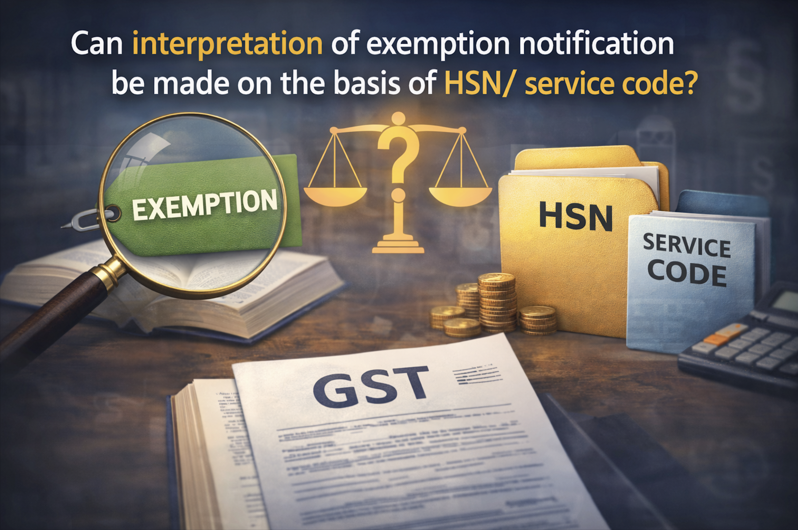

Slide 31
Rate Notification – Goods
NOTIFICATION NO. 9/2025-CENTRAL TAX (RATE), DATED 19-09-2025
In exercise of the powers conferred by sub-section (1) of section 9 ………, hereby notifies the rate of central tax of—
….
.....
appended to this notification (hereinafter referred to as the said Schedules), that shall be levied on intra-State supplies of goods, the description of which is specified in the corresponding entry in column (3) of the said Schedules, falling under the tariff item, sub-heading, heading or Chapter, as the case may be, as specified in the corresponding entry in column (2) of the said Schedules.

Slide 32
Exemption Notification – Goods
NOTIFICATION NO. 10/2025-CENTRAL TAX (RATE), DATED 19-09-2025
In exercise of the powers conferred by sub-section (1) of section 11 ……………
the Central Government, being satisfied that it is necessary in the public interest so to do, on the recommendations of the Council, hereby exempts intra-State supplies of goods, the description of which is specified in column (3) of the Schedule appended to this notification, falling under the tariff item, sub-heading, heading or Chapter, as the case may be, as specified in the corresponding entry in column (2) of the said Schedule, from the whole of the central tax leviable thereon under section 9 of the Central Goods and Services Tax Act, 2017 (12 of 2017).

Slide 33
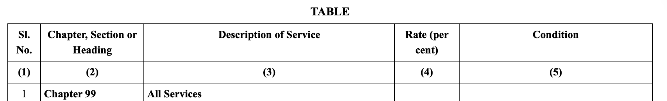
Rate Notification – Services
NOTIFICATION NO. 11/2017-CENTRAL TAX (RATE), DATED 28-06-2017
In exercise of the powers conferred by sub-section (1) ¹[, sub-section (3) and sub-section (4)] of section 9, sub-section (1) of section 11, sub-section (5) of section 15 sub-section (1) of section 16 and section 148] of the Central Goods and Services Tax Act, 2017(12 of 2017), the Central Government, on the recommendations of the Council, and on being satisfied that it is necessary in the public interest so to do, hereby notifies that the central tax, on the intra-State supply of services of description as specified in column (3) of the Table below, falling under Chapter, Section or Heading of scheme of classification of services as specified in column (2), shall be levied at the rate as specified in the corresponding entry in column (4), subject to the conditions as specified in the corresponding entry in column (5) of the said Table:—

Slide 34
Exemption Notification – Services
NOTIFICATION NO. 12/2017-CENTRAL TAX (RATE), DATED 28-06-2017
In exercise of the powers conferred by sub-section (3) and sub-section (4) of section 9, sub-section (1) of section 11, sub-section (5) of section 15 and section 148] of the Central Goods and Services Tax Act, 2017 (12 of 2017), the Central Government, on being satisfied that it is necessary in the public interest so to do, on the recommendations of the Council, hereby exempts the intra-State supply of services of description as specified in column (3) of the Table below from so much of the central tax leviable thereon under sub-section (1) of section 9 of the said Act, as is in excess of the said tax calculated at the rate as specified in the corresponding entry in column (4) of the said Table, unless specified otherwise, subject to the relevant conditions as specified in the corresponding entry in column (5) of the said Table, namely:—

Slide 35
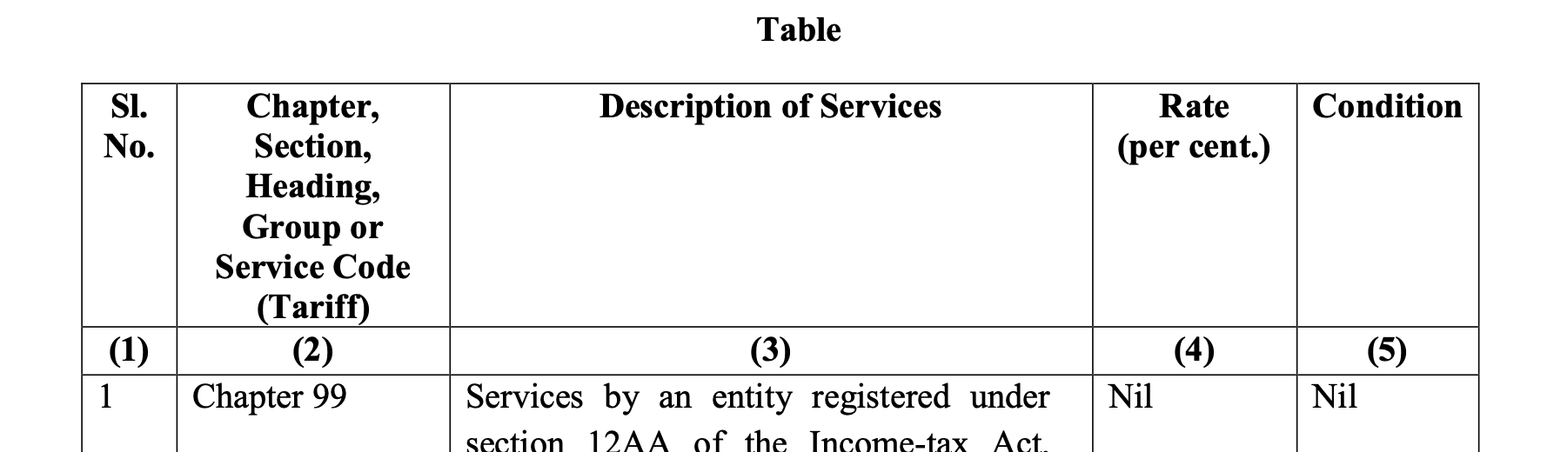
Exemption Notification – Services
3. Explanation.—For the purposes of this notification,—
Chapter, Section, Heading, Group, or Service Code mentioned in Column (2) of the Table are only indicative.
Notes:
Comm. of Central Excise Vs. Gujarat Ambuja Exports Ltd. [(2016) 15 SCC 208] – SC
In case of exemption notification, HSN Explanatory notes, serves as guide only and is not used to interpret the same [Para 23].

Slide 36
36
Notes:
21- Recovery of wrongly distributed credit from Recipient

Slide 37
Interpretation of Exemption Notification

Slide 38
Jurisprudence
Exemptions - M/s Dilip Kumar & Company & Others
Dt. 30.07.2018
(1) Exemption notification should be interpreted strictly; the burden of proving applicability would be on the assessee to show that his case comes within the parameters of the exemption clause or exemption notification.
(2) When there is ambiguity in exemption notification which is subject to strict interpretation, the benefit of such ambiguity cannot be claimed by the subject/assessee and it must be interpreted in favour of the revenue.
(3) The ratio in Sun Export case is not correct and all the decisions which took similar view as in Sun Export Case stands over­ruled.
38
Notes:
Dilip Kumar & Co. ➔ 2 Judges Bench ➔ 3 Judges Bench ➔ Constitutional Bench to examine Ratio of Sun Exports
Sun Exports Corporation Vs. Coll. Of Customs (1997) 6 SCC 564 (Three Judges Bench): ambiguity in a tax exemption provision or notification must be interpreted so as to favour the assessee claiming the benefit of such exemption - Overruled by Dilip Kumar & Co.
Doctrine of Sufficient Compliance : Constitutional Bench Judgement - CCE v. Hari Chand Shri Gopal, (2011) 1 SCC 236 (SC) : Not touched upon by Dilip Kumar & Co. (Para 51) :

Slide 39
Jurisprudence
CCE v. Hari Chand Shri Gopal, (2011) 1 SCC 236 (SC)
... The mandatory requirements of those conditions must be obeyed or fulfilled exactly, thought at times, some latitude can be shown, if there is failure to comply with some requirements which are directory in nature, the non-compliance of which would not affect the essence or substance of the notification granting exemption.
Doctrine of Substantial Compliance & Intended use
39
Notes:
21- Recovery of wrongly distributed credit from Recipient

Slide 40
Jurisprudence – Dilip Kumar (Para 51)
“In Hari Chand Case, as already discussed, the question was whether a person claiming exemption is required to comply with the procedure strictly to avail the benefit. The question posed and decided was indeed different. The said decision, which we have already discussed supra, however, indicates that while construing an exemption notification, the Court has to distinguish the conditions which require strict compliance, the non-compliance of which would render the assessee ineligible to claim exemption and those which require substantial compliance to be entitled for exemption. We are pointing out this aspect to dispel any doubt about the legal position as explored in this decision. As already concluded in para 50 above, we may reiterate that we are only concerned in this case with a situation where there is ambiguity in an exemption notification or exemption clause, in which event the benefit of such ambiguity cannot be extended to the subject/assessee by applying the principle that an obscure and/or ambiguity or doubtful fiscal statute must receive a construction favouring the assessee.
Both the situations are different and while considering an exemption notification, the distinction cannot be ignored.”
40
Notes:
21- Recovery of wrongly distributed credit from Recipient

Slide 41
41
Notes:
21- Recovery of wrongly distributed credit from Recipient

Slide 42
Registration
Sec. 23: Persons not liable for registration:
(1) The following persons shall not be liable to registration, namely:—
  any person engaged exclusively in the business of supplying goods or services or both that are not liable to tax or wholly exempt from tax under this Act or under the Integrated Goods and Services Tax Act;
  an agriculturist, to the extent of supply of produce out of cultivation of land.
(2) Notwithstanding anything to the contrary contained in sub-section (1) of section 22 or section 24, the Government may, on the recommendations of the Council, by notification, subject to such conditions and restrictions as may be specified therein, specify the category of persons who may be exempted from obtaining registration under this Act.
24. Notwithstanding anything contained in sub-section (1) of section 22, the following categories of persons shall be required to be registered under this Act,
(iii) persons who are required to pay tax under reverse charge;
Notes:
Notification u/s 23(2) –
5/2017(CT) Dt. 19.06.2017 – Exemption from registration for persons who are exclusively deals in supplies covered by Sec. 9(3)
32/2017(CT) Dt. 15.07.2017 – Exemption from CTP Registration to dealers of Handicraft Goods (vetted in Rule 138 also)
10/2017(IT) Dt. 13.10.2017 - Exemption from mandatory registration for Service Providers (AT < 20 Lacs)
65/2017(CT) Dt. 15.11.2017 – Exemption from Registration for persons supplying SERVICES through E-Com. Operator (AT < 20 Lacs).

Slide 43
Charge of GST
Sec. 9 of CGST Act:- Levy and Collection of Tax
Subject to provisions of sub. Section 2, there shall be levied a tax called the CGST on all intra-state supplies of goods or services or both, except on the supply of alcoholic liquor for human consumption, on the value determined u/s 15 and at such rates, not exceeding 20%, as may be notified by the Government on the recommendations of the Council and collected in such manner as may be prescribed and shall be paid by the taxable person.
…
The Government may, on the recommendation of the GSTC, by notification, specify categories of supply of goods or services or both the tax on which shall be paid on reverse charge basis by the recipient of such goods or services or both and all the provisions of this Act shall apply to such recipient as if he is the person liable for paying the tax in relation to supply of such goods or services or both.
43

Slide 44
Circular No. 199/10/2023 – Dt. 17.07.2023
ISD Vs. Cross Charge
Important Takeaways:
Distribution of ITC through ISD or Making Cross Charge is Optional;
When Recipient is eligible for full ITC:
  Value declared in Invoice shall be the accepted Open Marked Value for discharge of GST liability.
  If invoices is not raised, it shall be deemed that nil value has been declared by the HO (Supplier)
  Indirectly circular has recognised Concept of ‘Revenue Neutrality’ in GST.
When Recipient is not eligible for full ITC:
  Cost of employment is not mandatorily required to include in Value of Internally generated services (Auxiliary Services/ Support Services/ Management Services to branch/ other units etc., by whatever name called).
44
Notes:
21- Recovery of wrongly distributed credit from Recipient

Slide 45
Whether RCM under GST law is tax neutral ?

Slide 46
Impact of 9(3) & 9(4)
Sec. 17 - Apportionment of credit and blocked credits.
(2) Where the goods or services or both are used by the registered person partly for effecting taxable supplies including zero-rated supplies under this Act or under the Integrated Goods and Services Tax Act and partly for effecting exempt supplies under the said Acts, the amount of credit shall be restricted to so much of the input tax as is attributable to the said taxable supplies including zero-rated supplies.
(3) The value of exempt supply under sub-section (2) shall be such as may be prescribed, and shall include supplies on which the recipient is liable to pay tax on reverse charge basis, transactions in securities, sale of land and, subject to clause (b) of paragraph 5 of Schedule II, sale of building.
46

Slide 47
Constitutional Aspects
Article 265:
No Tax shall be levied or collected except by authority of law.
Municipal Council Vs. Kamal Kumar (AIR 1965 SC 1321):
The wording of Article 265 clearly implies that the procedure for imposing the liability to pay a tax has to be strictly complied with and where it is not so complied with the liability to pay the tax cannot be said to be according to the law.
Hukum Chand Shyam Lal Vs. UOI [(1997) 2 SCC 128 (SC)]
It is well settled that when a power is required to be exercised by certain authority in a certain way, it should be exercised in that manner or not at all, and all other modes of performance are necessarily forbidden. It is all the more necessary to observe this rule where powers are of drastic nature and its exercise in a mode other than the one provided will be violative of the fundamental principles of natural justice.
Babu Verghese v. Bar Council of Kerala
[(1999) 3 SCC 422]
It is the basic principle of law long settled that if the manner of doing a particular act is prescribed under any statute, the act must be done in that manner or not at all. The origin of this rule is traceable to the decision in Taylor v. Taylor [(1875) 1 Ch D 426 : 45 LJCh 373] which was followed by Lord Roche in Nazir Ahmad v. King Emperor [(1936) 63 IA 372 : AIR 1936 PC 253] who stated as under:
  “Where a power is given to do a certain thing in a certain way, the thing must be done in that way or not at all.”
Notes:
Muncipal Council Vs. Kamal Kumar – Para 9
Hukum Chand Shyam Lal – Para 18
Babu Verghese – Para 31

Slide 48
Constitutional Protection
Part – III
19 – Right of Freedom
All citizens shall have the right –
  (d) To move freely throughout the territory of India
  (g) To practice any profession, or to carry on any occupation, trade or business
21 – Protection of Life and personal liberty
No person shall be deprived of his life or personal liberty except according to procedure established by law.
Part – XII
Chapter IV – Right to Property
A. 300A: No person shall be deprived of his property save by authority of law.
Right to Privancy - Whether Fundamental Right ?
M. P. Sharma Vs. Satish Chandra (1954)
Kharak Singh Vs. State of UP (1962)
Gobind Vs. State of UP (1975)
Right to privacy of an individual would have to give way to larger state interest, the nature of which must be convincing.
PUCL Vs Union of India (1996)
Individuals have privacy content in their telephonic communications.
Justice K. S. Puttuswamy Vs. Union of India (2018)
Larger Bench of hon’ble SC unanimously held that privacy is a fundamental right, and that the right to privacy is protected as an intrinsic part of the right to life and personal liberty, and protected by part II of constitution.
Notes:
R. J. Trading Co. Vs. Comm. of CGST, Delhi North [2021 (7) TMI 924 (Del HC), Order dated 20.07.2021]
power to issue search warrant are intrusive in nature and should be exercised with utmost care.
Pooran Mal – (1974) 93 ITR 505 (SC)

Slide 49
Various Proceedings
Investigation
Inquiry/
Enquiry
Trial
Proceedings for ascertainment of facts
Collecting evidence by examining witnesses, search of places etc.
All proceedings for the collection of evidence
Sec. 2(h) of CrPC: All proceedings for collection of evidence by IO
Hearing of the case i.e. recording evidence, admitting documents and generally completing the record upon which a finding would be based.
Sec. 2(g) of CrPC: every inquiry, other than tial conducted by Magistrate or Court
Determination of innocence or guild of suspect.
Scrutiny
Audit
Summons
Inspection
Search & Seizure
Assessment
IAR
Pre-SCN
Adjudication
Notes:
Investigation:
Sec. 2(h)- CrPC 7
Manubhai Ratilal Patel v. State of Gujarat, (2013) 1 SCC 314.
(g) ―inquiry‖ means every inquiry, other than a trial, conducted under this Code by a Magistrate or Court;
(h) ―investigation‖ includes all the proceedings under this Code for the collection of evidence conducted by a police officer or by any person (other than a Magistrate) who is authorised by a Magistrate in this behalf;

Slide 50

Thank You
Jatin Harjai
Advocate
B. Com, FCA, LL.B., DISA (ICAI)
jatin.harjai@icloud.com
@Jatin_Harjai
JHA Legal
208-209, Brij Anukampa, K-13,
Ashok Marg, C-Scheme,
Jaipur 302001
Ph: +91 141 4017982
Fax: +91 141 2373224
office.jpr@jharjai.com
50

