Slide 1
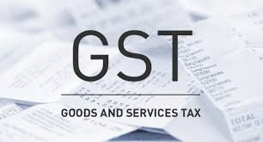


and Going Forward ….
Departmental Audit & Scrutiny under GST :-
Compliance Management & Defense Strategy
Yash Dhadda | Chartered Accountant | Jaipur

Slide 2
WHAT HAVE YOU RECEIVED?

Slide 3
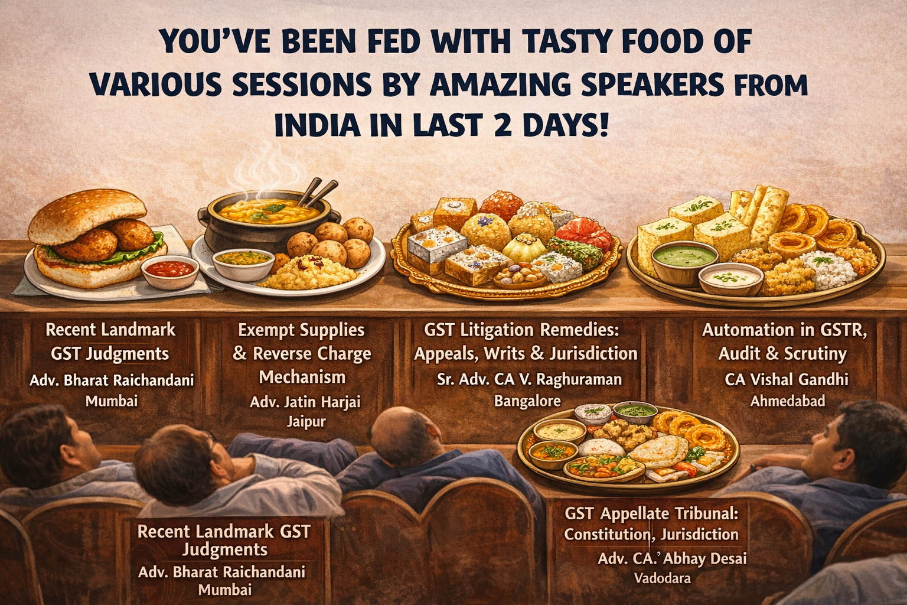

Slide 4
WHAT DO YOU NEED NOW?

Slide 5
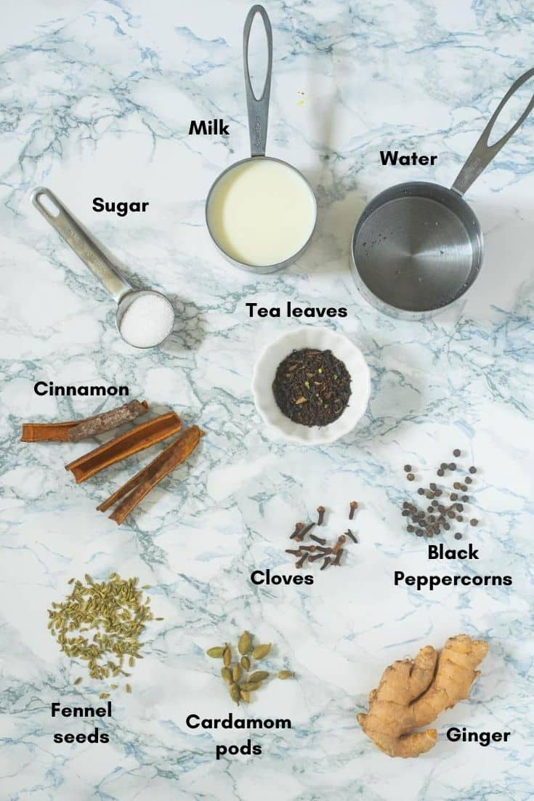

What Can I Offer?
What will you make?

Slide 6
PILLARS OF TAXATION

Slide 7
PILLARS OF TAXATION
In case of Mathuram Agarwal vs State of Madhya Pradesh (1999) 8 SCC 667 (SC), it was held by Hon’ble Supreme Court of India that:
“The statue should clearly and unambiguously convey the three components of the tax law i.e. the subject of the tax,
who is liable to pay the tax and
the rate at which the tax is to be paid.
If there is any ambiguity regarding any of these ingredients in a taxation statue then there is no tax in law. Then it is for the legislature to do the needful in the matter. ”

Slide 8
Adjudication under GST
ASMT (Ch-XII) Sec 59-64)
ADT (Ch XIII) Sec 65-66
INS (Ch XIV) Sec 67-72)
Fraud,
Suppression,
Mis-representation
(Sec 74)
DRC – (Ch XV)
(Sec 73 -84)
Other than above
(Sec 73)

Slide 9
Defaults for which Notice can be issued under Section 73 or 74
Tax Not Paid
Tax Short Paid
Tax Erroneously Refunded
Input Tax Credit Wrongly Availed
Input Tax Credit Wrongly Utilized

Slide 10
SCN U/S 74?

Slide 11
Para 3.2: C.B.I. & C. Instruction No. 5/2023-GST, dated 13-12-2023
3.2 In this regard, Section 74(1) of CGST Act reads as follows :
“(1) Where it appears to the proper officer that any tax has not been paid or short paid or erroneously refunded or where input tax credit has been wrongly availed or utilized by reason of fraud, or any wilful-misstatement or suppression of facts to evade tax,”
3.3 From the perusal of wording of Section 74(1) of CGST Act, it is evident that Section 74(1) can be invoked only in cases where there is a fraud or wilful misstatement or suppression of facts to evade tax on the part of the said taxpayer. Section 74(1) cannot be invoked merely on account of non-payment of GST, without specific element of fraud or wilful misstatement or suppression of facts to evade tax. Therefore, only in the cases where the investigation indicates that there is material evidence of fraud or wilful misstatement or suppression of fact to evade tax on the part of the taxpayer, provisions of Section 74(1) of CGST Act may be invoked for issuance of show cause notice, and such evidence should also be made a part of the show cause notice.

Slide 12
CBIC-20006/12/2025-GST/1657 dated 30.06.2025
Issued by CBIC Policy Wing
3. Though the above instructions have been issued in the context of secondment charges, the underlying principles regarding the invocation of provisions of section 74 of the CGST Act, 2017, shall apply to all cases. The phrases "fraud" or ''wilful misstatement" or "suppression of facts" are coupled with the phrase "to evade tax". Similar provisions exist under the Central Excise Act, 1944, and there are number of judicial pronouncements clearly laying down the interpretation of the aforesaid phrases.
4. It is reiterated that invoking Section 74 of the CGST Act, 2017, necessitates that the proper officer establish, with supporting material evidence, the presence of a deliberate intent to evade tax, whether through fraud, wilful misstatement, or suppression of facts- terms which inherently imply mens rea. A mere shortfall in tax payment, by itself, does not justify proceedings under Section 74. The SCN must specifically record the evidentiary basis that indicates such intent, thereby satisfying the legal prerequisites for invoking the extended period of limitation under Section 74. This ensures that the provision is applied judiciously, and not mechanically or presumptively.
5. In light of the above, it is requested that all officers under your jurisdiction be appropriately sensitised and guided on the correct legal interpretation and procedural requirements for invoking Section 74 of the CGST Act, 2017.
6. This issues with the approval of the Chairman, CBIC.

Slide 13
GST COMPLIANCE ECOSYSTEM

Slide 14

GST Compliance Ecosystem
GST Portal GSTR-1/1A/IFF, GSTR-2B, GSTR-3B,
GSTR-9, GSTR-9C,
GSTR-5, 5A, 6, 7, 8, 10, 11
Form ITC 04, IMS
E-Invoice Portal Invoice Registration Portal for generating IRNs for sales invoices
Income Tax Portal ITR 3, ITR 4, ITC 6, AS 26, Form 3CD
E-way Bill Portal
Portal for generating e-way bill for monitoring and tracking movement of goods

Slide 15
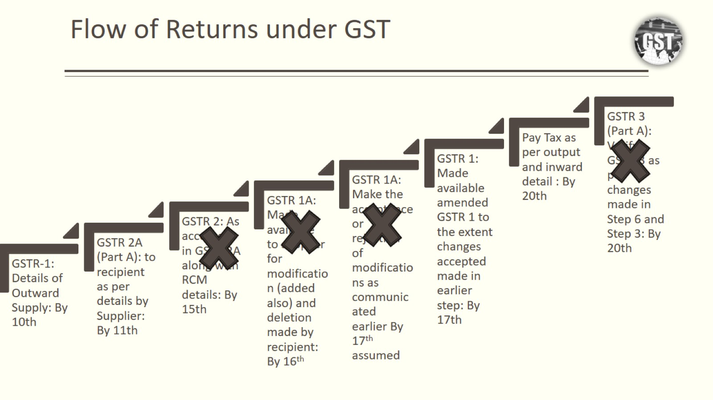

Slide 16
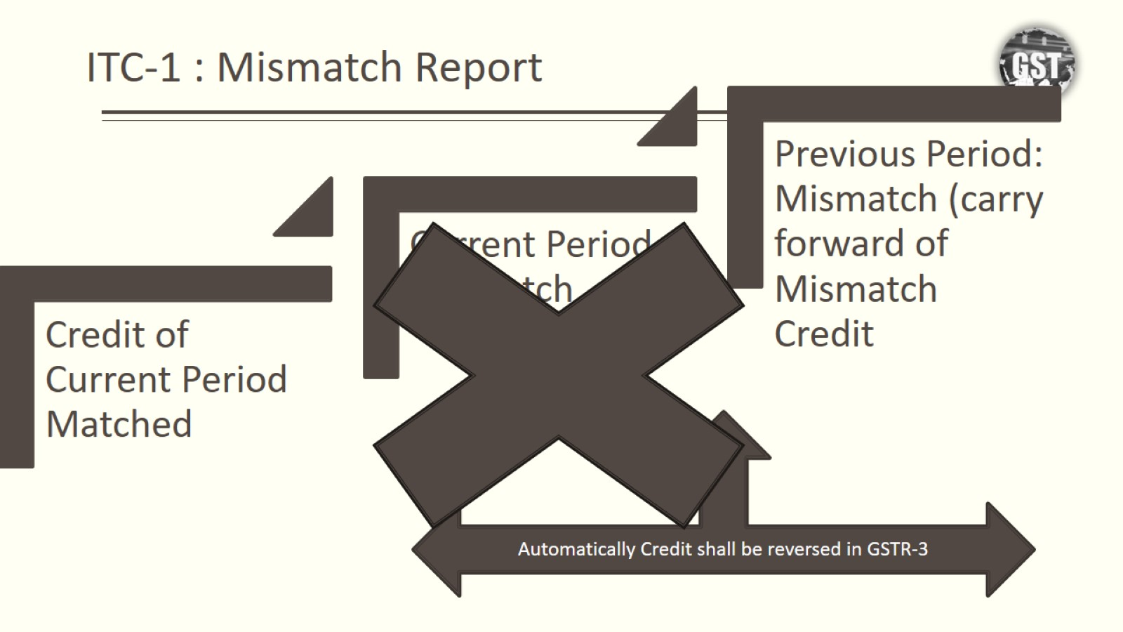

Slide 17
Compliance Work Flow
IRN-EWB
GSTR-1
GSTR-2B
GSTR-3B
GSTR-9/9C

Slide 18
NET DISCLOSURE IN GSTR-3B

Slide 19
C.B.E. & C. Circular No. 26/26/2017-GST, dated 29-12-2017
4. It is clarified that as return in FORM GSTR-3B do not contain provisions for reporting of differential figures for past month(s), the said figures may be reported on net basis alongwith the values for current month itself in appropriate tables i.e. Table No. 3.1, 3.2, 4 and 5, as the case may be. It may be noted that while making adjustment in the output tax liability or input tax credit, there can be no negative entries in the FORM GSTR-3B. The amount remaining for adjustment, if any, may be adjusted in the return(s) in FORM GSTR-3B of subsequent month(s) and, in cases where such adjustment is not feasible, refund may be claimed. Where adjustments have been made in FORM GSTR-3B of multiple months, corresponding adjustments in FORM GSTR-1 should also preferably be made in the corresponding months.

Slide 20
Reconciliation = correction

Slide 21
PIONEER COOPERATIVE CAR PARKING SERVICING AND CONSTRUCTION SOCIETY LTD. Versus STATE OF WEST BENGAL -
2025 (96) G.S.T.L. 358 (Cal.)
27. Section 44 of the Act deals with annual returns which states that every registered person other than an input tax distributor, a person paying tax under Section 51 or Section 52 shall furnish an annual return which may include a self-certified reconciliation statement, reconciling the value of supplies declared in the return furnished for the financial year, with the audited annual financial statement for every financial year electronically within such time and in such form and in such manner as may be prescribed.
28. Prima facie, we are of the view that the word “reconciliation” used in the statute could lead to the meaning that there can be a rectification of any error which might have occurred when the taxpayer files his return in FORM GSTR-3B.

Slide 22
Rectification of returns
Aberdare Technologies Pvt. Ltd. vs. Central Board of Indirect Taxes & Customs (2024) 21 Centax 227 (Bom.) maintained by SC (SPECIAL LEAVE PETITION (CIVIL) Diary No. 6332/2025)
Issue involved
Whether rectification of GSTR – 1 or GSTR – 3B can be undertaken after the statutory period u/s 37(3)
and 39(9)
Held
Technicalities on any legitimate rectification ought not to come in the way of assessee suffering an inadvertent error, which would have a cascading effect
The right to correct mistakes in the nature of clerical or arithmetical error is a right that flows from the right to do business and should not be denied unless there is a good justification and reason to deny the benefit of correction. Software limitation itself cannot be a good justification, as software is meant to ease compliance and can be configured.
Other relevant decisions
Star Engineers (I) (P.) Ltd. v. Union of India 2023 SCC Online Bom 2682
Union of India vs. Brij Systems Limited (WRIT PETITION NO.783 OF 2022) (Bom.) (SPECIAL LEAVE
PETITION (CIVIL) Diary No. 6334/2025 – notice issued to CBIC)

Slide 23
HIGH COURT NOTICES MERITS

Slide 24
INSTAKART SERVICES PVT. LTD.- 2023 (74) G.S.T.L. 403 (Del.)
Input Tax Credit - Matching, reversal and reclaim - Overstated tax liability - In its monthly return for September, 2017, assessee had erroneously typed its tax liability as ` 32.33 crore instead of ` 3.23 crore - Liability was discharged by using available balance of ITC of Rs. 29.10 crore which assessee claimed as an apparent error - Assessee stated that there was no defined mechanism to rectify submitted FORM GSTR-3B filed for September, 2017 - However, assessee reversed ITC that was used for discharging overstated liability and reported same in its monthly return filed for October, 2017 - Thereafter, assessee filed its return in form GSTR-1 for September, 2017 and correctly stated tax liability –
Revenue informed assessee as to mismatch in FORM GSTR-2A and FORM GSTR-3B for relevant financial year - Assessee’s clarification to same was not considered and a demand was issued for tax and interest thereon
- HELD : If there was an inadvertent or typographical error that had crept in any returns, taxpayer could not be mulcted with tax liability in excess of what was due and payable - It was apparent that explanation provided by assessee had not been considered and therefore, impugned show cause notice was to be quashed - Section 42 of Central Goods and Services Tax Act, 2017 - Section 42 of Delhi Goods and Services Tax Act, 2017. [paras 12 to 16]

Slide 25
SCRUNITY OF RETURNS

Slide 26
Procedure for Scrutiny
SECTION 61. Scrutiny of returns. — (1) The proper officer may scrutinize the return and related particulars furnished by the registered person to verify the correctness of the return and inform him of the discrepancies noticed
99. Scrutiny of returns.- (1) Where any return furnished by a registered person is selected for scrutiny, the proper officer shall scrutinize the same in accordance with the provisions of section 61 with reference to the information available with him.
Select Return with tax period
Scrutinize Return and related particulars
Notice for Scrutiny of GSTR-1 cannot be issued directly

Slide 27
Legal Framework of Scrutiny u/s 61
04
GST Returns Filed
(GSTR‑1, 3B, 9, 9C etc.)
Data Analysis by Department
Mismatch/Red Flags Identified
Notice for Scrutiny u/s 61
Form ASMT‑10 issued
Reply Acceptable?
Yes → ASMT‑12 (Proceedings Closed)
Taxpayer Reply within 30 days in Form ASMT-11 with Reco.
If Not Acceptable
Proceedings u/s 73/ 74/ 74A
Or Action may be taken u/s 65/ 66/ 67

Slide 28
Scrutiny of Returns u/s 61
04
Section 61 – Scrutiny of Returns
61. (1) The proper officer may scrutinize the return and related particulars furnished by the registered person to verify the correctness of the return and inform him of the discrepancies noticed, if any, in such manner as may be prescribed and seek his explanation thereto.
(2) In case the explanation is found acceptable, the registered person shall be informed accordingly and no further action shall be taken in this regard.
(3) In case no satisfactory explanation is furnished within a period of thirty days of being informed by the proper officer or such further period as may be permitted by him or where the registered person, after accepting the discrepancies, fails to take the corrective measure in his return for the month in which the discrepancy is accepted, the proper officer may initiate appropriate action including those under section 65 or section 66 or section 67, or proceed to determine the tax and other dues under section 73 or section 74 or section 74A.
Rule 99 of the CGST/SGST Rules 2017 provides the procedure for scrutiny of GST returns under Section 61.

Slide 29
Section 61 (r.w. R. 99): Scrutiny Assessment
Only on Registered Persons
Proper Officer may scrutinize the return and related particulars to verify correctness of return and inform discrepancies in ASMT-10. (need not be electronically)
The officer cannot determine the demand amount after issuance of ASMT-10.
It cannot be based on what is not in the return and should have been in written based on assumption
The doubt of correctness should be apparent in the notice
The Term Correctness means “Legal and Factually True”

Slide 30
Current Triggers
• GSTR-1 ≠ GSTR-3B • ITC > sector average ? • Negative cash ratio ? • High amendments ? • E-way bill > turnover • Refund heavy taxpayers ?
These are system generated RMS alerts.
By the time ASMT-10 comes, department already has computed difference.
Our job is to dismantle computation.

Slide 31
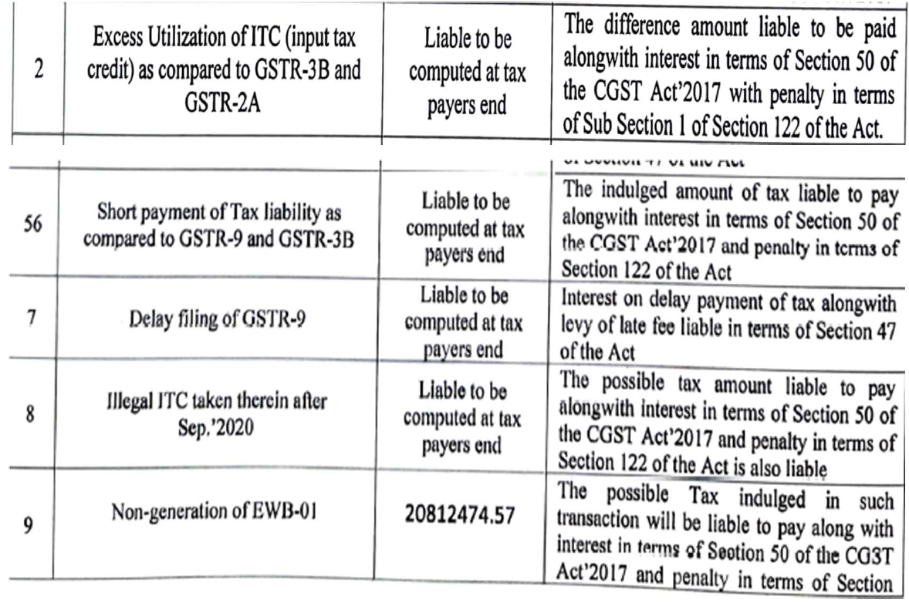
Scrutiny U/s 61 of the Act
Under section 61: Scrutiny of Returns;
a. What can be checked by PO -> GSTR-3B, GSTR-1, GSTR-2A/2B, E-way Bills, Returns of 3rd party.
b. Whether scope of S. 61 includes amount undetermined at the end of the PO? Also, whether mismatch of E-way Bills vs. GSTR-2A. E-way Bill vs. GSTR-1 is covered under Scrutiny of Returns, i.e. whether EWB is return?

Slide 32
Scope of Section 61
04
Scrutiny of Returns
The term “scrutiny” is not defined in the CGST Act, 2017. However, Section 61 provides for scrutiny of returns.
Sri Ram Stone Works vs. State of Jharkhand [2025] 174 taxmann.com 475 (Jharkhand)/[2025] 98 GSTL 424 (Jharkhand)[09-05-2025] Jharkhand High Court (In favour of Taxpayer)
section 61 is to enable an Assessing Officer to point out discrepancies and errors which are occurring in return filed by a registered person with that of related particulars; notice under section 61 cannot be issued comparing particulars at which assessee has sold its goods with that of prevalent market price

Slide 33
Is Section 61 pre-condition for issuing notice u/s 74 ?
04
Vadivel Pyrotech (P.) Ltd. vs. Assistant Commissioner (ST) [2022] 144 taxmann.com 179 (Madras)/[2023] 95 GST 10 (Madras)/[2023] 68 GSTL 120 (Madras)[27-09-2022] – Madras High Court (in favour of Taxpayer)
Scrutiny notice was issued under section 61 in Form ASMT-10 for certain discrepancies but show cause notice in Form DRC-01 and consequential order had been issued/passed for different discrepancies.
HELD : ASMT-10 notice is mandatory before issuing DRC-01 if same is pursuant to scrutiny under section 61 and not issuing DRC-01 in accordance with ASMT-10 will vitiate entire proceedings - Matter was remanded to Assessing Officer for redoing-assessment
Nagarjuna Agro Chemicals (P.) Ltd. vs. State of U.P. [2023] 153 taxmann.com 8 (Allahabad)/[2023] 99 GST 140 (Allahabad)/[2023] 76 GSTL 333 (Allahabad)[25-07-2023] – Allahabad High Court (In favour of Revenue)
ASMT was not issued for FY 18-19 - It was later at stage of consideration of return that department found that proper tax was not deposited and, consequently, proceedings under section 74 was initiated and concluded against petitioner.
HELD : Scrutiny proceedings of return as well as proceeding under section 74 are two separate and distinct exigencies and issuance of notice under section 61(3), therefore, cannot be construed as a condition precedent for initiation of action under section 74 - Merely because no notices were issued under section 61 of GST Act would not mean that issues of classification or short payment of tax cannot be dealt with under section 74 as exercise of such power is not dependent upon issuance of notice under section 61

Slide 34
DEVI TRADERS Versus STATE OF ANDHRA PRADESH
2023 (75) G.S.T.L. 134 (A.P.)
Demand and recovery - Scrutiny of returns - Period 1-4-2018 to 31-03-2019 - Demand of tax was raised under Section 74 of CGST Act, 2017 without having recourse to scrutiny under Section 61 ibid - Assessee contended that proper officer should first conduct scrutiny of returns and if any discrepancies were found, notice should be issued and if there was failure to give satisfactory explanation then he should proceed to take action under Section 74 ibid - Department contended that proper officer could directly invoke Section 74 ibid - HELD : Sections 73 and 74 ibid are not controlled by Section 61 ibid as reference to same is absent - Section 74 ibid uses “where it appears” conferring wide scope as information may be from any credible source - Proper officer may proceed under Section 74 ibid based on action under Section 61 ibid on scrutiny of returns or Section 65 ibid on audit or some other fact - Argument against initiation of proceedings by show cause notice under Section 74 ibid without scrutiny of returns under Section 61 ibid was to be rejected - Section 74 read with Section 61 of Central Goods and Services Tax Act, 2017 - Section 74 read with Section 61 of Andhra Pradesh Goods and Services Tax Act, 2017. [para 11]

Slide 35
Instruction No. 02/2022-GST dated 22.03.2022

Slide 36
Instruction No. 02/2022-GST dated 22.03.2022
Superintendent shall conduct scrutiny of returns
Minimum 3 GSTINs per month
Scrutiny of all returns for relevant financial year and single ASMT-10 to be issued for FY
Information from DGARM, ADVAIT, GSTN, E-Way Bill Portal, to be relied upon
Scrutiny of returns should have minimal interface between the proper officer and the registered person and, there should normally not be any need for seeking documents/ records from the taxpayers before issuance of FORM GST ASMT-10.

Slide 37
Scrutiny Selection Parameters
CBIC Instruction No. 02/2022-GST dated 22-03-2022
04
Variances in GSTR 1 Vs GSTR 3B
RCM Liability discharged Vs RCM ITC availed
GSTR 3B Vs GSTR 2B/2A
GSTR 3B Vs GSTR 1 Vs GSTR 7
GST Portal Vs E-way Bill Portal
ITC availed on invoice of Tax payers whose GSTIN cancelled retrospectively
ITC availed on Invoices of 3B Non-filers

Slide 38
Scrutiny Selection Parameters
CBIC Instruction No. 02/2022-GST dated 22-03-2022
04
ITC on import of Goods Vs GSTR 2A Vs ICEGATE Portal
Reversal under Rule 42/ 43 if exempt income has been reported in GSTR 1 and GSTR 3B
Non payment of Interest u/s 50 Liability on delayed payment of Tax
Non-payment of Late fee on delayed filing of returns
ITC availed beyond time limit u/s 16(4)

Slide 39
Types of Mismatches
GSTR-1 vs GSTR-3B mismatch
Most common reasons:
• Amendments • Credit notes • Time lag • advances
Always provide:
✓ month-wise reconciliation ✓ invoice mapping ✓ amendment trail
ITC mismatch with 2B
Explain:
• Timing difference • ISD credits • Imports • transitional credits
Attach vendor ledger + Invoices + Line Item level reconciliation.

Slide 40
Interest notice u/s 61?

Slide 41
What will happen if Self Assessed Tax is not paid?
Section 73(11): 10% of tax of Rs 10000/- whichever is higher.
Circular 76/50/2018 dated 31/12/2018 (S.No 2) gives relief for late filing of GSTR-3B.
Recovery Proceedings for self assessed tax [Section 75(12)]

Slide 42
L.C. Infra Projects Pvt Ltd- 2019 (28) G.S.T.L. 3 (Kar)
Interest recovery under GST - Show Cause Notice, requirement of – Attachment of Bank Account - Natural justice - Statutory provision of recovery of interest without notice is applicable only in case of self-assessment and not in case of determination by authorities - Issuance of SCN is sine qua non to proceed with recovery of interest payable under Section 50 of Central Goods and Services Tax Act, 2017 –
Thus, determination of interest without Show Cause Notice and also attaching Bank account for its recovery again without issuing any notice, is violative of principles of natural justice - Impugned communications set aside being perverse and illegal - Sections 73 and 75 of Central Goods and Services Tax Act, 2017 - Article 226 of Constitution of India. [paras 5, 6, 7]

Slide 43
AUDIT U/S 65

Slide 44
Some Generally said Sentences
I have been issued a notice by department for GST Audit. But my audit has already been done by my CA?
What did I do because of which I have received notice for audit as other company has not received it?
Once my audit is done, now no one will come to my premises?
They are raising audit objection and saying that they will attach my bank account?
My GST Audit was done in 19-20. I have received notice for 20-21 also. Department is harassing me?
Can I manage to get my name removed from list of audit?

Slide 45
FAQs
If Scrutiny of Return has taken place, can audit be done?
If search has happened can audit be done?
Can additional time be sought to submit information?
It is necessary to give copy of books of account in pen drive/cd/ over email?
Physical Verification of Stock can be done by the Audit Team?
Is it necessary to pay tax at the time of audit?
Should one contest every para?
It is trade off- We have to prove to client, officer has to prove to senior.
Ideal: No para
Worst: All paras
Practical: 5 small para are better than 1 big para

Slide 46
Audit: Section 2(13)
“audit” means the examination of
records,
returns and
other documents
maintained or furnished by the registered person
under this Act or the rules made thereunder or
under any other law for the time being in force
to verify the
correctness of turnover declared,
taxes paid,
refund claimed and input tax credit availed, and
to assess his compliance with the provisions of this Act or the rules made thereunder;

Slide 47
Legal Framework of Audit u/s 65
04
Selection of Taxpayer for Departmental Audit
Notice u/s 65 in Form ADT-01 intimating initiation of Audit
(15 days prior)
Data submission by Auditee
Audit Observation/ Paras Communicated vide Audit Memo
Departmental Audit Conducted (On-site/Desk)
(Time Limit – Within 3 + 6 Months form the date of Commencement)
Explanation by Auditee
Audit Report issued – ADT-02
No further proceedings if Para settled
If Not – Proceedings u/s 73/ 74/ 74A

Slide 48
Documents and Information
04
Information sought during department Audit
Annual report and Director‘s report (if any)
Profit & Loss A/C and Balance Sheet
Notes to accounts
Trial Balance
Tax Audit Report
Statement of Income Tax and TDS
List of HSN /SAC of the goods /or services in respect of the business
Reconciliation statement in respect of Form GSTR 9, GSTR-1 AND GSTR 3B
Suppliers list with GSTIN (where applicable)
Ledger accounts of the suppliers
Statement of sales party wise and POS wise
Supply for which tax paid in RCM.
Bank Statement for the period under audit
Stock register
Other documents and records as applicable as provided in section 35 of the Act
As per Audit definition, The examination need not be limited to the records maintained under GST Act only, the tax authorities may examine the records beyond the GST to verify the correctness of the Tax paid or ITC availed.

Slide 49

Access to Business Premises – Section 71
04
Section 71 empowering the authorised officer (Not below Joint Commissioner) to access any place of business for the purpose of inspection of books of account, documents, etc.
Documents that can be accessed:
Records required to be maintained under GST Act
(ii) Trial balance or its equivalent (though not mandatory to be maintained under any Act.)
(iii) Audited Financial Statements
(iv) Cost Audit Report u/s 148 of the Companies Act, 2013 (18 of 2013)
(v) IT Audit Report
(vi) Other relevant record
Statutory obligation on auditee to make available the records on demand by the officer.
A.C.L. Education Centre (P.) Ltd. vs. Union of India [2014] 42 taxmann.com 344 (Allahabad)/[2014] 33 STR 609 (Allahabad)/[2014] 43 GST 687 (Allahabad)/[2014] 73 VST 236 (Allahabad)[19-12-2013] (In favour of Revenue)
Service Tax: Rule 5A(2) mandating every assessee to make available requisite documents/reports to authorised officer or audit party is not ultra vires section 72A or section 94 of Finance Act, 1994 and is valid

Slide 50
GSTR-9C – Multi-State presence

Slide 51
VADIM INFRASTRUCTURE PVT. LTD. Versus COMMERCIAL TAX OFFICER, EKKATUTHANGAL SOUTH-II, CHENNAI-I 2024 (87) G.S.T.L. 189 (Mad.)
Demand - Tax or ITC not involving fraud etc. - Turnover reconciliation - Mismatch between Form GSTR-3B and Form 26AS - Period 2017-18 - Impugned order was issued confirming demand on ground that there was turnover mismatch between Form GSTR-3B return and Form 26AS and that assessee did not place on record documents pertaining to turnover from Tamil Nadu - HELD : Though it could not be completely disregarded that assessee should have placed on record trial-balance relating to Tamil Nadu and supported it with a certificate from a Chartered Accountant, it appeared that tax demand was confirmed against assessee by taking into account total turnover from assessee’s profit and loss account - Also, prima facie, there could be duplication as between head relating to turnover and head relating to differences between Form GSTR-3B return and Form 26AS - Assessee should be provided another opportunity to contest tax demand - Section 73 of Central Goods and Services Tax Act, 2017 - Section 73 of Tamil Nadu Goods and Services Tax Act, 2017. [para 6]

Slide 52
Key Records to maintain
Every registered person maintain retain records u/s 35 for a minimum period of 72 months (i.e., 6 years) from the due date of furnishing the annual return for that financial.
Records u/s 35
Production or manufacture of goods register
Inward and outward Registers
Stock Register
E-Way Bills: All generated and received E-Way Bills linked to invoices, confirming the physical movement of goods.
Tax Payable and paid details

Slide 53
Key Documents to retain
Documents prescribed under Law
Tax Invoices as - Section 31(1)
Debit Notes and Credit Notes – Section 34
Bill of Supply – Section 31(3)(c)
Receipt Voucher - Section 31(3)(d)
Refund Voucher –Section 31(3)(e)
Payment Voucher – Section 31(3)(g)
Delivery Challan – Rule 55
E-way bill – Rule 138
Job work Challan – Rule 45(1)

Slide 54
Key Documents to retain
Documents not prescribed but shall be maintained
Transport Documents: Copies of Bilty or Goods Receipts Note to prove the date and location of goods delivery.
Contracts and Agreements: Original Contracts or service agreements that justify the nature and value of the supply.
Vendor Communication Trail: Documented emails/letters requesting vendor amendments or follow-up on missing GSTR-2B invoices.
System Audit Logs: Internal System Audit Logs confirming the date and time of critical data entry or return submissions.
GSTR Portal Download Files: The raw JSON/Excel files downloaded from the GST portal (GSTR-1, GSTR-2A, GSTR-2B) used for reconciliation.
Journal Vouchers (JVs): All Journal Vouchers passed to account for the reconciliation differences or ITC reversals.

Slide 55
Records – Stock, Job Work, Production etc.
GST - Accounts and Records
Registers/Records: | Nature of details required
Stock Register | Stock of goods as on a date
Stock Movement Register | Stock information including Opening Balances Receipt Supply Goods lost , destroyed, written off, or disposed of by way of gift or free samples Balance of stock including raw materials, finished goods, scrap, and waste
Production Register | Quantitative details of RM or services used in the manufacture of goods and quantity of goods manufactured including waste and by products
Delivery Challan Register | Delivery challans issued and received
Job Work Register | Challan wise detail of Goods sent to job worker Goods received back from job worker Goods sold from job workers place.

Slide 56
Who, How and Where can undertake the Audit?
Who ?
The Commissioner or
any officer authorised by him,
by way of a general or a specific order, may undertake audit of any registered person
Period, Frequency and Manner
for such period, (1 FY, or 2 Years or 6 months, all are possible)
at such frequency
and in such manner.
as may be prescribed
Where?
At the place of business of the registered person
or in their office.

Slide 57
Intimation and Completion of Audit
Intimation
by way of a notice
not less than fifteen working days prior to the conduct of audit
in such manner as may be prescribed. (ADT-01)
“Commencement of audit” shall mean the date on which
the records and other documents, called for by the tax authorities, are made available by the registered person
or the actual institution of audit at the place of business,
whichever is later.
Completion
Within a period of three months from the date of commencement of the audit
Further extension by Commissioner for the reasons to be recorded in writing, extend the period by a further period not exceeding six months

Slide 58
HUBERGROUP INDIA PVT. LTD. Versus UNION OF INDIA
IN THE HIGH COURT OF GUJARAT AT AHMEDABAD BHARGAV D. KARIA AND D.N. RAY, JJ. HUBERGROUP INDIA PVT. LTD. Versus UNION OF INDIA (2024) 24 Centax 56 (Guj.)/2025 (92) G.S.T.L. 142 (Guj.) [17-10-2024] – Gujarat High Court
SCNs were issued under Section 65(7) read with Section 74 of CGST Act for raising demand after audit while assessee submitted that audit was concluded beyond period prescribed under Section 65(4) of CGST Act and, hence, impugned notices were without jurisdiction. The proceeding are pending before Gujarat HC.

Slide 59
Expectation and Verification
Legal Expectation of audit officer?
to afford him the necessary facility to verify the books of account or other documents as he may require;
to furnish such information as he may require and
render assistance for timely completion of the audit.
What can be verified by the Audit Officer?
Verify the documents on the basis of which the books of account are maintained and the returns and statements furnished
the correctness of the turnover, exemptions and deductions claimed,
the rate of tax applied in respect of the supply of goods or services or both,
the input tax credit availed and utilised,
refund claimed, and
other relevant issues and
record the observations in his audit notes.

Slide 60
Conclusion and SCN
On Conclusion of Audit
Inform the discrepancies noticed, if any, as observed in the audit and
Registered Person may file his reply and
the proper officer shall finalise the findings of the audit after due consideration of the reply furnished.
Findings of the Audit
The proper officer shall, within thirty days, inform the registered person, whose records are audited, about the findings, his rights and obligations and the reasons for such findings.
On conclusion of the audit, the proper officer shall inform the findings of audit in FORM GST ADT-02*.
Proper Officer as per circular 3/3/2017 dated 05.07.2017 is Deputy Commissioner
SCN Proceedings
Where the audit conducted under sub-section (1) results in detection of tax not paid or short paid or erroneously refunded, or input tax credit wrongly availed or utilised, the proper officer may initiate action under section 73 or section 74.

Slide 61
Natural Justice – 65(6)
04
Section 65(6) On conclusion of audit, the proper officer shall, within thirty days, inform the registered person, whose records are audited, about the findings, his rights and obligations and the reasons for such findings.
Rule 101(4) The proper officer may inform the registered person of the discrepancies noticed, if any, as observed in the audit and the said person may file his reply and the proper officer shall finalise the findings of the audit after due consideration of the reply furnished.
The auditee shall have the right to make its submission against the audit findings and shall be given the opportunity of being heard.
The proper officer shall duly consider the reply filed by the auditee.
Tinton River Palms vs. State of Karnataka [2023] 147 taxmann.com 545 (Karnataka)/[2023] 97 GST 33 (Karnataka)/[2023] 72 GSTL 39 (Karnataka)[30-01-2023] Karnataka High Court (in favour of the taxpayer)
Audit report issued within seven days from date of issuance of notice under section 65(6) was not sustainable when same had been issued without providing reasonable opportunity for filing reply.
Dhruv Medicos (P.) Ltd. vs. Deputy Commissioner Central GST, Delhi [2025] 176 taxmann.com 975 (Delhi)/[2025] 111 GST 238 (Delhi)/[2025] 101 GSTL 374 (Delhi)[24-07-2025] Delhi High Court (In favour of Taxpayer)
Where audit findings were finalized without considering assessee’s reply submitted after receiving audit documents and interpretation of Rule 101(4) of CGST Rules, which mandates that reply must be considered before finalizing audit.

Slide 62
Parallel Proceedings – section 6(2)(b)
04
Section 6(2)(b) – bar on parallel proceedings
“2) Subject to the conditions specified in the notification issued under sub-section (1),—
(a) where any proper officer issues an order under this Act, he shall also issue an order under the State Goods and Services Tax Act or the Union Territory Goods and Services Tax Act, as authorised by the State Goods and Services Tax Act or the Union Territory Goods and Services Tax Act, as the case may be, under intimation to the jurisdictional officer of State tax or Union territory tax;
(b) where a proper officer under the State Goods and Services Tax Act or the Union Territory Goods and Services Tax Act has initiated any proceedings on a subject matter, no proceedings shall be initiated by the proper officer under this Act on the same subject matter.”
G.K. Trading Co. v. Union of India [2021] 126 taxmann.com 211/51 GSTL 288 (All.), the Allahabad High Court held that proceedings under Section 6(2)(b) mean adjudicatory steps—such as those under Sections 73 or 74—and not inquiries or summons under Section 70.
The Madras High Court in Kuppan Gounder P.G. Natarajan v. DGGI [2022] 143 taxmann.com 289/58 GSTL 292/[2023] 95 GST 341 reached the same conclusion, emphasising that "inquiry" and "proceedings" denote distinct statutory stages.
More recently, the Supreme Court in Armour Security (India) Ltd. v. Commissioner, CGST, Delhi East [2025] 177 taxmann.com 478/111 GST 400 harmonised these views. The Court held that the "initiation of proceedings" occurs only when a proper officer assumes adjudicatory jurisdiction to determine rights and liabilities; the conduct of inquiry or collection of information does not amount to such initiation. Section 6(2)(b) thus preserves administrative freedom to investigate while maintaining the constitutional principle of non-duplication of adjudication between the Union and the States.

Slide 63
Audit Selection Parameters
04
Turnover of the Taxpayer and unexpected change in turnover
High variation in ITC as per GSTR 3B and GSTR 2A/2B
Taxpayers claiming high refunds
Non-Complaint Taxpayers
Higher incidence of supply without issuance of E-way bills
Financial Ratio analysis
Sector Specific
Based on specific information received from other governmental authorities

Slide 64
Low Hanging Fruits
04
Input Tax Credit
Highest Risk Area
Outward
High Risk Area
Others
Moderate Risk Areas
Wrong Refund claimed
ITC mismatch (GSTR 3B Vs GSTR-2B vs Books )
ITC from non-filers/suspended dealers
Blocked credit u/s 17(5)
RCM Liability paid Vs ITC claimed
ITC without invoice
ITC without receiving goods/ services
ITC taken beyond 16(4) time limit
Reversal of ITC under Rule 42/43
Non-Payment to vendors beyond 180 days
Turnover mismatch (GSTR 3B vs GSTR 1 VS GSTR 9 VS Books)
RCM liability Paid Vs Reflecting in GSTR 2B
E-invoice mismatch (GSTR 1 Vs E-Invoice)
E-way Bill mismatch (GST Portal Vs E-way Bill Portal)
Valuation in case of Related Party Transaction
Incorrect Classification of Rates/ HSN
Incorrect exemption claimed
BRCs/ FIRCs not maintained against Exports
LUT conditions not met
Goods sent on Job work not received – Non filing of ITC 04
Non compliance of returns
Non Maintenance of mandatory records

Slide 65
How Audit Teams Function (Ground Reality)
They operate on:
• predefined objection formats • Excel analytics • comparison ratios
They already carry “draft paras”.
You must attack assumptions, not conclusions.

Slide 66
RECONCILATION TRIGGERS IN AUDIT

Slide 67
GST Notice Triggers
GSTR-1 vs GSTR-3B
GST Returns Vs Books
GSTR 1 Vs GSTR 3B Vs GSTR 9
GSTR 1 vs E-way Bill
GSTR 1 vs E-Invoice
GSTR 3B vs GSTR 7
ITC 04 Vs E-Way Bill
GSTR Vs Income Tax Returns
GST Portal Vs ICE Gate

Slide 68
GST Notice Triggers
GSTR-2B vs GSTR-3B ITC
GSTR 2B vs GSTR 3B RCM liability
RCM Liability discharged (Table 3 of GSTR 3B) vs RCM ITC availed (Table 4 of GSTR 3B)
GSTR 9 Vs GSTR 3B
GSTR 9 Vs GSTR 9C
GSTR 2B Vs ITC on Import of goods
Credit Notes Vs ITC reversed

Slide 69
Outward reconciliation

Slide 70
Reconciliation is the First Line of Defense!
GSTR 1 Vs GSTR 3B Vs GSTR 9 Vs Books
Outward
Reconcile | Comparison | Impact
Turnover (Taxable, Exempt, Export, Nil rated) | GSTR 1 Vs GSTR 3B Vs GSTR 9 | Liability on over/under reported turnover
B2B and B2C Classification | GSTR 1 Vs GSTR 9 | Denial of ITC to the recipient
Tax Rate Wise Liability | GSTR 1 Vs GSTR Books | Liability due to incorrect classification or incorrect reporting
Tax Head Classification based on POS | GSTR 1 Vs GSTR 3B | Additional Liability do to wrong jurisdiction
Credit Notes/ Debit Notes | GSTR 1 Vs GSTR 3B Vs GSTR 9 | Time limit to issue and report Credit notes to adjust Tax liability. CN to be issued latest by 30th October of following FY and to be reported by 30th November of the following FY Confirmation from recipient ensuring reversal of ITC against the CN

Slide 71
Other Cross Head Taxes?
Scenario | Possible Outcome
Correct IGST charged in invoice and collected from customers. Tax wrongly paid as CGST + SGST | Circular no 26/26/2017- Pay Correct Tax and adjust the excess tax paid wrongly paid
Wrong CGST+SGST charged on invoice instead of IGST. However, while paying correct type of taxes IGST paid. | Issue Credit Note for C+S and Issue D/N for IGST.
Wrong CGST + SGST charged from Customer and paid instead of IGST | Follow Mechanism under Sec 77 of CGST and 19 of IGST. Else wait for assessment.

Slide 72
Typical format of sales register/ Outward Supplies register
Inv Date | Inv No | Customer Name | GSTIN | GSTR-9 Category | Ledger | HSN/ SAC | Taxable Value | Rate | IGST | CGST | SGST/ UTGST
 |  |  |  | B2B
 |  |  |  | B2B-DN
 |  |  |  | B2B-CDN
 |  |  |  | EXPWP
 |  |  |  | EXPWOP
 |  |  |  | SEZWP
 |  |  |  | SEZWOP
 |  |  |  | B2C
 |  |  |  | B2C-DN/ CDN
 |  |  |  | Non-GST
 |  |  |  | Non-DN/ CDN

Slide 73
E-INVOICING

Slide 74

E-Invoicing and Matching
E-Invoice Portal
Uploads information through GSTR-1
GST Portal
Invoice
ERP
MATCHING PROCESS
Approval and Recording in ERP systems
Made available through GSTR 2B
Company
Applicable on Exporters also
Matched
Missing in ERP
Missing in GST Portal
Immediate
Up to 30-Nov
0% Tolerance

Slide 75
Reconciliation is the First Line of Defense!
GST Portal Vs E-Invoice Portal
Reconcile | Comparison | Impact
No of Invoices/CN/DN Issued | GSTR 1 Vs IRP | Delay in generation of IRN beyond 30 days may attract penalty ITC eligibility of the recipient
Cancelled Invoices | GSTR 1 Vs IRP | Duplication tax liability on cancelled invoices due to non-cancellation on IRP Portal
Taxable Value and Tax | GSTR 1 Vs IRP | Inflation in Tax and Taxable Value due to inconsistency Additional liability due to Incorrect POS
Document Types and Series | GSTR 1 Vs IRP | Skipped sequence may shall trigger suspicion of Tax evasion

Slide 76
Non-Issuance of IRN
Recipient is eligible to claim credit? – Sec 16(1) is applicable – Yes
Principle of Interpretation: Literal vs Purposive. Applicable for Sec 16(2) also.
Sec 16(2): Some conditions are procedural and hence should be read liberally
Example Sec 16(2)(c) cant be satisfied before claiming ITC by recipient
Liberal interpretation should be given for not having IRN and ITC should be claimed
There is substantive compliance of law, tax has been paid and supply has been made
It is a condonable lapse since it is procedural in case
Advisory dated 03.03.2022 : Para 3 of advisory : Nov Invoice, IRN in Dec, It will appear in GSTR-1 of Nov 21
Tax Invoice is not defined in the Act and hence there is some invoice is existence
Rule 48(4) which says it will not be a invoice but where is statutory backing to the same

Slide 77
Non-Issuance of IRN
Can penalty under Sec 122(1)- Incorrect or False Invoice can be made applicable
Is it aiding or abating any offence?
Aid or abtening an offence: tax has been paid hence no aiding or abeting
122(1)(i): Supply without invoice? – Here 30 days time to raise invoice is there because it is a case of supply of service
Fails to comply with law: Not applicable, document issued but not recgonized by the department
Sec 122: penalty under Section 122 of the Act can be made applicable?

Slide 78
Suggestive Year End Best Practises
As a Supplier
Analyse the condition and comply !
IT Automated
E-Way Compliance to be also embedded
Tracker / Reconciliation to be prepared
Send letter/email to all customers to avoid mis-communications
As a Receiver
Take declaration from the Suppliers
Financial Burden to be minimized in case of non compliance through consent
Ensure mechanism for recording of IRN in ERP
SOP for scanning QR Code on E-Invoice

Slide 79
HSN Codes

Slide 80
HSN Code
N.N. 78/2020-CT dated 15-10-2020
Supplier exporting goods – 8 digits (already)
Aggregate Turnover | HSN Code Requirement on Tax Invoice
Up to 5 cr | 4 digits
Beyond 5 cr | 6 digits
HSN Code
Goods
Customs Tariff Act
Services
UNCPC

Slide 81
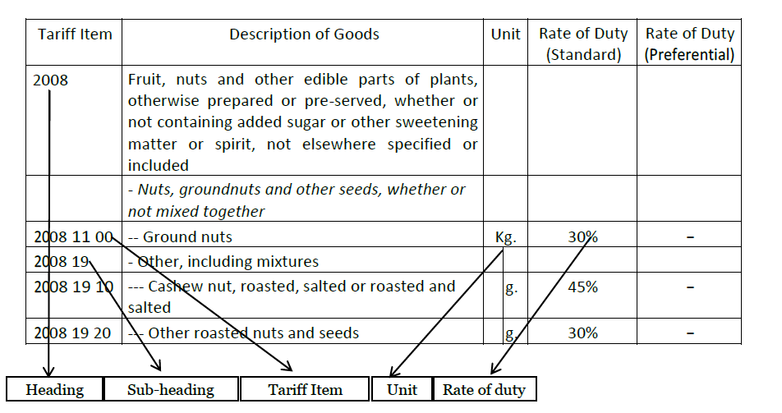
A Practical View of Chapter 20

Slide 82
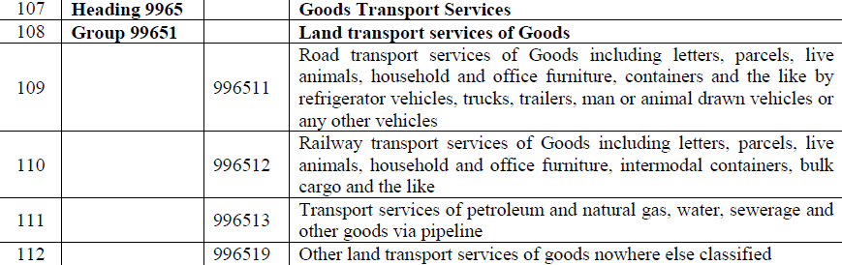
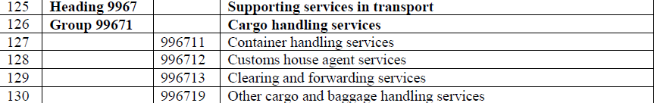
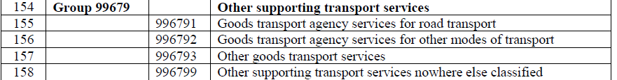


GTA Classification

Slide 83
HSN What to do?
Revisit your HSN Codes before implementation
Communicate with Customer and appraise your 4 /6 digit HSN
Communicate with Supplier and enquire about his 4 / 6 digit HSN
Map “Master of ERP” with 4 / 6 digit HSN
In case the HSN for same item is given differently by 2 suppliers, re-assess the same and communicate with either of the 1 for suggestive action
In case of multiplicity of HSN from different suppliers, take a declaration.

Slide 84
E-Invoice + HSN Code: Gold Mine of Information?
The IRP software picks data from “Master of the ERP”
Mater of ERP contains the internal product classification, coding and rates
HSN is housed on such internal Master of ERP
The description in Master may not be consistent with description of the HSN
The data of inward also now get accumulated with revenue with HSN Code
Same may be tallied with data punched by the assessee in Financial Statement, Annual Return
Department gets equipped with information which you are not aware of.

Slide 85
CREDIT NOTES AND DEBIT NOTES

Slide 86
Issues in GSTR-2B- Credit Note vs Invoices
Credit Note issued by Supplier on Receiver.
Such Credit Note reflected in GSTR 2B of the Receiver
Receiver did not account for such Credit Note in its books of accounts
Receiver Issued an Invoice for Incentive upon the Supplier
Such Invoice reflected in GSTR-2A of the Supplier
Supplier did not account for such Invoice in its books of accounts

Slide 87
Credit Notes and Debit Notes
Credit Notes
Debit Notes
Proof of “Incidence of Tax” not passed on.
Taking necessary certificate from the customer for reversal of ITC
Copies of GRN, E-Way Bill for receipt of rejected goods
Recording of Credit Note as Sales Return or part of claims, damages
To ensure Purchase Invoice of customer is not entertained
Delinking of C/N does not mean that time limit for issuance has been extended from 17.09.2020
Segregating Financial vis-à-vis GST Debit Notes
Ensuring to GST effect not taken of Debit Note issued by the customer.
Taking ITC of Debit Notes issued for prior periods also from the supplier in the current FY (2020-21) after 1.01.2021
For debiting account of customer, employee or vendor for tolerating any situation check if requirement of issuance of “Tax Invoice” is there.

Slide 88
Declaration- Circular No 212/06/2024
Certificate from CA/CMA: Until a functionality is available on the portal, suppliers can obtain a certificate from a Chartered Accountant (CA) or Cost Accountant (CMA) from the recipient, confirming ITC reversal.
Certificate Details: The certificate should include:
Details of the credit notes.
Relevant invoice numbers.
Amount of ITC reversal for each credit note.
FORM GST DRC-03/return/other document details showing ITC reversal.
UDIN (Unique Document Identification Number) for verification (ICAI website for CAs, ICMAI website for CMAs).
Undertaking for Small Amounts: For discounts involving tax amounts up to ₹5,00,000 in a financial year, an undertaking or certificate from the recipient can be used instead of a CA/CMA certificate.

Slide 89
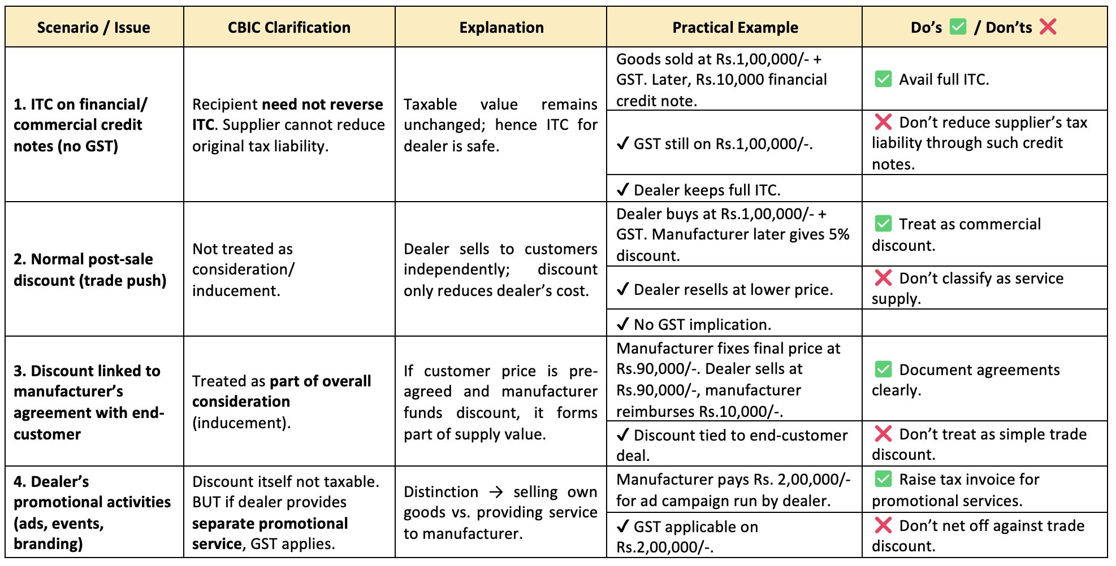
𝗚𝗦𝗧 & 𝗣𝗼𝘀𝘁-𝗦𝗮𝗹𝗲 𝗗𝗶𝘀𝗰𝗼𝘂𝗻𝘁𝘀 – 𝗖𝗕𝗜𝗖 𝗖𝗹𝗮𝗿𝗶𝗳𝗶𝗰𝗮𝘁𝗶𝗼𝗻 (𝗖𝗶𝗿𝗰𝘂𝗹𝗮𝗿 𝗡𝗼. 𝟮𝟱𝟭/𝟬𝟴/𝟮𝟬𝟮𝟱)

Slide 90
Sec. 15(3)(b)
Existing Provision
(3) The value of the supply shall not include any discount which is given—
(b) after the supply has been effected, if—
such discount is established in terms of an agreement entered into at or before the time of such supply and specifically linked to relevant invoices; and
input tax credit as is attributable to the discount on the basis of document issued by the supplier has been reversed by the recipient of the supply.
Proposed Changes
(3) The value of the supply shall not include any discount which is given—
(b) after the supply has been effected, if for such discount, a credit note has been issued by the supplier and input tax credit as is attributable to such discount has been reversed by the recipient of the supply, in accordance with the provisions of section 34

Slide 91
Section 34
Insertion of reference to Sec. 15(3)(b):
(1) Where one or more tax invoices have been issued for supply of any goods or services or both and the taxable value or tax charged in that tax invoice is found to exceed the taxable value or tax payable in respect of such supply, or where the goods supplied are returned by the recipient, or where goods or services or both supplied are found to be deficient or where a discount referred to in clause (b) of sub-section (3) of section 15 is given, the registered person, who has supplied such goods or services or both, may issue to the recipient one or more credit notes for supplies made in a financial year containing such particulars as may be prescribed.
Memo Explaining Finance Bill:
Section 34 of the Central Goods and Services Tax Act, 2017 is being amended so as to include the reference of section 15 in the said section.

Slide 92
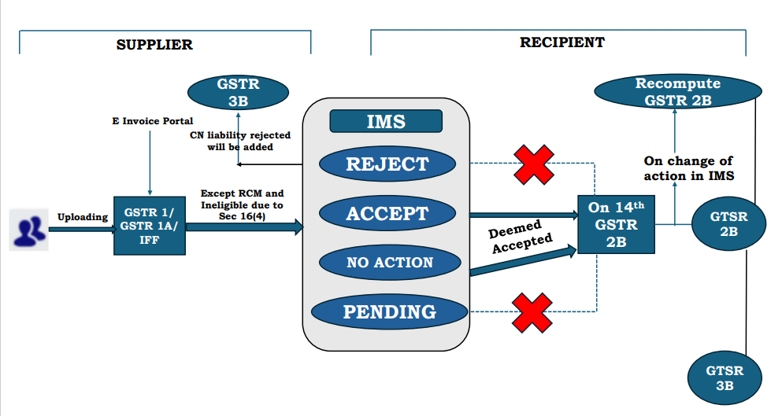
IMS FLOW

Slide 93
TURNOVER RECONCILATION

Slide 94
GSTR-9C – Table 5: Gross Turnover Reconciliation
5 | Reconciliation of Gross Turnover
S.No | Description | Amount (₹)
A | Turnover (including exports) as per Audited Financial Statement for the State / UT (For multi-GSTIN units under same PAN, the turnover shall as be derived from the Audited Annual Financial Statements )* | 10,85,39,28,057.00
B | Unbilled revenue at the beginning of the Financial Year
C | Unadjusted advances at the end of the Financial Year
D | Deemed Supply under Schedule I | 13,74,77,746.00
E | Credit Notes issued after the end of the financial year but reflected in the annual return
F | Trade Discounts accounted for in the audited Annual Financial Statement but are not permissible under GST
G | Turnover from April 2017 to June 2017 | 0.00
H | Unbilled revenue as at the end of the Financial Year
I | Unadjusted Advances as at the beginning of the Financial Year
J | Credit notes accounted for in the audited Annual Financial Statement but are not permissible under GST | 0.00
K | Adjustments on account of supply of goods by SEZ units to DTA Units
L | Turnover for the period under composition scheme
M | Adjustments in turnover under section 15 and rules thereunder
N | Adjustments in Turnover due to foreign exchange fluctuation
O | Adjustment in Turnover due to reasons not listed above | 16,43,871.00
P | Annual Turnover after adjustments as above(A+B+C+D-E+F-G-H-I+J-K-L+M+N+O) * | 10,99,30,49,674.00
Q | Turnover as declared in Annual return (GSTR9)* | 10,99,30,49,674.00
R | Un-Reconciled turnover (Q- P) * | 0.00
Table 5 of GSTR-9C
Description |  | Taxable Value (₹) | (Amount in ₹ in all tables)
 |  |  | Central Tax | State Tax / UT Tax | Integrated Tax | Cess
10 | Supplies / tax declared through Amendments (+) (net of debit notes)
11 | Supplies / tax reduced through Amendments (-) (net of credit notes)
12 | Reversal of ITC availed during previous financial year
13 | ITC availed for the previous financial year |  | 1133062.00 | 1133062.00 | 29912.00 | 0.00
 | Total turnover (5N +10-11) | 10,99,30,49,674.00 | 41,91,49,919.00 | 41,91,49,919.00 | 66,17,43,911.00 | 0.00
Total After 10/11 of GSTR-9

Slide 95
GSTR-9C – Multi-State presence

Slide 96
INCOME VS SUPPLY

Slide 97
Tax Invoice Vs Revenue Recognition
AS-7 vs Completion of Service
Exchange Difference in Tax Invoice and AS-11
AS-9 vs Removal of Goods
Financial Credit Note vs GST Credit Note

Slide 98
Income Vs Supply (GST is not a Tax on Income)
Particulars | Income | Supply
Meaning | Money received i.e. End Result | Activity or Transaction i.e. Starting Point
Consideration | Yes mandatory, no deeming fiction | Not mandatory, by deeming fiction
Two Persons | Yes mandatory, one cannot earn from itself | Yes but, by deeming fiction one person can be treated as two persons
Business | Not Mandatory | Mandatory
Can be –ve in value | Yes includes loss | No as value will always be positive or Zero
Can expense be I/S | No | Yes (Import of Services)
Windfall Gain | Yes (without activity) | No (Quid-Pro-Quo)
Return on Investment | Yes | No
Recovery of Cost | Yes | No, if does not form part of an activity

Slide 99
The Classic Proposition for Taxability
Supplier
Consideration
Recipient
Enforceable Contract
Supply
Process:
- Supply is sub-specie is an enforceable contract (Bai Mamubai Trust- Bombay High Court)
- Are there two parties
Supplier should make a supply
Consideration is in connection with supply coming from enforceable contract
Tax should not be on presumption that since money is flowing and hence can be treated as a supply
Notes:
-Bai Mamubhai Trust gave the principle:
Process:
- Supply is sub-specie is an enforceable contract
- Are there two parties
Supplier should make a supply
Consideration is in connection with supply coming from enforceable contract
Tax should not be on presumption that since money is flowing and hence can be treated as a supply

Slide 100
UNBLLED REVENUE

Slide 101
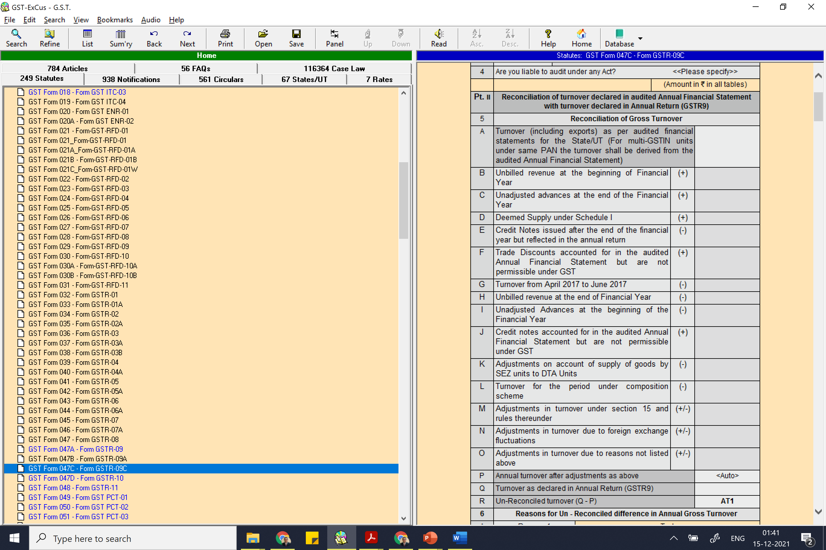
Turnover as per Books of Account
Turnover should be
Revenue from Operations?
Total of Credit Side?
Total of Outward Register?
5O should contain figures?
Eg : Accounting Provisions

Slide 102
Time of Supply of Continuous Supply of Service
“continuous supply of services” means a supply of services which is provided, or agreed to be provided, continuously or on recurrent basis, under a contract, for a period exceeding three months with periodic payment obligations and includes supply of such services as the Government may, subject to such conditions, as it may, by notification, specify;
Earlier of
Date of Issuance of Invoice
Receipt of Advance
Situation | Time of Supply
Where the due date of payment is ascertainable from the contract | Invoice shall be issued on or before the due date of payment
Where the due date of payment is not ascertainable from the contract | Invoice shall be issued on or before the date when supplier receives the payment
Where the payment is linked to the completion of an event, | the invoice shall be issued on or before the date of completion of that event.

Slide 103
Date of Completion of Service
Circular No. 144/13/2011-S.T., dated 18-7-2011- Service Tax
2. These representations have been examined. The Service Tax Rules, 1994 require that invoice should be issued within a period of 14 days from the completion of the taxable service. The invoice needs to indicate inter alia the value of service so completed. Thus it is important to identify the service so completed. This would include not only the physical part of providing the service but also the completion of all other auxiliary activities that enable the service provider to be in a position to issue the invoice. Such auxiliary activities could include activities like measurement, quality testing etc. which may be essential pre-requisites for identification of completion of service. The test for the determination whether a service has been completed would be the completion of all the related activities that place the service provider in a situation to be able to issue an invoice. However such activities do not include flimsy or irrelevant grounds for delay in issuance of invoice.

Slide 104
MOBILIZATION ADVANCE

Slide 105
Mobilization Advance
GAMMON INDIA LTD- 2020-TIOL-1526-CESTAT-MUM
ST - The dispute concerns the stage - on receipt or on issue of the bill - at which 'mobilization advance' paid to the assessee is leviable to tax - The several contracts provide for payment to be made at different, pre-determined stages of performance and are, generally, subject to evaluation of work undertaken - The 'mobilization advance' is adjusted against the final payment due and is not linked to the work but as a pledge of contract between the assessee and principal - It is also subject to furnishing of prescribed 'bank guarantee'; there is no connection with the performance of contract - It is not in dispute that 'mobilization advance', carrying interest, is granted to enable the contractor to prepare for undertaking the contracted work - The subsequent adjustment with the final payment due does not suffice to construe this as an advance payment for the work to be done merely because the recipient and payee happened to be the provider of service - The payment of 'mobilization advance' is but a separate financial transaction within the contract for providing of service

Slide 106
Reconciliation is the First Line of Defense!
GSTR 1 Vs GSTR 3B Vs GSTR 9 Vs Books
Outward
Reconcile | Comparison | Impact
Advances Received against Advance Adjusted | GSTR 1 Vs GSTR 3B Vs GSTR 9 | Additional tax liability on advances not disclosed. Dual of tax liability in case advances remain unadjusted
Other/ Misc. Income | GST Returns Vs Books | GST impact on other/ misc. Income e.g.- Sale of vehicles, sale of securities, sale of scrap, etc.
Exempt to Total Turnover Ratio | GSTR 1 Vs GSTR 3B Vs GSTR 9 Vs Books | Additional reversal under Rue 42/43 in case of inconsistency in the turnover
HSN Summary | GSTR 1 Vs GSTR 9 Vs Books | Additional tax liability due to mismatch HSN Summary
Document Summary | GSTR 1 Vs Books | Inconsistency in Document Summary shall trigger suspicion

Slide 107
DOCUMENTS + E-WAY BILL

Slide 108
Reconciliation is the First Line of Defense!
GST Portal Vs E-way Bill Portal
Reconcile | Comparison | Impact
No of Invoices/CNs (above specified consignment Value) | GSTR 1 Vs EWB Portal | Additional liability on duplication of e-way bills Penalty in cases where e-way bill against Invoices not found
Cancelled Waybills | GSTR 1 Vs EWB Portal | Active invoice against cancelled way bill shall trigger suspicion of tax evasion
E-way bill generated but Invoice cancelled | GSTR 1 Vs GSTR 3B Vs EWB Portal | Additional liability with penalty due to suspicion of movement without payment of tax
Movement due to reason other than supply | EWB Portal Vs Books (Delivery Challan Register) | Tax liability with penalty on goods moved without DC
Quantity of goods moved | E-Invoice Vs E-way Bills Vs Physical | Differential quantities shall attract tax along with penalty

Slide 109
Reconciliation is the First Line of Defense!
GST Portal Vs E-way Bill Portal
Reconcile | Comparison | Impact
Movement of goods from Principal to Job worker and Back | EWB Portal Vs Form ITC 04 | Tax Liability with penalty where goods are moved without e-way bill. Goods not returned as per E-way bill shall be considered deemed supply.
Distance Covered by Vehicle | E-way Bill Vs Distance Actually covered by Vehicle (Tolls crossed) | As per “Data Sharing Policy from National Transport Repository(NTR)” dated 18-08-2025 issued by Ministry of Road Transport and Highways, any data can be shared with other government departments on request. Thus any inconsistency in kms travelled as per waybill and Tolls actually crossed by the vehicle shall invite suspicion
Inward movement of Goods | GSTR 2A Vs EWB Portal | Denial of ITC u/s 16(2)(b) with penalty where EWB not found against Invoice Penalty where only EWB has been generated, whereas goods have not been received

Slide 110
Malik Traders vs State of UP
The court held that producing
tax invoices,
e-way bills,
GR records, and
proof of payment,
while important, was insufficient to establish the legitimacy of the transactions.
Specific details such as
vehicle numbers used for transportation,
payment of freight charges,
acknowledgment of goods delivery, and
Toll Receipts
were deemed necessary to support their claim for input tax credit.

Slide 111
Movement of Goods
Goods in Transit- Whether ITC claimed ? (Condition of receipt of goods fulfilled?)
Goods sent on Job Work- Whether returned back within 1 / 3 years ?
Filing of ITC-04
Apply for extension if required
Goods sent on approval – Whether returned back within 6 months?
Goods lying at a premises not added in the RC- Whether deemed supply?

Slide 112
Reconciliation is the First Line of Defense!
GSTR 7 of Deductor Vs GSTR 3B of Deductee
Reconcile | Comparison | Impact
TDS/TCS deducted Vs Invoice raised by Deductee | GSTR 1 Vs TDS/TCS credit received or accepted | Additional Liability if one to one correlation not established Erroneous acceptance of excess credit received may invoke cash liability with interest.
Period of TDS Deposit | GSTR 1 Vs GSTR 3B Vs TDS/ TCS Credit received | Difference due to Time of Supply and Payment Cycle by the deductor. Usually, tax liability is discharged by the deductee first, whereas payment is received in the later months. This mismatch in time period creates discrepancy in departmental reports.
Rate and Value at which TDS is being deducted | GSTR 1 Vs TDS credit received | It has been observed in many cases that TDS is being deducted on Invoice Value instead of Taxable value causing discrepancy in system generated reports for Department’s perusal
Note : GSTIN has now enabled the functionality for invoice-wise reporting in GSTR-7 from September 2025 tax period. The update shall address the variances due to time lag. N. No. 09/2025 – CT dated 11.02.2025

Slide 113
Reconciliation is the First Line of Defense!
GST Portal Vs ICE Gate Vs RBI Compliance
Exports
Reconcile | Comparison | Impact
Export of Goods with Payment | GSTR 1 Vs Ice Gate IGST Validation Report Vs Realization in Foreign Currency | Denial of IGST refund in case non-transmission due to errors IGST liability in cash with interest where foreign currency not received within prescribed time limit
Export of Goods without payment | GSTR 1 Vs Shipping Bill Details Vs Realization in Foreign Currency | Denial of ITC refund due Inconsistency in Invoice Details Vs Shipping Bill details Refund repayment in cash with interest where foreign currency not received within prescribed time limit
Export of Service | GSTR 1 Vs FIRC/ BRC | Denial of refund due to non-reconciliation IGST liability in cash with interest where foreign currency not received within prescribed time limit
Movement of goods | GSTR 1 Vs E-way Bills | Additional tax with penalty where movement is not reconciled with E-way Bills

Slide 114
RCM

Slide 115
RCM Compliances
Supplies from Registered Supplier
Supplies from Unregistered Supplier
Check Invoice of Supplier is in prescribed manner
Show in GSTR-2B
Self Invoice is not allowed
Check supplier is actually unregistered
If yes, raise RCM Invoice on time
Report series in GSTR-1
If any tax under RCM is paid for previous years, then ITC of same can be claimed (Subject to issuance of self-invoice)
Check
Import of Services (Reconcile with 15 CA / 15CB documents)
In case of builders supplies from unregistered supplier cannot exceed 20% of total inward supplies

Slide 116
Government Payments by a Factory under RCM?
S.No. 9: Rs 5000 per supply
S.No. 47: For registration required under any law
Protection for safety of workers and public at large
Fire License
Exemption Notification 12/2017
Factory License
Boiler’s License
ROC Fees
ESI / PF Registration
Pollution License
DGFT License Fees
Donation to PM Fund

Slide 117
ITC

Slide 118
Section 155
Sec. 155 of the CGST Act, 2017
Burden of proof.
Where any person claims that he is eligible for input tax credit under this Act, the burden of proving such claim shall lie on such person
obligation on a party to establish the truth of a fact in issue or to prove the case to a certain standard set by law.

Slide 119
Onus of Proof
Onus of proof is the shifting responsibility of producing evidence at different stages of a proceeding.
While the burden of proof is static and fundamental, the onus of proof may shift back and forth between parties as each presents evidence.
Aspect | Burden of Proof | Onus of Proof
Nature | Substantive & fixed | Procedural & shifting
Who Holds It | Determined by law (usually taxpayer) | Shifts as evidence is presented
Relates To | Ultimate responsibility to prove a case | Duty to produce evidence at each stage
Example in Taxation | Proving eligibility for ITC | Refuting or substantiating a claim/document

Slide 120
Discharge of Burden of Proof – Revenue Judgments
State of Karnataka Vs. M/s. Ecom Gill Coffee Trading Pvt. Ltd- SC
Mere production of tax invoices or payment by cheque is insufficient to discharge this burden.
Purchaser must prove actual physical movement and genuineness of transactions.
Required proof includes:
Seller’s name and address
Delivery vehicle details
Freight payments
Receipt of toll charges
Delivery acknowledgments
Tax invoices and payment details
Being a bona fide purchaser alone doesn’t satisfy the burden; the genuineness must be established by concrete evidence.
The court affirmed that tax authorities need not disprove ITC claims unless the purchaser proves its validity beyond doubt.
120

Slide 121
ITC – Changing Goal Post
1-7-17 to 8-10-19
GSTR-2A / 3B matching was not mandatory
9-10-2019 to 31-12-2021
GSTR-2A/ 3B matching was required up to extent of 120 % / 110% or 105%
Matching could have been done on gross basis post-facto
Take certificate from supplier basis above limits
1-1-2022 to 30-09-2022
GSTR-2B / 3B matching is mandatory.
The matching has to be on individual invoice level but not on gross level
GSTR-3B filing status of supplier is irrelevant
All notices for reversal of ITC are invalid
Take certificate from supplier
If certificate not possible, contents on merits
From 1-10-2022
GSTR-2B /3B matching is mandatory
GSR-2A / GSTR-3B yearly matching is mandatory.
Non filing of GSTR-3B to cause ITC reversal subject to subsequent reclaiming on filing of GSTR 3B

Slide 122
Reconciliation is the First Line of Defense!
GSTR 3B Vs GSTR 2B/ 2A Vs GSTR 9 Vs Books
Inward
Reconcile | Comparison | Impact
Input Tax Credit | GSTR 2B vs GSTR 3B | Denial of ITC not reflecting in GSTR 2B - Section 16(2)(aa)
Input Tax Credit | GSTR 3B Vs GSTR 2B VS Books (ITC Ledgers) | Denial of ITC not accounted for in the books
Ineligible ITC u/s 17(5) | GSTR 3B Vs Books | Denial of ITC u/s 17(5) based on scrutiny of GSTR 2B by department
ITC under RCM | GSTR 2B Vs GSTR 3B Vs Books (Expense Ledgers) | GST Liability on RCM reflecting in GSTR 2B Denial of ITC where ITC claimed is more than RCM liability discharged
ITC based on POS | GSTR 2A Vs GSTR 3B | Denial of ITC based on POS where POS is different than recipient state.
GSTR 3B non-filers | GSTR 2A Vs GSTR 3B | Denial of ITC due to non-filing of GSTR 3B by the supplier by 30th September of the following FY – Section 16(2)(c) read with Rule 37A

Slide 123
ITC Register
Invoice Date | Inv No | Supplier Name | GSTIN | Inputs/Input Services/Capital goods | Ledger Name | Item Discription | HSN | Qty | UQC | Taxable Value | CGST | SGST | IGST | CESS | Rate | Whether Ineligible 17(5) | 2A Comments | Whether RCM
Include Payment Date to Vendor in the register

Slide 124
ITC AND RECEIPT OF GOODS / SERVICES
Stock Records

Slide 125
Records – Stock, Job Work, Production etc.
GST - Accounts and Records
Registers/Records: | Nature of details required
Stock Register | Stock of goods as on a date
Stock Movement Register | Stock information including Opening Balances Receipt Supply Goods lost , destroyed, written off, or disposed of by way of gift or free samples Balance of stock including raw materials, finished goods, scrap, and waste
Production Register | Quantitative details of RM or services used in the manufacture of goods and quantity of goods manufactured including waste and by products
Delivery Challan Register | Delivery challans issued and received
Job Work Register | Challan wise detail of Goods sent to job worker Goods received back from job worker Goods sold from job workers place.

Slide 126
Reconciliation is the First Line of Defense!
GSTR 3B Vs GSTR 2B/ 2A Vs GSTR 9 Vs Books
Inward
Reconcile | Comparison | Impact
Payment to vendors beyond 180 days | GSTR 3B Vs Books (Creditor’s Ageing) | Denial of ITC with interest where payment has not been made beyond 180 days Interest liability where payment has been made beyond 180 days – Section 16(2) proviso read with Rule 37
ITC claimed beyond 16(4) timelimit | GSTR 3B Vs GSTR 2A Vs Books | Denial of ITC where ITC claimed in GSTR 3B beyond 16(4) time limit Denial of ITC where GSTR 1 filed by the supplier beyond 16(4) time limit Section 16(5) to rescue for ITC pertaining to FY 17-18, 18-19, 19-20 and 20-21 claimed by 30-11-2021.

Slide 127
Reconciliation is the First Line of Defense!
GSTR 3B Vs GSTR 2B/ 2A Vs GSTR 9 Vs Books
Inward (ITC Reversal)
Reconcile | Comparison | Impact
ITC Reversed under Table 4(B)(1) of GSTR 3B – Permanent Reversal Rule 42, Rule 43 and Section 17(5) | GSTR 3B Vs Books | Additional reversal under Rule 42/43 based on Annual calculation ITC reversed under Table 4(B)(1) can not be reclaimed Permanent ITC reversed under 4(B)(2) shall be reclaimed and reversed under 4(B)(1) and report in 4(D)(2)
ITC Reversed under Table 4(B)(2) of GSTR 3B – Temporary Reversal Reclaimable ITC | ITC Reversed Vs ITC Reclaimable Ledger ITC Reclaimable Balance= Opening Balance + Reversal (4B(2)) - Reclaimed (4D(1))) | ITC can not be reclaimed beyond ITC available in Reclaimable Ledger

Slide 128

Sample ITC Register with Tagging

Slide 129
JUDGMENTS FOR RECONCILATION

Slide 130
Mangalore Chemicals & Fertilizers Ltd. v. Deputy Commissioner, reported in 1991 (55) E.L.T. 437 (S.C.)
Interpretation of statute - Exemption and refund - Condition precedent - Distinction to be made between a procedural condition of a technical nature and a substantive condition - Non-observance of the former condonable while that of the latter not condonable as likely to facilitate commission of fraud and introduce administrative inconveniences. -
The consequences (denial of benefit) which Shri Narasimhamurthy (learned Counsel for the Revenue) suggests should flow from the non-compliance would, indeed, be the result if the condition was a substantive one and one fundamental to the policy underlying the exemption. Its stringency and mandatory nature must be justified by the purpose intended to be served. The mere fact that it is statutory does not matter one way or the other. There are conditions and conditions. Some may be substantive, mandatory and based on considerations of policy and some others may merely belong to the area of procedure. It will be erroneous to attach equal importance to the non-observance of all conditions irrespective of the purposes they were intended to serve. A distinction between the provisions of statute which are of substantive character and were built-in with certain specific objectives of policy on the one hand and those which are merely procedural and technical in their nature on the other must be kept clearly distinguished. [1965 (3) SCR 626; 1989 (1) SCC 345; 1967 (1) WLR 1000 and “Statutory Interpretation” by Francis Bennion, 1984 edition, p. 683 relied on]. [para 11]

Slide 131
Sun Dye Chem Vs. The Assistant Commissioner (ST) [2020 VIL 524 (Mad)
17. …………..Admittedly, Forms in GSTR-2A and GSTR-1A are yet to be notified as on date. The statutory procedure contemplated for seamless availment is, as on date, unavailable.
19. …………However, and also admittedly, the Forms, by filing of which the petitioner might have noticed the error and sought amendment, viz. GSTR-2A and GSTR-1A are yet to be notified. Had the requisite Forms been notified, the mismatch between the details of credit in the petitioner’s and the supplier’s returns might well have been noticed and appropriate and timely action taken. The error was noticed only later when the petitioners’ customers brought the same to the attention of the petitioner.
20. In the absence of an enabling mechanism, I am of the view that assessees should not be prejudiced from availing credit that they are otherwise legitimately entitled to. The error committed by the petitioner is an inadvertent human error and the petitioner should be in a position to rectify the same, particularly in the absence of an effective, enabling mechanism under statute.

Slide 132
Pentacle Plant Machineries Pvt. Ltd. Vs 1.Office of the GST Council
Petitioner sought a mandamus directing the respondents to rectify the mistake in its GSTR-1 return, wherein it, instead of the GST number of the purchaser in Andhra Pradesh, mentioned the GST number of the purchaser in Uttar Pradesh and credit was sought to be denied to the recipient on account of the error committed by the supplier.
5. Had the requisite statutory Forms been notified, this error would have been captured in the GSTR-2 return, an online form, wherein the details of transactions contained in the GSTR-3 return would be auto-populated and any mismatch noted. Likewise, had the GSTR-1A return been notified, the mismatch might have been noticed at the end of the purchaser/recipient. However, neither Form GSTR-2 nor Form GSTR-1A have been notified till date. No doubt, the time for modification/amendment of a GSTR-3B return was extended till the 31st of March 2019, which benefit the petitioner did not avail since it was unaware that a mistake had crept into its original returns.
However, the credit claimed on the basis of accompanying invoices has been denied solely on account of the mismatch in GSTR number. It is only on 15.07.2019 when the recipient notified the petitioner of the rejection of the credit, seeking amendment of the return, and threatening legal action, that the petition came to be aware of the mismatch.

Slide 133
REFUND OF INPUT TAX USED IN ZERO RATED SUPPLIES

Slide 134

Refund of Input Tax?
Input Tax
Input Tax Credit
ITC availed
C/S/I/CC on Inward Supplies
Credit of Input Tax
ITC in GSTR-3B

Slide 135
Missed Refund
Refund of
Blocked Credit?
Food, Car Repair, Mediclaim, Personal Consumption etc
Wrong Tax charged by supplier in Invoice?
Tax not appearing in GSTR-2A?
Tax paid by SEZ unit to DTA Unit?
Tax paid to supplier but return not filed by supplier?

Slide 136
Section 54 has a Solution?
SECTION 54. Refund of tax. — (1) Any person claiming refund of any tax and interest, if any, paid on such tax or any other amount paid by him, may make an application before the expiry of two years from the relevant date in such form and manner as may be prescribed :
(3) Subject to the provisions of sub-section (10), a registered person may claim refund of any unutilised input tax credit at the end of any tax period :
Provided that no refund of unutilised input tax credit shall be allowed in cases other than — (i) zero rated supplies made without payment of tax;
Explanation. — For the purposes of this section, —
(1) “refund” includes refund of tax paid on zero-rated supplies of goods or services or both or on inputs or input services used in making such zero-rated supplies, or refund of tax on the supply of goods regarded as deemed exports, or refund of unutilized input tax credit as provided under sub-section (3).

Slide 137
Statutory Time Limits for Rectification
Correction/Control Point | Statutory/Operational Deadline | Relevant Section/Rule | Consequence of Missing Deadline
Claiming ITC | Earlier of: 1. 30th November of the following FY OR 2. Date of filing GSTR-9. | Sec. 16(4) | Permanent forfeiture of the ITC.
Issuing Credit Notes (CNs) | Earlier of: 1. 30th November of the following FY OR 2. Date of filing GSTR-9. | Sec. 34(2) | Supplier cannot reduce their output tax liability.
Amending GSTR-1 | 30th November of the following Financial Year. | Sec. 37(3) | Permanent inability to report or correct past sales data.

Slide 138
Correction/Control Point | Statutory/Operational Deadline | Relevant Section/Rule | Consequence of Missing Deadline
E-Invoicing Cancellation | Within 24 hours of invoice generation on the Invoice Registration Portal (IRP). | Rule 48(4) | If missed, cancellation must be done through a Credit Note in GSTR-1, which impacts the recipient's GSTR-2B.
E-Way Bill Generation for Consignment | Before the commencement of the movement of goods. | Rule 138 | Vehicle detention and high penalties if intercepted.
Job Work (ITC-04) Return | Quarterly Filing/ semi annually: By the 25th of the month following the quarter. | Rule 45 | Failure to file or timely return of goods leads to the input being treated as a deemed supply and tax/interest demand.

Slide 139
Section 126 (5) Writing a letter to the Department
(5) When a person voluntarily discloses to an officer under this Act the circumstances of a breach of the tax law, regulation or procedural requirement prior to the discovery of the breach by the officer under this Act, the proper officer may consider this fact as a mitigating factor when quantifying a penalty for that person. (Writing a letter helps before hand)

Slide 140
Correcting Post-Deadline Mistakes (The Fraud Defense)
Scenario | Legal Section | Action Required (The Fraud Defense) | Penalty Mitigation
Mistake Without Intent (Clerical error, misinterpretation, genuine oversight) | Section 73 (Non-Fraud) | Voluntarily pay the Tax + Applicable Interest (18% p.a.) using Form GST DRC-03 before any SCN is issued. | Zero Penalty. (Penalty is waived if tax and interest are paid before SCN).
Mistake With Potential Allegation of Fraud (Suppression of facts, wilful misstatement) | Section 74 (Fraud) | Voluntarily pay the Tax + Applicable Interest + 15% Penalty of the tax amount using Form GST DRC-03 before any SCN is issued. | Significantly Reduced Penalty (15% vs. potential 100% after adjudication).

Slide 141
POS or TAX TYPE MISMATCH
RING FENCING OF ITC

Slide 142
Reversal of ITC due to wrong Place of Supply?
IGST Credit claimed by a company located in Rajasthan claimed in which the invoice issued by Supplier had mentioned POS as Rajasthan? Should ITC be reversed?
Table 8A of GSTR-9 does not auto populates it?
Legal Backing?
CGST & SGST credit claimed by a company located in Gujrat, where the invoice was issued by a vendor located in Rajasthan?

Slide 143
ITC and Business
SECTION 16. Eligibility and conditions for taking input tax credit. —
(1) Every registered person shall, subject to such conditions and restrictions as may be prescribed and in the manner specified in section 49, be entitled to take credit of input tax charged on any supply of goods or services or both to him which are used or intended to be used in the course or furtherance of his business and the said amount shall be credited to the electronic credit ledger of such person.
Inward Supply
Used or Intended to be Used
Own Business

Slide 144
Section 16(1) Issues: Input Tax Charged
What is the meaning of ‘input tax charged’?
Section 2(62) -- “input tax” in relation to a registered person, means the central tax, State tax, integrated tax or Union territory tax charged on any supply of goods or services or both made to him and includes —
the integrated goods and services tax charged on import of goods;
the tax payable under the provisions of sub-sections (3) and (4) of section 9;
the tax payable under the provisions of sub-sections (3) and (4) of section 5 of the Integrated Goods and Services Tax Act;
the tax payable under the provisions of sub-sections (3) and (4) of section 9 of the respective State Goods and Services Tax Act; or
the tax payable under the provisions of sub-sections (3) and (4) of section 7 of the Union Territory Goods and Services Tax Act,
but does not include the tax paid under the composition levy

Slide 145
Changes in GSTR-3B

Slide 146
Circulars on Place of Supply
C.B.I. & C. Circular No. 170/02/2022-GST, dated 6-7-2022
(F) ITC not available, on account of limitation of time period as delineated in sub-section (4) of section 16 of the CGST Act or where the recipient of an intra-State supply is located in a different State/UT than that of place of supply, may be reported by the registered person in Table 4D(2). Such details are available in Table 4 of FORM GSTR-2B.
Circular 184 /2022 dated 27.12.2022
Section 16 of the CGST Act lays down the eligibility and conditions for taking input tax credit whereas, section 17 of the CGST Act provides for apportionment of credit and blocked credits under circumstances specified therein. The said provisions of law do not restrict availment of input tax credit by the recipient located in India if the place of supply of the said input service is outside India.

Slide 147
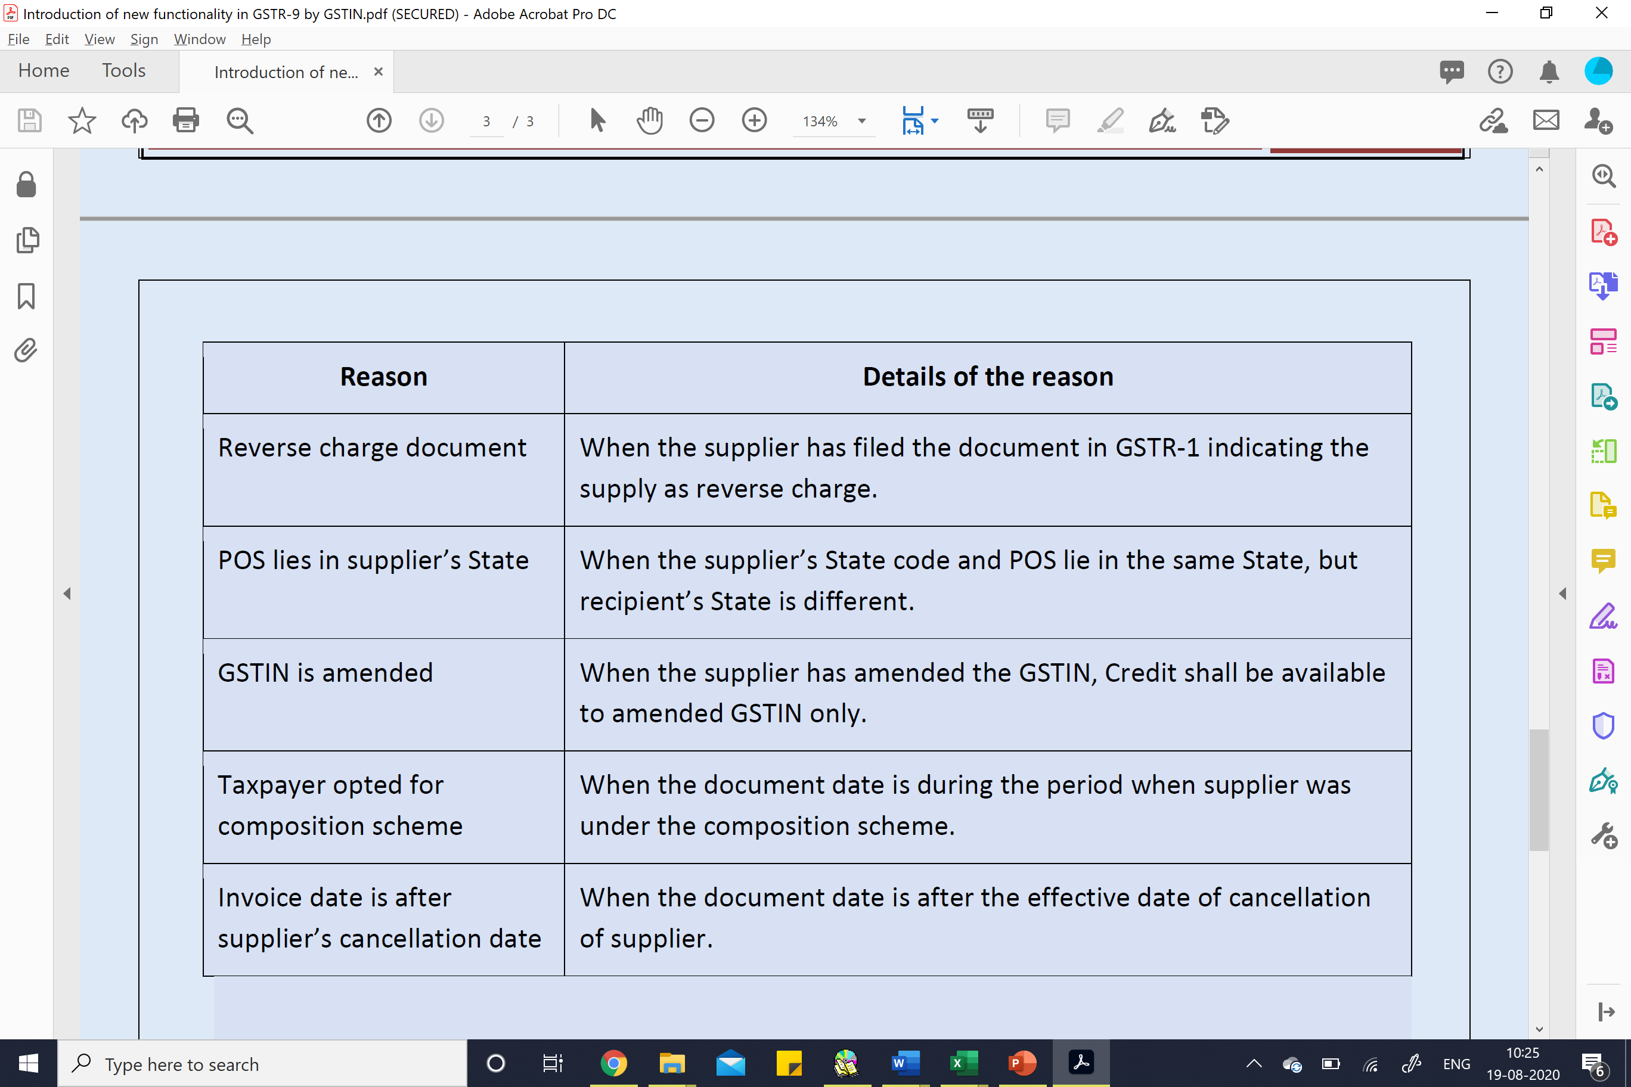
Reasons why ITC is not shown in Table 8A

Slide 148
SECTION 17. Apportionment of tax and settlement of funds.
— (1) Out of the integrated tax paid to the Central Government, -
(a) in respect of inter-State supply of goods or services or both to an unregistered person or to a registered person paying tax under section 10 of the Central Goods and Services Tax Act;
(b) in respect of inter-State supply of goods or services or both where the registered person is not eligible for input tax credit;
the amount of tax calculated at the rate equivalent to the central tax on similar intra-State supply shall be apportioned to the Central Government.

Slide 149
Sec. 16(2)(c)
National Plasto Moulding V. State of Assam (2024) 21 Centax 182 (Gau.)
Issue involved
Denial of the ITC on non-payment of tax by the supplier when the genuineness of the transaction is not
questioned
Held
ITC cannot be denied when the genuineness of the transaction is not questioned. Department is free to act in those cases, where the purchase transactions are not bona fide, in accordance with law.
Other relevant decisions
On Quest Merchandising India (P.) Ltd. v. Government of NCT of Delhi 2018 (10) G.S.T.L. 182 (Del.) (maintained by SC Special Leave to Appeal No.36750/2017)

Slide 150
ITC cannot be denied to the recipient when he has proved the genuineness through documents
R.T. Infotech vs. Additional Commissioner Grade 2 [2025] 175 taxmann.com 189 (Allahabad)
Issue
Whether Input Tax Credit under Section 16(2) of the CGST Act can be denied to the recipient who has duly received goods/services against valid tax invoices and made payment through banking channels, merely because the supplier has failed to deposit the tax with the government?
Conclusion
Purchase were made through bill and GST was charged.
The amount of GST charged over the said tax invoices, were paid through banking channel i.e. by R.T.G.S.
For non discharge of their duties by the selling dealer, the proceedings were initiated against the selling dealer.
The purchasing dealer can also not compel the selling dealer to file the return within stipulated time and deposit the tax collected.
The authority ought to have counterpart of the selling dealer have initiated action and action has been taken with the benefit ought to have given to the petitioner.

Slide 151
ITC cannot be denied to the recipient when he has proved the genuineness through documents
Hon'ble Apex Court in the case of Asstt. Commissioner of State Tax v. Suncraft Energy (P.) Ltd. [2023] 157 taxmann.com 352 (para 13) had occasioned to consider that the party who has paid the tax on invoices being raised and non-discharge of duties by the counterpart of the seller, the Court was pleased to remand the matter for making due inquiry from the supplier.
Similarly, the Madaras High Court in the case of D.Y. Beathel Enterprises v. State Tax Officer (Data Cell) [2021] 127 taxmann.com 80 (para 14) has taken a view that in absence of non-performance of duty by the supplier, action must be taken against the supplier simultaneously and the purchaser alone shall not be suffered.

Slide 152
Standard Department Allegations on ITC
Credit not reflecting in 2B
Supplier non-payment of tax
Fake / cancelled GSTIN vendors
Section 17(5) blocked credits
Capital goods reversal

Slide 153
2B Mismatch
Always argue:
• Timing difference • Subsequent reflection • Vendor amendments
Attach:
✓ Month-wise vendor reconciliation ✓ subsequent 2B screenshots ✓ payment proofs
Avoid theoretical arguments first. Lead with evidence.

Slide 154
Supplier Default
Department alleges recipient responsibility.
Your technical positioning:
• Recipient has no statutory machinery to enforce supplier payment • Invoice + goods receipt + payment completed • Commercial impossibility doctrine
But remember:
Courts expect factual diligence.
So always show:
• Vendor confirmation • bank trail • transport documents

Slide 155
Blocked Credits (Section 17(5))
Typical mistakes:
• guest house expenses • employee insurance • vehicle expenses • club subscriptions
Create expense ledger tagging system:
Eligible Ineligible Conditional

Slide 156
Reply Drafting Architecture
Never write flowing paragraphs.
Use this format:
Department allegation
Factual matrix
Accounting reconciliation
Legal provision
Supporting evidence
Conclusion
Each issue on separate heading.

Slide 157
Collapsing Section 74 into Section 73
Most SCNs mechanically invoke Section 74.
Our job: destroy “intent”.
Attack:
• Returns filed regularly • Books disclosed • No parallel accounts • Interpretation involved • Revenue neutral situations
Once intent collapses → 74 fails → penalty drops from 15%/100% to NIL/10%.

Slide 158
DRC-01A Strategy
Treat DRC-01A as commercial negotiation window.
Evaluate:
• probability of success • interest exposure • working capital impact
Sometimes partial settlement is financially superior to litigation.

Slide 159
INTERNAL GST AUDIT MODEL (CA MONETISATION MODULE)
Quarterly:
• GSTR-1 vs 3B • 2B vs books • vendor compliance tracker • e-way vs turnover
Half yearly:
• Contract review • classification check • valuation review
Annual:
• Trial balance mapping • ITC eligibility matrix • branch transfer review • related party valuation
Not compliance — risk insurance.

Slide 160
MISSING ELEMENTS OF SCN

Slide 161
Missing Elements in SCN
Third Party Reliance
Opportunity of Cross Objection
Precise Allegation vs Factual Understanding
Service of RUD
Reliance on Non RUD
Invocation of wrong section
Opportunity of being heard is mandatory for tax paid during investigation
Separate SCN to be served to director for penalty upon them
A letter issued for payment of tax is not SCN and is without principles of Natural Justice
Every communication cannot be equated with SCN unless it has necessary ingredients of SCN

Slide 162
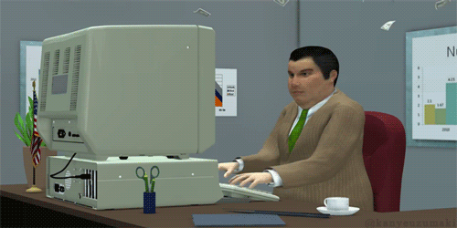

THIS ? || THAT?

Slide 163
Thank You
Yash Dhadda
Dhadda & Co.
Chartered Accountants
Jaipur |Mumbai |Bangalore | Ahmadabad
Phone :
+91-9829186074
: yash@dhaddaonline.com
Email

