Slide 1
Capacity Building Program for GST Officers – Rajkot, Gujarat
Topic: Audit under GST
The Institute of Chartered Accountants of India
GST & Indirect Taxes Committee
CA. Viral M Khandhar
© Indirect Taxes Committee, ICAI

Slide 2

SESSION AGENDA
Audit of returns, published financials or entire books of taxable person.
Authorization to audit – open for inspection or fait accompli.
Audit procedure – permit to call for new reports to be generated and submitted, duration of audit, off-site or on-site.
Audit findings – confidentiality or otherwise, opportunity to respond to audit findings.
Reply to audit findings –
- detailed or brief,
- strategy or statutory requirement.
Period of Limitation to issue SCN
Special audit under section 66 of the
CGST Act,2017

Slide 3
OBJECTIVES AND PRINCIPLES OF GST AUDIT
📊
Preventive Effect
🔍
Deterrent Effect
Taxpayers, aware of audit activity, voluntarily declare correct tax liability to avoid detection.
Audit discovers & stops taxpayers from under-declaring or manipulating their tax liability.
Systematic & comprehensive conduct of audit
Emphasis on identified risk areas — scrutinize records in normal course of business
Apply audit techniques based on materiality and nature of risk factors
Proper recording of all checks & findings during entire audit
Educate taxpayer for voluntary compliance
Identify unexplored compliance verification parameters

Slide 4
CHAPTER XIII
Audit under Sec. 65

Slide 5
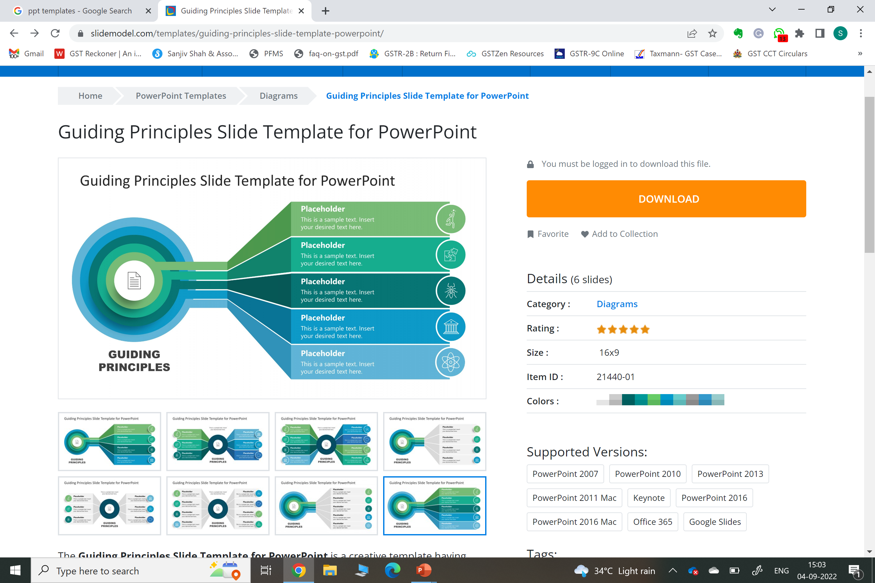

AUDIT BY TAX AUTHORITIES
DEFINITION - Sub-sec. (13) of Sec. 2 of the CGST Act, 2017
Correctness :
Turnover declared
Turnover declare
Taxes paid
ITC taken
Refund claimed
Assess compliance with other provisions
“audit” means
Examination
Records, Returns & other Documents maintained under this law or any other law for the time being in force
Why Audit by Tax Authorities

Slide 6
AUDIT BY TAX AUTHORITIES
Turnover declared
Turnover declare
  Sec. 59 - Self-Assessment
  Every registered person shall self-assess the taxes payable under this Act and furnish a return for each tax period as specified under section 39.
→ Tax Invoice
→ Bill of Supply
→ Credit Note
→ Debit Note
→ Self Invoice
→ Payment Receipt
→ Advance Receipt
→ Payment Voucher
Delivery Challan

Slide 7






REQUIREMENT AS PER LAW
Keep and maintain a separate account of advances received, paid and adjustments made thereto.
-----
-----
-----
-----
01
OUTWARD REGISTER
Turnover declare
OUTWARD REGISTER
Classification of Transaction
Nature of Supply
Point of Supply
ADVANCE REGISTER
INWARD REGISTER
-----
-----
-----
-----
02
REGISTERS :
06
INWARD REGISTER
S. 35
Type of Inward Supplies
Documentary Evidence
Classification as per R. 42 / R. 43
Abide with Sec. 16 (4) & R. 37
Compliance of Sec. 9 (3) & (4) / sec. 5 (3) & (4)
RCM REGISTER
STOCK REGISTER
05
03
STOCK REGISTER
-----
-----
EXPORT & IMPORT
Date of Inward and Outward
Document Reference for payout
Reversal U/Sec. 17 (5)
04
Compliance of Rule 96A & 96B

Slide 8
AUDIT PROCEDURE
Sec. 65 read with R. 101

Slide 9
AUDIT BY TAX AUTHORITIES
Sec. 65 of the CGST Act, 2017 read with rule 101 of the CGST Act, 2017
Undertake
The Commissioner or any officer authorized by him, by way of a general or a specific order may undertake audit.
1
Where
At the place of business of the registered person / in their office.
2
Notice
Audit intimation (Form GST ADT – 01) within 15 days from the date of commencement of the audit by the proper officer.
3
Time limit
Completed within 3 months from the commencement of audit***. (extension – not exceeding 6 months)
4
After completion
Audit findings (Form GST ADT – 02) within 30 days by the proper officer. In case of deviation issue notice under sec. 73 / sec. 74 by the proper officer.
5
It's not a "fait accompli" in the sense of a pre-determined outcome. The audit is a process of examination and verification.

Slide 10
Who can conduct the Audit?
The Commissioner or any officer authorised by him.
Who has the power to issue Audit Observations?
Who has the power to issue ADT-02?
Who has the power to issue Show Cause Notices?
Can unregistered persons be audited?

Slide 11
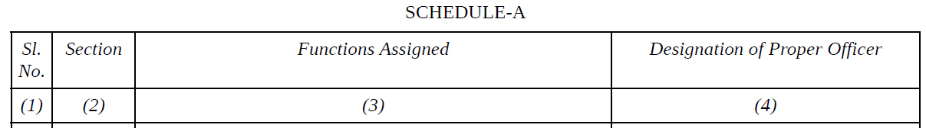
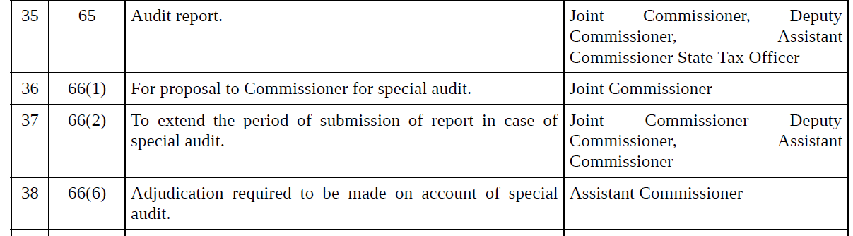
(Ref – GGST Circular similar to CGST Circular 3/3/2017 - GST dated 05.07.2017) –
ORDER NO.GSL/S.5(1)/B.1, DATED 23-6-2017

Slide 12
Commencement of Audit
***Explanation. – For the purposes of this sub-section, the expression ‘commencement of audit‘ shall mean the date on which the records and other documents, called for by the tax authorities, are made available by the registered person OR the actual institution of audit at the place of business, whichever is LATER.
Turnover declared
Turnover declare
During the course of audit, the authorised officer may require the registered person,—
to afford him the necessary facility to verify the books of account or other documents as he may require;
to furnish such information as he may require and render assistance for timely completion of the audit (Ref: section 71)

Slide 13
WHAT DOCUMENTS CAN BE COLLECTED?
Documents required to be maintained as per Section 35 of the CGST/GGST Act, 2017 and Rule 56/57 of the CGST/GGST Rules, 2017
  production or manufacture of goods
  inward and outward supply of goods or services or both;
  stock of goods;
  input tax credit availed;
  output tax payable and paid; and
  such other particulars as may be prescribed
Goods or services imported or exported
RCM register, Stock register, Advances register, ITC register
Details of suppliers, customers, place of storage of goods

Slide 14
AUDIT BY TAX AUTHORITIES
REVIEW OF INTERNAL REPORTS OF THE REGISTERED PERSON BY THE AUDITORS
1
2
DIRECTOR’s REPORT
AUDITOR’s REPORT
AUDITED BALANCE SHEET
&
PROFIT AND LOSS A/c.
Information on the operation carried out.
The opinion of on financial statements
3CB REPORT
CARO REPORT
Reporting as per Income Tax Act.
Reporting as per companies Act.
Financial statements are the primary evidence base for a GST audit. An officer who can read and interrogate financials is equipped to detect mismatches, suppressed income, and inflated ITC claims that no return-level review would uncover.
4
3

Slide 15
AUDIT BY TAX AUTHORITIES
REVIEW OF INTERNAL REPORTS
DIRECTOR’s REPORT
AUDITOR’s REPORT
CARO REPORT
3CD REPORT
Information on the operation carried out.
Introduction of new product/service line.
Change in Marketing Pattern etc.
Fire and loss of material in the company.
Forex earned and spend during the year.
Fixed Assets records.
Physical verification of stocks and Assets and it’s interval.
Disputed tax liabilities under various Law.
Status of records for unserviceable or damaged goods.
.
Provision for obsolete items.
Goods meant for outward supply available in stock were not reconciled.
Internal control mechanism is commensurate with the size and extent of business of the company.
Clause 18 : Depreciation on Fixed Assets u/s. 32.
Clause 27 (a) - ITC availed and C/f.
Clause 21 (b) : Prior Period Income & Expenditures.
Clause 39 ; Cost audit report
Clause 40 : Ratios

Slide 16
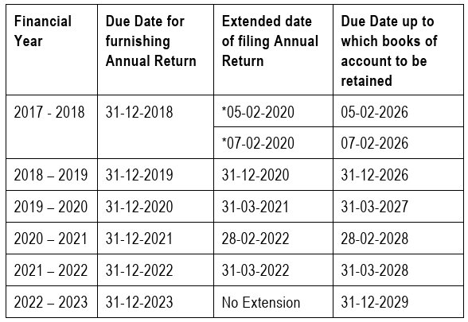
PERIOD OF RETENTION OF ACCOUNTS AND RECORDS
Every registered person is required to retain books of accounts or other records until the expiry of 72 months i.e. for a period of 6 years, from the due date of furnishing of annual return for the year pertaining to such accounts and records.

Slide 17
MODEL GST AUDIT MANUAL 2023
This is prepared by the Committee of Officers on GST Audits to harmonise audit practice across Central and State Tax administrations

Slide 18
AUDIT FLOW — STEP-BY-STEP PROCESS
1
2
3
4
5
6
Selection of RTP
Allotment
Notice ADT-01
Desk Review
Audit Plan
Commencement
Risk-based / random / suo motu
Assign to jurisdictional officer
Min. 15 working days in advance
Pre-audit analysis & data study
Prepare & get approved
Records made available / field visit
11
10
9
8
7
Closure / Demand
FAR (ADT-02)
DAR
Communicate
Examination
Payment or Sec 73/74 proceedings
Final Audit Report issued
Draft Audit Report + MCM approval
Discrepancies in writing to RTP
Books, returns, documents
Notes:
Walk through the 11-step audit flow. Emphasize commencement = date records are made available OR actual field visit, whichever is later. This has implications for the 3-month clock.

Slide 19
SELECTION OF RTP FOR AUDIT — RISK-BASED APPROACH
Major Risk Heads
Selection Methods
Entity Level
A
Risk-Based
Turnover, Tax paid, ITC claimed, Refund claimed, Commodity/Service sector
Score all RTPs on risk parameters; descend order final score
B
Random Sample
Compliance Behaviour
% fixed by admin; reveals latent compliance issues as controls
Late filer, Non-submission of GSTR-1, GSTR-3B, GSTR-9, GSTR-9C
C
Local Parameters
Intelligence inputs, past compliance, local enforcement data
Key Ratios
Output tax:Input tax | Cash payment:Output tax | Inter-state:Intra-state supply
D
Suo-Motu
Officer proposes for specific RTP with written reasons to Commissioner
Exceptional Reports
E
DGARM / GSTN
ITC in 3B vs 2A/2B | GSTR-3B vs GSTR-1 | ITC from cancelled RTPs | E-way bill vs. turnover
States can request DGARM for central targeting methodology
Notes:
Emphasize that risk-based selection is dynamic — criteria evolve each year based on past audit outcomes. States can also leverage DGARM's analytics. Multi-PAN registrations should ideally all be selected.

Slide 20
AUDIT PLANNING, NOTICE & DESK REVIEW
FORM GST ADT-01 (Notice)
Pre-Audit Desk Review
• Issue within 5 working days of file allotment
• Review TAG / RPMF (Taxpayer at a Glance)
• Review TAG / RPMF (Taxpayer at a Glance)
• Minimum 15 working days advance notice
• Reasons for selection — focus areas
• Attach questionnaire for auditee
• Registration history incl. pre-GST periods
• Mention list of documents required
• Business nature: goods/services/mixed
• Letter for mutual assistance (staggered production)
• Return filing pattern: GSTR-1, 3B, 9, 9C
• Focus document requests on identified risk factors
• Compare GSTR-3B vs 2A/2B, IT Return, e-Way Bills
Audit Plan — Key Elements
Risk Focus Areas
Auditee Profile
Supply Types
From desk review & selection criteria
PAN, places of business, pre-GST history
Resale, mfg, export, works contract, ISD
Return Analysis
Sampling Strategy
Source & Back-up Docs
Late fees, mismatch GSTR-1 vs 3B vs 9C
Time-period & value-based samples
Invoices, ledgers, bank statements

Slide 21
CONDUCT OF AUDIT — EXAMINATION PARAMETERS
Registration / Migration
Return Analysis
Invoicing Compliance
▸ Verify pre-GST registration history
▸ GSTR-1 vs GSTR-3B vs GSTR-9 reconciliation
▸ Continuity of invoice serial numbers
▸ Check for suppressed pre-registration liability
▸ HSN/SAC codes vs applicable tax rates
▸ Credit note/debit note within time limits (Sec 34)
▸ Up-to-date bank accounts, authorised signatory
▸ Advances received (service time of supply)
▸ Commercial credit notes — GST applicability
ITC Verification
Books of Accounts
Trend & Ratio Analysis
▸ ITC vs GSTR-2A/2B auto-population
▸ P&L, Balance Sheet, Trial Balance
▸ Abnormal year-on-year deviations
▸ Blocked credits (Sec 17(5))
▸ Stock register, bank statements
▸ Output tax:Input tax ratio
▸ ITC from cancelled / non-existent RTPs
▸ Supplier ledgers, RCM payments
▸ Industry-level benchmarking

Slide 22
COMMUNICATION OF FINDINGS, DAR, MCM & FAR
Communication of Discrepancies
• Communicate findings to RTP in writing (preferably electronic)
• RTP must be given at least 7 days to file explanation
• Para-wise — concise, self-contained, with legal citations
• Encourage voluntary payment via Form GST DRC-03 during audit
• Must be done within 30 days of conclusion of audit
Draft Audit Report (DAR)
• Prepared after considering RTP's explanation
• High demand paras: sent to higher authority with narration
• Internal document — not issued to auditee
• Cite all relevant circulars, court judgements, AAR rulings
• Placed before audit plan sanctioning authority
Monitoring Committee Meeting (MCM)
• Held monthly under chairmanship of Commissioner
• Ensures uniformity across audit teams in jurisdiction
• All audit teams present status in prescribed format (Annexure 7)
• Special focus areas identified for the unit
• Committee reviews & decides on audit objections / paras

Slide 23
COMMUNICATION OF FINDINGS, DAR, MCM & FAR
Final Audit Report — FORM GST ADT-02
▸ Issued after MCM approval and consideration of RTP's reply [Rule 101(4)]
▸ Issued preferably electronically within 30 working days of DAR approval
▸ Marks formal conclusion of the audit process
▸ Copy endorsed to coordination committee for thematic audits
Post-FAR Outcomes
✓ Case Closure
⚠ Technical Lapses
⚡ Demand & Recovery
RTP agrees & pays dues via
GST DRC-03 within 30 days;
or Nil revenue impact FAR
No revenue impact;
correction advised;
recorded for compliance improvement
RTP does not pay within 30 days;
SCN u/s 73 (non-fraud) or
u/s 74 (fraud / suppression)

Slide 24
COMPETENCIES OF A GST AUDIT OFFICER
Legal Knowledge
Pre-Audit Planning
⚖
Act, Rules, Notifications, Circulars, AAR Rulings, Court judgements; stay updated with amendments
📊
What to examine? How to examine? Sampling strategy, risk identification, desk review mastery
Industry / Sector Knowledge
Computation of Dues
🏭
Trade practices, market trends, accounting standards (Ind AS / IFRS), sector-specific norms
🔢
Tax, interest, late fee, penalty calculations; DRC-03 voluntary payment procedure
Taxpayer Engagement
IT & Analytics Proficiency
🤝
Unbiased, judicious, transparent; gain goodwill; motivate voluntary compliance; confidentiality
💻
GST back-office portal, BI Tools, DGARM analytics, Taxpayer at a Glance (TAG)

Slide 25
THEMATIC AUDIT & MULTI-LOCATIONAL CO-AUDIT
Thematic Audit
Multi-Locational Co-Audit
Focused audit on sensitive sectors or compliance areas instead of comprehensive entity audits
Coordinated audit of RTPs with multiple registrations across states under one PAN
When to use:
SOP Steps:
• Same supply chain RTPs across states
1. AICC selects theme & communicates to CoO
• Simultaneous audit: same evasion modus operandi
2. CoO selects taxpayers in each state
• Evasion-prone goods/services (e-commerce, online gaming, jewellery)
3. Audit groups prepare desk review & audit plan
• Sectors with low cash pay-out or high ITC utilisation
4. CoO reviews plans for uniformity; issues common minimum plan
• Sectors flagged by CAG or Parl. Committee
5. Simultaneous commencement date fixed
All India Coordination Committee (AICC)
6. Draft audit paras forwarded to CoO for approval
Selects themes → Committee of Officers per state → Common minimum Audit Plan → Simultaneous commencement → Consolidated FAR
7. MCM approves → FAR issued → copy to AICC
8. Agreed paras closed on payment; disagreed → SCN

Slide 26
CHAPTER XIII
Special Audit under Sec. 66

Slide 27
SPECIAL AUDIT
Triggers: Assistant Commissioner or higher rank officer must believe there is a problem – At the time of Scrutiny, inquiry, investigation, with suspicion of:
  Incorrect value declaration
  Abnormal credit availment.
Turnover declared
Triggers
Purpose
Approval
Special Audit
Turnover declare
Purpose: To address complex cases where revenue may be at risk.
Commissioner Approval is needed.

Slide 28
AUDIT PROCEDURE
Sec. 66 read with R. 102

Slide 29
AUDIT BY TAX AUTHORITIES
Nomination
Chartered Accountant/
Cost Accountant
Report
Auditor submits a report within 90 days (extendable by 90 days).
PoNJ (point of non-compliance justified)
Taxpayer has the right to defend findings.
Audit expenses
Commissioner pays audit expenses and it is final.
Turnover declared
Turnover declare
  Action under Sections 73, 74, or 74A may follow (if discrepancies are found)
Outcomes & Actions

Slide 30

Thank You
CA. Viral M Khandhar
Email - viral@ssaca.in
Mobile + 91 988 411 5250

