Slide 1
GSTAT Outreach Program
Organized by
Rajkot Branch
The Western India Regional Council of
The Institute of Chartered Accountants of India
2 July 2026
Pramod Kumar Rai, Ex IRS
B.Tech (IIT Kanpur), LLB (Gold Medal), LLM (USA)
Member (Judicial)
GST Appellate Tribunal, Rajkot

Slide 2
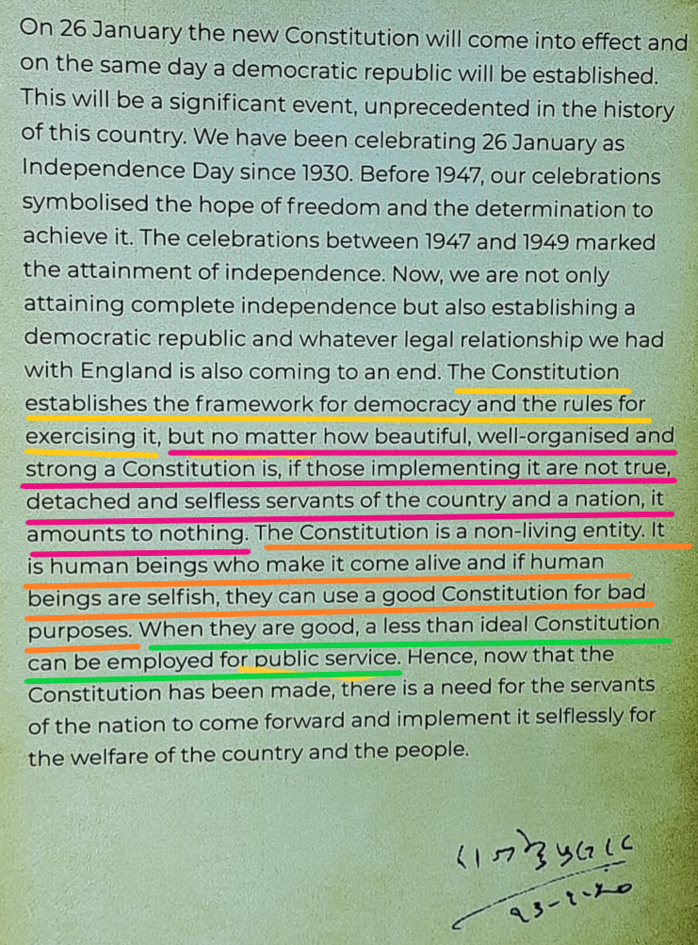

Slide 3
GSTAT
Established under Section 109 of the CGST Act, 2017
Article 323B of the Constitution of India
Section 109 to 116 of the CGST/SGST Act, 2017
Rule 110 to 116 of the CGST/SGST Rules, 2017
GST Appellate Tribunal (Procedure) Rules, 2025
GSTAT (Appointment and Conditions of Service of President and Members) Rules, 2023

Slide 4
GSTAT [u/s 109-116]
Unified Tribunal for GST: One Principal Bench and 31 state benches (46 locations of State Benches)
Every bench, be it principal bench or state bench shall have four members: Member(Judicial)-2, Member Technical(Centre)-1, Member Technical (State)-1.
Some of the benches have been split into two: With One M(J) and one M(T) at each location.
GSTAT is headed by president.
State benches are headed by Vice president.

Slide 5
Cases before GSTAT
Appeals against orders passed under Section 107 and 108 of CGST Act 2017 and connected miscellaneous matters.
Anti-profiteering matters under Section 171(2) of CGST Act [Notification No. 18/2024-Central Tax dated 30.09.2024, powers of NAA were transferred to GSTAT’s Principal Bench ]
Till National Appellate Authority is constituted, GSTAT shall be Second Appellate Authority for advance ruling [Section 101A- Notification No. 18/2024 02/2026–Central Tax dated 7 May 2026]

Slide 6
Principal Bench Exclusive Jurisdiction
[Sec 109(5)]
Appeals involving any issue related to "place of supply”
Anti-profiteering matters under Section 171(2) of CGST Act
Appeals against State Appellate Authority for advance ruling orders u/s 101[Section 101A]
Any other matter specifically notified by the government on the recommendation of GST Council

Slide 7
State Bench Jurisdiction
All matters other than what is reserved for Principal bench [Sec 109(5)]
President can transfer matters from one bench to another and to Principal bench [Sec 109(6)]
  Identical matter pending before multiple state benches

Slide 8
Powers of Tribunal
Tribunal can confirm, modify, annul, or remand to FA/RA/Adj Auth [Section 113]
Inherent Powers: Tribunal has inherent powers to make orders or give directions necessary for meeting the ends of justice or preventing abuse of the Tribunal process. [Rule 10 of Proc Rules]
Can exempt the parties from compliance with any requirement of GSTAT Proc Rules to render substantial justice. [Rule 13 of Proc Rules]
Can award cost of litigation [Rule 120 of Proc Rules]
Can impose exemplary costs on defaulting party. [Rule 120 of Proc Rules]

Slide 9
Do’s and Don’t
File appeal on time
GSTAT do not have unlimited powers to condone the delay
Last fact-finding authority
  Be Careful with factual disputes/bring facts on record
Do raise all legal issues
  Keep in mind that it is the last tax specific forum

Slide 10
Presentation before GSTAT
Philosophically you are officer of court and need to work towards justice
Practically answerable towards client/department without violating law, decorum etc.
  Maintain factual accuracy
  You can have your own interpretations
  Honesty with precedent decisions

Slide 11
Presentation before GSTAT
मनुस्मृति
सत्यं ब्रूयात् प्रियं ब्रूयात् न ब्रूयात् सत्यमप्रियम्।
प्रियं च नानृतं ब्रूयात् एष धर्मः सनातनः॥
चाणक्य नीति दर्पण
सत्यं वदेत् प्रियं वदेत् न वदेत् सत्यमप्रियम्।
प्रियं च नानृतं वदेत् एष धर्मः सनातनः॥
“Speak the truth; speak it in a pleasant manner.
Do not speak the truth in an unpleasant way,
nor speak an untruth even if it is pleasant.
This is the eternal dharma.”

Slide 12
How to proceed
Tax liability is not a contractual liability
The fact
The Law
Application of law to given facts
Court decisions covering above situations
Argue that discretion to be exercised in the interest of Justice

Slide 13
Case Summary: Allegations and Counter allegations
In 01 minute
In 05 minute
Formulate core issue in dispute, respondent version and how you propose to demolish their version.
If you do not argue to the point, perception is either you do not know or you have no case.
Summarize case before start and again summarize at the end

Slide 14
Content Vs Art of presentation
Content rocks
Keep audience in mind/tech issue for the bench
Admitted position should not be disputed
Josh mein hosh nahi khona hai/जोश में होश नहीं खोना है

Slide 15
Thank You

